Slide 1
Marketing Management,
A South Asian Perspective
Setting Product Strategy
Kotler Koshy
Keller Jha

Slide 2
Product
Anything that can be offered to a market to
satisfy a want or need.

Slide 3
Five Product Levels
Level 1 Core benefit: This is the fundamental benefit or service that the customer is buying. For example A customer going to a Hotel is buying rest, sleep etc.
Level 2 Basic Product: Basic functional attributes. All Hotels provide rest and sleep. The aim is to ensure that your potential customers purchase your one service. Thus the functional attributes like Room, Bed, Bath are important.
Level 3 Expected product : Set of attributes that the buyer expects (Clean room, large towels, quietness)

Slide 4
Five Product Levels
Level 4 Augmented product: What additional non-tangible benefits can be offered? This meets the customer’s desires beyond his expectations – (Prompt room service, music, aroma etc)
Level 5 Potential product: The possible evolutions that can be made to make the product a distinguished offer (all suite room)

Slide 5
Product Classes
Two broad classes
  Consumer products
  Business products

Slide 6
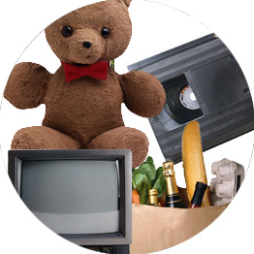
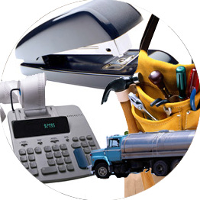
Product Classes Help Plan Marketing Strategy
Consumer Products
Products meant for the final consumer.
Business Products
Products meant for use in producing other products.
Notes:
Summary Overview
Developing product strategies is simplified somewhat because some product classes require similar marketing mixes. Understanding the product classes is a useful strategic starting point.
Key Issues
Consumer products are products meant for the final consumer.
Business products are products meant for use in producing other products.
It is possible that some products might be in both groups.
Discussion Question: Have you ever been to a warehouse club, such as Sam’s or Costco? Business and final consumers often purchase the same items there. How might their purchases be different?
Selling the same product to final consumers and business customers may require different strategies for each customer group.
This slide relates to material on p. 241.
: Indicates place where slide “builds” to include the corresponding point.
:
:

Slide 7
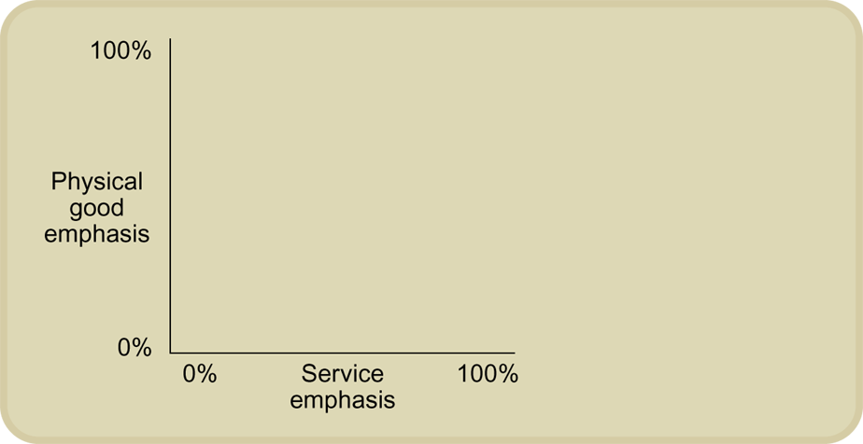
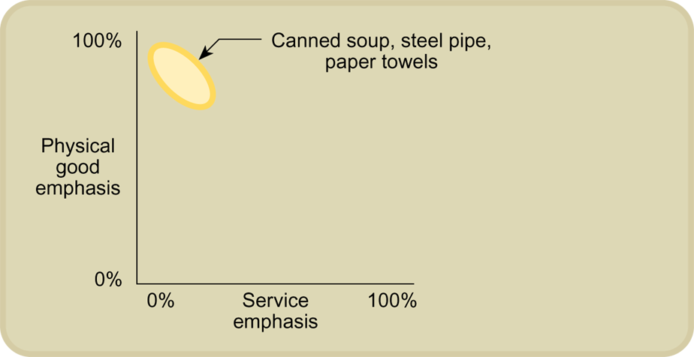
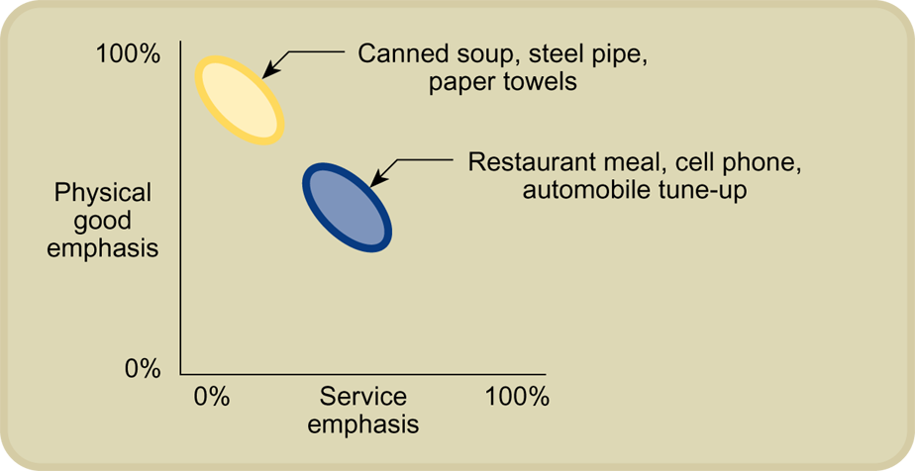
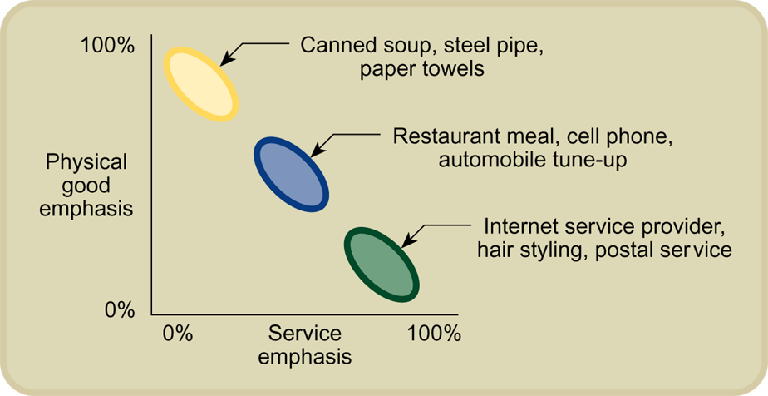
Goods and/or Services Are the Product
Notes:
Summary Overview
A product can be a physical good or an intangible service, or it can be a blend of both.
Key Issues
This diagram shows how one can position products in terms of their physical good emphasis or their service emphasis.
Some products, such as canned soup, steel pipe, and paper towels, have an emphasis that is almost completely physical.
Other products have a significant service component, such as a restaurant meal, a cellular phone, or an automobile tune-up.
Still other products have an emphasis mainly on the service component, such as an Internet service provider, a hair stylist, or a postal service.
Consumers are increasingly demanding more services with the goods they buy. Both the physical good and the service make up the total product the customer buys.
Discussion Question: Why does the increased demand for more service make product management more difficult?
This slide relates to material on pp. 238-239.
: Indicates place where slide “builds” to include the corresponding point.
:
:
:
:

Slide 8
Product Classification Schemes
Durability: A durable good does not quickly wear out and can be used for multiple times like electronics items
Non-durable goods: Tangibles goods normally consume in one or few uses like soft drink, shoe polish etc
Services: These are intangible, inseparable, variable and perishable products e.g. legal/medical advice,

Slide 9
Consumer Goods Classification
Convenience: They may be inexpensive, bought often, require little service or selling, and bought by habit.
Shopping: These are the goods for which customers compares the quality, price, style, ability etc.

Slide 10
Consumer Goods Classification
Specialty: Products that the consumer really wants, because there are no acceptable substitutes. They are characterized by the consumer’s willingness to search.
Unsought: These products need promotion; they are those that customers don’t want yet or don’t know that they can buy.

Slide 11
Industrial Goods Classification
Accessories
Accessories
short-lived capital items—tools & production equipment
Raw Materials
unprocessed expense items that become a physical part of a physical good
Installations
Raw Materials
Installations
important capital items
Business
Product
Classes
Component Parts & Materials
processed expense items that become part of a finished product
Professional Services
specialized services to support a firm’s operations--consulting services
Component Parts & Materials
MRO Supplies
Supplies for Maintenance, Repair, and Operating
MRO Supplies
Notes:
Summary Overview
Business product classes are based on how buyers see products and their uses:
Key Issues
Installations are important capital items. One-of-a-kind installations such as office buildings and custom-made equipment require special negotiations for each sale. Installations are a boom-or-bust business. Economic upturns spur expansion while downturns cause sales of installations to fall off sharply.
Accessories are important but short-lived capital items, such as tools and production equipment.
Raw materials are unprocessed expense items that become a physical part of a physical good the firm makes and are expense items. Farm products are grown or raised by farmers. Natural products are those that occur in nature, such as timber and mineral ores.
Components are processed expense items that become part of a finished product. Component parts are finished or nearly finished products that go into other products. Component materials require more processing before becoming part of the final product. Both component parts and materials must meet the specifications of the buyer.
Supplies for Maintenance, Repair, and Operating (MRO) are another category. Maintenance supplies include products like paint and light bulbs. Repair supplies are parts needed to fix worn or broken equipment. Operating supplies include things needed to do work, like copier toner and paper clips.
Professional services are specialized services firms pay for in order to get them done. They support a firm’s operations, such as consulting services might.
This slide relates to material on pp. 245-248.
: Indicates place where slide “builds” to include the corresponding point.
:
:
:
:
:
:
:

Slide 12
Product Differentiation
Product form—size, shape, or physical structure
Features—supplement basic functions
Customization–individual versus mass
Performance—level at which the product’s primary characteristics operate
Conformance—degree to which all the produced units are identical and meet the promised specifications
Durability—product’s operating life
Reliability—probability that a product will not malfunction or fail
Repairability—the ease of fixing a product when it malfunction or fails
Style—product’s look and feel to the buyer.

Slide 13

Service Differentiation
Ordering ease—how easy to place an order
Delivery—how well (e.g., speed, accuracy, and care) product or service is brought to the customer
Installation—work done to make a product operational
Customer training—training the customers to operate the vendor’s equipment properly and efficiently
Customer consulting—data, information, systems, and advice that the seller offers to buyers
Maintenance and repair—service programs for helping customers keep purchased products in good working order
Returns

Slide 14
The Product Hierarchy
Need family – the core need that underlies the existence of a product family. Example : security
Product family – all the product classes that can satisfy a core need with reasonable effectiveness. Example : savings and income .
Product class – a group of products within recognized as having a certain functional coherence . Also known as product category. Example : financial instruments.

Slide 15
Cont…..
Product line- a group of product within a product class that are closely related because they perform a similar function, are sold to the same customer groups, are marketed through the same outlets or channels, or fall within given price ranges. Example : life insurance.
Product type – a group of items within a product line that share one of several possible forms of the product, example :term life insurance .
Item (also called stock keeping unit or product variant): a distinct unit within a brand or product line distinguishable by size , price, appearance, or some other attribute, Example: ICICI prudential renewable life insurance.

Slide 16
Product Systems and Mixes
Product system—Group of diverse but related items (e.g., Palm One handheld and Smartphone product lines come with attachable—headsets, cameras, keyboards, etc.)
Product mix or assortment—Various product lines (e.g., GE’s consumer Appliance Division—refrigerators, stoves, washing machines, etc.)
Depth—Variants of each product (e.g., tide comes in two scents)
Length—Total number of items in the mix (e.g., PG—Detergents (Ivory, tide, etc); Toothpaste (Gleem, Crest); Bar soap (Camay, Zest, etc); Disposable Diapers (Pampers, Luvs) ; Paper Products (Charmin, Bounty)
Width—Number of different product lines (PG—Detergents, Toothpaste, Bar Soap, Disposable Diapers, Paper Products)
Consistency—How closely related various product lines are in some way (e.g., consumer goods that go through the same distribution channel.

Slide 17
Product Line Analysis
Core product (basic products;
e.g., laptop computers)
Staples (items with lower sales
volume but not promoted;
e.g., CPU, bigger
memories)
Specialties (items with lower
sales volume but highly
promoted; e.g., digital
moviemaking equipment)
Convenience Items
(peripheral items; e.g.,
carrying cases and accessories)

Slide 18
Line Stretching
A product line extension is the use of an established product’s brand name for a
new item in the same product category.
It has three Types
1. Down-Market Stretch
A company positioned in the middle market may want to introduce a lower-priced
line for any of the three reasons:
a. The company may notice strong growth opportunities as mass retailers such as
Wal-Mart, Best Buy, and others attract a growing number of shoppers who want
value-priced goods.
b. The company may wish to tie up lower-end competitors who might otherwise try to
move up-market. If the company has been attacked by a low-end competitor, it often
decides to counterattack by entering the low end of the market.
c. The company may find that the middle market is stagnating or declining.

Slide 19
Line Stretching
2. Up-Market Stretch
Companies may wish to enter the high end of the market for more growth,
Higher margins, or simply to position themselves as full-line manufacturers.
Many markets have spawned surprising upscale segments: Starbucks in
coffee, Haagen-Dazs in ice cream and Evian in bottled water.
Leading Japanese auto companies have each introduced an upscale
automobile: Toyota's Lexus, Nissan's Infiniti, and Honda's Acura.
Note that they invented entirely new names rather than using or including their
Own names.

Slide 20
Line Stretching
3. Two Way Stretch
Companies serving the middle market might decide to stretch their line in both directions. Texas Instruments (TI) introduced its first calculators in the medium-price-medium-quality end of the market. Gradually, it added calculators at the lower end taking the share from Bowmar, and at the higher end to compete with Hewlett-Packard. This two-way stretch won Texas Instruments (TI) an early market leadership in the hand-calculator market.

Slide 21
Product-Mix Pricing
Product-line pricing (various levels: $200, $400, and $600)
Optional-feature pricing (sunroof, theft protection)
Captive-product pricing (require the use of ancillary products: razors, films)
Two-part pricing (fixed fee plus variable usage fee: telephone service)
By-product pricing (production of certain goods often result in by-products; meat and fat in sausage)
Product-bundling pricing—offer products only in a bundle: product plus service

Slide 22
Packaging: The 5th P
All the activities of designing and producing
the container for a product.

Slide 23
Packaging has been influenced by:
Self-service
Consumer affluence
Company and brand image
Innovation opportunity

Slide 24
Functions of Labels
1. Labeling identifies the product
Label helps to identify the product and brand. It popularizes the product and its brand name.
2. Labeling grades the product
Label helps to express grade of the product. For example, wheat can be express with the grades such as 1, 2, 3, 4. Label becomes useful to grade any product according to its quality.

Slide 25
Functions of Labels
3. Labeling describes the product
Label gives introduction of the product, describes and expresses its grade. Information and instructions about- who manufactured the product, when and where it was manufactured, how many ingredients have been used in it, how to use the product, how to keep the product safe, etc. are given on the label. This becomes helpful to the customers.

Slide 26
Functions of Labels
4. Labeling promotes the product
Label helps to promote the product. Customers' attention is drawn by attractive and fascinating graphs, figures or marks. This motivates the customers to buy the product. Label plays an important role in sales and distribution as it makes the customers take buying decision.
5. Labeling protects the customers
Label protects the customers. As maximum selling price, quantity, quality etc. are mentioned on the label, the customers are protected from the possible malpractice of middlemen.

Slide 27
Functions of Labels
5. Labeling protects the customers
Label protects the customers. As maximum selling price, quantity, quality etc. are mentioned on the label, the customers are protected from the possible malpractice of middlemen.

Slide 28
Thank you

