Slide 1
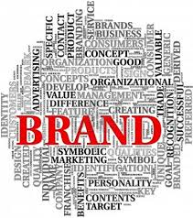

Slide 2
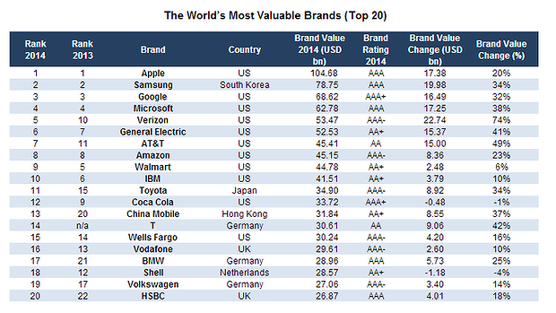

Slide 3
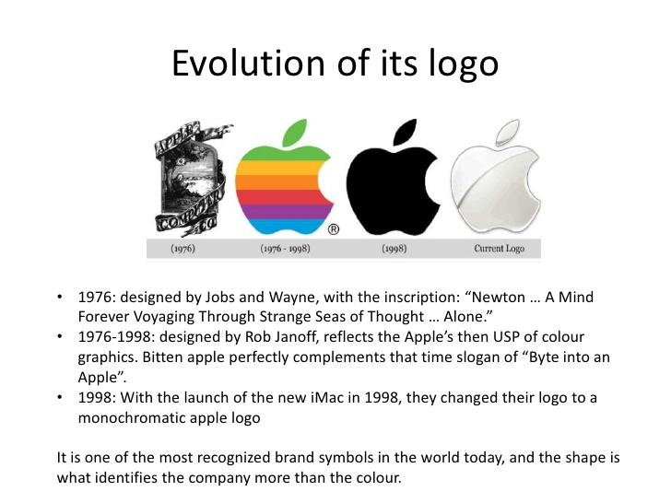
Branding of Apple
Notes:
Brands identify the source or maker of a product and allow consumers—either individuals or organizations—to assign responsibility for its performance to a particular manufacturer or distributor. Consumers may evaluate the identical product differently depending on how it is branded. They learn about brands through past experiences with the product and its marketing program, finding out which brands satisfy their needs and which do not. As consumers’ lives become more complicated, rushed, and time-starved, a brand’s ability to simplify decision making and reduce risk becomes invaluable. Brands also perform valuable functions for firms. First, they simplify product handling or tracing. Brands help to organize inventory and accounting records. A brand also offers the firm legal protection for unique features or aspects of the product.

Slide 4
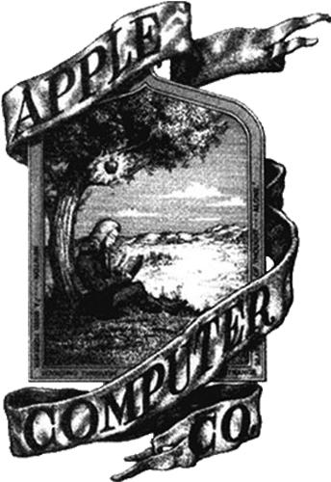
History of Apple, Inc.
1976
Apple Computer Company founded.
1983 -1984
Enters Fortune 500.
John Sculley becomes president and CEO.
Apple airs “1984” during Super Bowl.
1985
Jobs forced out of company
1993
Sculley forced out.
1997
Steve Jobs returns to Apple.
2007
Apple changes name to Apple, Inc.

Slide 5
The start…
1975 – Steve Wozniak was working for Hewlett Packard (calculator manufacturers) by day and was a computer hobbyist by night.
He realized that the prices of some computer parts had gotten so low he could buy them himself.
Decided to work with fellow hobbyist Steve Jobs to build their own computer
On 4/1/1976 – released the Apple I (for $666) and started Apple Computers. Had 8 KB of RAM.

Slide 6
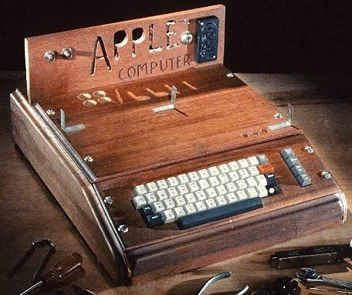
Apple I – did not have a case – the user was required to build a box for its components. (picture from Smithsonian) Apr 1,1976

Slide 7
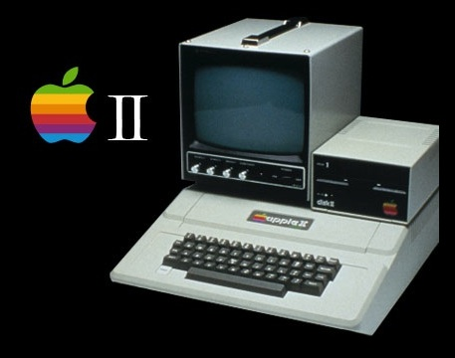
Apple II
In 1977, Apple II was released for $1298
Had color graphics – a first for a personal computer
Originally used an audio cassette drive for storage but later it was replaced by a floppy disk drive
Had 64 KB of memory
Supported the BASIC program
Notes:
http://www.apple-history.com/

Slide 8
Other early endeavors
Apple III
  Released May 1980
  Had 128K of RAM
  Designed for businesses – expensive!! > $4300!!!
  Had lots of problems – didn’t do well..
Apple Lisa
  Released in 1983
  Became the first personal computer sold to the public with a GUI. Aimed at large businesses
  Commercial failure due to high price tag (almost $10,000) and limited software it could run
Notes:
http://www.apple-history.com/

Slide 9
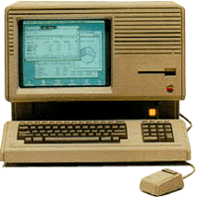
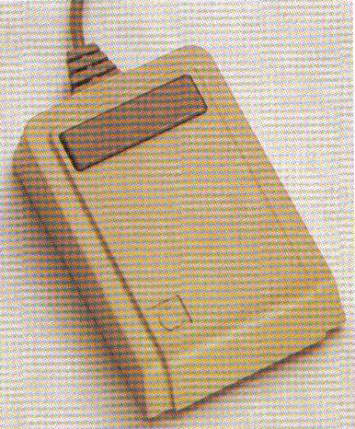
The Lisa
Notes:
http://www.apple-history.com/

Slide 10
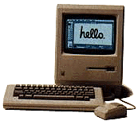
The intro of the Macintosh
Apple introduced the Macintosh in 1984
  Sales not initially as strong as desired
  Changed with the intro of
    LaserWriter – first reasonably priced laser printer
    PageMaker – early desktop publishing package
(These capitalized on its advanced graphics capabilities)
  128 KB memory
  Sold for $2495
Historical note: When the Mac was released, the company bought all 39 pages of advertisement space in the Nov/Dec version of Newsweek magazine!

Slide 11
Early endeavors (con’t)
Sustained growth of Apple during these early years was partly due to the education sector --
  Many schools introduced the concept of programming by using the LOGO programming language on the Apple II

Slide 12
Early Years -- Computer Comparison
Product | Cost | Storage | RAM | Year
Apple I | $666 | --- | 8 KB | 1976
Apple II | $1298 | Floppy | 64 KB | 1977
Apple III | $4300 (for business) | Floppy | 128 KB | 1980
Apple Lisa | $10,000 (for business) | Floppy | 1 MB (1000 KB) | 1983
Macintosh | $2495 | Floppy | 128 KB | 1984

Slide 13
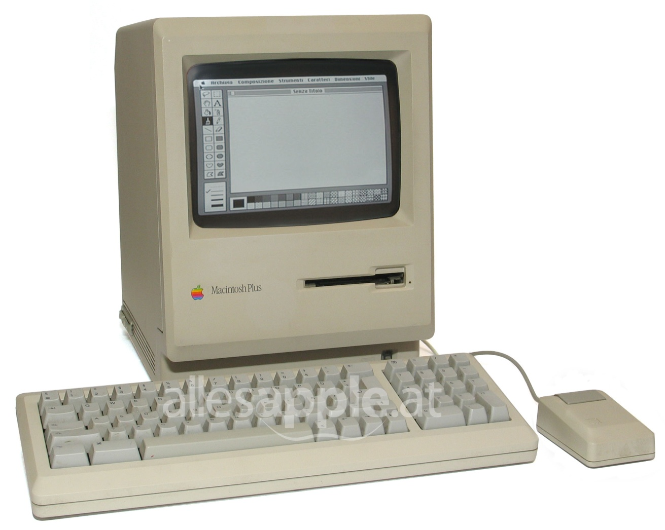
Early endeavors (con’t)
Macintosh Plus
  Released in 1986
  4 MB of memory
  $2600

Slide 14
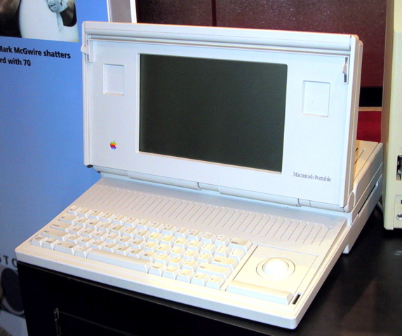
Macintosh Portable
Apple’s first attempt at a “portable” computer
Released in 1989
8 MB RAM
40 MB Hard drive
Clunky, slow
Weight: 15.8 lbs !!!!!
$6500
Notes:
First introduction of hard drive! Previously – all storage primarily floppy (there were capabilities for external hard drives – but nothing built in..)

Slide 15
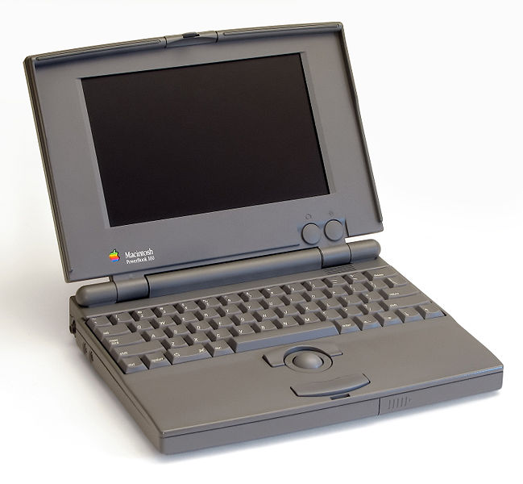
More portable efforts..
PowerBook 100
  Released in 1991
  40 MB hard drive
  8 MB RAM
  $2500

Slide 16
Various other Apple efforts..
In 1987 – 2001
  Macintosh (desktops)
  PowerBooks (laptops)
  Servers

Slide 17
Other Major Apple Milestones..
1997 – Steve Jobs announced that Apple would join Microsoft to release new versions of Microsoft Office for the Mac
1997 – Apple introduced the Apple Store

Slide 18
Other Major Apple Milestones..
1998 – Introduced a new all-in-one computer – the iMac
2001 – Mac OS X was released
(a huge operating system overhaul like Windows XP compared to Windows 95 and Windows 98)
2001 – first Apple retail store available
2001 – iPod introduced
2003 – iTunes Store introduced
2007 – iPhone introduced

Slide 19
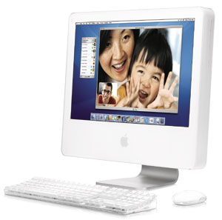
Desktop Evolution - iMac G5
Released 2004
RAM – 2 GB
160 GB hard drive
$1499

Slide 20
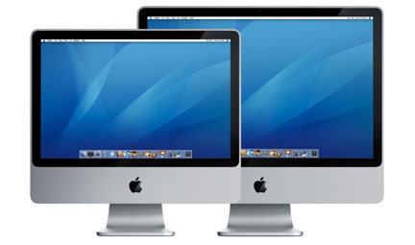
Desktop Evolution - iMac
Released in 2007
RAM: 4 GB
320 GB hard drive
Includes a new thin aluminum keyboard
$1799

Slide 21
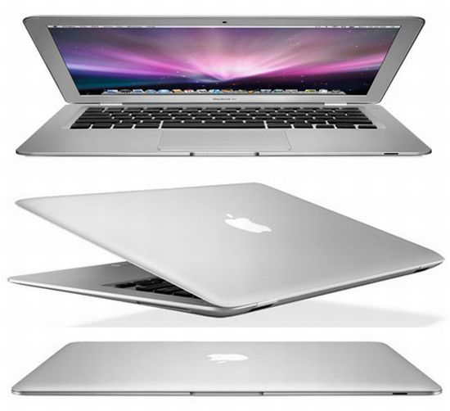
Laptop Evolution – Macbook Air
Weight: 3 lbs
2 GB memory
120 GB hard drive
$1799

Slide 22
An Additional Computer Comparison
Product | Cost | Storage | RAM | Year
Macintosh | $2495 | Floppy | 128 KB | 1984
Mac Plus | $2600 | Floppy | 4 MB | 1986
iMac | $1799 | 320 GB | 4GB | 2007
Mac Portable (laptop) | $6500 | 40MB hd | 8 MB | 1989
Powerbook 100 (laptop) | $2500 | 40MB hd | 8 MB | 1991
Macbook Air (laptop) | $1799 | 120GB hd | 2GB | 2008

Slide 23
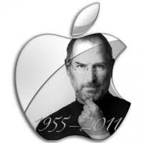
In October 2011 Steve Jobs died but his contribution towards technology remained
alive

Slide 24

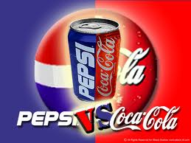
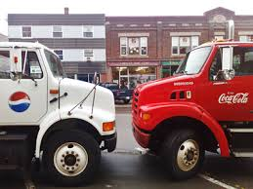
PespsiCo
Vs
Coca Cola

Slide 25

History
1898: Pepsi founded
1923: Pepsi-Cola declares Bankruptcy
1923: Roy C. Marginal buys Pepsi and Pepsi-Cola Corporation formed
1934: Pepsi begins selling 12oz bottles for 5 cents
1946: WWII sugar rationing
Pepsi buys a sugar plant
in Cuba

Slide 26
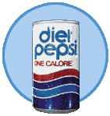
History Continued…
1950: Alfred Steele becomes CEO
Joan Crawford promotes Pepsi brand
1956: 149 Bottling Plants in 62 countries
1962: Pepsi’s sixth new logo “Pepsi Generation”
1964: Diet Pepsi introduced
1964: Pepsi acquires Mountain Dew

Slide 27
History Continued…
1965: Frito Lay merges with Pepsi-Cola
Becomes Pepsico
1965: Mountain Dew’s first campaign
“Ya-Hoo Mountain Dew…It'll tickle your innards”
1966: Pepsi enters the Japanese and European markets.

Slide 28
History Continued…
1967: Advertising campaign is
“Come alive, you’re in the Pepsi Generation”
1975: The Pepsi Challenge
1984: Lemon Lime and Mandarin Orange Slice
introduced
2002: Pepsi Blue introduced

Slide 29

Pepsi’s Competition: Coca-Cola
1886: Founded on May 8, 1886 by a pharmacist named John S. Pemberton.
1887: Established its trademark
1895: Coke began selling soft drinks
Today: They produce more than 400 different types of beverages in 200 countries.
Coke is the most successful soft drink maker in history and is ranked #1 in the world.

Slide 30
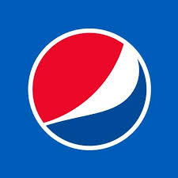
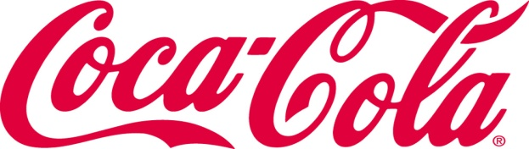
A perfect match of products
Vanilla Pepsi (2002)
Tropicana (1998)
Gatorade (2001)
Aquafina (1993)
Cherry Pepsi (1989)
7-Up (1986)
Diet Pepsi (1964)
Vanilla Coke (2002)
Minute Maid (1960)
PowerAde (2001)
Dasani (1999)
Cherry coke (1985)
Sprite (1960)
Diet coke (1982)

Slide 31
Failed Products for Pepsi
Crystal Clear Pepsi introduced in 1992 and lasted for a couple years than was pulled off the market.
Pepsi Blue was introduced in 2001 was not a disappointment and was discontinued due to lackluster sales
Pepsi One has shown a decline in sales

Slide 32
Failed International Marketing for Coke
In 1999 hundreds of students and adults got very ill in Belgium and France after drinking coke products.
  Led to a recall of 14 million cases spanning 5 European countries
  The bottling plant in Europe failed in there Quality Control testing.
2000: Coke failed in an attempt to buy Quaker Oats from Pepsi for 14 billion.

Slide 33
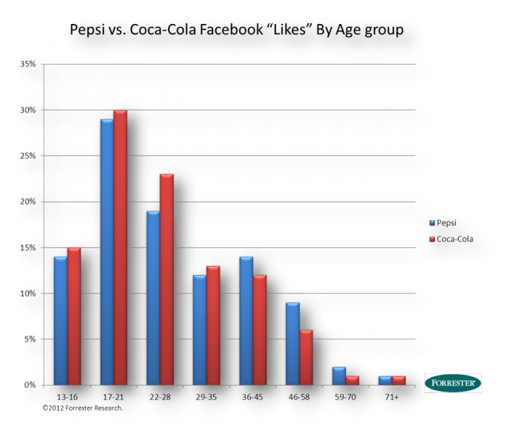
Pepsi and Coca Cola on Face Book

Slide 34
Thank You

