Slide 1

Creating Brand Equity

Slide 2
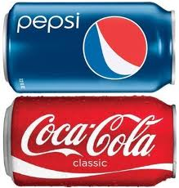

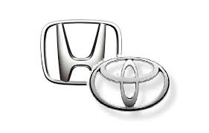



Brand Equity
American Marketing Association defines brand as a name, term, sign, symbol, or design or a combination of them intended to identify goods or services of one seller or group of sellers and to differentiate them from those of competitors.

Slide 3
The Role of Brands
Identify the maker
Simplify product handling
Organize accounting
Offer legal protection
Notes:
Brands identify the source or maker of a product and allow consumers—either individuals or organizations—to assign responsibility for its performance to a particular manufacturer or distributor. Consumers may evaluate the identical product differently depending on how it is branded. They learn about brands through past experiences with the product and its marketing program, finding out which brands satisfy their needs and which do not. As consumers’ lives become more complicated, rushed, and time-starved, a brand’s ability to simplify decision making and reduce risk becomes invaluable. Brands also perform valuable functions for firms. First, they simplify product handling or tracing. Brands help to organize inventory and accounting records. A brand also offers the firm legal protection for unique features or aspects of the product.

Slide 4
The Role of Brands
Signify quality
Create barriers to entry
Serve as a competitive advantage
Secure price premium
Notes:
The brand name can be protected through registered trademarks; manufacturing processes can be protected through patents; and packaging can be protected through copyrights and proprietary designs. These intellectual property rights ensure that the firm can safely invest in the brand and reap the benefits of a valuable asset. A credible brand signals a certain level of quality so that satisfied buyers can easily choose the product again. Brand loyalty provides predictability and security of demand for the firm, and it creates barriers to entry that make it difficult for other firms to enter the market. Loyalty also can translate into customer willingness to pay a higher price often 20 percent to 25 percent more than competing brands.

Slide 5
What is Branding?
Branding is endowing products and services with the power of the brand.
It’s all about creating differences between products. Branding creates mental structures that help consumers organize their knowledge about products and services in a way that clarifies their decision making and, in the process, provides value to the firm.
Notes:
How do you “brand” a product? Although firms provide the impetus to brand creation through marketing programs and other activities, ultimately a brand resides in the minds of consumers. It is a perceptual entity rooted in reality but reflecting the perceptions and idiosyncrasies of consumers. Branding is endowing products and services with the power of a brand. It’s all about creating differences between products. Marketers need to teach consumers “who” the product is—by giving it a name and other brand elements to identify it—as well as what the product does and why consumers should care. Branding creates mental structures that help consumers organize their knowledge about products and services in a way that clarifies their decision making and, in the process, provides value to the firm.

Slide 6
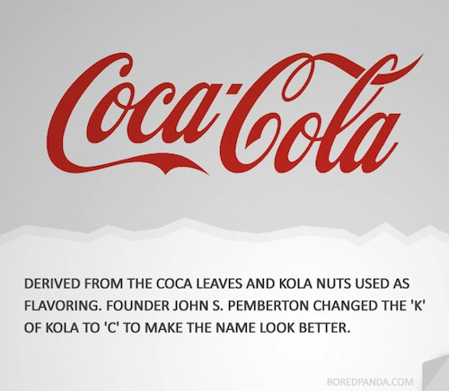
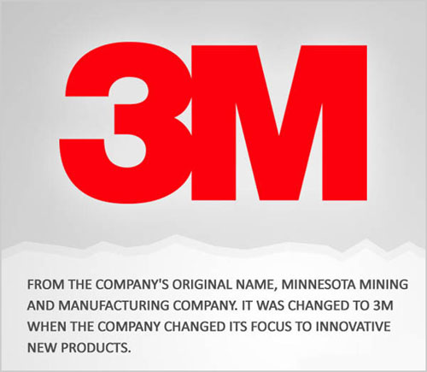
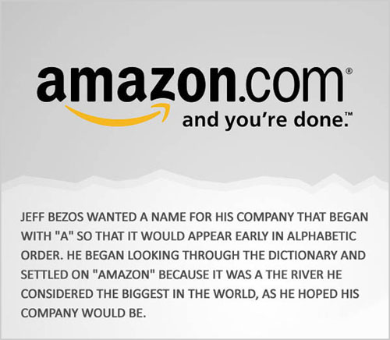
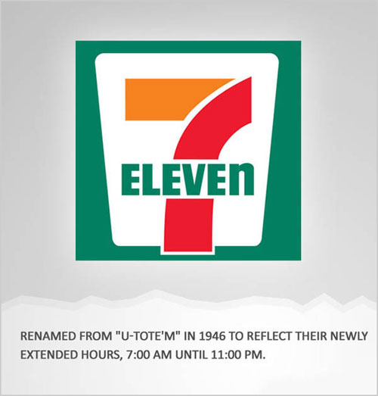

Slide 7
What is Brand Equity?
Brand equity is the added value endowed on products and services, which may be reflected in the way consumers, think, feel, and act with respect to the brand.
Marketers and researchers use various perspectives to study brand equity.
Customer-based approaches view it from the perspective of the consumer
Notes:
Brand equity is the added value endowed on products and services. It may be reflected in the way consumers think, feel, and act with respect to the brand, as well as in the prices, market share, and profitability the brand commands. Marketers and researchers use various perspectives to study brand equity. Customer-based approaches view it from the perspective of the consumer—either an individual or an organization— and recognize that the power of a brand lies in what customers have seen, read, heard, learned, thought, and felt about the brand over time. Customer-based brand equity is thus the differential effect brand knowledge has on consumer response to the marketing of that brand. A brand has positive customer-based brand equity when consumers react more favorably to a product and the way it is marketed when the brand is identified, than when it is not identified. A brand has negative customer-based brand equity if consumers react less favorably to marketing activity for the brand under the same circumstances. There are three key ingredients of customer-based brand equity.

Slide 8
Cont…
There are three key ingredients of customer-based brand equity.
1. Brand equity arises from differences in customers response.
2. Differences in responses are a result of consumer’s brand knowledge which deals with all the thoughts, feelings, images, experiences and beliefs.
3. Brand equity is reflected in perceptions, references and behavior
Notes:
Brand equity is the added value endowed on products and services. It may be reflected in the way consumers think, feel, and act with respect to the brand, as well as in the prices, market share, and profitability the brand commands. Marketers and researchers use various perspectives to study brand equity. Customer-based approaches view it from the perspective of the consumer—either an individual or an organization— and recognize that the power of a brand lies in what customers have seen, read, heard, learned, thought, and felt about the brand over time. Customer-based brand equity is thus the differential effect brand knowledge has on consumer response to the marketing of that brand. A brand has positive customer-based brand equity when consumers react more favorably to a product and the way it is marketed when the brand is identified, than when it is not identified. A brand has negative customer-based brand equity if consumers react less favorably to marketing activity for the brand under the same circumstances. There are three key ingredients of customer-based brand equity.

Slide 9
Advantages of Strong Brands
Improved perceptions of product performance
Greater loyalty
Less vulnerability to competitive marketing actions
Less vulnerability to crises
Larger margins
More inelastic consumer response
Greater trade cooperation
Increased marketing communications effectiveness
Possible licensing opportunities
Notes:
Table 9.1 lists the advantages of strong brands.

Slide 10
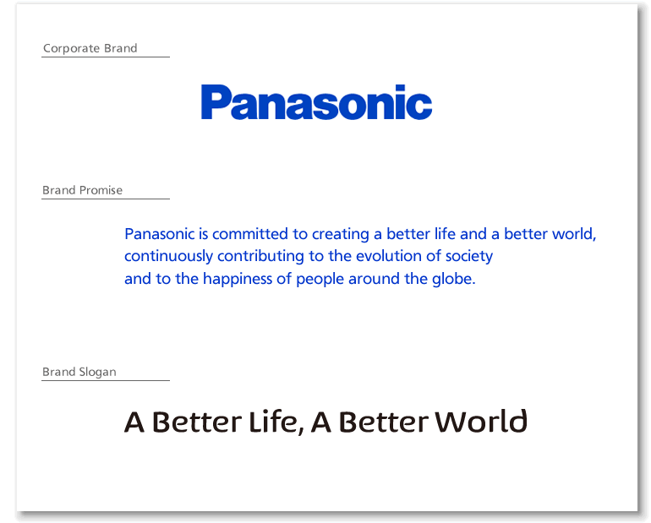
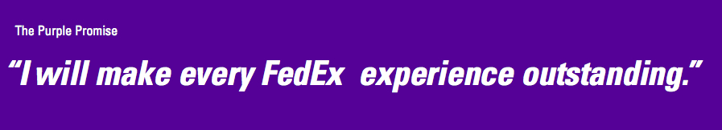
What is a Brand Promise?
A brand promise is the marketer’s vision of what the brand must be and do for consumers.
Notes:
Every brand makes a promise to its customers. The promise is expressed in the brand’s promotional work but must be delivered when the product is used.

Slide 11
Brand Equity Models
Brand Asset Valuator (BAV)
Brandz
Brand Resonance
Notes:
Although marketers agree about basic branding principles, a number of models of brand equity offer some differing perspectives.

Slide 12
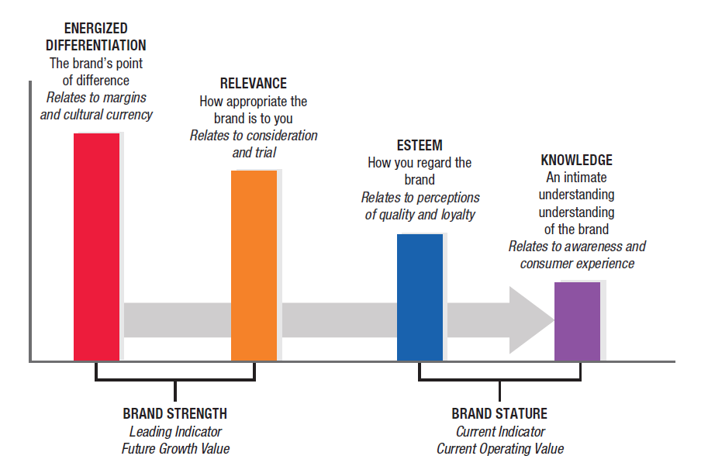
BAV Model
Advertising agency Young and Rubicam (Y&R) developed a model of brand equity
called the BrandAsset® Valuator (BAV). Based on research with almost 800,000
consumers in 51 countries, BAV compares the brand equity of thousands of brands
across hundreds of different categories.
Notes:
Advertising agency Young and Rubicam (Y&R) developed a model of brand equity called the BrandAsset® Valuator (BAV). Based on research with almost 800,000 consumers in 51 countries, BAV compares the brand equity of thousands of brands across hundreds of different categories. There are four key components—or pillars—of brand equity, according to BAV (see Figure 9.1). Energized differentiation measures the degree to which a brand is seen as different from others, and its perceived momentum and leadership. Relevance measures the appropriateness and breadth of a brand’s appeal. Esteem measures perceptions of quality and loyalty, or how well the brand is regarded and respected. Knowledge measures how aware and familiar consumers are with the brand. The relationships among these dimensions—a brand’s “pillar pattern”—reveal much about a brand’s current and future status.

Slide 13
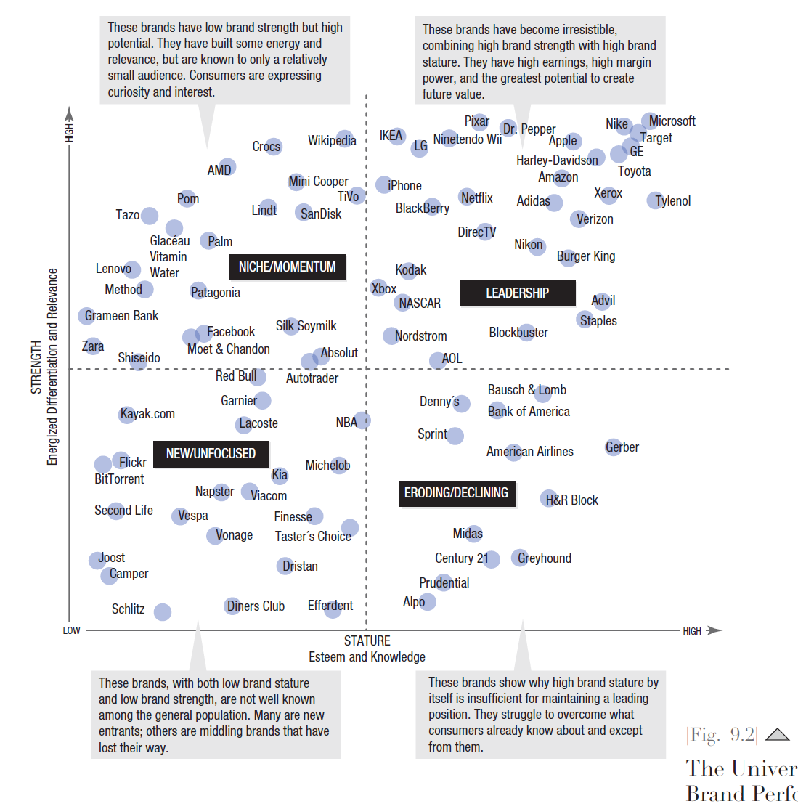
Universe of Brand Performance
Notes:
Energized differentiation and relevance combine to determine brand strength—a leading indicator that predicts future growth and value. Esteem and knowledge together create brand stature, a “report card” on past performance and a current indicator of current value. The relationships among these dimensions—a brand’s “pillar pattern”—reveal much about a brand’s current and future status. Energized brand strength and brand stature combine to form the power grid, depicting stages in the cycle of brand development in successive quadrants (see Figure 9.2). Strong new brands show higher levels of differentiation and energy than relevance, whereas both esteem and knowledge are lower still. Leadership brands show high levels on all pillars. Finally, declining brands show high knowledge—evidence of past performance— a lower level of esteem, and even lower relevance, energy, and differentiation.

Slide 14
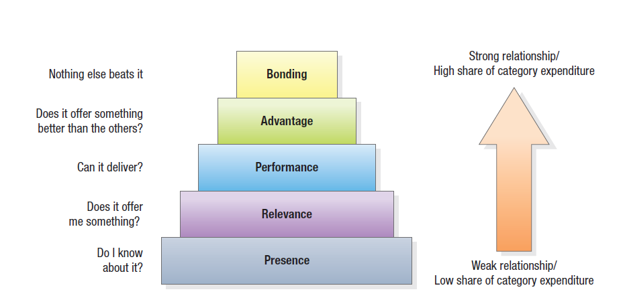
Brandz: Brand Dynamics Pyramid
Notes:
Marketing research consultants Millward Brown and WPP have developed the BrandZ model of brand strength, at the heart of which is the BrandDynamics pyramid. According to this model, brand building follows a series of steps (see Figure 9.3). For any one brand, each person interviewed is assigned to one level of the pyramid depending on their responses to a set of questions. The BrandDynamics Pyramid shows the number of consumers who have reached each level.
• Bonding. Rational and emotional attachments to the brand to the exclusion of most other brands
• Advantage. Belief that the brand has an emotional or rational advantage over other brands in the category
• Performance. Belief that it delivers acceptable product performance and is on the consumer’s short-list
• Relevance. Relevance to consumer’s needs, in the right price range or in the consideration set
• Presence. Active familiarity based on past trial, saliency, or knowledge of brand promise
There are more consumers at the lower levels, so the challenge for marketers is to help them move up.

Slide 15
Cont…..
• Bonding. Rational and emotional attachments to the brand to the
exclusion of most other brands
• Advantage. Belief that the brand has an emotional or rational
advantage over other brands in the category
• Performance. Belief that it delivers acceptable product
performance and is on the consumer’s short-list
• Relevance. Relevance to consumer’s needs, in the right price
range or in the consideration set
• Presence. Active familiarity based on past trial, saliency, or
knowledge of brand promise

Slide 16
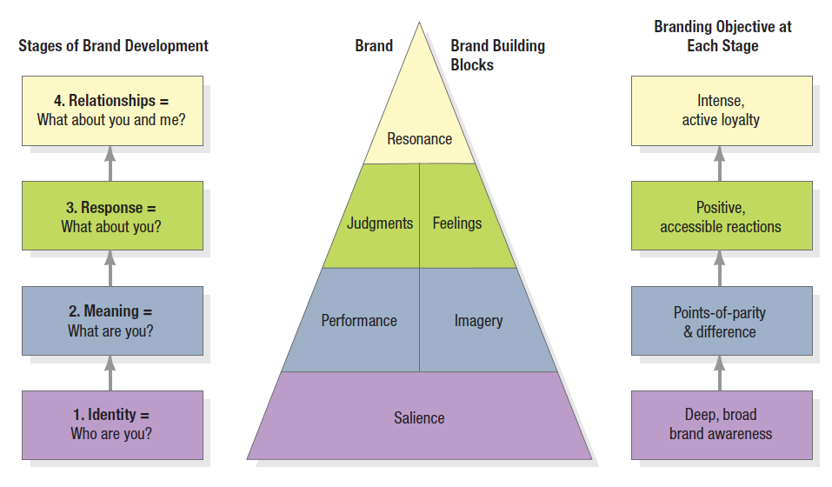
Brand Resonance Pyramid
Notes:
The brand resonance model also views brand building as an ascending series of steps, from bottom to top: (1) ensuring customers identify the brand and associate it with a specific product class or need; (2) firmly establishing the brand meaning in customers’ minds by strategically linking a host of tangible and intangible brand associations; (3) eliciting the proper customer responses in terms of brand-related judgment and feelings; and (4) converting customers’ brand response to an intense, active loyalty. According to this model, enacting the four steps means establishing a pyramid of six “brand building blocks” as illustrated in Figure 9.4. The model emphasizes the duality of brands—the rational route to brand building is on the left side of the pyramid and the emotional route is on the right side.

Slide 17
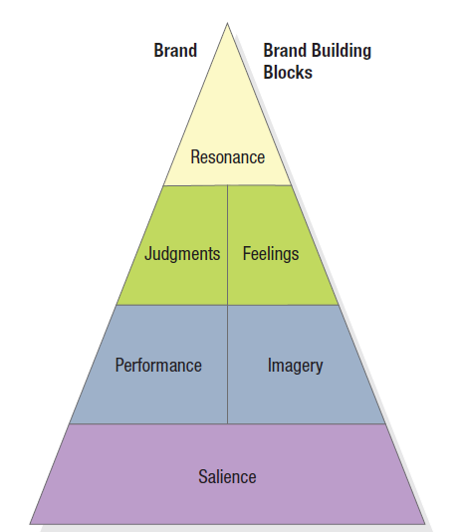
Brand Building Blocks
Notes:
Creating significant brand equity requires reaching the top of the brand pyramid, which occurs only if the right building blocks are put into place.
• Brand salience is how often and how easily customers think of the brand under various purchase or consumption situations.
• Brand performance is how well the product or service meets customers’ functional needs.
• Brand imagery describes the extrinsic properties of the product or service, including the ways in which the brand attempts to meet customers’ psychological or social needs.
• Brand judgments focus on customers’ own personal opinions and evaluations.
• Brand feelings are customers’ emotional responses and reactions with respect to the brand.
• Brand resonance describes the relationship customers have with the brand and the extent to which they feel they’re “in sync” with it.

Slide 18
Cont...
Brand salience is how often and how easily customers think of the brand under various purchase or consumption situations.
• Brand performance is how well the product or service meets customers’ functional
needs.
• Brand imagery describes the extrinsic properties of the product or service, including
the ways in which the brand attempts to meet customers’ psychological or social needs.
• Brand judgments focus on customers’ own personal opinions and evaluations.
• Brand feelings are customers’ emotional responses and reactions with respect to the
brand.
• Brand resonance describes the relationship customers have with the brand and the
extent to which they feel they’re “in sync” with it.

Slide 19
Brand Elements
Brand names
Slogans
Characters
Symbols
Logos
URLs
Nike has the distinctive “swoosh” logo, the empowering “Just Do It” slogan, and the “Nike” name from the Greek winged goddess of victory.
Notes:
Brand elements are devices, which can be trademarked, that identify and differentiate the brand. Most strong brands employ multiple brand elements. Nike has the distinctive “swoosh” logo, the empowering “Just Do It” slogan, and the “Nike” name from the Greek winged goddess of victory. Marketers should choose brand elements to build as much brand equity as possible. The test is what consumers would think or feel about the product if the brand element were all they knew. Based on its name alone, for instance, a consumer might expect SnackWell’s products to be healthful snack foods and Panasonic Toughbook laptop computers to be durable and reliable.

Slide 20
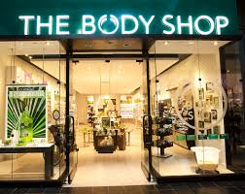
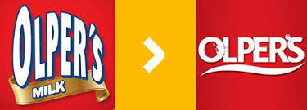




Brand Element Choice Criteria
Memorable
Meaningful
Likeable
Transferable
Adaptable
Protectable
Notes:
There are six criteria for choosing brand elements. The first three memorable, meaningful, and likable—are “brand building.” The latter three—transferable, adaptable, and protectable—are “defensive” and help leverage and preserve brand equity against challenges.
These criteria can be assessed with the following questions:
How easily do consumers recall and recognize the brand element, and when—at both purchase and consumption?
Is the brand element credible? Does it suggest the corresponding category and a product ingredient or the type of person who might use the brand?
How aesthetically appealing is the brand element?
Can the brand element introduce new products in the same or different categories?
How adaptable and updatable is the brand element?
How legally protectable is the brand element? How competitively protectable?

Slide 21
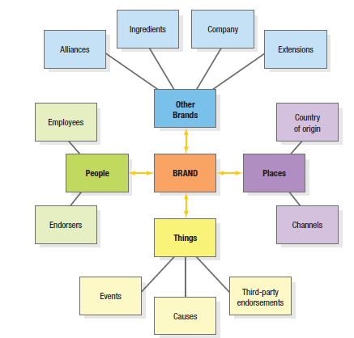
Secondary Sources of Brand Knowledge
Notes:
The third and final way to build brand equity is, in effect, to “borrow” it. That is, create brand equity by linking the brand to other information in memory that conveys meaning to consumers as shown in Figure 9.5.
These “secondary” brand associations can link the brand to sources, such as the company itself (through branding strategies), to countries or other geographical regions (through identification of product origin), and to channels of distribution (through channel strategy); as well as to other brands (through ingredient or co-branding), characters (through licensing), spokespeople (through endorsements), sporting or cultural events (through sponsorship), or some other third party sources (through awards or reviews).

Slide 22
Internal Branding
Choose the right moment: Turning points are ideal opportunities to capture employees’ attention and imagination.
Link internal and external marketing: Internal and external messages must match. use of Internet technology.
Bring the brand alive for employees: Internal communications should be informative and energizing.
Notes:
Marketers must now “walk the walk” to deliver the brand promise. They must adopt an internal perspective to be sure employees and marketing partners appreciate and understand basic branding notions and how they can help—or hurt—brand equity. Internal branding consists of activities and processes that help inform and inspire employees. Brand bonding occurs when customers experience the company as delivering on its brand promise. All the customers’ contacts with company employees and communications must be positive. The brand promise will not be delivered unless everyone in the company lives the brand.
1. Choose the right moment. Turning points are ideal opportunities to capture employees’ attention and imagination.
2. Link internal and external marketing. Internal and external messages must match. use of Internet technology.
3. Bring the brand alive for employees. Internal communications should be informative and energizing.

Slide 23
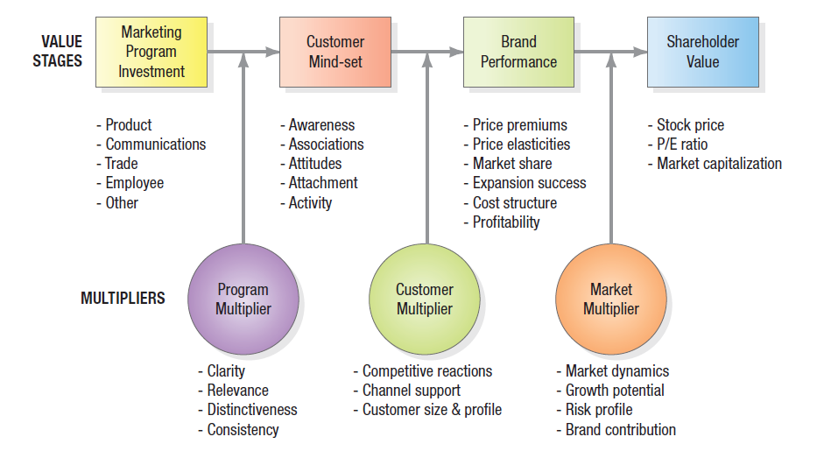
Brand Value Chain
Notes:
The brand value chain is a structured approach to assessing the sources and outcomes of brand equity and the way marketing activities create brand value (see Figure 9.6). It is based on several premises. First, brand value creation begins when the firm targets actual or potential customers by investing in a marketing program to develop the brand, including product research, development, and design; trade or intermediary support; and marketing communications. Next, we assume customers’ mind-sets, buying behavior, and response to price will change as a result of the marketing program; the question is how. Finally, the investment community will consider market performance, replacement cost, and purchase price in acquisitions (among other factors) to assess shareholder value in general and the value of a brand in particular. The model also assumes that three multipliers moderate the transfer between the marketing program and the subsequent three value stages. The program multiplier determines the marketing program’s ability to affect the customer mind-set and is a function of the quality of the program investment. The customer multiplier determines the extent to which value created in the minds of customers affects market performance. The market multiplier determines the extent to which the value shown by the market performance of a brand is manifested in shareholder value.

Slide 24
Measuring Brand Equity
Brand audit is a consumer-focused series of procedures to assess the health of the brand, uncover its sources of brand equity, and suggest ways to improve and leverage its equity.
Brand tracking studies collect quantitative data from consumers over time to provide consistent, baseline information about how brands and marketing programs are performing.
Brand valuation: Total financial value of the brand
Notes:
A brand audit is a consumer-focused series of procedures to assess the health of the brand, uncover its sources of brand equity, and suggest ways to improve and leverage its equity. Marketers should conduct a brand audit when setting up marketing plans and when considering shifts in strategic direction. Conducting brand audits on a regular basis, such as annually, allows marketers to keep their fingers on the pulse of their brands so they can manage them more proactively and responsively.
Brand-tracking studies collect quantitative data from consumers over time to provide consistent, baseline information about how brands and marketing programs are performing. Tracking studies help us understand where, how much, and in what ways brand value is being created, to facilitate day-to-day decision making. Marketers should distinguish brand equity from brand valuation, which is the job of estimating the total financial value of the brand.

Slide 25
Managing Brand Equity
Brand reinforcement deals with
What products it represents, what core benefits it supplies, and what needs it satisfies, and
(2) how the brand makes products superior, and which strong, favorable, and unique brand associations should exist in consumers’ minds.
Brand revitalization is to understand what the sources of brand equity were to begin with. Are positive associations losing their strength or uniqueness? Have negative associations become linked to the brand? Then decide whether to retain the same positioning or create a new one, and if so, which new one.
Notes:
Marketers can reinforce brand equity by consistently conveying the brand’s meaning in terms of: (1) What products it represents, what core benefits it supplies, and what needs it satisfies, and (2) how the brand makes products superior, and which strong, favorable, and unique brand associations should exist in consumers’ minds. Often, the first thing to do in revitalizing a brand is to understand what the sources of brand equity were to begin with. Are positive associations losing their strength or uniqueness? Have negative associations become linked to the brand? Then decide whether to retain the same positioning or create a new one, and if so, which new one. The beginning of the 21st century was not kind to 165-year-old Pabst Brewing Company. Revenue from its portfolio of legacy brands—including Pabst Blue Ribbon, Old Milwaukee, Lone Star, Rainier, Stroh’s, and Schlitz—declined from an overall barrelage of 9.5 million in 2000 to 6.5 million in 2005. In response, new management set the company on a new course, including contract brewing with carefully selected partners and a new emphasis on its distributor network. PBR, as it became known as, was suddenly hip. The brand’s resurgence was marked by a 25 percent increase in sales in 2009 that far exceeded even other sub-premium brews.

Slide 26
Devising a Branding Strategy
Develop new brand elements
Apply existing brand elements
Use a combination of old and new
Notes:
A firm’s branding strategy—often called the brand architecture—reflects the number and nature of both common and distinctive brand elements. Deciding how to brand new products is especially critical. A firm has three main choices:
1. It can develop new brand elements for the new product.
2. It can apply some of its existing brand elements.
3. It can use a combination of new and existing brand elements.

Slide 27
Branding Terms
Brand line: It consists of all products—original as well as line and category extensions—sold under a particular brand.
Brand mix: set of all brand lines that a particular seller makes.
Brand extension: When a firm uses an established brand to introduce a new product.
Sub-brand: When marketers combine a new brand with an existing brand.
Parent brand: Existing brand that gives birth to a brand extension or sub-brand
Family brand: When parent brand already associated with multiple products through brand extensions.
Line extension: Parent brand covers a new product within a product category it currently serves, such as with new flavors, forms, colors, ingredients, and package sizes.
Category extension: Marketers use the parent brand to enter a different product category, such as Swiss Army watches.
Branded variants: Specific brand lines supplied to specific retailers or distribution channels.
Licensed product: A licensed product is one whose brand name has been licensed to other manufacturers that actually make the product.
Notes:
A brand line consists of all products—original as well as line and category extensions—sold under a particular brand. A brand mix (or brand assortment) is the set of all brand lines that a particular seller makes. When a firm uses an established brand to introduce a new product, the product is called a brand extension. When marketers combine a new brand with an existing brand, the brand extension can also be called a sub-brand, such as Hershey Kisses candy, Adobe Acrobat software, Toyota Camry automobiles, and American Express Blue cards. The existing brand that gives birth to a brand extension or sub-brand is the parent brand. If the parent brand is already associated with multiple products through brand extensions, it can also be called a master brand or family brand. Brand extensions fall into two general categories:63 In a line extension, the parent brand covers a new product within a product category it currently serves, such as with new flavors, forms, colors, ingredients, and package sizes. In a category extension, marketers use the parent brand to enter a different product category, such as Swiss Army watches. Many companies are introducing branded variants, which are specific brand lines supplied to specific retailers or distribution channels. A licensed product is one whose brand name has been licensed to other manufacturers that actually make the product.

Slide 28
Thank You

