Slide 1

Crafting the Brand Position

Slide 2
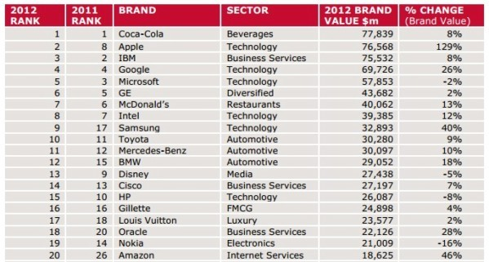
Top Brands

Slide 3
Marketing Strategy
Companies seek to discover different needs and groups in the market (Segmentation),
target those they can satisfy better than competitors, and then position their offerings
so the target market is aware of the distinctive differences.
Segmentation
Targeting
Positioning
S
T
P
Notes:
Segmentation and targeting were discussed in chapter 8. Companies seek to discover different needs and groups in the market (Segmentation), target those they can satisfy better than competitors, and then position their offerings so the target market is aware of the distinctive differences.

Slide 4

Positioning
The act of designing a company’s offering and image to occupy a distinctive place in the minds of the target market.
Notes:
The goal of positioning is to locate the brand in the minds of consumers to maximize the potential benefit to the firm. A good brand positioning helps guide marketing strategy by clarifying the brand’s essence, identifying the goals it helps the consumer achieve, and showing how it does so in a unique way.

Slide 5
Brand Positioning
Quality
Customer wants and needs
Company capabilities
Competitive actions
Brand A
Price
E
D
G
F
C
B
Notes:
To create a well-differentiated brand position marketers must have a keen understanding of customer wants and needs, company capabilities, and competitive actions.

Slide 6


Value Proposition
A customer-focused value proposition gives customers a persuasive reason to buy
a product.
What the brand could be
What the brand is
Notes:
A customer-focused value proposition gives customers a persuasive reason to buy your product.

Slide 7
Brand Positioning
Positioning requires that marketers define and communicate similarities and differences
between their brand and its competitors:
Frame of Reference
Identifying the target market and relevant competition
Points of parity / difference
Identify the optimal points of parity and points of difference
Brand mantra
Summarize the positioning and essence of the brand
Notes:
Positioning requires that marketers define and communicate similarities and differences between their brand and its competitors:
Determine a frame of reference by identifying the target market and relevant competition
Identify the optimal points of parity and points of difference brand associations given that frame of reference
Create a brand mantra to summarize the positioning and essence of the brand

Slide 8


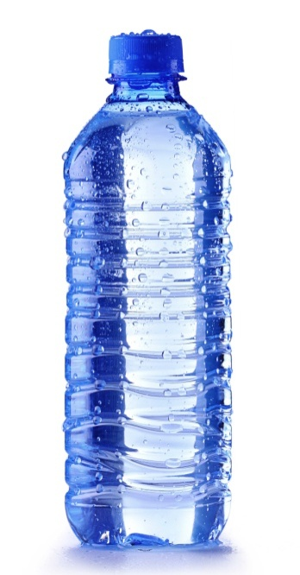

Competitive Frame of Reference
A frame of reference begins by determining the category to which the product belongs,
which includes all products that a brand competes with, or can serve as a substitute.
Competitors can then be analyzed and more narrowly defined.
Identifying Competitors
Analyzing Competitors
Notes:
A frame of reference begins by determining the category to which the product belongs, which includes all products that a brand competes with, or can serve as a substitute. Competitors can then be analyzed and more narrowly defined. For example, even though a new brand in the premium bottled water space is in the same category as Coke’s Dasani, it must focus more on other premium priced brands such as Fiji.

Slide 9
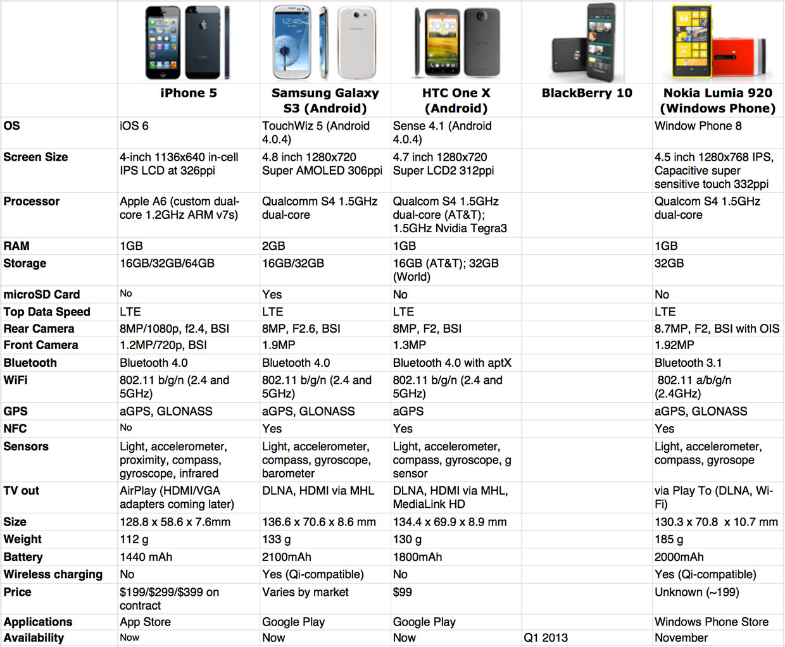
Frame of Reference example
Notes:
Positioning requires that marketers define and communicate similarities and differences between their brand and its competitors:
Determine a frame of reference by identifying the target market and relevant competition
Identify the optimal points of parity and points of difference brand associations given that frame of reference
Create a brand mantra to summarize the positioning and essence of the brand

Slide 10

Points of Parity POP
Attribute or benefit associations that are not necessarily unique to the brand but may in fact be shared with other brands. These include category POP that are essential to a legitimate and credible offering within a certain product or service category and competitive POP that are associations designed to overcome perceived weaknesses of the brand.
Notes:
POP: attribute or benefit associations that are not necessarily unique to the brand but may in fact be shared with other brands. These include category POP that are essential to a legitimate and credible offering within a certain product or service category and competitive POP that are associations designed to overcome perceived weaknesses of the brand.
POD: attributes or benefits that consumers strongly associate with a brand, positively evaluate, and believe they could not find to the same extent with a competitive brand. These attribute or benefit should be sufficiently desirable, deliverable, and differentiating.
Often, the key to positioning is not so much achieving a POD as achieving POD. The brand does not literally need to be seen as equal to competitors, but consumers must feel it does well enough on that particular attribute or benefit. A light beer presumably would never taste as good as a full-strength beer, but it would need to taste close enough to be able to effectively compete.

Slide 11
Points of Difference POD
Attributes or benefits that consumers strongly associate with a brand, positively evaluate, and believe they could not find to the same extent with a competitive brand. These attribute or benefit should be sufficiently desirable, deliverable, and differentiating.
Notes:
POP: attribute or benefit associations that are not necessarily unique to the brand but may in fact be shared with other brands. These include category POP that are essential to a legitimate and credible offering within a certain product or service category and competitive POP that are associations designed to overcome perceived weaknesses of the brand.
POD: attributes or benefits that consumers strongly associate with a brand, positively evaluate, and believe they could not find to the same extent with a competitive brand. These attribute or benefit should be sufficiently desirable, deliverable, and differentiating.
Often, the key to positioning is not so much achieving a POD as achieving POD. The brand does not literally need to be seen as equal to competitors, but consumers must feel it does well enough on that particular attribute or benefit. A light beer presumably would never taste as good as a full-strength beer, but it would need to taste close enough to be able to effectively compete.

Slide 12
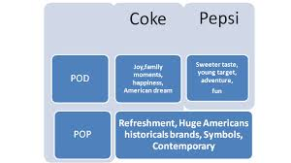
Points of Parity/difference Example
Notes:
Positioning requires that marketers define and communicate similarities and differences between their brand and its competitors:
Determine a frame of reference by identifying the target market and relevant competition
Identify the optimal points of parity and points of difference brand associations given that frame of reference
Create a brand mantra to summarize the positioning and essence of the brand

Slide 13

Brand Mantras
A brand mantra is the articulation of the heard and soul of the brand. They are short, three- to five-word phrases that capture the essence or spirit of the brand positioning. Brand mantras can provide guidance about what products to introduce under a brand, what ad campaigns to use, where, and how to sell the brand.
Brand Mantra Criteria:
  Communicate: Should state what is unique about the brand.
  Simplify: It should be memorable; short, crisp, and vivid in meaning.
  Inspire: It should be personally meaningful and relevant.
Notes:
A brand mantra is the articulation of the heard and soul of the brand. They are short, three- to five-word phrases that capture the essence or spirit of the brand positioning. Brand mantras can provide guidance about what products to introduce under a brand, what ad campaigns to use, where, and how to sell the brand.
Three key criteria for establishing a brand mantra are:
Communicate – It should define the category of business for the brand and set the boundaries. Should state what is unique about the brand.
Simplify – It should be memorable; short, crisp, and vivid in meaning.
Inspire – It should be personally meaningful and relevant to as many employees as possible.

Slide 14
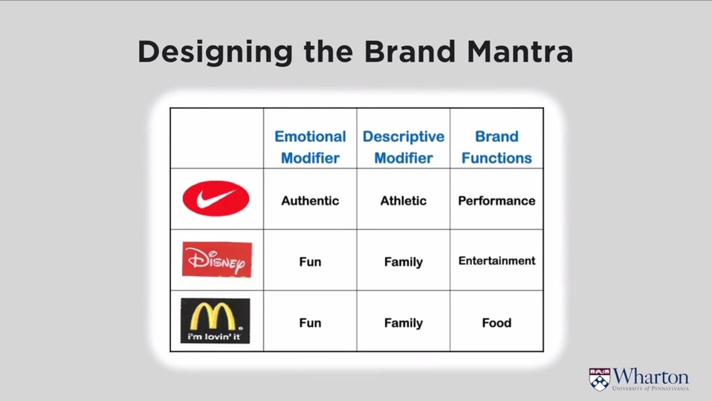
Brand Mantra
Notes:
Positioning requires that marketers define and communicate similarities and differences between their brand and its competitors:
Determine a frame of reference by identifying the target market and relevant competition
Identify the optimal points of parity and points of difference brand associations given that frame of reference
Create a brand mantra to summarize the positioning and essence of the brand

Slide 15


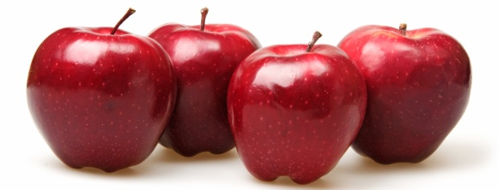
Establishing Brand Positioning
Communicate
Category Membership
  Category Benefits
  Compare to exemplars
  Product descriptor
Internally
Points of difference
Points of parity
Notes:
Establishing the brand positioning in the marketplace requires that consumers understand in which category or categories the brand competes and its POP and POD with respect to those competitors.

Slide 16
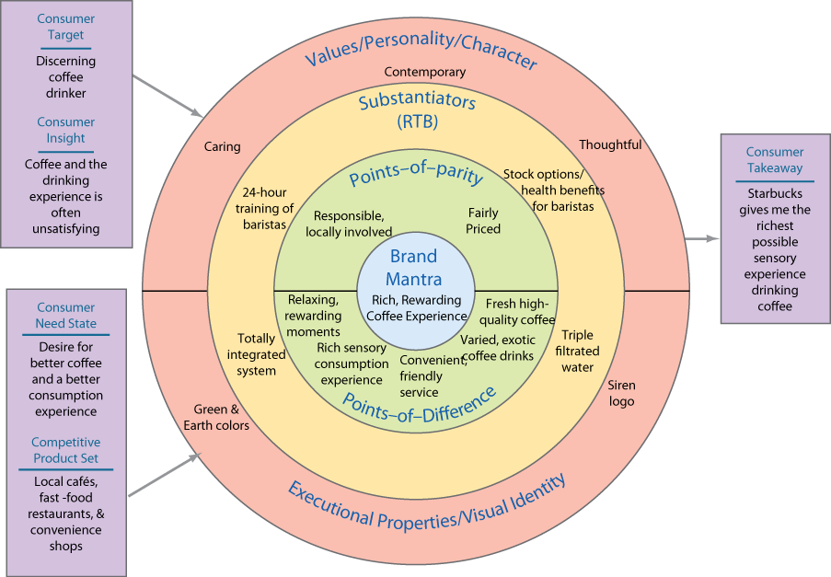
Brand Positioning Bull’s-eye
Notes:
“Marketing Memo: Constructing a Brand Positioning Bull’s-eye” outlines a helpful schematic way marketers can formally express brand positioning.

Slide 17


Differentiation Strategies
Competitive Advantage: company’s ability to perform in one or more ways that competitors cannot or will not match.
Sustainable
Leverageable
Customer Advantage
Notes:
A competitive advantage is a company’s ability to perform in one or more ways that competitors cannot or will not match.
While strategist, such as Michael Porter, urge companies to build sustainable competitive advantages, few CA’s are sustainable. But they can be Leverageable, which mean the advantage can be used as a source of new advantages.
For a brand to be effectively positioned, customers must see any competitive advantage as a customer advantage. Meaning that the product has an advantage over competitive products.

Slide 18

Means of Differentiation
Employees: train employees to provide superior customer service.
Channels: Design distribution channels’ coverage, expertise, and performance to make buying the product easier and more enjoyable and rewarding.
Image: Craft powerful, compelling images that appeal to consumers’ social and psychological needs.
Services: Design a better and faster delivery system that provides more effective and efficient solutions to consumers.
Notes:
Employee differentiation: train employees to provide superior customer service. Singapore Airlines is well regarded in large part because of its flight attendants.
Channel differentiation: design distribution channels’ coverage, expertise, and performance to make buying the product easier and more enjoyable and rewarding. Dayton, Ohio–based Iams found success selling premium pet food through regional veterinarians, breeders, and pet stores.
Image differentiation: craft powerful, compelling images that appeal to consumers’ social and psychological needs. E.g., Marlboro’s
Services differentiation: design a better and faster delivery system that provides more effective and efficient solutions to consumers.

Slide 19


Emotional Branding
A good positioning should contain POD and POP that appeal both to the head and to the
heart. Brands that are lovemarks command both respect and love and result from a brand’s
ability to achieve mystery, sensuality, and intimacy:
Lovemarks
Mystery
Sensuality
Intimacy
Emotional
Rational
Notes:
A good positioning should contain POD and POP that appeal both to the head and to the heart. Brands that are lovemarks command both respect and love and result from a brand’s ability to achieve mystery, sensuality, nd intimacy:

Slide 20
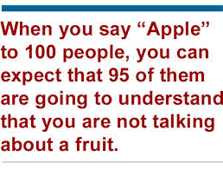


Emotional Branding Examples
Notes:
A good positioning should contain POD and POP that appeal both to the head and to the heart. Brands that are lovemarks command both respect and love and result from a brand’s ability to achieve mystery, sensuality, nd intimacy:

Slide 21

Emotional Branding
Share of Market
Share of Mind
Share of Heart
Notes:
Firm should monitor three variables when analyzing potential threats posed by competitors:
Share of market—The competitor’s share of the target market.
Share of mind—The percentage of customers who named the competitor in responding to the statement,“Name the first company that comes to mind in this industry.”
Share of heart—The percentage of customers who named the competitor in responding to the statement,“Name the company from which you would prefer to buy the product.”

Slide 22
Alternative Positioning Approaches
Brand Narratives / Storytelling
Brand Journalism
Cultural Branding
Notes:
Position a brand as telling a narrative or story based on deep metaphors that connect to people’s memories, associations, and stories.
Communicate different messages to different market segments, as long as they at least broadly fit within the basic broad image of the brand.
Build iconic, leadership brands with cultural knowledge, cultural branding principles, and cultural experts

Slide 23



Small Business Positioning
Creative, low-cost research
Focus on fewer, stronger brands
Integrated brand elements
Create buzz
Build a brand community
Secondary associations

Slide 24
Thank You

