Slide 1
Phillip
Kevin Lane
Kotler • Keller
Marketing Management • 14e

Slide 2

Defining Marketing for the 21st Century
Chapter 1

Slide 3

Marketing is a societal process by which individuals and groups obtain what they need and want through creating, offering, and exchanging
products and services of value freely with others.

Slide 4
Marketing Management is the process of planning and executing the conception, pricing, promotion, and distribution of ideas, goods, and services to create exchanges that satisfy individual and organizational goals.

Slide 5
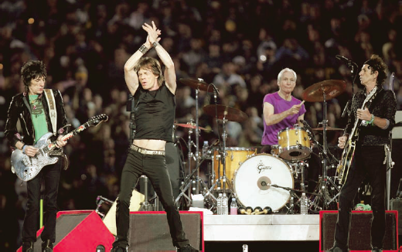

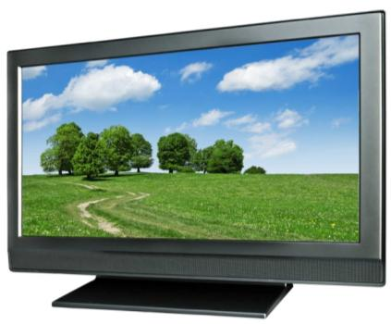
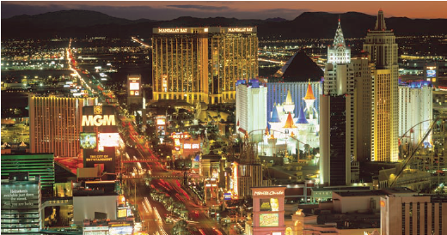
What is Marketed?
Persons
Experiences
Events
Properties
Organizations
Information
Ideas
Goods
Places
Services
Notes:
Experiences include a trip to Disney World, Fantasy baseball camp, a cruise.
Events can include trade shows, the Olympics, Super Bowl, etc.
Properties include real estate as well as stocks and bonds.
Organizations use marketing to connect with their target market.
Information is marketed by universities, textbook publishers, newspapers, etc.
Ideas include “Friends don’t let friends drive drunk”

Slide 6
What is Marketed?
Goods. Physical goods constitute the bulk of most countries’ production and marketing effort e.g furniture, cars, etc.
Services. As economies advance, a growing proportion of their activities are focused on the production of services e.g lawyers, doctors.
Experiences. By orchestrating several services and goods, one can create, stage, and market experiences e.g theme parks

Slide 7
What is Marketed?
Events. Marketers promote time-based events, such as the Olympics, trade shows etc.
Persons. Celebrity marketing has become a major business. Artists, musicians, CEOs, physicians, high-profile lawyers etc. draw help from celebrity marketers.
Places. Cities, states, regions, and nations compete to attract tourists, factories, company headquarters, and new residents.

Slide 8
What is Marketed?
Properties. Properties are intangible rights of ownership of either real property (real estate) or financial property (stocks and bonds).
Organizations. Organizations actively work to build a strong, favorable image in the mind of their publics e.g Philips said “lets make things better.

Slide 9
What is Marketed?
Information. The production, packaging, and distribution of information is one of society’s major industries e.g schools, universities, encyclopedias etc.
Ideas. Every market offering has a basic idea at its core. In essence, products and services are platforms for delivering some idea or benefit to satisfy a core need.

Slide 10
Demand Management by Marketers
Marketers are responsible for demand management. They may have to manage
  Negative demand (avoidance of a product),
  No demand (lack of awareness or interest in a product),
  Latent demand (a strong need that cannot be satisfied by existing products),
  Declining demand (lower demand),
  Irregular demand (demand varying by season, day, or hour),

Slide 11
Cont..
  full demand (a satisfying level of demand),
  overfull demand (more demand than can be handled), or
  unwholesome demand (demand for unhealthy or dangerous products).
Marketing Managers seek to influence the level, timing, and composition of these various demand states.

Slide 12
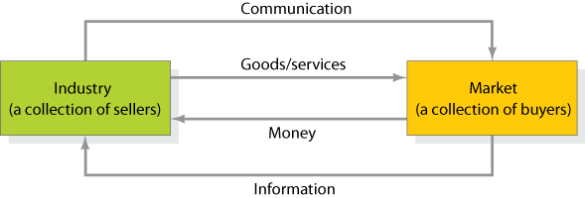
Simple Marketing System

Slide 13
Satisfying Diverse Customer Needs
Market segmentation is examining demographic, psychographic, and behavioral differences among buyers.
For each segment, the firm develops a market offering which are more beneficial for company.

Slide 14
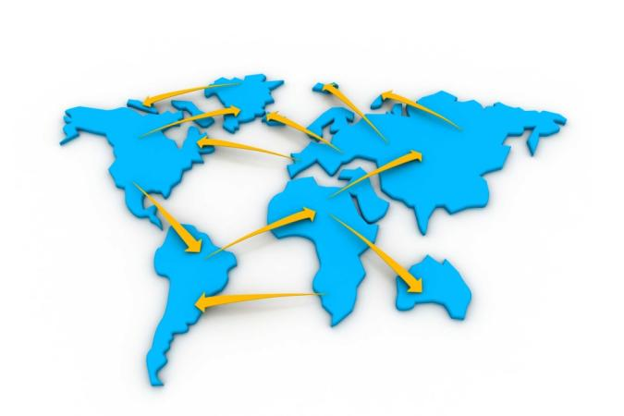


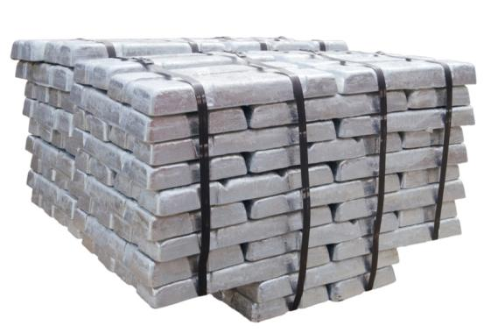
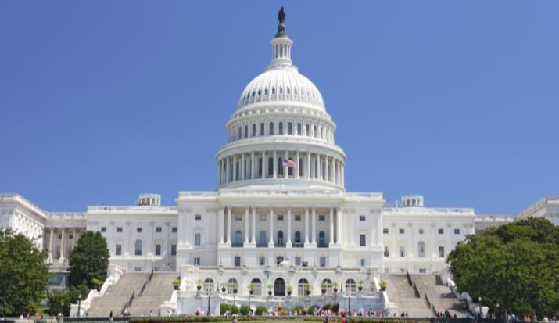
Key Customer Markets
Global Markets
Consumer Market
Business Markets
Government Market

Slide 15
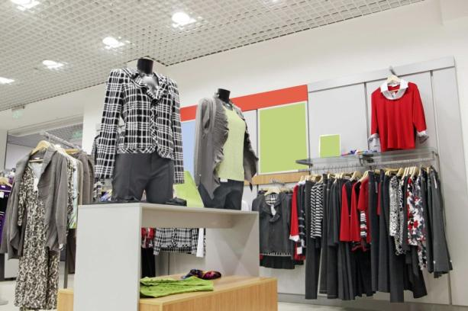
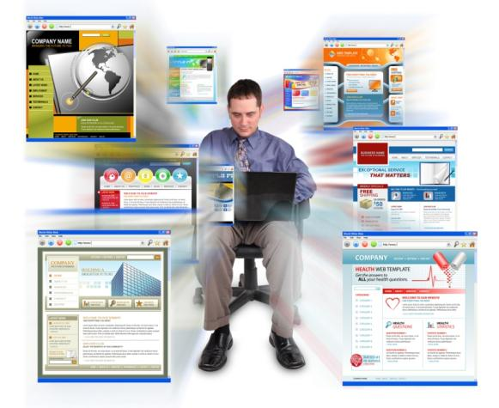
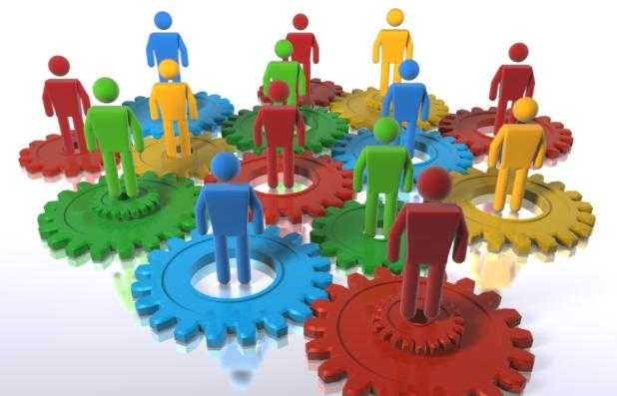
Markets
Marketplaces
Marketspaces
Metamarkets
Notes:
Marketplace – physical locations (such as retail store)
Marketspace – digital location (online retailer)
Metamarkets – The cluster of complementary products and services related in consumers mind, but spread across diverse set of industries.

Slide 16
Markets
The Marketplace is physical, as when one goes shopping in a store.
Marketspace is digital, as when one goes shopping on the Internet. E-commerce—business transactions conducted on-line—has many advantages for both consumers and businesses, including convenience,
savings, selection, personalization, and information.
Metamarket, describes a cluster of complementary products and services that are closely related in the minds of consumers but are spread across a diverse set of industries.

Slide 17

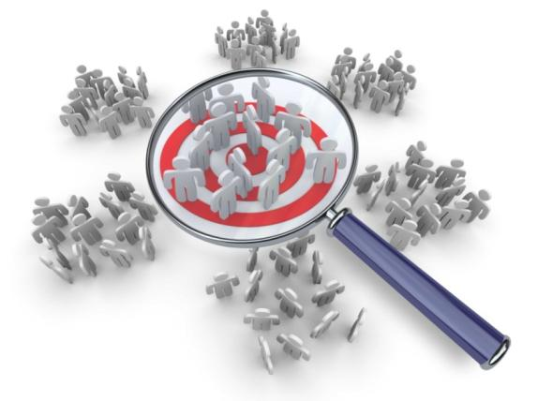

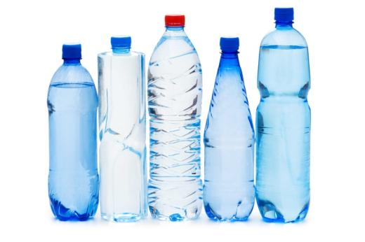
Core Marketing Concepts
Target Markets, Positioning, and Segmentation
Needs, Wants, and Demands
Offerings and Brands
Value and Satisfaction

Slide 18
Definitions of Marketing Concepts
Needs describe basic human requirements such as food, air, water, clothing, and shelter. People also have strong needs for recreation, education, and entertainment.
Needs become Wants when they are directed to specific objects that might satisfy the need.
Demands are wants for specific products backed by an ability to pay. Many people want a Mercedes; only a few are able and willing to buy one.
A brand is an offering from a known source. A brand name such as McDonald’s carries many associations in the minds of people like burgers, fun, children, fast food.
In terms of marketing, the product or offering will be successful if it delivers value and satisfaction to the target buyer.

Slide 19
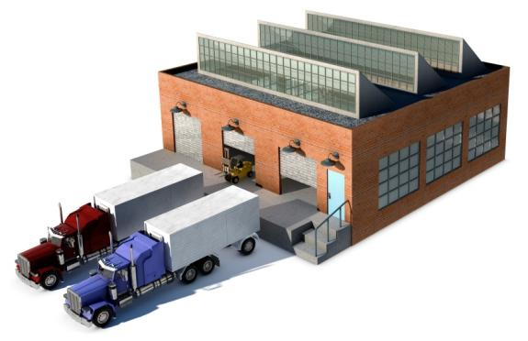
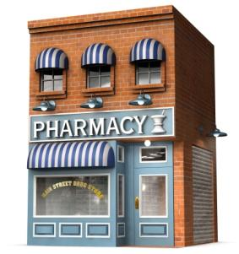
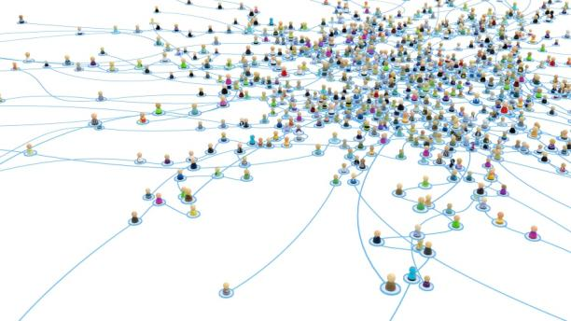
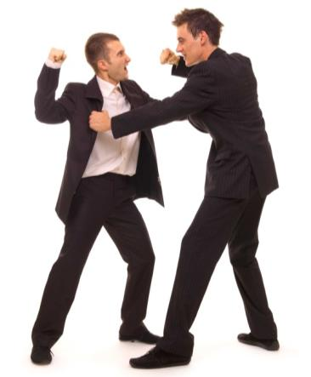
Core Marketing Concepts
Marketing Channels
Supply Chain
Marketing Environment
Competition

Slide 20
Definitions of Marketing Concepts
To reach a target market, the marketer uses three kinds of marketing channels
  Communication channels deliver messages to and receive messages from target buyers. For example newspapers, magazines, radio, television, mail, telephone etc.
  Distribution Channels to display or deliver the physical product or service(s) to the buyer or user. For example warehouses, transportation vehicles, and various trade channels such as distributors, wholesalers, and retailers etc.
  Selling channels include not only the distributors and retailers but also the banks and insurance companies that facilitate transactions.

Slide 21
Definitions of Marketing Concepts
Supply Chain describes a longer channel stretching from raw materials to components to final products that are carried to final buyers.
Competition, includes all of the actual and potential rival offerings and substitutes that a buyer might consider.
  Brand competition
  Industry competition
  Form competition:
  Generic competition

Slide 22
Thank You

