Slide 1
Research Tools and Techniques
The Research Process: Step 4
Lecture 9

Slide 2
Lecture Topics Covered Previously in the Last Lecture
Need and Objectives of a Theoretical Framework
Variables and their Four Types

Slide 3
What we are going to Cover in this Lecture
Variables and their Four Types
Theoretical Framework Development
Theoretical Framework – Some Real Life Examples

Slide 4
THE RESEARCH PROCESS
(1).
Observation
The Broad Problem Area
(4).
Theoretical
Framework
Variables
Identification
(3).
Problem Definition
(6).
Scientific
Research
Design
(7).
Data Collection and Analysis
(5)
Generation of
Hypothesis
(2).
Preliminary Data Gathering
Interviews and Library Search
(8)
Deduction
(9).
Report Writing
(10).
Report Presentation
(11).
Managerial Decision Making

Slide 5
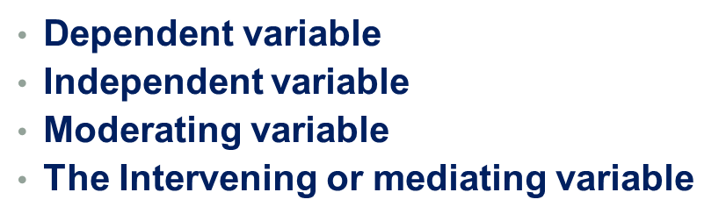
4 Types of Variables

Slide 6
MODERATING VARIABLE
The moderating variable is one that has strong contingent effect on the independent – dependent variable relationship. The presence of the third variable modifies the originally expected relationship between the independent and dependent variables.
Example 1:
Availability of Policy Guidelines → Low Electricity Consumption
Interest & inclination of employees
Example 2:
Workforce Diversity
Organizational Effectiveness
Managerial Expertise

Slide 7
The Effects of Moderating Variable
Moderating Effect
Organizational
Effectiveness
b
Managerial
Expertise
a
Workforce Diversity

Slide 8
INTERVENING/MEDIATING VARIABLE
An intervening variable is one that surfaces between the time the independent variable operate to influence the dependent variable and the impact on the dependent variable is actually felt.
Workforce diversity-> creative synergy ->organizational effectiveness
(managerial expertise)
Pay Increase
Employee Motivation
Worker Productivity
Time t1 t2 t3

Slide 9
THEORETICAL FRAMEWORK
The theoretical framework is the foundation on which the entire research project is based. It is logically developed, described and elaborated network of association among variables that have been identified through such processes as interviews, observations and literature survey.
The components of theoretical frame are
The variables.
The relationship between variables.
The nature of the direction of the relationship.
Explanation why this relationship exists.
A schematic diagram.

Slide 10
Theoretical Framework – A Real Life Example
Communication Among Cockpit Members
Communication Between Ground Control and Cockpit
Air safety Violations
Decentralization
Training of Cockpit Crew
Nervousness and Diffidence

Slide 11
Example 2
Conflict Management Style
Integrating
Obliging
Trust in Supervisor
(-)
Turnover Intention
Compromising
(-)
Dominating
(-)
Avoiding

Slide 12
Example 3
(-)
Productivity Level
Noise

Slide 13
Summary
Variables and their Four Types
Theoretical Framework Development
Theoretical Framework – Some Real Life Examples

