Slide 1
Research Tools and Techniques
The Research Process: Step 6
Lecture 11

Slide 2
Lecture Topics Covered Previously in the Last Lecture
Theoretical Framework – Some Real Life Examples
Hypotheses Development
Null and Alternate Hypotheses
Hypotheses Testing
Introduction to Research Design

Slide 3
What we are going to Cover in this Lecture
Four Types of Research According to the Purpose of Study
Type of Investigation: Causal Versus Correlational

Slide 4
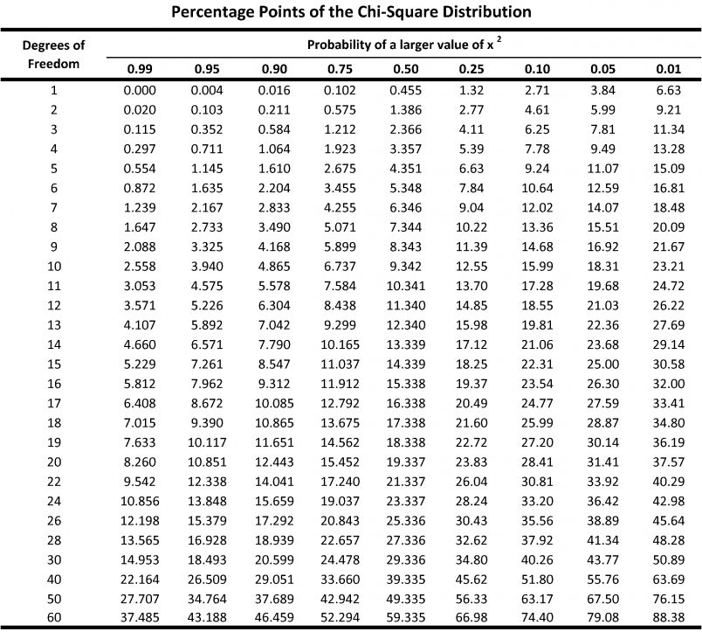
Chi-Square Table

Slide 5
THE RESEARCH PROCESS
(1).
Observation
The Broad Problem Area
(4).
Theoretical
Framework
Variables
Identification
(3).
Problem Definition
(6).
Scientific
Research
Design
(7).
Data Collection and Analysis
(5)
Generation of
Hypothesis
(2).
Preliminary Data Gathering
Interviews and Library Search
(8)
Deduction
(9).
Report Writing
(10).
Report Presentation
(11).
Managerial Decision Making

Slide 6
THE ELEMENTS OF RESEARCH DESIGN
1. Purpose of
Study
Exploratory
Descriptive
Hypothesis
Testing
Case Study
2. Type of
Investigation
Establishing:
Causal
Relationship
or
Co-relational
3. Extent of
Researcher
Interference
Minimal
Moderate
Excessive
4. Study Setting
Contrived
Non-Contrived
5. Measurement
& Measures
Operational Definition
Scaling
Categorizing
Coding
10. Test
Application
Feel for
Data
Goodness
of Data
Hypotheses
Testing
Problem Statement
9. Data
Collection
Method
Observation
Interview
Questionnaire
Physical
Measurement
6.Unit of Analysis
(Population to be
studied)
Individuals
Dyads
Groups
Organizations
Machines
etc.
7. Sampling
Design
Probability
Non-probability
Sample Size (n)
8. Time Horizon
One-Shot
(Cross-Sectional)
or
Longitudinal

Slide 7
PURPOSE OF STUDY (NATURE OF STUDY)
From the point of view of purpose, the research has four types.
Exploratory study
Descriptive study
Hypotheses testing
Case study analysis
1. Exploratory study:
Exploratory study is done when not much is known about the situation under consideration.
The researcher do extensive interviewing, focus group study and library search.
Generally qualitative data is gathered.

Slide 8
Later on hypotheses can be developed and tested.
Some facts are known, but more study is needed to have a thorough understanding of problem or phenomena.
Examples
I). The lack of entrepreneurship opportunities for the women in Baluchistan.
Ii). Would there be a market for apple’s new vision device in Pakistan?
2. Descriptive study:
Descriptive study describes characteristics of variables under consideration.
These are generally quantitative in nature.
Data is gathered to make simple decisions and offer ideas to probe further.

Slide 9

Examples
I). MBA III B class composition and characteristics SP08
(a). Number of students (b). Age (c). Gender
(d). CGPA (e). Number of students in different major groups (f). Courses covered so far (g). Courses remaining to be taught etc.
II). Descriptive Study of Group of Employees.
III). Advances in Milling of Rice.
IV). Company Competitors etc.

Slide 10


3. Hypothesis Testing:
Nature of certain relationships is explained.
Difference among groups is found.
How much a problem will increase/decrease by a factor or a variable.
The factors responsible for a given situation.
Examples
If we increase the employee benefits then loyalty with the organization will increase.
Factors responsible for increase in demand of guns in a society.
More men than women are addicts.
Marital status and employee productivity are related.

Slide 11

4. Case Study Analysis:
How similar problems were solved in different organizations.
Contextual analysis of the matter is done.

Slide 12
TYPE OF INVESTIGATION: CAUSAL vs CORRELATIONAL
Causal study:
Cause and effect relationship
Definitive
Does smoking causes cancer
X causes y
High interest rate causes people to save money

Slide 13
Correlational
Identification of factors related with the problem or the phenomena
Are smoking and cancer related
Are smoking, drinking, chewing tobacco associated with the cancer of the elementary canal
Reasons of the failure of educational system in Pakistan
Effects of earthquake on the property buying behavior

Slide 14
Hypotheses Establishing Group Difference
Establish differences between different groups i.e.
Male versus female smoking characteristics
Differences between night and morning shift employees
Differences between senior and middle management groups.

Slide 15
Summary
Four Types of Research According to the Purpose of Study
Type of Investigation: Causal Versus Correlational

