Slide 1
Research Tools and Techniques
The Research Process: Step 4, 5 & 6
Lecture 10

Slide 2
Lecture Topics Covered Previously in the Last Lecture
Variables and their Four Types
Theoretical Framework Development
Theoretical Framework – Some Real Life Examples

Slide 3
What we are going to Cover in this Lecture
Theoretical Framework – Some Real Life Examples
Hypotheses Development
Null and Alternate Hypotheses
Hypotheses Testing
Introduction to Research Design

Slide 4
THE RESEARCH PROCESS
(1).
Observation
The Broad Problem Area
(4).
Theoretical
Framework
Variables
Identification
(3).
Problem Definition
(6).
Scientific
Research
Design
(7).
Data Collection and Analysis
(5)
Generation of
Hypothesis
(2).
Preliminary Data Gathering
Interviews and Library Search
(8)
Deduction
(9).
Report Writing
(10).
Report Presentation
(11).
Managerial Decision Making

Slide 5
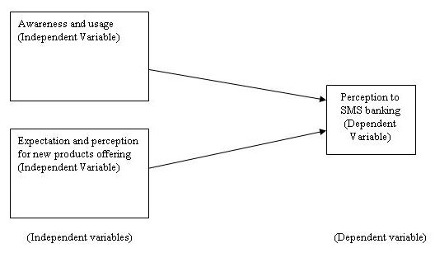
Example 4

Slide 6
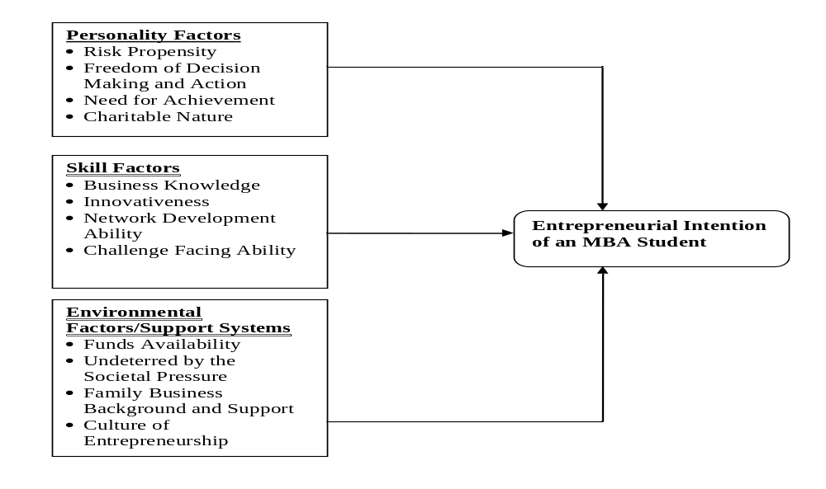
Example 5

Slide 7
In the previous five examples so we have learned the components of a theoretical framework and also how do we construct it after literature review and the interviews
The variables.
The relationship between variables.
The nature of the direction of the relationship.
Explanation why this relationship exists.
A schematic diagram.

Slide 8
HYPOTHESES DEVELOPMENT
Once we have identified the important variables in a situation and established relationships among them through logical reasoning in the theoretical framework, we are now in a position to test whether the relationship that have been theorized so in fact hold true. Formulating such testable statements is called hypothesis development.
A hypotheses can be defined as a logically conjectured relationship between two or more variables expressed in the form of a testable statement.

Slide 9
HYPOTHESIS STATEMENT FORMATS
IF THEN STATEMENTS
- If employee are more healthy then they will take less sick leaves.
DIRECTIONAL AND NON DIRECTIONAL STATEMENTS
Directional hypotheses (examples)
- Women are more motivated than men.
- The greater the stress experienced in the job, lower the job satisfaction of employees.

Slide 10
NON DIRECTIONAL HYPOTHESIS
There is a relationship between age and job satisfaction
There is difference between the work ethics values of American and Asian employees.

Slide 11
NULL AND ALTERNATE HYPOTHESES
Null hypothesis is a proposition that states a definite, exact relationship between two variables. That is it is stated that the population correlation between two variables is equal to zero or some definite number.
The alternative hypothesis which is the opposite of the null is a statement expressing a relationship between two variables or indicating difference between groups.

Slide 12
Ho and Ha
Ho: Um = Uw
Ho: Um-Uw=0
Ha: Um < Uw
Ha: Uw > Um
Ho: Uam = Uas
Ho: Uam-Uas=0
Ha: Uam (is not equal to) Uas
Ho: p = 0
Ha: p < 0
Or
Ha: p> 0

Slide 13
HYPOTHESIS TESTING
State null and alternate hypotheses
Choose appropriate test depending on the nature of data collected
Determine the significance level
Find critical values either from computer or from the table
When the value results > than critical value then null is rejected and alternate is accepted and vice versa

Slide 14
THE RESEARCH PROCESS
(1).
Observation
The Broad Problem Area
(4).
Theoretical
Framework
Variables
Identification
(3).
Problem Definition
(6).
Scientific
Research
Design
(7).
Data Collection and Analysis
(5)
Generation of
Hypothesis
(2).
Preliminary Data Gathering
Interviews and Library Search
(8)
Deduction
(9).
Report Writing
(10).
Report Presentation
(11).
Managerial Decision Making

Slide 15
THE ELEMENTS OF RESEARCH DESIGN
1. Purpose of
Study
Exploratory
Descriptive
Hypothesis
Testing
Case Study
2. Type of
Investigation
Establishing:
Causal
Relationship
or
Co-relational
3. Extent of
Researcher
Interference
Minimal
Moderate
Excessive
4. Study Setting
Contrived
Non-Contrived
5. Measurement
& Measures
Operational Definition
Scaling
Categorizing
Coding
10. Test
Application
Feel for
Data
Goodness
of Data
Hypotheses
Testing
Problem Statement
9. Data
Collection
Method
Observation
Interview
Questionnaire
Physical
Measurement
6.Unit of Analysis
(Population to be
studied)
Individuals
Dyads
Groups
Organizations
Machines
etc.
7. Sampling
Design
Probability
Non-probability
Sample Size (n)
8. Time Horizon
One-Shot
(Cross-Sectional)
or
Longitudinal

Slide 16
Summary
Theoretical Framework – Some Real Life Examples
Hypotheses Development
Null and Alternate Hypotheses
Hypotheses Testing
Introduction to Research Design

