Slide 1
Organizational Behavior
Lecture 7
Dr. Amna Yousaf
PhD (HRM)
University of Twente, the Netherlands

Slide 2
Managing Motivation
Lecture 7

Slide 3
Recap Lecture 6
Motivation theories
  McClelland’s Theory of Needs
  Cognitive Evaluations Theory
  Goal Setting Theory

Slide 4
Outline
Goal Setting Theory
MBO as application of Goal Setting
Self-efficacy Theory
Reinforcement Theory
Equity Theory
Justice and Equity Theory
Expectancy Theory
Implications for Managers

Slide 5
Goal-Setting Theory (Edwin Locke)
Basic Premise: That specific and difficult goals, with self-generated feedback, lead to higher performance.
But, the relationship between goals and performance will depend on
goal commitment
  “I want to do it & I can do it”
  Increased through participatory goals, making them public, specific, top management involvement

Slide 6
Goal-Setting Theory (Edwin Locke)
task characteristics (simple versus complex, well-learned versus novel, independent versus interdependent)
national culture
  Goal setting well aligned with north American cultures
  Independent : not too high on power distance
  Challenging goals: low in uncertainty avoidance
  Performance is important: high in achievement

Slide 7
Goal Setting in Action: MBO Programs
Management By Objectives Programs
Company wide goals & objectives
Goals aligned at all levels
Based on Goal Setting Theory

Slide 8
What is MBO?
Management by Objectives (MBO)
A program that encompasses specific goals, participatively set, for an explicit time period, with feedback on goal progress.
Key Elements
Goal specificity
Participative decision making
An explicit time period
Performance feedback

Slide 9
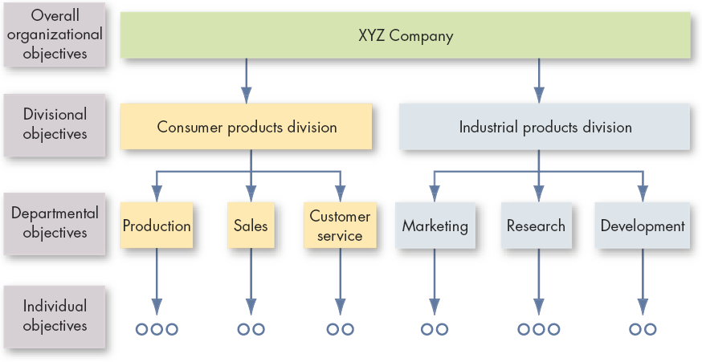
Cascading of Objectives
E X H I B I T 6–1

Slide 10
Linking MBO and Goal-Setting Theory
MBO Goal-Setting Theory
Goal Specificity Yes Yes
Goal Difficulty Yes Yes
Feedback Yes Yes
Participation Yes No
(qualified)

Slide 11
MBO and Goal Setting
MBO emphasizes on participative goal setting
In Goal Setting theory goals assigned as well as participatory can be equally effective

Slide 12

Why MBOs Fail
Unrealistic expectations about MBO results
Lack of commitment by top management
Failure to allocate reward properly
Cultural incompatibilities

Slide 13
Self-Efficacy
An individual’s feeling that s/he can complete a task (e.g. “I know I can!”)
Enhances probability that goals will be achieved
Not to be confused with:
Self Esteem, which is….
Individuals’ degree of liking or disliking themselves.

Slide 14
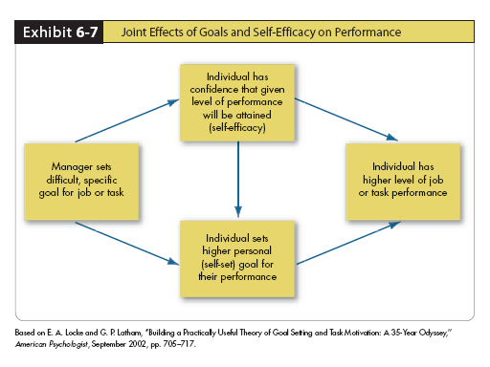
Self-Efficacy and Goal Setting

Slide 15
Four Ways of Increasing Self Efficacy (Bandura)
Enactive Mastery
Vicarious Modeling
Verbal Persuasion
Arousal
Note: Basic Premise/Mechanism of Pygmalion and Galatea Effects

Slide 16
Self-Efficacy
Mastery Orientation
  If you have done a task in the past, your slef efficacy to perform will be higher
Vicarious modeling
  Some one similar to you doing a task increases your confidence of doing it
    some one else loosing weight
    Some one of same handicap as you playing golf
Verbal persuasion
  Some one convinces you that you have necessary skills to do some task. Motivational speakers use this tactic
Arousal
  Energized state to do a task.

Slide 17
Self-efficacy and Goal Setting
Self efficacy works together with goal setting
Self efficacious individuals more likely to work harder in response to negative feedback and vice versa

Slide 18
Reinforcement Theory
Argues that behavior is a function of its consequences.
Assumptions:
Behavior is environmentally caused.
Behavior can be modified (reinforced) by providing (controlling) consequences.
Reinforced behavior tends to be repeated.

Slide 19
Reinforcement Theory
Behaviorist approach: not cognitive but environmental factors control behavior
Ignores inner state and focuses on what is response from external environment of his actions
Behavior is the consequence of your prior behavior.

Slide 20
Equity Theory
Equity Theory
Individuals compare their job inputs and outcomes with those of others and then respond to eliminate any inequities.
Referent Comparisons:
Self-inside
Self-outside
Other-inside
Other-outside

Slide 21
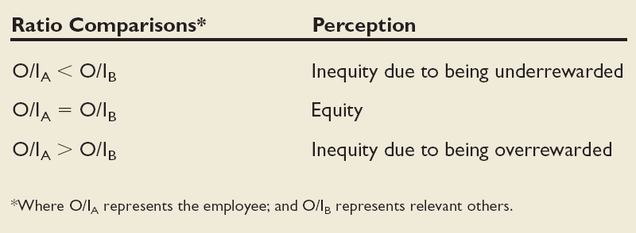
Equity Theory (cont’d)
E X H I B I T 6–8

Slide 22
Equity Theory (cont’d)
Choices for dealing with inequity:
Change inputs (slack off)
Change outcomes (increase output)
Distort/change perceptions of self
Distort/change perceptions of others
Choose a different referent person
Leave the field (quit the job)

Slide 23
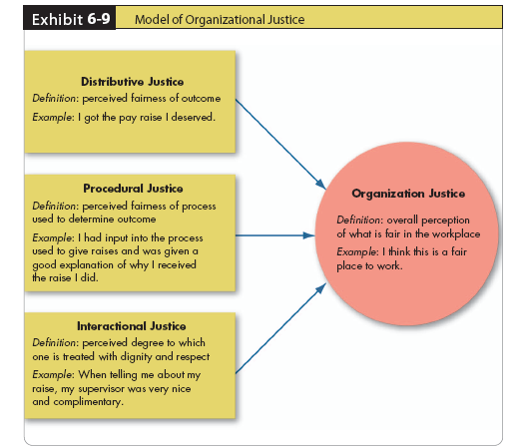
Justice and Equity Theory

Slide 24
Three types of Justice
Distributive Justice
Perceived fairness of the outcome (the final distribution).
“Who got what?”
Procedural Justice
The perceived fairness of the process used to determine the outcome (the final distribution). “How was who gets what decided?”
Interactional Justice
The degree to which one is treated with dignity and respect.
“Was I treated well?”

Slide 25
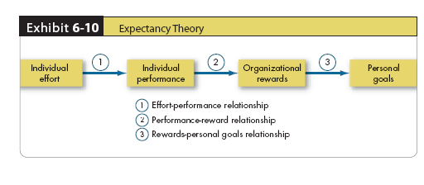
Expectancy Theory
Ethical Values and Behaviors of Leaders
Bottom line
All three links between the boxes must be intact or motivation will not occur. Thus,
  Individuals must feel that if they try, they can perform
And
  If they perform, they will be rewarded
And
  When they are rewarded, the reward will be something they care about

Slide 26
Check-Up: Motivation
Elizabeth’s boss starts out the day each morning saying, “Bet you wish you didn’t have to be here, huh?” Knowing this, which theory gives us insight as to why Elizabeth may not be motivated at work?

Slide 27
Check-Up: Motivation
Elizabeth’s boss my well be a Theory X manager, as s/he assumes employees don’t like work and/or want to be there.

Slide 28
Check-Up: Motivation
If you study really hard and only get a B on an exam, but your classmate barely studies at all and gets an A, what theory will help explain why you feel less motivated to go to class?

Slide 29
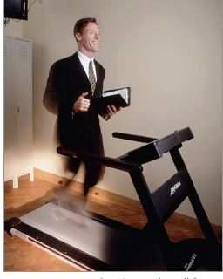
Chapter Check-Up: Motivation
What theory would say that this man, who knows he works hard and is performing well, will be motivated by a gym membership for being a high performer?

Slide 30
Chapter Check-Up: Motivation
Expectancy Theory.
Would a gym membership be considered a motivator or hygiene factor, according to Herzberg? Discuss with a classmate.

