Slide 1
Organizational Behavior
Lecture 30
Dr. Amna Yousaf
PhD (HRM)
University of Twente, the Netherlands

Slide 2
Foundations of Organizational Structure and Strategy Development
Lecture 30

Slide 3
Lecture Objectives
What is Structure
Matching Strategy with structure
Forms of organizational structure
  Functional structure
  Divisional structure
  SBU Structure
  Matrix structure
Conclusions and implications
How Strategy Develops, Vision and mission statement

Slide 4
Basic Forms of Structure
  Functional Structure
    Groups tasks and activities by business function
    Simple and inexpensive
    Speicalization of business activities
    Minimizes need of elaborate control systems
    Accountability at the top
    Delegation of authority not encouraged

Slide 5
Basic Forms of Structure
  Functional Structure
    Low employee morale
    Inadequate planning of products and markets
    Leads to short term and narrow thinking
    Lack of integration and communication
    Centralized
    R & D may strive to overdesign products while manufacturing may favor low frills products that are mass produced.
    Speicailization, economies of scale, standarized products such as manufacturing.
    Sharp – consumer electronics firm as an examaple

Slide 6
Basic Forms of Structure
  2. Divisional Structure
    Decentralized
    Promotes delegation of authority
    Allows local control of local situations
    Can be costly
    Requires elaborate control system
    Competition can become dysfunctional , limited sharing of ideas
    Some division/regions may receive preferential treatment

Slide 7
Basic Forms of Structure
  Hershey foods – consumer goods company
  Divisions by geographic region such as USA, Mexico, Brazil etc
  However, Divisions by product might be more useful such as chocolate, non chocolate and grocery

Slide 8
The SBU Structure
Similar divsions put under one SBU
Makes strategy implementation easier
Costly
  Dell reorganized in to two SBU’s: Consumer products and commercial products

Slide 9
Basic Forms of Structure
  3. Matrix Structure
    Most complex of all designs. Depends upon both vertical and horizontal flows of authority and communication
    Voilation of unity of command principal, dual lines of budget authority, dual sources of reward and punishment, shared authority, dual reporting channels,
    Project objectives clear

Slide 10
Project and Functional Leaders
Project leaders define features and functionalities of product, timilness and delivery. They need to be well connected with customer
Functional leaders are technical specialist having high specialized knowledge of their area. They take product requirements and vision from project leaders and motivate and train their staff to achieve desired product specifications and technical sound.

Slide 11
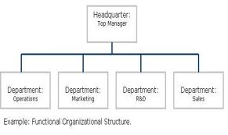

Slide 12
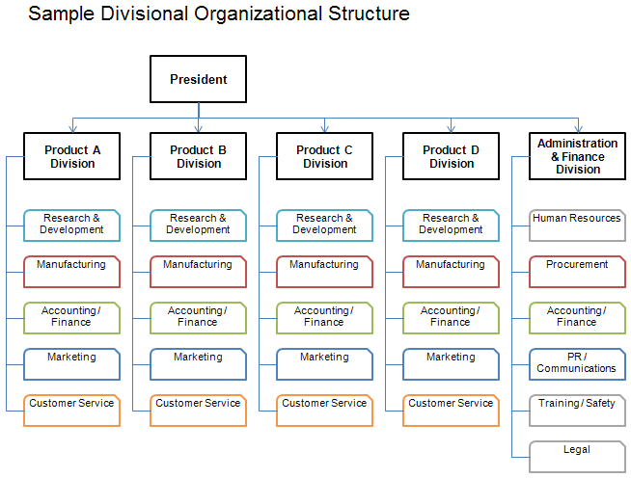

Slide 13
Matrix Structure (College of Business Administration)
(Director)
(Dean)
Employee
E X H I B I T 16–6

Slide 14
Matching Structure with Strategy
No one optimal organizational design
  Small firms - functional structure
  Consumer firms - divisional
  Large firms - matrix structure
Changes in strcuture may not make bad strategy good, bad managers good and make bad products sell

Slide 15
Chapter Check-Up: Structure
What kind of structure might someone who has a low tolerance for ambiguity feel most comfortable in?
Bureaucratic
Organic
Matrix
Virtual
Discuss with your neighbor why a virtual organization would not make this same person feel comfortable.

Slide 16
Chapter Check-Up: Structure
If someone has a high need for affiliation, would a virtual organization be a good fit for him or her? Why or why not?
Discuss with a classmate whether or not an organic organization would be a good fit for this same person.

Slide 17
Chapter Check-Up: Structure
With which type of structure do you think trust is most necessary? Why? Are the “substitutes for trust” that are potentially built into some structures? If so, which ones?

Slide 18
Forms of Strategy Development
Intended Strategy
Emergent Strategy

Slide 19
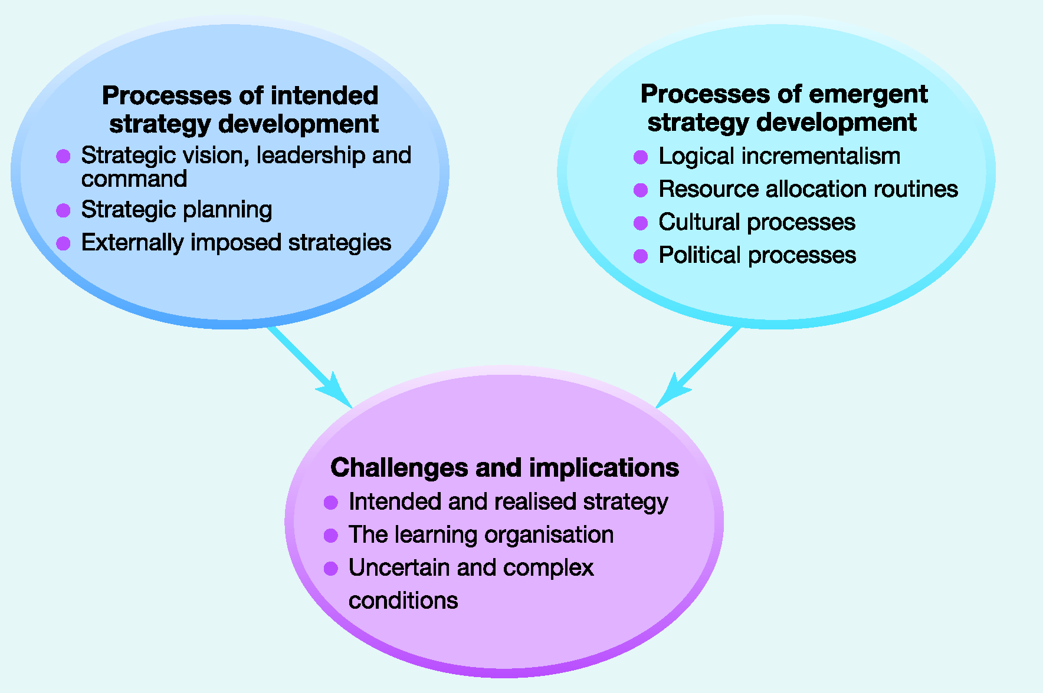
Strategy Development Processes

Slide 20

What is an
Intended Strategy?
An intended strategy is an expression of a desired strategy as deliberately formulated or planned by managers.
  Drawn up in careful ways
  Systemic
  Underpinning explainations well grounded and explained
  Number of issues prioritized
  Also planned in terms of resource allocations, control systems and organzational structure

Slide 21
Intended Strategy Development Processes
1. Stages of Strategic Planning
Initial guidelines
Business-level planning
Corporate-level planning
Financial and strategic targets

Slide 22
Intended but Unrealized!
Large part of strategy in practice remains unrealized
  The plans are not workable in practice
  Environemntal change later on
  Influencial people or stakeholders may not go along with the plan
  Managers may not implement

Slide 23
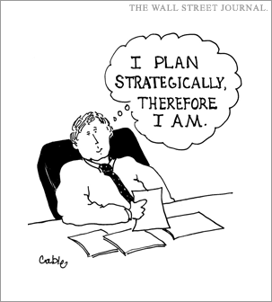

Slide 24
Intended Strategy Development Processes
2. Strategic Workshops
Purely top down management planning process is unrealistsic
  Group of top executives make discussions from functiional/line managers and other lower level management – their direct personal experiences about company operations , customers etc
  Such workshops could also intend to examine existing strategy
  To examine blockages to strategic change
  To monitor the progress of strategy
  To generate new ideas which may otherwise remain surfaced
    Lower level involvement important to innovate!

Slide 25
Intended Strategy Development Processes
3. External Consultants
    Analyze, develop, prioritize different options
    Resolve disagreements between managers
    Consultants may be engaged in coachings and trainings associated with strategic change thus promoting the same
    Provide more objective view of issues relating strategy of thier organzation
  Role of Mckinsey criticized in Swissair strategic policy – strategic expansion of investment in shares of small and troubled companies

Slide 26
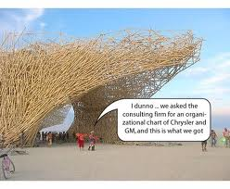

Slide 27
Intended Strategy Development Processes
4. Externally Imposed Strategy
Extrenally powerful stakeholders may impose restrictions or dictate strategic actions
  Government imposing regulations on public sector or choose to derregulate/privatize private sector firms
  May serve as a way of bringing necessary change where managemnet fails to do so

Slide 28
Possible Benefits of Planning
Help structure analysis and thinking about complex problems
Encourage questioning
Encourage longer-term view
Enhance coordination
Improve communication
Provide agreed objectives
Involve people
Provide a sense of security

Slide 29
Dangers Associated with
Strategic Planning Programs
Detachment from reality
Lack of ownership
Dampening of innovation
Managers cede responsibility-intellectual exercise
Information overload

Slide 30
Emergent Strategy Developemnt
Realized strategies of organziations better accounted for as emergent
Emergent strategy comes about through everyday routines, activities and processes in organization
Processes and activities in the oragnzation give rise to long term direction which becomes strategy of organization
    These decisions formally described in annual reports as strategy of organization

Slide 31
Emergent Strategy Developemnt Processes
Logical Incrementalism
Strategy does not change fundamentally but incrementally
Developemnt of strategy by experimentation and learning from partial commitments Specifying precise objectives too early may stifle ideas and prevent experiemntation
One strategic move evolves from the previous such as a new product launch may guide future strategic decision such as market development

Slide 32
Emergent Strategy Development Processes
  Effective managers realize they can not avoid uncertainity by predicting future; constant scanning and small steps make strategy effective
  Helps build people’s psychologucal identification resulting in less resistence to change
  Continual testing of strategy
  Improved quality of information for decision making
  Better sequencing of elements of major decisions

Slide 33
Emergent Strategy Developemnt
Processes
2.Resource Allocation Routines
The resource allocation process (RAP) explanation of strategy development explains that realised strategies emerge as a result of the way resources are allocated in organisations.
Nature of projects approved

Slide 34
Emergent Strategy Development Processes
3. Cultural Processes
Organizational culture might be understood in terms of taken for granted
If performance of an organization falls, managers may tighten controls and apply for stringent checks but if that does not work, change of strategy may occur in line with culture.
  Expansion in target market similar to the current one

Slide 35
Emergent Strategy Developemnt Processes
  Managers’ need to change might be hampered by strong cultural norms
  Outcomes of change in stragtey guided by culture may not encapsulate environemntal change and strategic drift might occur
    Strategic drift is where strategise progressively fail to address market challeneges and perforamnce deteriorates

Slide 36
Emergent Strategy Development Processes
4. Organizational Politics
Political view suggests that organizational strategy is guided by the political powers of top executives
  They try to keep hold of organziatioanl resources and want to protect thier interests
  Rational and analytical processes in strategy development may not be as objective.
    Objectives set in organizatioanl strategies may reflect ambitions of power people
    Different organizational managers seem to protect thier own views in approaching strategic problems
    Political activity may result in incremental or emergent paterns of strategy developemnt

Slide 37
Mutiple Strategic Processes
No one right way of strategy developemnt
Strategy development depends on context, environemntal change and the process differs over time
Strategy development perceptions also vary by managerial position
  Coroprate head may view it as an intended effort
  middle manager may view it as guided by political and cultural processes

Slide 38
Mutiple Strategic Processes
  Government sector employees may view it as imposed by governemnt
  Employees of family owned businesses may view it as owned by the few important people
Multiple processes at work! Strategic and systemetic planning is also intervened by political and cultural processes
  Organziations adopting multiple processes tend to be more successful

Slide 39
Challenges of Strategy Development
The challenge of strategic drift
  Changes in oragnziational environment at greater rate than rate of incremental strategic change
  Organizations are merely reactive which means they show minimum steps to innovate and create new opportunities
People should show the capability and motivation to challenge the existing assumtions of busniess and ways of doing things

Slide 40
What is a Learning Organisation?
The learning organisation is capable of continual regeneration from the variety of knowledge, experience and skills of individuals within a culture which encourages mutual questioning and challenge around a shared purpose or vision.

Slide 41
Tenets of
Organisational Learning
Managers facilitate rather than direct
Information flows and relationships are lateral as well as vertical
Organisations are pluralistic
Experimentation is the norm

Slide 42
Vision
“The last thing IBM needs right now is a vision.” (July 1993)
What IBM needs most right now is a vision.” (March 1996)
-- Louis V. Gerstner, Jr., CEO, IBM Corporation

Slide 43

Vision
Agreement on the basic vision for which the firm strives to achieve in the long run is critically important to the firm’s success.
What do we want to become?

Slide 44
Vision Statement Examples
A national organization which represents its members in all aspects of poultry and eggs on both a national and international level
-- U.S. Poultry & Egg Association

Slide 45
Vision Statement Examples
The Vision of USGS is to be a world leader in the natural sciences through our scientific excellence and responsiveness to society’s needs
-- U.S. Geological Survey (USGS)

Slide 46
Mission Statements
-- 90% of all companies have used a mission statement in the previous five years
What is our business?”
Reveal what an organization wants to be and whom it wants to serve

Slide 47

Mission Statements
Enduring statement of purpose
Distinguish one firm from another
Declare the firm’s reason for being
Essential for effectively establishing objectives and formulating strategies

Slide 48
Mission Statements
Also referred to as:
Creed statement
Statement of purpose
Statement of philosophy
Statement of business principles

Slide 49
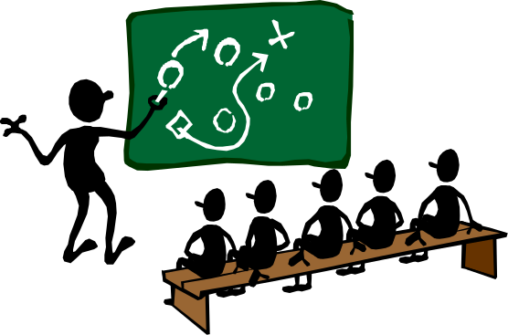
Vision & Mission
Many organizations develop both vision & mission statements
Profit and vision are necessary to effectively motivate a workforce

Slide 50
Developing Vision & Mission
Clear mission is needed before alternative strategies can be formulated and implemented

Slide 51

Developing Vision & Mission
Participation from diverse managers is important in developing the mission
Read as many artricles as possible
Committee of top managers put these documents into a single document
Requests for modifications, additions and deletions
Consultants may be hired - draft of language
Final document communicated to stakeholders

Slide 52
Importance of Mission
Benefits from a strong mission
Unanimity of Purpose – specifies
organizational purposes which
translate into objectives
Mission
Basis for
Resource Allocation
General tone or
Organizational Climate
Focal point for employees

Slide 53
Resolution of Divergent Views
Failure to develop a compehensive vision and mission amounts to loss of portraying itself favorbale in eyes of stakeholders
  Effective way of communication with external and internal stakeholders
  Help resolve divergent opinions among managers
  Profitability

Slide 54
Effective Missions
Broad in scope
Generate strategic alternatives
Reconciles interests among diverse stakeholders
Finely balanced between specificity & generality

Slide 55

Effective Missions
Arouse positive feelings & emotions
Generate favorable impression of the firm

Slide 56

Effective Missions
Reflect future growth
Provide criteria for strategy selection
Basis for generating & evaluating strategic options
Are dynamic in nature

Slide 57
Products
Services
Markets
Customers
Technology
Employees
Mission
Elements
Survival
Growth
Profit
Public
Image
response to
envrnmnt
Self-Concept
Philosophy –
basic beliefs

