Slide 1
Organizational Behavior
Lecture 21
Dr. Amna Yousaf
PhD (HRM)
University of Twente, the Netherlands

Slide 2
Recap Lecture 20
Why Safety is Important
Occupational Safety Laws in Pakistan
Responsibilities and Rights of Employers and Employees
Top Management’s Role in Safety
What Causes Accidents?
  Unsafe conditions and other work related factors
What causes unsafe acts?
How to prevent accidents?
  Reducing unsafe conditions

Slide 3
Recap Lecture 20
Reducing unsafe acts by emphasizing safety
Reducing unsafe acts through
  selection and placement
  Training
  motivation
Conduct safety and health audits
Workplace health hazards
Workplace substance abuse
Infectious diseases
Stress burnout and depression

Slide 4
Recap Lecture 20
Computer related health problems
Workplace smoking
Violence at work

Slide 5
Power, Politics, Policies and Organizational Resources
Lecture 21

Slide 6
Lecture Outline
What is Power?
Contrasting leadership and power
Basis of power
Dependency – the key to power
Power Tactics
Factors Influencing the Choice and Effectiveness of Power Tactics
Political Behavior
Determinants of Political Behavior
Influences of Political Behavior
Organizational Policies and Resource Allocations

Slide 7
A Definition of Power
Power
A capacity that A has to influence the behavior of B so that B acts in accordance with A’s wishes.
Dependency
B’s relationship to A when A possesses something that B requires.

Slide 8
Contrasting Leadership and Power
Leadership
  Focuses on goal achievement.
  Requires goal compatibility with followers.
  Focuses influence downward.
Research Focus
  Leadership styles and relationships with followers.
Power
  Used as a means for achieving goals.
  Requires follower dependency.
  Used to gain lateral and upward influence.
Research Focus
  Power tactics for gaining compliance.

Slide 9
Bases of Power: Formal Power
Formal Power
Is established by an individual’s position in an organization; conveys the ability to coerce or reward, from formal authority, or from control of information.
Coercive Power
A power base dependent on fear.
Reward Power
Compliance achieved based on the ability to distribute rewards that others view as valuable.

Slide 10
Bases of Power: Formal Power (cont’d)
Legitimate Power
The power a person receives as a result of his or her position in the formal hierarchy of an organization.

Slide 11

Bases of Power: Personal Power
Expert Power
Influence based on special skills or knowledge.
Referent Power
Influence based on possession by an individual of desirable resources or personal traits.

Slide 12
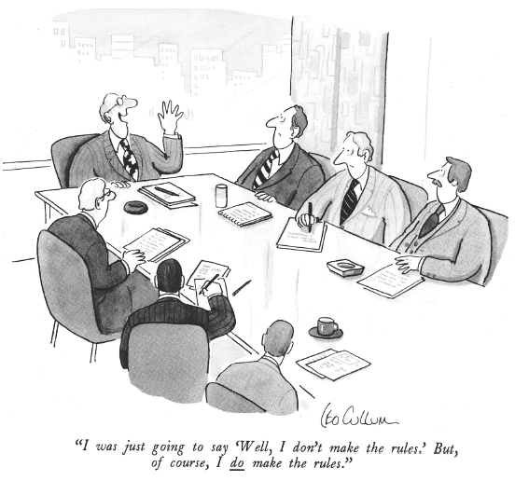
Source: Drawing by Leo Cullum in The New Yorker, copyright ©1986 The New Yorker Magazine. Reprinted by permission.
E X H I B I T 14–1

Slide 13
Dependency: The Key To Power
The General Dependency Postulate
  The greater B’s dependency on A, the greater the power A has over B.
  Possession/control of scarce organizational resources that others need makes a manager powerful.
  Access to optional resources (e.g., multiple suppliers) reduces the resource holder’s power.
What Creates Dependency
  Importance of the resource to the organization
  Scarcity of the resource
  Nonsubstitutability of the resource

