Slide 1
Organizational Behavior
Lecture 17
Dr. Amna Yousaf
PhD (HRM)
University of Twente, the Netherlands

Slide 2
Recap Lecture 16
What is leadership
Trait Theories of Leadership
  Big five personality model
  Limitations
Behavioral Approaches to leadership
  Ohio State Studies/U. of Michigan
  University of Michigan Studies
Contingency Theories of Leadership
  Fiedler’s Contingency Model
  Cognitive Resource Theory
  Hersey and Blanchard’s Situational Leadership Model

Slide 3
Basic Approaches to Leadership
Lecture 17

Slide 4
Lecture Outline
Cognitive Resource Theory
Contingency Approach: Hersey & Blanchard Situational Model
Path Goal Theory
LMX Theory
Inspirational Approaches to Leadership
  Transformational Leaders
  Transactional Leaders
  Laissez-Faire Leadership
  Ethical Leadership
  Online Leadership
  Mentoring

Slide 5
Cognitive Resource Theory
Cognitive Resource Theory
A theory of leadership that states that the level of stress in a situation is what impacts whether a leader’s intelligence or experience will be more effective.
Research Support:
Less intelligent individuals perform better in leadership roles under high stress than do more intelligent individuals.
Less experienced people perform better in leadership roles under low stress than do more experienced people.

Slide 6
Contingency Approach: Hersey & Blanchard Situational Model
Considers Leader Behaviors (Task & Relationship)
  Assumes Leaders CAN change their behaviors
Considers Followers as the Situation
  Follower Task maturity (ability & experience)
  Follower Psychological maturity (willingness to take responsibility)
Assumptions
  Leaders can and should change their style to fit their followers’ degree of readiness (willingness and ability)
  Therefore, it is possible to TRAIN leaders to better fit their style to their followers.
  Unable, unwilling : Directive. Able, unwilling:participative. Unable,willing, task orineted. Able,willing, lessiz faire

Slide 7
Hersey and Blanchard’s Situational Leadership Theory
Situational Leadership Theory (SLT)
A contingency theory that focuses on followers’ readiness; the more “ready” the followers (the more willing and able) the less the need for leader support and supervision.
LOW Amount of Follower Readiness HIGH
Amount of Leader Support &
Supervision Required
HIGH
LOW

Slide 8
Leader–Member Exchange Theory
Leader-Member Exchange (LMX) Theory
Leaders select certain followers to be “in” (favorites)
    Based on competence and/or compatibility & similarity to leader
“Exchanges” with these “In” followers will be higher quality than with those who are “Out”
RESULT: “In” subordinates will have higher performance ratings, less turnover, and greater job satisfaction

Slide 9
Leadership Styles and Follower Readiness
(Hersey and Blanchard)
Follower Readiness
Unwilling
Willing
Able
Supportive Participative
Monitoring
Leadership
Styles
High Task
and
Relationship
Orientations
Unable
Directive

Slide 10
Leader-Member Exchange Theory
E X H I B I T 12–3

Slide 11

Path-Goal Theory
Premise
Leader must help followers attaining goals and reduce roadblocks to success
Leaders must change behaviors to fit the situation (environmental contingencies & subordinate contingencies)

Slide 12
The Path-Goal Theory
E X H I B I T 12–4

Slide 13
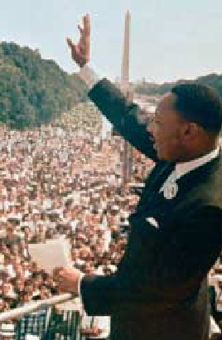
Framing: Using Words to Shape Meaning and Inspire Others
Framing
A way to use language to manage meaning.
Leaders use framing (selectively including or excluding facts) to influence how others see and interpret reality.

Slide 14
Inspirational Approaches to Leadership
Charismatic Leadership Theory
Followers make attributions of heroic or extraordinary leadership abilities when they observe certain behaviors.
Charismatic Leaders
Have a vision
Are willing to take personal risks to achieve the vision
Are sensitive to follower needs
Exhibit behaviors that are out of the ordinary

Slide 15
Key Characteristics of Charismatic Leaders
Vision and articulation. Has a vision—expressed as an idealized goal—that proposes a future better than the status quo; and is able to clarify the importance of the vision in terms that are understandable to others.
Personal risk. Willing to take on high personal risk, incur high costs and engage in self-sacrifice to achieve the vision.
Environmental sensitivity. Able to make realistic assessments of the environmental constraints and resources needed to bring about change.
Sensitivity to follower needs. Perceptive of others’ abilities and responsive to their needs and feelings.
Unconventional behavior. Engages in behaviors that are perceived as novel and counter to norms.
Source: Based on J. A. Conger and R. N. Kanungo, Charismatic Leadership in Organizations (Thousand Oaks, CA: Sage, 1998), p. 94.
E X H I B I T 13–1

Slide 16
Transactional and Transformational Leadership
Transactional Leaders
Leaders who guide or motivate their followers in the direction of established goals by clarifying role and task requirements.
Contingent Reward
Management by Exception (active)
Management by Exception (passive)
Laissez-Faire
Transformational Leaders
Leaders who provide the four “I’s” (individualized consideration, inspirational motivation, idealized influence, and intellectual stimulation
Idealized Influence
Inspirational Motivation
Intellectual Stimulation
Individual Consideration

Slide 17
Characteristics of Transactional Leaders
Contingent Reward: Contracts exchange of rewards for effort, promises rewards for good performance, recognizes accomplishments.
Management by Exception (active): Watches and searches for deviations from rules and standards, takes corrective action.
Management by Exception (passive): Intervenes only if standards are not met.
Laissez-Faire: Abdicates responsibilities, avoids making decisions.
Source: B. M. Bass, “From Transactional to Transformational Leadership: Learning to Share the Vision,” Organizational Dynamics, Winter 1990, p. 22. Reprinted by permission of the publisher. American Management Association, New York. All rights reserved.
E X H I B I T 13–2

Slide 18
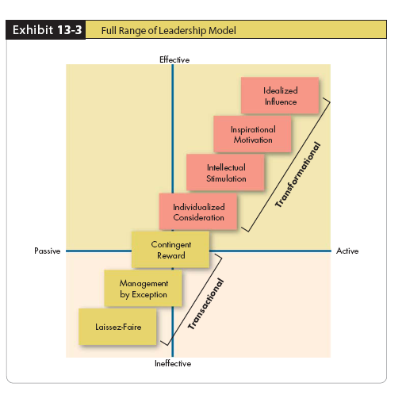
Full Range of Leadership Model

Slide 19
Characteristics of Transformational Leaders
Idealized Influence: Provides vision and sense of mission, instills pride, gains respect and trust.
Inspiration: Communicates high expectations, uses symbols to focus efforts, expresses important purposes in simple ways.
Intellectual Stimulation: Promotes intelligence, rationality, and careful problem solving.
Individualized Consideration: Gives personal attention, treats each employee individually, coaches, advises.
E X H I B I T 13–2 (cont’d)

Slide 20
Ethical Leadership
Actions:
Work to positively change the attitudes and behaviors of employees.
Engage in socially constructive behaviors.
Do not abuse power or use improper means to attain goals.

Slide 21
Contemporary Leadership Roles: Mentoring
Mentor
A senior employee who sponsors and supports a less-experienced employee (a protégé).
Mentoring Activities:
Present ideas clearly
Listen well
Empathize
Share experiences
Act as role model
Share contacts
Provide political guidance

Slide 22
Online Leadership
Leadership at a Distance: Building Trust
  The lack of face-to-face contact in electronic communications removes the nonverbal cues that support verbal interactions.
  There is no supporting context to assist the receiver with interpretation of an electronic communication.
  The structure and tone of electronic messages can strongly affect the response of receivers.
  An individual’s verbal and written communications may not follow the same style.
  Writing skills will likely become an extension of interpersonal skills

Slide 23
Challenges to the Leadership Construct
Attribution Theory of Leadership
The idea that leadership is merely an attribution that people make about other individuals.
Qualities attributed to leaders:
Leaders are intelligent, outgoing, have strong verbal skills, are aggressive, understanding, and industrious.
Effective leaders are perceived as consistent and unwavering in their decisions.
Effective leaders project the appearance of being a leader.

Slide 24
Finding and Creating Effective Leaders
Selection
  Review specific requirements for the job.
  Use tests that identify personal traits associated with leadership, measure self-monitoring, and assess emotional intelligence.
  Conduct personal interviews to determine candidate’s fit with the job.
Training
  Recognize that all people are not equally trainable.
  Teach skills that are necessary for employees to become effective leaders.
  Provide behavioral training to increase the development potential of charismatic employees.

Slide 25
Chapter Check-Up: Contemporary Issues in Leadership
Which theory suggests that if you’re a lawyer, you might not need a relationship or a task oriented leader?
Substitutes for Leadership Theory suggests that professionalism (which a professional lawyer would have) can actually substitute for task and relationship-based leadership.

Slide 26
Chapter Check-Up: Contemporary Issues in Leadership
If your leader skips down the hall, which theory suggests the type of leader s/he is?
Transformational
Transactional
Level 5
Full Range
Charismatic
Your leader is exhibiting unconventional behavior, which is something charismatic leaders do.

Slide 27
Chapter Check-Up: Contemporary Issues in Leadership
Julie spends time with each subordinate and knows their development plans for the next five years. Julie exhibits ____________
Inspirational Motivation
Unconventional Behavior
Individualized Consideration
Full Range Leadership
Charismatic Leadership
Julie is showing individualized consideration, part of transformational leadership.

Slide 28
Chapter Check-Up: Leadership
Which leadership theory (ies) say(s) that a leader cannot be trained?
Ohio State Model
Fiedler’s Contingency Theory
U. Of Michigan Studies
Path Goal Theory
All of the above

Slide 29
Chapter Check-Up: Leadership
Which leadership theory (ies) say(s) that a leader cannot be trained?
Ohio State Model
Fiedler’s Contingency Theory
U. Of Michigan Studies
Path Goal Theory
All of the above
Fielder’s Contingency Theory is the only one which says a leader’s style is fixed and cannot be trained. But, what do all of the theories above have in common?

Slide 30
Chapter Check-Up: Leadership
What one theory discussed in this chapter could readily explain how leaders often act towards their followers in “Boot Camp” and why it may be very effective?
Hersey and Blanchard’s Situational Leadership Theory explains that when followers are unwilling and unable, as many newly enlisted Boot Camp attendees are, the leader should be highly focused on providing task-based behaviors and not relationship-based behaviors.

Slide 31
        Thank You

