Slide 1
Organizational Behavior
Dr. Amna Yousaf
PhD (HRM)
University of Twente, the Netherlands
Lecture 16

Slide 2
Recap Lecture 15
Contrast formal communication networks and the grapevine
Analyze the advantages and challenges of electronic communication
Show how channel richness underlies the choice of communication channel
Identify common barriers to effective communication
Show how to overcome potential barriers in cross-cultural communication

Slide 3
Basic Approaches to Leadership
Lecture 16

Slide 4
Lecture Outline
What is leadership
Trait Theories of Leadership
  Big five personality model
  Limitations
Behavioral Approaches to leadership
  Ohio State Studies/U. of Michigan
  University of Michigan Studies
Contingency Theories of Leadership
  Fiedler’s Contingency Model
  Cognitive Resource Theory
  Hersey and Blanchard’s Situational Leadership Model
  Path Goal Theory
  LMX Theory

Slide 5

What Is Leadership?
Leadership
The ability to influence a group toward the achievement of goals.
Management
Use of authority inherent in designated formal rank to obtain compliance from organizational members.

Slide 6

Trait Theories
Traits Theories of Leadership
Theories that consider personality, social, physical, or intellectual traits to differentiate leaders from nonleaders.
Leadership Traits:
Extraversion
  Sociable, assertive, dominant
Conscientiousness
  Dutiful, committed
Openness
Emotional Intelligence
  Empathy

Slide 7
Trait Theories
Limitations:
No universal traits found that predict leadership in all situations.
Unclear evidence of the cause and effect of relationship of leadership and traits.
Better predictor of the appearance of leadership than distinguishing effective and ineffective leaders.

Slide 8
Trait Approach
Traits (examples)
  Extraversion
  Conscientiousness
  Openness
Assumption: Leaders are born
Goal: Select leaders
Problems
  Traits do not generalize across situations
  Better at predicting leader emergence than leader effectiveness

Slide 9
Behavioral Theories
Behavioral Theories of Leadership
Theories proposing that specific behaviors differentiate leaders from nonleaders.
Behavioral theory:
Leadership behaviors can be taught.
Vs.
Trait theory:
Leaders are born, not made.

Slide 10
Behavioral Approach
Ohio State Studies/U. of Michigan
  Initiating Structure/Production Orientation
  Consideration/Employee Orientation
Assumption: Leaders can be trained
Goal: Develop leaders
Problem: Effective behaviors do not generalize across situations

Slide 11
Ohio State Studies
Initiating Structure
The extent to which a leader is likely to define and structure his or her role and those of sub-ordinates in the search for goal attainment.
Consideration
The extent to which a leader is likely to have job relationships characterized by mutual trust, respect for subordinate’s ideas, and regard for their feelings.

Slide 12
University of Michigan Studies
Employee-Oriented Leader
Emphasizing interpersonal relations; taking a personal interest in the needs of employees and accepting individual differences among members.
Production-Oriented Leader
One who emphasizes technical or task aspects of the job.

Slide 13
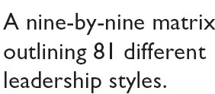
The Managerial Grid
(Blake and Mouton)
E X H I B I T 12–1

Slide 14
Behavioral Theories - Conclusions
Ohio State Studies
  Initiating Structure, greater productivity
  Consideration, greater employee commitment
University of Michigan Studies
  Employee oriented leaders, greater productivity and job satisfaction
  Production-oriented, lower productivity and satisfaction
Ohio State emphasizes more research; Michigan emphasizes employee-oriented style

Slide 15
CONTINGENCY THEORIES
All Consider the Situation
  Fiedler’s Contingency Model
  Cognitive Resource Theory
  Hersey and Blanchard’s Situational Leadership Model
  Path Goal Theory
  Assumptions underlying the different models:
  Fiedler: Leader’s style is fixed
  Other’s: Leader’s style can and should be changed

Slide 16
Fiedler Model
Leader: Style is Fixed (Task oriented vs. Relationship oriented)
Considers Situational Favorableness for Leader
  Leader-member relations
  Task structure
  Position power
Key Assumption
  Leader must fit situation; options to accomplish this:
    Select leader to fit situation
    Change situation to fit leader

Slide 17
Fiedler’s Model: The Leader
Assumption: Leader’s Style is Fixed & Can be Measured by the Least Preferred Co-Worker (LPC) Questionnaire
Least Preferred Co-Worker (LPC) Questionnaire
The way in which a leader will evaluate a co-worker that is not liked will indicate whether the leader is task- or relationship-oriented.

Slide 18
Fiedler’s Model: Defining the Situation
Leader-Member Relations
The degree of confidence, trust, and respect subordinates have in their leader.
Task Structure
The degree to which the job assignments are procedurized.
Position Power
Influence derived from one’s formal structural position in the organization; includes power to hire, fire, discipline, promote, and give salary increases.

Slide 19
Findings of the Fiedler Model
Good
Task-Oriented
Performance
Relationship
-Oriented
Poor
Favorable
Moderate
Unfavorable
Category
Leader-Member
Relations
Task Structure
Position Power
I
Good
High
Strong
II
Good
High
Weak
III
Good
Low
Strong
IV
Good
Low
Weak
V
Poor
High
Strong
VI
Poor
High
Weak
VII
Poor
Low
Strong
VIII
Poor
Low
Weak

Slide 20
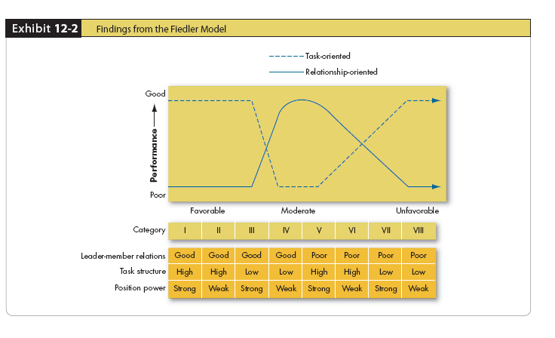
Findings from Fiedler Model
E X H I B I T 12–2

Slide 21
Findings from Fiedler Model
Fiedler asserts that if the leader’s style matches the situation, he or she will be effective. His model predicts that low-LPC, task motivated leaders will be effective in high and low situational control. High-LPC, relationship motivated leaders will be effective in moderate situational control.
The Fiedler model has several practical implications for managers:
Leaders must understand their style and the situation.
Leaders should focus on changing the situation to match their style.

