Slide 1
Organizational Behavior
Lecture 15
Dr. Amna Yousaf
PhD (HRM)
University of Twente, the Netherlands

Slide 2
Recap Lecture 14
Identify main functions of communication
Describe the communication process and distinguish between formal and informal communication
Contrast downward, upward and lateral communication and provide examples of each
Contrast oral, written and non verbal communication

Slide 3
Communication (II)
Lecture 15

Slide 4
Outline
Contrast formal communication networks and the grapevine
Analyze the advantages and challenges of electronic communication
Show how channel richness underlies the choice of communication channel
Identify common barriers to effective communication
Show how to overcome potential barriers in cross-cultural communication

Slide 5
Grapevine
Grapevine Characteristics
  Informal, not controlled by management.
  Perceived by most employees as being more believable and reliable than formal communications.
  Largely used to serve the self-interests of those who use it.
  75% employees listen about news first through rumors on grapevine
  About an executive resign 81% knew but 11% shared with others
  Can be positive for organization; managers know what is important for employees
  Results from:
    Desire for information about important situations
    Ambiguous conditions
    Conditions that cause anxiety

Slide 6


The Grapevine
Control
Reliability
Self-
Interests

Slide 7
Suggestions for Reducing the Negative Consequences of Rumors
Announce timetables for making important decisions.
Explain decisions and behaviors that may appear inconsistent or secretive.
Emphasize the downside, as well as the upside, of current decisions and future plans.
Openly discuss worst-case possibilities—it is almost never as anxiety-provoking as the unspoken fantasy.
Source: Adapted from L. Hirschhorn, “Managing Rumors,” in L. Hirschhorn (ed.), Cutting Back (San Francisco: Jossey-Bass, 1983), pp. 54–56. With permission.
E X H I B I T 11–5

Slide 8
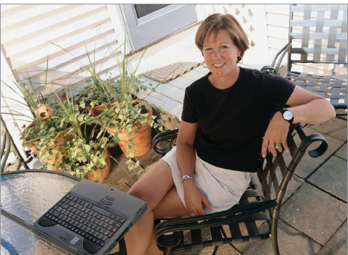
Computer-Aided Communication
E-mail
  Advantages: quickly written, sent, and stored; low cost for distribution.
  Disadvantages: 50% chances of information being misinterpreted.
  Caution: communicating negative messages
  information overload, 58% spend 2-4hours
  lack of emotional content - emoticons, cold and impersonal. In response to aggressive mails stay calm
  Privacy concerns-from corporate to personal

Slide 9
Computer-Aided Communication
Instant messaging – via desktops/laptops
  Advantage: “real time” e-mail transmitted straight to the receiver’s desktop.
  Disadvantage: can be intrusive and distracting.
Text messaging – via cell phones
  Prefderable for one-two line message
  Can be distracting – 86% of meetings emplloyees check TM
  Informality of TM should not spill over to emails

Slide 10
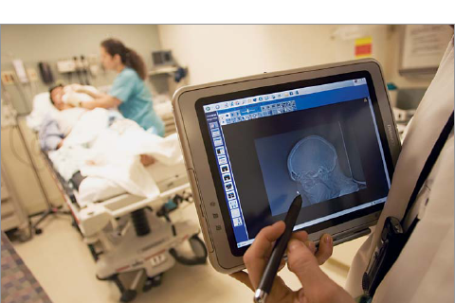
Computer-Aided Communication (cont’d)
Social networking: face book, my space, professional: LinkedIn
Intranet
  A private organization-wide information network.
Extranet
  An information network connecting employees with external suppliers, customers, and strategic partners.
  Web blogs: sites about companies where employees and customers post comments
  Some companies have policies as to content of logs, some don’t have – can be harmful. 39% people post negative comments
Videoconferencing
  An extension of an intranet or extranet that permits face-to-face virtual meetings via video links.

Slide 11
Knowledge Management (KM)
Knowledge Management
A process of organizing and distributing an organization’s collective wisdom so the right information gets to the right people at the right time.
Why KM is important:
Intellectual assets are as important as physical assets.
When individuals leave, their knowledge and experience goes with them.
A KM system reduces redundancy and makes the organization more efficient.

Slide 12
Choice of Communication Channel
Channel Richness
The amount of information that can be transmitted during a communication episode.
Characteristics of Rich Channels
Handle multiple cues simultaneously.
Facilitate rapid feedback.
Are very personal in context.

Slide 13
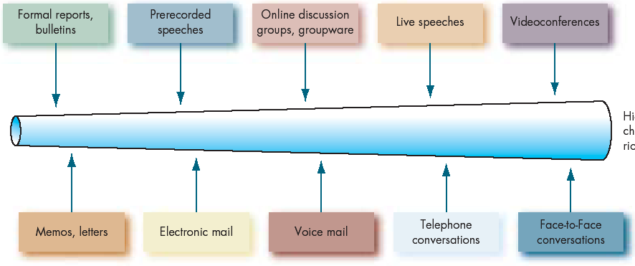
Information Richness of Communication Channels
Low channel richness
High channel richness
Routine
Nonroutine
Source: Based on R.H. Lengel and D.L. Daft, “The Selection of Communication Media as an Executive Skill,” Academy of Management Executive, August 1988, pp. 225–32; and R.L. Daft and R.H. Lengel, “Organizational Information Requirements, Media Richness, and Structural Design,” Managerial Science, May 1996, pp. 554–72. Reproduced from R.L. Daft and R.A. Noe, Organizational Behavior (Fort Worth, TX: Harcourt, 2001), p. 311.
E X H I B I T 11–7

Slide 14
Barriers to Effective Communication
Filtering
A sender’s manipulation of information so that it will be seen more favorably by the receiver.
Selective Perception
People selectively interpret what they see on the basis of their interests, background, experience, and attitudes.
Information Overload
A condition in which information inflow exceeds an individual’s processing capacity.

Slide 15

Barriers to Effective Communication (cont’d)
Emotions
How a receiver feels at the time a message is received will influence how the message is interpreted.
Language
Words have different meanings to different people.
Communication Apprehension
Undue tension and anxiety about oral communication, written communication, or both.

Slide 16
Communication Barriers Between Men and Women
Men talk to:
  Emphasize status, power, and independence.
  Complain that women talk on and on.
  Offer solutions.
  To boast about their accomplishments.
Women talk to:
  Establish connection and intimacy.
  Criticize men for not listening.
  Speak of problems to promote closeness.
  Express regret and restore balance to a conversation.

Slide 17
Silence as Communication
Absence of speech or noise
  Powerful form of communication
  Can indicate
    Thinking
    Anger
    Fear
  Watch for gaps, pauses, & hesitations in conversations

Slide 18
“Politically Correct” Communication
Certain words stereotype, intimidate, and insult individuals.
In an increasingly diverse workforce, we must be sensitive to how words might offend others.
  Removed: handicapped, blind, and elderly
  Replaced with: physically challenged, visually impaired, and senior.
  Foreign for international
  Little people -dwarfs
Removing certain words from the vocabulary makes it harder to communicate accurately.
  Removed: garbage, quotas, and women.
  Replaced with terms: postconsumer waste materials, educational equity, and people of gender.

Slide 19
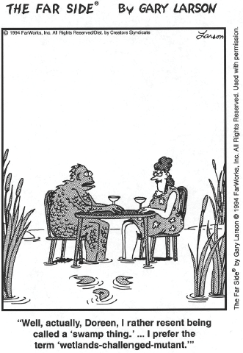
Source: The Far Side by Gary Larson © 1994 Far Works, Inc. All rights reserved. Used with permission.
E X H I B I T 11–8

Slide 20

Semantics
Words as efficiency
not translatable
into Russian
Word
Connotations
Hai means yes
im listening than
than yes I agree as in US
Barriers to Effective
Cross-Cultural
Communication
Perception
Differences
Thais have no word as
no in dictionary
Tone
Differences
People speak different at
home, office, formally,
informally
ﴀ© 2007 Prentice Hall Inc. All rights reserved.

Slide 21
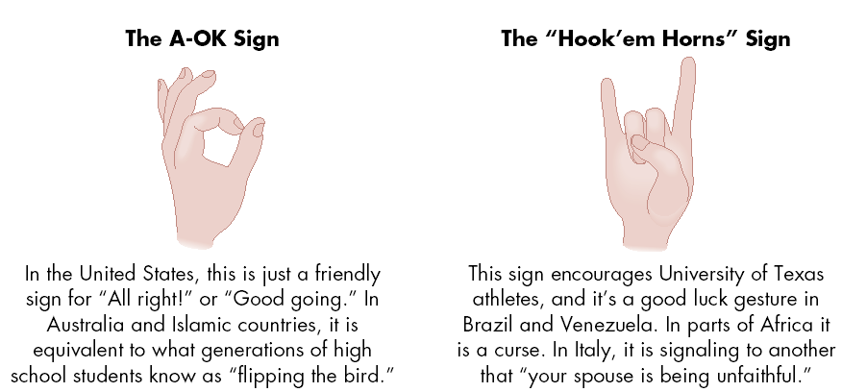
Hand Gestures Mean Different Things in Different Countries
E X H I B I T 11–9

Slide 22
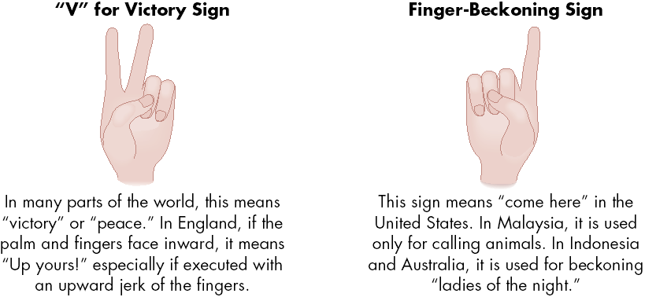
Hand Gestures Mean Different Things in Different Countries (cont’d)
E X H I B I T 11–9 (cont’d)

Slide 23
Communication Barriers and Cultural Context
High-Context Cultures
Cultures that rely heavily on nonverbal and subtle situational cues to communication.
Low-Context Cultures
Cultures that rely heavily on words to convey meaning in communication.

Slide 24
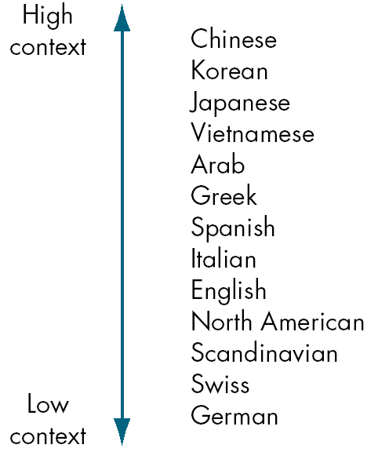
High- vs.
Low-Context Cultures
E X H I B I T 11–10

Slide 25





A Cultural Guide
Assume
Differences
Emphasize
Description-rather than your
subjective evaluations
Cultivate
Empathy-put yourself
in other’s shoes
Develop a
Hypothesis

Slide 26
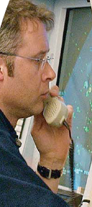
Chapter Check-Up: Communication
Consider the way in which this man is communicating? What channel is he using? How rich is it? For what kinds of message would it be appropriate? Not appropriate?

