Slide 1
Organizational Behavior
Lecture 10
Dr. Amna Yousaf
PhD (HRM)
University of Twente, the Netherlands

Slide 2
Recap Lecture 9
Employee Involvement
  Participative Management
  Representative Participation
  Quality Circles
Linking Employee Involvement programs & Motivation Theories
Using Rewards to Motivate Employees
What to Pay: establishing a Pay Structure
How to Pay: Rewarding individual Employees Through Variable-Pay Programs
  Piece-Rate Pay
  Merit Based Pay

Slide 3
Recap Lecture 9
  Bonuses
  Skill Based Pay
  Profit-sharing plans
  Gain –sharing
  Employee Stock Ownership Plans
Global Implications

Slide 4
Organizational Change Management
Lecture 10

Slide 5

Learning Goals
Forces for change
Planned versus unplanned change
Resistance to change
Overcoming resistance to change
Approaches to managing change
  Lewin’s three step change model
  Kotter’s eight step plan for implementing change
Organizational development
Creating culture for change
  Innovation
  Learning organization
© 2005 Prentice Hall Inc. All rights reserved.
14–5

Slide 6
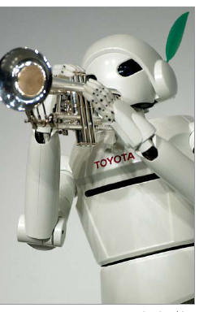
Forces for Change
Force Examples
Nature of the workforce More cultural diversity
Aging population
Many new entrants with inadequate skills
Technology Faster, cheaper, and more mobile computers
On-line music sharing
Deciphering of the human genetic code
Economic shocks Rise and fall of dot-com stocks
Economic ressession
Record low interest rates
Competition Global competitors
Mergers and consolidations
Growth of e-commerce
E X H I B I T 19–1

Slide 7
Forces for Change
Force Examples
Social trends Internet chat rooms
Retirement of Baby Boomers
Rise in discount and “big box” retailers
World politics Iraq–U.S. war
Opening of markets in China
War on terrorism following 9/11/01
E X H I B I T 19–1 (cont’d)

Slide 8
Managing Planned Change
Change
Making things different.
Goals of Planned Change:
Improving the ability of the organization to adapt to changes in its environment.
Changing the behavior of individuals and groups in the organization.
Planned Change
Activities that are intentional and goal oriented.
Change Agents
Persons who act as catalysts and assume the responsibility for managing change activities.

Slide 9

Resistance to Change
Forms of Resistance to Change
  Overt and immediate
    Voicing complaints, engaging in job actions such as slow down operations, striking
  Implicit and deferred
    Loss of employee loyalty and motivation, increased errors or mistakes, increased absenteeism

Slide 10
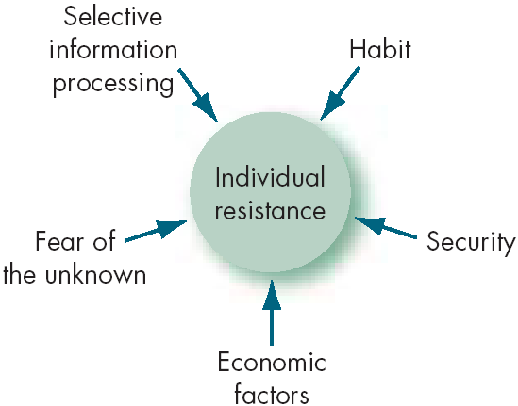
Sources of Individual Resistance to Change
E X H I B I T 19–2

Slide 11
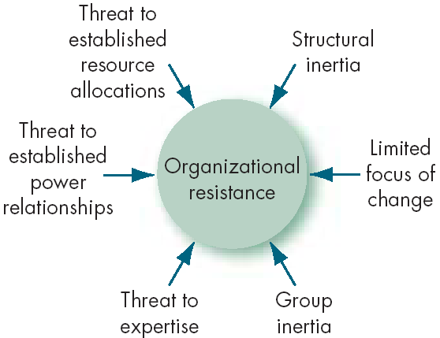
Sources of Organizational Resistance to Change
E X H I B I T 19–2 (cont’d)

Slide 12
Overcoming Resistance to Change
Tactics for dealing with resistance to change:
Education and communication
Participation
Facilitation and support
Procedural fairness
Manipulation and cooptation
Selecting people who accept change
Coercion

Slide 13
The Politics of Change
Impetus for change is likely to come from outside change agents.
Internal change agents are most threatened by their loss of status in the organization.
Long-time power holders tend to implement only incremental change.
The outcomes of power struggles in the organization will determine the speed and quality of change.

Slide 14
Lewin’s Three-Step Change Model
Unfreezing
Change efforts to overcome the pressures of both individual resistance and group conformity.
Refreezing
Stabilizing a change intervention by balancing driving and restraining forces.
Movement
towards the new equilibrium
Driving Forces
Forces that direct behavior away from the status quo.
Restraining Forces
Forces that hinder movement from the existing equilibrium.
A hotel in US attempted to consolidate operations from Seattle, and Los Angeles to San Francisco…..

Slide 15
Lewin’s Three-Step Change Model
E X H I B I T 19–3

Slide 16
Unfreezing the Status Quo
E X H I B I T 19–4

Slide 17
Kotter’s Eight-Step Plan for Implementing Change
Establish a sense of urgency by creating a compelling reason for why change is needed.
Form a coalition with enough power to lead the change.
Create a new vision to direct the change and strategies for achieving the vision.
Communicate the vision throughout the organization.
Empower others to act on the vision by removing barriers to change and encouraging risk taking and creative problem solving.
Plan for, create, and reward short-term “wins” that move the organization toward the new vision.
Consolidate improvements, reassess changes, and make necessary adjustments in the new programs.
Reinforce the changes by demonstrating the relationship between new behaviors and organizational success.
E X H I B I T 19–5
Source: Based on J. P. Kotter, Leading Change (Boston: Harvard Business School Press, 1996).

Slide 18
Action Research
Action Research
A change process based on systematic collection of data and then selection of a change action based on what the analyzed data indicates.
Process Steps:
Diagnosis
Analysis
Feedback
Action
Evaluation
Action research benefits:
Problem-focused rather than solution-centered.
Heavy employee involvement reduces resistance to change.

Slide 19
Organizational Development
Organizational Development (OD)
A collection of planned interventions, built on humanistic-democratic values, that seeks to improve organizational effectiveness and employee well-being.
OD Values:
Respect for people
Trust and support
Power equalization
Confrontation
Participation

Slide 20
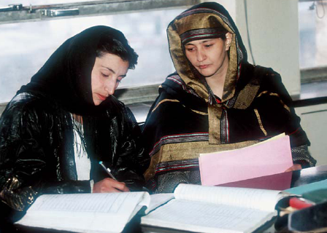
Organizational Development Techniques
Sensitivity Training
Training groups (T-groups) that seek to change behavior through unstructured group interaction.
Provides increased awareness of others and self.
Increases empathy with others, improves listening skills, greater openness, and increased tolerance for others.
Leader acts only as a moderator to enhance interactive learning

Slide 21

Organizational Development Techniques (cont’d)
Survey Feedback Approach
The use of questionnaires to identify discrepancies among member perceptions; discussion follows and remedies are suggested.

Slide 22

Organizational Development Techniques (cont’d)
Process Consultation (PC)
A consultant gives a client insights into what is going on around the client, within the client, and between the client and other people; identifies processes that need improvement.

Slide 23
Organizational Development Techniques (cont’d)
Team Building
High interaction among team members to increase trust and openness.
Team Building Activities:
Goal and priority setting.
Developing interpersonal relations.
Role analysis to each member’s role and responsibilities.

Slide 24
Organizational Development Techniques (cont’d)
Intergroup Development
OD efforts to change the attitudes, stereotypes, and perceptions that groups have of each other.
Intergroup Problem Solving:
Groups independently develop lists of perceptions.
Share and discuss lists.
Look for causes of misperceptions.
Work to develop integrative solutions.

Slide 25
Contemporary Change Issues For Today’s Managers
How are changes in technology affecting the work lives of employees?
What can managers do to help their organizations become more innovative?
How do managers create organizations that continually learn and adapt?
Is managing change culture-bound?

Slide 26
Technology in the Workplace
Continuous Improvement Processes
  Good isn’t good enough.
  Focus is on constantly reducing the variability in the organizational processes to produce more uniform products and services.
    Lowers costs and raises quality.
    Increases customer satisfaction.
  Organizational impact
    Additional stress on employees to constantly excel.
    Requires constant change in organization.

Slide 27
Contemporary Change Issues for Today’s Managers: Stimulating Innovation
Innovation
A new idea applied to initiating or improving a product, process, or service.
Sources of Innovation:
Structural variables
  Organic structures
  Long-tenured management
  Slack resources
  Interunit communication
Organization’s culture
Human resources

Slide 28

Contemporary Change Issues for Today’s Managers: Stimulating Innovation (cont’d)
Idea Champions
Individuals who take an innovation and actively and enthusiastically promote the idea, build support, overcome resistance, and ensure that the idea is implemented.
Transformational leaders
Risk takers, confident,
persistent & energetic

Slide 29
Creating a Learning Organization
Learning Organization
An organization that has developed the continuous capacity to adapt and change.
Characteristics:
Holds a shared vision.
Discards old ways of thinking.
Views organization as system of relationships.
Communicates openly.
Works together to achieve shared vision.
E X H I B I T 19–6
Source: Based on P. M. Senge, The Fifth Discipline (New York: Doubleday, 1990).

Slide 30

Creating a Learning Organization
Single-Loop Learning
Errors are corrected using past routines and present policies.
Double-Loop Learning
Errors are corrected by modifying the organization’s objectives, policies, and standard routines.

Slide 31
Creating a Learning Organization
Fundamental Problems in Traditional Organizations:
Fragmentation based on specialization.
Overemphasis on competition.
Reactiveness that misdirects attention to problem-solving rather than creation.

Slide 32
Managing a Learning Organization
Establish
a strategy
Managing Learning
Redesign the
organization’s
structure
Reshape the
organization’s culture

Slide 33
Managing Resistance to Change
Resistance to change –
  Single greatest threat to successful strategy implementation
Change raises anxiety over fear of:
  Economic loss
  Inconvenience
  Uncertainty

Slide 34
Change Strategies
Force Change Strategy
  Giving and fulfilling orders, low commitment and morale
Educative Change Strategy
  Greater commitment but slow implementation
Rational or Self-Interest Change Strategy
  Attempts to convince that change is to self interest of employee – seldom so

Slide 35
Production/Operations Concerns
Production processes typically constitute more than 70% of firm’s total assets
Decisions on:
  Plant size
  Inventory/inventory control
  Quality control
  Cost control
  Technological innovation

Slide 36
Production/Operations Adjustments
Hospital
  Adding a cancer center (product development)
    Purchase specialized equipment
Bank
  Adding 10 new branches (market development)
    Perform site location analysis

Slide 37
Human Resource Concerns
Strategic HR : Attitudes linking HR and performance
Strength of HR system and organziational climate
Horizontal and vertical Alignment of HR
Context
Assessing staffing needs and costs
Develop performance incentives
Child-care policies
Work-life balance

Slide 38
Marketing Concerns
Internet marketing may be more effective
  Market segments easy to identify
  More time spent on net
Effective strategy implementation may come from
  Instant messaging and chatting with customers
  Social interaction – rapport
  Instead of “sell” focus on “attract”
  Consumer shift from “want’to need

Slide 39
Finance/Accounting Concerns
Debt/Equity Ratio
  Short term or long term debt
To lease or buy fixed assets
Accounts receivables and payables
Discount on accounts
Cash on hand

Slide 40
R & D Concerns
Emphasize product or process improvements
Use university researchers or private sector researchers
Amount of money on R & D
Perform R & D within or outsource
  Low technical progress and low to moderate market growth – in house R & D
  High technical growth, market slow, R&D may be risky
  Low technical growth, high market growth, outsource – building in house may take time
  High on both aspects – acquire well estabished firm on R& D in the indusrty
Be leaders or followers in R & D
  First mover or imitator

Slide 41
MIS Concerns
Effective MIS for change implementation
  Information collection, storage and retreival
  Reduce costs by quick processing of information
  Direct cmmunication with value network

Slide 42
Thank You

