Slide 1
Chapter 6
Lecture 9
Master Budgeting and Responsibility Accounting
Readings
Chapter 6,Cost Accounting, Managerial Emphasis, 14th edition by Horengren
Chapter 10, Managerial Accounting 6th edition by Weygandt, kimmel, kieso

Slide 2
Master Budgeting and Responsibility Accounting
Learning Objectives
After studying this chapter, you should be able to:
[1] Describe the concept of budgetary control.
[2] Evaluate the usefulness of static budget reports.
[3] Explain the development of flexible budgets and the usefulness of flexible budget reports.
[4] Describe the concept of responsibility accounting.
[5] Indicate the features of responsibility reports for cost centers.
[6] Identify the content of responsibility reports for profit centers.
[7] Explain the basis and formula used in evaluating performance in investment centers.

Slide 3
Budget defined
The quantitative expression of a proposed plan of action by management for a specified period, and
An aid to coordinating what needs to be done to implement that plan
May include both financial and non-financial data

Slide 4
The Ongoing Budget Process:
Managers and accountants plan the performance of the company, taking into account past performance and anticipated future changes
Senior managers distribute a set of goals against which actual results will be compared

Slide 5
The Ongoing Budget Process:
Accountants help managers investigate deviations from budget. Corrective action occurs at this point
Managers and accountants assess market feedback, changed conditions, and their own experiences as plans are laid for the next budget period

Slide 6
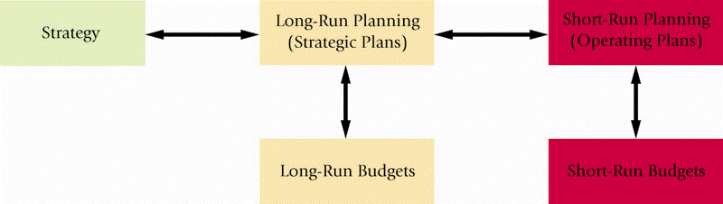
Strategy, Planning and Budgets, Illustrated

Slide 7
Advantages of Budgets
Provides a framework for judging performance
Motivates managers and other employees
Promotes coordination and communication among subunits within the company

Slide 8
Components of Master Budgets
Operating Budget – building blocks leading to the creation of the Budgeted Income Statement
Financial Budget – building blocks based on the Operating Budget that lead to the creation of the Budgeted Balance Sheet and the Budgeted Statement of Cash Flows

Slide 9
Basic Operating Budget Steps
Prepare the Revenues Budget
Prepare the Production Budget (in Units)
Prepare the Direct Materials Usage Budget and Direct Materials Purchases Budget
Prepare the Direct Manufacturing Labor Budget

Slide 10
Basic Operating Budget Steps
Prepare the Manufacturing Overhead Costs Budget
Prepare the Ending Inventories Budget
Prepare the Cost of Goods Sold Budget
Prepare the Operating Expense (Period Cost) Budget
Prepare the Budgeted Income Statement

Slide 11
Basic Financial Budget Steps
Based on the Operating Budgets:
Prepare the Capital Expenditures Budget
Prepare the Cash Budget
Prepare the Budgeted Balance Sheet
Prepare the Budgeted Statement of Cash Flows

Slide 12
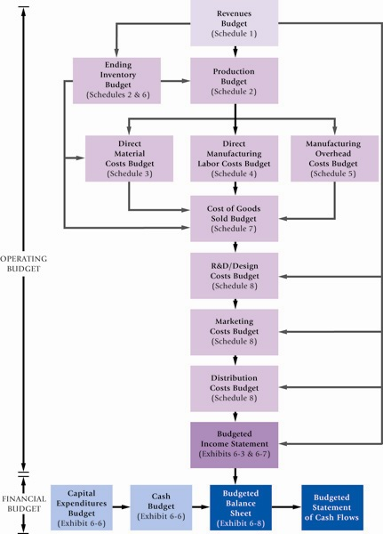
Sample
Master
Budget,
Illustrated

Slide 13
Other Budgeting Issues
Financial-planning software may be employed to conduct sensitivity (“what-if”) analysis to assist in the budgetary process
Kaizen Budgeting – incorporating continuous improvement factors in the budgeting process
Activity-Based Budgeting – incorporating Activity-Based Costing in the budgetary process

Slide 14
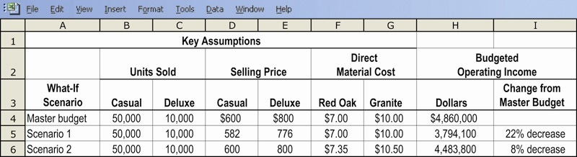
Kaizen Budgeting, Illustrated

Slide 15
Budgeting and the Organization:
Responsibility Accounting
Responsibility Center – a part, segment, or subunit of a organization whose manager is accountable for a specified set of activities
Responsibility Accounting – a system that measures the plans, budgets, actions and actual results of each Responsibility Center

Slide 16
Types of Responsibility Centers
Cost – accountable for costs only
Revenue – accountable for revenues only
Profit – accountable for revenues & costs
Investment – accountable for investments, revenues, and costs

Slide 17
Budgets and Feedback
Budgets offer feedback in the form of variances: actual results deviate from budgeted targets
Variances provide managers with
  Early warning of problems
  A basis for performance evaluation
  A basis for strategy evaluation

Slide 18
Controllability
Controllability is the degree of influence that a manager has over costs, revenues, or related items for which he is being held responsible
Responsibility Accounting focuses on information sharing, not in laying blame on a particular manager

Slide 19
Budgeting and Human Behavior
The budgeting process may be abused both by superiors and subordinates, leading to negative outcomes
Superiors may dominate the budget process or hold subordinates accountable for events they have no control over
Subordinates may build “budgetary slack” into their budgets

Slide 20
Budgetary Slack
The practice of underestimating budgeted revenues, or overestimating budgeted expenses, in an effort to make the resulting budgeted goals (profits) more easily attainable

Slide 21
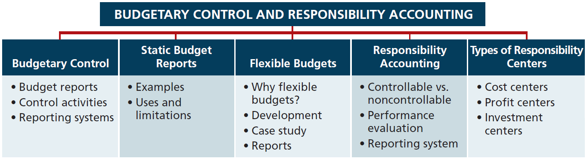

Slide 22
Budgetary Control
The use of budgets in controlling operations is known as budgetary control.
  Takes place by means of budget reports which compare actual results with planned objectives.
  Provides management with feedback on operations.
  Budget reports can be prepared as frequently as needed.
  Analyze differences between actual and planned results and determines causes.

Slide 23
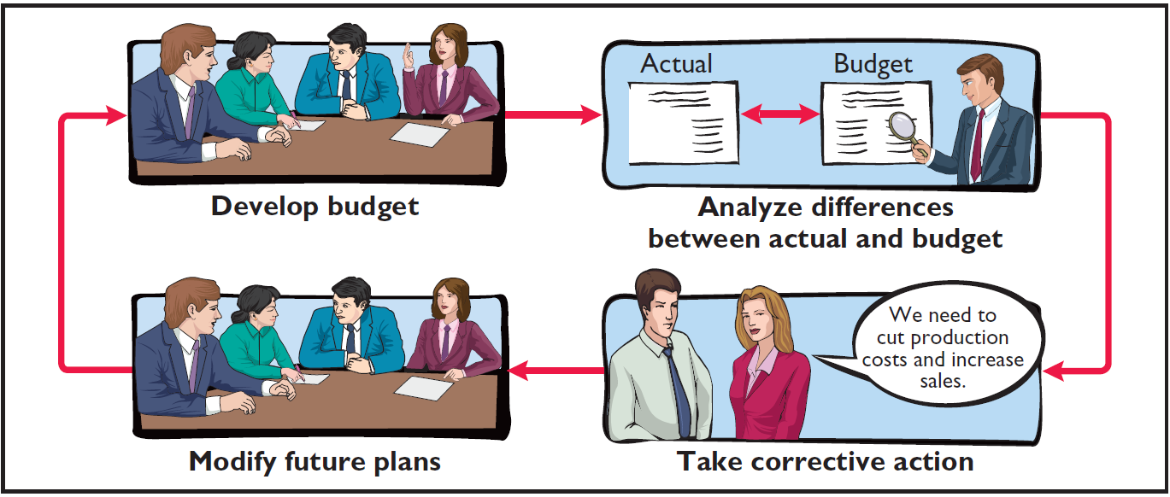
Budgetary Control
Budgetary control involves the following activities.

Slide 24
Budgetary Control
Works best when a company has a formalized reporting system which:
  Identifies the name of the budget report.
  States the frequency of the report.
  Specifies the purpose of the report.
  Indicates recipient(s) of the report.

Slide 25
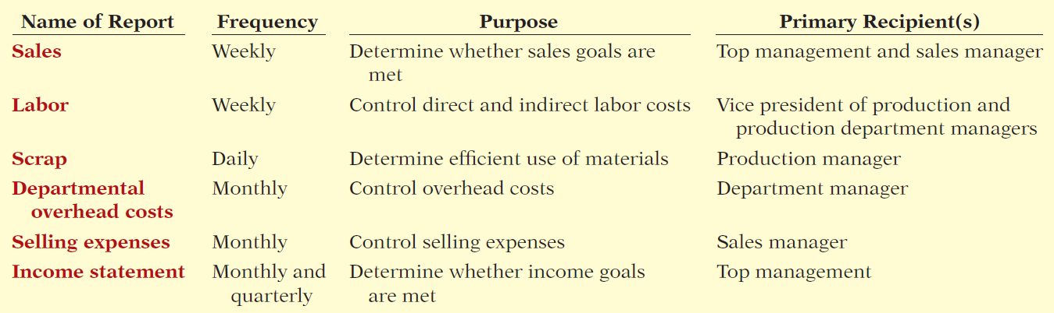
Budgetary Control
Partial budgetary control system for manufacturing company.

Slide 26
Budgetary Control
Review Question
Budgetary control involves all but one of the following:
  Modifying future plans.
  Analyzing differences.
  Using static budgets.
  Determining differences between actual and planned results.

Slide 27
Static Budget Reports
Static budget is a projection of budget data at one level of activity.
  When used in budgetary control, each budget included in the master budget is considered to be static.
  Ignores data for different levels of activity.
  Compares actual results with budget data at the activity level used in the master budget.

Slide 28
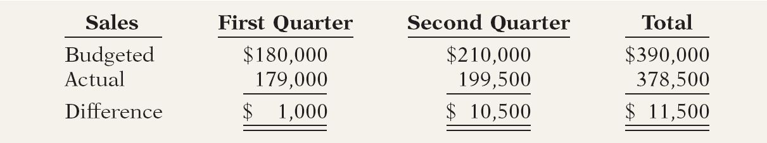
Static Budget Reports
Illustration: Budget and actual sales data for the Rightride product in the first and second quarters of 2014 are as follows.

Slide 29
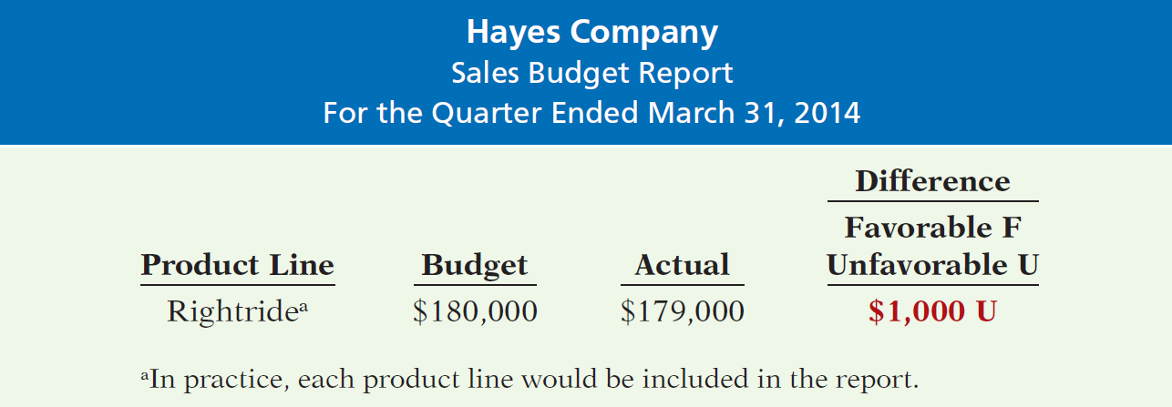
Static Budget Reports
Illustration: Sales budget report for Hayes Company’s first quarter.

Slide 30
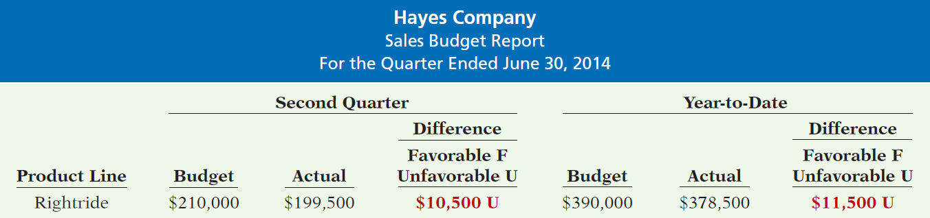
Static Budget Reports
Illustration: Budget report for the second quarter contains one new feature: cumulative year-to-date information.

Slide 31
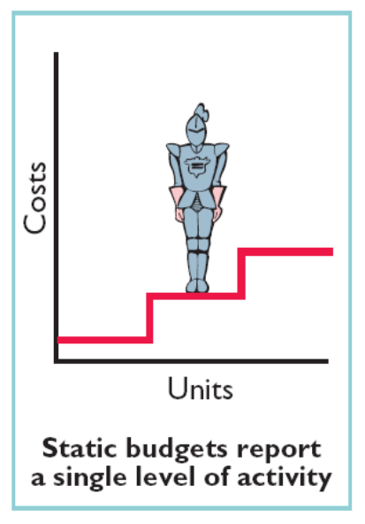
Static Budget Reports
Uses and Limitations
Appropriate for evaluating a manager’s effectiveness in controlling costs when:
  Actual level of activity closely approximates master budget activity level.
  Behavior of costs is fixed in response to changes in activity.
Appropriate for fixed costs.
Not appropriate for variable costs.

Slide 32
Static Budget Reports
Review Question
A static budget is useful in controlling costs when cost behavior is:
  Mixed.
  Fixed.
  Variable.
  Linear.

Slide 33
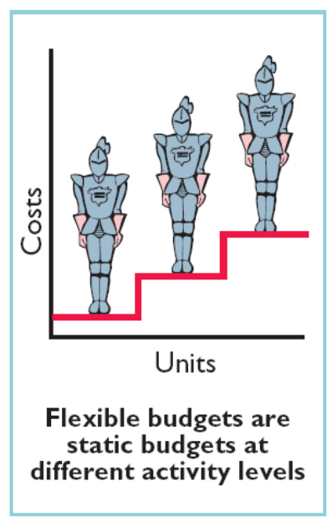
Flexible Budgets
Flexible budget projects budget data for various levels of activity.
  Budgetary process more useful if it is adaptable to changes in operating conditions.
  Essentially a series of static budgets at different activity levels.
  Can be prepared for each type of budget in the master budget.

Slide 34
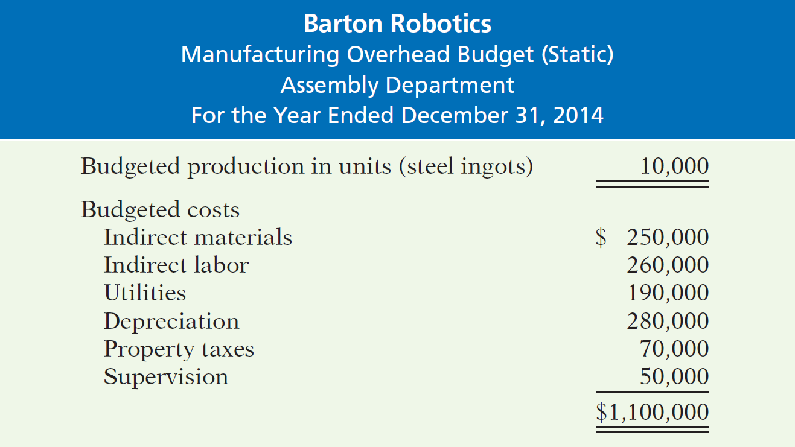
Flexible Budgets
Why Flexible Budgets?
Illustration: Barton Robotics, static budget based on a production volume of 10,000 units of robotic controls.

Slide 35
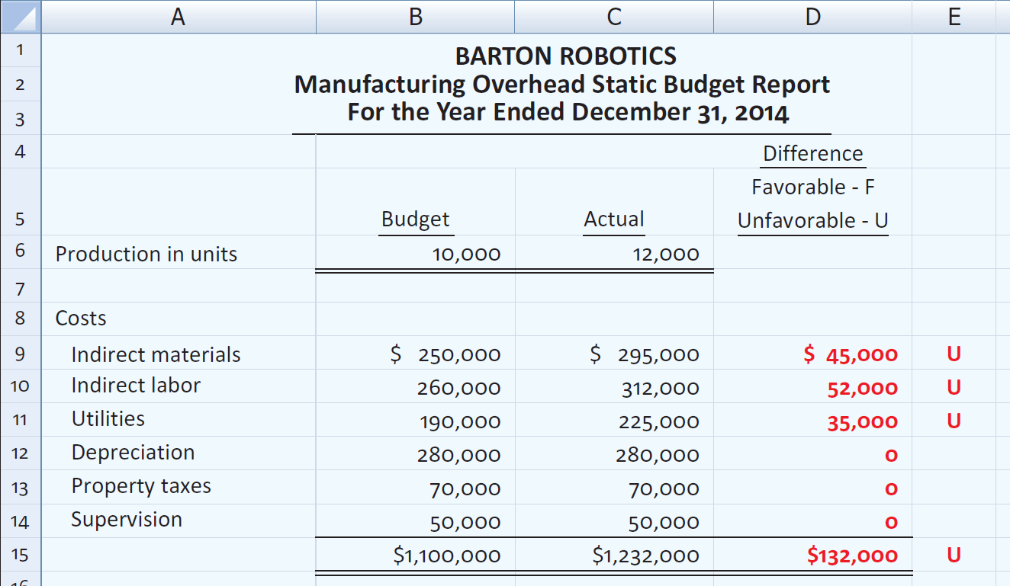
Flexible Budgets
Illustration: Overhead Static Budget report assuming 12,000 units were actually produced.

Slide 36
Flexible Budgets
Over budget in three of six overhead costs.
  Unfavorable difference of $132,000 – 12% over budget.
Comparison based on budget data for 10,000 units - the original activity level which is not relevant.
  Meaningless to compare actual variable costs for 12,000 units with budgeted variable costs for 10,000 units.
  Variable cost increase with production.
Budgeted variable amounts should increase proportionately with production

Slide 37
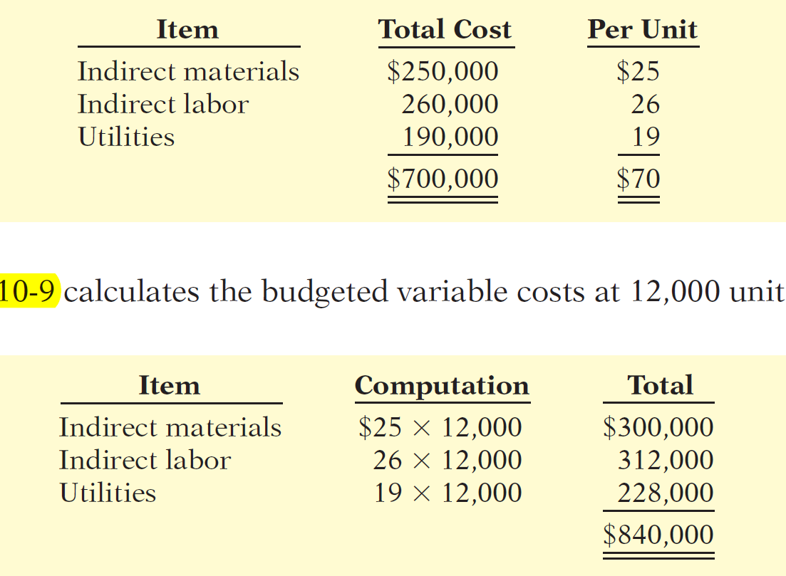
Flexible Budgets
Illustration: Analyzing the budget data for these costs at 10,000 units, you arrive at the following per unit results.
Budgeted variable costs at 12,000 units.

Slide 38
Flexible Budgets
Developing the Flexible Budget
Identify the activity index and the relevant range of activity.
Identify the variable costs and determine the budgeted variable cost per unit of activity for each cost.
Identify the fixed costs and determine the budgeted amount for each cost.
Prepare the budget for selected increments of activity within the relevant range.

Slide 39
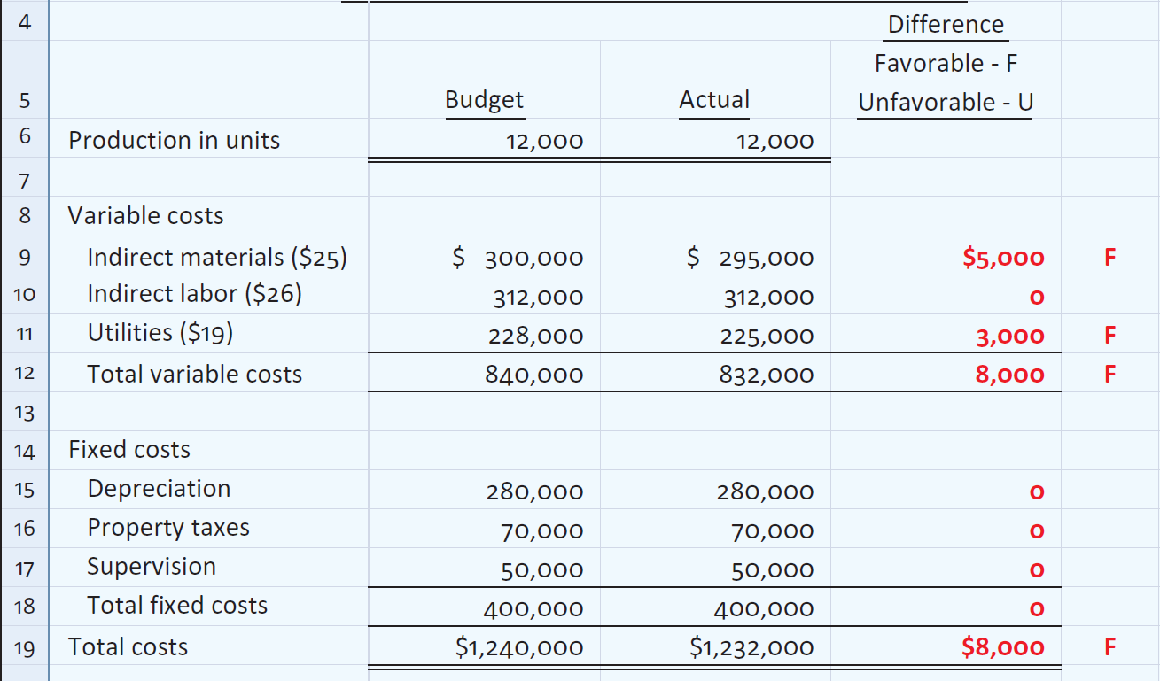
Flexible Budgets
Illustration: Prepare the budget report based on the flexible budget for 12,000 units of production.

Slide 40
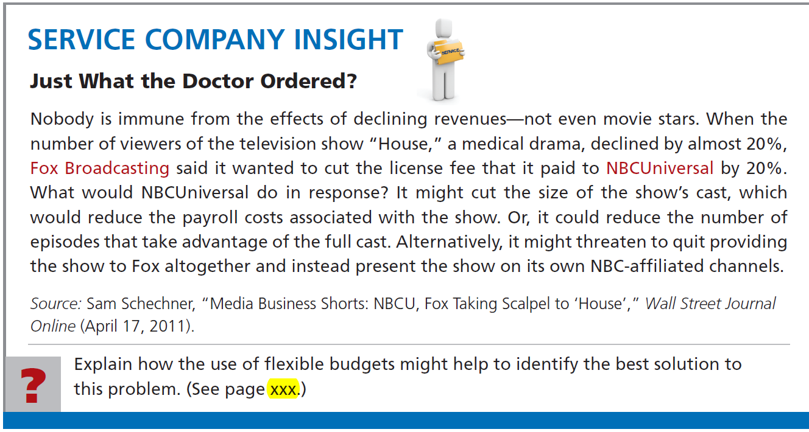


Slide 41
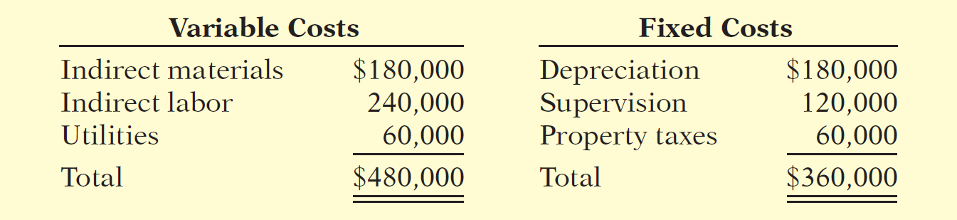
Flexible Budgets
Flexible Budget – A Case Study
Illustration: Fox Company’s management uses a flexible budget for monthly comparisons of actual and budgeted manufacturing overhead costs of the Finishing department. The master budget for the year ending December 31, 2014, shows expected annual operating capacity of 120,000 direct labor hours and the following overhead costs.

Slide 42
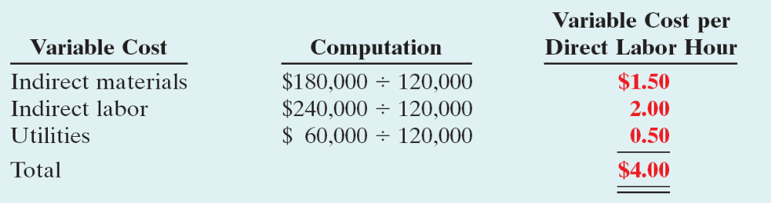
Flexible Budgets
Four steps for developing the flexible budget.
  Identify the activity index and the relevant range.
    Activity index: direct labor hours.
    Relevant range: 8,000 – 12,000 direct labor hours per month.
  Identify variable costs and determine the budgeted variable cost per unit of activity for each cost.

Slide 43
Flexible Budgets
Four steps for developing the flexible budget.
  Identify the fixed costs and determine the budgeted amount for each cost.
    Three fixed costs per month:
      Depreciation $15,000.
      Supervision $10,000.
      Property taxes $5,000.
  Prepare the budget for selected increments of activity within the relevant range.
    Prepared in increments of 1,000 direct labor hours.

Slide 44
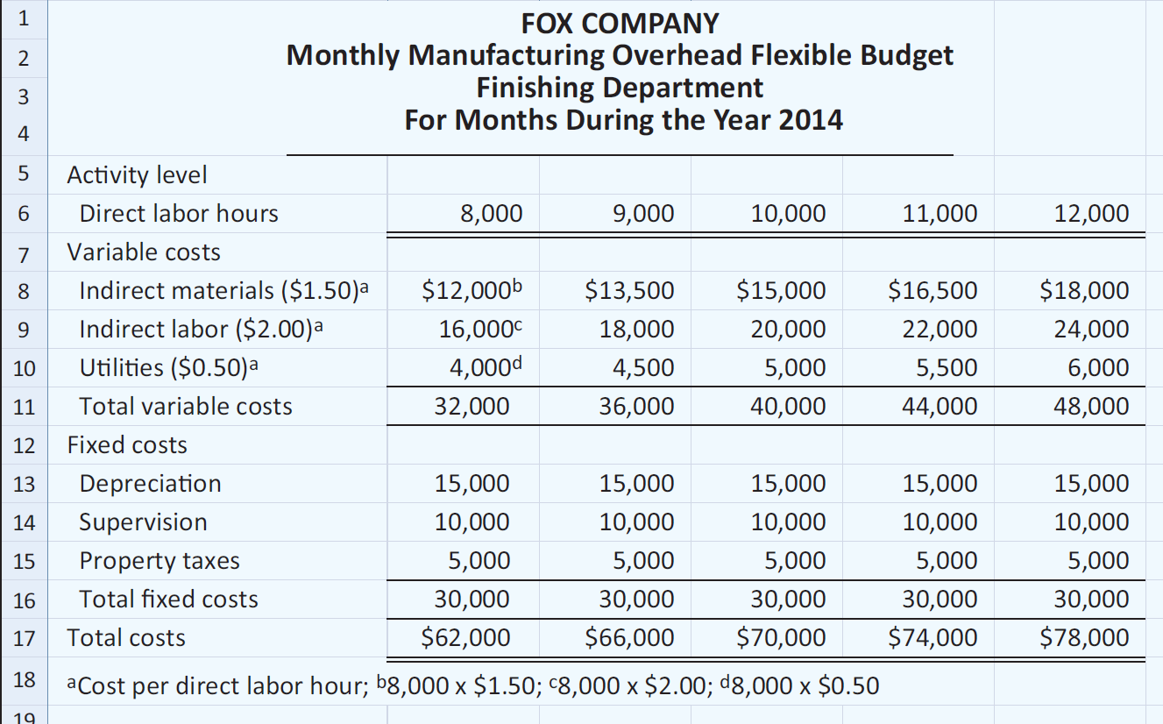
Flexible Budgets
Monthly overhead flexible budget

Slide 45

Flexible Budgets
Fox uses the formula below to determine total budgeted costs at any level of activity.
Determine total budgeted costs for Fox Manufacturing Company with fixed costs of $30,000 and total variable cost $4 per unit:
  9,000 direct labor hours : $30,000 + ($4 x 9,000) = $66,000
  8,622 direct labor hours: $30,000 + ($4 x 8,622) = $64,488

Slide 46
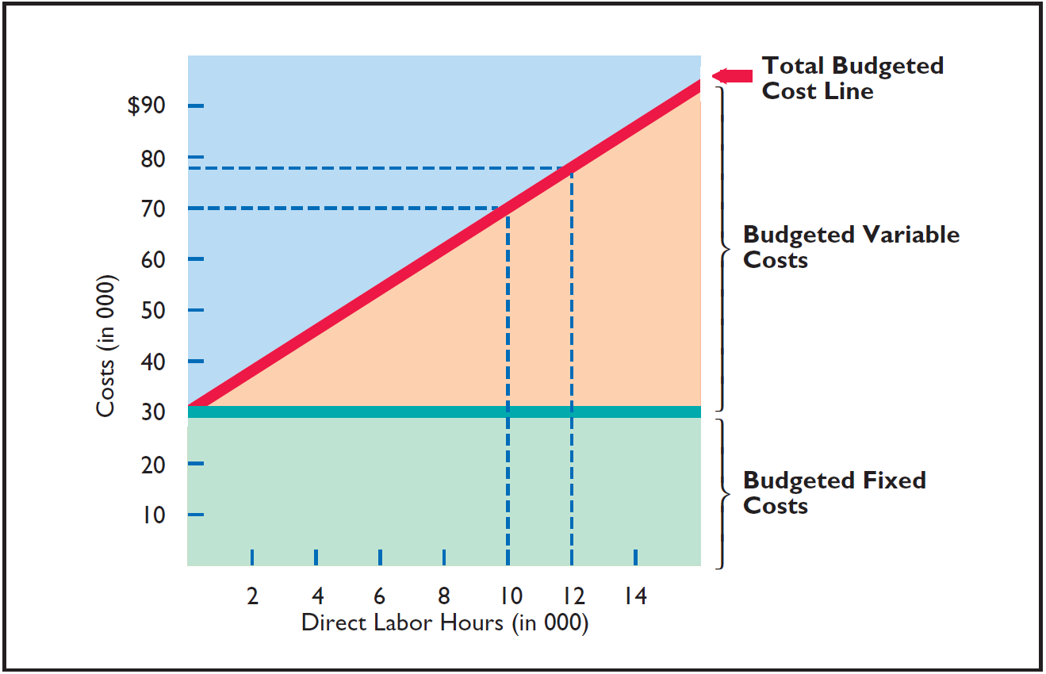
Flexible Budgets
Graphic flexible budget data highlighting 10,000 and 12,000 activity levels.

Slide 47
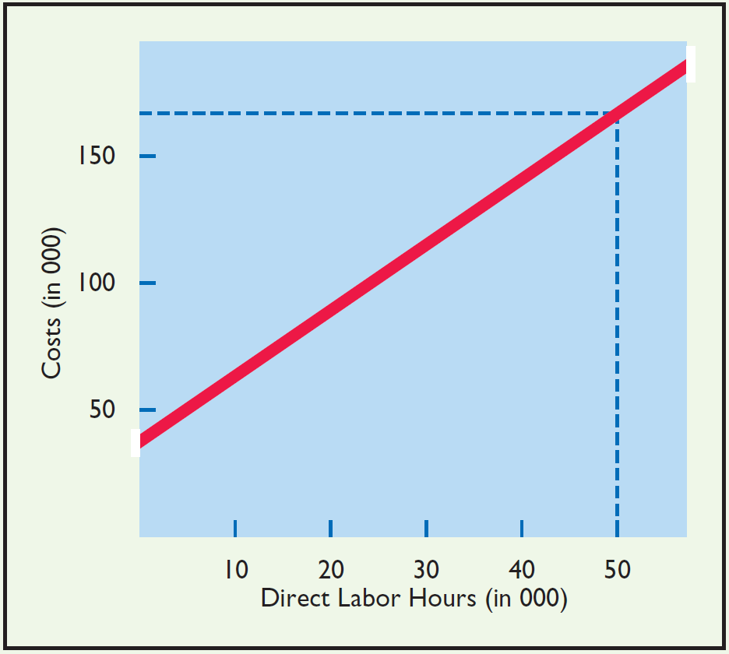
In Strassel Company’s flexible budget graph, the fixed cost line and the total budgeted cost line intersect the vertical axis at $36,000. The total budgeted cost line is $186,000 at an activity level of 50,000 direct labor hours. Compute total budgeted costs at 30,000 direct labor hours.

Slide 48
In Strassel Company’s flexible budget graph, the fixed cost line and the total budgeted cost line intersect the vertical axis at $36,000. The total budgeted cost line is $186,000 at an activity level of 50,000 direct labor hours. Compute total budgeted costs at 30,000 direct labor hours.
Variable costs:
Total budgeted cost line $ 186,000
Fixed costs - 36,000
Variable costs at 50,000 hours 150,000
Activity level at intersect (hours) ÷ 50,000
Variable costs per direct labor hour $ 3
Direct labor hours x 30,000
Total variable costs 90,000
Total fixed costs + 36,000
Total budgeted costs $ 126,000

Slide 49
End of Lecture 9

