Slide 1
Chapter 5-Continued
Lecture 8
Activity Based Costing and Activity based Management
Readings
Chapter 5,Cost Accounting, Managerial Emphasis, 14th edition by Horengren
Chapter 4, Managerial Accounting 6th edition by Weygandt, kimmel, kieso
Chapter 8, Managerial Accounting 12th edition by Garrison, Noreen, Brewer

Slide 2
Activity-Based Costing
Learning Objectives
After studying this chapter, you should be able to:
[1] Know how companies identify and use cost drivers in activity-based costing.
[2] Understand the benefits and limitations of activity-based costing.
[3] Differentiate between value-added and non–value added activities.
[4] Understand the value of using activity levels in activity-based costing.
[5] Apply activity-based costing to service industries.

Slide 3
Activity-Based Costing: A Closer Look
Benefits of ABC
More accurate product costing through:
  Use of more cost pools to assign overhead costs.
  Enhanced control over overhead costs.
  Better management decisions.
Limitations of ABC
  Can be expensive to use.
  Some arbitrary allocations continue.

Slide 4

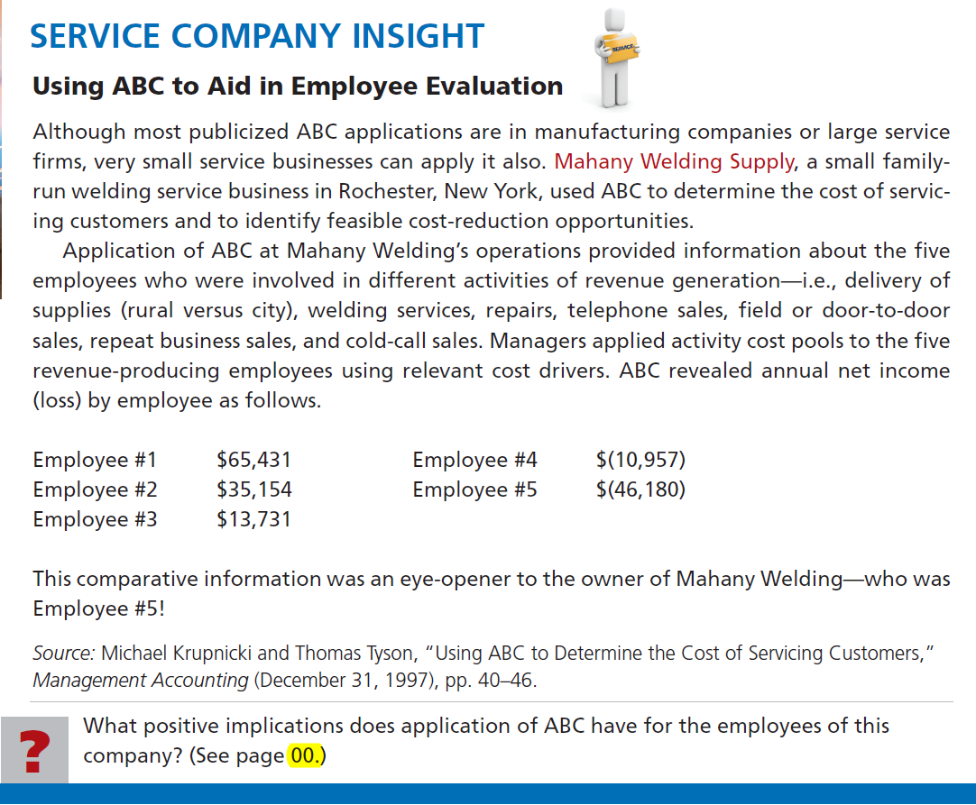

Slide 5
Activity-Based Costing: A Closer Look
When to Use ABC
Factors to consider:
  Product lines differ in volume and manufacturing complexity.
  Product lines are numerous and diverse.
  Overhead costs constitute a significant portion of total costs.
  The manufacturing process or the number of products has changed significantly.
  Production or marketing managers are ignoring data provided by the existing system.

Slide 6
Activity-Based Costing: A Closer Look
Value-Added Versus Non–Value-Added Activities
Activity Based Management (ABM):
An extension of ABC from a product costing system to a management function that focuses on reducing costs and improving processes and decision making.
  Value-added activities
  Non–value-added activities

Slide 7
Activity-Based Costing: A Closer Look
Value-Added Versus Non–Value-Added Activities
An activity that increases the perceived worth of a product or service such as:
Manufacturing Company
Engineering design
Machining services
Assembly
Painting
Service Company
Performing surgery
Legal research
Delivering packages

Slide 8
Activity-Based Costing: A Closer Look
Value-Added Versus Non–Value-Added Activities
An activity that adds cost to, or increases the time spent on, a product/service without increasing its market value such as:
Manufacturing Company
Repair of machines
Storage of inventory
Moving of inventory
Building maintenance
Inspections
Inventory Control
Service Company
Taking appointments
Reception
Bookkeeping and billing
Traveling
Ordering supplies
Advertising

Slide 9
Classify each of the following activities within a water-ski manufacturer as value-added (VA) or non–value-added (NVA).
NVA
Inspecting completed skis.
Storing raw materials.
Machine setups.
Installing bindings on skis.
Packaging skis for shipment.
Reworking defective skis.
NVA
NVA
VA
VA
NVA

Slide 10
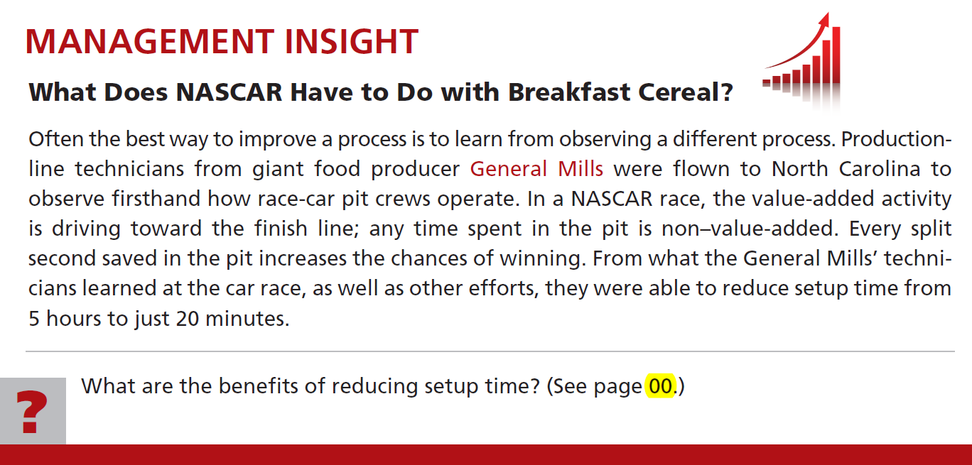


Slide 11
Activity-Based Costing: A Closer Look
Classification of Activity Levels
ABC activities levels:
  Unit-level activities
  Batch-level activities
  Product-level activities
  Facility-level activities

Slide 12
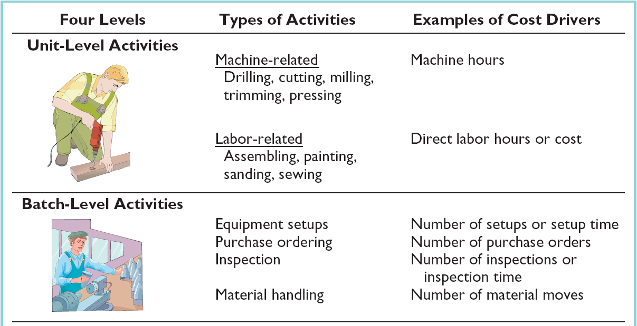
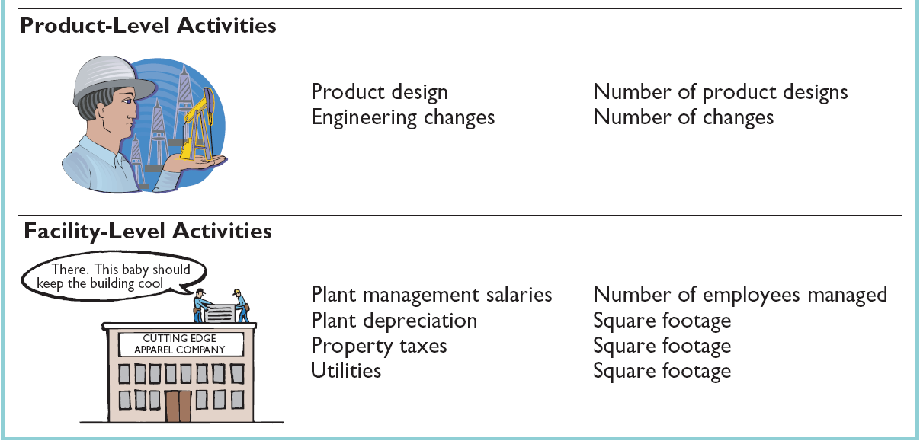
Activity-Based Costing: A Closer Look
Classification of Activity Levels

Slide 13
Morgan Toy Company manufactures six primary product lines in its Morganville plant. As a result of an activity analysis, the accounting department has identified eight activity cost pools. Each of the toy products is produced in large batches, with the whole plant devoted to one product at a time. Classify each of the following activities as either unit-level, batch-level, product-level, or facility-level:
Product-level
Engineering design,
Machine setup,
Toy design,
Interviews of prospective employees,
Batch-level
Product-level
Facility-level

Slide 14
Morgan Toy Company manufactures six primary product lines in its Morganville plant. As a result of an activity analysis, the accounting department has identified eight activity cost pools. Each of the toy products is produced in large batches, with the whole plant devoted to one product at a time. Classify each of the following activities as either unit-level, batch-level, product-level, or facility-level:
Batch-level
Inspections after each setup,
Polishing parts,
Assembling parts,
Health and safety.
Unit-level
Unit-level
Facility-level

Slide 15
Activity-Based Costing in Service Industries
Overall objective: Identify key cost-generation activities and keep track of quantity of activities performed for each service provided.
  General approach is to identify activities, cost pools, and cost drivers.
  Labeling of activities as value-added or non-value-added.
  A larger proportion of overhead costs are company-wide costs that cannot be directly traced to specific services provided by the company.

Slide 16
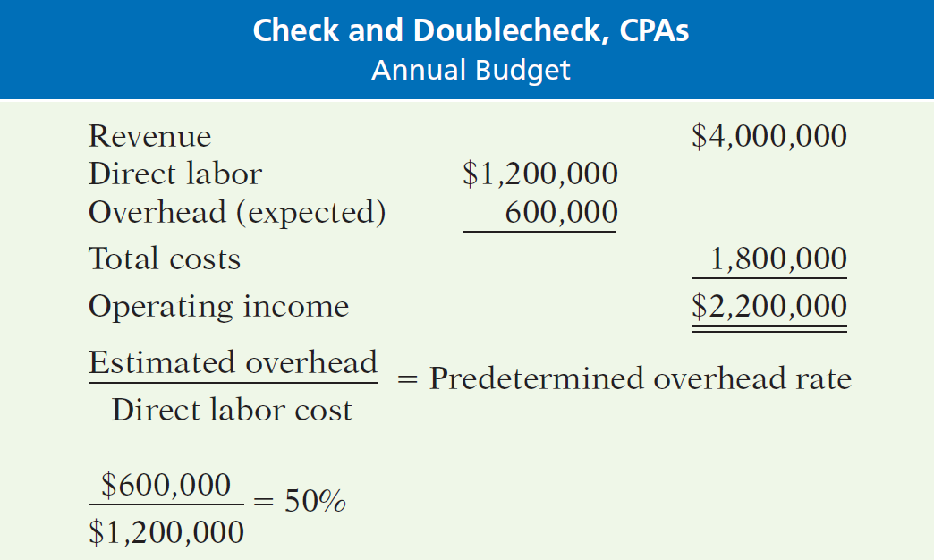
Activity-Based Costing in Service Industries
Traditional Costing Example
The public accounting firm of Check and Doublecheck prepares the following condensed annual budget.

Slide 17
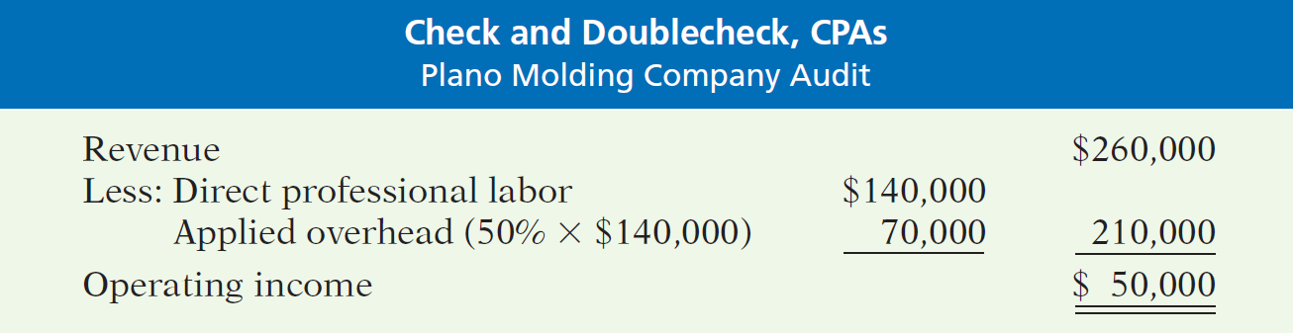
Activity-Based Costing in Service Industries
Traditional Costing Example
Under traditional costing Check and Doublecheck would compute applied overhead and operating income as:

Slide 18
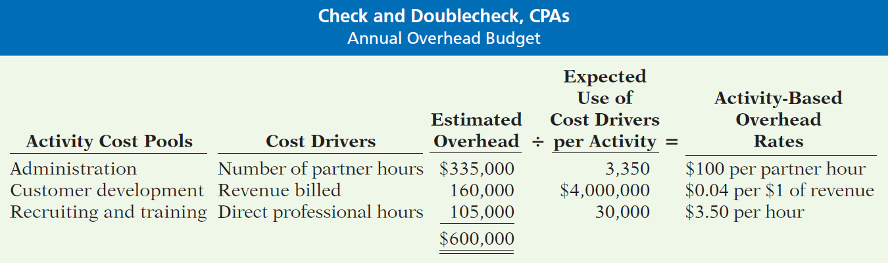
Activity-Based Costing in Service Industries
Activity-Based Costing Example
Check and Doublecheck distributes its estimated annual overhead costs of $1,200,000 to several activity cost pools.

Slide 19
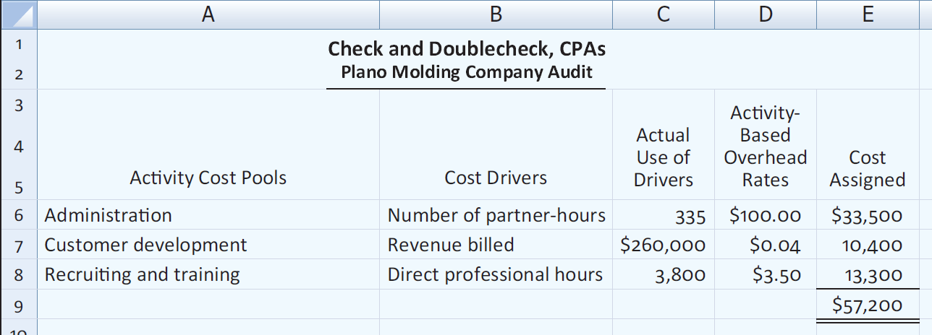
Activity-Based Costing in Service Industries
Activity-Based Costing Example
Assigning overhead in a service industry

Slide 20
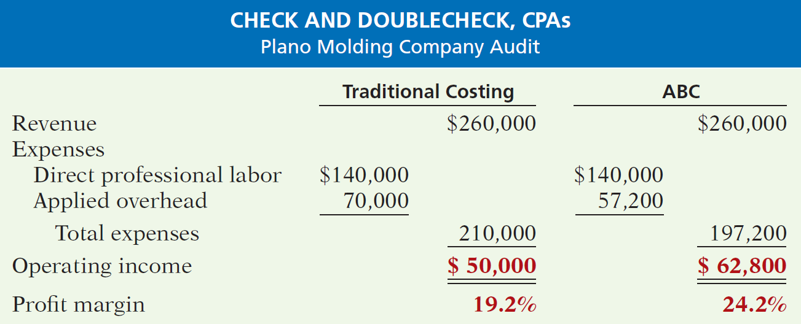
Activity-Based Costing in Service Industries
Activity-Based Costing Example
Comparison of traditional costing with ABC in a service company.

Slide 21

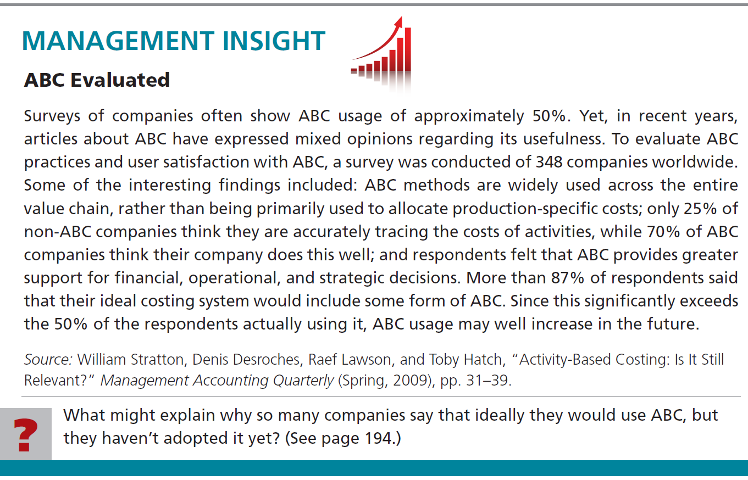

Slide 22
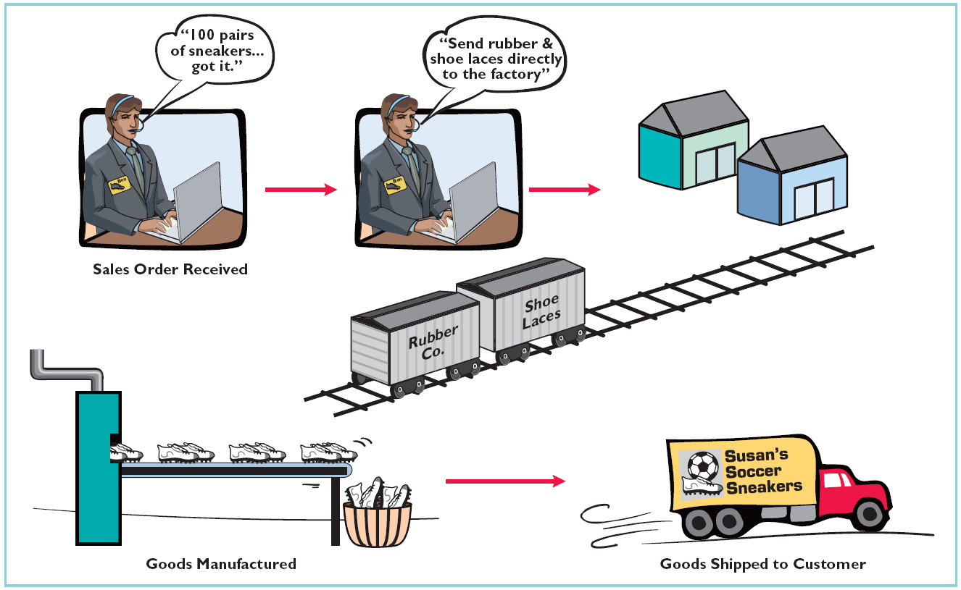
JUST-IN-TIME PROCESSING
.
JIT manufacturing is dedicated to having the right amount of materials, parts, or products just as they are needed.

Slide 23
JUST-IN-TIME PROCESSING
Objective of JIT Processing
To eliminate all manufacturing inventories.
Elements of JIT Processing
Dependable suppliers.
Multiskilled work force.
Total quality control system.

Slide 24
JUST-IN-TIME PROCESSING
Benefits of JIT Processing
Significant reduction or elimination of manufacturing inventories.
Enhanced product quality.
Reduction or elimination of rework costs and inventory storage costs.
Production cost savings from the improved flow of goods through the processes.

Slide 25
The Differences Between ABC and Traditional Product Costs
The traditional cost
system overcosts the
standard stanchions
and reports a lower
product margin
for this product.
The traditional cost
system undercosts the
custom compass
housings and reports
a higher product
margin for this product.
Notes:
The changes in product margins caused by switching from the traditional cost system to the activity-based costing system are as shown. Notice:
The traditional cost system overcosts the standard stanchions, and consequently,
reports an artificially low product margin for this product.
Conversely, the traditional cost system undercosts the custom compass housings,
and consequently, reports an artificially high product margin for this product.

Slide 26
Differences Between ABC and Traditional Product Costs
There are three reasons why the
reported product margins for the two
costing systems differ from one another.
❶Traditional costing allocates all manufacturing
overhead to products. ABC costing only assigns
manufacturing overhead costs consumed by
products to those products.
Notes:
There are three reasons why the reported product margins for the two costing systems differ from one another.
❶ The traditional cost system allocates all manufacturing overhead to products. The
ABC system only assigns manufacturing overhead costs consumed by products to
those products. More specifically, the ABC system does not assign the
manufacturing overhead costs consumed by the customer relations activity to
products because these costs are caused by customers, not specific products. The
ABC system does not assign the manufacturing overhead costs included in the
“other” activity to products because these organization-sustaining and unused
capacity costs are not caused by products.

Slide 27
Differences Between ABC and Traditional Product Costs
There are three reasons why the
reported product margins for the two
costing systems differ from one another.
❷ Traditional costing allocates all manufacturing
overhead costs using a volume-related allocation
base. ABC costing also uses non-volume related
allocation bases.
Notes:
The second reason why the reported product margins for the two costing systems differ from one another is:
❷ The traditional cost system allocates all manufacturing overhead costs using a
volume-related allocation base (machine-hours). The ABC system uses volume-
related and non-volume related allocation bases to assign manufacturing overhead
to products. More specifically, the traditional cost system allocates 87.5% of all
manufacturing overhead to standard stanchions and 12.5% to custom compass
housings. The ABC system assigns 60% and 40% of customer orders activity
cost (a batch-level cost) to standard stanchions and custom compass housings,
respectively. The ABC system assigns 0% and 100% of product design activity
cost (a product-level cost) to standard stanchions and custom compass housings,
respectively.

Slide 28
Differences Between ABC and Traditional Product Costs
There are three reasons why the
reported product margins for the two
costing systems differ from one another.
❸ Traditional costing disregards selling and
administrative expenses because they are
assumed to be period expenses. ABC costing
directly traces shipping costs to products and
includes nonmanufacturing overhead costs caused
by products in the activity cost pools that are
assigned to products.
Notes:
The third reason why the reported product margins for the two costing systems differ from one another is:
❸ The traditional cost system disregards selling and administrative expenses because
they are assumed to be period expenses. The ABC system directly traces shipping
costs to products and includes nonmanufacturing overhead costs caused by
products in the activity cost pools that are assigned to products.

Slide 29

Targeting Process Improvement
Activity-based management is used in conjunction with ABC to identify areas that would benefit from process improvements.
While the theory of constraints approach discussed in Chapter 1
is a powerful tool for targeting improvement efforts, activity rates can also provide valuable clues on where to focus improvement efforts.
Benchmarking can be used to compare activity cost information with world-class standards of performance achieved by other organizations.
Notes:
Activity-based management is used in conjunction with ABC to identify areas that would benefit from process improvement. It involves focusing on activities to eliminate waste, decrease processing time, and reduce defects.
While the theory of constraints approach discussed in Chapter 1 is a powerful tool for targeting process improvement efforts, the activity rates computed in ABC can also provide valuable clues concerning where there is waste and the opportunity for improvement.
Benchmarking can be used to compare an organization’s activity rates with standards of performance that are external to the organization.

Slide 30
Activity-Based Costing and External Reporting
Most companies do not use ABC
for external reporting because . . .
External reports are less detailed than internal reports.
It may be difficult to make changes to the company’s accounting system.
ABC does not conform to GAAP.
Auditors may be suspect of the subjective allocation process based on interviews with employees.
Notes:
There are four reasons why most companies do not use ABC for external reporting purposes:
❶ External reports are less detailed than internal reports in the sense that
individual product costs are not reported. External reports only disclose
cost of goods sold and ending inventory. Therefore, if some products are
undercosted and others are overcosted, the errors tend to cancel each other
out when the product costs are added together.
❷ It is often very difficult to change a company’s accounting system because
it is deeply embedded within complex computer programs that have
evolved over many years.
❸ An ABC system, such as the one described in the chapter, does not conform
to generally accepted accounting principles (GAAP). It excluded some
organization-sustaining manufacturing costs and it included some
nonmanufacturing costs in its product cost calculations. These cost system
design attributes do not comply with GAAP.
❹ Auditors are likely to be uncomfortable with cost allocations that are based
upon interviews with the company’s personnel. This type of subjective data
can be easily manipulated by management.

Slide 31

ABC Limitations
Substantial resources
required to implement
and maintain.
Resistance to
unfamiliar numbers
and reports.
Desire to fully
allocate all costs
to products.
Potential
misinterpretation of
unfamiliar numbers.
Does not conform to
GAAP. Two costing
systems may be needed.
Notes:
There are five limitations of activity-based costing:
❶ Implementing an ABC system requires substantial resources. The benefits
of increased cost accuracy may not outweigh the implementation costs.
❷ ABC systems produce numbers, such as product margins, that are at odds
with the numbers produced by traditional cost systems. Managers are not
accustomed to managing their operations using these numbers; hence,
ABC inevitably faces resistance. This underscores the importance of
having top management support for and cross-functional involvement with
the ABC implementation.
❸ In practice, most managers insist on fully allocating all costs to products.
The ABC system described in the main portion of this chapter does not
conform to this preference.
❹ ABC systems do not automatically identify the relevant costs for particular
decisions; therefore, ABC data can be easily misinterpreted and must be
used with care when making decisions. Costs assigned to products,
customers, and other cost objects are only potentially relevant.
❺ Most organizations use ABC as a supplement to rather a replacement for
their existing cost system. Maintaining two cost systems is costlier than
maintaining just one system and it may cause confusion about which set of
numbers is to be relied on.

Slide 32
ABC Action Analysis
Conventional ABC analysis does not identify potentially relevant costs. An action analysis report helps because it:
  Shows what costs have been
  assigned to a cost object.
  Indicates how difficult it would be to
  adjust those costs in response to
  changes in the level of activity.
Notes:
A conventional ABC analysis does not identify potentially relevant costs. An action analysis report can help in this regard because it shows what costs have been assigned to a cost object and it indicates how difficult it would be to adjust those costs in response to changes in the level of activity.

Slide 33
ABC Action Analysis
Constructing an action analysis report begins with the first-stage allocation process. In addition to computing an overall activity rate for each activity cost pool, an activity rate is computed for each type of overhead cost that is consumed supporting a given activity.
Let’s revisit the stage-one allocations
from the Classic Brass example that we
discussed earlier.
Notes:
Constructing an action analysis report begins with the first-stage allocation process. In addition to computing an overall activity rate for each activity cost pool, an activity rate is computed for each type of overhead cost that is consumed supporting a given activity.
Let’s revisit the stage-one allocations from the Classic Brass example that we discussed earlier in the chapter.

Slide 34
ABC Action Analysis
$125,000 ÷ 1,000 orders = $125 per order
Other entries in the table are computed similarly.
Notes:
Part I.
Rather than computing one activity rate for each activity cost pool as was done previously (see the bottom of the slide for these rates), an activity rate is computed for each type overhead cost (or for each cell in the matrix).
Part II.
For example, the customer orders activity has six activity rates that sum to the total of $320 from the conventional ABC analysis.

Slide 35
ABC Action Analysis
$125 per order × 600 orders = $75,000
Other entries in the table are computed similarly.
Notes:
The second-stage allocation process requires assigning product costs by each type of overhead cost. In the Classic Brass illustration, there are, for example, six activity cost assignments from the customer orders activity to the standard stanchions. These six assignments total $192,000 as in the conventional ABC analysis.
Notice, the total ABC costs assigned to standard stanchions are $524,500, which is the same as in the conventional ABC analysis.

Slide 36
ABC Action Analysis
$125 per order × 400 orders = $50,000
Other entries in the table are computed similarly.
Notes:
As another example, there are four assignments from the product design activity to the custom compass housings. These four assignments total $252,000 as in the conventional ABC analysis.
Notice, the total ABC costs assigned to the custom compass housings is $427,500, which is the same as in the conventional ABC analysis.

Slide 37
ABC Action Analysis
Next, label each cost using an ease of adjustment code:
Green costs adjust more or less automatically to
changes in activity level without any action by
managers.
Yellow costs can be adjusted to changes in activity
level, but it would require management action to
realize the change in cost.
Red costs can be adjusted to changes in activity
level only with a great deal difficulty and with
management intervention.
Notes:
The next step in preparing an action analysis report is to label each cost using an ease of adjustment code. Green costs adjust more or less automatically to changes in activity level without any action by managers. For example, direct materials cost would automatically change in response to changes in activity level without management action.
Yellow costs can be adjusted to changes in activity level, but it would require management action to realize the change in cost. For example, direct and indirect labor may be classified as yellow costs because management action would be required to hire or layoff employees.
Red costs can be adjusted to changes in activity level only with a great deal difficulty and with management intervention. For example, a factory building lease would be a red cost because it would be very difficult and expensive to break the lease.

Slide 38
ABC Action Analysis
Notes:
The last step is to calculate green, yellow, and red margins. For example, the green, yellow, and red margins for the custom compass housing would be $465,500, $(3,000), and $(49,500), respectively.
In this example, before managers would decide to eliminate the custom compass product line, they would need to commit to taking management action where required to reduce costs or redeploy resources.

Slide 39
Modified Activity Based Costing: Example
A modified form of activity-based
costing can be used to develop product
costs for external financial reports.
ABC product costs:
Include organization-sustaining costs
and unused capacity costs.
Exclude nonmanufacturing costs even
if they are caused by the products.
Notes:
A modified form of activity-based costing can be used to develop product costs for external financial reports. With this approach, ABC:
Includes all manufacturing costs, such as organization-sustaining costs and
unused capacity costs, in product costs.
Excludes all nonmanufacturing costs even if they are clearly caused by the
products.

Slide 40
Modified Activity Based Costing: Example
Maxtar Industries provides the following information
for the company as a whole and for its only two
products—premium and standard smoker/barbecue units.
Notes:
Maxtar Industries – a traditional approach
Assume the following information for the company as a whole and for its only two products—premium and standard smoker/barbecue units.

Slide 41
Modified Activity Based Costing: Example
Assuming that Maxtar’s traditional cost system relies on one predetermined plantwide overhead rate with direct labor-hours (DLHs) as the allocation base, then its plantwide overhead rate is computed as follows:
Predetermined
overhead rate
$1,520,000
400,000 DLHs
=
= $3.80 per DLH
Notes:
If we assume that Maxtar’s traditional cost system relies on one predetermined plantwide overhead rate with direct labor-hours as the allocation base, then its plantwide overhead rate ($3.80 per direct labor-hour) would be computed as shown.

Slide 42
Modified Activity Based Costing: Example
Maxtar’s traditional cost system would
report unit product costs as follows:
2.0 DLH × $3.80 per DLH
1.5 DLH × $3.80 per DLH
Notes:
Maxtar’s traditional cost system would report unit product costs as shown. Notice:
The premium product line is assigned $7.60 of overhead cost per unit
(2.0 DLH × $3.80 per hour).
The standard product line is assigned $5.70 of overhead cost per unit
(1.5 DLH × $3.80 per hour).

Slide 43
Modified Activity Based Costing: Example
The ABC project team at Maxtar has
developed the following basic information.
Notes:
Assume that Maxtar assigned its $1,520,000 of manufacturing overhead costs to three activities with expected activity levels as shown.

Slide 44
Modified Activity Based Costing: Example
We can calculate the following activity rates:
Using the new activity rates, let’s assign overhead
to the two products based upon expected activity.
Notes:
The activity rates for each of the three activities would be computed as shown.

Slide 45
Modified Activity Based Costing: Example
Premium Product
Standard Product
Notes:
The overhead cost assignments to the premium and standard product lines are computed as shown. Notice that all manufacturing overhead has been assigned to products ($728,000 + $792,000 = $1,520,000).

Slide 46
Modified Activity Based Costing: Example
Activity-based unit product costs for both product lines
Notes:
The activity-based unit product costs for both product lines would be computed as shown.

Slide 47
Modified Activity Based Costing: Example
Activity-based unit product costs for both product lines
$728,000 ÷ 50,000 units
$792,000 ÷ 200,000 units
Notes:
The manufacturing overhead per unit for both products is computed by taking the total overhead assigned to that product and dividing it by the number of units produced.

Slide 48
Modified Activity Based Costing: Example
Comparing the two approaches
Note that the unit product cost of a Standard unit
decreased from $53.70 to $51.96 . . . . .
. . . . . while the unit cost of a Premium unit increased from $71.60 to $78.56.
Notes:
Maxtar Industries – comparing the two approaches
The difference in unit product costs between the two methods is as shown. Notice, the ABC unit product cost for the premium (standard) product line is higher (lower) than what was computed using the traditional cost system. This is because:
The ABC system contains two non-volume-related cost pools—“setting up machines,” which is a batch-level activity and “parts administration,” which is a product-level activity.
The ABC system accurately assigned these costs to products in a way that shifted costs from the high volume product (standard) to the low volume product (premium).

Slide 49
End of Lecture 8

