Slide 1
Chapter 5
Lecture 7
Activity Based Costing and Activity based Management
Readings
Chapter 5,Cost Accounting, Managerial Emphasis, 14th edition by Horengren
Chapter 4, Managerial Accounting 6th edition by Weygandt, kimmel, kieso
Chapter 8, Managerial Accounting 12th edition by Garrison, Noreen, Brewer

Slide 2
Activity-Based Costing
Learning Objectives
After studying this chapter, you should be able to:
[1] Recognize the difference between traditional costing and activity-based costing.
[2] Identify the steps in the development of an activity-based costing system.
[3] Know how companies identify the activity cost pools used in activity-based costing.
[4] Know how companies identify and use cost drivers in activity-based costing.
[5] Understand the benefits and limitations of activity-based costing.
[6] Differentiate between value-added and non–value added activities.
[7] Understand the value of using activity levels in activity-based costing.
[8] Apply activity-based costing to service industries.

Slide 3
Background
Recall that Factory Overhead is applied to production in a rational systematic manner, using some type of averaging. There are a variety of methods to accomplish this goal.
These methods often involve tradeoffs between simplicity and realism
Simple Methods Complex Methods
Unrealistic Realistic

Slide 4
Broad Averaging
Historically, firms produced a limited variety of goods while their indirect costs were relatively small.
Allocating overhead costs was simple: use broad averages to allocate costs uniformly regardless of how they are actually incurred
  Peanut-butter Costing
The end-result: overcosting & undercosting

Slide 5
Over & Undercosting
Overcosting – a product consumes a low level of resources but is allocated high costs per unit
Undercosting – a product consumes a high level of resources but is allocated low costs per unit

Slide 6
Cross-subsidization
The results of overcosting one product and undercosting another.
The overcosted product absorbs too much cost, making it seem less profitable than it really is
The undercosted product is left with too little cost, making it seem more profitable than it really is

Slide 7
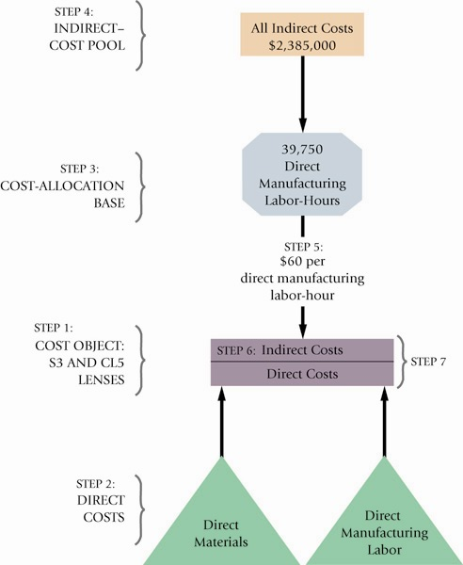
An Example:
Plastim

Slide 8
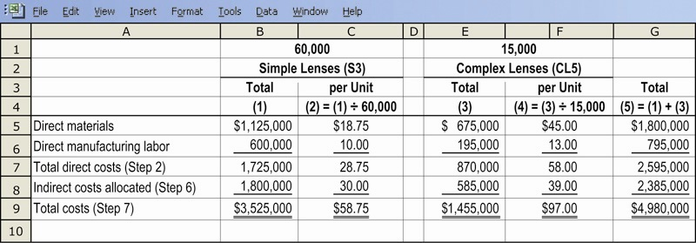
Plastim & Simple Costing

Slide 9
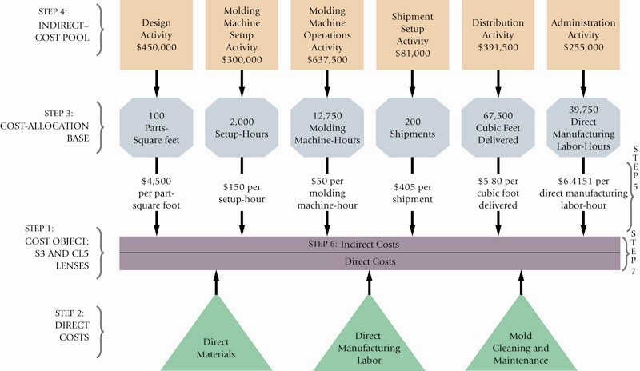
Plastim and ABC Illustrated

Slide 10
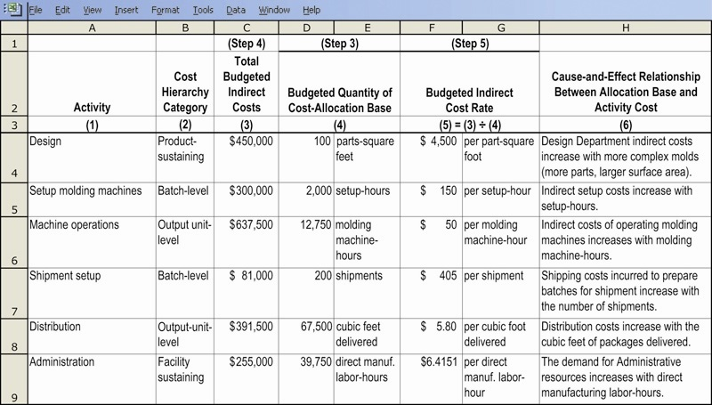
Plastim and ABC Rate Calculation

Slide 11
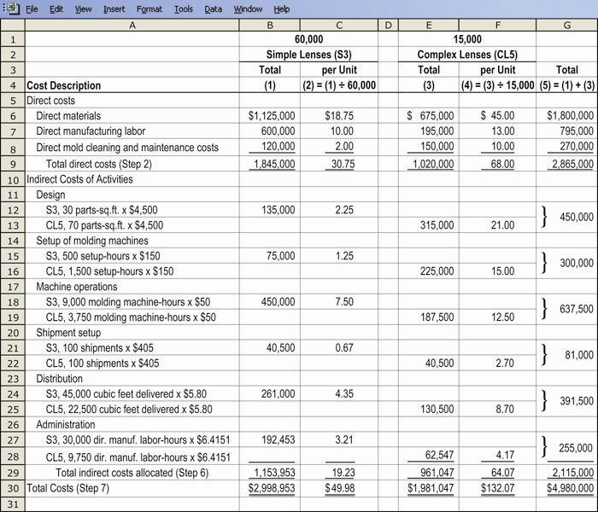
Plastim and ABC Product Costs

Slide 12
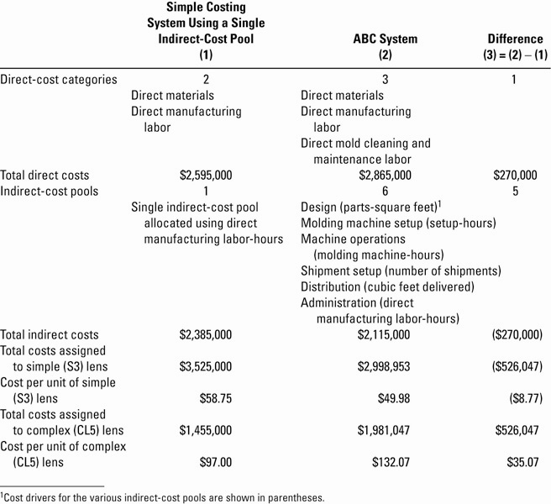
Plastim: Simple & ABC Compared

Slide 13
Conclusions
Each method is mathematically correct
Each method is acceptable
Each method yields a different cost figure, which will lead to different Gross Margin calculations
Only Overhead is involved. Total Costs for the entire firm remain the same – they are just allocated to different cost objects within the firm
Selection of the appropriate method and drivers should be based on experience, industry practices, as well as a cost-benefit analysis of each option under consideration

Slide 14
A Cautionary Tale
A number of critical decisions can be made using this information;
  Should one product be “pushed” over another?
  Should one product be dropped?
Accounting for overhead costs is an imprecise science. Accordingly, best efforts should be put forward to arrive at a cost that is fair and reasonable.

Slide 15
Rationale for selecting a more refined costing system
Increase in product diversity
Increase in Indirect Costs
Advances in information technology
Competition in foreign markets

Slide 16
Cost Hierarchies
ABC uses a four-level cost structure to determine how far down the production cycle costs should be pushed:
  Unit-level (output-level)
  Batch-level
  Product-sustaining-level
  Facility-sustaining-level

Slide 17
ABC vs. Simple Costing Schemes
ABC is generally perceived to produce superior costing figures due to the use of multiple drivers across multiple levels
ABC is only as good as the drivers selected, and their actual relationship to costs. Poorly chosen drivers will produce inaccurate costs, even with ABC

Slide 18
Activity-Based Management
A method of management that used ABC as an integral part in critical decision-making situations, including:
  Pricing & product-mix decisions
  Cost reduction & process improvement decisions
  Design decisions
  Planning & managing activities

Slide 19
Signals that suggest that ABC implementation could help a firm:
Significant overhead costs allocated using one or two cost pools
Most or all overhead is considered unit-level
Products that consume different amounts of resources
Products that a firm should successfully make and sell consistently show small profits
Operations staff disagreeing with accounting over manufacturing and marketing costs

Slide 20
ABC and Service / Merchandising Firms
ABC implementation is widespread in a variety of applications outside manufacturing, including:
  Health Care
  Banking
  Telecommunications
  Retailing
  Transportation

Slide 21
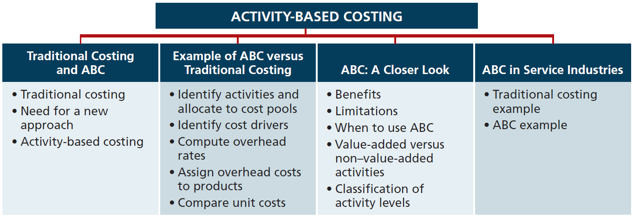

Slide 22
Traditional Costing and Activity-Based Costing
Traditional Costing Systems
  Allocates overhead using a single predetermined rate.
    Job order costing: direct labor cost may be the relevant activity base.
    Process costing: machine hours may be the relevant activity base.
  Assumption was satisfactory when direct labor was a major portion of total manufacturing costs.
    Wide acceptance of a high correlation between direct labor and overhead costs.

Slide 23
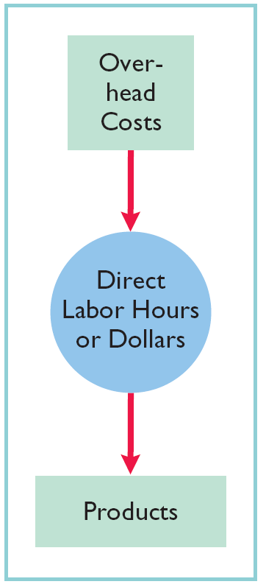
Traditional Costing and Activity-Based Costing
The Need for a New Approach
  Tremendous change in manufacturing and service industries.
  Decrease in amount of direct labor usage.
  Significant increase in total overhead costs.
  Inappropriate to use plant-wide predetermined overhead rates when a lack of correlation exists.
  Complex manufacturing processes may require multiple allocation bases; this approach is called Activity-Based Costing (ABC).

Slide 24
Traditional Costing and Activity-Based Costing
Activity-Based Costing
  Allocates overhead to multiple activity cost pools and
  Assigns the activity cost pools to products or services by means of cost drivers.

Slide 25
Traditional Costing and Activity-Based Costing
Activity-Based Costing
  Activity: any event, action, transaction, or work sequence that causes a cost to be incurred in producing a product or providing a service.
  Activity Cost Pool: a distinct type of activity. For example: ordering materials or setting up machines.
  Cost Drivers: any factors or activities that have a direct cause-effect relationship with the resources consumed.

Slide 26
Traditional Costing and Activity-Based Costing
Activity-Based Costing
  ABC allocates overhead costs in two stages:
Stage 1: Overhead costs are allocated to activity cost pools.
Stage 2: Assigns overhead allocated to the activity cost pools to products, using cost drivers.
  The more complex a product’s manufacturing operation, the more activities and cost drivers are likely to be present.

Slide 27
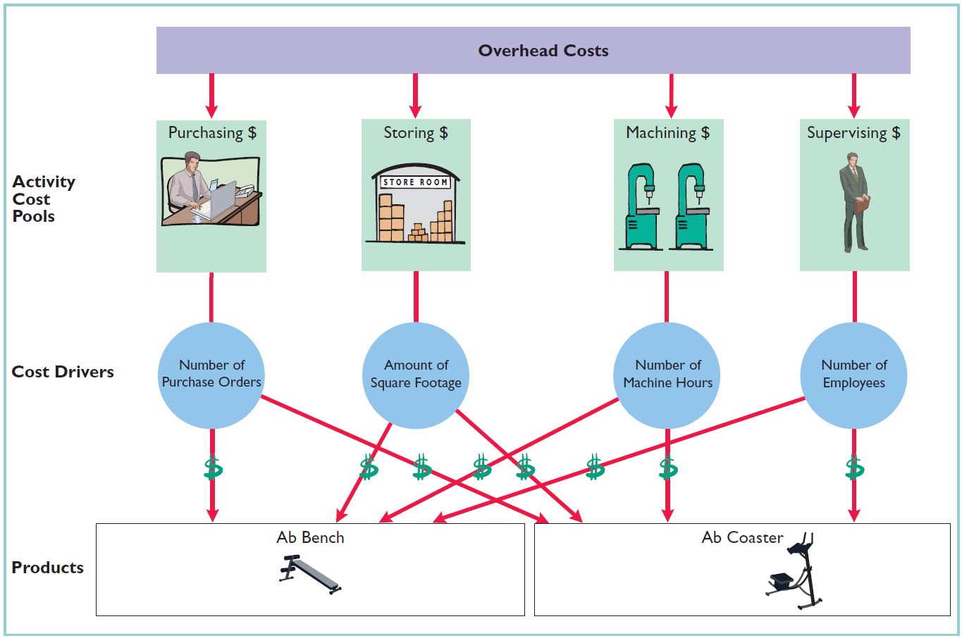
Traditional Costing and Activity-Based Costing
Activity-Based Costing

Slide 28
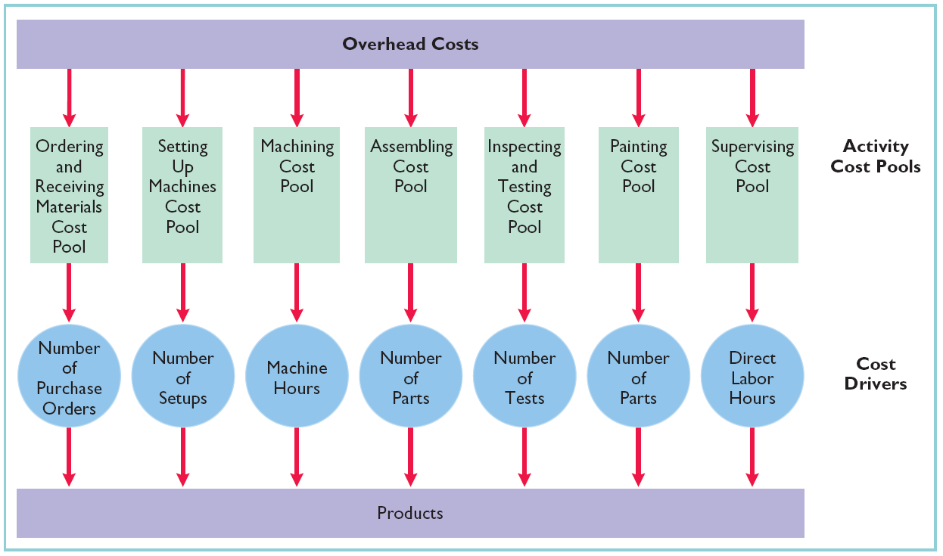
Traditional Costing and Activity-Based Costing
Activity-Based Costing

Slide 29
Indicate whether the following statements are true or false.
A traditional costing system allocates overhead by means of multiple overhead rates.
Activity-based costing allocates overhead costs in a two-stage process.
Direct material and direct labor costs are easier to trace to products than overhead.
As manufacturing processes have become more automated, more companies have chosen to allocate overhead on the basis of direct labor costs.
In activity-based costing, an activity is any event, action, transaction, or work sequence that incurs cost when producing a product.
Solution: 1. false. 2. true. 3. true. 4. false. 5. true.

Slide 30
Example of ABC Versus Traditional Costing
Activity-Based Costing
Involves the following four steps.
  Identify and classify the activities involved in the manufacture of specific products, and allocate overhead to cost pools.
  Identify the cost driver that has a strong correlation to the costs accumulated in the cost pool.
  Compute the activity-based overhead rate for each cost driver.
  Assign overhead costs to products, using the overhead rates determined for each cost pool (cost per driver).

Slide 31
Example of ABC Versus Traditional Costing
Illustration:
Atlas Company produces two products (abdominal trainers):
  Ab Bench: a high volume item with sales totaling 25,000 units annually.
  Ab Coaster: a low volume item with sales totaling 5,000 units annually.
Each product requires 1 hour of direct labor.
  Total annual direct labor hours (DLH) 30,000 (25,000 + 5,000)
  Direct labor cost $12 per unit for each product
Expected annual manufacturing overhead costs $900,000.
Direct materials cost:
  Ab Bench - $40 per unit
  Ab Coaster - $30 per unit
Required: Calculate unit costs under ABC.

Slide 32
Example of ABC Versus Traditional Costing
Illustration:
Manufacturing costs
Ab Bench
Ab Coaster
Direct materials
$40
$30
Direct labor
12
12
Overhead
30
30
Total unit cost
$82
$72
* Overhead rate = $900,000/30,000 DLH = $30 per DLH
Overhead = ($30 X 1 hr. = $30)

Slide 33
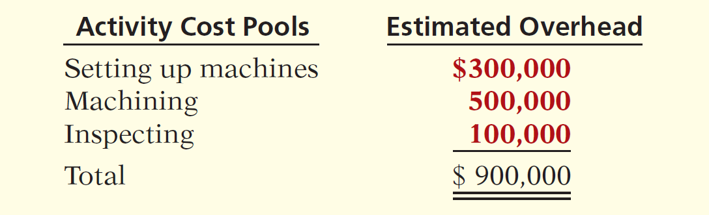
Example of ABC Versus Traditional Costing
Identify and Classify Activities and Allocate
Overhead to Cost Pools (Step 1)
Overhead costs are assigned directly to the appropriate activity cost pool.

Slide 34
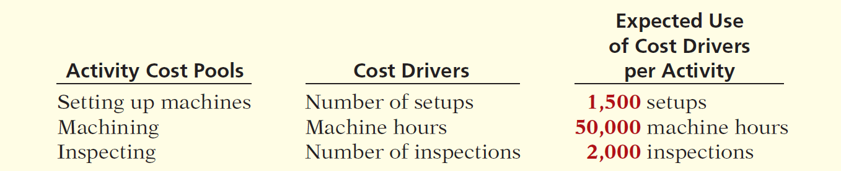
Example of ABC Versus Traditional Costing
Identify Cost Drivers (Step 2)
Cost driver must accurately measure the actual consumption of the activity by the various products.

Slide 35
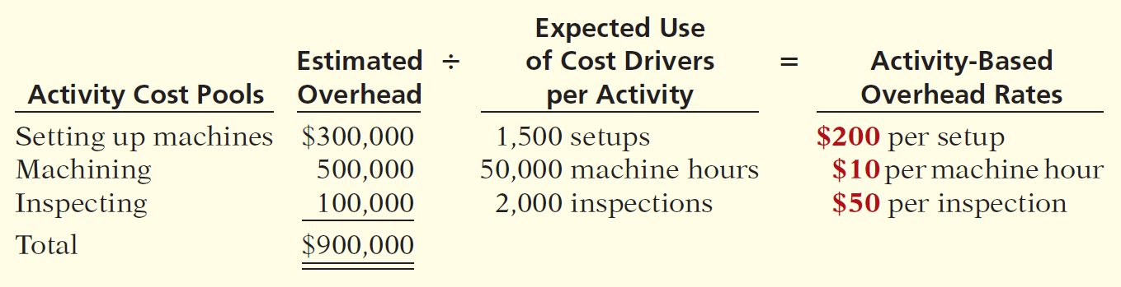
Example of ABC Versus Traditional Costing
Compute Overhead Rates (Step 3)
Next, the company computes an activity-based overhead rate per cost driver.
Illustration 4-7
LO4 Know how companies identify and use cost drivers in activity-based costing.

Slide 36
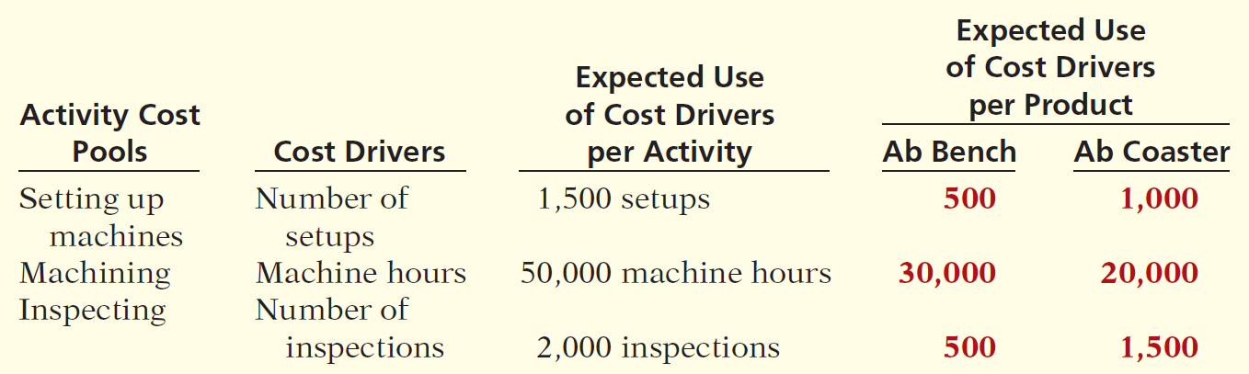
Example of ABC Versus Traditional Costing
Assign Overhead Cost to Products (Step 4)
In assigning overhead costs, it is necessary to know the expected use of cost drivers for each product. Because of its low volume, Ab Coaster requires more set-ups and inspections than Ab Bench.
Illustration 4-8

Slide 37
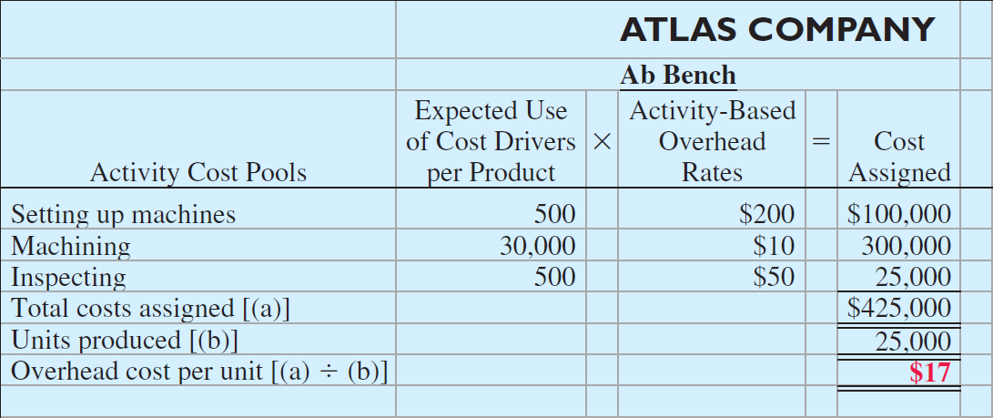
Example of ABC Versus Traditional Costing
Assign Overhead Cost to Products (Step 4)
To assign overhead costs, Atlas multiplies the activity-based overhead rates per cost driver (Ill. 4-7) by the number of cost drivers expected to be used per product (Ill. 4-8).

Slide 38
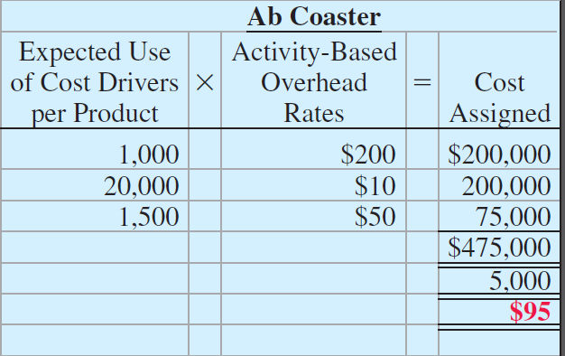
Example of ABC Versus Traditional Costing
Assign Overhead Cost to Products (Step 4)
To assign overhead costs, Atlas multiplies the activity-based overhead rates per cost driver by the number of cost drivers expected to be used per product .

Slide 39
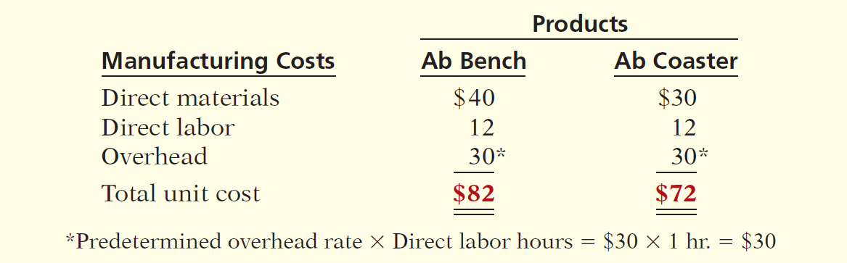
Example of ABC Versus Traditional Costing
Comparing Unit Costs
  A likely consequence of the differences in assigning overhead is
  that Atlas has been overpricing the Ab Bench and possibly losing market share to competitors. It also has been sacrificing profitability by underpricing the Ab Coaster.

Slide 40
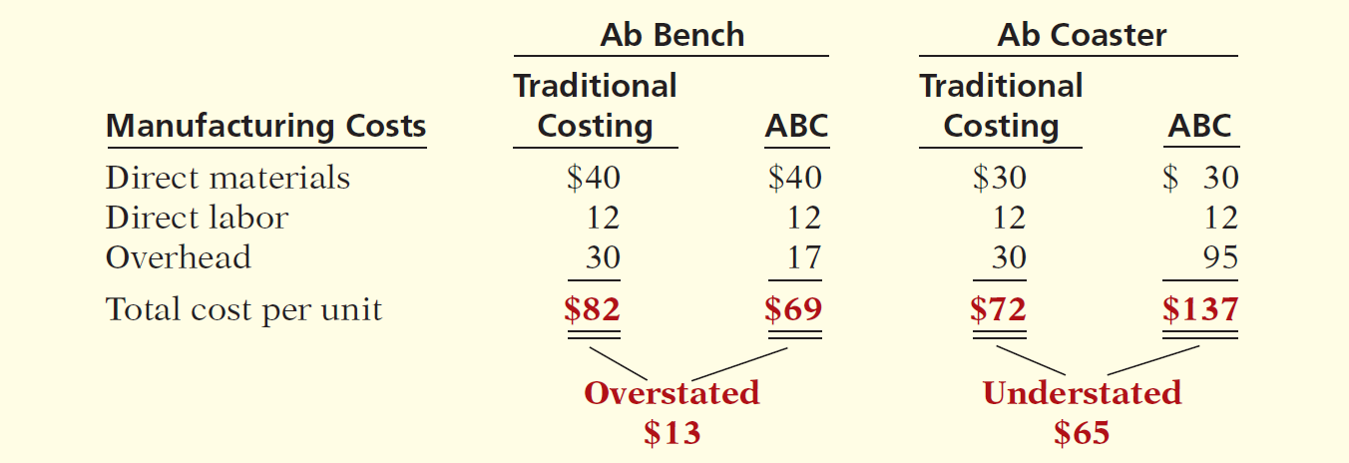
Example of ABC Versus Traditional Costing
Comparing Unit Costs

Slide 41
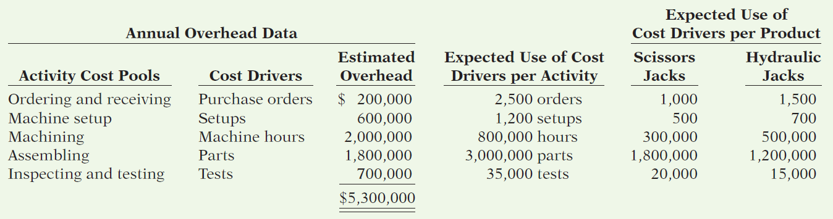
Casey Company has five activity cost pools and two products. It expects to produce 200,000 units of its automobile scissors jack and 80,000 units of its truck hydraulic jack. Having identified its activity cost pools and the cost drivers for each cost pool, Casey Company accumulated the following data relative to those activity cost pools and cost drivers.

Slide 42
Casey Company has five activity cost pools and two products. It expects to produce 200,000 units of its automobile scissors jack and 80,000 units of its truck hydraulic jack. Having identified its activity cost pools and the cost drivers for each cost pool, Casey Company accumulated the following data relative to those activity cost pools and cost drivers.
Using the above data, do the following.
  Prepare a schedule showing the computations of the activity-based overhead rates per cost driver.
  Prepare a schedule assigning each activity’s overhead cost to the two products.
  Compute the overhead cost per unit for each product.
  Comment on the comparative overhead cost per unit.

Slide 43
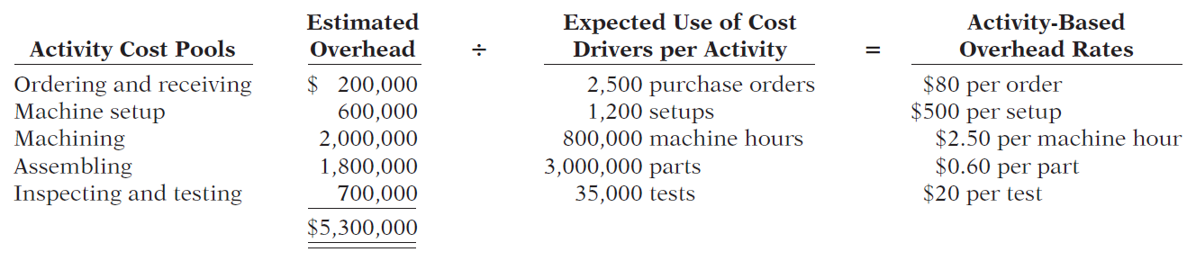
Prepare a schedule showing the computations of the activity-based overhead rates per cost driver.

Slide 44
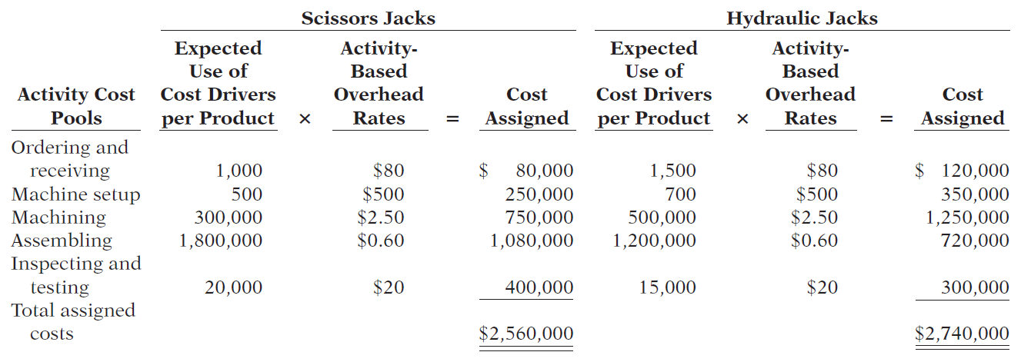
  Prepare a schedule assigning each activity’s overhead cost to the two products.

Slide 45
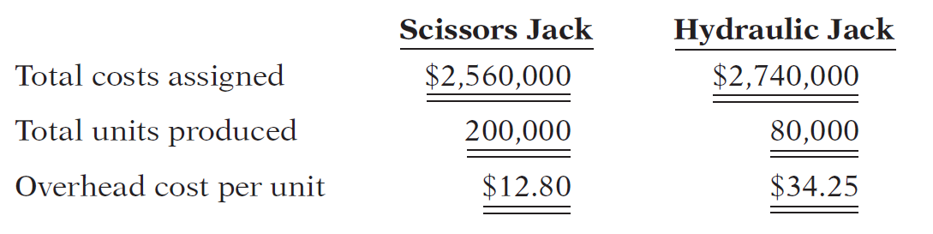
  c. Compute the overhead cost per unit for each product.
  d. Comment on the comparative overhead cost per unit.
These data show that the total overhead assigned to 80,000 hydraulic jacks exceeds the overhead assigned to 200,000 scissors jacks. The overhead cost per hydraulic jack is $34.25. It is only $12.80 per scissors jack.

Slide 46

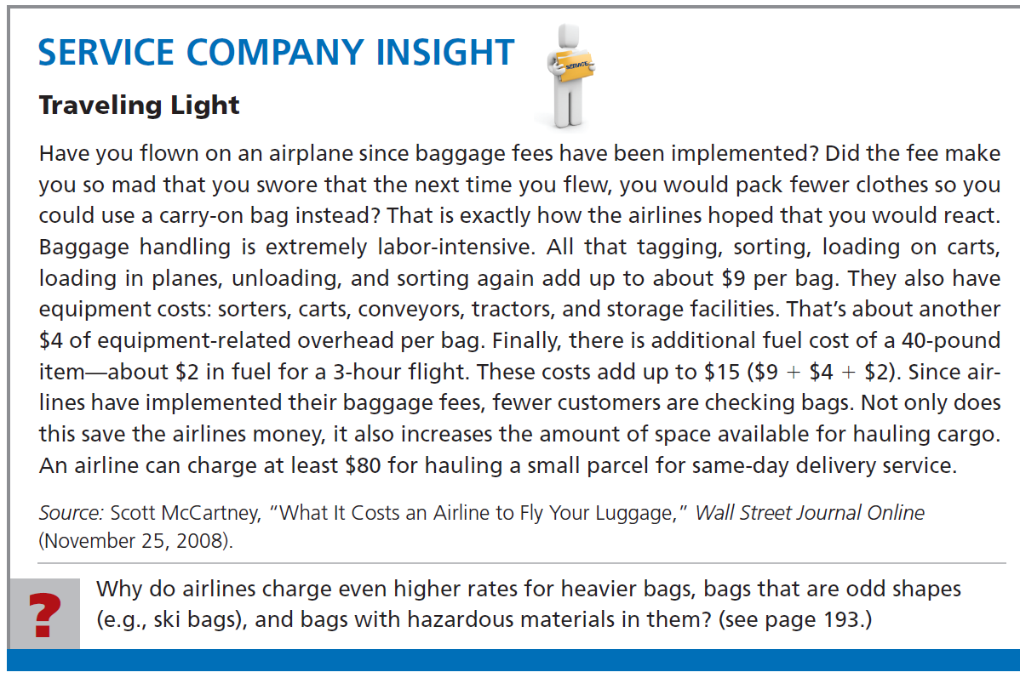

Slide 47
End of Lecture 7

