Slide 1
Chapter 4-Continued
Lecture 6
Job Costing

Slide 2
Job Order Cost Flow
Assigning Manufacturing Costs to Work in Process
Manufacturing costs are assigned to Work in Process with
Debits to Work in Process Inventory
Credits to Raw Materials Inventory
Factory Labor
Manufacturing Overhead

Slide 3
Job Order Cost Flow
Job Cost Sheet
  Used to record costs chargeable to specific jobs.
  Constitutes the subsidiary ledger for the work in process account.
  Each entry to a Work in Process Inventory must be accompanied by a corresponding posting to one or more job cost sheets.

Slide 4
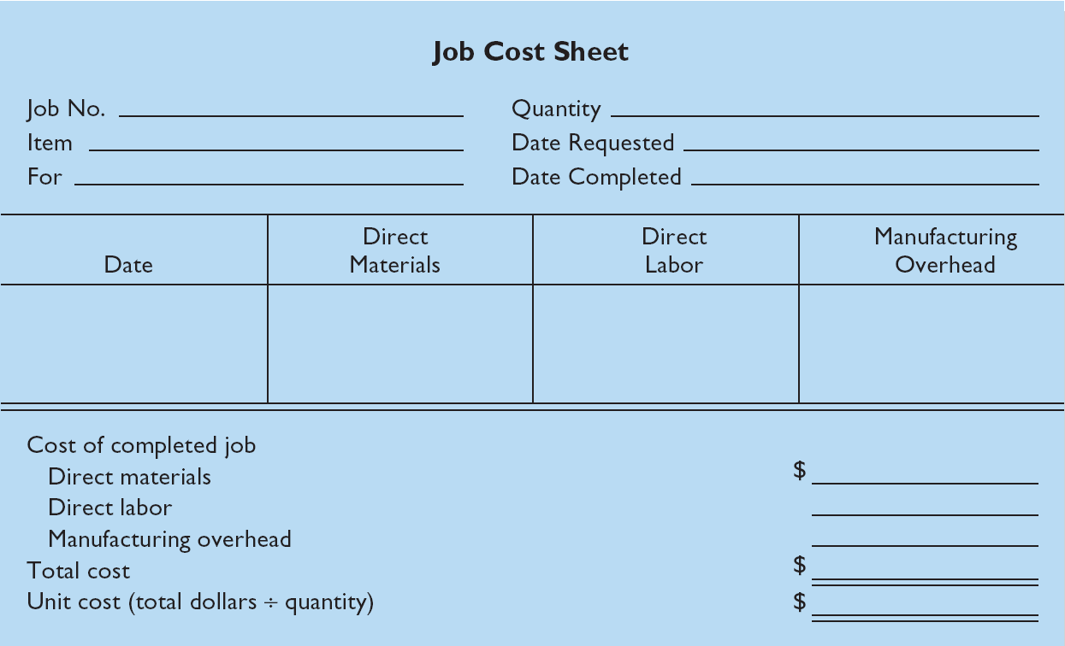
Job Order Cost Flow

Slide 5
Job Order Cost Flow
Assigning Manufacturing Costs to WIP
Raw Material Costs
  Assigned to a job when materials are issued
  Materials requisition slip
    Written authorization for issuing raw materials.
    May be directly issued to use on a job - direct materials.
    May be considered indirect materials – part of manufacturing overhead.

Slide 6
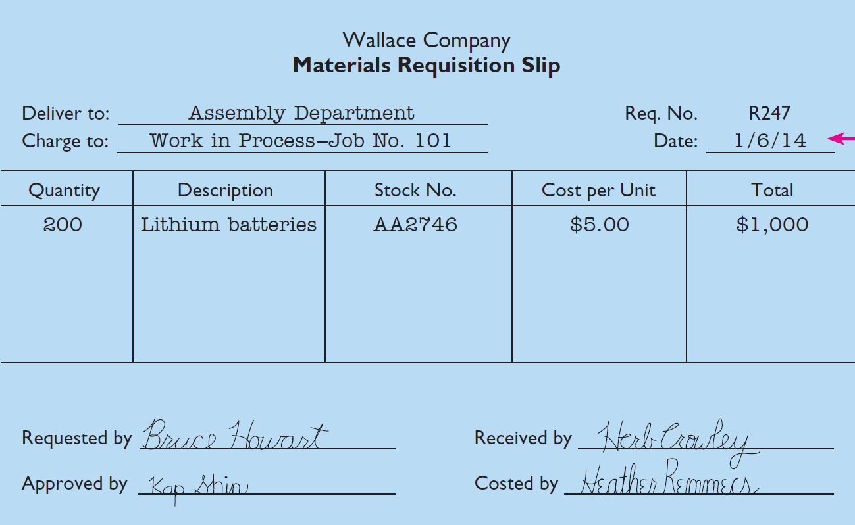
Job Order Cost Flow

Slide 7
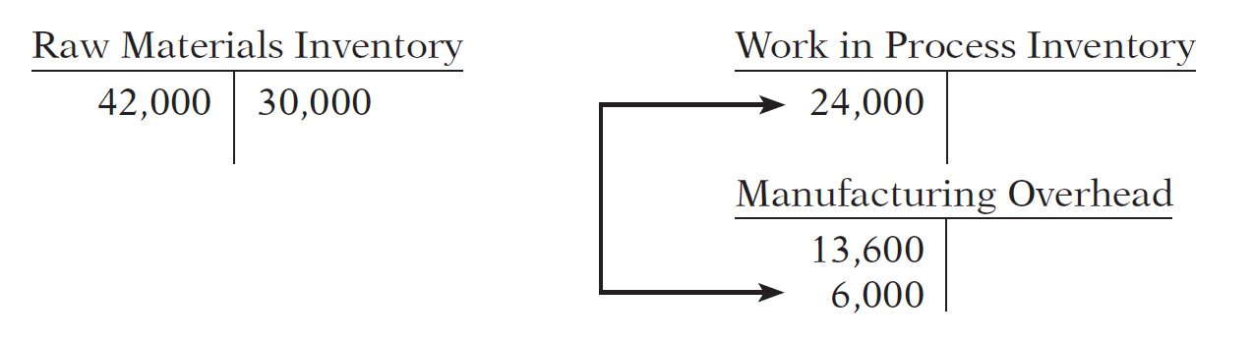
Job Order Cost Flow
Assigning Raw Material Costs
Illustration: Wallace uses $24,000 of direct materials and $6,000 of indirect materials in January, the entry is:
Jan. 31 Work in Process Inventory 24,000
Manufacturing Overhead 6,000
Raw Materials Inventory 30,000

Slide 8
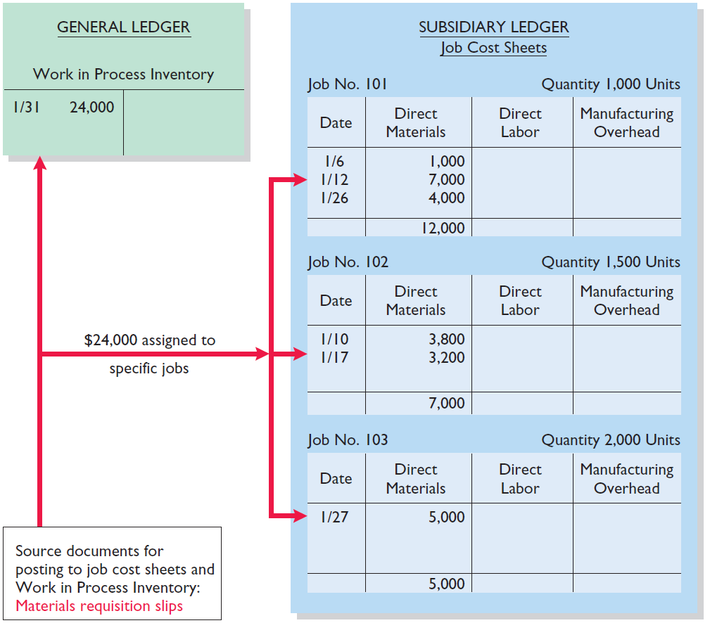
Job Order Cost Flow
Assigning Raw Materials Cost
The sum of the direct materials columns of the job cost sheets should equal the direct materials debited to Work in Process Inventory.

Slide 9
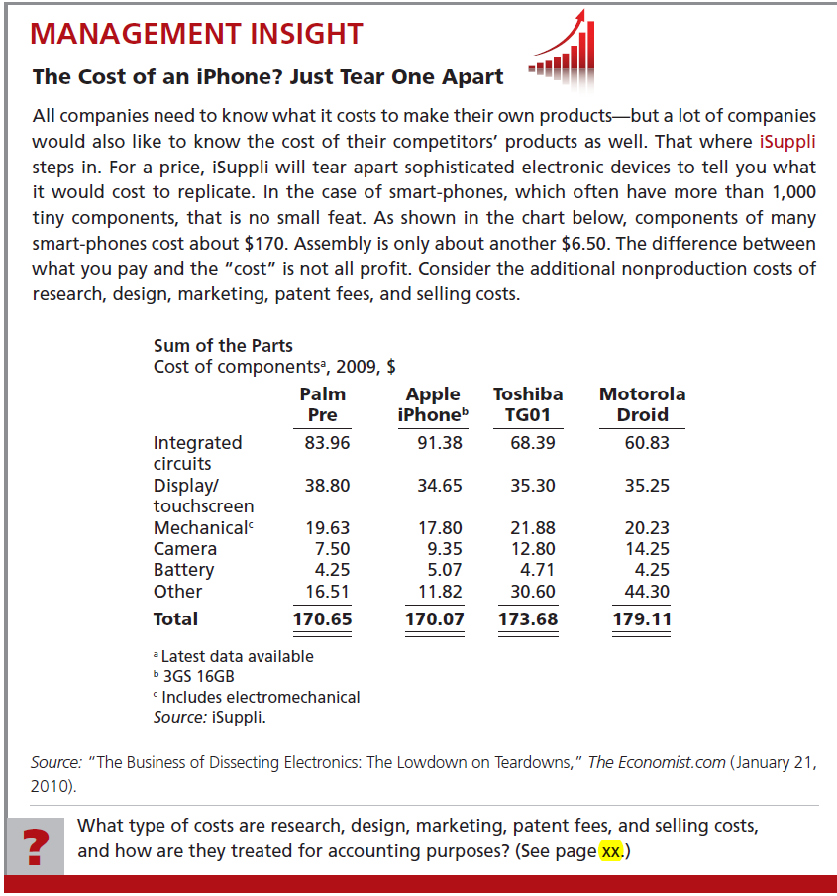
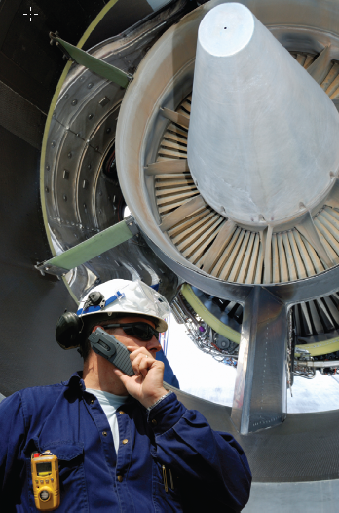

Slide 10
Job Order Cost Flow
Factory Labor Costs
  Assigned to jobs on the basis of time tickets
  Time tickets are prepared when the work is performed
  Time tickets indicate
    Employee
    Hours worked
    Account and job charged
    Total labor cost

Slide 11
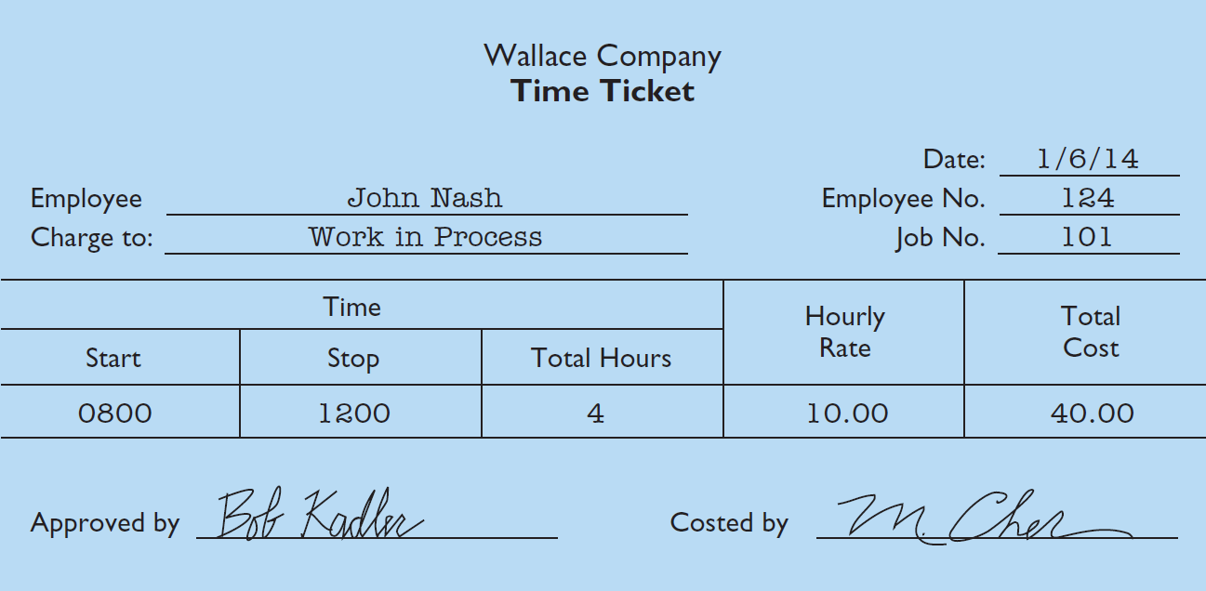
Job Order Cost Flow

Slide 12
Job Order Cost Flow
Factory Labor Costs
Illustration: The time tickets are later sent to the payroll department, which applies the employee’s hourly wage rate and computes the total labor cost. If the $32,000 total factory labor cost consists of $28,000 of direct labor and $4,000 of indirect labor, the entry is:
Jan. 31 Work in Process Inventory 28,000
Manufacturing Overhead 4,000
Factory Labor 32,000

Slide 13
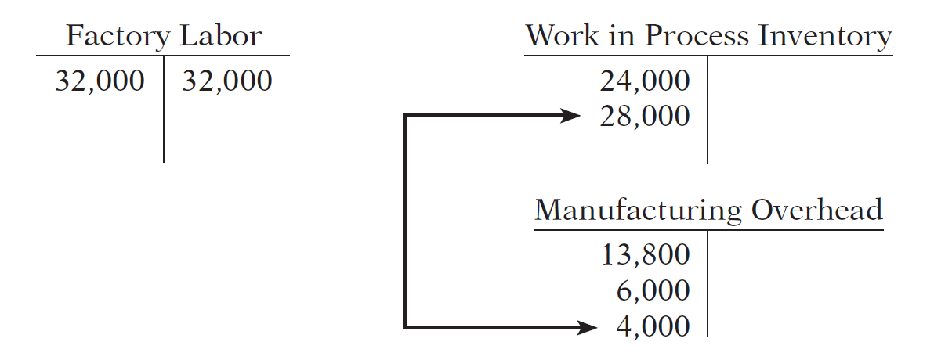
Job Order Cost Flow
Factory Labor Costs
Jan. 31 Work in Process Inventory 28,000
Manufacturing Overhead 4,000
Factory Labor 32,000

Slide 14
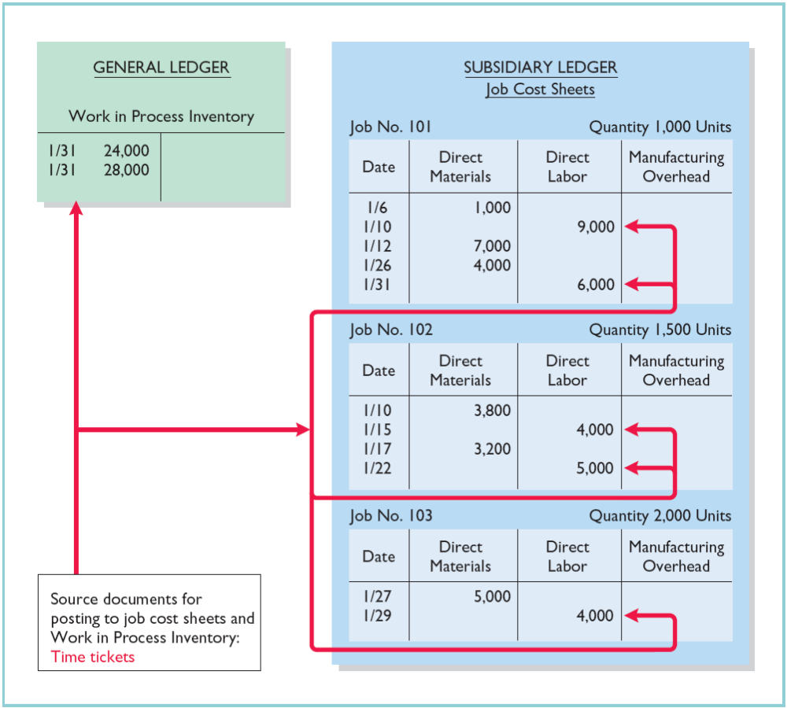
Job Order Cost Flow
Job Cost Sheets – Direct Labor
The sum of the direct labor columns of the job cost sheets should equal the direct labor debited to Work in Process Inventory.

Slide 15
Job Order Cost Flow
Review Question
The source documents for assigning material and factory labor costs to job cost sheets are:
a. Invoices and time tickets.
b. Invoices and payroll register.
c. Materials requisition slips and payroll register.
d. Materials requisition slips and time tickets.

Slide 16
Job Order Cost Flow
Manufacturing Overhead Costs
  Relates to production operations as a whole.
  Cannot be assigned to specific jobs based on actual costs incurred.
  Companies assign to work in process and to specific jobs on an estimated basis through the use of a …
Predetermined Overhead Rate

Slide 17
Job Order Cost Flow
Predetermined Overhead Rate
  Based on the relationship between estimated annual overhead costs and expected annual operating activity
  Expressed in terms of an activity base such as
    Direct labor costs
    Direct labor hours
    Machine hours
    Any other activity that is an equitable base for applying overhead costs to jobs

Slide 18
Job Order Cost Flow
Predetermined Overhead Rate
  Established at the beginning of the year.
  May use a single, company-wide predetermined rate.
  May use a different rate for each department and each department may have a different activity base.
  Formula for computing the predetermined rate overhead rate is

Slide 19
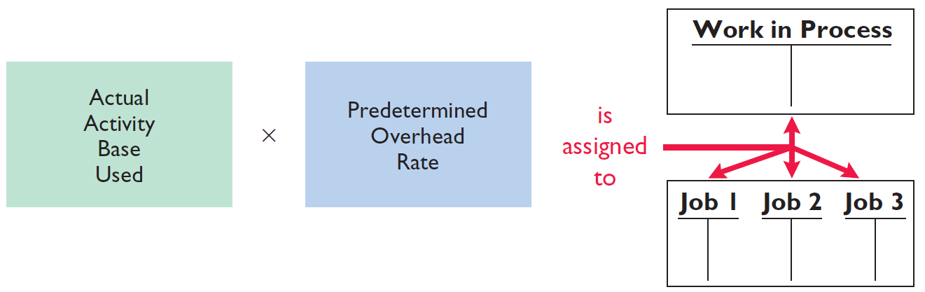
Job Order Cost Flow
Manufacturing Overhead Costs
Assigned to Work in Process during the period to get timely information about the cost of a completed job.
Illustration 2-10

Slide 20

Job Order Cost Flow
Manufacturing Overhead Costs
Illustration: Wallace uses direct labor cost as the activity base. Assuming that the company expects annual overhead costs to be $280,000 and direct labor costs for the year to be $350,000, compute the overhead rate.
$280,000 $350,000 = 80%
This means that for every dollar of direct labor, Wallace will assign _______ of manufacturing overhead to a job.
80 cents

Slide 21
Job Order Cost Flow
Manufacturing Overhead Costs
Illustration: Wallace applies manufacturing overhead to work in process when it assigns direct labor costs. Calculate the amount of applied overhead assuming direct labor costs were $28,000.
$28,000 x 80% = $22,400
The following entry records this application.
Jan. 31 Work in Process Inventory 22,400
Manufacturing Overhead 22,400

Slide 22
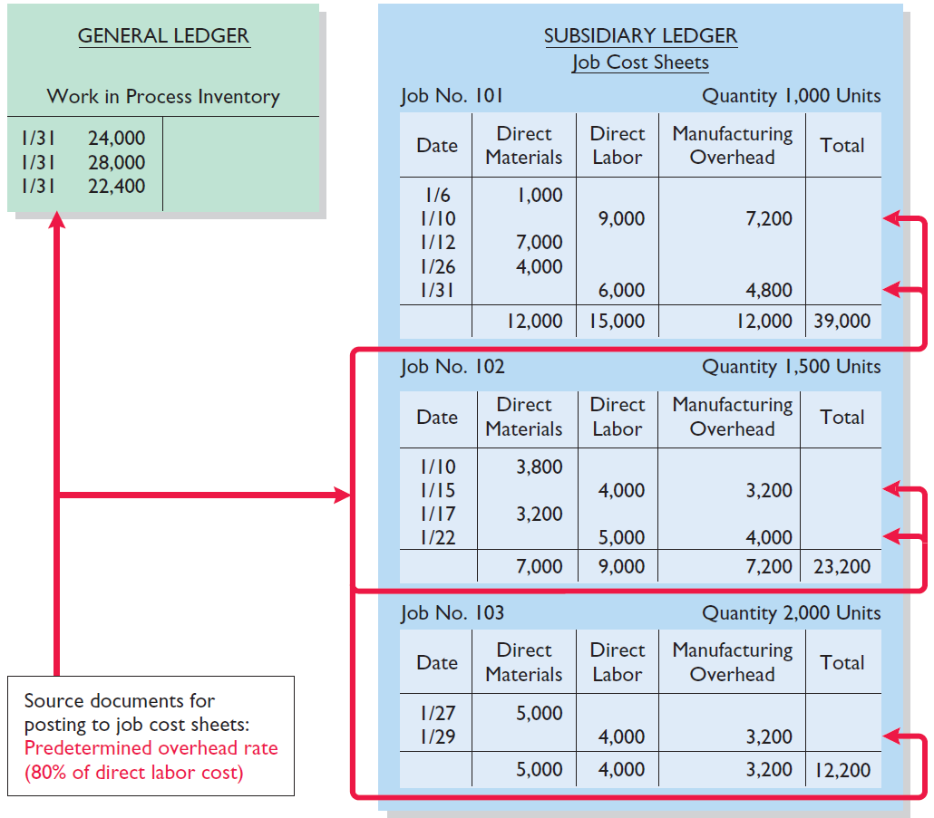
Job Order Cost Flow
Manufacturing Overhead Costs
The sum of the manufacturing overhead columns of the job cost sheets should equal the manufacturing overhead debited (i.e., applied) to Work in Process Inventory.
Illustration 2-11

Slide 23
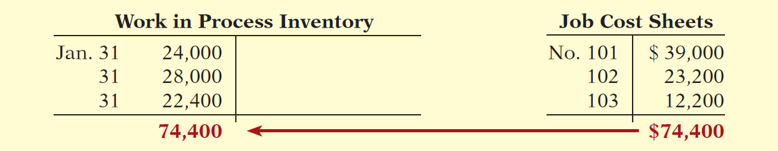
Job Order Cost Flow
Manufacturing Overhead Costs
At the End of Each Month:
The balance in the Work in Process Inventory should equal the sum of the costs shown on the job cost sheets of unfinished jobs.

Slide 24
Job Order Cost Flow
Review Question
The formula for computing the predetermined manufacturing overhead rate is estimated annual overhead costs divided by an expected annual operating activity, expressed as:
a. Direct labor cost.
b. Direct labor hours.
c. Machine hours.
d. Any of the above.

Slide 25
Danielle Company is working on two job orders. The job cost sheets show the following:
Direct materials—Job 120 $6,000; Job 121 $3,600
Direct labor—Job 120 $4,000; Job 121 $2,000
Manufacturing overhead—Job 120 $5,000; Job 121 $2,500
Prepare the three summary entries to record the assignment of costs to Work in Process from the data on the job cost sheets.

Slide 26
The three summary journal entries are:
Work in Process Inventory 9,600
Raw Materials Inventory 9,600
Work in Process Inventory 6,000
Factory Labor 6,000
Work in Process Inventory 7,500
Manufacturing Overhead 7,500

Slide 27
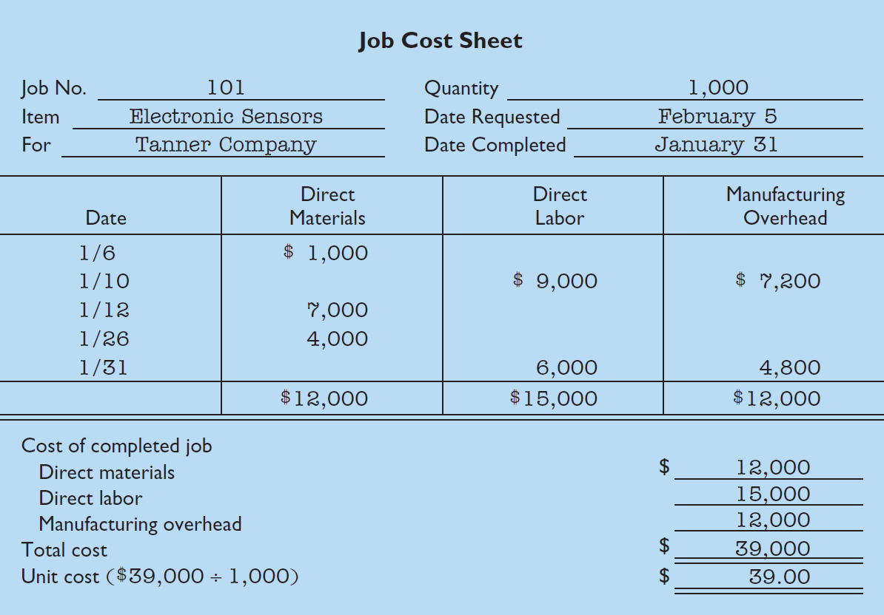
Job Order Cost Flow
Assigning Costs to Finished Goods
When a job is completed, the costs are summarized and the job cost sheet is completed.

Slide 28
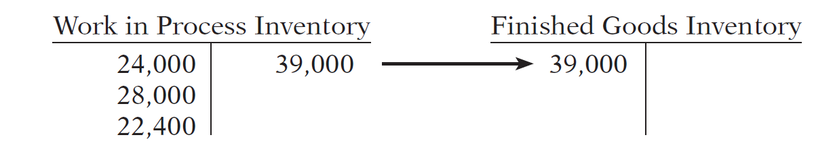
Job Order Cost Flow
Assigning Costs to Finished Goods
Illustration: When a job is finished, Wallace makes an entry to transfer its total cost to finished goods inventory.
Jan. 31 Finished Goods Inventory 39,000
Work in Process Inventory 39,000

Slide 29
Job Order Cost Flow
Assigning Costs to Cost of Goods Sold
Illustration: On January 31 Wallace Manufacturing sells on account Job 101. The job cost $39,000, and it sold for $50,000. The entries to record the sale and recognize cost of goods sold are:
Jan. 31 Accounts Receivable 50,000
Sales revenue 50,000
Cost of Goods Sold 39,000
Finished Goods Inventory 39,000

Slide 30
Job Order Cost Flow
Review Question
In M Company, Job No. 26 is completed at a cost of $4,500 and later sold for $7,000 cash. A correct entry is:
a. Debit Finished Goods Inventory $7,000 and credit Work in Process Inventory $7,000.
b. Debit Cost of Goods Sold $7,000 and credit Finished Goods Inventory $7,000.
c. Debit Finished Goods Inventory $4,500 and credit Work in Process Inventory $4,500.
d. Debit Accounts Receivable $7,000 and credit Sales $7,000.

Slide 31
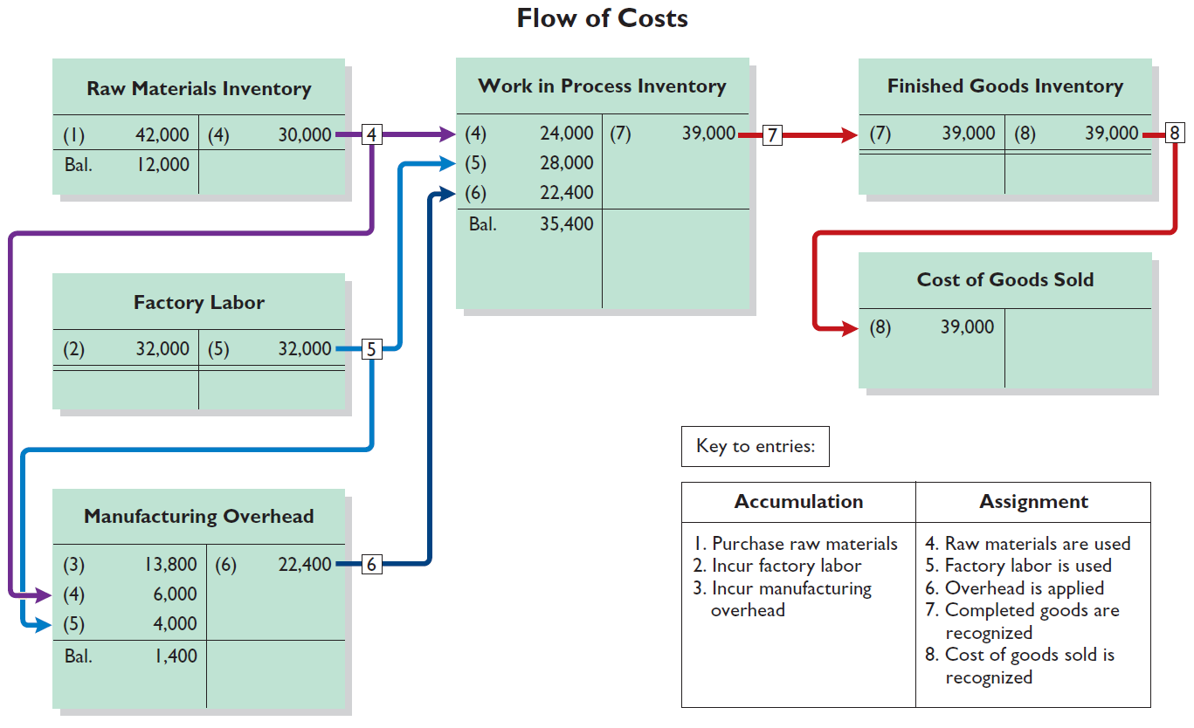
Job Order Cost Flow
Summary
Illustration 2-15

Slide 32
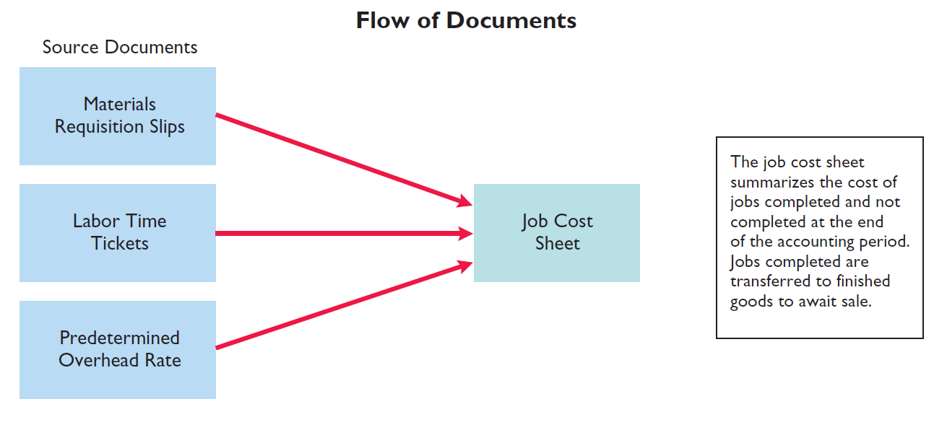
Job Order Cost Flow
Summary

Slide 33
During the current month, Onyx Corporation completed Job 109 and Job 112. Job 109 cost $19,000 and Job 112 costs $27,000. Job 112 was sold on account for $42,000. Journalize the entries for the completion of the two jobs and the sale of Job 112.
Finished Goods Inventory 46,000
Work in Process Inventory 46,000
Accounts Receivable 42,000
Sales 42,000
Cost of Goods Sold 27,000
Finished Goods Inventory 27,000

Slide 34
Job Order Cost Flow
Job Order Costing for Service Companies
While service companies do not have inventory, the techniques of job order costing are still quite useful in many service-industry environments. Consider, for example, the Mayo Clinic (health care), PricewaterhouseCoopers (accounting), and Goldman Sachs (investment banking).

Slide 35
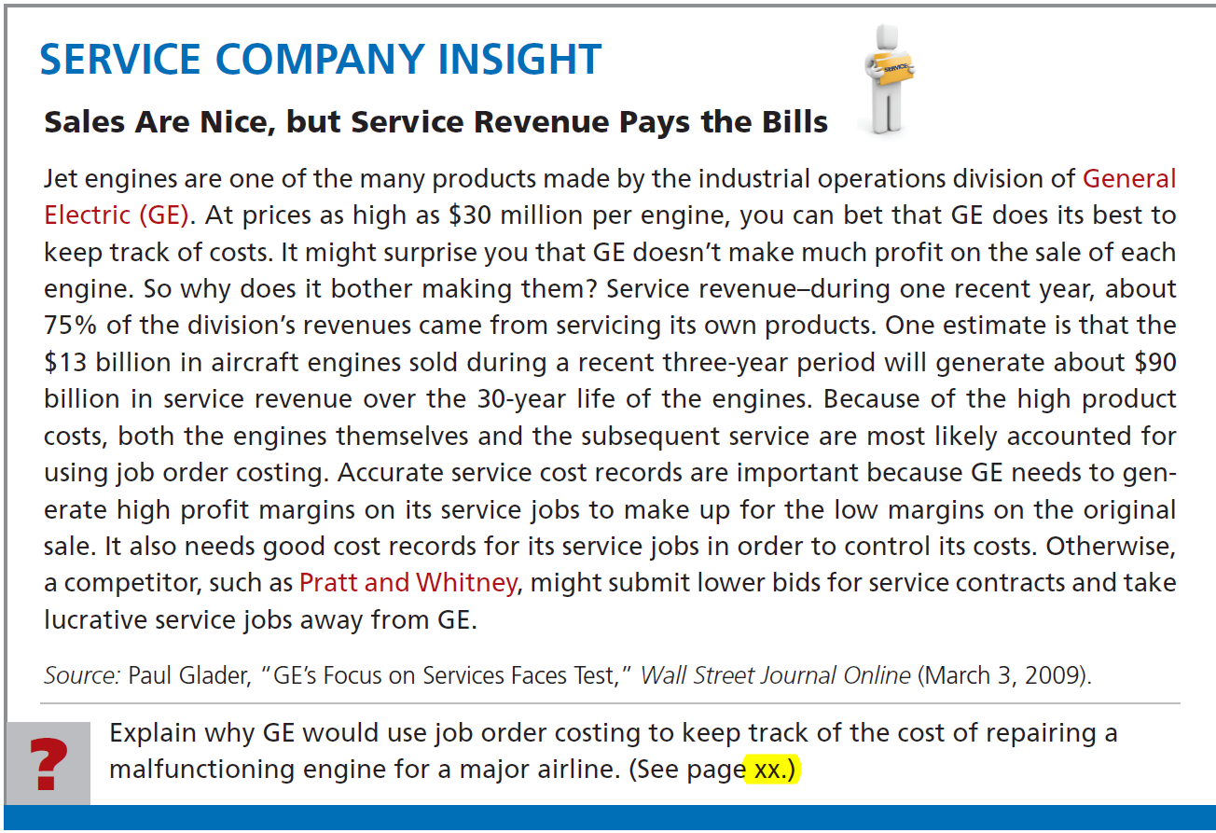

Slide 36
Job Order Cost Flow
Advantages
  More precise in assignment of costs to projects than process costing.
  Provides more useful information for determining the profitability of particular projects and for estimating costs when preparing bids on future jobs.
Disadvantage
  Requires a significant amount of data entry.

Slide 37
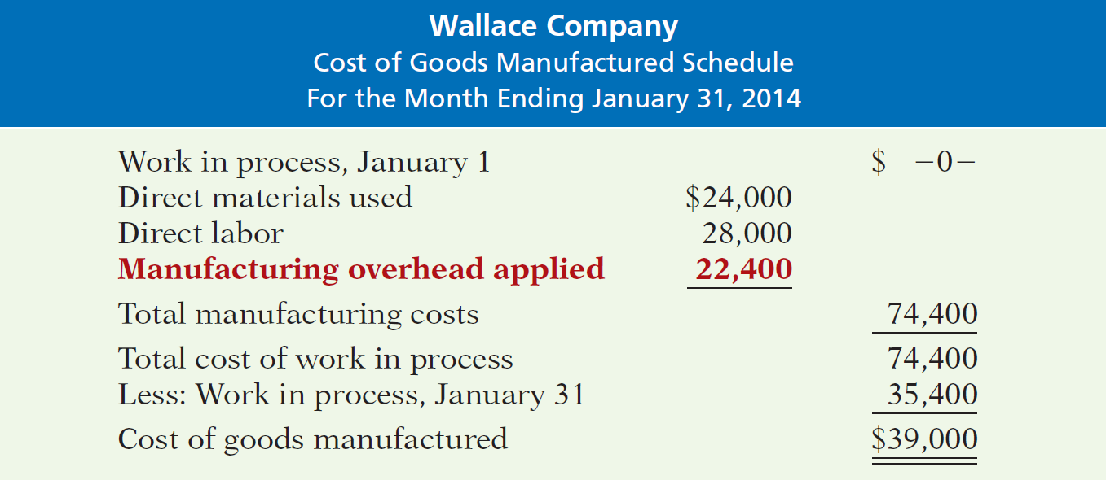
Reporting Job Cost Data
Shows manufacturing overhead applied rather than actual overhead costs.
Applied overhead is added to direct materials and direct labor to determine total manufacturing costs

Slide 38
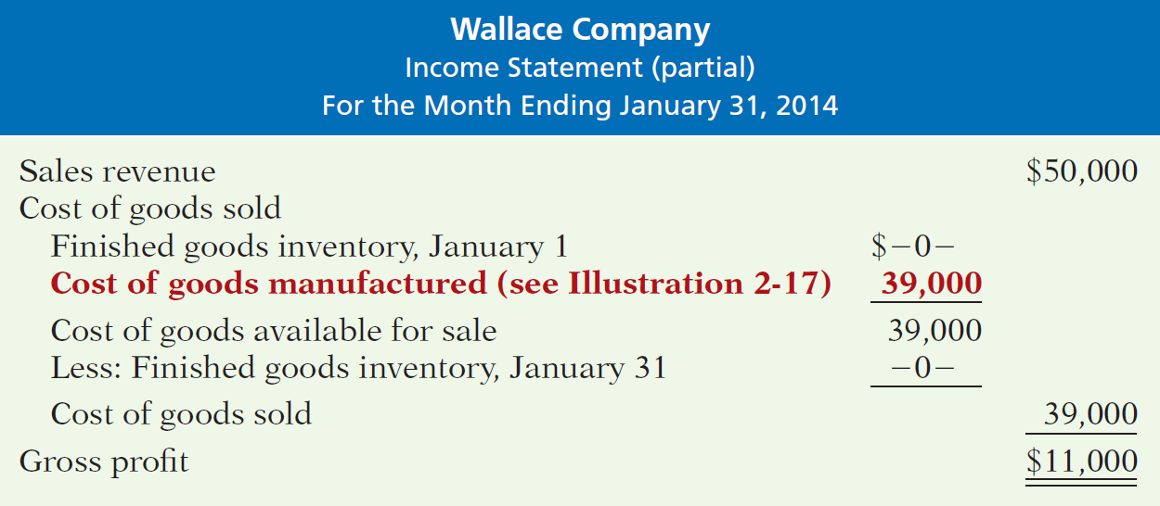
Reporting Job Cost Data
Partial Income Statement

Slide 39
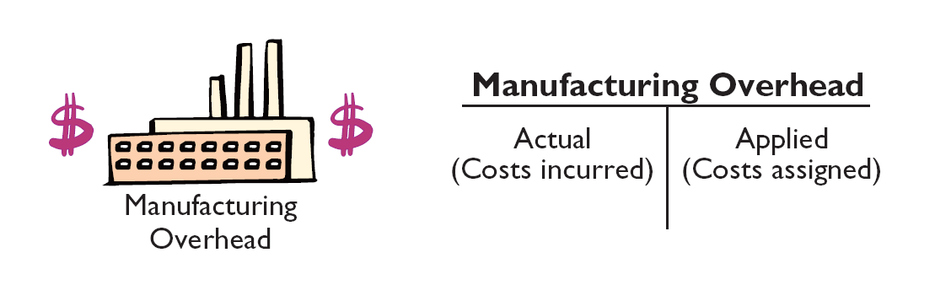
Reporting Job Cost Data
Under- or Overapplied Overhead
  A debit balance in manufacturing overhead means that overhead is underapplied.
  A credit balance in manufacturing overhead means that overhead is overapplied.

Slide 40
Reporting Job Cost Data
Under- or Overapplied Overhead
Any Year-End Balance in manufacturing overhead is eliminated by adjusting cost of goods sold.
  Underapplied overhead is debited to COGS
  Overapplied overhead is credited to COGS

Slide 41
Reporting Job Cost Data
Under- or Overapplied Overhead
Illustration: Wallace has a $2,500 credit balance in Manufacturing Overhead at December 31. The adjusting entry for the over-applied overhead is:
Dec. 31 Manufacturing Overhead 2,500
Cost of Good Sold 2,500

Slide 42
Reporting Job Cost Data
Review Question
Manufacturing overhead is underapplied if:
a. Actual overhead is less than applied.
b. Actual overhead is greater than applied.
c. The predetermined rate equals the actual rate.
d. Actual overhead equals applied overhead.

Slide 43
For Karr Company, the predetermined overhead rate is 140% of direct labor cost. During the month, Karr incurred $90,000 of factory labor costs, of which $80,000 is direct labor and $10,000 is indirect labor. Actual overhead incurred was $119,000. Compute the amount of manufacturing overhead applied during the month. Determine the amount of under- or overapplied manufacturing overhead.
Manufacturing overhead applied
Underapplied manufacturing overhead
(140% x $80,000) = $112,000
($119,000 - $112,000) = $7,000

Slide 44
End of Lecture 6

