Slide 1
Chapter 4
Lecture 5
Job Costing

Slide 2
Basic Costing Terminology…
Several key points from prior chapters:
  Cost Objects - including responsibility centers, departments, customers, products, etc.
  Direct costs and tracing – materials and labor
  Indirect costs and allocation - overhead

Slide 3
…logically extended
Cost Pool – any logical grouping of related cost objects
Cost-allocation base – a cost driver is used as a basis upon which to build a systematic method of distributing indirect costs.
  For example, let’s say that direct labor hours cause indirect costs to change. Accordingly, direct labor hours will be used to distribute or allocate costs among objects based on their usage of that cost driver

Slide 4
Costing Systems
Job-Costing: system accounting for distinct cost objects called Jobs. Each job may be different from the next, and consumes different resources
  Wedding announcements, aircraft, advertising
Process-Costing: system accounting for mass production of identical or similar products
  Oil refining, orange juice, soda pop

Slide 5
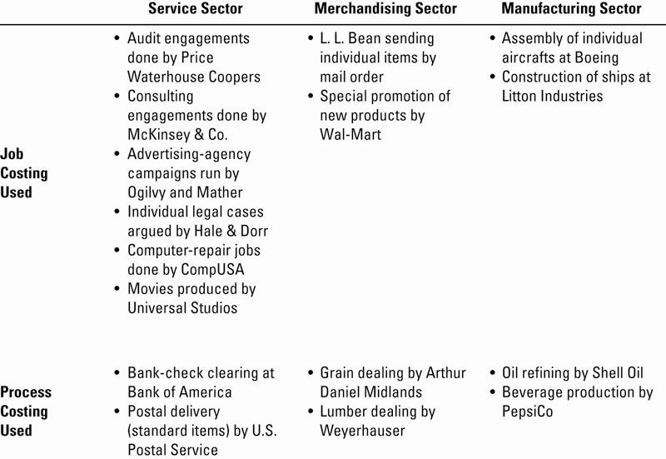
Costing Systems Illustrated

Slide 6
Costing Approaches
Actual Costing - allocates:
  Indirect costs based on the actual indirect-cost rates times the actual activity consumption
Normal Costing – allocates:
  Indirect costs based on the budgeted indirect-cost rates times the actual activity consumption
Both methods allocate Direct costs to a cost object the same way: by using actual direct-cost rates times actual consumption

Slide 7
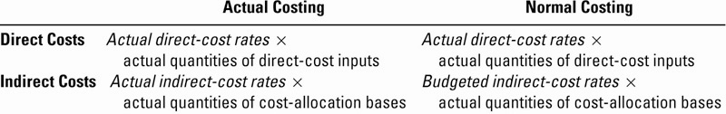
Costing Approaches Summarized

Slide 8
Seven-step Job Costing
Identify the Job that is the Chosen Cost Object
Identify the Direct Costs of the Job
Select the Cost-Allocation base(s) to use for allocating Indirect Costs to the Job
Match Indirect Costs to their respective Cost-Allocation base(s)

Slide 9
Seven-step Job Costing (continued)
Calculate an Overhead Allocation Rate:
  Actual OH Costs ÷ Actual OH Allocation Base
Allocate Overhead Costs to the Job:
  OH Allocation Rate x Actual Base Activity For the Job
Compute Total Job Costs by adding all direct and indirect costs together

Slide 10
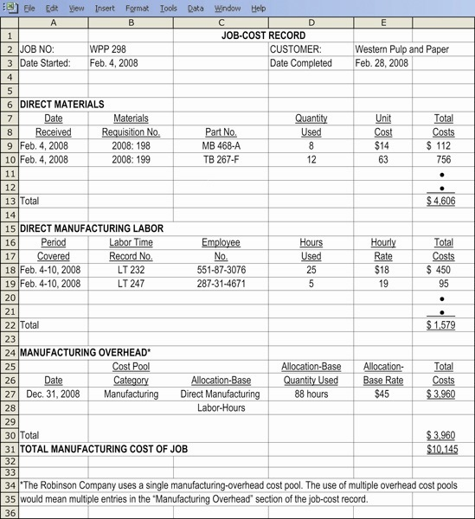
Sample
Job
Cost
Document

Slide 11
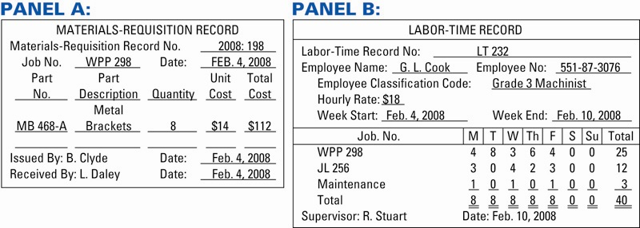
Sample Job Cost Source Documents

Slide 12
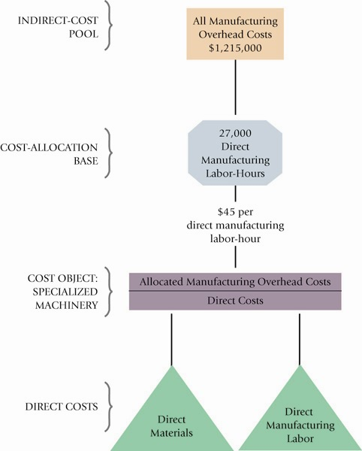
Job Costing
Overview

Slide 13
Journal Entries
Journal entries are made at each step of the production process
The purpose is to have the accounting system closely reflect the actual state of the business, its inventories and its production processes.

Slide 14
Journal Entries, continued
All Product Costs are accumulated in the Work-in-Process Control Account
  Direct Materials used
  Direct Labor incurred
  Factory Overhead allocated or applied
Actual Indirect Costs (overhead) are accumulated in the Manufacturing Overhead Control account

Slide 15
Journal Entries, continued
Purchase of Materials on credit:
  Materials Control XX
  Accounts Payable Control XX
Requisition of Direct and Indirect Materials (OH) into production:
  Work-in-Process Control X
  Manufacturing Overhead Control Y
  Materials Control Z

Slide 16
Journal Entries, continued
Incurred Direct and Indirect (OH) Labor Wages
  Work-in-Process Control X
  Manufacturing Overhead Control Y
  Cash Control Z

Slide 17
Journal Entries, continued
Incurring or recording of various actual
Indirect Costs:
  Manufacturing Overhead Control X
  Salaries Payable Control A
  Accounts Payable Control B
  Accumulated Depreciation Control C
  Prepaid Expenses Control D

Slide 18
Journal Entries, continued
Allocation or application of Indirect Costs (overhead) to the Work-in-Process account is based on a predetermined overhead rate.
  Work-in-Process Control X
  Manufacturing Overhead Allocated X
    Note: actual overhead costs are never posted directly into Work-in-Process

Slide 19
Journal Entries, continued
Products are completed and transferred out of production in preparation for being sold
  Finished Goods Control X
  Work-in-Process Control X

Slide 20
Journal Entries, continued
Products are sold to customers on credit
  Accounts Receivable Control X
  Sales X
And the associated costs are transferred to an expense (cost) account
  Cost of Goods Sold Y
  Finished Goods Control Y
    Note: The difference between the sales and cost of goods sold amounts represents the gross margin (profit) on this particular transaction

Slide 21
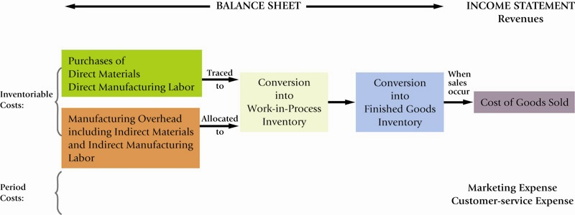
Flow of Costs Illustrated

Slide 22
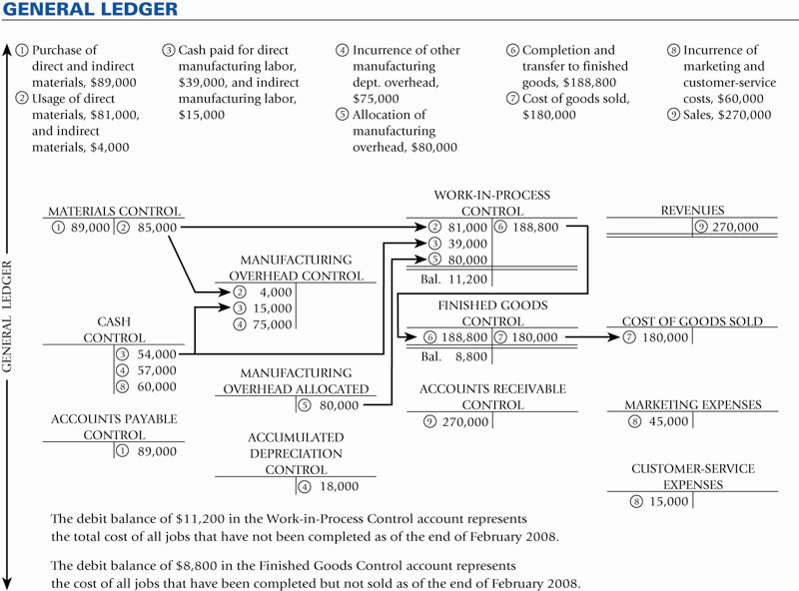
Illustrated General Ledger in a Job Cost Environment

Slide 23
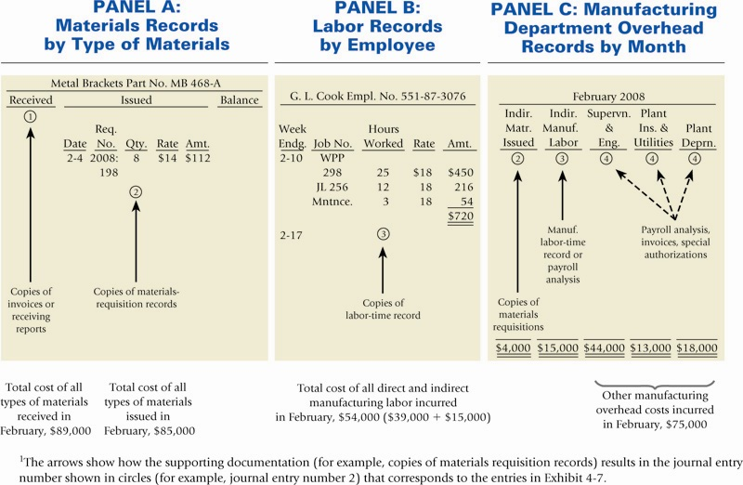
Illustrated Subsidiary Ledger in a Job Cost Environment

Slide 24
Accounting for Overhead
Recall that two different overhead accounts were used in the preceding journal entries:
  Manufacturing Overhead Control was debited for the actual overhead costs incurred.
  Manufacturing Overhead Allocated was credited for estimated (budgeted) overhead applied to production through the Work-in-Process account.

Slide 25
Accounting for Overhead
Actual costs will almost never equal budgeted costs. Accordingly, an imbalance situation exists between the two overhead accounts
  If Overhead Control > Overhead Allocated, this is called Underallocated Overhead
  If Overhead Control < Overhead Allocated, this is called Overallocated Overhead

Slide 26
Accounting for Overhead
This difference will be eliminated in the end-of-period adjusting entry process, using one of three possible methods
The choice of method should be based on such issues as materiality, consistency and industry practice

Slide 27
Three Methods for Adjusting Over/Underapplied Overhead
Adjusted Allocation Rate Approach – all allocations are recalculated with the actual, exact allocation rate.
Proration Approach – the difference is allocated between Cost of Goods Sold, Work-in-Process, and Finished Goods based on their relative sizes
Write-Off Approach – the difference is simply written off to Cost of Goods Sold

Slide 28
Cost Accounting Systems
Cost Accounting involves:
Measuring,
Recording, and
Reporting product costs.
  Accounts are fully integrated into the general ledger.
  Perpetual inventory system provides immediate, up-to-date information.
  Two basic types: (1) a job order cost system and (2) a process cost system.

Slide 29
Cost Accounting Systems
Job Order Cost System
  Costs are assigned to each job or batch.
  Key feature: Each job or batch has its own distinguishing characteristics.
  Objective: Compute the cost per job.
  Measures costs for each job completed – not for set time periods.

Slide 30
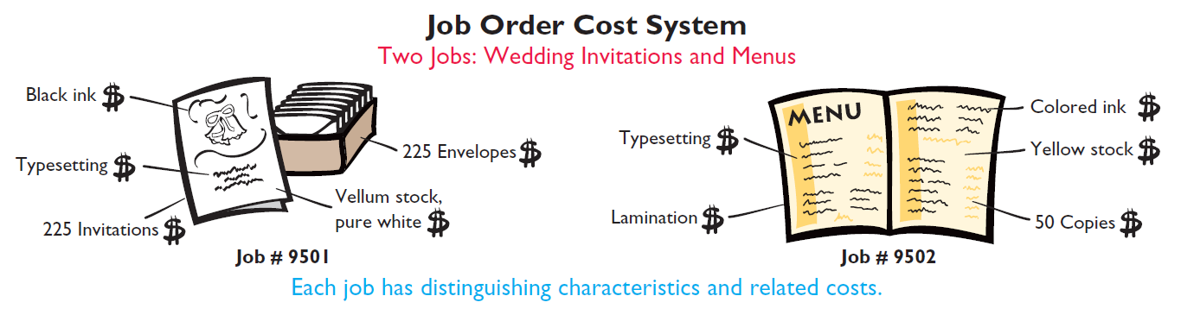
Cost Accounting Systems
Illustration 2-1

Slide 31
Cost Accounting Systems
Process Cost System
  Used when a large volume of similar products are manufactured - (cereal, refining of petroleum, production of ice cream).
  Costs are accumulated for a time period – (week or month).
  Costs are assigned to departments or processes for a specified period of time.

Slide 32
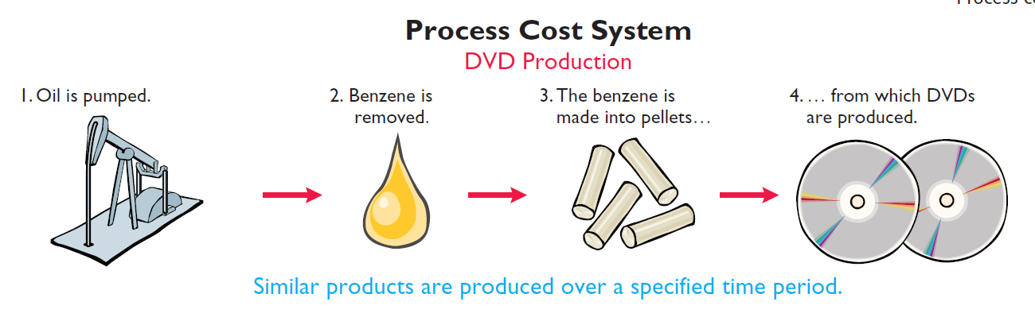
Cost Accounting Systems
Illustration 2-2

Slide 33
Cost Accounting Systems
Review Question
Cost accounting involves the measuring, recording, and reporting of:
a. Product costs.
b. Future costs.
c. Manufacturing processes.
d. Managerial accounting decisions.

Slide 34
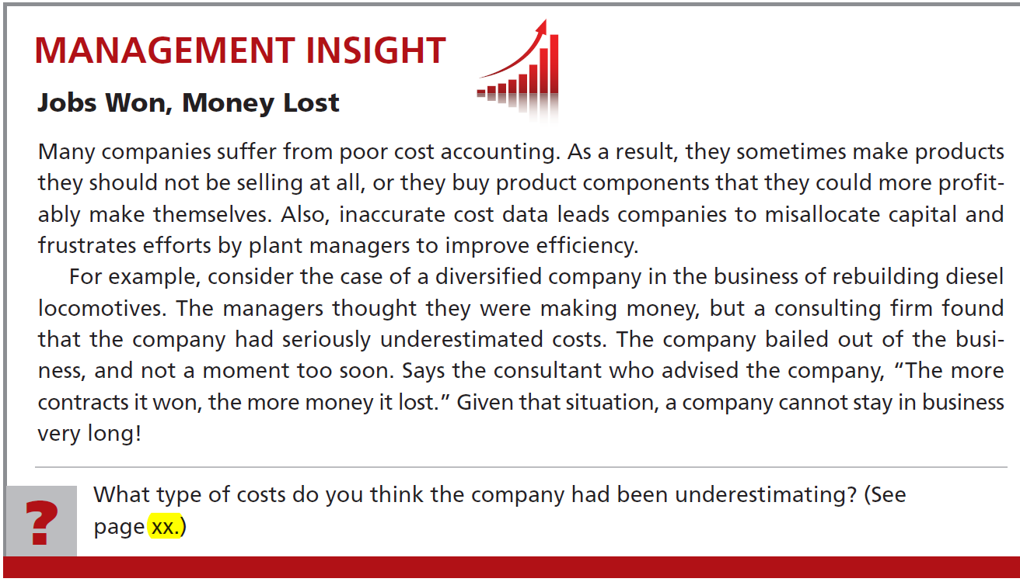
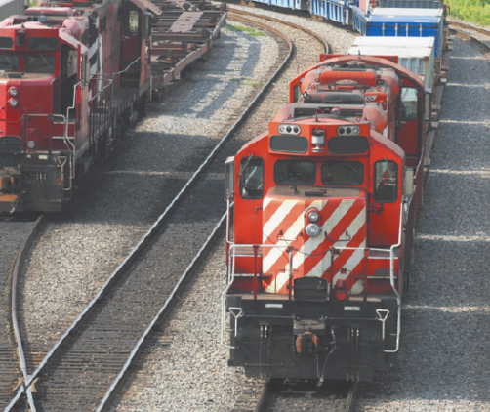

Slide 35
Job Order Cost Flow
The cost flow parallels the physical flow of the materials as they are converted into finished goods
  Manufacturing costs are assigned to Work in Process (WIP).
  Cost of completed jobs is transferred to Finished Goods.
  When units are sold, the cost is transferred to Cost of Goods Sold.

Slide 36
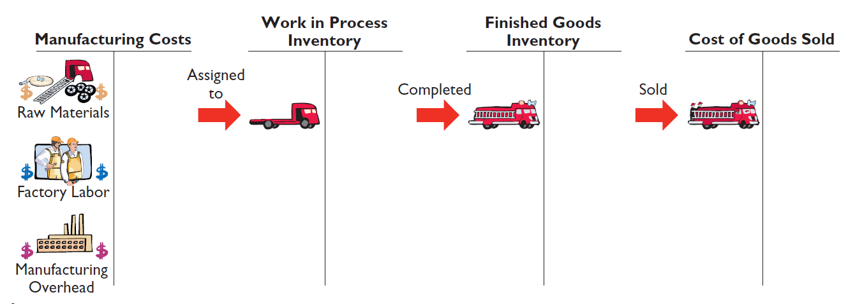
Job Order Cost Flow
Illustration 2-3

Slide 37
Job Order Cost Flow
Accumulating Manufacturing Costs
Raw Material Costs
Illustration: Wallace Company purchases 2,000 lithium batteries (Stock No. AA2746) at $5 per unit ($10,000) and 800 electronic modules (Stock No. AA2850) at $40 per unit ($32,000) for a total cost of $42,000 ($10,000 + $32,000). The entry to record this purchase on January 4 is:
Jan. 4 Raw Materials Inventory 42,000
Accounts Payable 42,000

Slide 38
Job Order Cost Flow
Factory Labor Costs
Consists of three costs:
  Gross earnings of factory workers,
  Employer payroll taxes on these earnings, and
  Fringe benefits incurred by the employer.

Slide 39
Job Order Cost Flow
Factory Labor Costs
Illustration: Wallace incurs $32,000 of factory labor costs. Of that amount, $27,000 relates to wages payable and $5,000 relates to payroll taxes payable in February. The entry to record factory labor for the month is:
Jan. 31 Factory Labor 32,000
Factory Wages Payable 27,000
Employer Payroll Taxes Payable 5,000

Slide 40
Job Order Cost Flow
Manufacturing Overhead Costs
  Many types of overhead costs
    For example, property taxes, depreciation, insurance, and repairs.
  Costs unrelated to manufacturing process are expensed.
  Costs related to manufacturing process are accumulated in Manufacturing Overhead.
    Manufacturing overhead subsequently assigned to work in process.

Slide 41
Job Order Cost Flow
Manufacturing Overhead Costs
Illustration: Using assumed data, the summary entry for manufacturing overhead in Wallace Manufacturing Company is:
Jan. 31 Manufacturing Overhead 13,800
Utilities Payable 4,800
Prepaid Insurance 2,000
Accounts Payable (for repairs) 2,600
Accumulated Depreciation 3,000
Property Taxes Payable 1,400

Slide 42
During the current month, KRT Company incurs the following manufacturing costs:
(a) Raw material purchases of $4,200 on account.
Incurs factory labor of $18,000. Of that amount, $15,000 relates to wages payable and $3,000 relates to payroll taxes payable.
Factory utilities of $2,200 are payable, prepaid factory insurance of $1,800 has expired, and depreciation on the factory building is $3,500.
Prepare journal entries for each type of manufacturing cost.

Slide 43
Prepare journal entries for each type of manufacturing cost.
(a) Raw material purchases of $4,200 on account.
Raw Materials Inventory 4,200
Accounts Payable 4,200
(b) Incurs factory labor of $18,000. Of that amount, $15,000 relates to wages payable and $3,000 relates to payroll taxes payable..
Factory Labor 18,000
Factory Wages Payable 15,000
Employer Payroll Taxes Payable 3,000

Slide 44
Prepare journal entries for each type of manufacturing cost.
(c) Factory utilities of $2,200 are payable, prepaid factory insurance of $1,800 has expired, and depreciation on the factory building is $3,500.
Manufacturing Overhead 7,500
Utilities Payable 2,200
Prepaid Insurance 1,800
Accumulated Depreciation 3,500

Slide 45
Job Order Cost Flow
Review Question
When incurred, factory labor costs are debited to:
a. Work in Process.
b. Factory Wages Expense.
c. Factory Labor.
d. Factory Wages Payable.

Slide 46
End of Lecture 5

