Slide 1
Chapter 3-Continued
Lecture 4
Cost-Volume-Profit Analysis

Slide 2
Cost-Volume-Profit
Cost Behavior Analysis
Cost-Volume-Profit Analysis
Variable costs
Fixed costs
Relevant range
Mixed costs
Identifying variable and fixed costs
Basic components
CVP income statement
Break-even analysis
Target net income
Margin of safety
Notes:
Service Cost - Actuaries compute service cost as the present value of the new benefits earned by employees during the year. Future salary levels considered in calculation.
Interest on Liability - Interest accrues each year on the PBO just as it does on any discounted debt.
Actual Return on Plan Assets - Increase in pension funds from interest, dividends, and realized and unrealized changes in the fair market value of the plan assets.
Amortization of Unrecognized Prior Service Cost - The cost of providing retroactive benefits is allocated to pension expense in the future, specifically to the remaining service-years of the affected employees.
Gain or Loss - Volatility in pension expense can be caused by sudden and large changes in the market value of plan assets and by changes in the projected benefit obligation. Two items comprise the gain or loss:
difference between the actual return and the expected return on plan assets and,
amortization of the unrecognized net gain or loss from previous periods

Slide 3

Cost-Volume-Profit Analysis
CVP Analysis - the study of the effects of changes in costs and volume on a company’s profits
Important in profit planning
A critical factor in setting selling prices, determining product mix, and maximizing use of production facilities
Notes:
1. On the topic, “Challenges Facing Financial Accounting,” what did the AICPA Special Committee on Financial Reporting suggest should be included in future financial statements?
Non-financial Measurements (customer satisfaction indexes, backlog information, and reject rates on goods purchases).
Forward-looking Information
Soft Assets (a company’s know-how, market dominance, marketing setup, well-trained employees, and brand image).
Timeliness (no real time financial information)

Slide 4
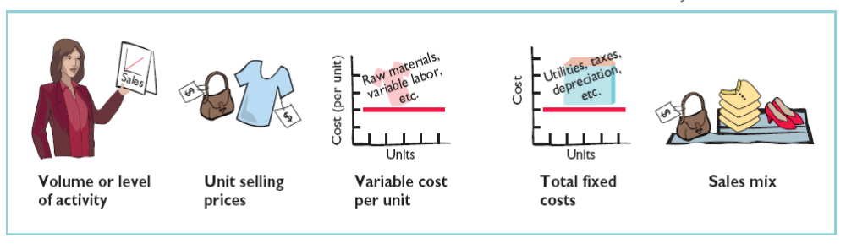
Cost-Volume-Profit Analysis
CVP analysis considers the interrelationships among five basic components:
Notes:
1. On the topic, “Challenges Facing Financial Accounting,” what did the AICPA Special Committee on Financial Reporting suggest should be included in future financial statements?
Non-financial Measurements (customer satisfaction indexes, backlog information, and reject rates on goods purchases).
Forward-looking Information
Soft Assets (a company’s know-how, market dominance, marketing setup, well-trained employees, and brand image).
Timeliness (no real time financial information)

Slide 5
Assumptions Underlying CVP Analysis
Behavior of both costs and revenues is linear throughout the relevant range of the activity index
Costs can be classified accurately as either variable or fixed
Changes in activity are the only factors that affect costs
All units produced are sold
When more than one type of product is sold, the sales mix will remain constant
Notes:
1. On the topic, “Challenges Facing Financial Accounting,” what did the AICPA Special Committee on Financial Reporting suggest should be included in future financial statements?
Non-financial Measurements (customer satisfaction indexes, backlog information, and reject rates on goods purchases).
Forward-looking Information
Soft Assets (a company’s know-how, market dominance, marketing setup, well-trained employees, and brand image).
Timeliness (no real time financial information)

Slide 6
Let’s Review
One of the following is NOT involved in CVP analysis. That factor is:
a. Sales mix.
b. Unit selling prices.
c. Fixed costs per unit.
d. Volume or level of activity.

Slide 7

CVP Income Statement
Classifies costs and expenses as fixed or variable
Reports contribution margin in the body of the statement.
  Contribution margin –
amount of revenue
remaining after
deducting all variable costs
Reports the same net
income as a traditional income statement
A statement for internal use only
Notes:
1. On the topic, “Challenges Facing Financial Accounting,” what did the AICPA Special Committee on Financial Reporting suggest should be included in future financial statements?
Non-financial Measurements (customer satisfaction indexes, backlog information, and reject rates on goods purchases).
Forward-looking Information
Soft Assets (a company’s know-how, market dominance, marketing setup, well-trained employees, and brand image).
Timeliness (no real time financial information)

Slide 8

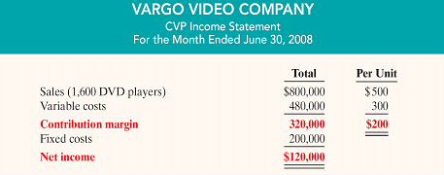
CVP Income Statement - Example
Vargo Video Company produces a DVD player/recorder.
Relevant data for June 2008:
Notes:
1. On the topic, “Challenges Facing Financial Accounting,” what did the AICPA Special Committee on Financial Reporting suggest should be included in future financial statements?
Non-financial Measurements (customer satisfaction indexes, backlog information, and reject rates on goods purchases).
Forward-looking Information
Soft Assets (a company’s know-how, market dominance, marketing setup, well-trained employees, and brand image).
Timeliness (no real time financial information)

Slide 9
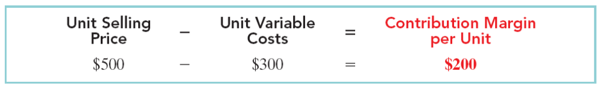
Contribution Margin Per Unit
Contribution margin is the amount available to cover fixed costs and to contribute to income
The formula for contribution margin per unit and the computation of the contribution margin per unit for Vargo Video are:
Thus, for every DVD player sold, Vargo Company has $200 to cover fixed costs and contribute to net income
Notes:
1. On the topic, “Challenges Facing Financial Accounting,” what did the AICPA Special Committee on Financial Reporting suggest should be included in future financial statements?
Non-financial Measurements (customer satisfaction indexes, backlog information, and reject rates on goods purchases).
Forward-looking Information
Soft Assets (a company’s know-how, market dominance, marketing setup, well-trained employees, and brand image).
Timeliness (no real time financial information)

Slide 10
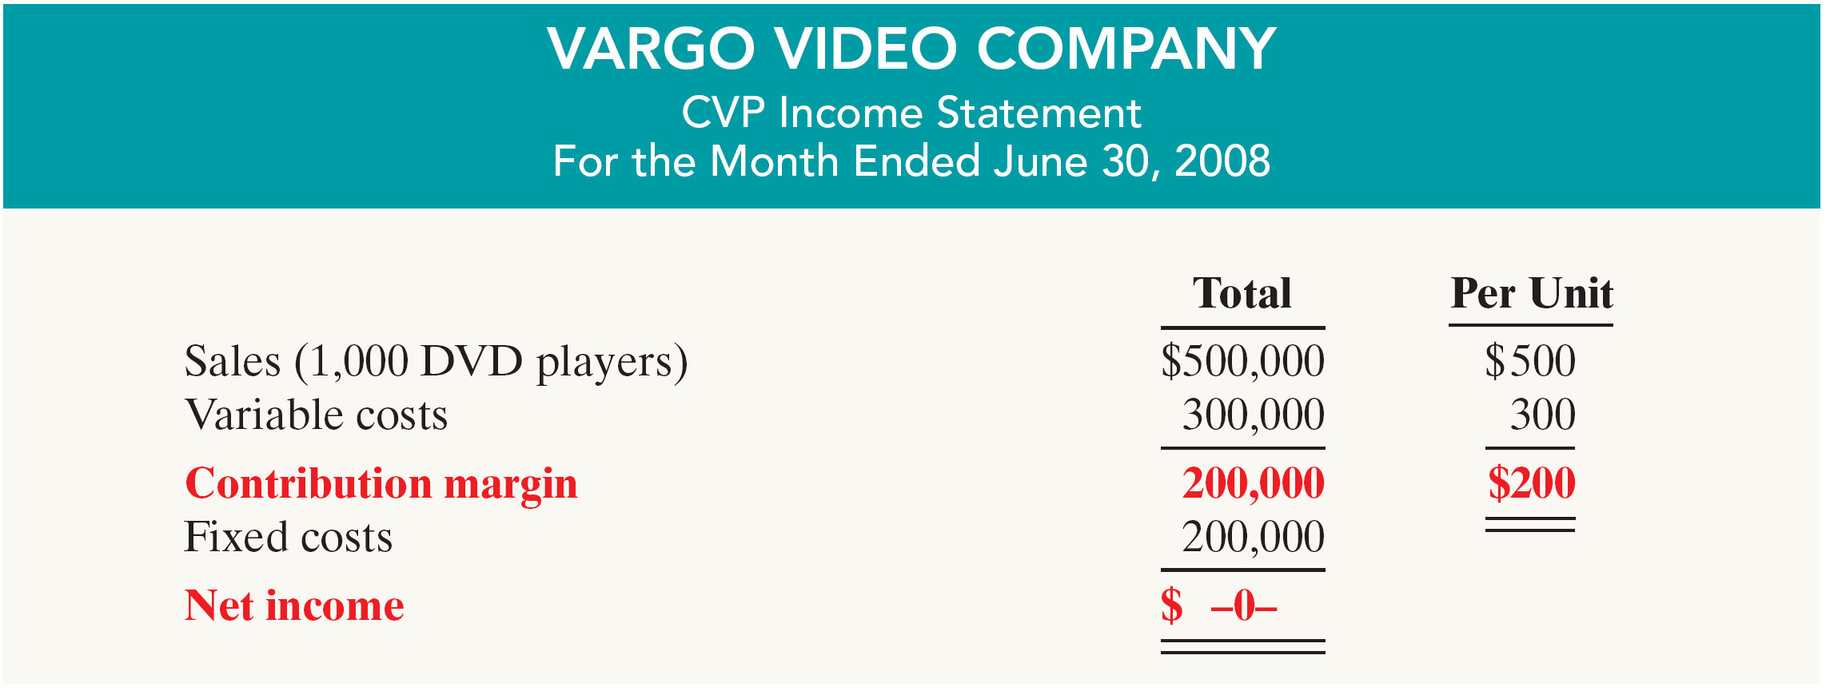
CVP Income Statement – Contribution Margin Effect
Since Vargo Company has fixed costs of $200,000, it must sell 1,000 DVD players ($200,000 ÷ $200) before it can earn any net income
Vargo’s CVP income statement, assuming a zero net income is:
Notes:
1. On the topic, “Challenges Facing Financial Accounting,” what did the AICPA Special Committee on Financial Reporting suggest should be included in future financial statements?
Non-financial Measurements (customer satisfaction indexes, backlog information, and reject rates on goods purchases).
Forward-looking Information
Soft Assets (a company’s know-how, market dominance, marketing setup, well-trained employees, and brand image).
Timeliness (no real time financial information)

Slide 11
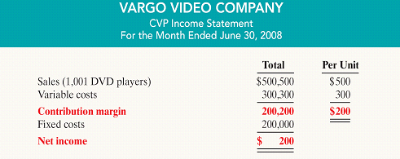
CVP Income Statement – Contribution Margin Effect
For every DVD player that Vargo sells above 1,000 units, net income increases by the amount of the contribution margin, $200
Vargo’s CVP income statement, assuming 1001 units sold is:
Notes:
1. On the topic, “Challenges Facing Financial Accounting,” what did the AICPA Special Committee on Financial Reporting suggest should be included in future financial statements?
Non-financial Measurements (customer satisfaction indexes, backlog information, and reject rates on goods purchases).
Forward-looking Information
Soft Assets (a company’s know-how, market dominance, marketing setup, well-trained employees, and brand image).
Timeliness (no real time financial information)

Slide 12
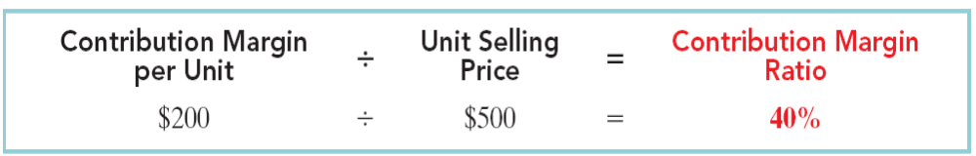
Contribution Margin Ratio
Shows the percentage of each sales dollar available to apply toward fixed costs and profits
The contribution margin ratio is the contribution margin per unit divided by the unit selling price. For Vargo Company, the computation is:
In this case, the contribution margin ratio of 40% means that $ .40 of each sales dollar is available to apply to fixed costs and contribute to net income
Notes:
1. On the topic, “Challenges Facing Financial Accounting,” what did the AICPA Special Committee on Financial Reporting suggest should be included in future financial statements?
Non-financial Measurements (customer satisfaction indexes, backlog information, and reject rates on goods purchases).
Forward-looking Information
Soft Assets (a company’s know-how, market dominance, marketing setup, well-trained employees, and brand image).
Timeliness (no real time financial information)

Slide 13
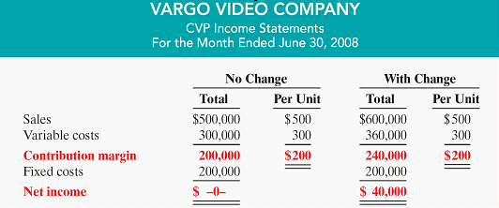
Contribution Margin Ratio
As shown below, the contribution margin ratio helps to determine the effect of changes in sales on net income
Notes:
1. On the topic, “Challenges Facing Financial Accounting,” what did the AICPA Special Committee on Financial Reporting suggest should be included in future financial statements?
Non-financial Measurements (customer satisfaction indexes, backlog information, and reject rates on goods purchases).
Forward-looking Information
Soft Assets (a company’s know-how, market dominance, marketing setup, well-trained employees, and brand image).
Timeliness (no real time financial information)

Slide 14
Let’s Review
Contribution margin:
a. Is revenue remaining after deducting variable costs.
b. May be expressed as contribution margin per unit.
c. Is selling price less cost of goods sold.
d. Both (a) and (b) above.

Slide 15
Break-Even Analysis
A key relationship in CVP analysis is the level of activity at which total revenue equals total costs (both fixed and variable)
This level of activity is called the break-even point
At this volume of sales, the company will realize no income, but will also suffer no loss
Can be computed or derived:
  from a mathematical equation,
  by using contribution margin, or
  from a cost-volume profit (CVP) graph
The break-even point can be expressed either in sales units or in sales dollars
Notes:
1. On the topic, “Challenges Facing Financial Accounting,” what did the AICPA Special Committee on Financial Reporting suggest should be included in future financial statements?
Non-financial Measurements (customer satisfaction indexes, backlog information, and reject rates on goods purchases).
Forward-looking Information
Soft Assets (a company’s know-how, market dominance, marketing setup, well-trained employees, and brand image).
Timeliness (no real time financial information)

Slide 16
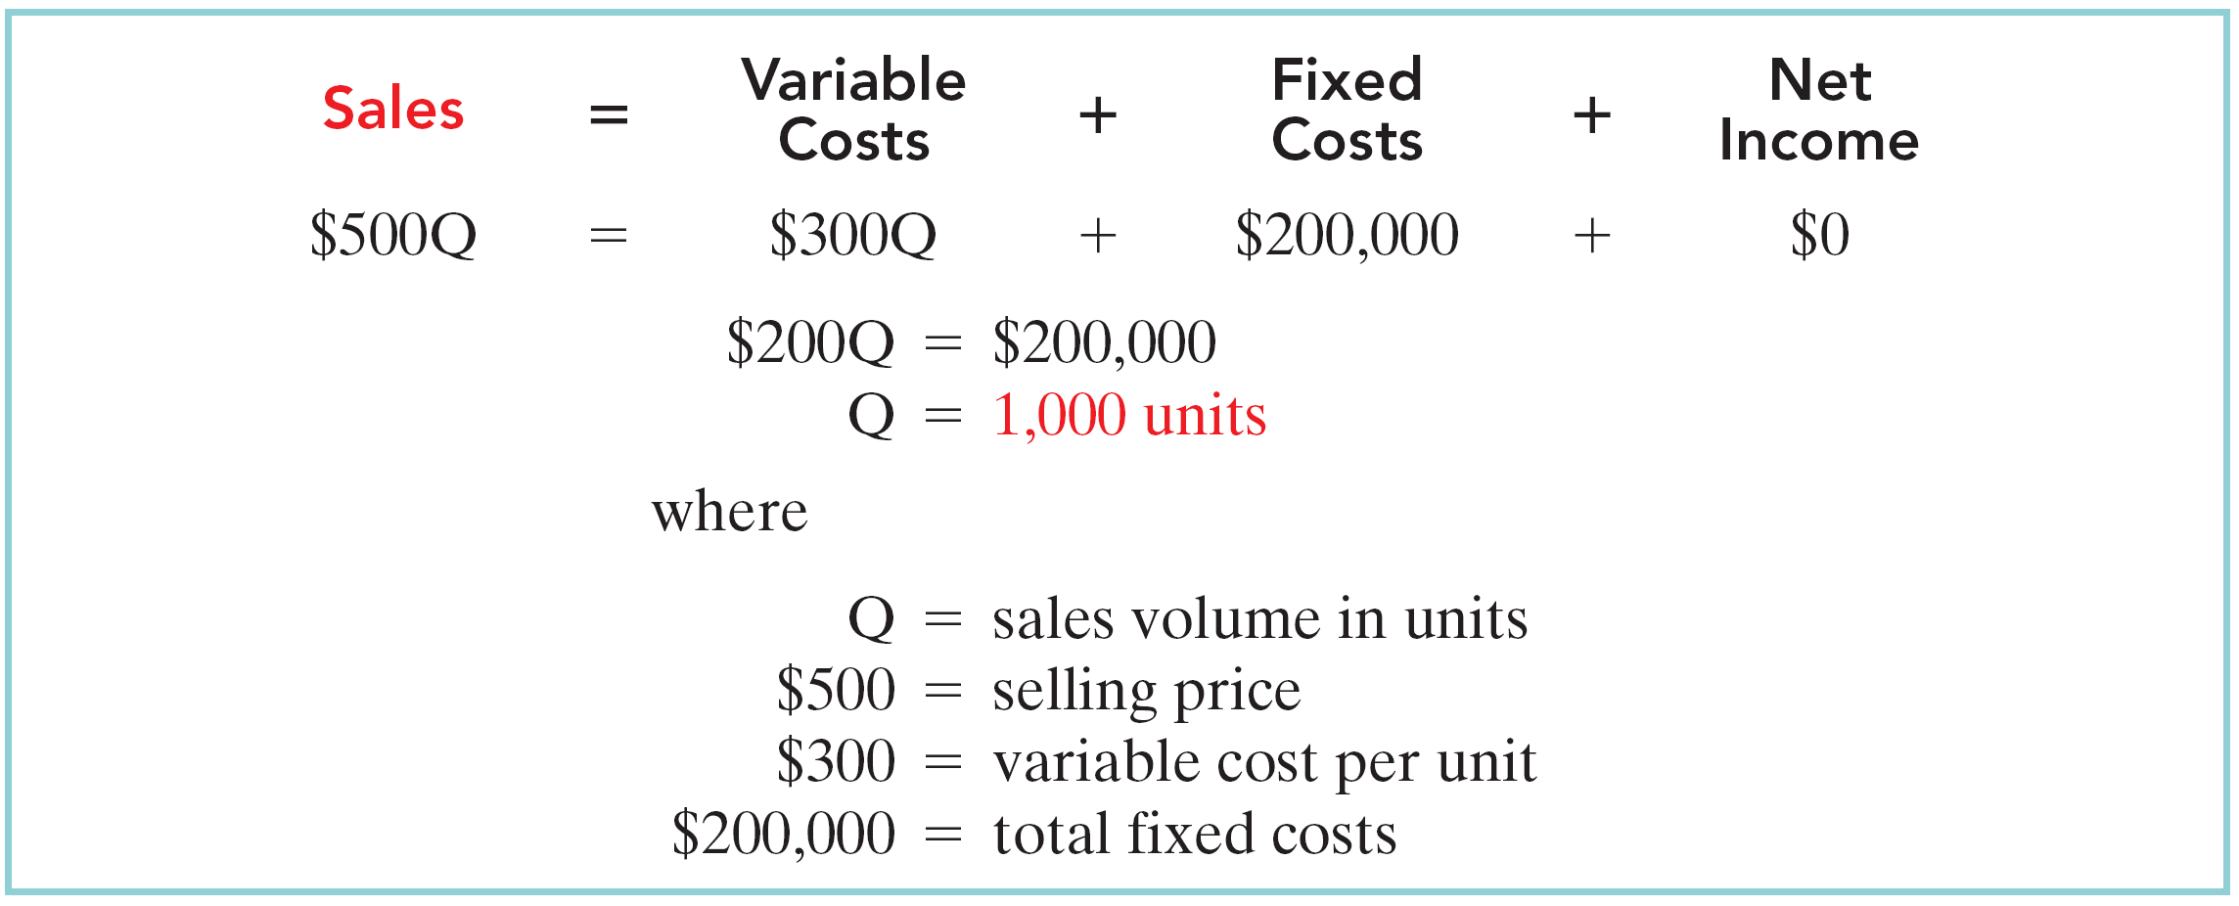
Break-Even Analysis: Mathematical Equation
Break-even occurs where total sales equal variable costs plus fixed costs; i.e., net income is zero.
The formula for the break-even point in units and the computation for Vargo Video are:
To find sales dollars required to break-even:
1,000 units X $500 = $500,000 (break-even sales dollars)
Notes:
1. On the topic, “Challenges Facing Financial Accounting,” what did the AICPA Special Committee on Financial Reporting suggest should be included in future financial statements?
Non-financial Measurements (customer satisfaction indexes, backlog information, and reject rates on goods purchases).
Forward-looking Information
Soft Assets (a company’s know-how, market dominance, marketing setup, well-trained employees, and brand image).
Timeliness (no real time financial information)

Slide 17

Break-Even Analysis:
Contribution Margin Technique
At the break-even point, contribution margin must equal total fixed costs
(Contribution Margin = total revenues – variable costs)
The break-even point (BEP) can be computed using either contribution margin per unit or contribution margin ratio.
Notes:
1. On the topic, “Challenges Facing Financial Accounting,” what did the AICPA Special Committee on Financial Reporting suggest should be included in future financial statements?
Non-financial Measurements (customer satisfaction indexes, backlog information, and reject rates on goods purchases).
Forward-looking Information
Soft Assets (a company’s know-how, market dominance, marketing setup, well-trained employees, and brand image).
Timeliness (no real time financial information)

Slide 18


Contribution Margin Technique
When the contribution margin per unit is used, the formula to compute the BEP in units for Vargo Video is:
When the BEP in dollars is desired, contribution margin ratio is used in the following formula for Vargo Video:
Notes:
1. On the topic, “Challenges Facing Financial Accounting,” what did the AICPA Special Committee on Financial Reporting suggest should be included in future financial statements?
Non-financial Measurements (customer satisfaction indexes, backlog information, and reject rates on goods purchases).
Forward-looking Information
Soft Assets (a company’s know-how, market dominance, marketing setup, well-trained employees, and brand image).
Timeliness (no real time financial information)

Slide 19

Break-Even Analysis: Graphic Presentation
A cost-volume profit (CVP) graph shows the relationships between costs, volume and profits.
To construct a CVP graph:
  Plot the total-sales line starting at the zero activity level
  Plot the total fixed cost using a horizontal line
  Plot the total-cost line (starts at the fixed-cost line at zero activity)
  Determine the break-even point from the intersection of the total-cost line and the total-sales line
Notes:
1. On the topic, “Challenges Facing Financial Accounting,” what did the AICPA Special Committee on Financial Reporting suggest should be included in future financial statements?
Non-financial Measurements (customer satisfaction indexes, backlog information, and reject rates on goods purchases).
Forward-looking Information
Soft Assets (a company’s know-how, market dominance, marketing setup, well-trained employees, and brand image).
Timeliness (no real time financial information)

Slide 20
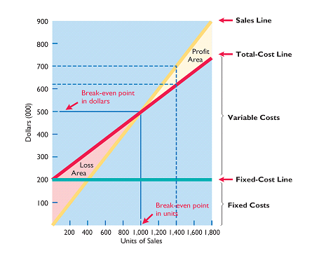
Break-Even Analysis: Graphic Presentation
Notes:
1. On the topic, “Challenges Facing Financial Accounting,” what did the AICPA Special Committee on Financial Reporting suggest should be included in future financial statements?
Non-financial Measurements (customer satisfaction indexes, backlog information, and reject rates on goods purchases).
Forward-looking Information
Soft Assets (a company’s know-how, market dominance, marketing setup, well-trained employees, and brand image).
Timeliness (no real time financial information)

Slide 21
Let’s Review
Gossen Company is planning to sell 200,000 pliers for $4 per unit. The contribution margin ratio is 25%. If Gossen will break even at this level of sales, what are the fixed costs?
a. $100,000.
b. $160,000.
c. $200,000.
d. $300,000.

Slide 22
Break-Even Analysis: Target Net Income
Rather than just breaking even, management usually sets an income objective called “target net income”
Indicates sales or units necessary to achieve this specified level of income
Can be determined from each of the approaches used to determine break-even sales/units:
  from a mathematical equation,
  by using contribution margin, or
  from a cost-volume profit (CVP) graph
Expressed either in sales units or in sales dollars
Notes:
1. On the topic, “Challenges Facing Financial Accounting,” what did the AICPA Special Committee on Financial Reporting suggest should be included in future financial statements?
Non-financial Measurements (customer satisfaction indexes, backlog information, and reject rates on goods purchases).
Forward-looking Information
Soft Assets (a company’s know-how, market dominance, marketing setup, well-trained employees, and brand image).
Timeliness (no real time financial information)

Slide 23
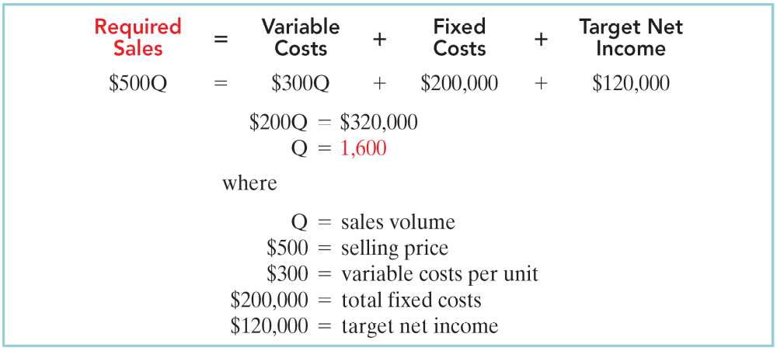
Break-Even Analysis: Target Net Income
Mathematical Equation
Using the basic formula for the break-even point, simply include the desired net income as a factor. The computation for Vargo Video is as follows:
Notes:
1. On the topic, “Challenges Facing Financial Accounting,” what did the AICPA Special Committee on Financial Reporting suggest should be included in future financial statements?
Non-financial Measurements (customer satisfaction indexes, backlog information, and reject rates on goods purchases).
Forward-looking Information
Soft Assets (a company’s know-how, market dominance, marketing setup, well-trained employees, and brand image).
Timeliness (no real time financial information)

Slide 24
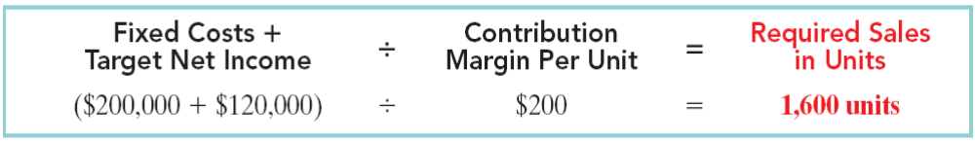

Break-Even Analysis: Target Net Income
Contribution Margin Technique
To determine the required sales in units for Vargo Video:
To determine the required sales in dollars for Vargo Video:
Notes:
1. On the topic, “Challenges Facing Financial Accounting,” what did the AICPA Special Committee on Financial Reporting suggest should be included in future financial statements?
Non-financial Measurements (customer satisfaction indexes, backlog information, and reject rates on goods purchases).
Forward-looking Information
Soft Assets (a company’s know-how, market dominance, marketing setup, well-trained employees, and brand image).
Timeliness (no real time financial information)

Slide 25
Let’s Review
The mathematical equation for computing required sales to obtain target net income is:
Required sales = ?
a. Variable costs + Target net income.
b. Variable costs + Fixed costs + Target net income.
c. Fixed costs + Target net income.
d. No correct answer is given.

Slide 26
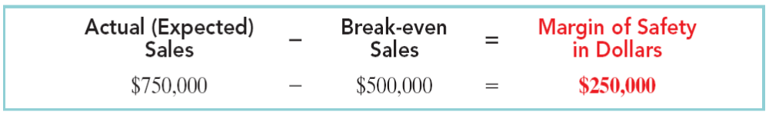
Break-Even Analysis: Margin of Safety
Difference between actual or expected sales and sales at the break-even point
Measures the “cushion” that management has, allowing it to break-even even if expected sales fail to materialize
May be expressed in dollars or as a ratio
To determine the margin of safety in dollars for Vargo Video assuming that actual/expected sales are $750,000:
Notes:
1. On the topic, “Challenges Facing Financial Accounting,” what did the AICPA Special Committee on Financial Reporting suggest should be included in future financial statements?
Non-financial Measurements (customer satisfaction indexes, backlog information, and reject rates on goods purchases).
Forward-looking Information
Soft Assets (a company’s know-how, market dominance, marketing setup, well-trained employees, and brand image).
Timeliness (no real time financial information)

Slide 27

Break-Even Analysis: Margin of Safety
Margin of Safety Ratio
Computed by dividing the margin of safety in dollars by the actual or expected sales
To determine the margin of safety ratio for Vargo Video assuming that actual/expected sales are $750,000:
The higher the dollars or the percentage, the greater the margin of safety
Notes:
1. On the topic, “Challenges Facing Financial Accounting,” what did the AICPA Special Committee on Financial Reporting suggest should be included in future financial statements?
Non-financial Measurements (customer satisfaction indexes, backlog information, and reject rates on goods purchases).
Forward-looking Information
Soft Assets (a company’s know-how, market dominance, marketing setup, well-trained employees, and brand image).
Timeliness (no real time financial information)

Slide 28
Let’s Review
Marshall Company had actual sales of $600,000 when break-even sales were $420,000. What is the margin of safety ratio?
a. 25%.
b. 30%.
c. 33 1/3%.
d. 45%.

Slide 29


All About You
A Hybrid Dilemma
Hybrid vehicles typically cost $3,000 to $5,000 more than conventional vehicles
The most fuel efficient hybrids can save about $660 per year in fuel costs
Each gallon of gas not burned reduces carbon dioxide emissions by 19 pounds

Slide 30

All About You
A Hybrid Dilemma
What do you think?
Do you think that making the investment in a hybrid car will slow the cash outflow from your wallet due to high gas prices and save your feet?
Because of the premium charged for hybrid cars, would you ever break-even on your investment?

Slide 31
Chapter Review - Brief Exercise 5-4
Deines Company accumulates the following data concerning a mixed cost, using miles as the activity level.
Miles Total Miles Total
Driven Cost Driven Cost
January 8,000 $14,150 March 8,500 $15,000
February 7,500 $13,600 April 8,200 $14,490
Compute the variable and fixed cost elements using the high-low method.

Slide 32
Chapter Review - Brief Exercise 5-4
High Level of Activity: March $15,000 8,500 miles
Low Level of Activity: February 13,600 7,500 miles
Difference $ 1,400 1,000 miles
Step 1:
Variable Cost per Unit = $1,400 ÷ 1,000 miles
= $1.40 variable cost per mile
Step 2: High Low
Total Cost: $15,000 $13,600
Variable Cost:
8,500 X $1.40 11,900
7,500 X $1.40 10,500
Total Fixed Costs $ 3,100 $ 3,100

Slide 33

Sales Mix
When a company sells more than one product
It is important to understand
its sales mix
The sales mix is the relative percentage in which a company sells its products.
If a company’s unit sales are 80% printers and 20% computers, its sales mix is 80% to 20%.
Sales mix is important because different products often have very different contribution margins.
Notes:
1. On the topic, “Challenges Facing Financial Accounting,” what did the AICPA Special Committee on Financial Reporting suggest should be included in future financial statements?
Non-financial Measurements (customer satisfaction indexes, backlog information, and reject rates on goods purchases).
Forward-looking Information
Soft Assets (a company’s know-how, market dominance, marketing setup, well-trained employees, and brand image).
Timeliness (no real time financial information)

Slide 34

Break-Even Sales in Units
A company can compute break-even sales for a mix of two or more products by determining the
Weighted-average unit contribution margin of all products
The weighted-average unit contribution margin is the sum of the weighted contribution margin of each product
Notes:
1. On the topic, “Challenges Facing Financial Accounting,” what did the AICPA Special Committee on Financial Reporting suggest should be included in future financial statements?
Non-financial Measurements (customer satisfaction indexes, backlog information, and reject rates on goods purchases).
Forward-looking Information
Soft Assets (a company’s know-how, market dominance, marketing setup, well-trained employees, and brand image).
Timeliness (no real time financial information)

Slide 35
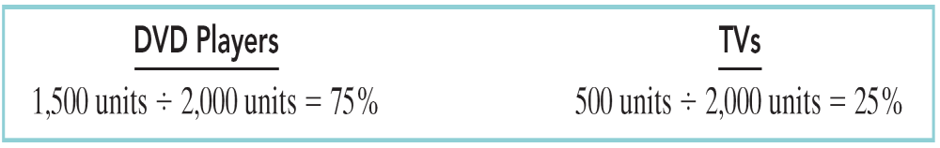
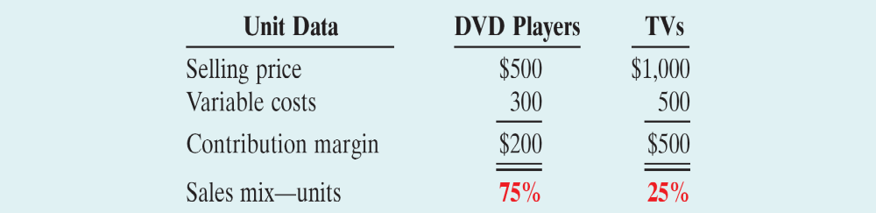
Break-Even Sales in Units - Example
Assume that Vargo Company sells two products and has the following sales mix and related information:
Notes:
1. On the topic, “Challenges Facing Financial Accounting,” what did the AICPA Special Committee on Financial Reporting suggest should be included in future financial statements?
Non-financial Measurements (customer satisfaction indexes, backlog information, and reject rates on goods purchases).
Forward-looking Information
Soft Assets (a company’s know-how, market dominance, marketing setup, well-trained employees, and brand image).
Timeliness (no real time financial information)

Slide 36
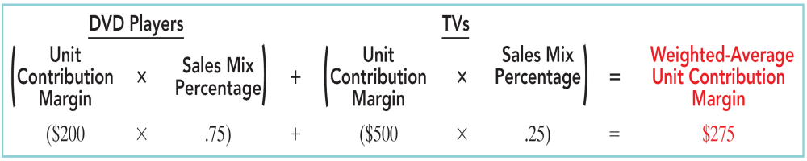
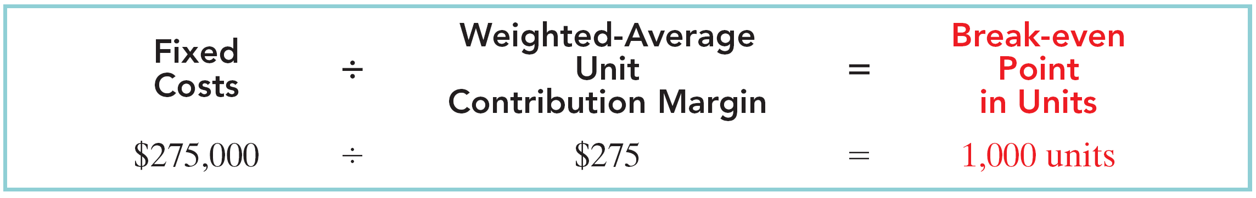
Break-Even Sales in Units - Example
First, determine the weighted-average contribution margin for Vargo’s two products:
Second, use the weighted-average unit contribution margin to compute the break-even point in units
Notes:
1. On the topic, “Challenges Facing Financial Accounting,” what did the AICPA Special Committee on Financial Reporting suggest should be included in future financial statements?
Non-financial Measurements (customer satisfaction indexes, backlog information, and reject rates on goods purchases).
Forward-looking Information
Soft Assets (a company’s know-how, market dominance, marketing setup, well-trained employees, and brand image).
Timeliness (no real time financial information)

Slide 37
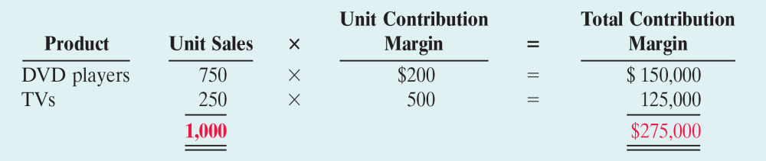
Break-Even Sales in Units - Example
With a break-even point of 1,000 units, Vargo must sell:
750 DVD Players (1,000 units x 75%)
250 TVs (1,000 units x 25%)
At this level, the total contribution margin will equal the fixed costs of $275,000
Notes:
1. On the topic, “Challenges Facing Financial Accounting,” what did the AICPA Special Committee on Financial Reporting suggest should be included in future financial statements?
Non-financial Measurements (customer satisfaction indexes, backlog information, and reject rates on goods purchases).
Forward-looking Information
Soft Assets (a company’s know-how, market dominance, marketing setup, well-trained employees, and brand image).
Timeliness (no real time financial information)

Slide 38
Break-Even Sales in Dollars
The calculation of break-even point in units works well if the company has only a few products
Consider 3M which has over 30,000 different products:
3M would need to calculate 30,000 different
unit contribution margins
When there are many products, calculate the break-even point in terms of sales dollars for divisions or product lines, NOT individual products
Notes:
1. On the topic, “Challenges Facing Financial Accounting,” what did the AICPA Special Committee on Financial Reporting suggest should be included in future financial statements?
Non-financial Measurements (customer satisfaction indexes, backlog information, and reject rates on goods purchases).
Forward-looking Information
Soft Assets (a company’s know-how, market dominance, marketing setup, well-trained employees, and brand image).
Timeliness (no real time financial information)

Slide 39
Break-Even Sales in Dollars - Example
Assume that Kale Garden Supply Company has two divisions: Indoor Plants and Outdoor Plants
Each division has hundreds of different plant types
Compute sales mix as a percentage of total dollar sales rather than units sold
and
Compute the contribution margin ratio rather than the contribution margin per unit
Notes:
1. On the topic, “Challenges Facing Financial Accounting,” what did the AICPA Special Committee on Financial Reporting suggest should be included in future financial statements?
Non-financial Measurements (customer satisfaction indexes, backlog information, and reject rates on goods purchases).
Forward-looking Information
Soft Assets (a company’s know-how, market dominance, marketing setup, well-trained employees, and brand image).
Timeliness (no real time financial information)

Slide 40
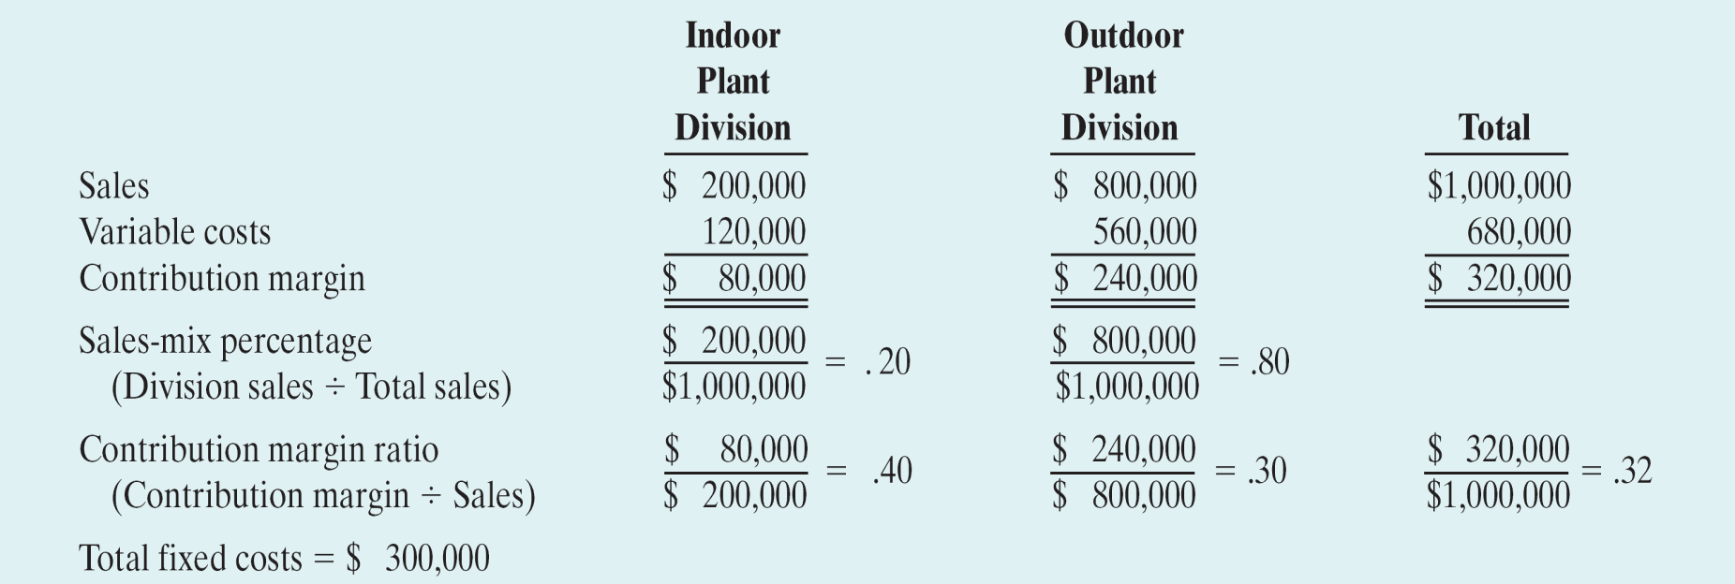
Break-Even Sales in Dollars - Example
The information necessary to perform cost-volume-profit analysis is:
Notes:
1. On the topic, “Challenges Facing Financial Accounting,” what did the AICPA Special Committee on Financial Reporting suggest should be included in future financial statements?
Non-financial Measurements (customer satisfaction indexes, backlog information, and reject rates on goods purchases).
Forward-looking Information
Soft Assets (a company’s know-how, market dominance, marketing setup, well-trained employees, and brand image).
Timeliness (no real time financial information)

Slide 41
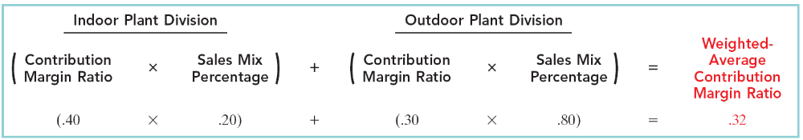
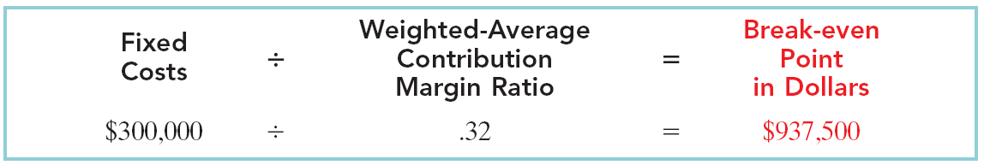
Break-Even Sales in Dollars - Example
First, determine the weighted-average contribution margin ratio for each division:
Second, use the weighted-average unit contribution margin ratio to compute the break-even point in dollars:
Notes:
1. On the topic, “Challenges Facing Financial Accounting,” what did the AICPA Special Committee on Financial Reporting suggest should be included in future financial statements?
Non-financial Measurements (customer satisfaction indexes, backlog information, and reject rates on goods purchases).
Forward-looking Information
Soft Assets (a company’s know-how, market dominance, marketing setup, well-trained employees, and brand image).
Timeliness (no real time financial information)

Slide 42
Break-Even Sales in Dollars - Example
With break-even sales of $937,500 and a sales mix of 20% to 80%, Kale must sell:
$187,500 from the Indoor Plant division
$750,000 from the Outdoor Plant division
If the sales mix between the divisions changes, the weighted-average contribution margin ratio also changes, resulting in a new break-even point in dollars.
Example - If the sales mix becomes 50% to 50%, the weighted average contribution margin ratio changes to 35%, resulting in a lower break-even point of $857,143.
Notes:
1. On the topic, “Challenges Facing Financial Accounting,” what did the AICPA Special Committee on Financial Reporting suggest should be included in future financial statements?
Non-financial Measurements (customer satisfaction indexes, backlog information, and reject rates on goods purchases).
Forward-looking Information
Soft Assets (a company’s know-how, market dominance, marketing setup, well-trained employees, and brand image).
Timeliness (no real time financial information)

Slide 43
Let’s Review
Net income will be:
a. Greater if more higher-contribution margin units are sold than lower-contribution margin units.
b. Greater is more lower-contribution margin units are sold than higher-contribution margin units.
c. Equal as song as total sales remain equal, regardless of which products are sold.
d. Unaffected by changes in the mix of products sold.

Slide 44
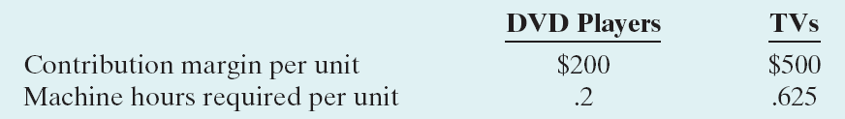
Sales Mix with Limited Resources
All companies have limited resources whether it be floor space, raw materials, direct labor hours, etc.
Limited resources force management to decide which products to sell to maximize net income.
Example: Vargo makes DVD players and TVs. The limiting resource is machine capacity – 3,600 hours per month. Relevant date is as follows:
Notes:
1. On the topic, “Challenges Facing Financial Accounting,” what did the AICPA Special Committee on Financial Reporting suggest should be included in future financial statements?
Non-financial Measurements (customer satisfaction indexes, backlog information, and reject rates on goods purchases).
Forward-looking Information
Soft Assets (a company’s know-how, market dominance, marketing setup, well-trained employees, and brand image).
Timeliness (no real time financial information)

Slide 45
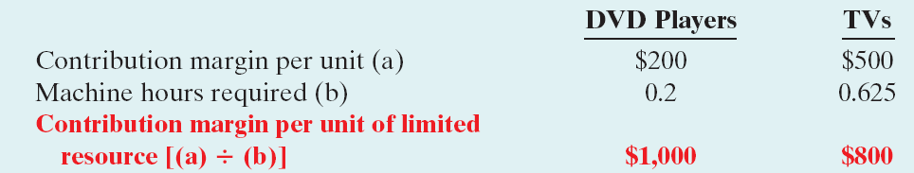
Sales Mix with Limited Resources - Example
The TVs seem to be more profitable since they have the higher contribution margin per unit, but they require more machine hours to produce than the DVD Players
To determine the appropriate sales mix, compute the contribution margin per unit of limited resource:
Since DVD players have higher contribution margin per machine hour, management should produce more DVD players if demand exists or else increase machine capacity.
Notes:
1. On the topic, “Challenges Facing Financial Accounting,” what did the AICPA Special Committee on Financial Reporting suggest should be included in future financial statements?
Non-financial Measurements (customer satisfaction indexes, backlog information, and reject rates on goods purchases).
Forward-looking Information
Soft Assets (a company’s know-how, market dominance, marketing setup, well-trained employees, and brand image).
Timeliness (no real time financial information)

Slide 46
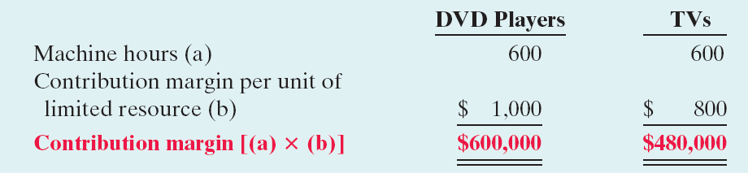
Sales Mix with Limited Resources - Example
  Alternative: Increase machine capacity from 3,600 to 4,200 hours
To maximize net income, all 600 hours should be used to produce and sell DVD players.

Slide 47

Theory of Constraints
Approach used to identify and manage constraints so as to achieve company goals
Requires identification of constraints
Continual attempts to reduce or eliminate constraints
Notes:
1. On the topic, “Challenges Facing Financial Accounting,” what did the AICPA Special Committee on Financial Reporting suggest should be included in future financial statements?
Non-financial Measurements (customer satisfaction indexes, backlog information, and reject rates on goods purchases).
Forward-looking Information
Soft Assets (a company’s know-how, market dominance, marketing setup, well-trained employees, and brand image).
Timeliness (no real time financial information)

Slide 48
Let’s Review
If the contribution margin per unit is $15 and it takes 3.0 machine hours to produce the unit, the contribution margin per unit of limited resource is:
a. $25.
b. $5.
c. $4.
d. No correct answer is given.

Slide 49

Cost Structure and Operating Leverage
Cost Structure is the relative proportion of fixed versus variable costs that a company incurs
May have a significant effect on profitability
Thus, a company must carefully choose its cost structure.
Notes:
1. On the topic, “Challenges Facing Financial Accounting,” what did the AICPA Special Committee on Financial Reporting suggest should be included in future financial statements?
Non-financial Measurements (customer satisfaction indexes, backlog information, and reject rates on goods purchases).
Forward-looking Information
Soft Assets (a company’s know-how, market dominance, marketing setup, well-trained employees, and brand image).
Timeliness (no real time financial information)

Slide 50
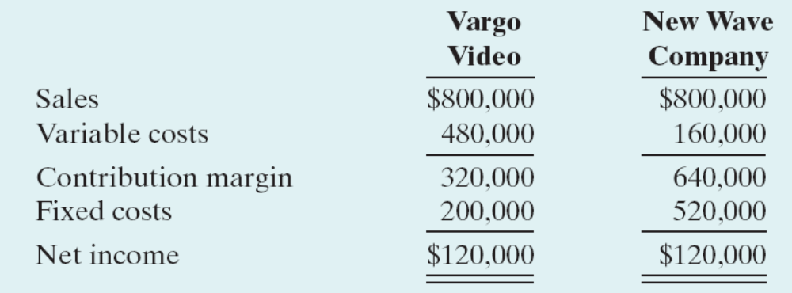
Comparison of Cost Structures
Vargo Video manufactures DVD players using a traditional, labor-intensive manufacturing process
New Wave Company also manufactures DVD players, but uses a completely automated system where factory employees only set up, adjust, and maintain the machinery.
Both companies have the same sales and net income; however, each has different risks and rewards due to changes in sales as a result of their cost structures.
Notes:
1. On the topic, “Challenges Facing Financial Accounting,” what did the AICPA Special Committee on Financial Reporting suggest should be included in future financial statements?
Non-financial Measurements (customer satisfaction indexes, backlog information, and reject rates on goods purchases).
Forward-looking Information
Soft Assets (a company’s know-how, market dominance, marketing setup, well-trained employees, and brand image).
Timeliness (no real time financial information)

Slide 51
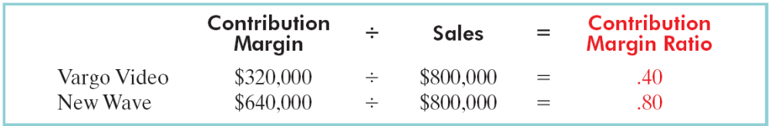
Effect on Contribution Margin Ratio
The contribution margin ratio for each company is as follows:
Thus, New Wave contributes 80 cents to net income for each dollar of increased sales while Vargo only contributes 40 cents.
However, New Wave loses 80 cents per dollar of sales decrease while Vargo only loses 40 cents.
New Wave’s cost structure which relies on fixed costs is more sensitive to changes in sales
Notes:
1. On the topic, “Challenges Facing Financial Accounting,” what did the AICPA Special Committee on Financial Reporting suggest should be included in future financial statements?
Non-financial Measurements (customer satisfaction indexes, backlog information, and reject rates on goods purchases).
Forward-looking Information
Soft Assets (a company’s know-how, market dominance, marketing setup, well-trained employees, and brand image).
Timeliness (no real time financial information)

Slide 52
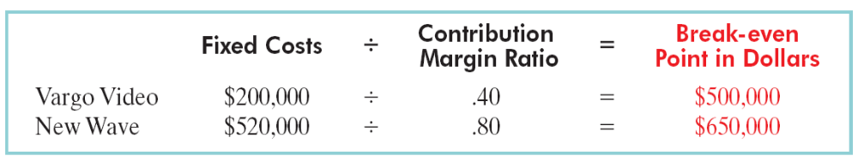
Effect on Break-even Point
The break-even point for each company is as follows:
New Wave needs to generate $150,000 more in sales than Vargo to break-even.
Because of the greater break-even sales required, New Wave is a riskier company than Vargo.
Notes:
1. On the topic, “Challenges Facing Financial Accounting,” what did the AICPA Special Committee on Financial Reporting suggest should be included in future financial statements?
Non-financial Measurements (customer satisfaction indexes, backlog information, and reject rates on goods purchases).
Forward-looking Information
Soft Assets (a company’s know-how, market dominance, marketing setup, well-trained employees, and brand image).
Timeliness (no real time financial information)

Slide 53
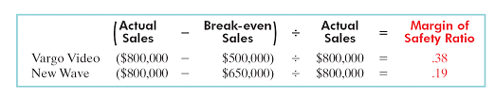
Effect on Margin of Safety Ratio
The margin of safety ratio of each company is as follows:
The difference in the margin of safety ratio reflects the difference in risk between New Wave and Vargo.
Vargo can sustain a 38% decline in sales before operating at a loss versus only a 19% decline for New Wave before it would be operating “in the red.”
Notes:
1. On the topic, “Challenges Facing Financial Accounting,” what did the AICPA Special Committee on Financial Reporting suggest should be included in future financial statements?
Non-financial Measurements (customer satisfaction indexes, backlog information, and reject rates on goods purchases).
Forward-looking Information
Soft Assets (a company’s know-how, market dominance, marketing setup, well-trained employees, and brand image).
Timeliness (no real time financial information)

Slide 54
Operating Leverage
Operating leverage refers to the extent that net income reacts to a given change in sales.
Higher fixed costs relative to variable costs cause a company to have higher operating leverage.
When sales revenues are increasing, high operating leverage means that profits will increase rapidly – a good thing.
When sales revenues are declining, too much operating leverage can have devastating consequences.
Notes:
1. On the topic, “Challenges Facing Financial Accounting,” what did the AICPA Special Committee on Financial Reporting suggest should be included in future financial statements?
Non-financial Measurements (customer satisfaction indexes, backlog information, and reject rates on goods purchases).
Forward-looking Information
Soft Assets (a company’s know-how, market dominance, marketing setup, well-trained employees, and brand image).
Timeliness (no real time financial information)

Slide 55
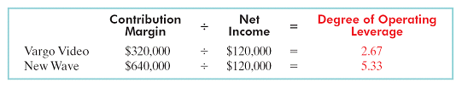
Operating Leverage
The degree of operating leverage provides a measure of a company’s earnings volatility.
The degree of operating leverage is computed by dividing total contribution margin by net income.
The computations for Vargo and New Wave are:
New Wave’s earnings would go up (or down) by about two times (5.33 ÷ 2.67 = 1.99) as much as Vargo’s with an equal increase in sales.
Notes:
1. On the topic, “Challenges Facing Financial Accounting,” what did the AICPA Special Committee on Financial Reporting suggest should be included in future financial statements?
Non-financial Measurements (customer satisfaction indexes, backlog information, and reject rates on goods purchases).
Forward-looking Information
Soft Assets (a company’s know-how, market dominance, marketing setup, well-trained employees, and brand image).
Timeliness (no real time financial information)

Slide 56
Let’s Review
The degree of operating leverage:
a. Can be computed by dividing total contribution margin by net income.
b. Provides a measure of the company’s earnings volatility.
c. Affects a company’s break-even point.
d. All of the above.

Slide 57
Chapter Review - Brief Exercise 6-9
Presto Candle Supply makes candles. The sales mix (as a percent of total dollar sales) of its three product lines is as follows: birthday candles, 30%; standard tapered candles, 50%; and large scented candles, 20%. The contribution margin ratio of each candle type is shown below.
Candle Type Contribution Margin Ratio
Birthday 10%
Standard tapered 20%
Large scented 45%
What is the weighted-average contribution margin ratio?

Slide 58
Chapter Review - Brief Exercise 6-9
Type of Candles CMR Sales Mix
Birthday 10% X 30% = 03%
Standard tapered 20% X 50% = 10%
Large scented 45% X 20% = 09%
Weighted Average Contribution Margin Ratio 22%
If the company’s fixed costs are $440,000 per year, what is the dollar amount of each type of candle that must be sold to break even?
Step 1: Fixed Costs $440,000 ÷ WA CMR 22% = $ BEP $2,000,000
Step 2:
Birthday candles $2,000,000 X 30% = $ 600,000
Standard tapered $2,000,000 X 50% = 1,000,000
Large scented $2,000,000 X 20% = 400,000

Slide 59
End of Lecture 4

