Slide 1
Lecture 32
Revision
Readings
Cost Accounting, Managerial Emphasis, 14th edition by Horengren
Managerial Accounting 6th edition by Weygandt, kimmel, kieso
Managerial Accounting 12th edition by Garrison, Noreen, Brewer

Slide 2
Learning Objectives
Use time-and-material pricing to determine the cost of services provided.
Determine a transfer price using the negotiated, cost-based, and market-based approaches.
Explain issues involved in transferring goods between divisions in different countries.
Sales Variance analysis
Describe the sources for preparing the budgeted income statement.
Explain the principal sections of a cash budget.
Indicate the applicability of budgeting in non-manufacturing companies.

Slide 3
Pricing Services
Time-and-material pricing is an approach to cost-plus pricing in which the company uses two pricing rates:
  One for labor used on a job - includes direct labor time and other employee costs.
  One for material - includes cost of direct parts and materials and a material loading charge for related overhead.
Widely used in service industries, especially professional firms such as public accounting, law, and engineering.

Slide 4
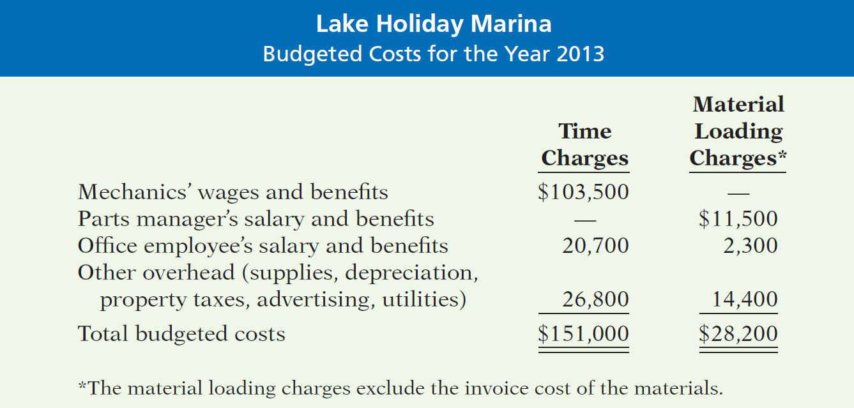
Pricing Services
Illustration: Assume the following data for Lake Holiday Marina, a boat and motor repair shop.

Slide 5
Pricing Services
Using time-and-material pricing involves three steps:
  calculate the per hour labor charge,
  calculate the charge for obtaining and holding materials, and
  calculate the charges for a particular job.

Slide 6
Pricing Services
Step 1: Calculate the labor charge.
  Express as a rate per hour of labor.
  Rate includes:
    Direct labor cost (includes fringe benefits).
    Selling, administrative, and similar overhead costs.
    Allowance for desired profit (ROI) per hour.
  Labor rate for Lake Holiday Marina for 2011 based on:
    5,000 hours of repair time.
    Desired profit margin of $8 per hour.

Slide 7
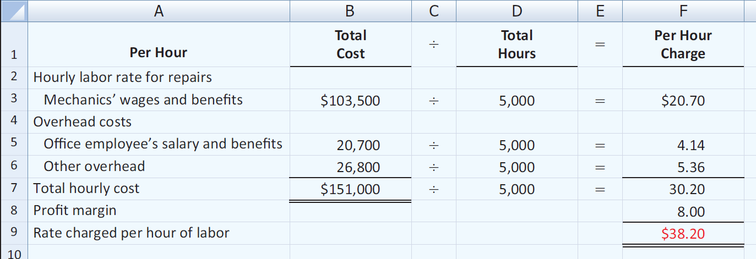
Pricing Services
Step 1: Calculate the labor charge.
Multiply the rate of $38.20 by the number of labor hours used on any particular job to determine the labor charges for the job.

Slide 8
Pricing Services
Step 2: Calculate the material loading charge.
  Material loading charge added to invoice price of materials.
  Covers the costs of purchasing, receiving, handling, storing + desired profit margin on materials.
  Expressed as a percentage of estimated costs of parts and materials for the year:
  Estimated purchasing, receiving, handling, storing costs
  Desired profit margin on materials
+
  Estimated costs of parts and materials

Slide 9
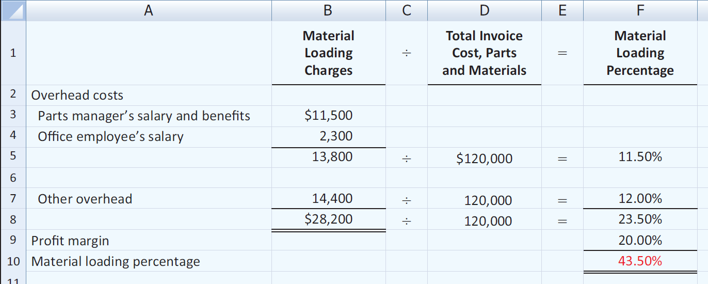
Pricing Services
Step 2: Calculate the material loading charge.
The marina estimates that the total invoice cost of parts and materials used in 2011 will be $120,000. The marina desires a 20% profit margin on the invoice cost of parts and materials.

Slide 10
Pricing Services
Step 3: Calculate charges for a particular job.
Labor charges
  +
  Material charges
  +
  Material loading charge

Slide 11
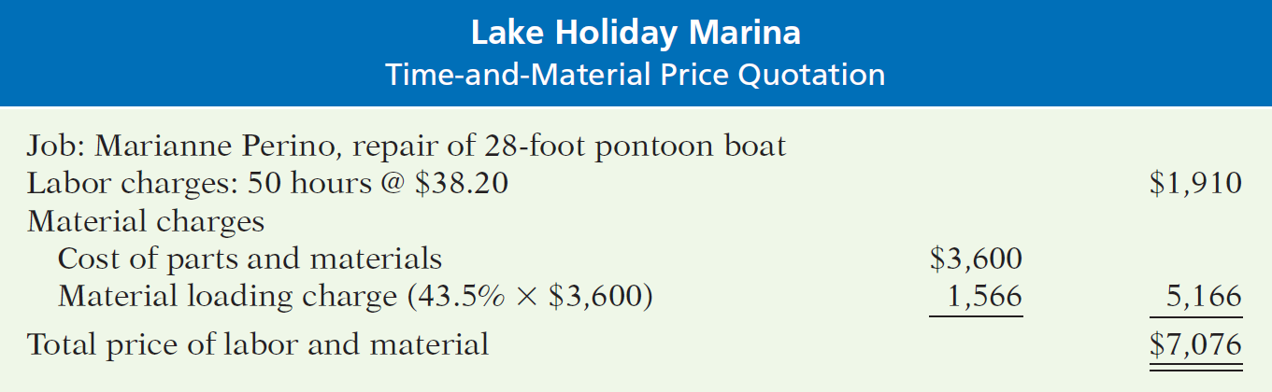
Pricing Services
Step 3: Calculate charges for a particular job.
Lake Holiday Marina prepares a price quotation to estimate the cost to refurbish a used 28-foot pontoon boat. Lake Holiday Marina estimates the job will require 50 hours of labor and $3,600 in parts and materials.

Slide 12
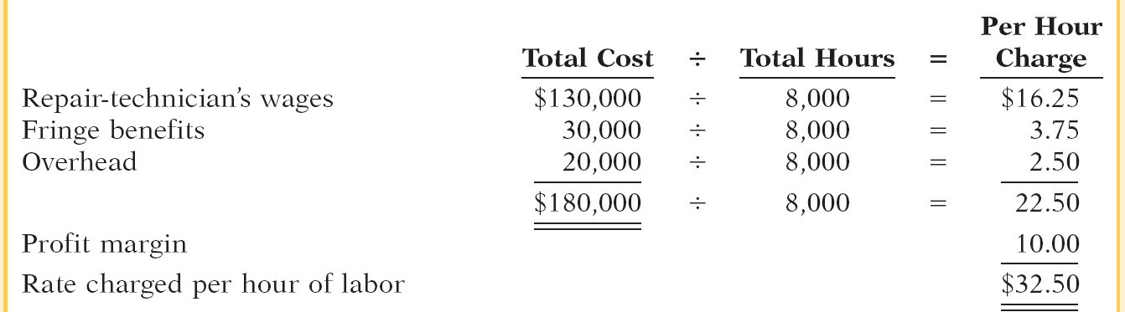
Presented below are data for Harmon Electrical Repair Shop for next year. The desired profit margin per labor hour is $10. The material loading charge is 40% of invoice cost. Harmon estimates that 8,000 labor hours will be worked next year. Compute the rate charged per hour of labor.

Slide 13
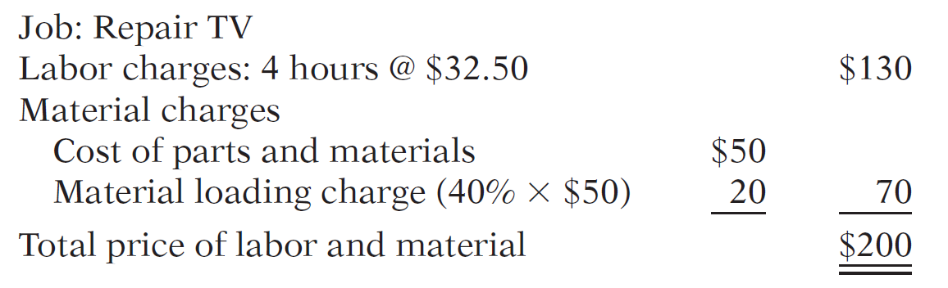
If Harmon repairs a TV that takes 4 hours to repair and uses parts of $50, compute the bill for this job.

Slide 14
Pricing Services
Review Question
Crescent Electrical Repair has decided to price its work on a time-and-material basis. It estimates the following costs for the year related to labor.
Technician wages and benefits $100,000
Office employee’s salary/benefits $40,000
Other overhead $80,000
Crescent desires a profit margin of $10 per labor hour and budgets 5,000 hours of repair time for the year. The office employee’s salary, benefits, and other overhead costs should be divided evenly between time charges and material loading charges. Crescent labor charge per hour would be:
a. $42 b. $34 c. $32 d. $30

Slide 15
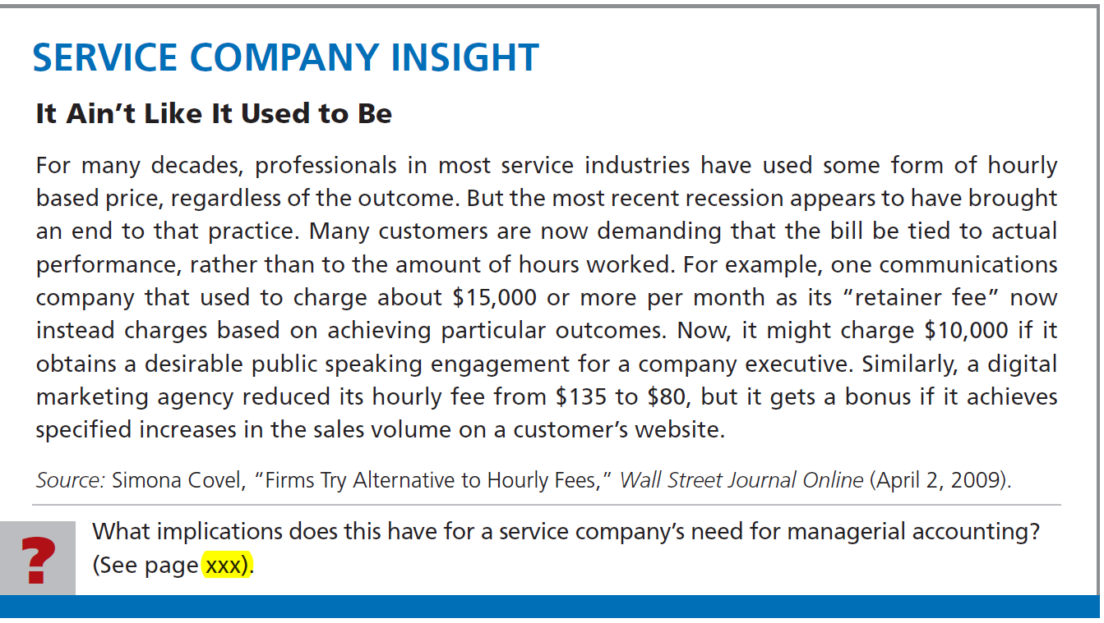

Slide 16
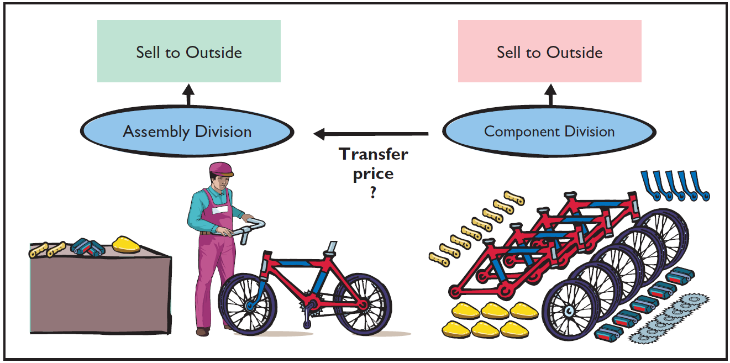
Transfer Pricing for Internal Sales
Vertically integrated companies
  Grow in either direction of its suppliers or its customers.
  Frequently transfer goods to other divisions as well as outside customers.
How do you price goods “sold” within the company?

Slide 17
Transfer Pricing for Internal Sales
Transfer price - price used to record the transfer between two divisions of a company.
  Ways to determine a transfer price:
    Negotiated transfer prices.
    Cost-based transfer prices.
    Market-based transfer prices.
  Conceptually - a negotiated transfer price is best.
  Due to practical considerations, companies often use the other two methods.

Slide 18
Transfer Pricing for Internal Sales
Negotiated Transfer Prices
Illustration: Alberta Company makes rubber soles for work & hiking boots.
  Two Divisions:
    Sole Division - sells soles externally.
    Boot Division - makes leather uppers for hiking boots which are attached to purchased soles.
  Division managers compensated on division profitability.
  Management now wants Sole Division to provide at least some soles to the Boot Division.

Slide 19
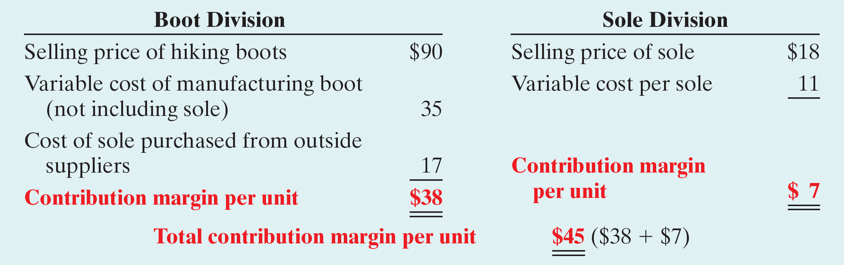
Negotiated Transfer Prices
Computation of the contribution margin per unit for each division when the Boot Division purchases soles from an outside supplier.
“What would be a fair transfer price if the Sole Division sold 10,000 soles to the Boot Division?”

Slide 20

Negotiated Transfer Prices
No Excess Capacity
  If Sole sells to Boot,
    payment must at least cover variable cost per unit plus
    its lost contribution margin per sole (opportunity cost).
  The minimum transfer price acceptable to Sole is:

Slide 21
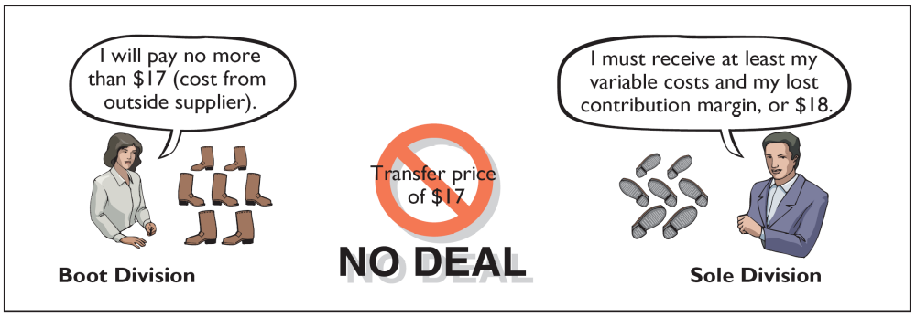
Negotiated Transfer Prices
Maximum Boot Division will pay is
what the sole would cost from an
outside buyer: $17

Slide 22

Negotiated Transfer Prices
Excess Capacity
  Can produce 80,000 soles, but can sell only 70,000.
  Available capacity of 10,000 soles.
  Contribution margin of $7 per unit is not lost.
  Minimum transfer price acceptable to Sole:

Slide 23
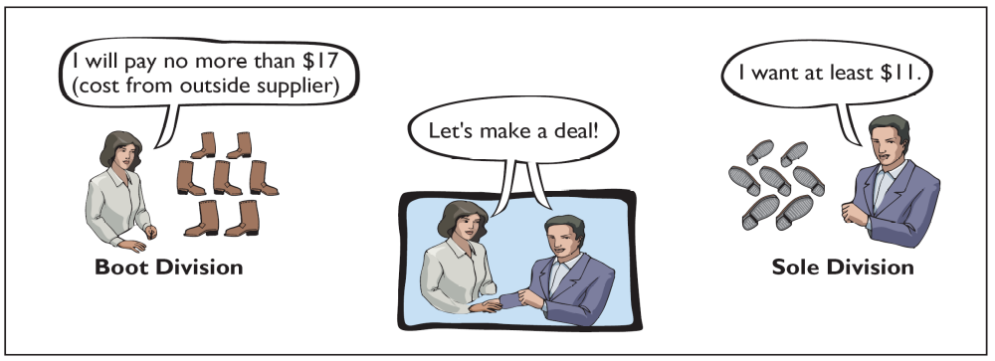
Negotiated Transfer Prices
Negotiate a transfer price between $11
(minimum acceptable to Sole) and $17
(maximum acceptable to Boot)

Slide 24
Negotiated Transfer Prices
Variable Costs
  In the minimum transfer price formula, variable cost is the variable cost of units sold internally.
  May differ - higher or lower - for units sold internally versus those sold externally.
  The minimum transfer pricing formula can still be used – just use the internal variable costs.

Slide 25
Negotiated Transfer Prices
Summary of Negotiated Transfer Pricing
  Transfer prices established:
    Minimum by selling division.
    Maximum by the purchasing division.
  Often not used because:
    Market price information sometimes not easily obtainable.
    Lack of trust between the two divisions.
    Different pricing strategies between divisions.

Slide 26
The clock division of Control Central Corporation manufactures clocks and then sells them to customers for $10 per unit. Its variable cost is $4 per unit, and its fixed cost per unit is $2.50. Management would like the clock division to transfer 8,000 of these clocks to another division within the company at a price of $5. The clock division could avoid $0.50 per clock of variable packaging costs by selling internally. (a) Determine the minimum transfer price, assuming the clock division is not operating at full capacity.
Opportunity cost + Variable cost = Minimum transfer price
$0 $3.50 $3.50

Slide 27
The clock division of Control Central Corporation manufactures clocks and then sells them to customers for $10 per unit. Its variable cost is $4 per unit, and its fixed cost per unit is $2.50. Management would like the clock division to transfer 8,000 of these clocks to another division within the company at a price of $5. The clock division could avoid $0.50 per clock of variable packaging costs by selling internally. (b) Determine the minimum transfer price, assuming the clock division is operating at full capacity.
Opportunity cost + Variable cost = Minimum transfer price
$6 $3.50 $9.50

Slide 28
Transfer Pricing for Internal Sales
Cost-Based Transfer Prices
  Uses costs incurred by the division producing the goods as its foundation.
  May be based on variable costs alone or on variable costs plus fixed costs.
  Selling division may also add markup.
  Can result in improper transfer prices causing:
    Loss of profitability for company.
    Unfair evaluation of division performance.

Slide 29
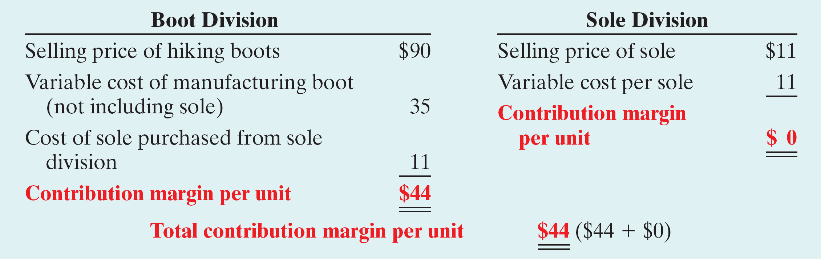
Cost-Based Transfer Prices
Illustration: Alberta Company requires the division to use a transfer price based on the variable cost of the sole. With no excess capacity, the contribution margins per unit for the two divisions are:
Cost-based transfer price—10,000 units

Slide 30
Cost-Based Transfer Prices
  Cost-based pricing is bad deal for Sole Division – no profit on transfer of 10,000 soles to Boot Division and loses profit of $70,000 on external sales.
  Boot Division is very happy; increases contribution margin by $6 per sole.
  If Sole Division has excess capacity, the division reports a zero profit on these 10,000 units and the Boot Division gains $6 per unit.

Slide 31
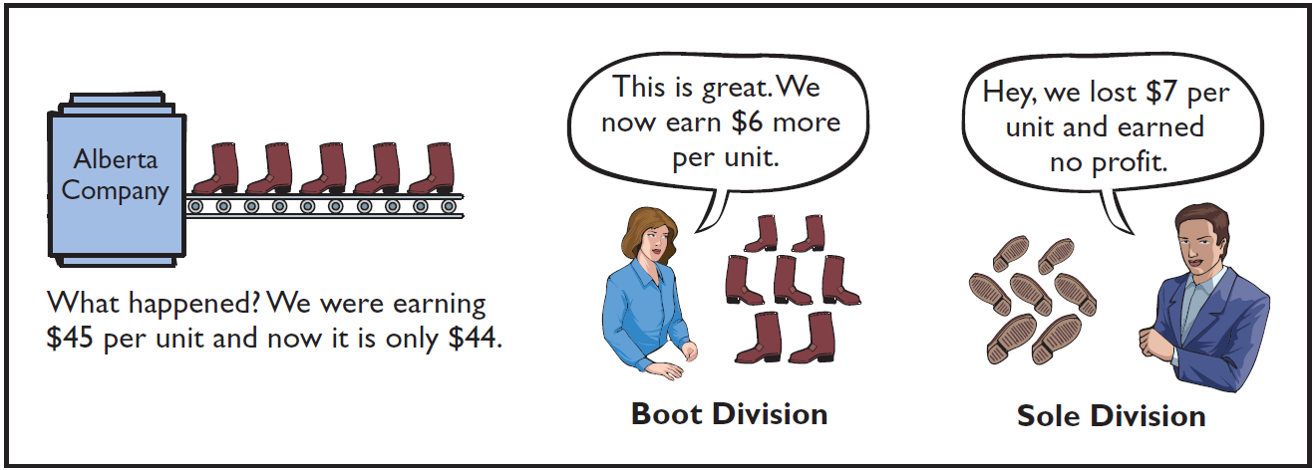
Cost-Based Transfer Prices
Overall, the Company is worse off by $60,000.
Does not reflect the division’s true profitability nor provide adequate incentive for the division to control costs.

Slide 32
Transfer Pricing for Internal Sales
Market-Based Transfer Prices
  Based on existing market prices of competing goods.
  Often considered best approach because it is objective and generally provides the proper economic incentives.
  It is indifferent between selling internally and externally if can charge/pay market price.
  Can lead to bad decisions if have excess capacity.
  Why? No opportunity cost.
  Where there is not a well-defined market price, companies use cost-based systems.

Slide 33
Market-Based Transfer Prices
Review Question
The Plastics Division of Weston Company manufactures plastic molds and then sells them for $70 per unit. Its variable cost is $30 per unit, and its fixed cost per unit is $10. Management would like the Plastics Division to transfer 10,000 of these molds to another division within the company at a price of $40. The Plastics Division is operating at full capacity. What is the minimum transfer price that the Plastics Division should accept?
a. $10 c. $40
b. $30 d. $70

Slide 34
Transfer Pricing for Internal Sales
Effect of Outsourcing on Transfer Pricing
  Outsourcing - Contracting with an external party to provide a good or service, rather than doing the work internally.
    Virtual companies outsource all of their production.
    Use incremental analysis to determine if outsourcing is profitable.
    As companies increasingly rely on outsourcing, fewer components are transferred internally thereby reducing the need for transfer pricing.

Slide 35
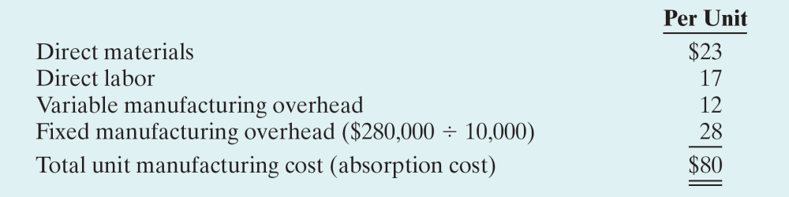
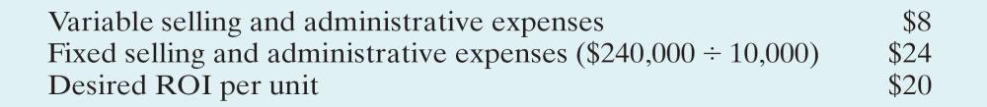
OTHER COST APPROACHES TO PRICING
Illustration
Step 1: Compute the unit manufacturing cost.
Additional information:

Slide 36
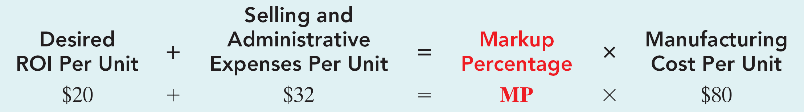
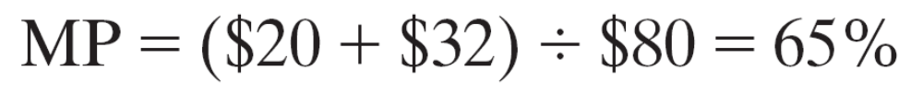
OTHER COST APPROACHES TO PRICING
Illustration
Step 2: Compute the markup percentage.

Slide 37
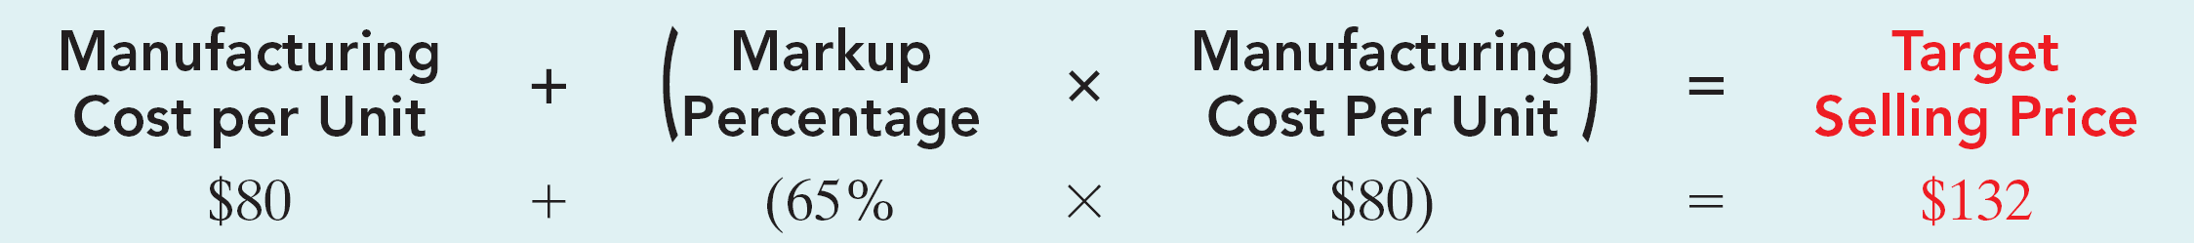
OTHER COST APPROACHES TO PRICING
Illustration
Step 3: Set the target selling price.
Because of fixed costs, if more than 10,000 units are sold, the ROI will be greater than 20% and vice versa.

Slide 38
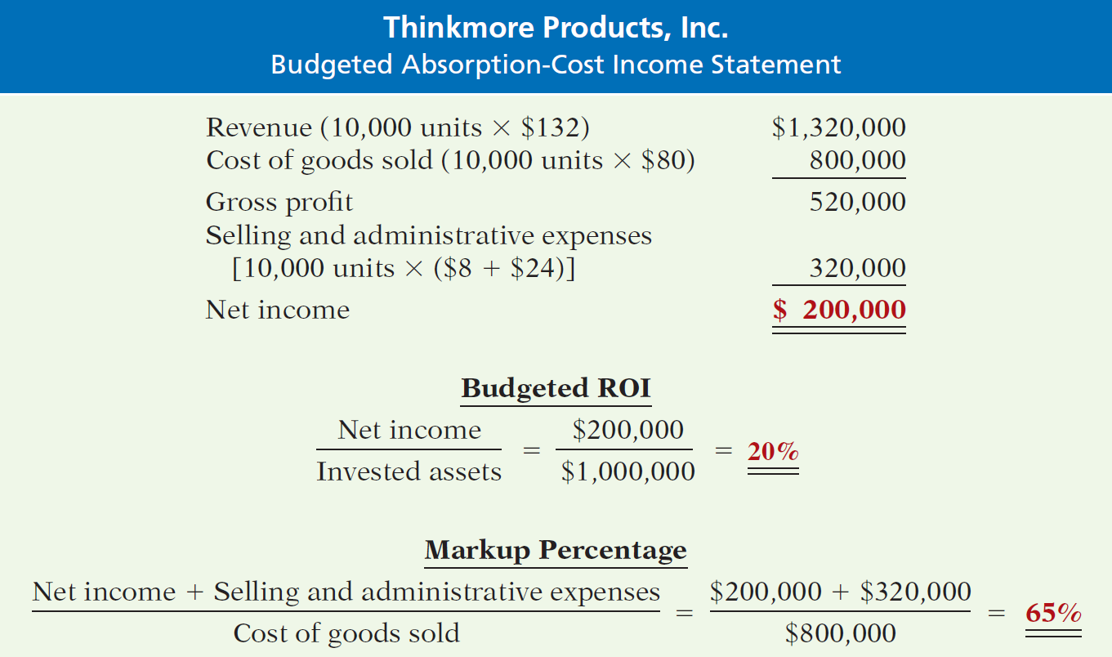
OTHER COST APPROACHES TO PRICING
Proof of 20% ROI—absorption-cost pricing

Slide 39
OTHER COST APPROACHES TO PRICING
Summary: Absorption-Cost Pricing
  Most companies that use cost-plus pricing use either absorption cost or full cost as the basis.
  Reasons:
    Information readily available – cost effective.
    Use of only variable costs may result in too low a price – suicidal price cutting.
    Most defensible base for justifying prices.

Slide 40
OTHER COST APPROACHES TO PRICING
Variable-Cost Pricing
  Cost base consists of all variable costs associated with a product – manufacturing, selling, administrative.
  Since fixed costs are not included in base, markup must provide for fixed costs (manufacturing, selling, administrative) and the target ROI.
  Useful for making short-run decisions because variable and fixed cost behaviors are considered separately.

Slide 41
OTHER COST APPROACHES TO PRICING
Variable-Cost Pricing
Steps:
  Compute the unit variable cost.
  Compute markup percentage.
  Set target selling price.

Slide 42
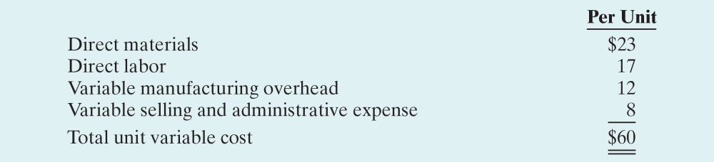
OTHER COST APPROACHES TO PRICING
Variable-Cost Pricing - Illustration
Step 1: Compute the unit variable cost.

Slide 43
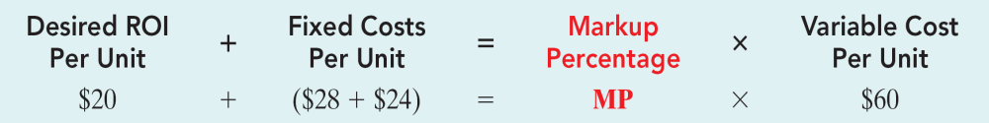
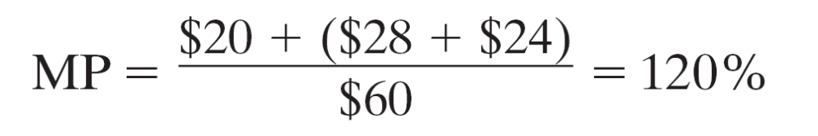
OTHER COST APPROACHES TO PRICING
Variable-Cost Pricing - Illustration
Step 2: Compute the markup percentage.

Slide 44
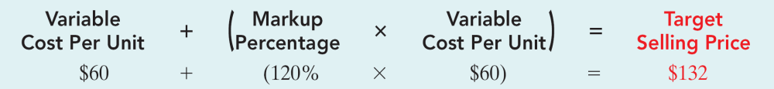
OTHER COST APPROACHES TO PRICING
Variable-Cost Pricing - Illustration
Step 3: Set target selling price.
Using the $132 target price produces the desired 20% ROI at a volume level of 10,000 units.

Slide 45
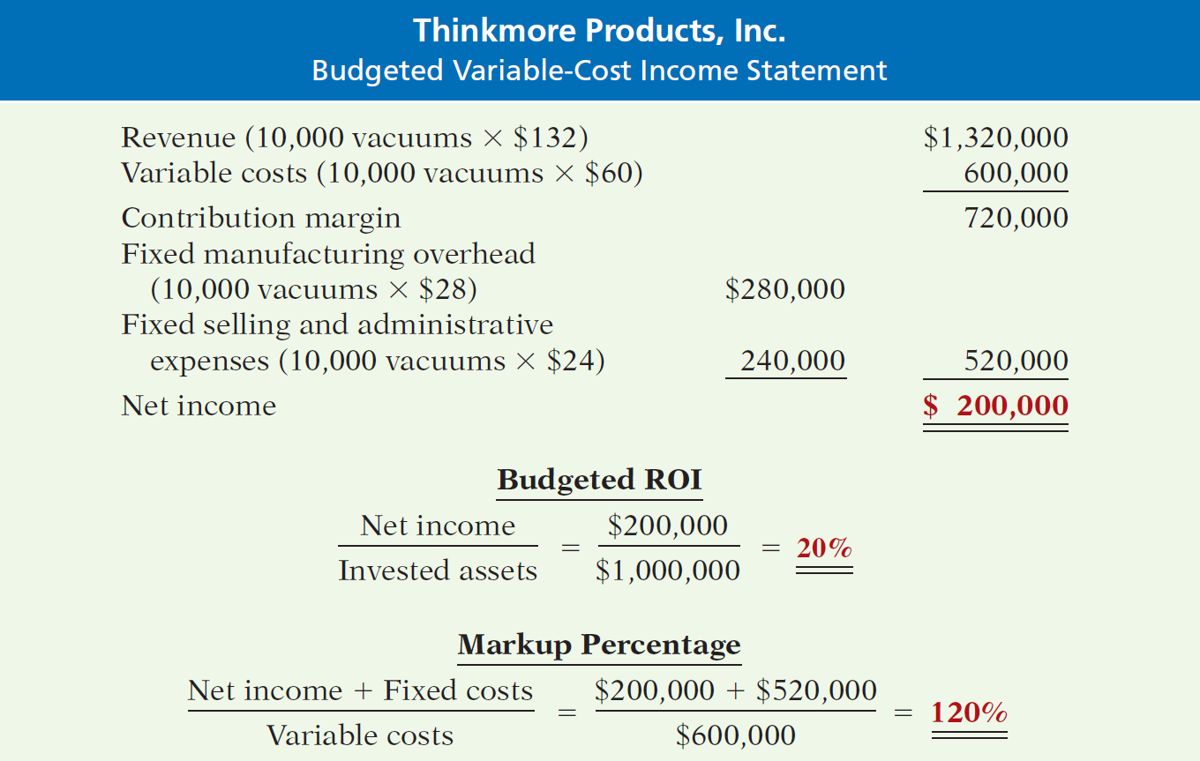
OTHER COST APPROACHES TO PRICING
Proof of 20% ROI—contribution approach

Slide 46
OTHER COST APPROACHES TO PRICING
Summary: Variable-Cost Pricing
  Avoids blurring effects of cost behavior on operating income.
  Reasons:
    More consistent with CVP analysis.
    Provides data for pricing special orders by showing incremental cost of accepting one more order.
    Avoids arbitrary allocation of common fixed costs to individual product lines.

Slide 47
Sales Variances
Level 1: Static-budget variance – the difference between an actual result and the static-budgeted amount
Level 2: Flexible-budget variance – the difference between an actual result and the flexible-budgeted amount
Level 2: Sales-volume variance
Level 3: Sales Quantity variance
Level 3: Sales Mix variance

Slide 48
Sales-Mix Variance
Measures shifts between selling more or less of higher or lower profitable products

Slide 49
Sales-Quantity Variance

Slide 50
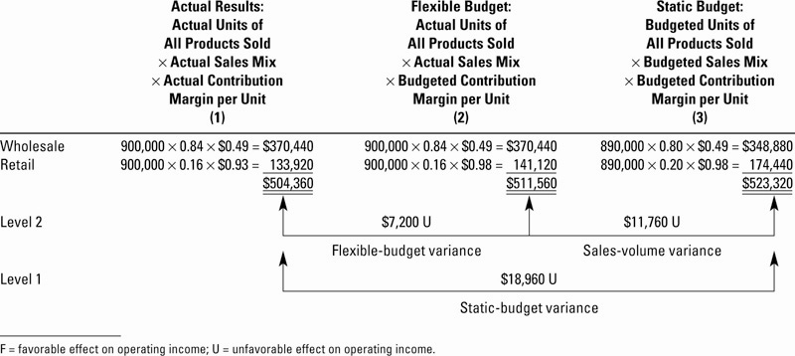
Flexible-Budget and Sales-Volume Variances Illustrated

Slide 51
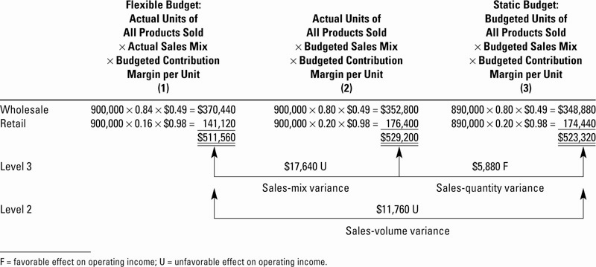
Sales-Mix and –Quantity Variances Illustrated

Slide 52
Market-Share Variance

Slide 53
Market-Size Variance

Slide 54
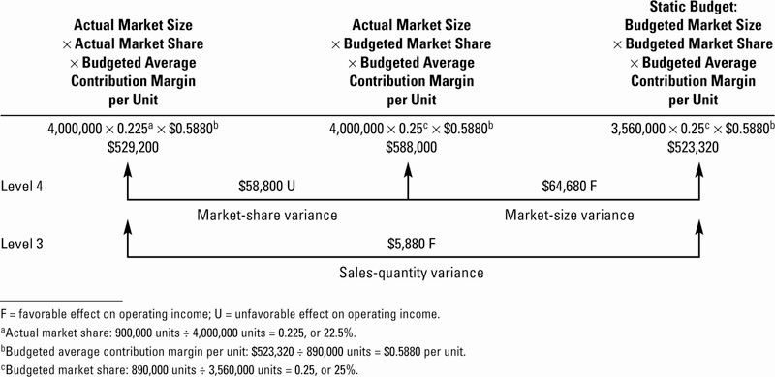
Market-Share and –Size Variances Illustrated

Slide 55
Market-Share and Market-Size Variances
Limitation: reliable information on the actual size and share of various markets is not always available
These are considered Level 4 variances (a decomposition of the Sales-Quantity variance

Slide 56
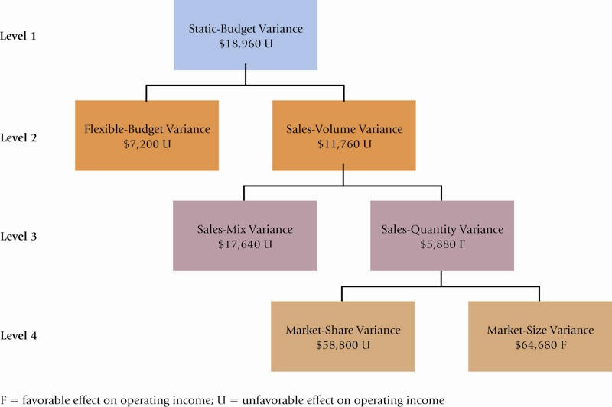
Sales Variances Summarized

Slide 57
Budgeting Basics
Budget: a formal written statement of management’s plans for a specified future time period, expressed in financial terms.
  Primary way to communicate agreed-upon objectives to all parts of the company.
  Promotes efficiency.
  Control device - important basis for performance evaluation once adopted.

Slide 58
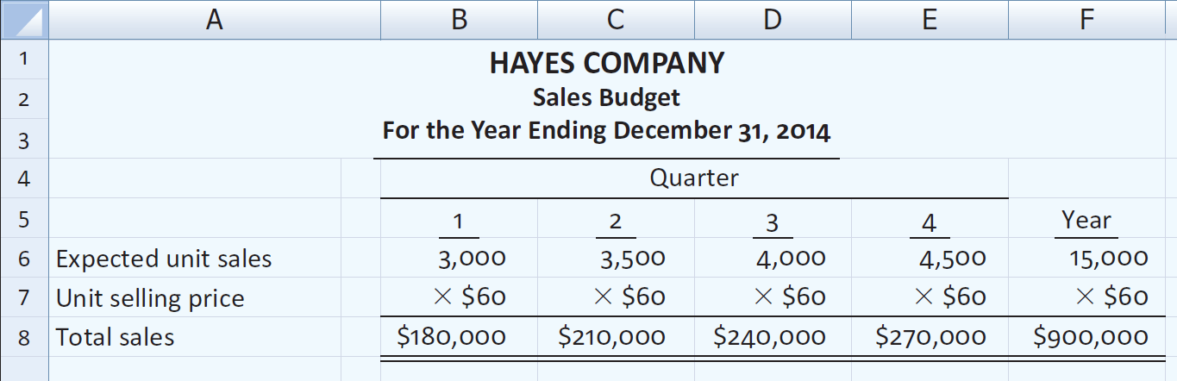
Preparing the Operating Budgets
Illustration – Hayes Company
Expected sales volume: 3,000 units in the first quarter with 500-unit increases in each succeeding quarter.
Sales price: $60 per unit.

Slide 59

Preparing the Operating Budgets
Production Budget
  Shows units that must be produced to meet anticipated sales.
  Derived from sales budget plus the desired change in ending finished goods inventory.
  Essential to have a realistic estimate of ending inventory.

Slide 60
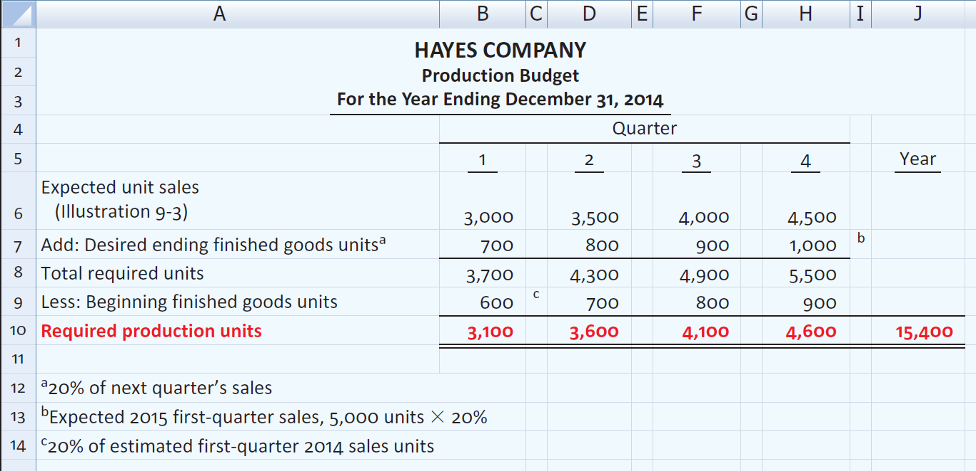
Preparing the Operating Budgets
Illustration – Hayes Company
Hayes Co. believes it can meet future sales needs with an ending inventory of 20% of next quarter’s sales.

Slide 61
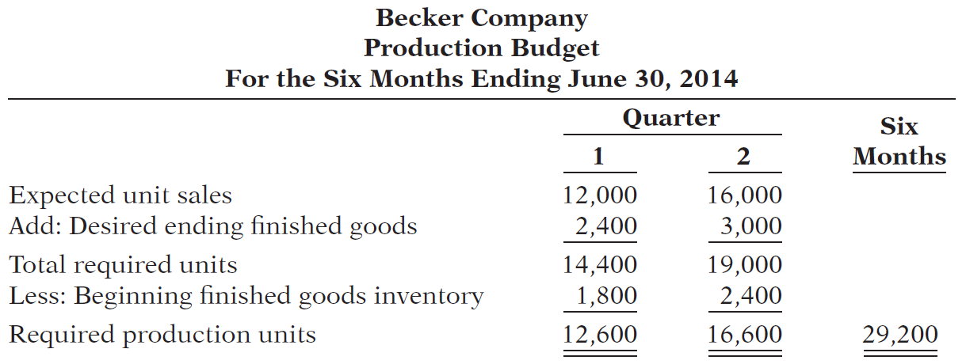
Becker Company estimates that 2014 unit sales will be 12,000 in quarter 1, 16,000 in quarter 2, and 20,000 in quarter 3, at a unit selling price of $30. Management desires to have ending finished goods inventory equal to 15% of the next quarter’s expected unit sales. Prepare a production budget by quarter for the first 6 months of 2014.

Slide 62
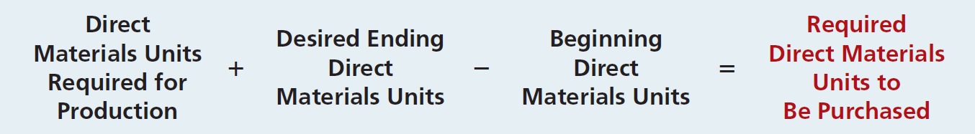
Preparing the Operating Budgets
Direct Materials Budget
  Shows both the quantity and cost of direct materials to be purchased.
  Formula for direct materials quantities.
  Budgeted cost of direct materials to be purchased = required units of direct materials x anticipated cost per unit.
  Inadequate inventories could result in temporary shutdowns of production.

Slide 63
Preparing the Operating Budgets
Illustration – Hayes Company
  Because of its close proximity to suppliers,
    Hayes Company maintains an ending inventory of raw materials equal to 10% of the next quarter’s production requirements.
    The manufacture of each Rightride requires 2 pounds of raw materials, and the expected cost per pound is $4.
    Assume that the desired ending direct materials amount is 1,020 pounds for the fourth quarter of 2011.
    Prepare a Direct Materials Budget.

Slide 64
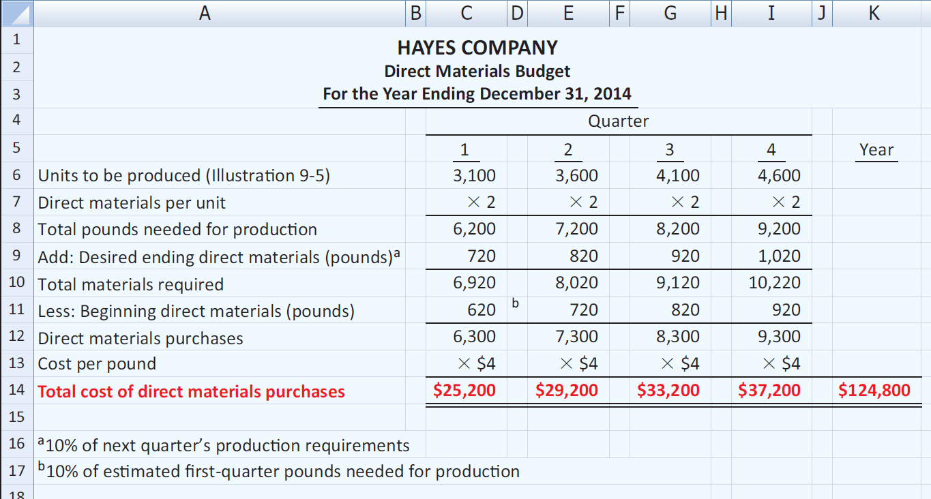
Preparing the Operating Budgets
Illustration – Hayes Company

Slide 65
Soriano Company is preparing its master budget for 2014. Relevant data pertaining to its sales, production, and direct materials budgets are as follows:
Sales: Sales for the year are expected to total 1,200,000 units. Quarterly sales are 20%, 25%, 30%, and 25% respectively. The sales price is expected to be $50 per unit for the first three quarters and $55 per unit beginning in the fourth quarter. Sales in the first quarter of 2015 are expected to be 10% higher than the budgeted sales for the first quarter of 2014.
Production: Management desires to maintain ending finished goods inventories at 25% of next quarter’s budgeted sales volume.
Direct materials: Each unit requires 3 pounds of raw materials at a cost of $5 per pound. Management desires to maintain raw materials inventories at 5% of the next quarter’s production requirements. Assume the production requirements for the first quarter of 2015 are 810,000 pounds.

Slide 66
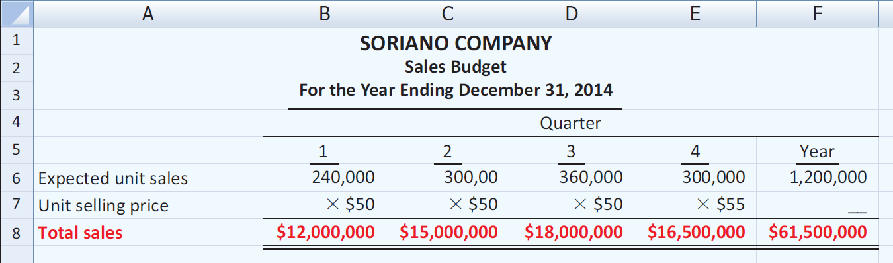
Prepare the sales, production, and direct materials budgets by quarters for 2014.

Slide 67
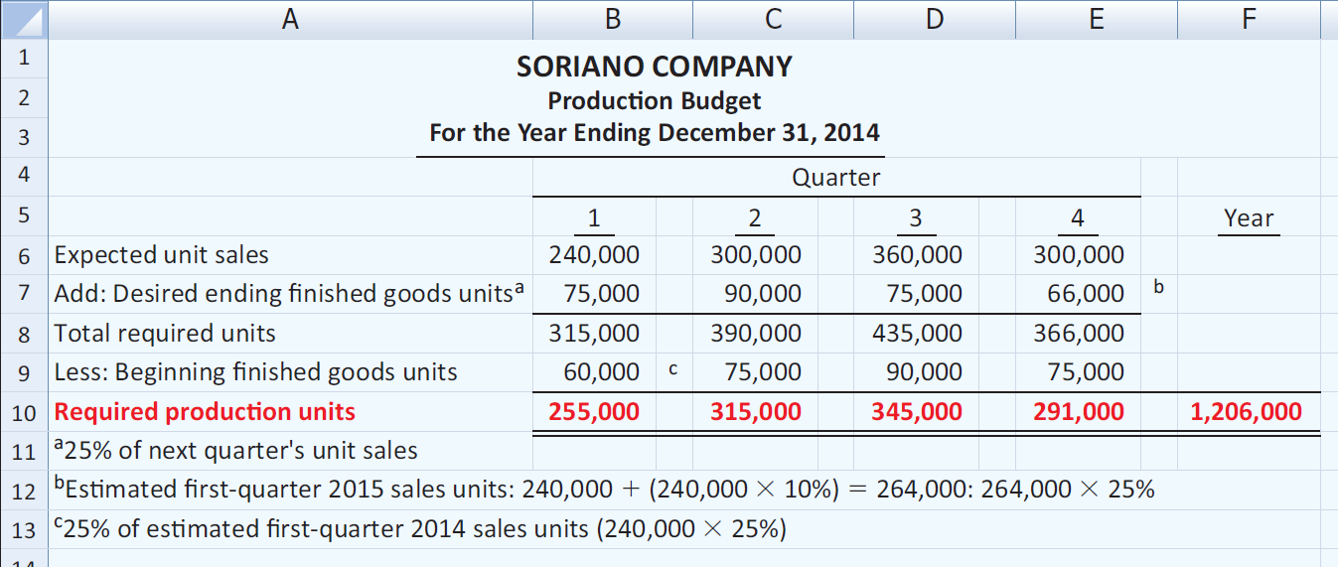
Prepare the sales, production, and direct materials budgets by quarters for 2014.

Slide 68
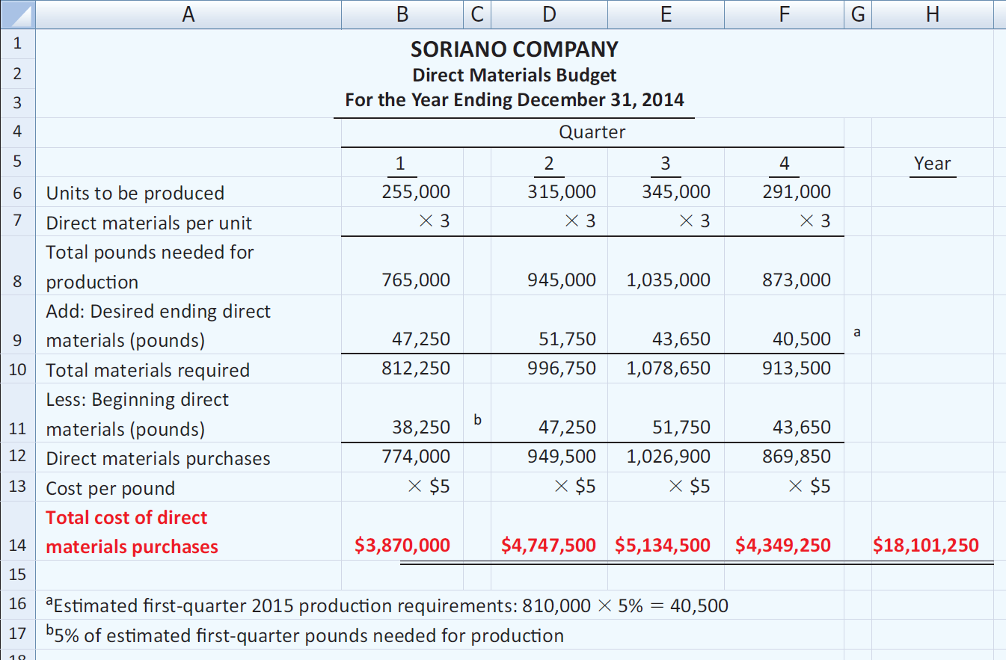
Prepare the sales, production, and direct materials budgets.

Slide 69

Preparing the Operating Budgets
Direct Labor Budget
  Shows both the quantity of hours and cost of direct labor necessary to meet production requirements.
  Critical in maintaining a labor force that can meet expected production.
  Total direct labor cost formula:

Slide 70
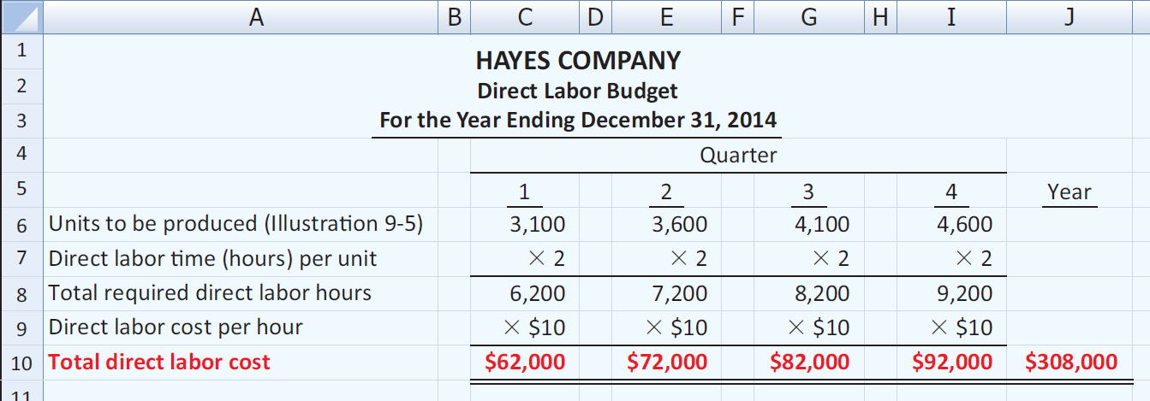
Preparing the Operating Budgets
Illustration: Direct labor hours are determined from the production budget. At Hayes Company, two hours of direct labor are required to produce each unit of finished goods. The anticipated hourly wage rate is $10.

Slide 71
Preparing the Operating Budgets
Manufacturing Overhead Budget
  Shows the expected manufacturing overhead costs for the budget period.
  Distinguishes between fixed and variable overhead costs.

Slide 72
Manufacturing Overhead Budget
Illustration: Hayes Company expects variable costs to fluctuate with production volume on the basis of the following rates per direct labor hour: indirect materials $1.00, indirect labor $1.40, utilities $0.40, and maintenance $0.20. Thus, for the 6,200 direct labor hours to produce 3,100 units, budgeted indirect materials are $6,200 (6,200 x $1), and budgeted indirect labor is $8,680 (6,200 x $1.40). Hayes also recognizes that some maintenance is fixed. The amounts reported for fixed costs are assumed.
Prepare a Manufacturing Overhead Budget.

Slide 73
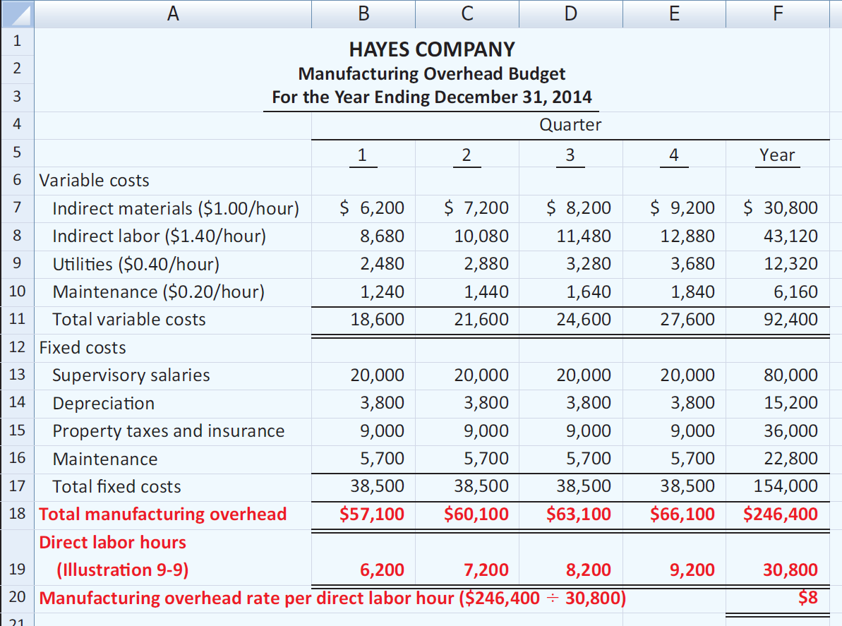
Manufacturing Overhead Budget

Slide 74
Preparing the Operating Budgets
Selling and Administrative Expense Budget
  Projection of anticipated operating expenses.
  Distinguishes between fixed and variable costs.
Illustration: Variable expense rates per unit of sales are sales commissions $3 and freight-out $1. Variable expenses per quarter are based on the unit sales from the sales budget (Illustration 9-3). Hayes expects sales in the first quarter to be 3,000 units. Fixed expenses are based on assumed data.
Prepare a selling and administrative expense budget.

Slide 75
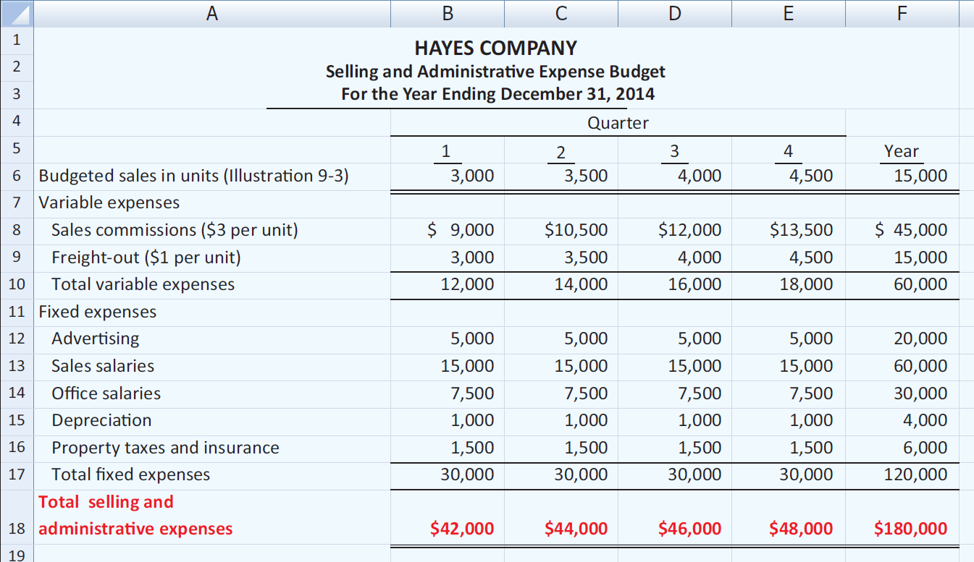
Selling and Administrative Expense Budget

Slide 76
Preparing the Operating Budgets
Budgeted Income Statement
  Important end-product of the operating budgets.
  Indicates expected profitability of operations.
  Provides a basis for evaluating company performance.
  Prepared from the operating budgets:
Sales
Direct Materials
Direct Labor
Manufacturing Overhead
Selling and Administrative Expense

Slide 77
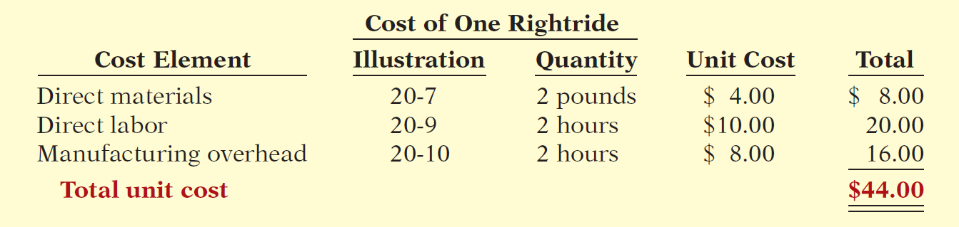
Budgeted Income Statement
Illustration: To find the cost of goods sold, it is first necessary to determine the total unit cost of producing one Rightride, as follows.
Second, determine Cost of Goods Sold by multiplying units sold times unit cost: 15,000 units x $44 = $660,000

Slide 78
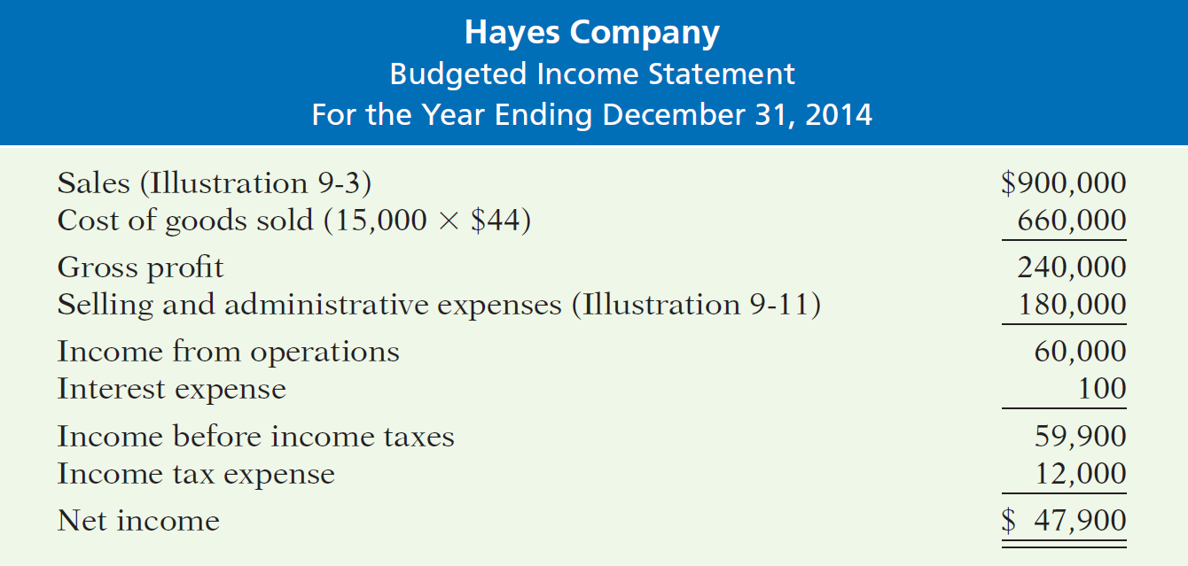
Preparing the Operating Budgets
Illustration: All data for the income statement come from the individual operating budgets except the following: (1) interest expense is expected to be $100, and (2) income taxes are estimated to be $12,000.

Slide 79
Soriano Company is preparing its budgeted income statement for 2014. Relevant data pertaining to its sales, production, and direct materials budgets can be found on the following slide. Soriano budgets 0.5 hours of direct labor per unit, labor costs at $15 per hour, and manufacturing overhead at $25 per direct labor hour. Its budgeted selling and administrative expenses for 2011 are $12,000,000. (a) Calculate the budgeted total unit cost. (b) Prepare the budgeted income statement for 2011.

Slide 80
Soriano Company is preparing its master budget for 2014. Relevant data pertaining to its sales, production, and direct materials budgets are as follows:
Sales: Sales for the year are expected to total 1,200,000 units. Quarterly sales are 20%, 25%, 30%, and 25% respectively. The sales price is expected to be $50 per unit for the first three quarters and $55 per unit beginning in the fourth quarter. Sales in the first quarter of 2015 are expected to be 10% higher than the budgeted sales for the first quarter of 2014.
Production: Management desires to maintain ending finished goods inventories at 25% of next quarter’s budgeted sales volume.
Direct materials: Each unit requires 3 pounds of raw materials at a cost of $5 per pound. Management desires to maintain raw materials inventories at 5% of the next quarter’s production requirements. Assume the production requirements for the first quarter of 2015 are 810,000 pounds.

Slide 81
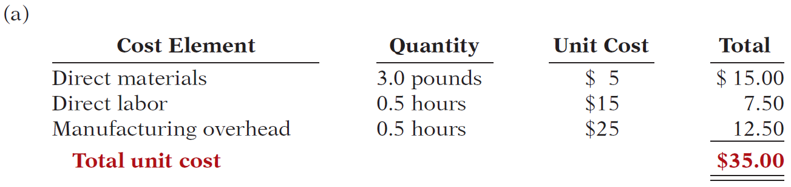
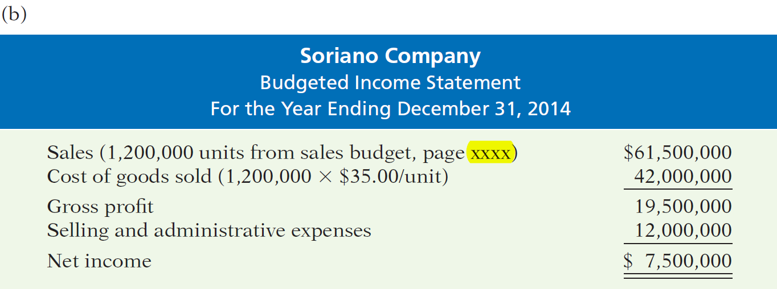

Calculate the budgeted total unit cost and prepare the budgeted income statement for 2014.

Slide 82
Cash Budget
Illustration – Hayes Company Assumptions
The January 1, 2014, cash balance is expected to be $38,000. Hayes wishes to maintain a balance of at least $15,000.
Sales (Illustration 9-3): 60% are collected in the quarter sold and 40% are collected in the following quarter. Accounts receivable of $60,000 at December 31, 2013, are expected to be collected in full in the first quarter of 2014.
Short-term investments are expected to be sold for $2,000 cash in the first quarter.
Continued

Slide 83
Preparing the Financial Budgets
Illustration – Hayes Company Assumptions
Direct materials (Illustration 9-7): 50% are paid in the quarter purchased and 50% are paid in the following quarter. Accounts payable of $10,600 at December 31, 2013, are expected to be paid in full in the first quarter of 2014.
Direct labor (Illustration 9-9): 100% is paid in the quarter incurred.
Manufacturing overhead (Illustration 9-10) and selling and administrative expenses (Illustration 9-11): All items except depreciation are paid in the quarter incurred.
Management plans to purchase a truck in the second quarter for $10,000 cash.

Slide 84
Preparing the Financial Budgets
Illustration – Hayes Company Assumptions
Hayes makes equal quarterly payments of its estimated annual income taxes.
Loans are repaid in the earliest quarter in which there is sufficient cash (that is, when the cash on hand exceeds the $15,000 minimum required balance).
Prepare a schedule of collections from customers.

Slide 85
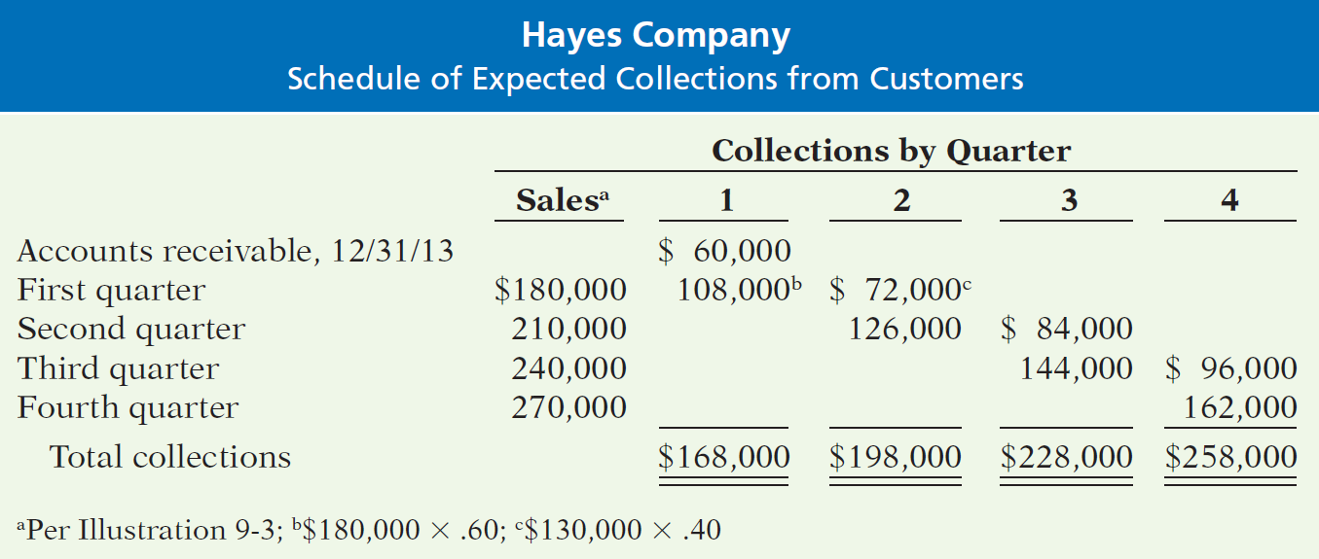
Preparing the Financial Budgets
Illustration – Prepare a schedule of collections from customers.

Slide 86
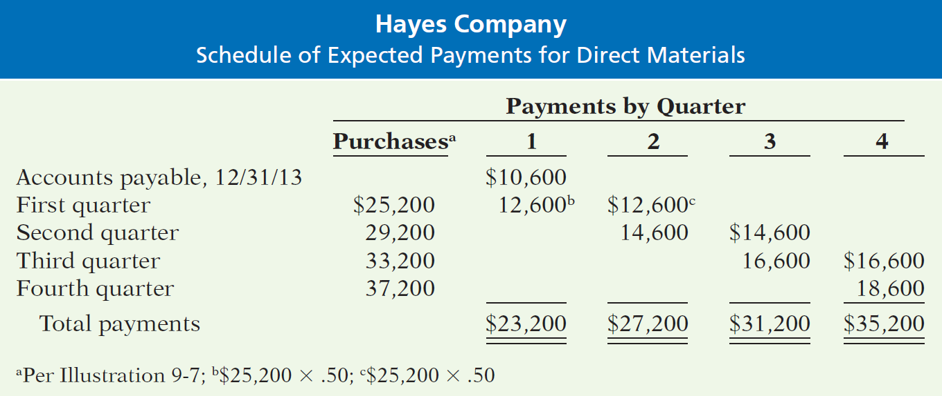
Preparing the Financial Budgets
Illustration – Prepare a schedule of cash payments for direct materials.

Slide 87
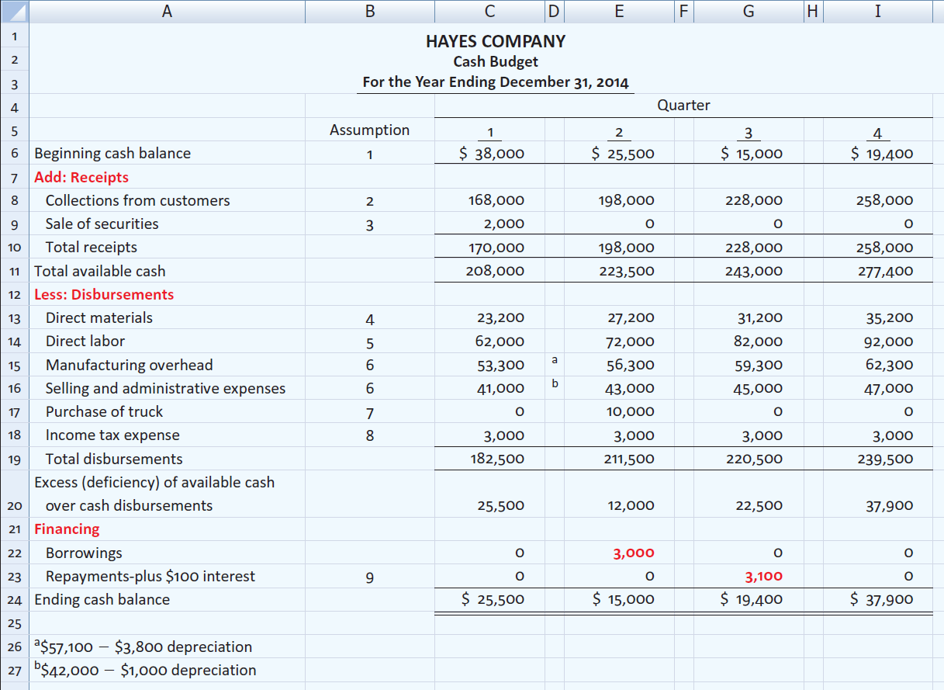
Preparing the Financial Budgets
Illustration

Slide 88
Preparing the Financial Budgets
Budgeted Balance Sheet
Developed from the budgeted balance sheet for the preceding year and the budgets for the current year.
Illustration: Pertinent data from the budgeted balance sheet at December 31, 2013, are as follows.

Slide 89
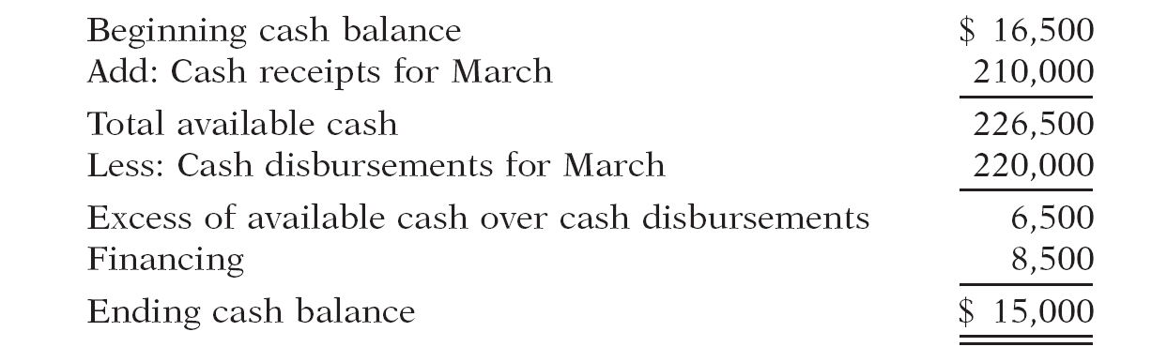
Martian Company management wants to maintain a minimum monthly cash balance of $15,000. At the beginning of March, the cash balance is $16,500, expected cash receipts for March are $210,000, and cash disbursements are expected to be $220,000. How much cash, if any, must be borrowed to maintain the desired minimum monthly balance?

Slide 90

Budgeting in Nonmanufacturing Companies
Merchandisers
Sales Budget: starting point and key factor in developing the master budget.
Use a purchases budget instead of a production budget.
Does not use the manufacturing budgets (direct materials, direct labor, manufacturing overhead).
To determine budgeted merchandise purchases:

Slide 91
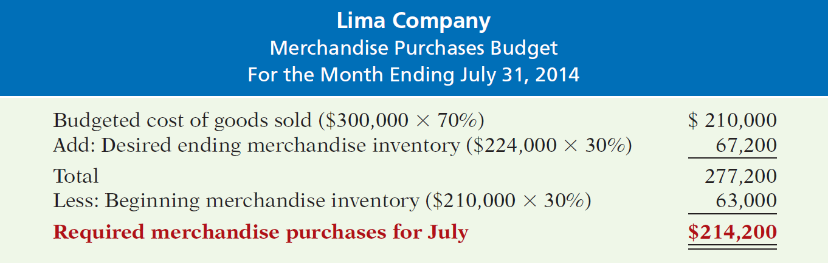
Budgeting in Nonmanufacturing Companies
Illustration: Lima’s budgeted sales for July $300,000 and for August $320,000. Cost of Goods Sold: 70% of sales. Desired ending inventory is 30% of next month’s Cost of Goods Sold. Required merchandise purchases for July are computed as follows.

Slide 92
End of Lecture 32
Notes:
End of chapter 14.

