Slide 1
Chapter 3
Lecture 3
Cost-Volume-Profit Analysis

Slide 2
A Five-Step Decision Making Process in Planning & Control Revisited
Identify the problem and uncertainties
Obtain information
Make predictions about the future
Make decisions by choosing between alternatives, using Cost-Volume-Profit (CVP) analysis
Implement the decision, evaluate performance, and learn

Slide 3
Foundational Assumptions in CVP
Changes in production/sales volume are the sole cause for cost and revenue changes
Total costs consist of fixed costs and variable costs
Revenue and costs behave and can be graphed as a linear function (a straight line)
Selling price, variable cost per unit and fixed costs are all known and constant
In many cases only a single product will be analyzed. If multiple products are studied, their relative sales proportions are known and constant
The time value of money (interest) is ignored

Slide 4
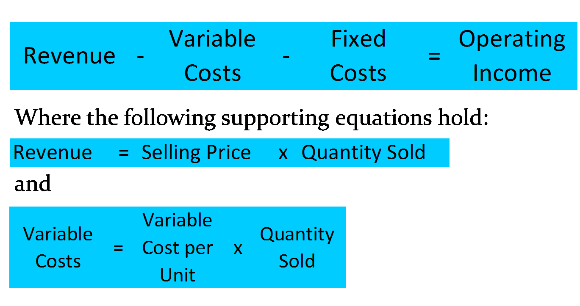
Basic Formulae

Slide 5
CVP: Contribution Margin
Manipulation of the basic equations yields an extremely important and powerful tool extensively used in Cost Accounting: the Contribution Margin
Contribution Margin equals sales less variable costs
  CM = S – VC
Contribution Margin per Unit equals unit selling price less variable cost per unit
  CMu = SP – VCu

Slide 6
Contribution Margin, continued
Contribution Margin also equals contribution margin per unit multiplied by the number of units sold (Q)
  CM = CMu x Q
Contribution Margin Ratio (percentage) equals contribution margin per unit divided by Selling Price
  CMR = CMu ÷ SP
  Interpretation: how many cents out of every sales dollar are represented by Contribution Margin

Slide 7
Basic Formula Derivations
The Basic Formula may be further rearranged and decomposed as follows:
Sales – VC – FC = Operating Income (OI)
(SP x Q) – (VCu x Q) – FC = OI
Q (SP – VCu) – FC = OI
Q (CMu) – FC = OI
Remember this last equation, it will be used again in a moment

Slide 8
Breakeven Point
Recall the last equation in an earlier slide:
  Q (CMu) – FC = OI
A simple manipulation of this formula, and setting OI to zero will result in the Breakeven Point (quantity):
  BEQ = FC ÷ CMu
At this point, a firm has no profit or loss at the given sales level
If per-unit values are not available, the Breakeven Point may be restated in its alternate format:
BE Sales = FC ÷ CMR

Slide 9
Breakeven Point, extended:
Profit Planning
With a simple adjustment, the Breakeven Point formula can be modified to become a Profit Planning tool.
  Profit is now reinstated to the BE formula, changing it to a simple sales volume equation
  Q = (FC + OI)
  CM

Slide 10
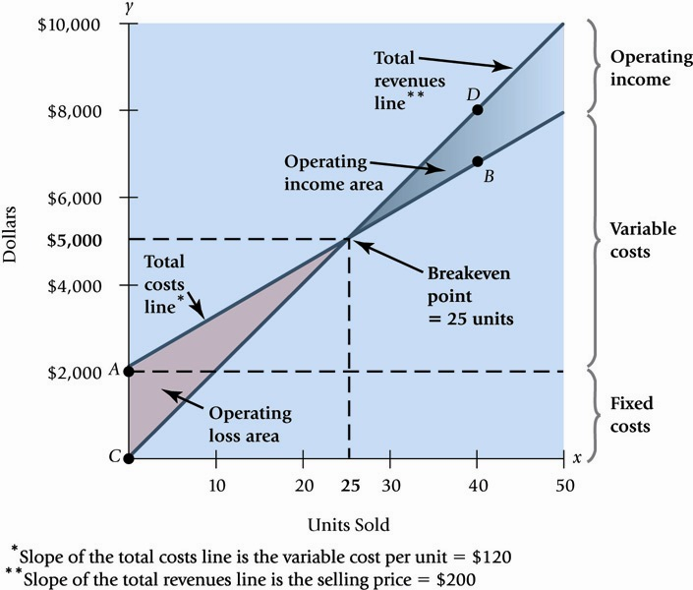
CVP: Graphically

Slide 11
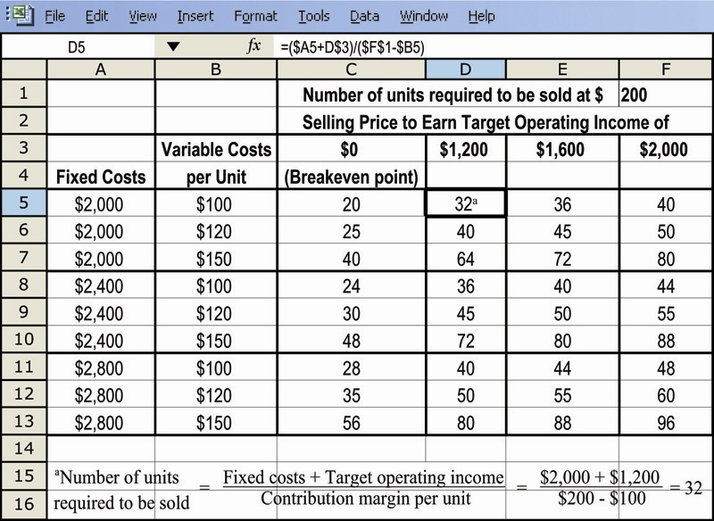
Profit Planning, Illustrated

Slide 12
CVP and Income Taxes
From time to time it is necessary to move back and forth between pre-tax profit (OI) and after-tax profit (NI), depending on the facts presented
After-tax profit can be calculated by:
  OI x (1-Tax Rate) = NI
NI can substitute into the profit planning equation through this form:
  OI = I I NI I
  (1-Tax Rate)

Slide 13
Sensitivity Analysis
CVP Provides structure to answer a variety of “what-if” scenarios
“What” happens to profit “if”:
  Selling price changes
  Volume changes
  Cost structure changes
    Variable cost per unit changes
    Fixed cost changes

Slide 14
Margin of Safety
One indicator of risk, the Margin of Safety (MOS) measures the distance between budgeted sales and breakeven sales:
  MOS = Budgeted Sales – BE Sales
The MOS Ratio removes the firm’s size from the output, and expresses itself in the form of a percentage:
  MOS Ratio = MOS ÷ Budgeted Sales

Slide 15
Operating Leverage
Operating Leverage (OL) is the effect that fixed costs have on changes in operating income as changes occur in units sold, expressed as changes in contribution margin
  OL = Contribution Margin
  Operating Income
Notice these two items are identical, except for fixed costs

Slide 16
Effects of Sales-Mix on CVP
The formulae presented to this point have assumed a single product is produced and sold
A more realistic scenario involves multiple products sold, in different volumes, with different costs
The same formulae are used, but instead use average contribution margins for bundles of products.

Slide 17
Multiple Cost Drivers
Variable costs may arise from multiple cost drivers or activities. A separate variable cost needs to be calculated for each driver. Examples include:
  Customer or patient count
  Passenger miles
  Patient days
  Student credit-hours

Slide 18
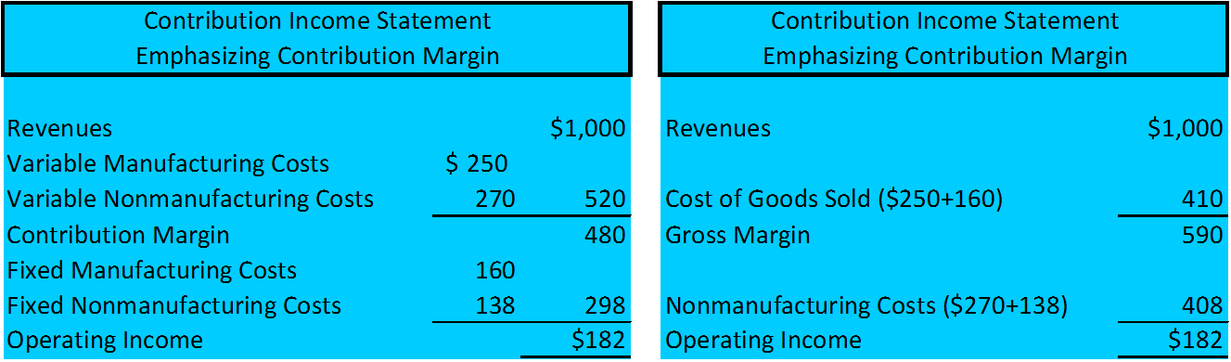
Alternative Income Statement Formats

Slide 19
Cost-Volume-Profit
Cost Behavior Analysis
Cost-Volume-Profit Analysis
Variable costs
Fixed costs
Relevant range
Mixed costs
Identifying variable and fixed costs
Basic components
CVP income statement
Break-even analysis
Target net income
Margin of safety
Notes:
Service Cost - Actuaries compute service cost as the present value of the new benefits earned by employees during the year. Future salary levels considered in calculation.
Interest on Liability - Interest accrues each year on the PBO just as it does on any discounted debt.
Actual Return on Plan Assets - Increase in pension funds from interest, dividends, and realized and unrealized changes in the fair market value of the plan assets.
Amortization of Unrecognized Prior Service Cost - The cost of providing retroactive benefits is allocated to pension expense in the future, specifically to the remaining service-years of the affected employees.
Gain or Loss - Volatility in pension expense can be caused by sudden and large changes in the market value of plan assets and by changes in the projected benefit obligation. Two items comprise the gain or loss:
difference between the actual return and the expected return on plan assets and,
amortization of the unrecognized net gain or loss from previous periods

Slide 20
Cost Behavior Analysis
Cost Behavior Analysis is
the study of how specific costs respond to changes in the level of business activity.
Some costs change; others remain the same
A knowledge of cost behavior helps management plan operations and decide between alternative courses of action
Cost behavior analysis applies to all types of entities
Notes:
1. On the topic, “Challenges Facing Financial Accounting,” what did the AICPA Special Committee on Financial Reporting suggest should be included in future financial statements?
Non-financial Measurements (customer satisfaction indexes, backlog information, and reject rates on goods purchases).
Forward-looking Information
Soft Assets (a company’s know-how, market dominance, marketing setup, well-trained employees, and brand image).
Timeliness (no real time financial information)

Slide 21

Cost Behavior Analysis - Continued
Starting point in cost behavior analysis is measuring key business activities
Activity levels may be expressed in terms of:
  Sales dollars (in a retail company)
  Miles driven (in a trucking company)
  Room occupancy (in a hotel)
  Dance classes taught (by a dance studio)
Many companies use more
than one measurement base
Notes:
1. On the topic, “Challenges Facing Financial Accounting,” what did the AICPA Special Committee on Financial Reporting suggest should be included in future financial statements?
Non-financial Measurements (customer satisfaction indexes, backlog information, and reject rates on goods purchases).
Forward-looking Information
Soft Assets (a company’s know-how, market dominance, marketing setup, well-trained employees, and brand image).
Timeliness (no real time financial information)

Slide 22
Cost Behavior Analysis - Continued
For an activity level to be useful:
Changes in the level or volume of activity should be correlated with changes in costs
The activity level selected is called the
activity or volume index
The activity index:
  Identifies the activity that causes changes in the behavior of costs
  Allows costs to be classified according to their response to changes in activity as either:
  Variable Costs Fixed Costs Mixed Costs
Notes:
1. On the topic, “Challenges Facing Financial Accounting,” what did the AICPA Special Committee on Financial Reporting suggest should be included in future financial statements?
Non-financial Measurements (customer satisfaction indexes, backlog information, and reject rates on goods purchases).
Forward-looking Information
Soft Assets (a company’s know-how, market dominance, marketing setup, well-trained employees, and brand image).
Timeliness (no real time financial information)

Slide 23
Variable Costs
Variable costs are costs that vary in total directly and proportionately with changes in the activity level
Example: If the activity level increases 10 percent, total variable costs will increase 10 percent
Example: If the activity level decreases by 25 percent, total variable costs will decrease by 25 percent
Variable costs remain the same per unit at every level of activity.
Notes:
1. On the topic, “Challenges Facing Financial Accounting,” what did the AICPA Special Committee on Financial Reporting suggest should be included in future financial statements?
Non-financial Measurements (customer satisfaction indexes, backlog information, and reject rates on goods purchases).
Forward-looking Information
Soft Assets (a company’s know-how, market dominance, marketing setup, well-trained employees, and brand image).
Timeliness (no real time financial information)

Slide 24
Variable Costs – Example
Damon Company manufactures radios that contain a $10 digital clock
The activity index is the number of radios produced
For each radio produced, the total cost of the clocks increases by $10:
    If 2,000 radios are produced, the total cost of the clocks is $20,000 (2,000 X $10)
    If 10,000 radios are produced, the total cost of the clocks is $100,000 (10,000 X $10)
Notes:
1. On the topic, “Challenges Facing Financial Accounting,” what did the AICPA Special Committee on Financial Reporting suggest should be included in future financial statements?
Non-financial Measurements (customer satisfaction indexes, backlog information, and reject rates on goods purchases).
Forward-looking Information
Soft Assets (a company’s know-how, market dominance, marketing setup, well-trained employees, and brand image).
Timeliness (no real time financial information)

Slide 25
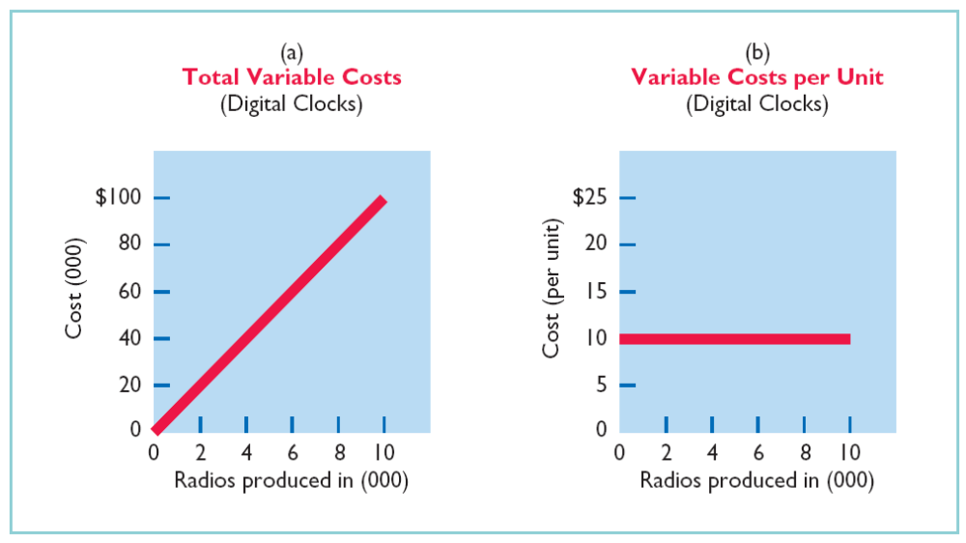
Variable Costs – Graphs
Notes:
1. On the topic, “Challenges Facing Financial Accounting,” what did the AICPA Special Committee on Financial Reporting suggest should be included in future financial statements?
Non-financial Measurements (customer satisfaction indexes, backlog information, and reject rates on goods purchases).
Forward-looking Information
Soft Assets (a company’s know-how, market dominance, marketing setup, well-trained employees, and brand image).
Timeliness (no real time financial information)

Slide 26
Fixed Costs
Fixed costs are costs that remain the same in total regardless of changes in the activity level.
Fixed costs per unit cost vary inversely with activity:
  As volume increases,
  unit cost declines, and vice versa
Examples include:
    Depreciation on buildings and equipment
    Property taxes Insurance
    Rent
Notes:
1. On the topic, “Challenges Facing Financial Accounting,” what did the AICPA Special Committee on Financial Reporting suggest should be included in future financial statements?
Non-financial Measurements (customer satisfaction indexes, backlog information, and reject rates on goods purchases).
Forward-looking Information
Soft Assets (a company’s know-how, market dominance, marketing setup, well-trained employees, and brand image).
Timeliness (no real time financial information)

Slide 27
Fixed Costs - Example
Damon Company leases its productive facilities at a cost of $10,000 per month
Total fixed costs of the facilities remain constant at every level of activity - $10,000 per month
Fixed costs on a per unit basis vary inversely with activity - as activity increases, unit cost declines and vice versa.
At 2,000 radios, the unit cost is $5 ($10,000 ÷ 2,000 units)
At 10,000 radios, the unit cost is $1 ($10,000 ÷ 10,000 units)
Notes:
1. On the topic, “Challenges Facing Financial Accounting,” what did the AICPA Special Committee on Financial Reporting suggest should be included in future financial statements?
Non-financial Measurements (customer satisfaction indexes, backlog information, and reject rates on goods purchases).
Forward-looking Information
Soft Assets (a company’s know-how, market dominance, marketing setup, well-trained employees, and brand image).
Timeliness (no real time financial information)

Slide 28
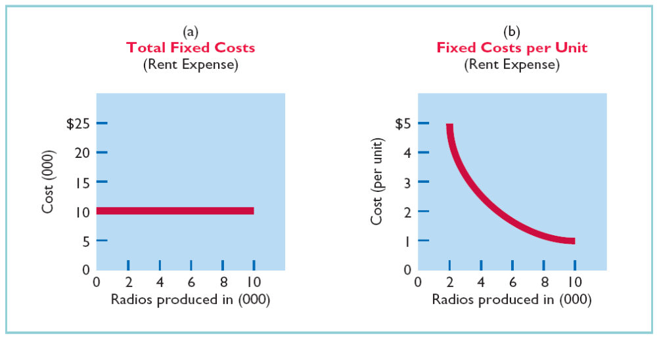
Fixed Costs - Graphs
Notes:
1. On the topic, “Challenges Facing Financial Accounting,” what did the AICPA Special Committee on Financial Reporting suggest should be included in future financial statements?
Non-financial Measurements (customer satisfaction indexes, backlog information, and reject rates on goods purchases).
Forward-looking Information
Soft Assets (a company’s know-how, market dominance, marketing setup, well-trained employees, and brand image).
Timeliness (no real time financial information)

Slide 29
Let’s Review
Variable costs are costs that:
a. Vary in total directly and proportionately with changes in the activity level.
b. Remain the same per unit at every activity level.
c. Neither of the above.
d. Both (a) and (b) above.

Slide 30
Relevant Range
Throughout the range of possible levels of activity, a straight-line relationship usually does not exist for either variable costs or fixed costs
The relationship between variable costs and changes in activity level is often curvilinear
For fixed costs, the relationship is also nonlinear – some fixed costs will not change over the entire range of activities while other fixed costs may change
Notes:
1. On the topic, “Challenges Facing Financial Accounting,” what did the AICPA Special Committee on Financial Reporting suggest should be included in future financial statements?
Non-financial Measurements (customer satisfaction indexes, backlog information, and reject rates on goods purchases).
Forward-looking Information
Soft Assets (a company’s know-how, market dominance, marketing setup, well-trained employees, and brand image).
Timeliness (no real time financial information)

Slide 31
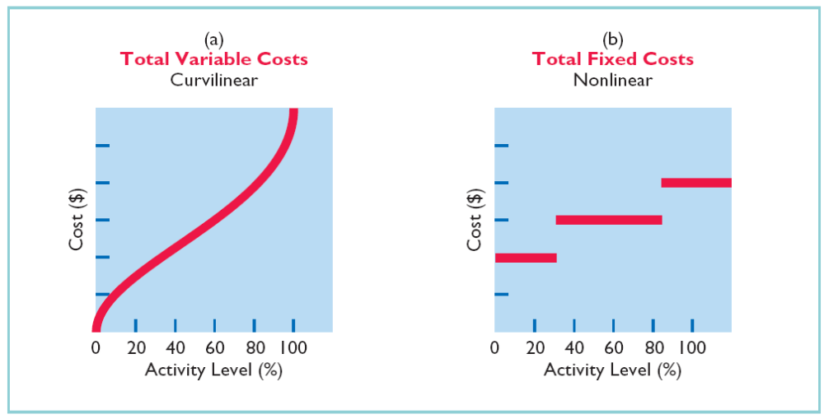
Relevant Range - Graphs
Notes:
1. On the topic, “Challenges Facing Financial Accounting,” what did the AICPA Special Committee on Financial Reporting suggest should be included in future financial statements?
Non-financial Measurements (customer satisfaction indexes, backlog information, and reject rates on goods purchases).
Forward-looking Information
Soft Assets (a company’s know-how, market dominance, marketing setup, well-trained employees, and brand image).
Timeliness (no real time financial information)

Slide 32
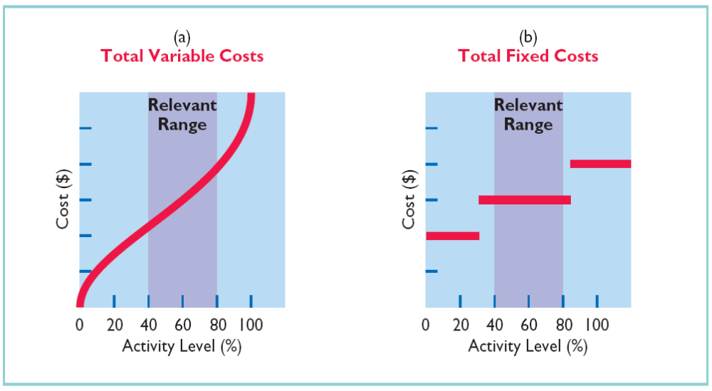
Relevant Range
Defined as the range of activity over which a company expects to operate during a year
Within this range, a straight-line relationship usually exists for both variable and fixed costs
Notes:
1. On the topic, “Challenges Facing Financial Accounting,” what did the AICPA Special Committee on Financial Reporting suggest should be included in future financial statements?
Non-financial Measurements (customer satisfaction indexes, backlog information, and reject rates on goods purchases).
Forward-looking Information
Soft Assets (a company’s know-how, market dominance, marketing setup, well-trained employees, and brand image).
Timeliness (no real time financial information)

Slide 33
Let’s Review
The relevant range is:
a. The range of activity in which variable costs will be curvilinear.
b. The range of activity in which fixed costs will be curvilinear.
c. The range over which the company expects to operate during a year.
d. Usually from zero to 100% of operating capacity.

Slide 34
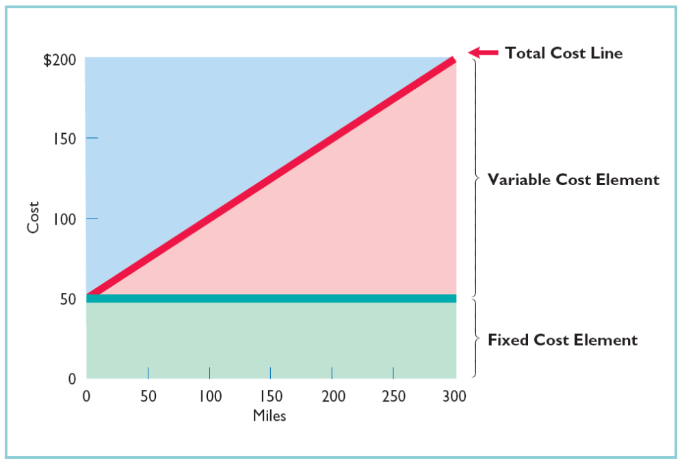
Mixed Costs
Costs that have
both a variable cost element
and a fixed
cost element
Sometimes called
semivariable cost
Change in total but not proportionately
with changes in
activity level
Notes:
1. On the topic, “Challenges Facing Financial Accounting,” what did the AICPA Special Committee on Financial Reporting suggest should be included in future financial statements?
Non-financial Measurements (customer satisfaction indexes, backlog information, and reject rates on goods purchases).
Forward-looking Information
Soft Assets (a company’s know-how, market dominance, marketing setup, well-trained employees, and brand image).
Timeliness (no real time financial information)

Slide 35
Mixed Costs: High–Low Method
For purposes of CVP analysis, mixed costs must be classified into their fixed and variable elements
One approach to separate the costs is called the high-low method
Uses the total costs incurred at the high and low levels of activity to classify mixed costs into fixed and variable components
The difference in costs between the high and low levels represents variable costs, since only variable costs change as activity levels change
Notes:
1. On the topic, “Challenges Facing Financial Accounting,” what did the AICPA Special Committee on Financial Reporting suggest should be included in future financial statements?
Non-financial Measurements (customer satisfaction indexes, backlog information, and reject rates on goods purchases).
Forward-looking Information
Soft Assets (a company’s know-how, market dominance, marketing setup, well-trained employees, and brand image).
Timeliness (no real time financial information)

Slide 36

Mixed Costs:
Steps in High–Low-Method
STEP 1: Determine variable cost per unit using the following formula:
STEP 2: Determine the fixed cost by subtracting the total variable cost at either the high or the low activity level from the total cost at that level
Notes:
1. On the topic, “Challenges Facing Financial Accounting,” what did the AICPA Special Committee on Financial Reporting suggest should be included in future financial statements?
Non-financial Measurements (customer satisfaction indexes, backlog information, and reject rates on goods purchases).
Forward-looking Information
Soft Assets (a company’s know-how, market dominance, marketing setup, well-trained employees, and brand image).
Timeliness (no real time financial information)

Slide 37
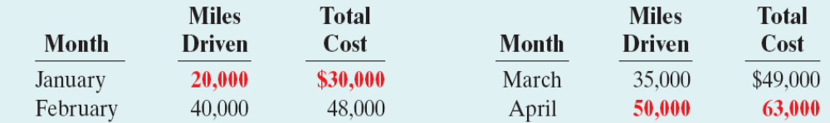
Mixed Costs:
High–Low Method Example
Data for Metro Transit Company for 4 month period:
High Level of Activity: April $63,000 50,000 miles
Low Level of Activity: January 30,000 20,000 miles
Difference $33,000 30,000 miles
Step 1: Using the formula, variable costs per unit are
$33,000 ÷ 30,000 = $1.10 variable cost per mile
Notes:
1. On the topic, “Challenges Facing Financial Accounting,” what did the AICPA Special Committee on Financial Reporting suggest should be included in future financial statements?
Non-financial Measurements (customer satisfaction indexes, backlog information, and reject rates on goods purchases).
Forward-looking Information
Soft Assets (a company’s know-how, market dominance, marketing setup, well-trained employees, and brand image).
Timeliness (no real time financial information)

Slide 38
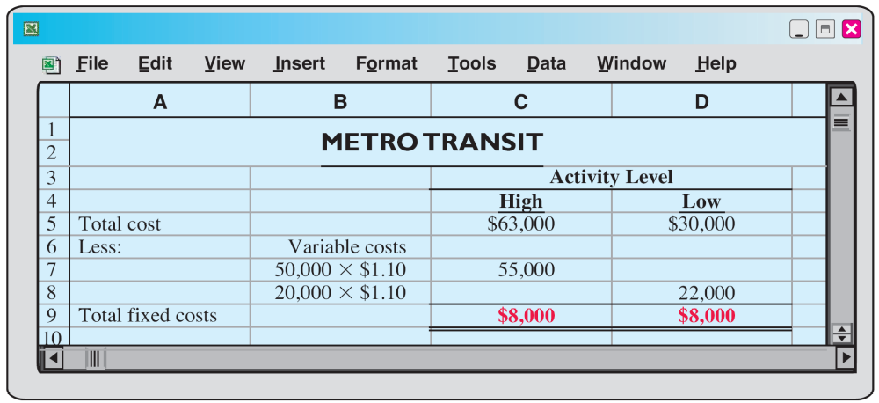
Mixed Costs:
High–Low-Method Example
Step 2: Determine the fixed costs by subtracting total variable costs at either the high or low activity level from the total cost at that same level
Notes:
1. On the topic, “Challenges Facing Financial Accounting,” what did the AICPA Special Committee on Financial Reporting suggest should be included in future financial statements?
Non-financial Measurements (customer satisfaction indexes, backlog information, and reject rates on goods purchases).
Forward-looking Information
Soft Assets (a company’s know-how, market dominance, marketing setup, well-trained employees, and brand image).
Timeliness (no real time financial information)

Slide 39
Mixed Costs:
High–Low-Method Example
Maintenance costs:
$8,000 per month plus $1.10 per mile
To determine maintenance costs at a particular activity level:
  1. multiply the activity level times the variable cost per unit
  2. then add that total to the fixed cost
  EXAMPLE: If the activity level is 45,000 miles, the estimated maintenance costs would be $8,000 fixed costs and $49,500 variable ($1.10 X 45,000 miles) for a total of $57,500.
Notes:
1. On the topic, “Challenges Facing Financial Accounting,” what did the AICPA Special Committee on Financial Reporting suggest should be included in future financial statements?
Non-financial Measurements (customer satisfaction indexes, backlog information, and reject rates on goods purchases).
Forward-looking Information
Soft Assets (a company’s know-how, market dominance, marketing setup, well-trained employees, and brand image).
Timeliness (no real time financial information)

Slide 40
Let’s Review
Mixed costs consist of a:
a. Variable cost element and a fixed cost element.
b. Fixed cost element and a controllable cost element.
c. Relevant cost element and a controllable cost element.
d. Variable cost element and a relevant cost element.

Slide 41
End of Lecture 3

