Slide 1
Chapter 21
Lecture 29
Capital Budgeting and Cost Analysis
Readings
Chapter 21, Cost Accounting, Managerial Emphasis, 14th edition by Horengren
Chapter 14, Managerial Accounting 12th edition by Garrison, Noreen, Brewer

Slide 2
Learning Objectives
Evaluate the acceptability of an investment project using the net present value method.
Evaluate the acceptability of an investment project using the internal rate of return method.
Evaluate an investment project that has uncertain cash flows
Rank investment projects in order of preference.
Determine the payback period for an investment.
Compute the simple rate of return for an investment.
Understand present value concepts and the use of present value tables
Include income taxes in a capital budgeting analysis.

Slide 3
Two Dimension of Cost Analysis
Project-by-Project Dimension: one project spans multiple accounting periods
Period-by-Period Dimension: one period contains multiple projects

Slide 4
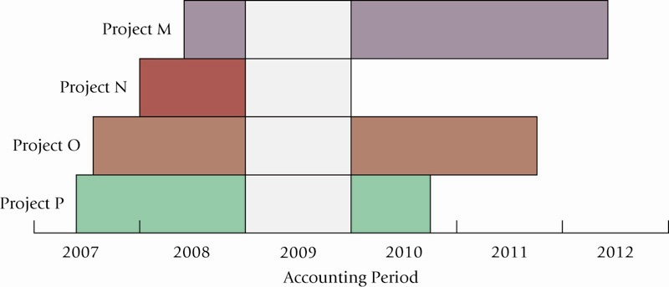
Project and Time Dimensions of Capital Budgeting Illustrated

Slide 5
Capital Budgeting
Capital Budgeting is making a long-run planning decisions for investing in projects
Capital Budgeting is a decision-making and control tool that spans multiple years

Slide 6
Six Stages in Capital Budgeting
Identification Stage – determine which types of capital investments are necessary to accomplish organizational objectives and strategies
Search Stage – Explore alternative capital investments that will achieve organization objectives

Slide 7
Six Stages in Capital Budgeting:
Continued
Information-Acquisition Stage – consider the expected costs and benefits of alternative capital investments
Selection Stage – choose projects for implementation
Financing Stage – obtain project financing
Implementation and Control Stage – get projects under way and monitor their performance

Slide 8
Four Capital Budgeting Methods
Net Present Value (NPV)
Internal Rate of Return (IRR)
Payback Period
Accrual Accounting Rate of Return (AARR)

Slide 9
Discounted Cash Flows
Discounted Cash Flow (DCF) Methods measure all expected future cash inflows and outflows of a project as if they occurred at a single point in time
The key feature of DCF methods is the time value of money (interest), meaning that a dollar received today is worth more than a dollar received in the future

Slide 10
Discounted Cash Flows (continued)
DCF methods use the Required Rate of Return (RRR), which is the minimum acceptable annual rate of return on an investment.
RRR is the return that an organization could expect to receive elsewhere for an investment of comparable risk
RRR is also called the discount rate, hurdle rate, cost of capital or opportunity cost of capital

Slide 11
Net Present Value (NPV) Method
NPV method calculates the expected monetary gain or loss from a project by discounting all expected future cash inflows and outflows to the present point in time, using the Required Rate of Return
Based on financial factors alone, only projects with a zero or positive NPV are acceptable

Slide 12
Three-Step NPV Method
Draw a sketch of the relevant cash inflows and outflows
Convert the inflows and outflows into present value figures using tables or a calculator
Sum the present value figures to determine the NPV. Positive or zero NPV signals acceptance, negative NPV signals rejection

Slide 13
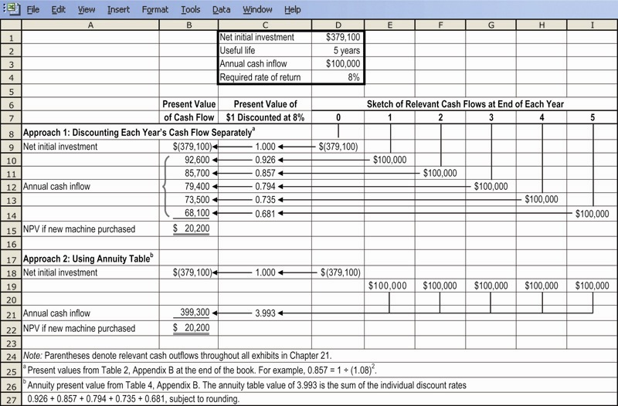
NPV Method Illustrated

Slide 14
Internal Rate of Return (IRR) Method
The IRR Method calculates the discount rate at which the present value of expected cash inflows from a project equals the present value of its expected cash outflows
A project is accepted only if the IRR equals or exceeds the RRR

Slide 15
IRR Method
Analysts use a calculator or computer program to provide the IRR
Trial and Error Approach:
  Use a discount rate and calculate the project’s NPV. Goal: find the discount rate for which NPV = 0
    If the calculated NPV is greater than zero, use a higher discount rate
    If the calculated NPV is less than zero, use a lower discount rate
    Continue until NPV = 0

Slide 16
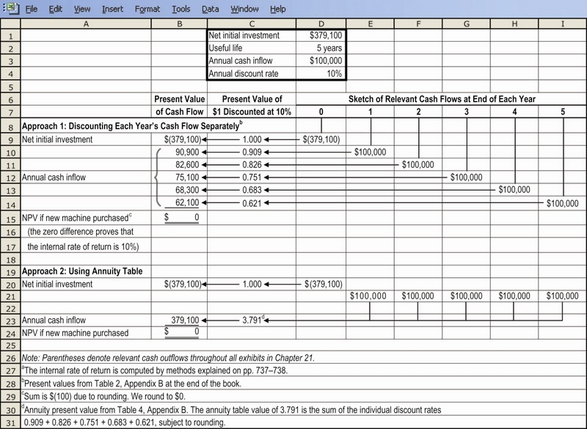
IRR Method Illustrated

Slide 17
Comparison NPV and IRR Methods
IRR is widely used
NPV can be used with varying RRR
NPV of projects may be combined for evaluation purposes, IRR cannot
Both may be used with sensitivity analysis (“what-if” analysis)

Slide 18
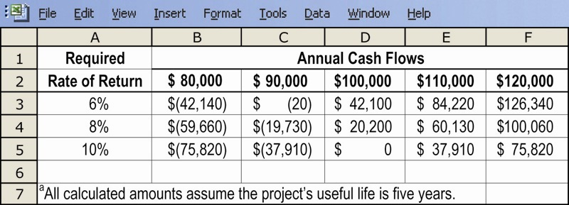
Sensitivity Analysis Illustration

Slide 19
Payback Method
Payback measures the time it will take to recoup, in the form of expected future cash flows, the net initial investment in a project
Shorter payback period are preferable
Organizations choose a project payback period. The greater the risk, the shorter the payback period
Easy to understand

Slide 20
Payback Method Continued
With uniform cash flows:
With non-uniform cash flows: add cash flows period-by-period until the initial investment is recovered; count the number of periods included for payback period

Slide 21
Accrual Accounting Rate of Return Method (AARR)
AARR Method divides an accrual accounting measure of average annual income of a project by an accrual accounting measure of its investment
Also called the Accounting Rate of Return

Slide 22
AARR Method Formula

Slide 23
AARR Method
Firms vary in how they calculate AARR
Easy to understand, and use numbers reported in financial statements
Does not track cash flows
Ignores time value of money

Slide 24
Evaluating Managers and
Goal-Congruence Issues
Some firms use NPV for capital budgeting decisions and a different method for evaluating performance
Managers may be tempted to make capital budgeting decisions on the basis of short-run accrual accounting results, even though that would not be in the best interest of the firm

Slide 25
Relevant Cash Flows in
DCF Analysis
Relevant cash flows are the differences in expected future cash flows as a result of making an investment
Categories of Cash Flows:
  Net Initial Investment
  After-tax cash flow from operations
  After-tax cash flow from terminal disposal of an asset and recovery of working capital

Slide 26
Net Initial Investment
Three Components:
Initial Machine Investment
Initial Working Capital Investment
After-tax Cash Flow from Current Disposal of Old Machine

Slide 27
Cash Flow from Operations
Two Components:
Inflows (after-tax) from producing and selling additional goods or services, or from savings in operating costs. Excludes depreciation, handled below:
Income tax cash savings from annual depreciation deductions

Slide 28
Terminal Disposal of Investment
Two Components:
After-tax cash flow from terminal disposal of asset (investment)
After-tax cash flow from recovery of working capital (liquidating receivables and inventory once needed to support the project)

Slide 29
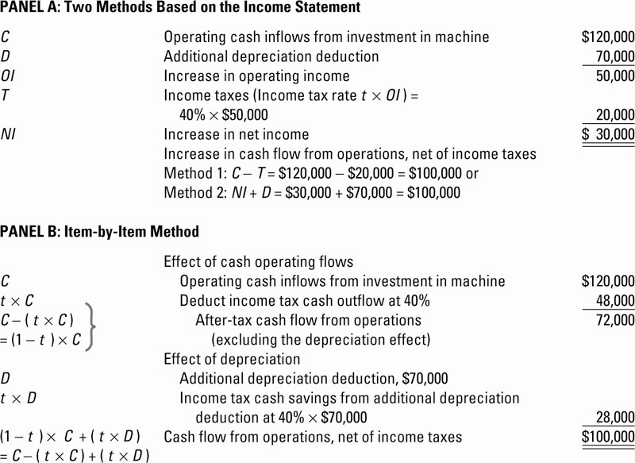
Cash Flow Effects From Investment Decisions, Illustrated

Slide 30
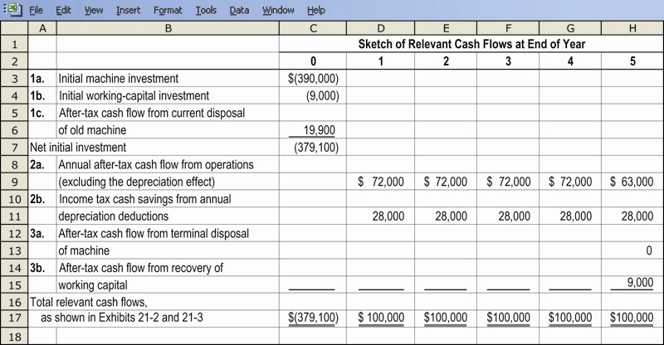
Cash Flow Effects From Investment Decisions, Illustrated

Slide 31
Managing the Project
Implementation and Control:
  Management of the investment activity itself
  Management control of the project as a whole
A post-investment audit may be done to provide management with feedback about the performance of a project, so that management can compare actual results to the costs and benefits expected at the time the project was selected

Slide 32
Strategic Considerations in
Capital Budgeting
A company’s strategy is the source of its strategic capital budgeting decisions
Some firms regard R&D projects as important strategic investments
  Outcomes very uncertain
  Far in the future

Slide 33
Typical Capital Budgeting Decisions
Plant expansion
Equipment selection
Equipment replacement
Lease or buy
Cost reduction
Notes:
Capital budgeting analysis can be used for any decision that involves an outlay now in order to obtain some future return. Typical capital budgeting decisions include:
Cost reduction decisions. Should new equipment be purchased to reduce costs?
Expansion decisions. Should a new plant or warehouse be purchased to increase capacity and sales?
Equipment selection decisions. Which of several available machines should be purchased?
Lease or buy decisions. Should new equipment be leased or purchased?
Equipment replacement decisions. Should old equipment be replaced now or later?

Slide 34
Typical Capital Budgeting Decisions
Capital budgeting tends to fall into two broad categories . . .
  Screening decisions. Does a proposed project meet some preset standard of acceptance?
  Preference decisions. Selecting from among several competing courses of action.
Notes:
There are two main types of capital budgeting decisions:
Screening decisions relate to whether a proposed project passes a preset hurdle. For example, a company may have a policy of accepting projects only if they promise a return of 20% on the investment.
Preference decisions relate to selecting among several competing courses of action. For example, a company may be considering several different machines to replace an existing machine on the assembly line.
In this chapter, we initially discuss ways of making screening decisions. Preference decisions are discussed toward the end of the chapter.

Slide 35
Time Value of Money
A dollar today is worth more than a dollar a year from now. Therefore, investments that promise earlier returns are preferable to those that promise later returns.
Notes:
The time value of money concept recognizes that a dollar today is worth more than a dollar a year from now. Therefore, projects that promise earlier returns are preferable to those that promise later returns.

Slide 36

Time Value of Money
The capital budgeting techniques that best recognize the time value of money are those that involve discounted cash flows.
Notes:
The capital budgeting techniques that best recognize the time value of money are those that involve discounted cash flows (the concepts of discounting cash flows and using present value tables are explained in greater detail in Appendix 14 A).

Slide 37
The Net Present Value Method
To determine net present value we . . .
  Calculate the present value of cash inflows,
  Calculate the present value of cash outflows,
  Subtract the present value of the outflows from the present value of the inflows.
Notes:
The net present value method compares the present value of a project’s cash inflows with the present value of its cash outflows. The difference between these two streams of cash flows is called the net present value.

Slide 38
The Net Present Value Method
General decision rule . . .
Notes:
The net present value is interpreted as follows:
If the net present value is positive, then the project is acceptable.
If the net present value is zero, then the project is acceptable.
If the net present value is negative, then the project is not acceptable.

Slide 39

The Net Present Value Method
Net present value analysis emphasizes cash flows and not accounting net income.
The reason is that accounting net income is based on accruals that ignore the timing of cash flows into and out of an organization.
Notes:
Net present value analysis (as well as the internal rate of return, which will be discussed shortly) emphasizes cash flows and not accounting net income. The reason is that accounting net income is based on accruals that ignore the timing of cash flows into and out of an organization.

Slide 40
Typical Cash Outflows
Repairs and
maintenance
Working
capital
Initial
investment
Incremental
operating
costs
Notes:
Examples of typical cash outflows that are included in net present value calculations are as shown. Notice the term working capital which is defined as current assets less current liabilities.
The initial investment in working capital is a cash outflow at the beginning of the project for items such as inventories. It is recaptured at the end of the project when working capital is no longer required. Thus, working capital is recognized as a cash outflow at the beginning of the project and a cash inflow at the end of the project.

Slide 41
Typical Cash Inflows
Salvage
value
Release of
working
capital
Reduction
of costs
Incremental
revenues
Notes:
Examples of typical cash inflows that are included in net present value calculations are as shown.

Slide 42

Recovery of the Original Investment
Depreciation is not deducted in computing the present value of a project because . . .
  It is not a current cash outflow.
  Discounted cash flow methods automatically provide for return of the original investment.
Notes:
The net present value method excludes depreciation for two reasons:
First, depreciation is not a current cash outflow.
Second, discounted cash flow methods automatically provide for a return of the original investment, thereby making a deduction for depreciation unnecessary.

Slide 43
Recovery of the Original Investment
Carver Hospital is considering the purchase of an attachment for its X-ray machine.
No investments are to be made unless they have an annual return of at least 10%.
Will we be allowed to invest in the attachment?
Notes:
Assume the facts as shown with respect to Carver Hospital. Will we be allowed to invest in the attachment?

Slide 44
Recovery of the Original Investment
Present value
of an annuity
of $1 table
Notes:
The net present value of the investment is zero.

Slide 45
Recovery of the Original Investment
This implies that the cash inflows are sufficient to recover the $3,170 initial investment (therefore depreciation is unnecessary) and to provide exactly a 10% return on the investment.
Notes:
This implies that the cash inflows are sufficient to recover the $3,170 initial investment (therefore depreciation is unnecessary) and to provide exactly a 10 percent return on the investment.

Slide 46

Two Simplifying Assumptions
Two simplifying assumptions are usually made in net present value analysis:
All cash flows other than the initial investment occur at the end of periods.
All cash flows generated by an investment project are immediately reinvested at a rate of return equal to the discount rate.
Notes:
Two simplifying assumptions are usually made in net present value analysis:
The first assumption is that all cash flows other than the initial investment occur at the end of periods.
The second assumption is that all cash flows generated by an investment project are immediately reinvested at a rate of return equal to the discount rate.

Slide 47
Choosing a Discount Rate
The firm’s cost of capital is usually regarded as the minimum required rate of return.
The cost of capital is the average rate of return the company must pay to its long-term creditors and stockholders for the use of their funds.
Notes:
A company’s cost of capital, which is defined as the average rate of return a company must pay to its long-term creditors and shareholders for the use of their funds, is usually regarded as the minimum required rate of return. When the cost of capital is used as the discount rate, it serves as a screening device in net present value analysis.

Slide 48
End of Lecture 29
Notes:
End of chapter 14.

