Slide 1
Chapter 12-Continued
Lecture 28
Budgetary Planning, Customer Profitability Analysis and Sales Variance Analysis
Readings
Chapter 14, Cost Accounting, Managerial Emphasis, 14th edition by Horengren
Chapter 9, Managerial Accounting 6th edition by Weygandt, kimmel, kieso

Slide 2
Budgetary Planning
Learning Objectives
After studying this chapter, you should be able to:
Indicate the benefits of budgeting.
State the essentials of effective budgeting.
Identify the budgets that comprise the master budget.
Describe the sources for preparing the budgeted income statement.
Explain the principal sections of a cash budget.
Indicate the applicability of budgeting in non-manufacturing companies.

Slide 3
Preparing the Operating Budgets
Sales Budget
  First budget prepared.
  Derived from the sales forecast.
    Management’s best estimate of sales revenue for the budget period.
  Every other budget depends on the sales budget.
  Prepared by multiplying expected unit sales volume for each product times anticipated unit selling price.

Slide 4
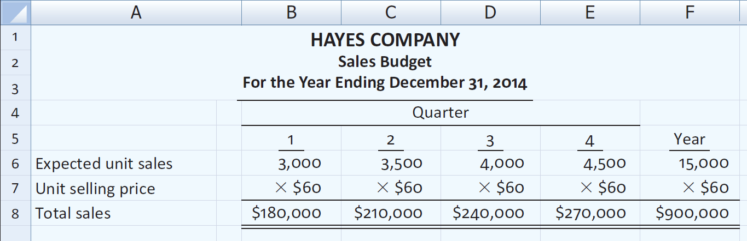
Preparing the Operating Budgets
Illustration – Hayes Company
Expected sales volume: 3,000 units in the first quarter with 500-unit increases in each succeeding quarter.
Sales price: $60 per unit.

Slide 5
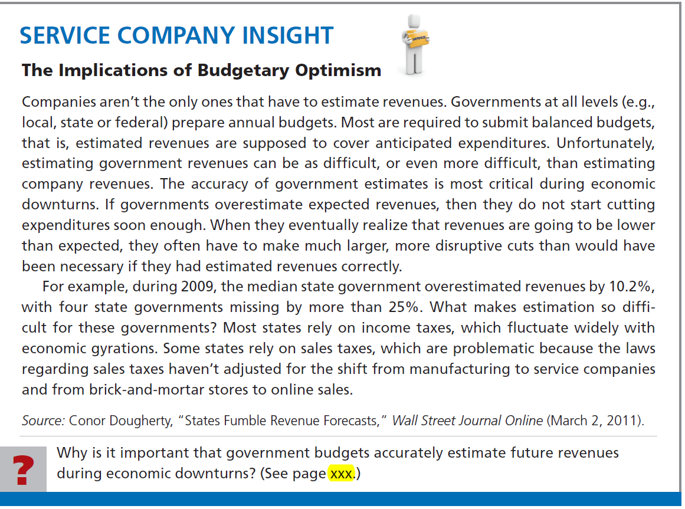

Slide 6

Preparing the Operating Budgets
Production Budget
  Shows units that must be produced to meet anticipated sales.
  Derived from sales budget plus the desired change in ending finished goods inventory.
  Essential to have a realistic estimate of ending inventory.

Slide 7
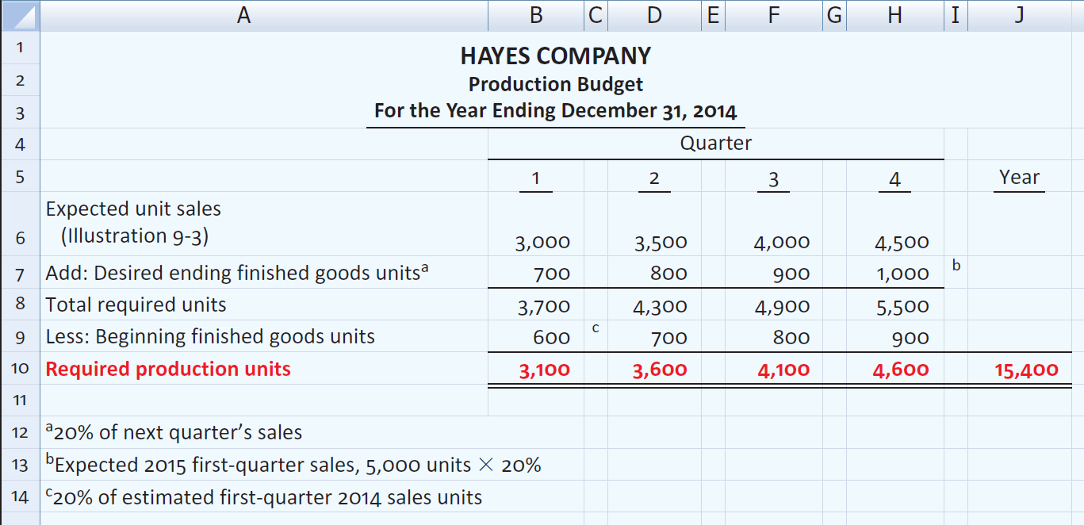
Preparing the Operating Budgets
Illustration – Hayes Company
Hayes Co. believes it can meet future sales needs with an ending inventory of 20% of next quarter’s sales.

Slide 8
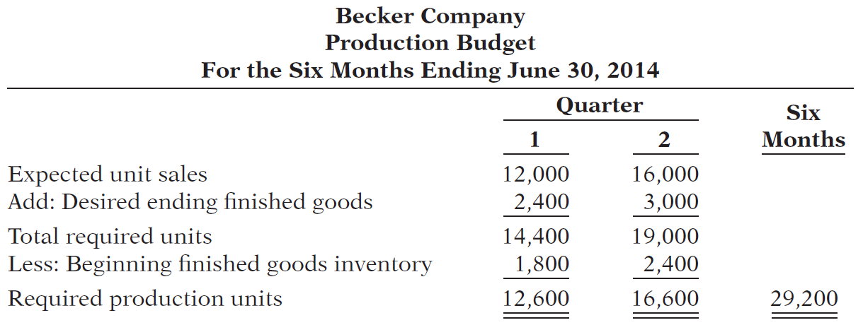
Becker Company estimates that 2014 unit sales will be 12,000 in quarter 1, 16,000 in quarter 2, and 20,000 in quarter 3, at a unit selling price of $30. Management desires to have ending finished goods inventory equal to 15% of the next quarter’s expected unit sales. Prepare a production budget by quarter for the first 6 months of 2014.

Slide 9
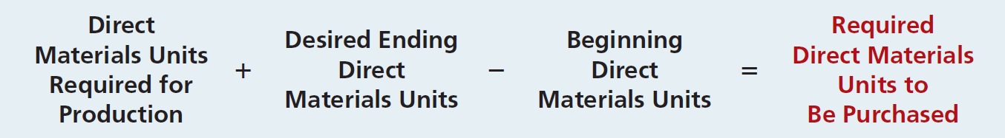
Preparing the Operating Budgets
Direct Materials Budget
  Shows both the quantity and cost of direct materials to be purchased.
  Formula for direct materials quantities.
  Budgeted cost of direct materials to be purchased = required units of direct materials x anticipated cost per unit.
  Inadequate inventories could result in temporary shutdowns of production.

Slide 10
Preparing the Operating Budgets
Illustration – Hayes Company
  Because of its close proximity to suppliers,
    Hayes Company maintains an ending inventory of raw materials equal to 10% of the next quarter’s production requirements.
    The manufacture of each Rightride requires 2 pounds of raw materials, and the expected cost per pound is $4.
    Assume that the desired ending direct materials amount is 1,020 pounds for the fourth quarter of 2011.
    Prepare a Direct Materials Budget.

Slide 11
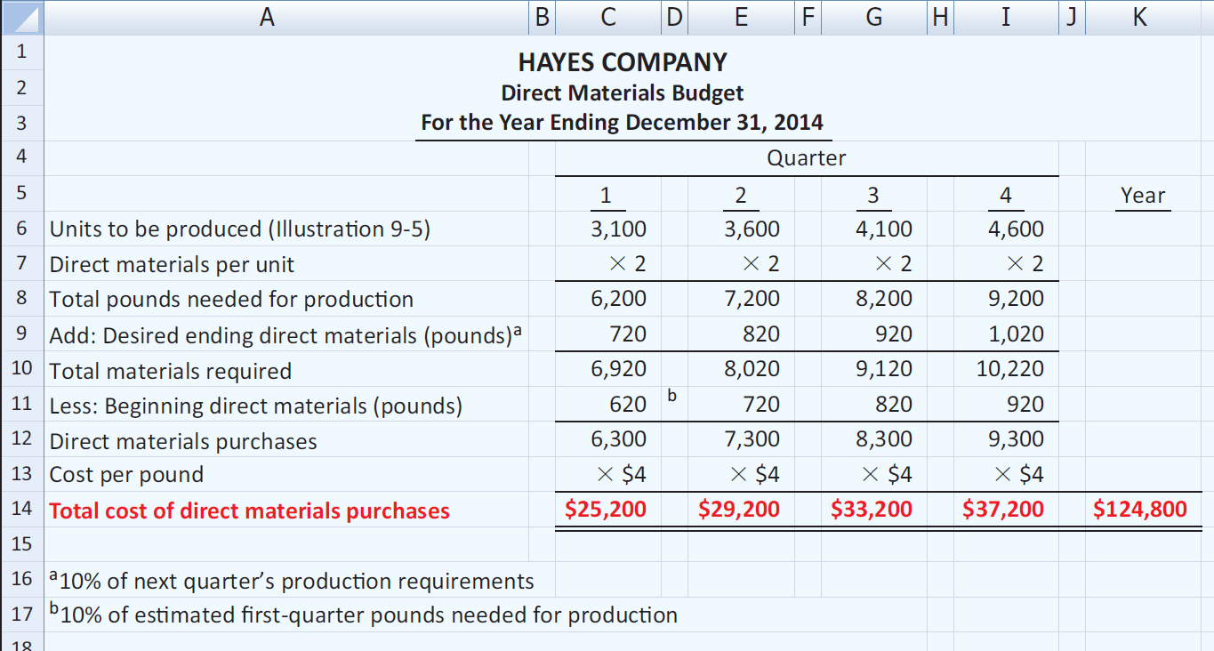
Preparing the Operating Budgets
Illustration – Hayes Company

Slide 12
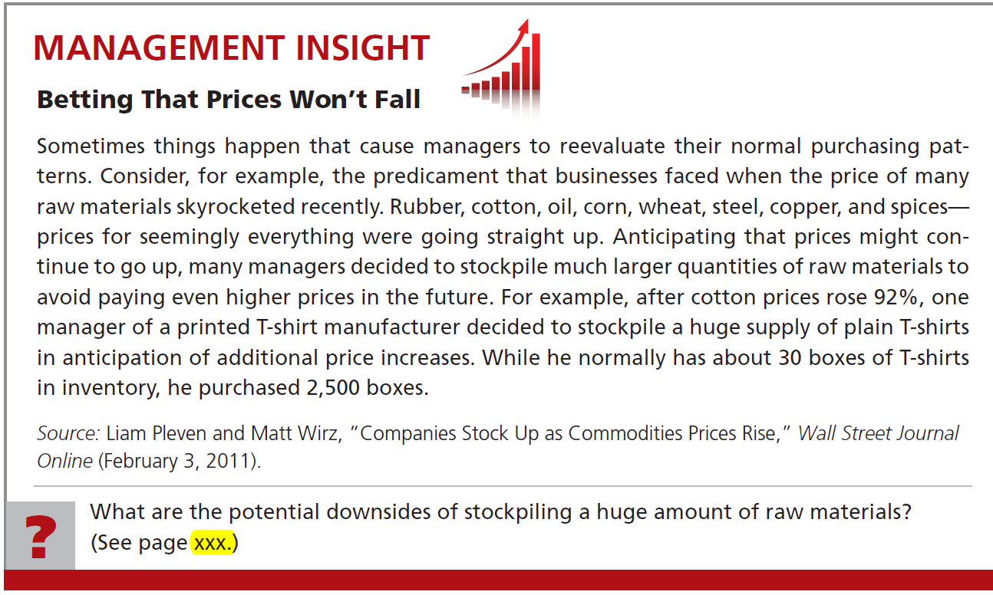


Slide 13
Soriano Company is preparing its master budget for 2014. Relevant data pertaining to its sales, production, and direct materials budgets are as follows:
Sales: Sales for the year are expected to total 1,200,000 units. Quarterly sales are 20%, 25%, 30%, and 25% respectively. The sales price is expected to be $50 per unit for the first three quarters and $55 per unit beginning in the fourth quarter. Sales in the first quarter of 2015 are expected to be 10% higher than the budgeted sales for the first quarter of 2014.
Production: Management desires to maintain ending finished goods inventories at 25% of next quarter’s budgeted sales volume.
Direct materials: Each unit requires 3 pounds of raw materials at a cost of $5 per pound. Management desires to maintain raw materials inventories at 5% of the next quarter’s production requirements. Assume the production requirements for the first quarter of 2015 are 810,000 pounds.

Slide 14
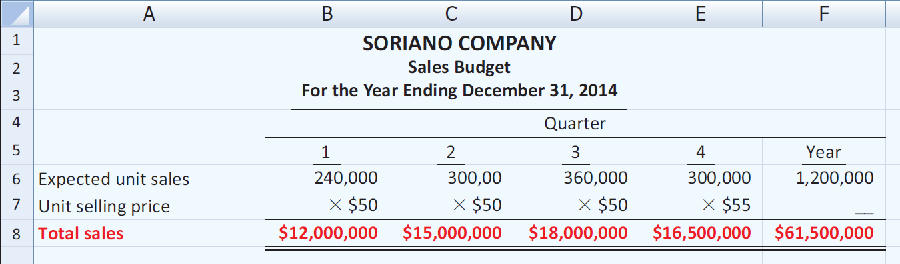
Prepare the sales, production, and direct materials budgets by quarters for 2014.

Slide 15
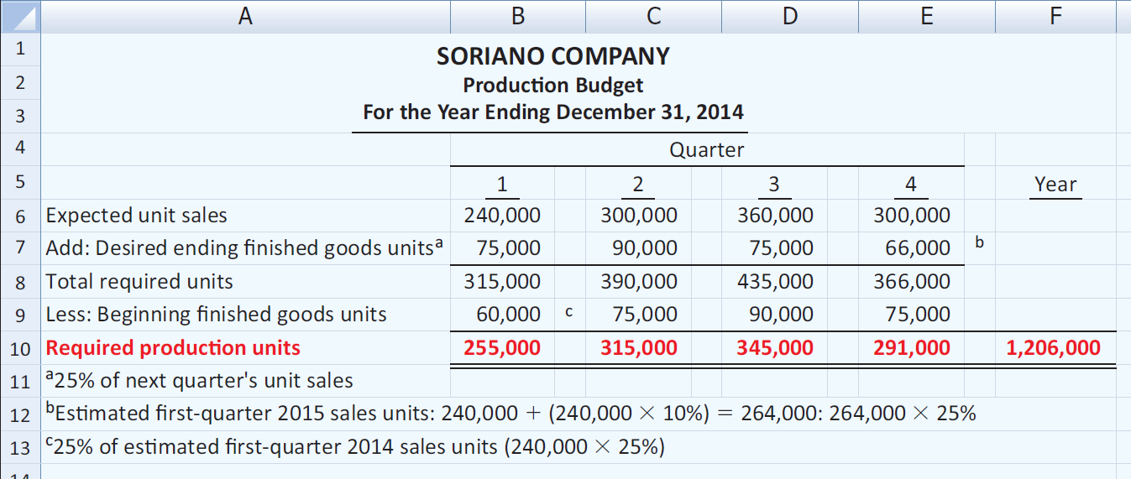
Prepare the sales, production, and direct materials budgets by quarters for 2014.

Slide 16
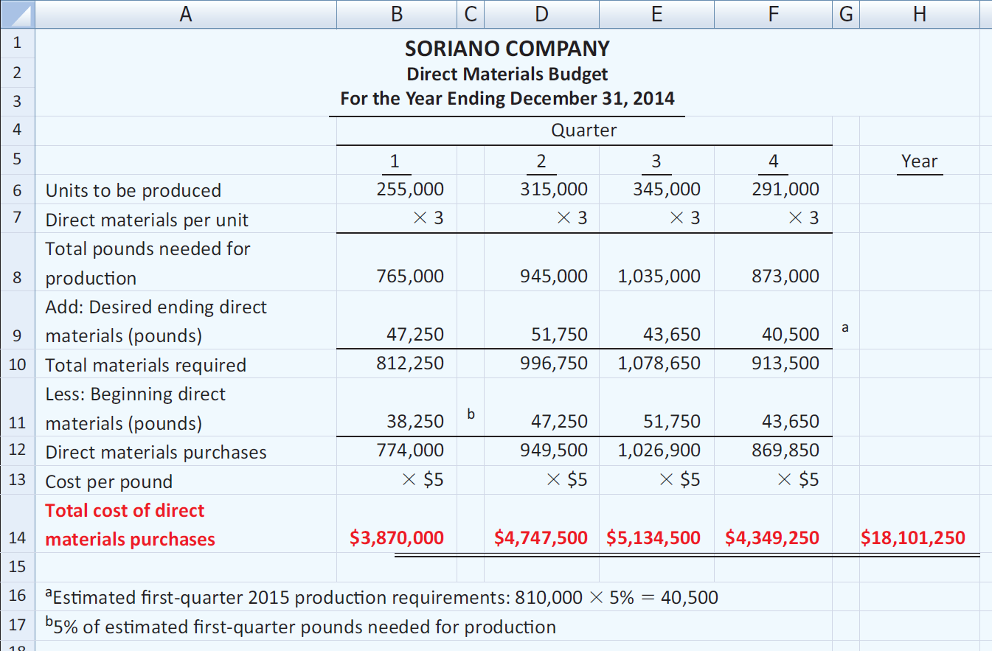
Prepare the sales, production, and direct materials budgets.

Slide 17

Preparing the Operating Budgets
Direct Labor Budget
  Shows both the quantity of hours and cost of direct labor necessary to meet production requirements.
  Critical in maintaining a labor force that can meet expected production.
  Total direct labor cost formula:

Slide 18
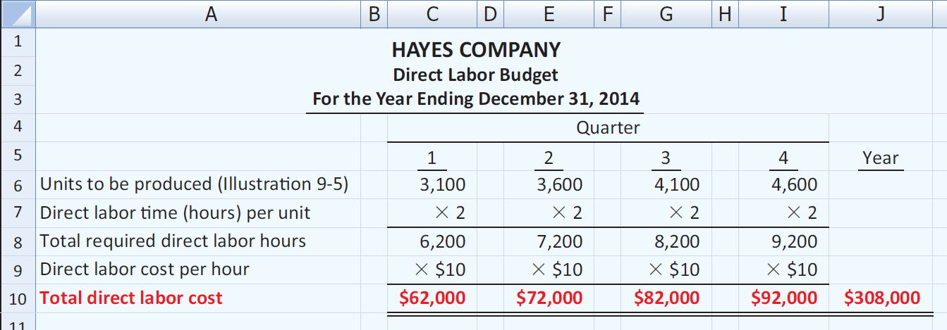
Preparing the Operating Budgets
Illustration: Direct labor hours are determined from the production budget. At Hayes Company, two hours of direct labor are required to produce each unit of finished goods. The anticipated hourly wage rate is $10.

Slide 19
Preparing the Operating Budgets
Manufacturing Overhead Budget
  Shows the expected manufacturing overhead costs for the budget period.
  Distinguishes between fixed and variable overhead costs.

Slide 20
Manufacturing Overhead Budget
Illustration: Hayes Company expects variable costs to fluctuate with production volume on the basis of the following rates per direct labor hour: indirect materials $1.00, indirect labor $1.40, utilities $0.40, and maintenance $0.20. Thus, for the 6,200 direct labor hours to produce 3,100 units, budgeted indirect materials are $6,200 (6,200 x $1), and budgeted indirect labor is $8,680 (6,200 x $1.40). Hayes also recognizes that some maintenance is fixed. The amounts reported for fixed costs are assumed.
Prepare a Manufacturing Overhead Budget.

Slide 21
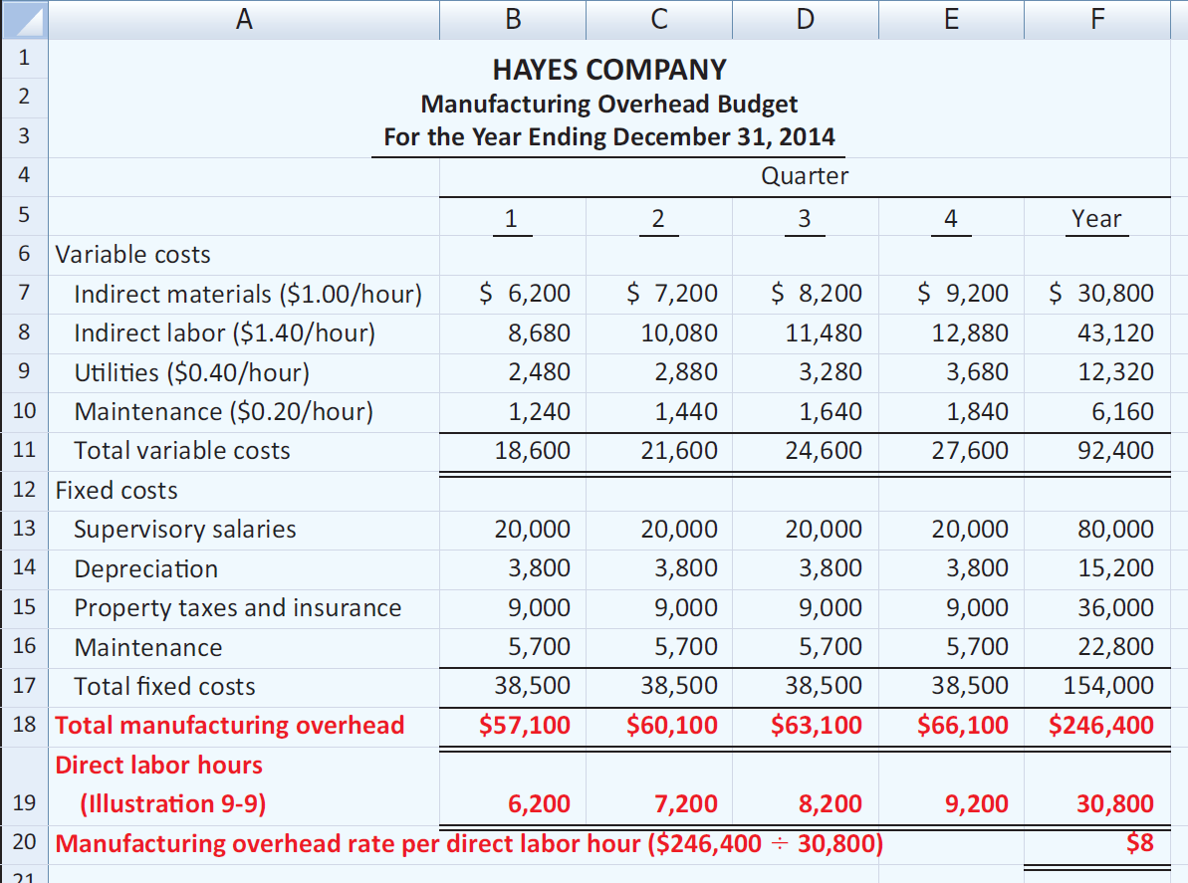
Manufacturing Overhead Budget

Slide 22
Preparing the Operating Budgets
Selling and Administrative Expense Budget
  Projection of anticipated operating expenses.
  Distinguishes between fixed and variable costs.
Illustration: Variable expense rates per unit of sales are sales commissions $3 and freight-out $1. Variable expenses per quarter are based on the unit sales from the sales budget (Illustration 9-3). Hayes expects sales in the first quarter to be 3,000 units. Fixed expenses are based on assumed data.
Prepare a selling and administrative expense budget.

Slide 23
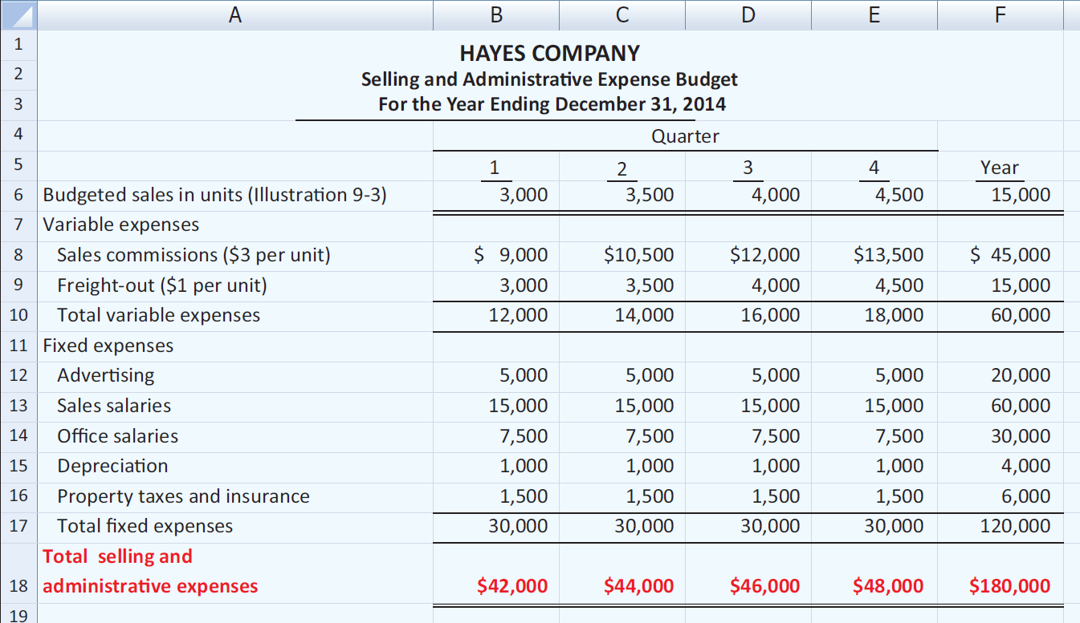
Selling and Administrative Expense Budget

Slide 24
Preparing the Operating Budgets
Review Question
A sales budget is:
a. Derived from the production budget.
b. Management’s best estimate of sales revenue for the year.
c. Not the starting point for the master budget.
d. Prepared only for credit sales.

Slide 25
Preparing the Operating Budgets
Budgeted Income Statement
  Important end-product of the operating budgets.
  Indicates expected profitability of operations.
  Provides a basis for evaluating company performance.
  Prepared from the operating budgets:
Sales
Direct Materials
Direct Labor
Manufacturing Overhead
Selling and Administrative Expense

Slide 26
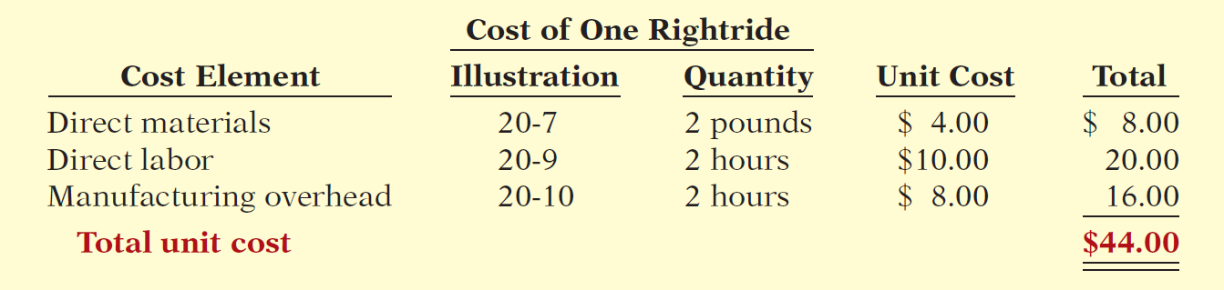
Budgeted Income Statement
Illustration: To find the cost of goods sold, it is first necessary to determine the total unit cost of producing one Rightride, as follows.
Second, determine Cost of Goods Sold by multiplying units sold times unit cost: 15,000 units x $44 = $660,000

Slide 27
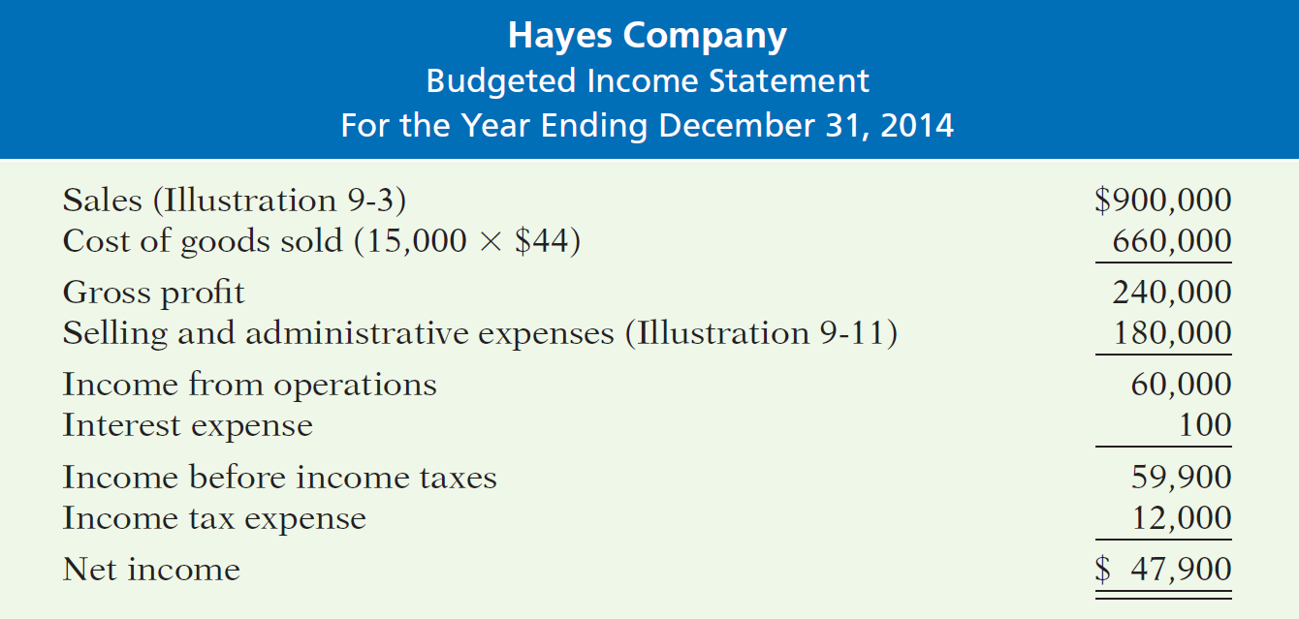
Preparing the Operating Budgets
Illustration: All data for the income statement come from the individual operating budgets except the following: (1) interest expense is expected to be $100, and (2) income taxes are estimated to be $12,000.

Slide 28
Preparing the Operating Budgets
Review Question
Each of the following budgets is used in preparing the budgeted income statement except the:
a. Sales budget.
b. Selling and administrative budget.
c. Capital expenditure budget.
d. Direct labor budget.

Slide 29
Soriano Company is preparing its budgeted income statement for 2014. Relevant data pertaining to its sales, production, and direct materials budgets can be found on the following slide. Soriano budgets 0.5 hours of direct labor per unit, labor costs at $15 per hour, and manufacturing overhead at $25 per direct labor hour. Its budgeted selling and administrative expenses for 2011 are $12,000,000. (a) Calculate the budgeted total unit cost. (b) Prepare the budgeted income statement for 2011.

Slide 30
Soriano Company is preparing its master budget for 2014. Relevant data pertaining to its sales, production, and direct materials budgets are as follows:
Sales: Sales for the year are expected to total 1,200,000 units. Quarterly sales are 20%, 25%, 30%, and 25% respectively. The sales price is expected to be $50 per unit for the first three quarters and $55 per unit beginning in the fourth quarter. Sales in the first quarter of 2015 are expected to be 10% higher than the budgeted sales for the first quarter of 2014.
Production: Management desires to maintain ending finished goods inventories at 25% of next quarter’s budgeted sales volume.
Direct materials: Each unit requires 3 pounds of raw materials at a cost of $5 per pound. Management desires to maintain raw materials inventories at 5% of the next quarter’s production requirements. Assume the production requirements for the first quarter of 2015 are 810,000 pounds.

Slide 31
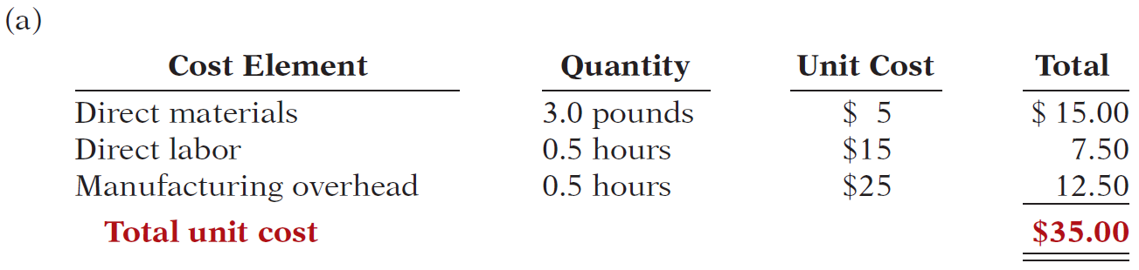
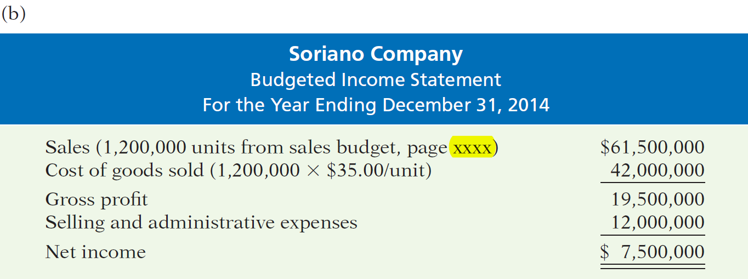

Calculate the budgeted total unit cost and prepare the budgeted income statement for 2014.

Slide 32
Preparing the Financial Budgets
Cash Budget
  Shows anticipated cash flows.
  Often considered to be the most important output in preparing financial budgets.
  Contains three sections:
    Cash Receipts
    Cash Disbursements
    Financing
  Shows beginning and ending cash balances.

Slide 33
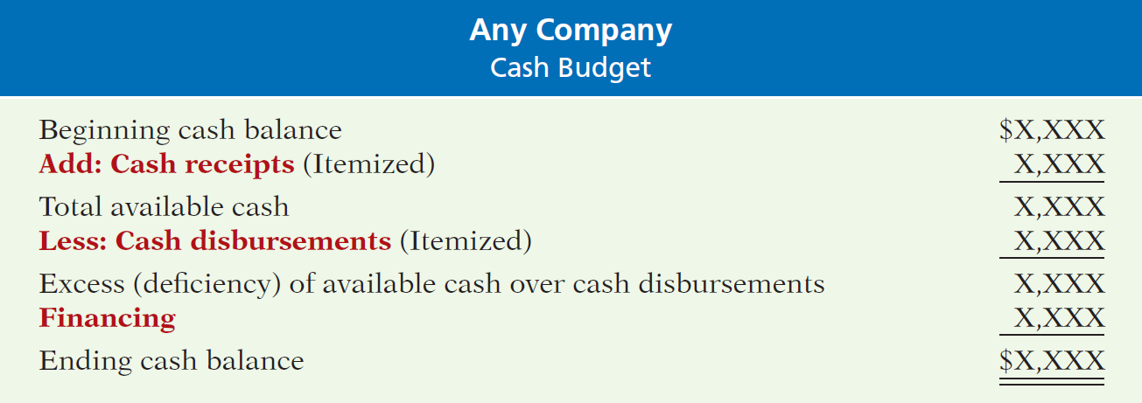
Preparing the Financial Budgets
Cash Budget - Basic Format

Slide 34
Cash Budget
  Cash Receipts Section
    Expected receipts from the principal sources of revenue.
    Expected interest and dividends receipts, proceeds from planned sales of investments, plant assets, and capital stock.
  Cash Disbursements Section
    Expected cash payments for direct materials and labor, taxes, dividends, plant assets, etc.
  Financing Section
    Expected borrowings and repayments of borrowed funds plus interest.

Slide 35

Preparing the Financial Budgets
Cash Budget
  Must prepare in sequence.
  Ending cash balance of one period is the beginning cash balance for the next.
  Data obtained from other budgets and from management.
  Often prepared for the year on a monthly basis.
  Contributes to more effective cash management.
  Shows managers the need for additional financing before actual need arises.
  Indicates when excess cash will be available.

Slide 36
Cash Budget
Illustration – Hayes Company Assumptions
The January 1, 2014, cash balance is expected to be $38,000. Hayes wishes to maintain a balance of at least $15,000.
Sales (Illustration 9-3): 60% are collected in the quarter sold and 40% are collected in the following quarter. Accounts receivable of $60,000 at December 31, 2013, are expected to be collected in full in the first quarter of 2014.
Short-term investments are expected to be sold for $2,000 cash in the first quarter.
Continued

Slide 37
Preparing the Financial Budgets
Illustration – Hayes Company Assumptions
Direct materials (Illustration 9-7): 50% are paid in the quarter purchased and 50% are paid in the following quarter. Accounts payable of $10,600 at December 31, 2013, are expected to be paid in full in the first quarter of 2014.
Direct labor (Illustration 9-9): 100% is paid in the quarter incurred.
Manufacturing overhead (Illustration 9-10) and selling and administrative expenses (Illustration 9-11): All items except depreciation are paid in the quarter incurred.
Management plans to purchase a truck in the second quarter for $10,000 cash.

Slide 38
Preparing the Financial Budgets
Illustration – Hayes Company Assumptions
Hayes makes equal quarterly payments of its estimated annual income taxes.
Loans are repaid in the earliest quarter in which there is sufficient cash (that is, when the cash on hand exceeds the $15,000 minimum required balance).
Prepare a schedule of collections from customers.

Slide 39
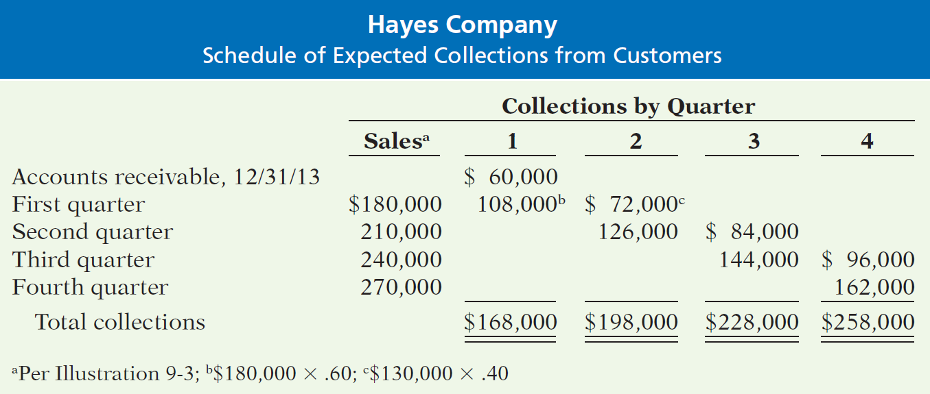
Preparing the Financial Budgets
Illustration – Prepare a schedule of collections from customers.

Slide 40
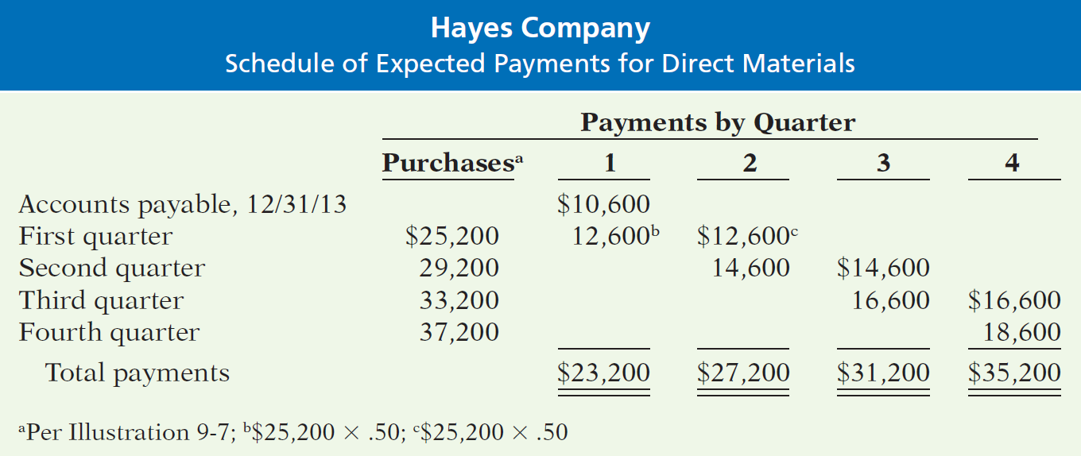
Preparing the Financial Budgets
Illustration – Prepare a schedule of cash payments for direct materials.

Slide 41
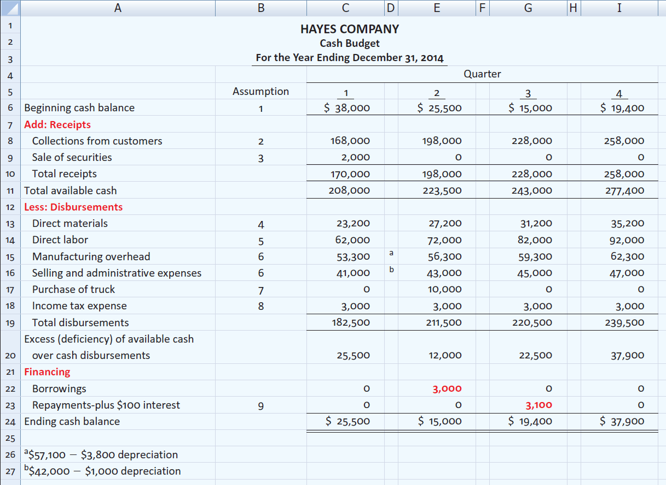
Preparing the Financial Budgets
Illustration

Slide 42



Slide 43
Preparing the Financial Budgets
Budgeted Balance Sheet
Developed from the budgeted balance sheet for the preceding year and the budgets for the current year.
Illustration: Pertinent data from the budgeted balance sheet at December 31, 2013, are as follows.

Slide 44
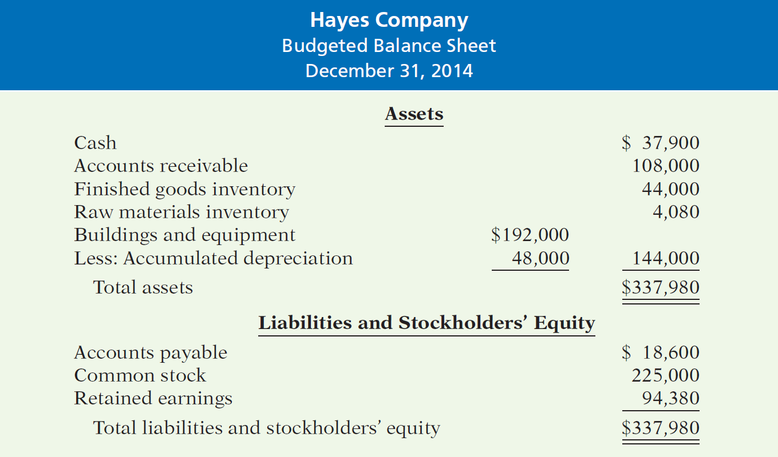
Preparing the Financial Budgets
Budgeted Balance Sheet

Slide 45
Preparing the Financial Budgets
Illustration: Pertinent data from the budgeted balance sheet at December 31, 2013, are as follows.
Cash: Ending cash balance $37,900, shown in the cash budget (Illustration 9-17).
Accounts receivable: 40% of fourth-quarter sales $270,000, shown in the schedule of expected collections from customers

Slide 46
Preparing the Financial Budgets
Finished goods inventory: Desired ending inventory 1,000 units, shown in the production budget (Illustration 9-5) times the total unit cost $44 (shown in Illustration 9-12).
Raw materials inventory: Desired ending inventory 1,020 pounds, times the cost per pound $4, shown in the direct materials budget (Illustration 9-7).
Buildings and equipment: December 31, 2013, balance $182,000, plus purchase of truck for $10,000 (Illustration).
Continued

Slide 47
Preparing the Financial Budgets
Accumulated depreciation: December 31, 2013, balance $28,800, plus $15,200 depreciation shown in manufacturing overhead budget (Illustration) and $4,000 depreciation shown in selling and administrative expense budget (Illustration 9-11).
Accounts payable: 50% of fourth-quarter purchases $37,200, shown in schedule of expected payments for direct materials (Illustration).
Common stock: Unchanged from the beginning of the year.
Retained earnings: December 31, 2013, balance $46,480, plus net income $47,900, shown in budgeted income statement (Illustration 9-13).

Slide 48
Preparing the Financial Budgets
Review Question
Expected direct materials purchases in Read Company are $70,000 in the first quarter and $90,000 in the second quarter. Forty percent of the purchases are paid in cash as incurred, and the balance is paid in the following quarter. The budgeted cash payments for purchases in the second quarter are:
a. $96,000
b. $90,000
$78,000
$72,000

Slide 49
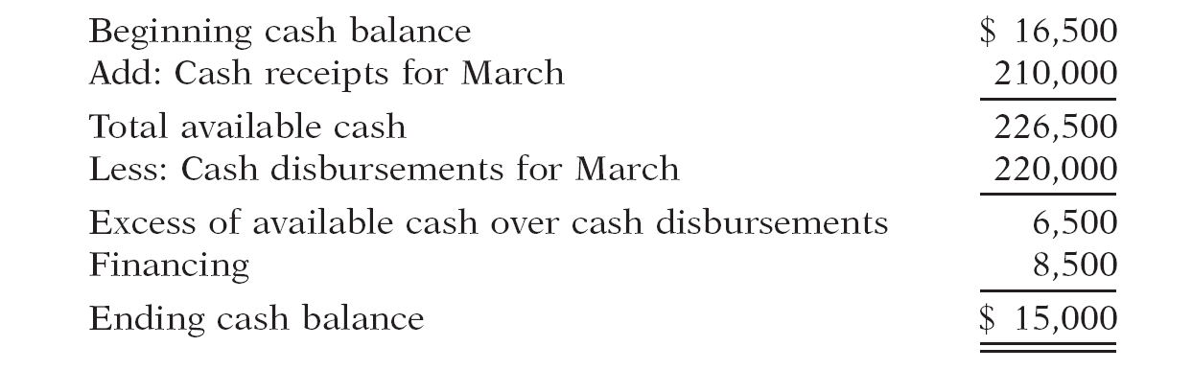
Martian Company management wants to maintain a minimum monthly cash balance of $15,000. At the beginning of March, the cash balance is $16,500, expected cash receipts for March are $210,000, and cash disbursements are expected to be $220,000. How much cash, if any, must be borrowed to maintain the desired minimum monthly balance?

Slide 50

Budgeting in Nonmanufacturing Companies
Merchandisers
Sales Budget: starting point and key factor in developing the master budget.
Use a purchases budget instead of a production budget.
Does not use the manufacturing budgets (direct materials, direct labor, manufacturing overhead).
To determine budgeted merchandise purchases:

Slide 51
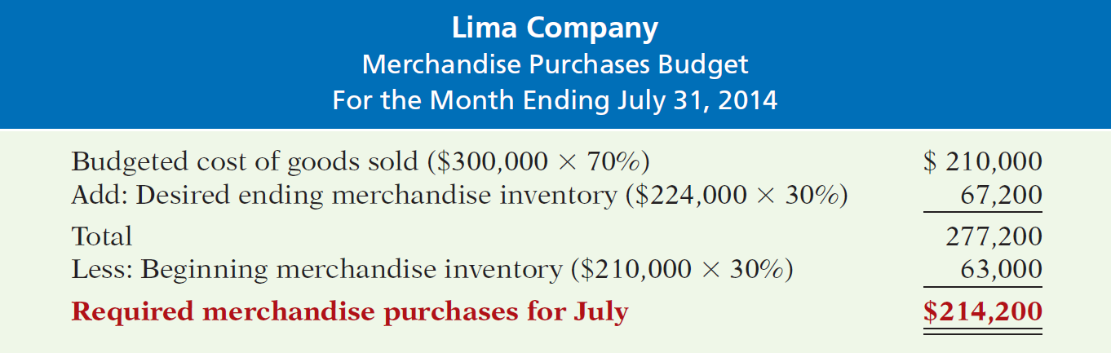
Budgeting in Nonmanufacturing Companies
Illustration: Lima’s budgeted sales for July $300,000 and for August $320,000. Cost of Goods Sold: 70% of sales. Desired ending inventory is 30% of next month’s Cost of Goods Sold. Required merchandise purchases for July are computed as follows.

Slide 52
Budgeting in Nonmanufacturing Companies
Service Enterprises
Critical factor in budgeting is coordinating professional staff needs with anticipated services.
Problems if overstaffed:
  Disproportionately high labor costs.
  Lower profits due to additional salaries.
  Increased staff turnover due to lack of challenging work.
Problems if understaffed:
  Lost revenues because existing and future client needs for services cannot be met.
  Loss of professional staff due to excessive work loads.

Slide 53
Budgeting in Nonmanufacturing Companies
Not-For-Profit Organizations
Just as important as for profit-oriented company.
Budget process differs from profit-oriented company.
Budget on the basis of cash flows (expenditures and receipts), not on a revenue and expense basis.
Starting point is usually expenditures, not receipts.
Management’s task is to find receipts needed to support planned expenditures.
Budget must be followed, overspending often illegal.

Slide 54
Budgeting in Nonmanufacturing Companies
Review Question
The budget for a merchandiser differs from a budget for a manufacturer because:
a. A merchandise purchases budget replaces the production budget.
b. The manufacturing budgets are not applicable.
c. None of the above.
d. Both (a) and (b) above

Slide 55
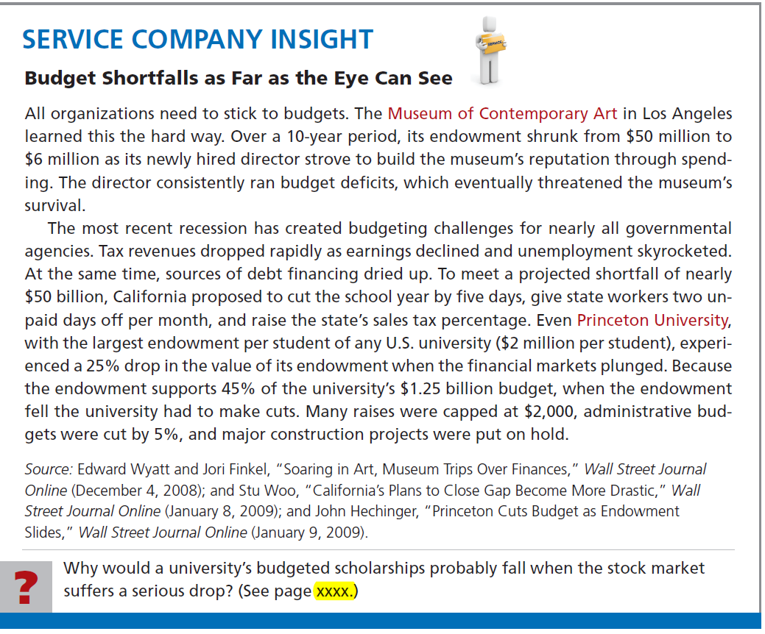

Slide 56
End of Lecture 28

