Slide 1
Chapter 14
Lecture 27
Budgetary Planning, Customer Profitability Analysis and Sales Variance Analysis
Readings
Chapter 14, Cost Accounting, Managerial Emphasis, 14th edition by Horengren
Chapter 9, Managerial Accounting 6th edition by Weygandt, kimmel, kieso

Slide 2
Budgetary Planning
Learning Objectives
After studying this chapter, you should be able to:
Indicate the benefits of budgeting.
State the essentials of effective budgeting.
Identify the budgets that comprise the master budget.
Describe the sources for preparing the budgeted income statement.
Explain the principal sections of a cash budget.
Indicate the applicability of budgeting in non-manufacturing companies.

Slide 3
Cost Allocation
Assigning indirect costs to cost objects
These costs are not traced
Indirect costs often comprise a large percentage of Total Overall Costs

Slide 4
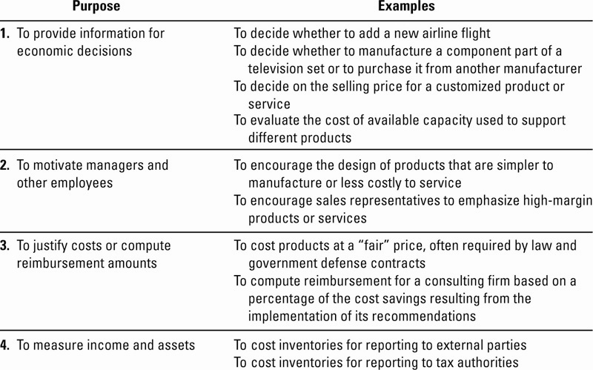
Purposes of Cost Allocation

Slide 5
Six-Function Value Chain
Traditional Life Cycle approach may not yield the costs necessary to meet the four-purpose criteria for cost allocation
Costs necessary for decision-making may pull costs from some or all of these six functions

Slide 6
Criteria for Cost-Allocation Decisions
Cause and Effect – variables are identified that cause resources to be consumed
  Most credible to operating managers
  Integral part of ABC
Benefits Received – the beneficiaries of the outputs of the cost object are charged with costs in proportion to the benefits received

Slide 7
Criteria for Cost-Allocation Decisions
Fairness (Equity) – the basis for establishing a price satisfactory to the government and its suppliers.
  Cost allocation here is viewed as a “reasonable” or “fair” means of establishing selling price
Ability to Bear – cost are allocated in proportion to the cost object’s ability to bear them
  Generally, larger or more profitable objects receive proportionally more of the allocated costs

Slide 8
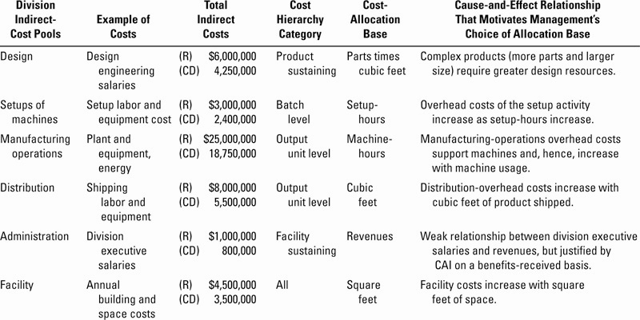
Cost Allocation Illustrated

Slide 9
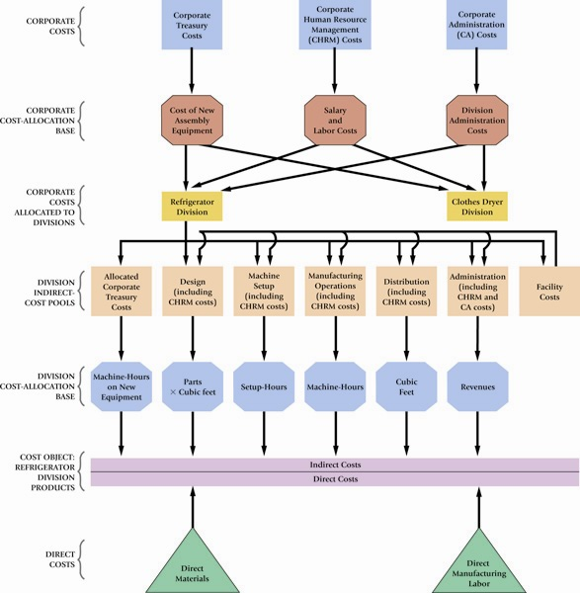
Corporate and Division Overhead Allocation Illustrated

Slide 10
Customer Revenues and
Customer Costs
Customer-Profitability Analysis is the reporting and analysis of revenues earned from customers and costs incurred to earn those revenues
An analysis of customer differences in revenues and costs can provide insight into why differences exist in the operating income earned from different customers

Slide 11
Customer Revenues
Price discounting is the reduction of selling prices to encourage increases in customer purchases
  Lower sales price is a tradeoff for larger sales volumes
Discounts should be tracked by customer and salesperson

Slide 12
Customer Cost Analysis
Customer Cost Hierarchy categorizes costs related to customers into different cost pools on the basis of different:
  types of drivers
  cost-allocation bases
  degrees of difficulty in determining cause-and-effect or benefits-received relationships

Slide 13
Customer Cost Hierarchy Example
Customer output unit-level costs
Customer batch-level costs
Customer-sustaining costs
Distribution-channel costs
Corporate-sustaining costs

Slide 14
Other Factors in Evaluating Customer Profitability
Likelihood of customer retention
Potential for sales growth
Long-run customer profitability
Increases in overall demand from having well-known customers
Ability to learn from customers

Slide 15
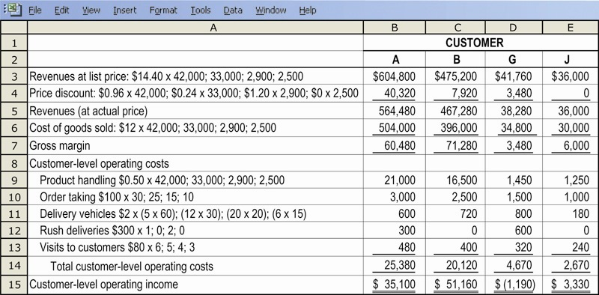
Customer Profitability Analysis Illustrated

Slide 16
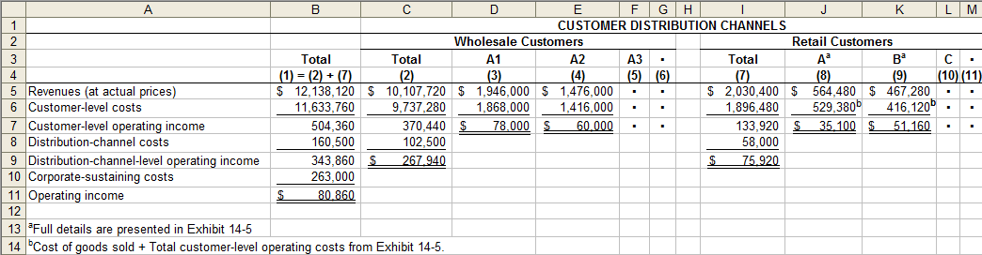
Customer Profitability Analysis Illustrated

Slide 17
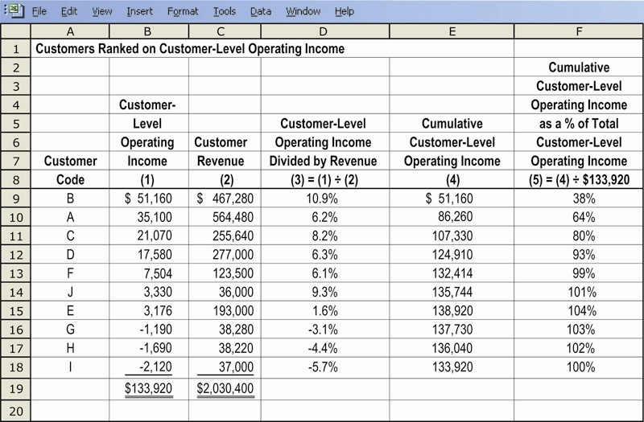
Customer Profitability Analysis Illustrated

Slide 18
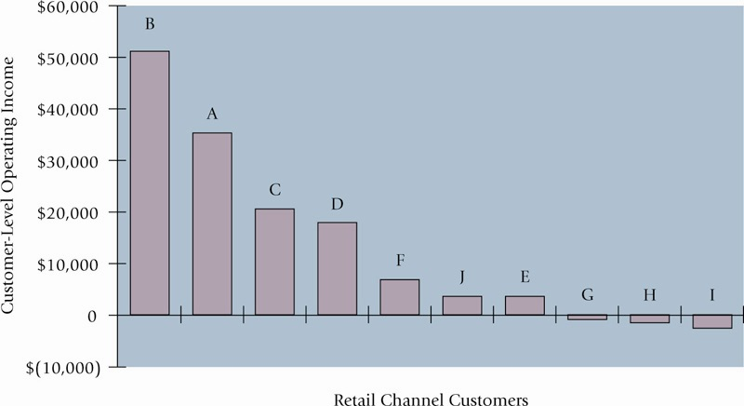
Customer Profitability Analysis Illustrated

Slide 19
Sales Variances
Level 1: Static-budget variance – the difference between an actual result and the static-budgeted amount
Level 2: Flexible-budget variance – the difference between an actual result and the flexible-budgeted amount
Level 2: Sales-volume variance
Level 3: Sales Quantity variance
Level 3: Sales Mix variance

Slide 20
Sales-Mix Variance
Measures shifts between selling more or less of higher or lower profitable products

Slide 21
Sales-Quantity Variance

Slide 22
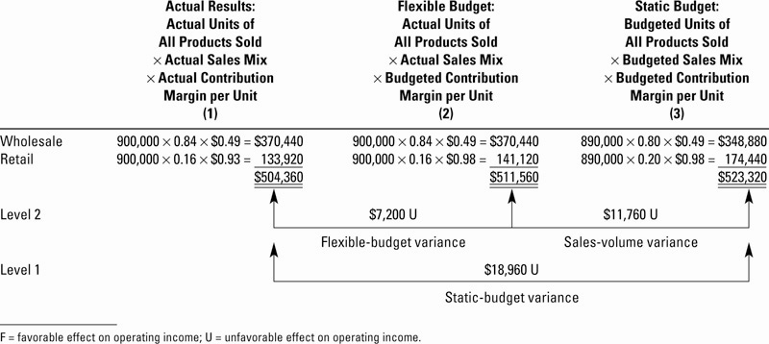
Flexible-Budget and Sales-Volume Variances Illustrated

Slide 23
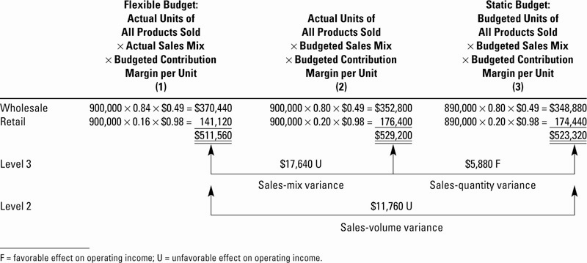
Sales-Mix and –Quantity Variances Illustrated

Slide 24
Market-Share Variance

Slide 25
Market-Size Variance

Slide 26
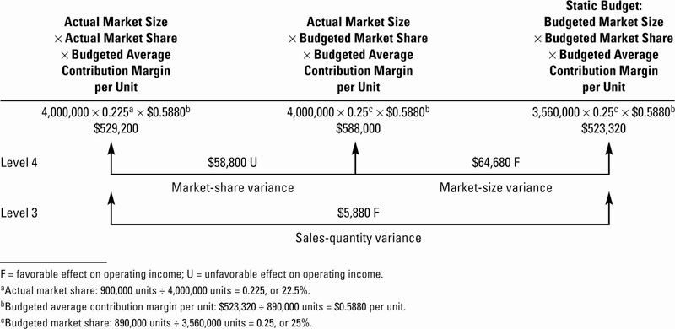
Market-Share and –Size Variances Illustrated

Slide 27
Market-Share and Market-Size Variances
Limitation: reliable information on the actual size and share of various markets is not always available
These are considered Level 4 variances (a decomposition of the Sales-Quantity variance

Slide 28
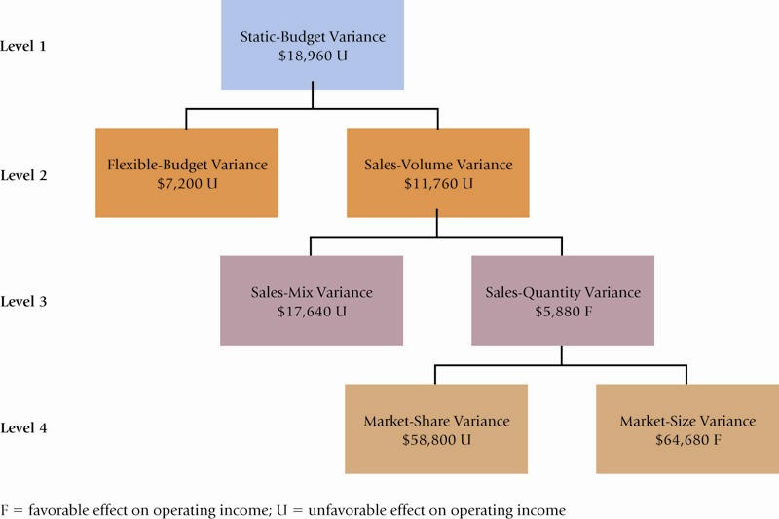
Sales Variances Summarized

Slide 29
Budgeting Basics
Budget: a formal written statement of management’s plans for a specified future time period, expressed in financial terms.
  Primary way to communicate agreed-upon objectives to all parts of the company.
  Promotes efficiency.
  Control device - important basis for performance evaluation once adopted.

Slide 30
Budgeting Basics
Budgeting and Accounting
  Historical accounting data on revenues, costs, and expenses help in formulating future budgets.
  Accountants normally responsible for presenting management’s budgeting goals in financial terms.
  The budget and its administration are the responsibility of management.

Slide 31
Budgeting Basics
The Benefits of Budgeting
  Requires all levels of management to plan ahead.
  Provides definite objectives for evaluating performance.
  Creates an early warning system for potential problems.
  Facilitates coordination of activities within the business.
  Results in greater management awareness of the entity’s overall operations.
  Motivates personnel throughout organization to meet planned objectives.

Slide 32
Budgeting Basics
Review Question
Which of the following is not a benefit of budgeting?
a. Management can plan ahead.
b. An early warning system is provided for potential problems.
c. It enables disciplinary action to be taken at every level of responsibility.
d. The coordination of activities is facilitated.

Slide 33
Budgeting Basics
Essentials of Effective Budgeting
  Depends on a sound organizational structure with authority and responsibility for all phases of operations clearly defined.
  Based on research and analysis with realistic goals.
  Accepted by all levels of management.

Slide 34
Budgeting Basics
Length of the Budget Period
May be prepared for any period of time.
  Most common - one year.
  Supplement with monthly and quarterly budgets.
  Different budgets may cover different time periods.
Long enough to provide an attainable goal and minimize seasonal or cyclical fluctuations.
Short enough for reliable estimates.

Slide 35
Budgeting Basics
The Budgeting Process
Base budget goals on past performance
  Collect data from organizational units.
  Begin several months before end of current year.
Develop budget within the framework of a sales forecast.
  Shows potential industry sales.
  Shows company’s expected share.

Slide 36
Budgeting Basics
The Budgeting Process
Factors considered in Sales Forecasting:
  General economic conditions
  Industry trends
  Market research studies
  Anticipated advertising and promotion
  Previous market share
  Price changes
  Technological developments

Slide 37
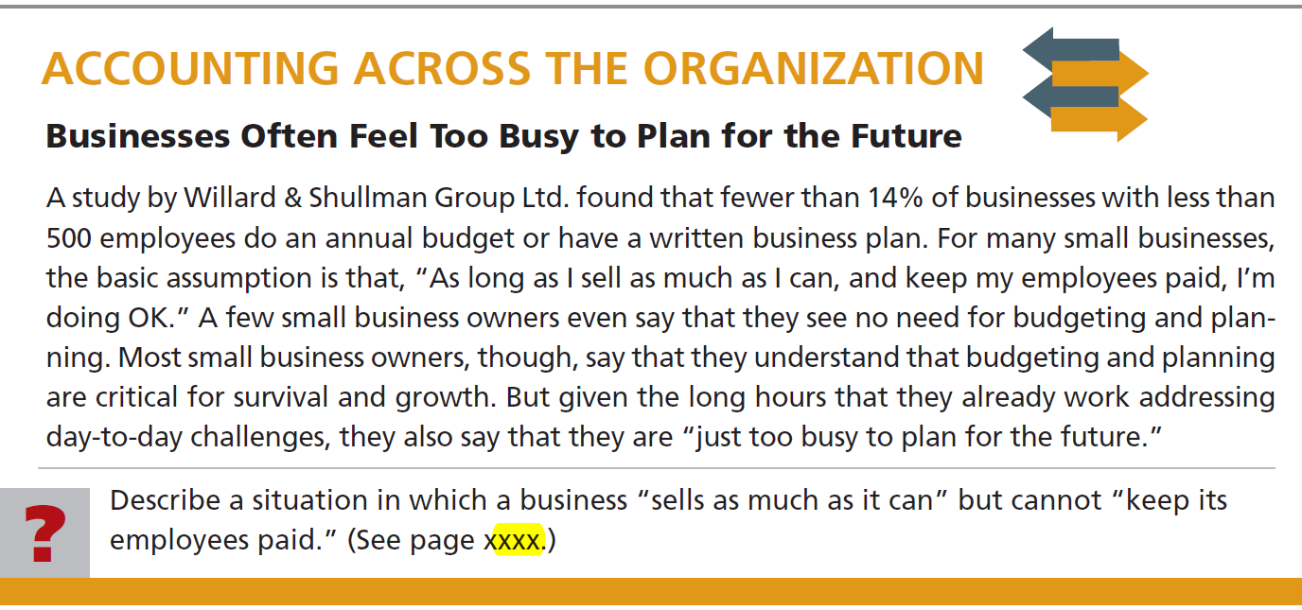


Slide 38
Budgeting Basics
Budgeting and Human Behavior
Participative Budgeting: Each level of management should be invited to participate.
  May inspire higher levels of performance or discourage additional effort.
  Depends on how budget developed and administered.

Slide 39
Budgeting Basics
Participative Budgeting
  Advantages:
    More accurate budget estimates because lower level managers have more detailed knowledge of their area.
    Tendency to perceive process as fair due to involvement of lower level management.
  Overall goal - produce budget considered fair and achievable by managers while still meeting corporate goals.
  Risk of unreliable budgets greater when they are “top-down.”

Slide 40
Budgeting Basics
Participative Budgeting
  Disadvantages:
    Can be time consuming and costly.
    Can foster budgetary “gaming” through budgetary slack.

Slide 41
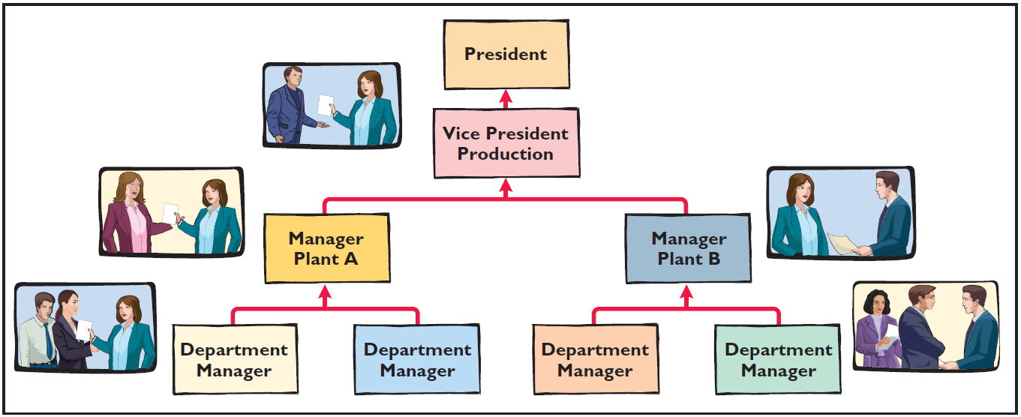
Budgeting Basics
Flow of budget data from lower management to top levels

Slide 42
Budgeting Basics
Budgeting and Long-Range Planning
Three basic differences :
  Time period involved.
  Emphasis
  Detail presented
Time period:
Budgeting is short-term – usually one year.
Long range planning - at least five years.

Slide 43
Budgeting Basics
Review Question
The essentials of effective budgeting do not include:
a. Top-down budgeting.
b. Management acceptance.
c. Research and analysis.
d. Sound organizational structure.

Slide 44
Budgeting Basics
The Master Budget
  Set of interrelated budgets that constitutes a plan of action for a specified time period.
  Contains two classes of budgets:
    Operating budgets.
    Financial budgets.
Individual budgets that result in the preparation of the budgeted income statement – establish goals for sales and production personnel.

Slide 45
Budgeting Basics
The Master Budget
  Set of interrelated budgets that constitutes a plan of action for a specified time period.
  Contains two classes of budgets:
    Operating budgets.
    Financial budgets.
The capital expenditures budget, the cash budget, and the budgeted balance sheet – focus primarily on cash needs to fund operations and capital expenditures.

Slide 46
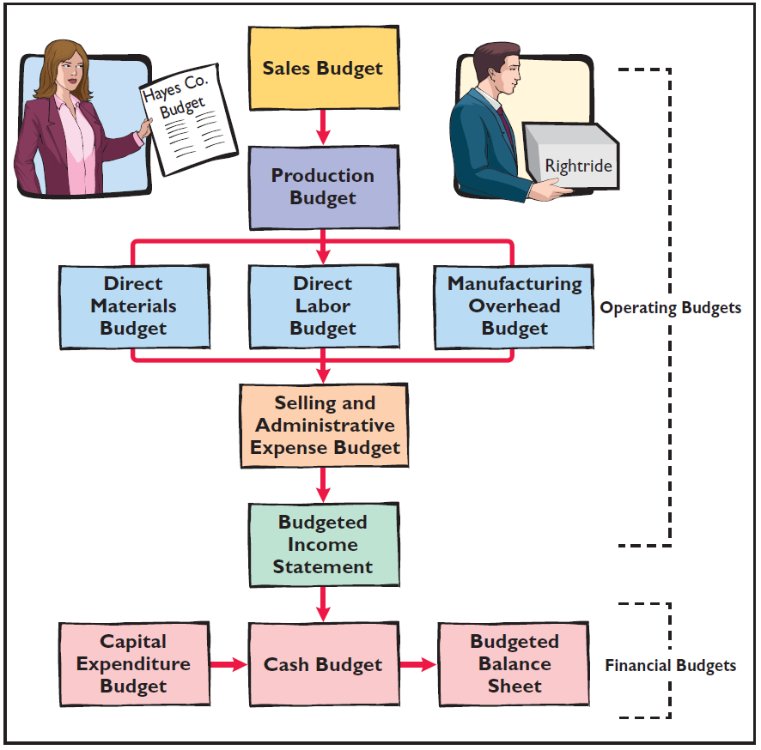
Budgeting Basics
Components of the Master
Budget

Slide 47
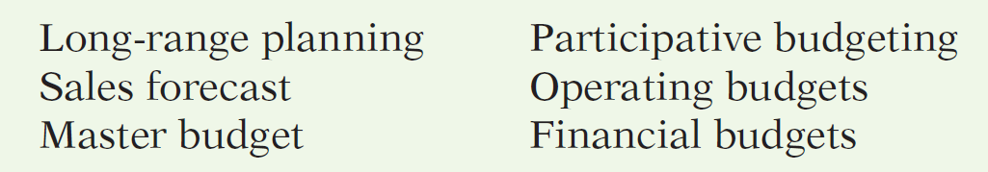
Use this list of terms to complete the sentences that follow.
  A sales forecast shows potential sales for the industry and a company’s expected share of such sales.
  Operating budgets are used as the basis for the preparation of the budgeted income statement.

Slide 48
Use this list of terms to complete the sentences that follow.
  The master budget is a set of interrelated budgets that constitutes a plan of action for a specified time period.
  Long-range planning identifies long-term goals, selects strategies to achieve these goals, and develops policies and plans to implement the strategies.

Slide 49
Use this list of terms to complete the sentences that follow.
  Lower-level managers are more likely to perceive results as fair and achievable under a participative budgeting approach.
  Financial budgets focus primarily on the cash resources needed to fund expected operations and planned capital expenditures.

Slide 50
End of Lecture 27

