Slide 1
Chapter 12-Continued
Lecture 26
Pricing Decision and Cost Management
Readings
Chapter 12, Cost Accounting, Managerial Emphasis, 14th edition by Horengren
Chapter 8, Managerial Accounting 6th edition by Weygandt, kimmel, kieso

Slide 2
Learning Objectives
After studying this chapter, you should be able to:
Compute a target cost when the market determines a product price.
Compute a target selling price using cost-plus pricing.
Use time-and-material pricing to determine the cost of services provided.
Determine a transfer price using the negotiated, cost-based, and market-based approaches.
Explain issues involved in transferring goods between divisions in different countries.

Slide 3
Pricing Services
Time-and-material pricing is an approach to cost-plus pricing in which the company uses two pricing rates:
  One for labor used on a job - includes direct labor time and other employee costs.
  One for material - includes cost of direct parts and materials and a material loading charge for related overhead.
Widely used in service industries, especially professional firms such as public accounting, law, and engineering.

Slide 4
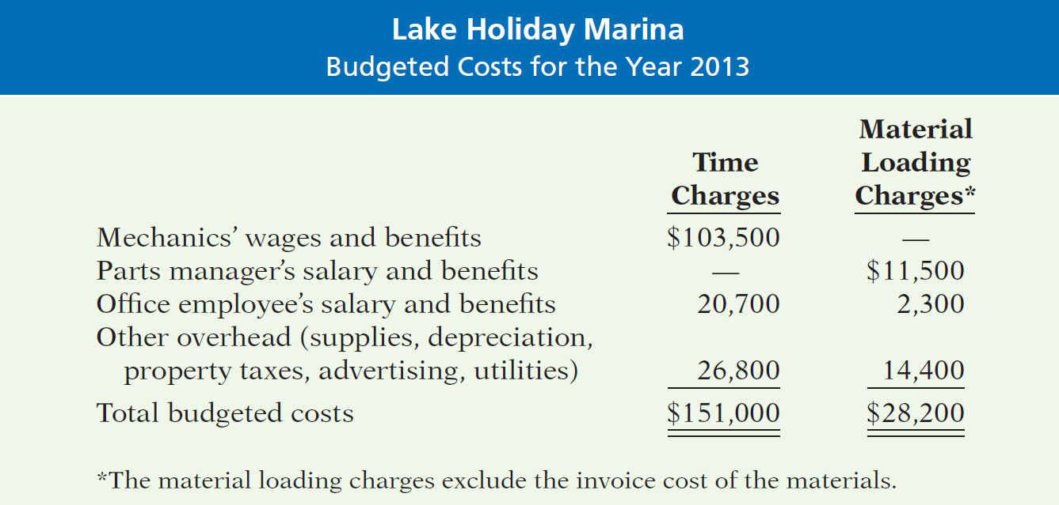
Pricing Services
Illustration: Assume the following data for Lake Holiday Marina, a boat and motor repair shop.

Slide 5
Pricing Services
Using time-and-material pricing involves three steps:
  calculate the per hour labor charge,
  calculate the charge for obtaining and holding materials, and
  calculate the charges for a particular job.

Slide 6
Pricing Services
Step 1: Calculate the labor charge.
  Express as a rate per hour of labor.
  Rate includes:
    Direct labor cost (includes fringe benefits).
    Selling, administrative, and similar overhead costs.
    Allowance for desired profit (ROI) per hour.
  Labor rate for Lake Holiday Marina for 2011 based on:
    5,000 hours of repair time.
    Desired profit margin of $8 per hour.

Slide 7
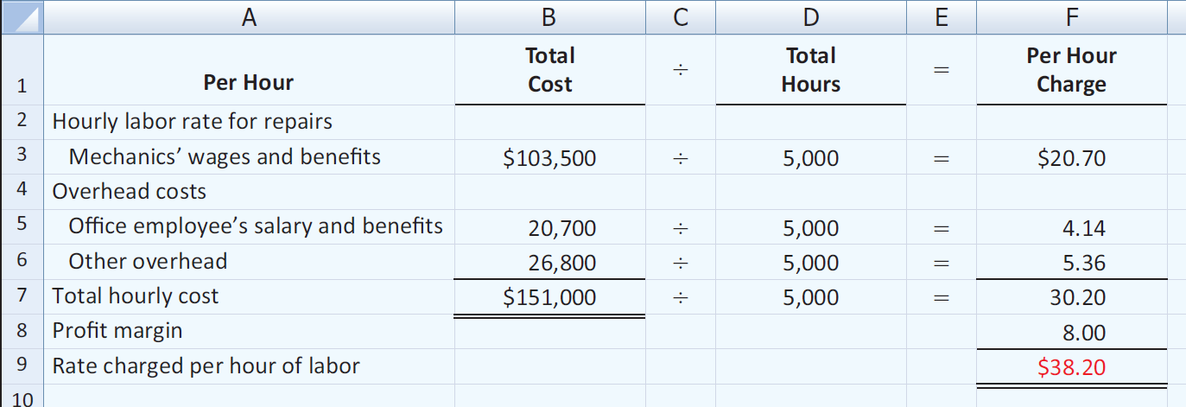
Pricing Services
Step 1: Calculate the labor charge.
Multiply the rate of $38.20 by the number of labor hours used on any particular job to determine the labor charges for the job.

Slide 8
Pricing Services
Step 2: Calculate the material loading charge.
  Material loading charge added to invoice price of materials.
  Covers the costs of purchasing, receiving, handling, storing + desired profit margin on materials.
  Expressed as a percentage of estimated costs of parts and materials for the year:
  Estimated purchasing, receiving, handling, storing costs
  Desired profit margin on materials
+
  Estimated costs of parts and materials

Slide 9
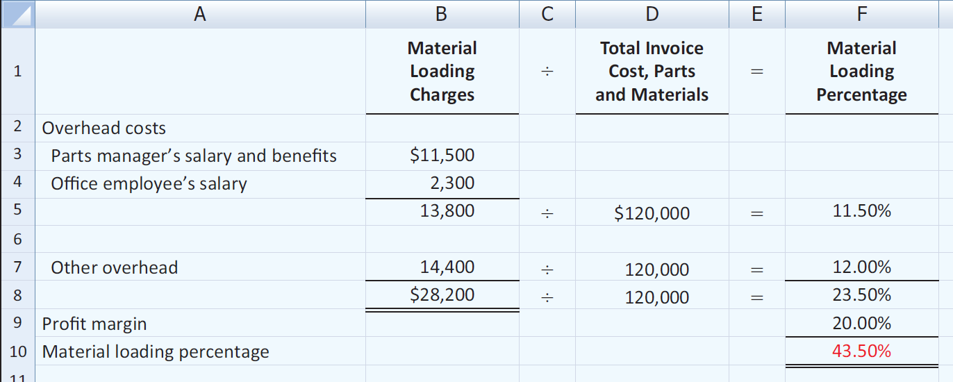
Pricing Services
Step 2: Calculate the material loading charge.
The marina estimates that the total invoice cost of parts and materials used in 2011 will be $120,000. The marina desires a 20% profit margin on the invoice cost of parts and materials.

Slide 10
Pricing Services
Step 3: Calculate charges for a particular job.
Labor charges
  +
  Material charges
  +
  Material loading charge

Slide 11
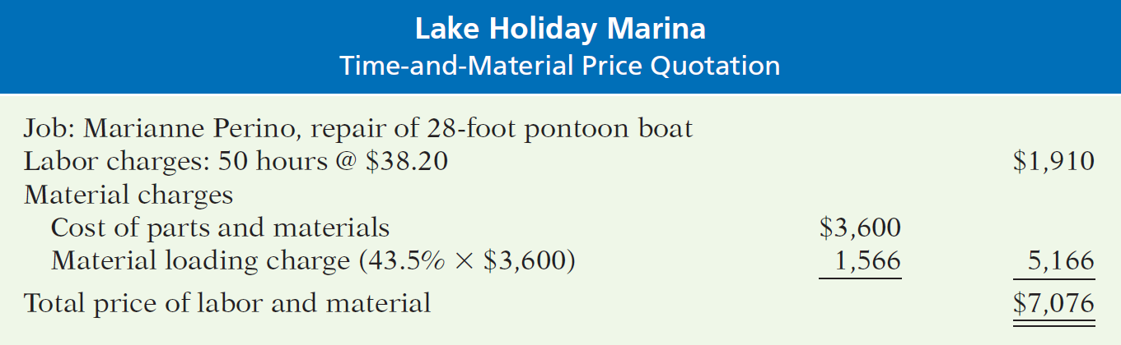
Pricing Services
Step 3: Calculate charges for a particular job.
Lake Holiday Marina prepares a price quotation to estimate the cost to refurbish a used 28-foot pontoon boat. Lake Holiday Marina estimates the job will require 50 hours of labor and $3,600 in parts and materials.

Slide 12
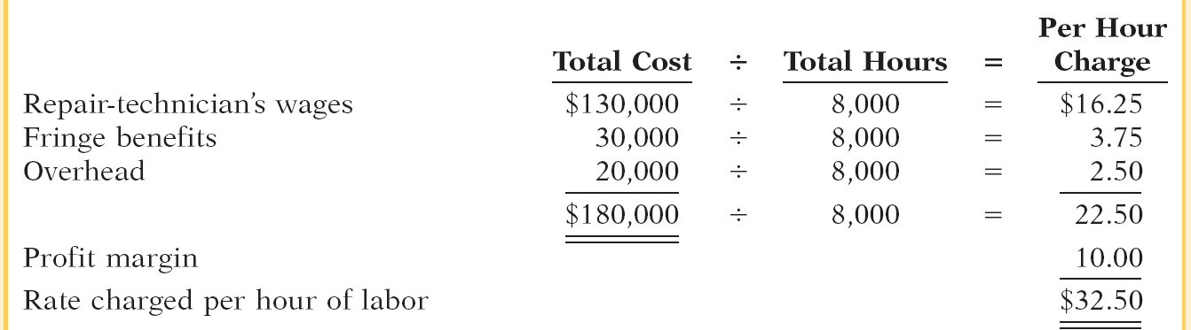
Presented below are data for Harmon Electrical Repair Shop for next year. The desired profit margin per labor hour is $10. The material loading charge is 40% of invoice cost. Harmon estimates that 8,000 labor hours will be worked next year. Compute the rate charged per hour of labor.

Slide 13
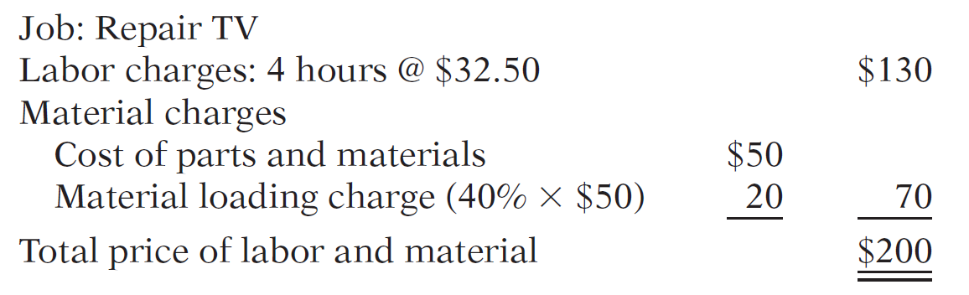
If Harmon repairs a TV that takes 4 hours to repair and uses parts of $50, compute the bill for this job.

Slide 14
Pricing Services
Review Question
Crescent Electrical Repair has decided to price its work on a time-and-material basis. It estimates the following costs for the year related to labor.
Technician wages and benefits $100,000
Office employee’s salary/benefits $40,000
Other overhead $80,000
Crescent desires a profit margin of $10 per labor hour and budgets 5,000 hours of repair time for the year. The office employee’s salary, benefits, and other overhead costs should be divided evenly between time charges and material loading charges. Crescent labor charge per hour would be:
a. $42 b. $34 c. $32 d. $30

Slide 15
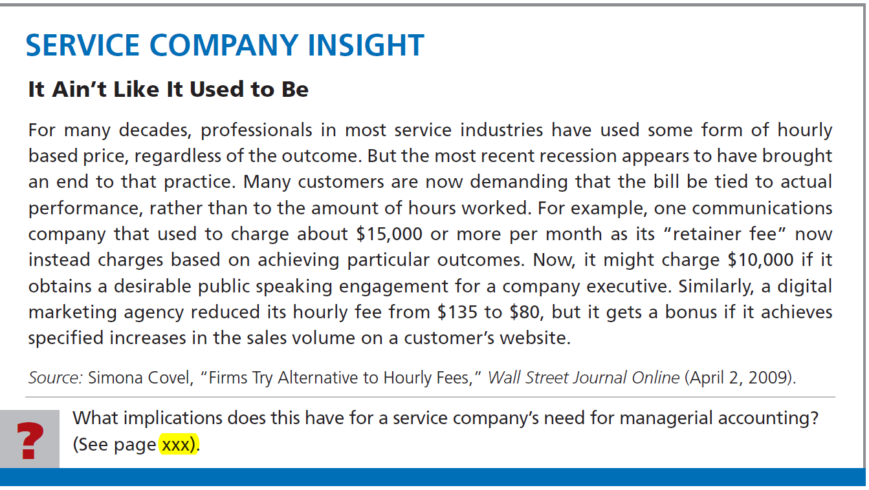

Slide 16
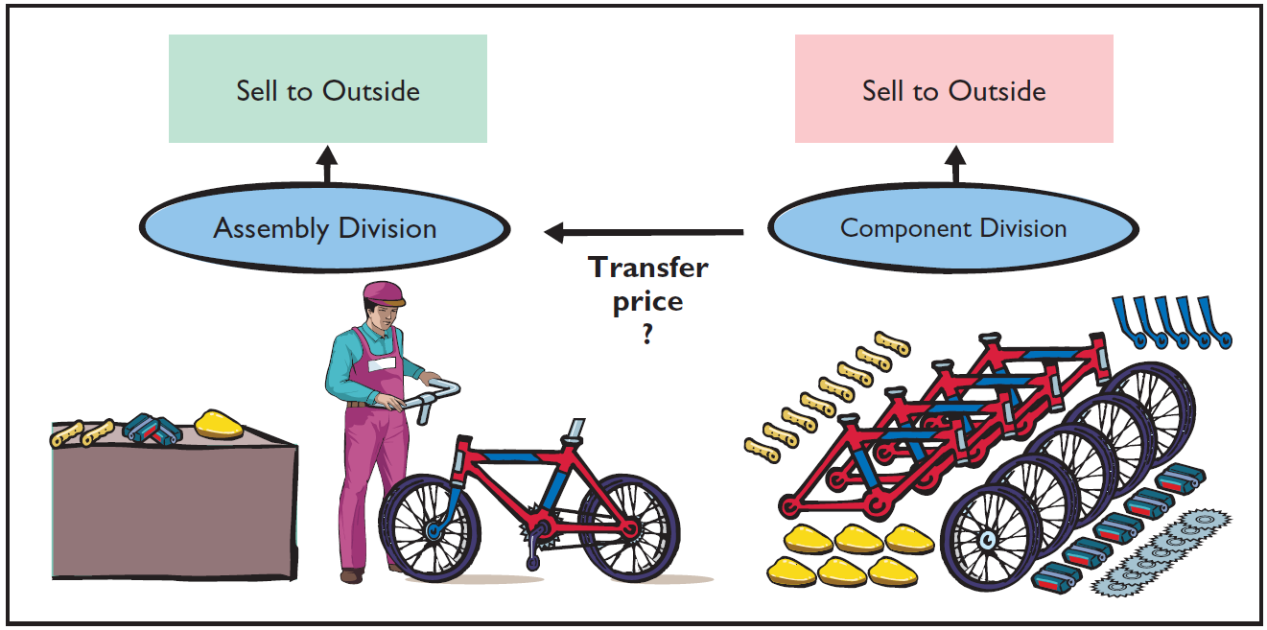
Transfer Pricing for Internal Sales
Vertically integrated companies
  Grow in either direction of its suppliers or its customers.
  Frequently transfer goods to other divisions as well as outside customers.
How do you price goods “sold” within the company?

Slide 17
Transfer Pricing for Internal Sales
Transfer price - price used to record the transfer between two divisions of a company.
  Ways to determine a transfer price:
    Negotiated transfer prices.
    Cost-based transfer prices.
    Market-based transfer prices.
  Conceptually - a negotiated transfer price is best.
  Due to practical considerations, companies often use the other two methods.

Slide 18
Transfer Pricing for Internal Sales
Negotiated Transfer Prices
Illustration: Alberta Company makes rubber soles for work & hiking boots.
  Two Divisions:
    Sole Division - sells soles externally.
    Boot Division - makes leather uppers for hiking boots which are attached to purchased soles.
  Division managers compensated on division profitability.
  Management now wants Sole Division to provide at least some soles to the Boot Division.

Slide 19
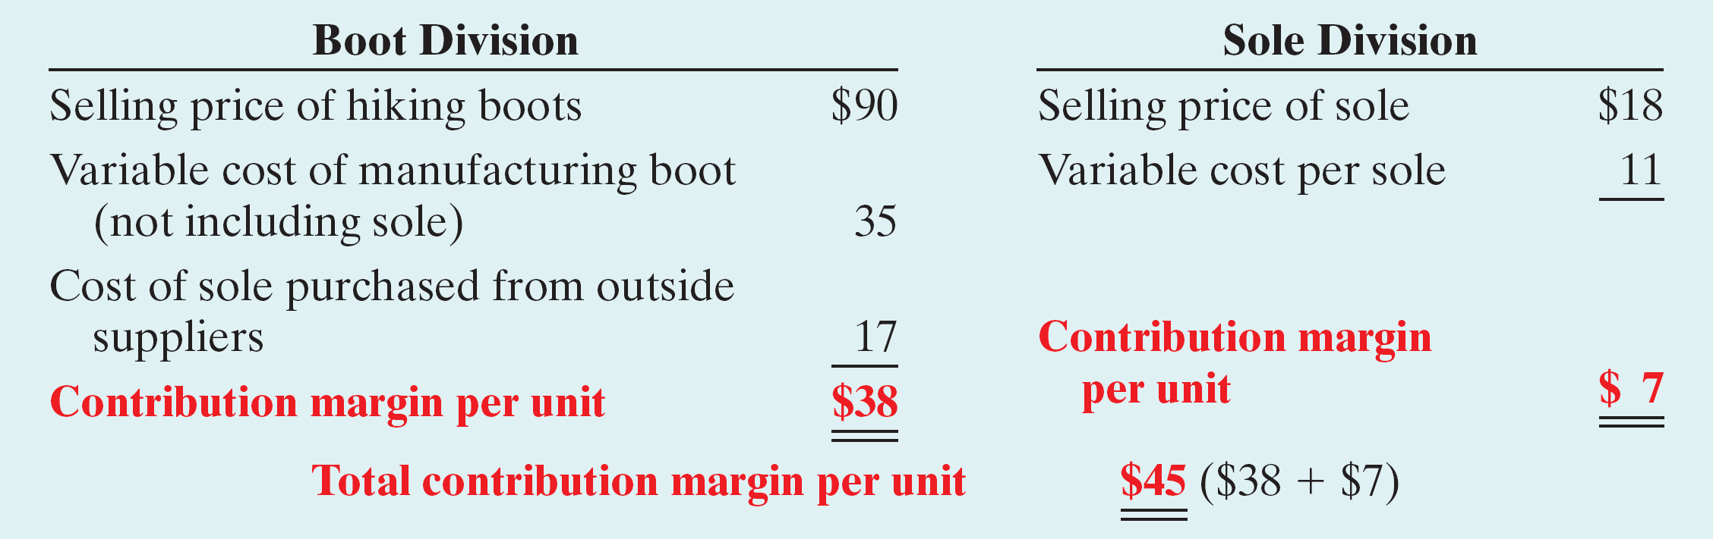
Negotiated Transfer Prices
Computation of the contribution margin per unit for each division when the Boot Division purchases soles from an outside supplier.
“What would be a fair transfer price if the Sole Division sold 10,000 soles to the Boot Division?”

Slide 20

Negotiated Transfer Prices
No Excess Capacity
  If Sole sells to Boot,
    payment must at least cover variable cost per unit plus
    its lost contribution margin per sole (opportunity cost).
  The minimum transfer price acceptable to Sole is:

Slide 21
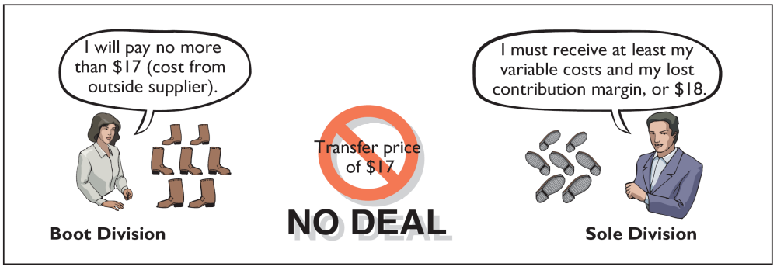
Negotiated Transfer Prices
Maximum Boot Division will pay is
what the sole would cost from an
outside buyer: $17

Slide 22
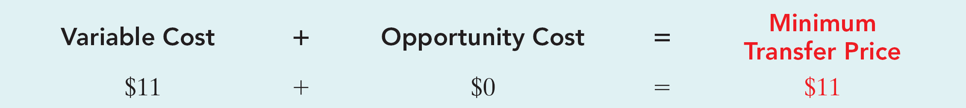
Negotiated Transfer Prices
Excess Capacity
  Can produce 80,000 soles, but can sell only 70,000.
  Available capacity of 10,000 soles.
  Contribution margin of $7 per unit is not lost.
  Minimum transfer price acceptable to Sole:

Slide 23
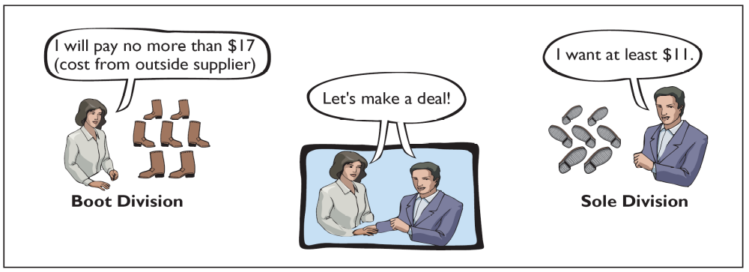
Negotiated Transfer Prices
Negotiate a transfer price between $11
(minimum acceptable to Sole) and $17
(maximum acceptable to Boot)

Slide 24
Negotiated Transfer Prices
Variable Costs
  In the minimum transfer price formula, variable cost is the variable cost of units sold internally.
  May differ - higher or lower - for units sold internally versus those sold externally.
  The minimum transfer pricing formula can still be used – just use the internal variable costs.

Slide 25
Negotiated Transfer Prices
Summary of Negotiated Transfer Pricing
  Transfer prices established:
    Minimum by selling division.
    Maximum by the purchasing division.
  Often not used because:
    Market price information sometimes not easily obtainable.
    Lack of trust between the two divisions.
    Different pricing strategies between divisions.

Slide 26
The clock division of Control Central Corporation manufactures clocks and then sells them to customers for $10 per unit. Its variable cost is $4 per unit, and its fixed cost per unit is $2.50. Management would like the clock division to transfer 8,000 of these clocks to another division within the company at a price of $5. The clock division could avoid $0.50 per clock of variable packaging costs by selling internally. (a) Determine the minimum transfer price, assuming the clock division is not operating at full capacity.
Opportunity cost + Variable cost = Minimum transfer price
$0 $3.50 $3.50

Slide 27
The clock division of Control Central Corporation manufactures clocks and then sells them to customers for $10 per unit. Its variable cost is $4 per unit, and its fixed cost per unit is $2.50. Management would like the clock division to transfer 8,000 of these clocks to another division within the company at a price of $5. The clock division could avoid $0.50 per clock of variable packaging costs by selling internally. (b) Determine the minimum transfer price, assuming the clock division is operating at full capacity.
Opportunity cost + Variable cost = Minimum transfer price
$6 $3.50 $9.50

Slide 28
Transfer Pricing for Internal Sales
Cost-Based Transfer Prices
  Uses costs incurred by the division producing the goods as its foundation.
  May be based on variable costs alone or on variable costs plus fixed costs.
  Selling division may also add markup.
  Can result in improper transfer prices causing:
    Loss of profitability for company.
    Unfair evaluation of division performance.

Slide 29
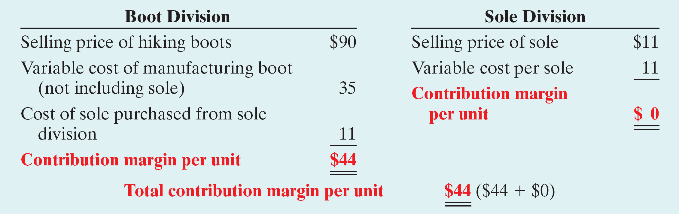
Cost-Based Transfer Prices
Illustration: Alberta Company requires the division to use a transfer price based on the variable cost of the sole. With no excess capacity, the contribution margins per unit for the two divisions are:
Cost-based transfer price—10,000 units

Slide 30
Cost-Based Transfer Prices
  Cost-based pricing is bad deal for Sole Division – no profit on transfer of 10,000 soles to Boot Division and loses profit of $70,000 on external sales.
  Boot Division is very happy; increases contribution margin by $6 per sole.
  If Sole Division has excess capacity, the division reports a zero profit on these 10,000 units and the Boot Division gains $6 per unit.

Slide 31
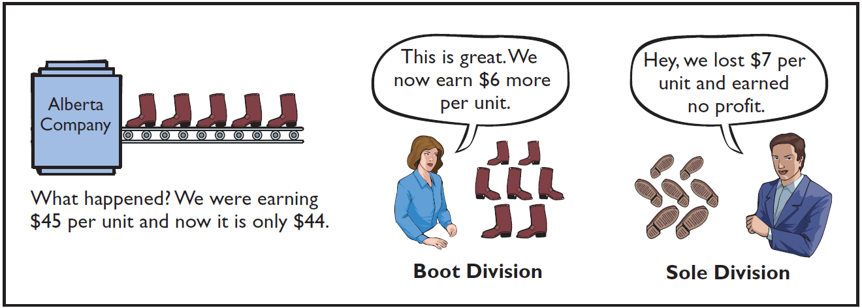
Cost-Based Transfer Prices
Overall, the Company is worse off by $60,000.
Does not reflect the division’s true profitability nor provide adequate incentive for the division to control costs.

Slide 32
Transfer Pricing for Internal Sales
Market-Based Transfer Prices
  Based on existing market prices of competing goods.
  Often considered best approach because it is objective and generally provides the proper economic incentives.
  It is indifferent between selling internally and externally if can charge/pay market price.
  Can lead to bad decisions if have excess capacity.
  Why? No opportunity cost.
  Where there is not a well-defined market price, companies use cost-based systems.

Slide 33
Market-Based Transfer Prices
Review Question
The Plastics Division of Weston Company manufactures plastic molds and then sells them for $70 per unit. Its variable cost is $30 per unit, and its fixed cost per unit is $10. Management would like the Plastics Division to transfer 10,000 of these molds to another division within the company at a price of $40. The Plastics Division is operating at full capacity. What is the minimum transfer price that the Plastics Division should accept?
a. $10 c. $40
b. $30 d. $70

Slide 34
Transfer Pricing for Internal Sales
Effect of Outsourcing on Transfer Pricing
  Outsourcing - Contracting with an external party to provide a good or service, rather than doing the work internally.
    Virtual companies outsource all of their production.
    Use incremental analysis to determine if outsourcing is profitable.
    As companies increasingly rely on outsourcing, fewer components are transferred internally thereby reducing the need for transfer pricing.

Slide 35
Transfer Between Divisions in Different Countries
Companies “globalize” their operations
  Going global increases transfers between divisions located in different countries.
  60% of trade between countries is estimated to be transfers between divisions.
  Different tax rates make determining appropriate transfer price more difficult.

Slide 36
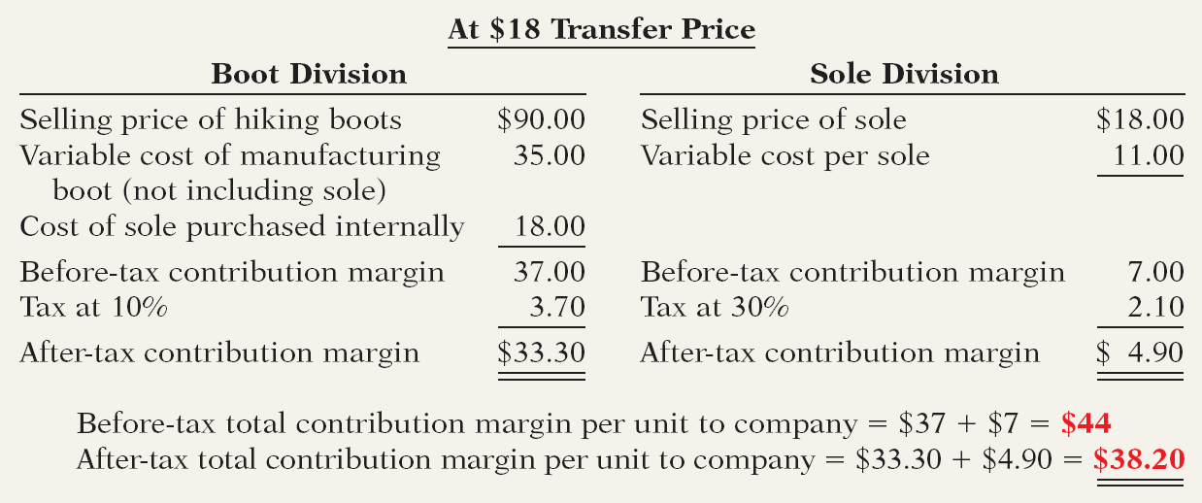
Transfer Between Divisions in Different Countries
Illustration: Alberta’s Boot Division is located in a country with a corporate tax rate of 10%, and the Sole Division is located in a country with a tax rate of 30%. The following illustrates the after-tax contribution margin per unit under transfer prices of $18 and $11.

Slide 37
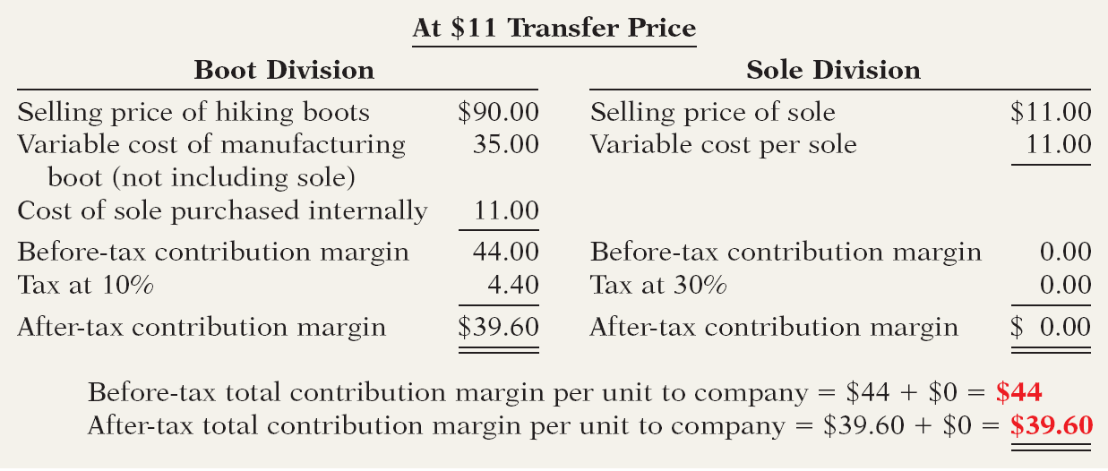
Transfer Between Divisions in Different Countries
The after-tax contribution margins differ because more of the contribution margin is attributed to the division in the country with the lower tax rate.

Slide 38
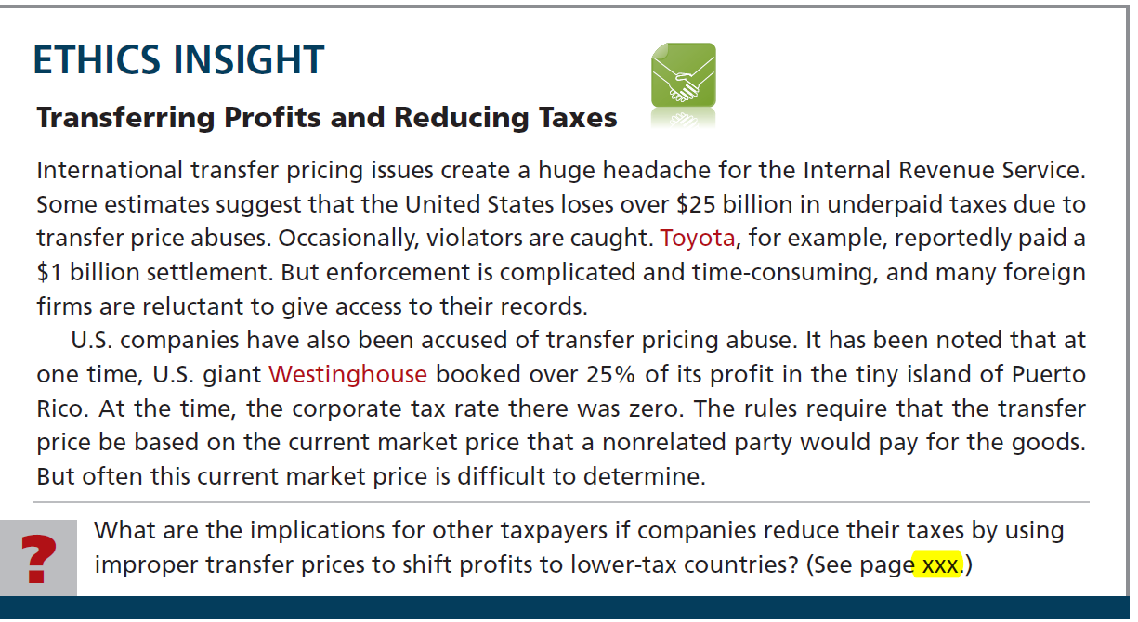

Slide 39
OTHER COST APPROACHES TO PRICING
Absorption-Cost Pricing
  Consistent with GAAP: includes both variable and fixed manufacturing costs as product costs
  Both variable and fixed selling and administrative costs are excluded from product cost base
  Steps in approach:
    Compute the unit manufacturing cost.
    Compute the markup percentage – must cover the desired ROI as well as selling/administrative expenses.
    Set the target selling price

Slide 40
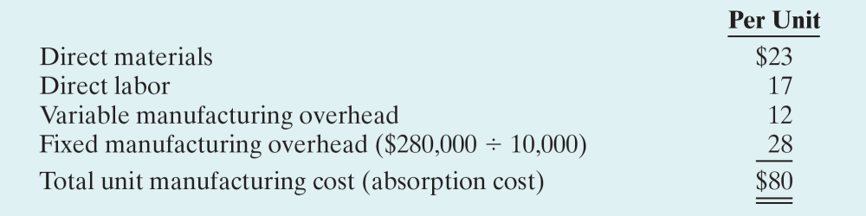
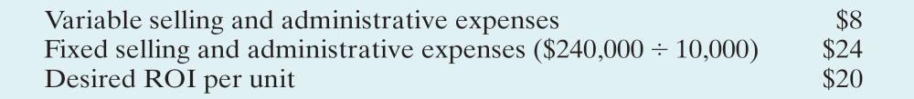
OTHER COST APPROACHES TO PRICING
Illustration
Step 1: Compute the unit manufacturing cost.
Additional information:

Slide 41
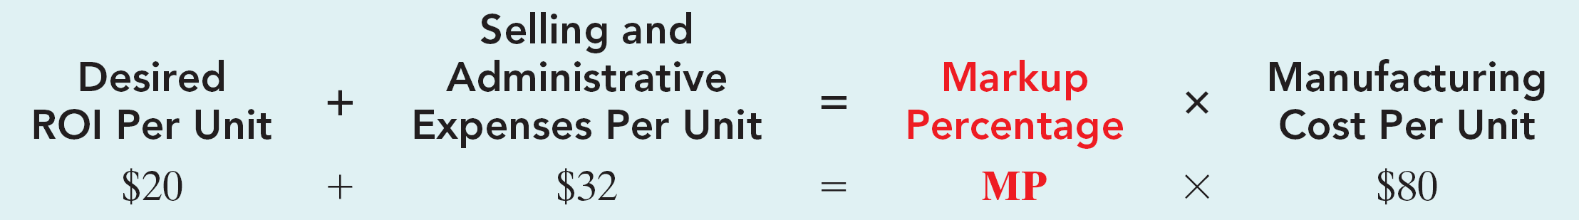
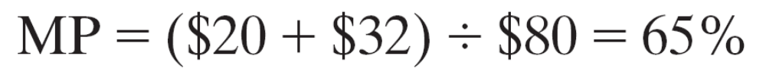
OTHER COST APPROACHES TO PRICING
Illustration
Step 2: Compute the markup percentage.

Slide 42
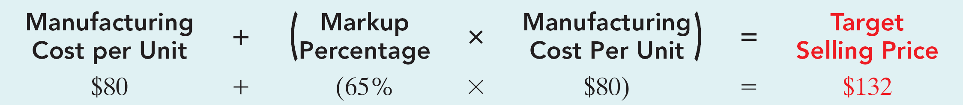
OTHER COST APPROACHES TO PRICING
Illustration
Step 3: Set the target selling price.
Because of fixed costs, if more than 10,000 units are sold, the ROI will be greater than 20% and vice versa.

Slide 43
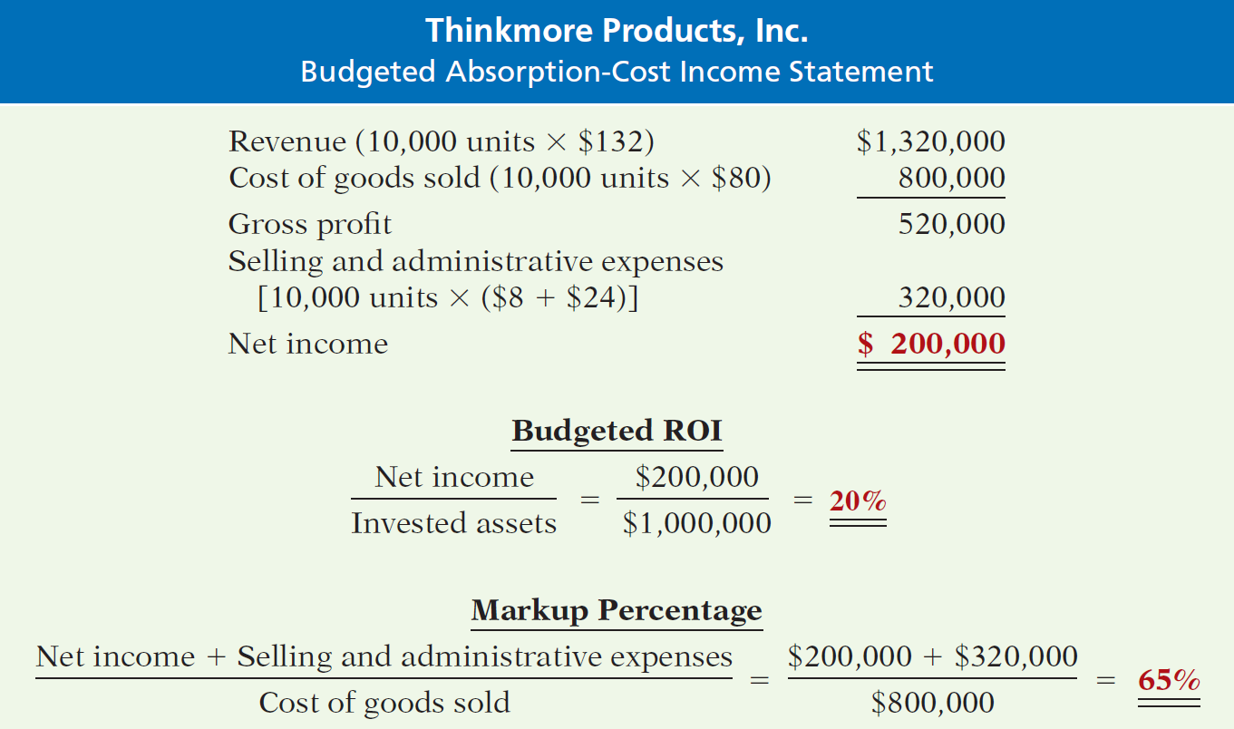
OTHER COST APPROACHES TO PRICING
Proof of 20% ROI—absorption-cost pricing

Slide 44
OTHER COST APPROACHES TO PRICING
Summary: Absorption-Cost Pricing
  Most companies that use cost-plus pricing use either absorption cost or full cost as the basis.
  Reasons:
    Information readily available – cost effective.
    Use of only variable costs may result in too low a price – suicidal price cutting.
    Most defensible base for justifying prices.

Slide 45
OTHER COST APPROACHES TO PRICING
Variable-Cost Pricing
  Cost base consists of all variable costs associated with a product – manufacturing, selling, administrative.
  Since fixed costs are not included in base, markup must provide for fixed costs (manufacturing, selling, administrative) and the target ROI.
  Useful for making short-run decisions because variable and fixed cost behaviors are considered separately.

Slide 46
OTHER COST APPROACHES TO PRICING
Variable-Cost Pricing
Steps:
  Compute the unit variable cost.
  Compute markup percentage.
  Set target selling price.

Slide 47
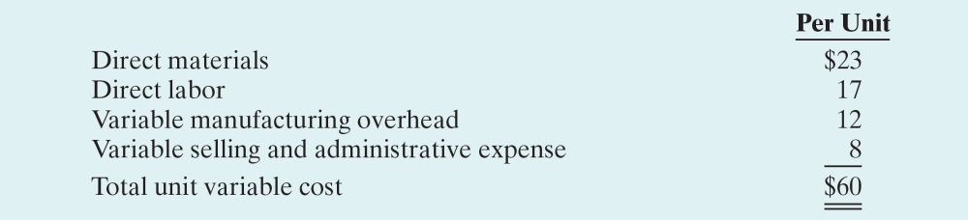
OTHER COST APPROACHES TO PRICING
Variable-Cost Pricing - Illustration
Step 1: Compute the unit variable cost.

Slide 48
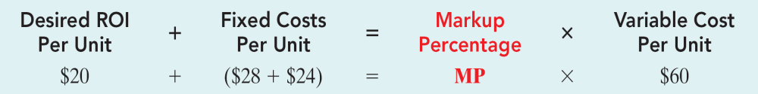
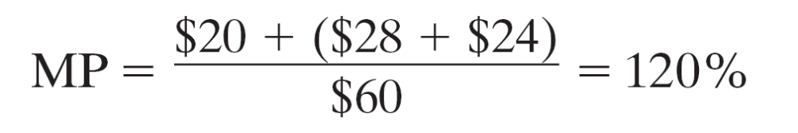
OTHER COST APPROACHES TO PRICING
Variable-Cost Pricing - Illustration
Step 2: Compute the markup percentage.

Slide 49
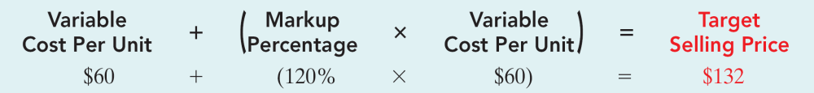
OTHER COST APPROACHES TO PRICING
Variable-Cost Pricing - Illustration
Step 3: Set target selling price.
Using the $132 target price produces the desired 20% ROI at a volume level of 10,000 units.

Slide 50
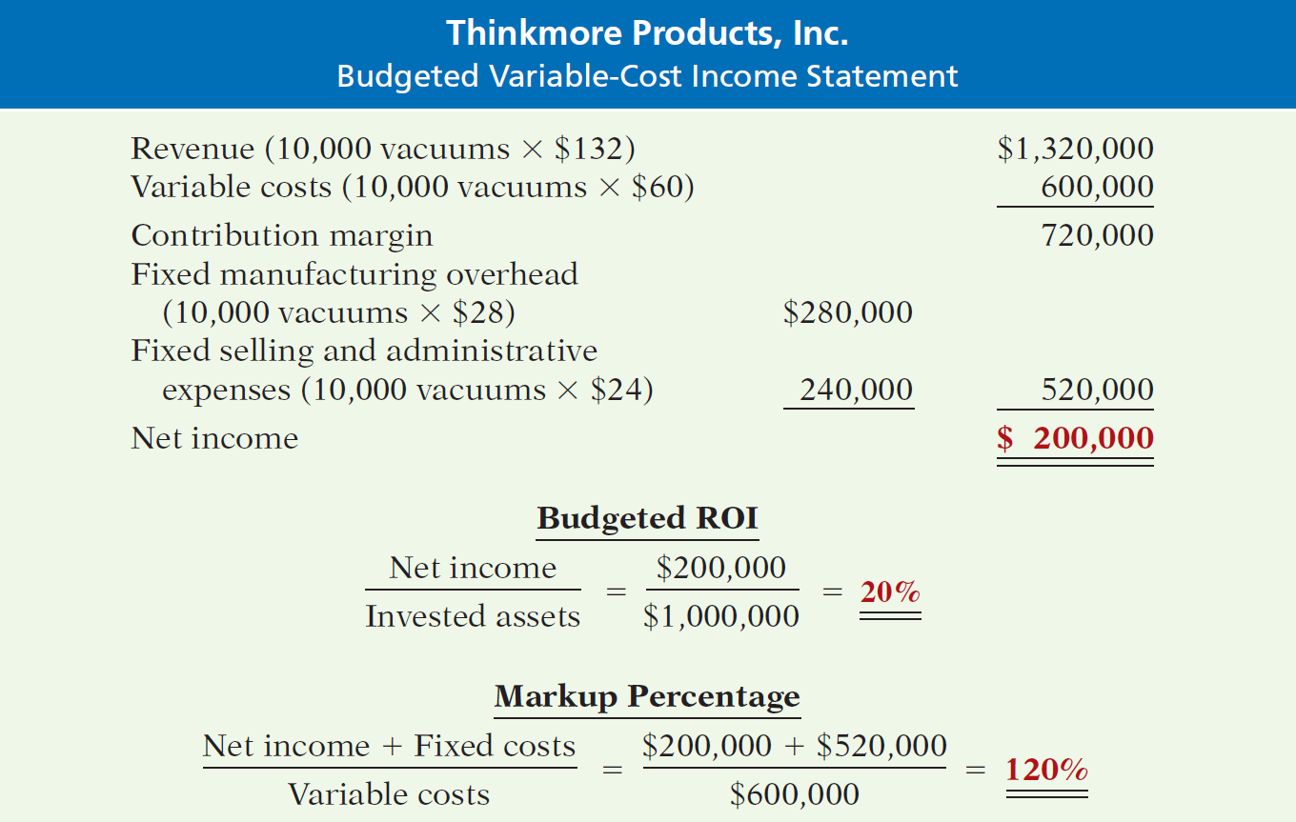
OTHER COST APPROACHES TO PRICING
Proof of 20% ROI—contribution approach

Slide 51
OTHER COST APPROACHES TO PRICING
Summary: Variable-Cost Pricing
  Avoids blurring effects of cost behavior on operating income.
  Reasons:
    More consistent with CVP analysis.
    Provides data for pricing special orders by showing incremental cost of accepting one more order.
    Avoids arbitrary allocation of common fixed costs to individual product lines.

Slide 52
End of Lecture 26

