Slide 1
Chapter 12
Lecture 25
Pricing Decision and Cost Management
Readings
Chapter 12, Cost Accounting, Managerial Emphasis, 14th edition by Horengren
Chapter 11, Managerial Accounting 6th edition by Weygandt, kimmel, kieso

Slide 2
Learning Objectives
After studying this chapter, you should be able to:
Compute a target cost when the market determines a product price.
Compute a target selling price using cost-plus pricing.
Use time-and-material pricing to determine the cost of services provided.
Determine a transfer price using the negotiated, cost-based, and market-based approaches.
Explain issues involved in transferring goods between divisions in different countries.

Slide 3
Pricing and Business
How companies price a product or service ultimately depends on the demand and supply for it
Three influences on demand & supply:
  Customers
  Competitors
  Costs

Slide 4
Influences on Demand & Supply
Customers – influence price through their effect on the demand for a product or service, based on factors such as quality and product features
Competitors – influence price through their pricing schemes, product features, and production volume
Costs – influence prices because they affect supply (the lower the cost, the greater the quantity a firm is willing to supply)

Slide 5
Time Horizons and Pricing
Short-run pricing decisions have a time horizon of less than one year and include decisions such as:
  Pricing a one-time-only special order with no long-run implications
  Adjusting product mix and output volume in a competitive market
Long-run pricing decisions have a time horizon of one year or longer and include decisions such as:
  Pricing a product in a major market where there is some leeway in setting price

Slide 6
Differences Affecting Pricing:
Long Run vs. Short Run
Costs that are often irrelevant for short-run policy decisions, such as fixed costs that cannot be changed, are generally relevant in the long run because costs can be altered in the long run
Profit margins in long-run pricing decisions are often set to earn a reasonable return on investment – prices are decreased when demand is weak and increased when demand is strong

Slide 7
Alternative Long-Run Pricing Approaches
Market-Based: price charged is based on what customers want and how competitors react
Cost-Based: price charged is based on what it cost to produce, coupled with the ability to recoup the costs and still achieve a required rate of return

Slide 8
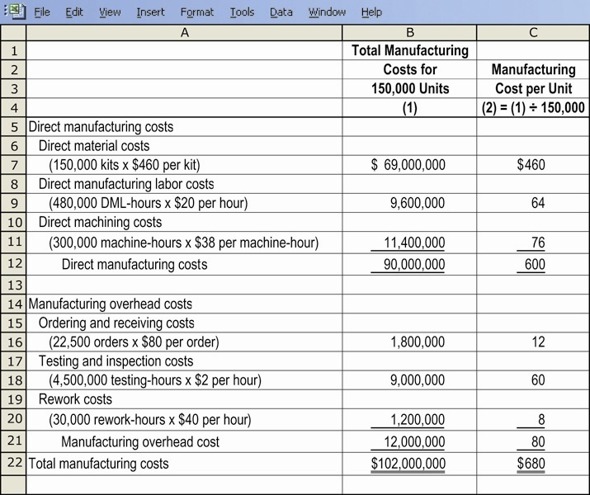
ABC Manufacturing Cost Illustration

Slide 9
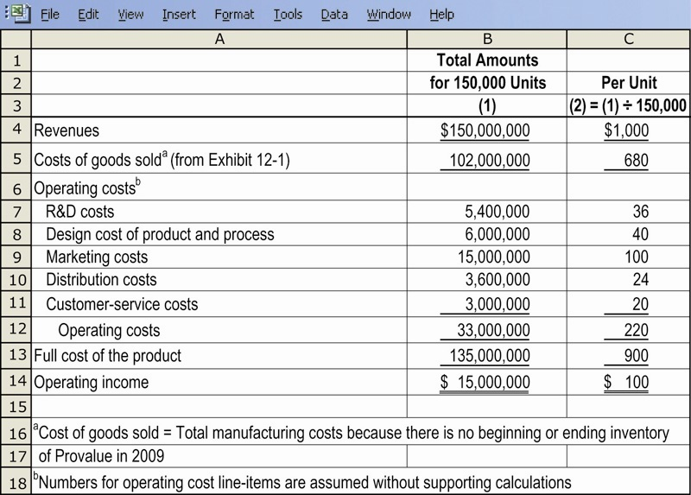
Product Profitability Using ABC Costing: Illustration

Slide 10
Markets and Pricing
Competitive Markets - use the market-based approach
Less-Competitive Markets – can use either the market-based or cost-based approach
Non-Competitive Markets – use cost-based approaches

Slide 11
Market-Based Approach
Starts with a target price
Target Price – estimated price for a product or service that potential customers will pay
Estimated on customers perceived value for a product or service and how competitors will price competing products or services

Slide 12
Understanding the
Market Environment
Understanding customers and competitors is important because:
  Competition from lower cost producers has meant that prices cannot be increased
  Products are on the market for shorter periods of time, leaving less time and opportunity to recover from pricing mistakes
  Customers have become more knowledgeable and demand quality products at reasonable prices

Slide 13
Five Steps in Developing
Target Prices and Target Costs
Develop a product that satisfies the needs of potential customers
Choose a target price
Derive a target cost per unit:
  Target Price per unit minus Target Operating Income per unit
Perform cost analysis
Perform value engineering to achieve target cost

Slide 14
Value Engineering
Value Engineering is a systematic evaluation of all aspects of the value-chain, with the objective of reducing costs while improving quality and satisfying customer needs
Managers must distinguish value-added activities and costs from non-value-added activities and costs

Slide 15
Value Engineering Terminology
Value-Added Costs – a cost that, if eliminated, would reduce the actual or perceived value or utility (usefulness) customers obtain from using the product or service
Non-Value-Added Costs – a cost that, if eliminated, would not reduce the actual or perceived value or utility customers obtain from using the product or service. It is a cost the customer is unwilling to pay for

Slide 16
Value Engineering Terminology
Cost Incurrence – describes when a resource is consumed (or benefit foregone) to meet a specific objective
Locked-in Costs (Designed-in Costs) – are costs that have not yet been incurred but, based on decisions that have already been made, will be incurred in the future
  Are a key to managing costs well

Slide 17
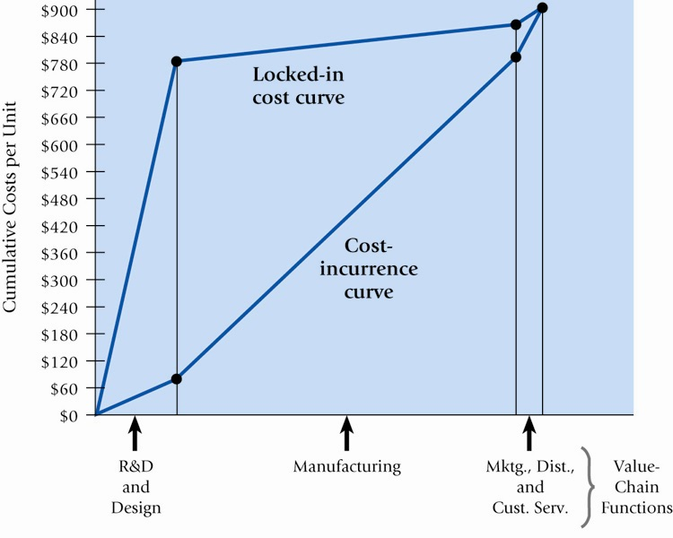
Cost Incurrence and Locked-In Costs Graph

Slide 18
Problems with Value Engineering and Target Costing
Employees may feel frustrated if they fail to attain targets
A cross-functional team may add too many feature just to accommodate the wishes of team members
A product may be in development for along time as alternative designs are repeatedly evaluated
Organizational conflicts may develop as the burden of cutting costs falls unequally on different business functions in the firm’s value chain

Slide 19
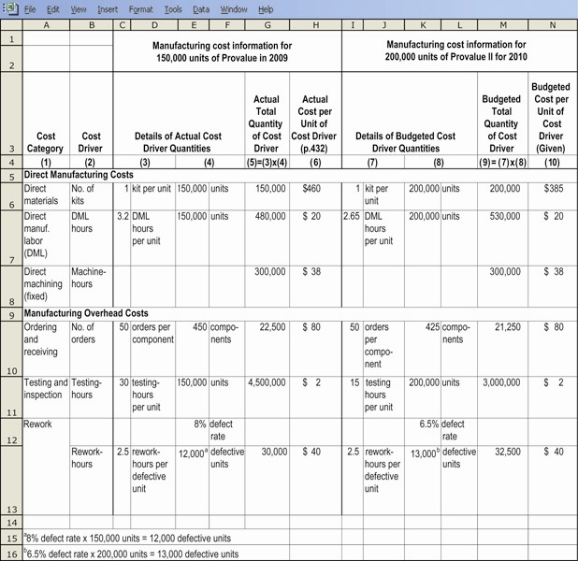
Target Costing Illustration

Slide 20
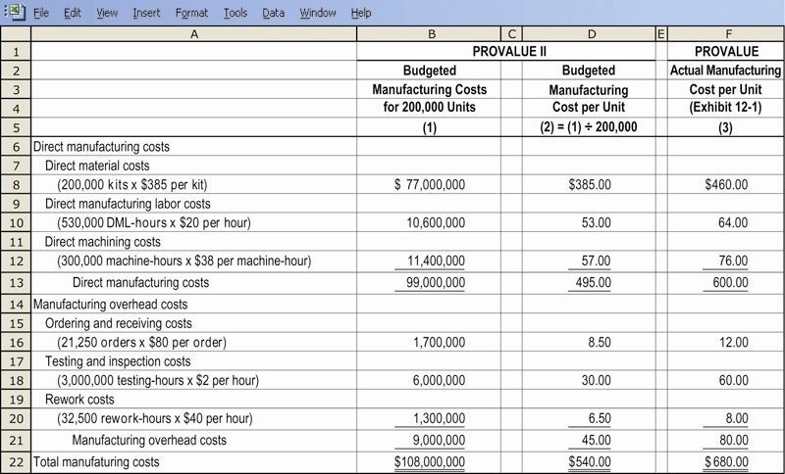
Target Costing Illustration, Continued

Slide 21
Cost-Based (Cost-Plus) Pricing
The general formula adds a markup component to the cost base to determine a prospective selling price
Usually only a starting point in the price-setting process
Markup is somewhat flexible, based partially on customers and competitors

Slide 22
Forms of Cost-Plus Pricing
Setting a Target Rate of Return on Investment: the Target Annual Operating Return that an organization aims to achieve, divided by Invested Capital
Selecting different cost bases for the “cost-plus” calculation:
  Variable Manufacturing Cost
  Variable Cost
  Manufacturing Cost
  Full Cost

Slide 23
Common Business Practice
Most firms use full cost for their cost-based pricing decisions, because:
  Allows for full recovery of all costs of the product
  Allows for price stability
  It is a simple approach

Slide 24
Life-Cycle Product
Budgeting and Costing
Product Life-Cycle spans the time from initial R&D on a product to when customer service and support are no long offered on that product (orphaned)
Life-Cycle Budgeting involves estimating the revenues and individual value-chain costs attributable to each product from its initial R&D to its final customer service and support
Life-Cycle Costing tracks and accumulates individual value-chain costs attributable to each product from its initial R&D to its final customer service and support

Slide 25
Important Considerations for
Life-Cycle Budgeting
Nonproduction costs are large
Development period for R&D and design is long and costly
Many costs are locked in at the R&D and design stages, even if R&D and design costs are themselves small

Slide 26
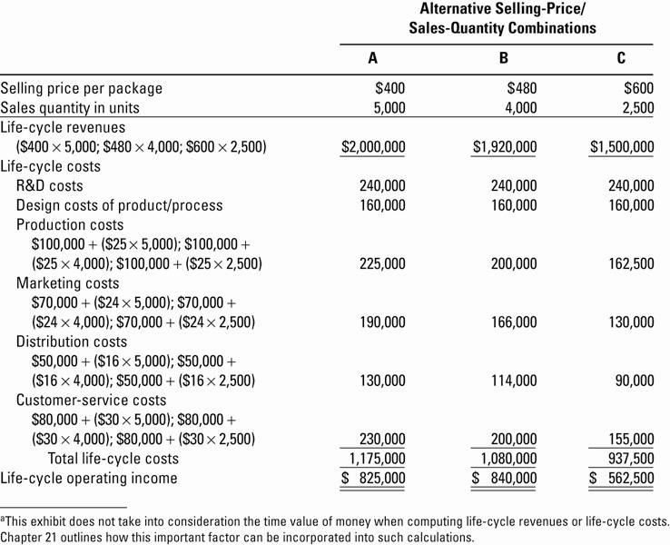
Life Cycle Budgeting, Illustrated

Slide 27
Other Important Considerations in Pricing Decisions
Price Discrimination – the practice of charging different customers different prices for the same product or service
  Legal Implications
Peak-Load Pricing – the practice of charging a higher price for the same product or service when the demand for it approaches the physical limit of the capacity to product that product or service

Slide 28
The Legal Dimension of
Price Setting
Price Discrimination is illegal if the intent is to lessen or prevent competition for customers
Predatory Pricing – deliberately lowering prices below costs in an effort to drive competitors out of the market and restrict supply, and then raising prices

Slide 29
The Legal Dimension of
Price Setting
Dumping – a non-US firm sells a product in the US at a price below the market value in the country where it is produced, and this lower price materially injures or threatens to materially injure an industry in the US
Collusive Pricing – occurs when companies in an industry conspire in their pricing and production decisions to achieve a price above the competitive price and so restrain trade

Slide 30
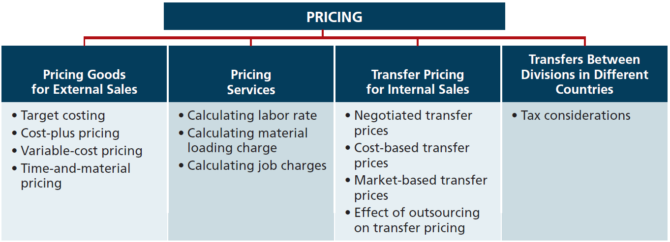

Slide 31
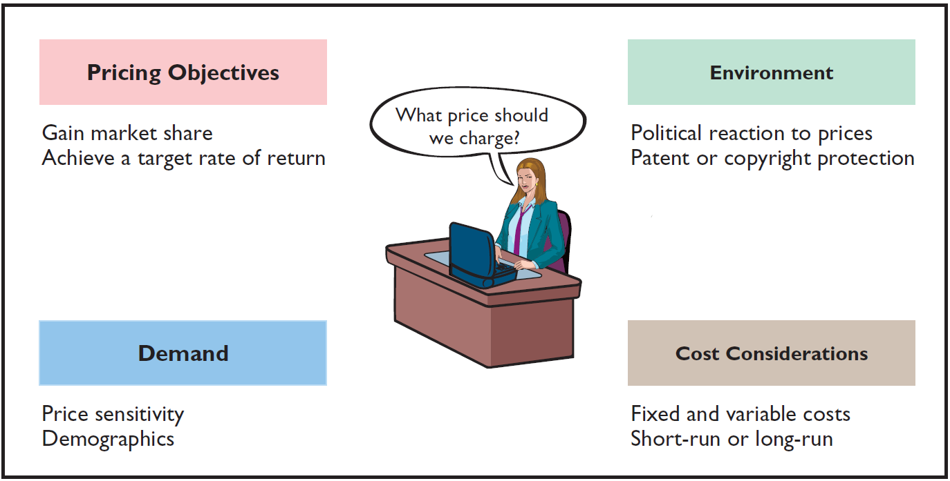
Pricing Goods for External Sales
The price of a good or service is affected by many factors.
Regardless of the factors involved, the price must cover the costs of the good or service as well as earn a reasonable profit.

Slide 32
Pricing Goods for External Sales
The price of a good or service is affected by many factors.
  Company must have a good understanding of market forces.
  Where products are not easily differentiated from competitor goods, prices are not set by the company, but rather by the laws of supply and demand – such companies are called price takers.
  Where products are unique or clearly distinguishable from competitor goods, prices are set by the company.

Slide 33
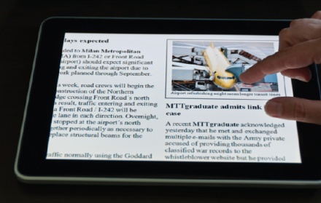
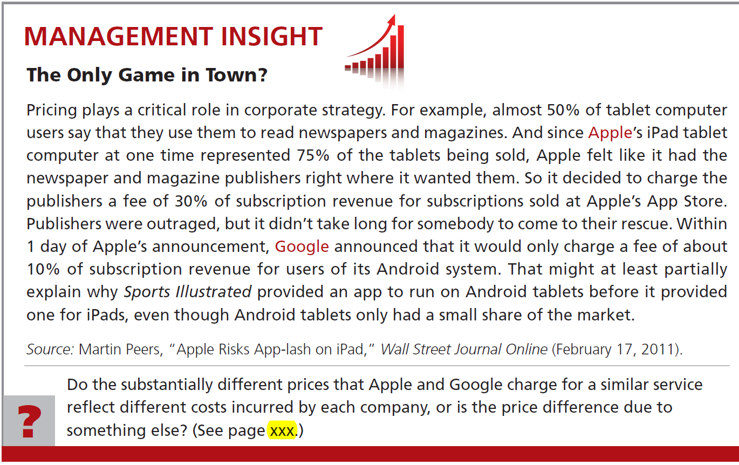

Slide 34
Pricing Goods for External Sales
Target Costing
  Laws of supply and demand significantly affect product price.
  To earn a profit, companies must focus on controlling costs.
  Requires setting a target cost that will provide the company’s desired profit.

Slide 35
Pricing Goods for External Sales
Target Costing
Target cost: Cost that provides the desired profit when the market determines a product’s price.
If a company can produce its product for the target cost or less, it will meet its profit goal.

Slide 36
Pricing Goods for External Sales
Target Costing
First, company should identify its market niche where it wants to compete.
Second, company conducts market research to determine the target price – the price the company believes will place it in the optimal position for the target consumers.
Third, company determines its target cost by setting a desired profit.
Last, company assembles a team to develop a product to meet the company’s goals.

Slide 37
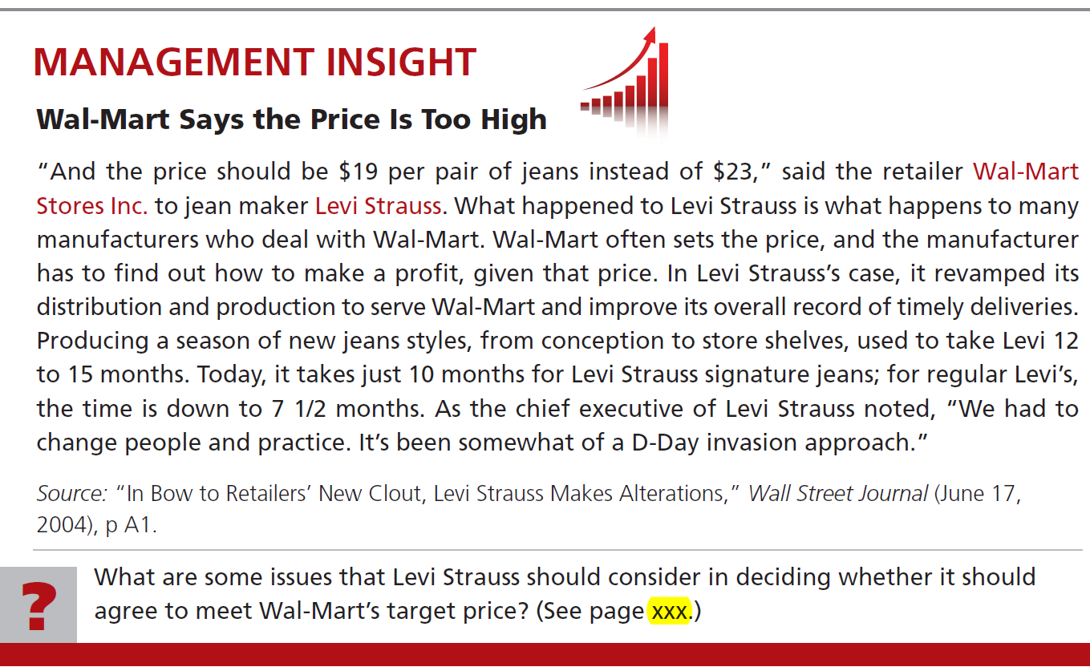


Slide 38
Fine Line Phones is considering introducing a fashion cover for its phones. Market research indicates that 200,000 units can be sold if the price is no more than $20. If Fine Line decides to produce the covers, it will need to invest $1,000,000 in new production equipment. Fine Line requires a minimum rate of return of 25% on all investments. Determine the target cost per unit for the cover.
The desired profit for this new product line is
$1,000,000 x 25% = $250,000
Each cover must result in profit of $250,000 ÷ 200,000 units = $1.25
Market price Desired profit Target cost per unit
$20 $1.25 $18.75 per unit
-
=

Slide 39
Pricing Goods for External Sales
Review Question
Target cost related to price and profit means that:
a. Cost and desired profit must be determined before selling price.
b. Cost and selling price must be determined before desired profit.
c. Price and desired profit must be determined before costs.
d. Costs can be achieved only if the company is at full capacity.

Slide 40
Pricing Goods for External Sales
Cost-Plus Pricing
  In an environment with little or no competition, a company may have to set its own price.
  When a company sets price, the price is normally a function of product cost: cost-plus pricing.
  Approach requires establishing a cost base and adding a markup to determine a target selling price.

Slide 41
Pricing Goods for External Sales
Cost-Plus Pricing
  In determining the proper markup, a company must consider competitive and market conditions.
  Size of the markup (the “plus”) depends on the desired return on investment for the product:
ROI = net income ÷ invested assets

Slide 42
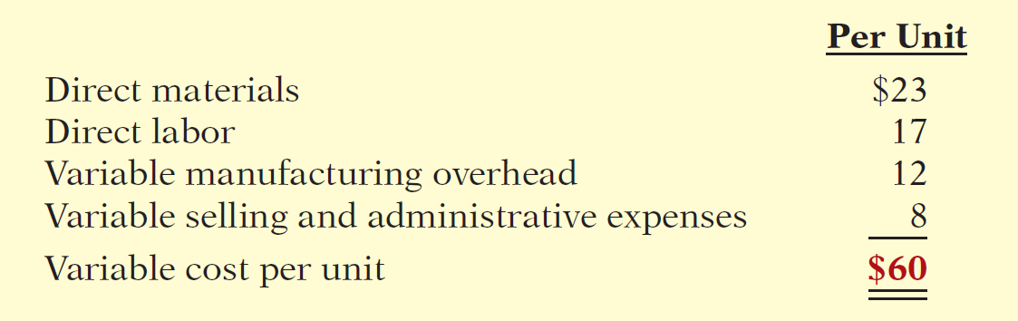
Cost-Plus Pricing
Illustration: Thinkmore Products, Inc. is in the process of setting a selling price on its new video camera pen. It is a functioning pen that will record up to 2 hours of audio and video. The per unit variable cost estimates for the new video camera pen are as follows.

Slide 43
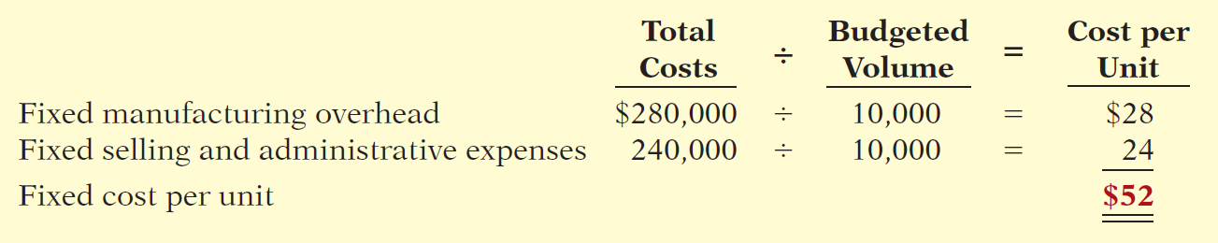
Cost-Plus Pricing
In addition, Thinkmore has the following fixed costs per unit at a budgeted sales volume of 10,000 units.

Slide 44
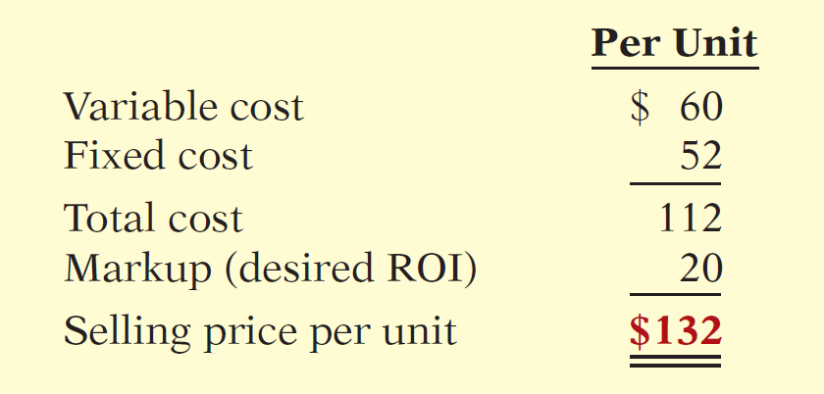
Cost-Plus Pricing
Thinkmore has decided to price its new video camera pen to earn a 20% return on its investment (ROI) of $1,000,000.
Markup = 20% ROI of $1,000,000
Expected ROI = $200,000 ÷ 10,000 units = $20
Sales price per unit =

Slide 45

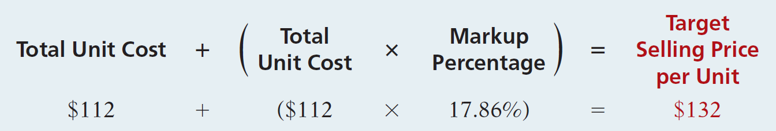
Cost-Plus Pricing
Use markup on cost to set a selling price:
  Compute the markup percentage to achieve a desired ROI of $20 per unit:
  Compute the target selling price:

Slide 46
Cost-Plus Pricing
Limitations of Cost-Plus Pricing
Advantage of cost-plus pricing: Easy to compute.
Disadvantages:
  Does not consider demand side:
    Will the customer pay the price?
  Fixed cost per unit changes with change in sales volume:
    At lower sales volume, company must charge higher price to meet desired ROI.

Slide 47
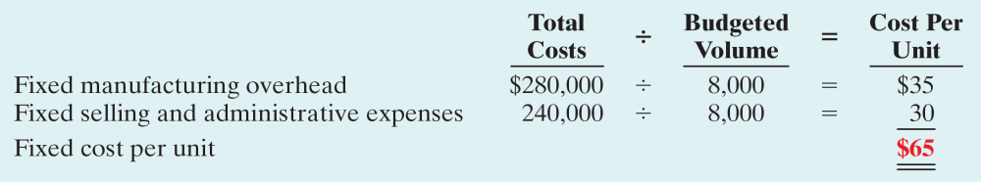
Cost-Plus Pricing
Illustration: If budgeted sales volume for Thinkmore’s Products was 8,000 instead of 10,000, Thinkmore’s variable cost per unit would remain the same. However, the fixed cost per unit would change as follows.
Thinkmore's desired 20% ROI now results in a $25 ROI per unit [(20% x $1,000,000) / 8,000].

Slide 48
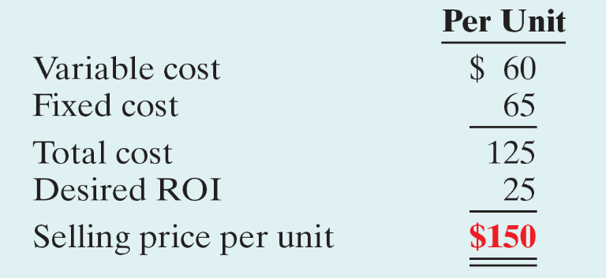
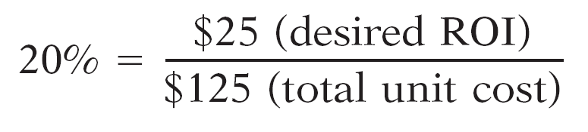
Cost-Plus Pricing
Thinkmore computes the selling price at 8,000 units as follows.
At 8,000 units, how much would Thinkmore mark up its total unit costs to earn a desired ROI of $25 per unit.

Slide 49
Pricing Goods for External Sales
Variable-Cost Pricing
Alternative pricing approach:
Simply add a markup to variable costs.
    Avoids the problem of uncertain cost information related to fixed-cost-per-unit computations.
    Helpful in pricing special orders or when excess capacity exists.
Major disadvantage is that managers may set the price too low and fail to cover fixed costs.

Slide 50

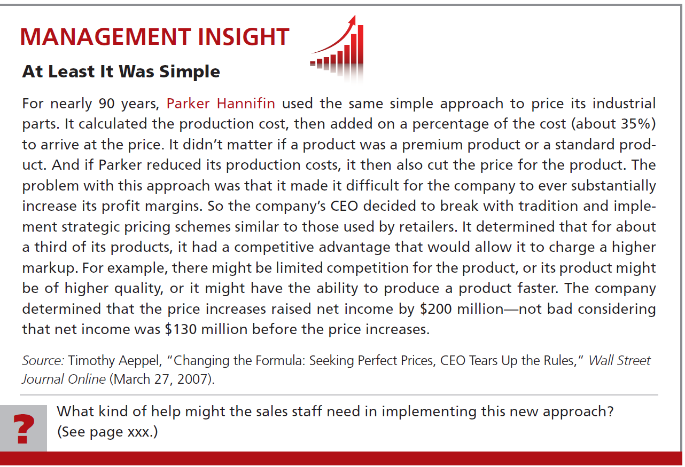

Slide 51
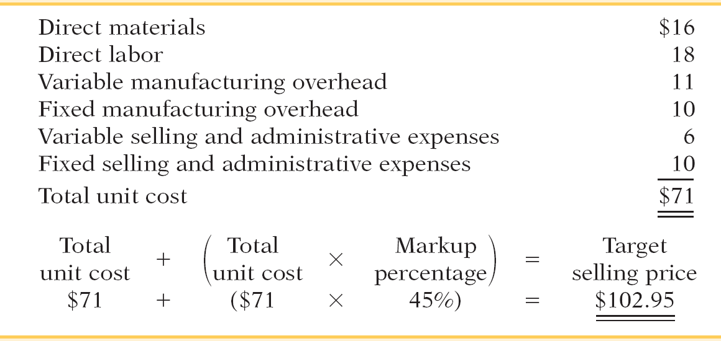
KRC Air Corporation produces air purifiers. Using a 45% markup percentage on total per unit cost, compute the target selling price.

Slide 52
Variable-Cost Pricing
Review Question
Cost-plus pricing means that:
a. Selling price = variable cost + (markup percentage + variable cost).
b. Selling price = cost + (markup percentage X cost).
c. Selling price = manufacturing cost + (markup percentage + manufacturing cost).
d. Selling price = fixed cost + (markup percentage X fixed cost).

Slide 53
End of Lecture 25

