Slide 1
Chapter 8 and 18
Lecture 23
Fixed Overhead Variance
Spoilage, Rework and Scrap
Readings
Chapter 8, 18 Cost Accounting, Managerial Emphasis, 14th edition by Horengren
Chapter 11, Managerial Accounting 12th edition by Garrison, Noreen, Brewer
Chapter 11, Managerial Accounting 6th edition by Weygandt, kimmel, kieso

Slide 2
Learning Objectives
Compute the predetermined overhead rate and apply overhead to products in a standard cost system.
Compute and interpret the fixed overhead budget and volume variances.
Accounting for spoilage under different methods of inventory systems and standard costing
Accounting for rework in different situations under different costing methods
Accounting for Scrap in different situations under different costing method
Examples of spoilage

Slide 3
Overhead Rates and Overhead Analysis
The predetermined overhead rate
can be broken down into fixed
and variable components.
The variable
component is useful
for preparing and analyzing
variable overhead
variances.
The fixed
component is useful
for preparing and analyzing
fixed overhead
variances.
Notes:
The predetermined overhead rate can be broken down into variable and fixed components. As we have seen, the variable component is useful in preparing variable overhead variances. As will be shown shortly, the fixed component is useful in preparing fixed overhead variances.

Slide 4


Normal versus Standard Cost Systems
In a normal cost
system, overhead is
applied to work in
process based on
the actual number
of hours worked
in the period.
In a standard cost
system, overhead is
applied to work in
process based on
the standard hours
allowed for the actual
output of the period.
Notes:
In a normal cost system (as discussed in Chapter 3), overhead is applied to work in process on the basis of the actual number of hours worked. In a standard cost system, overhead is applied to work in process based on the standard hours allowed for the actual output of the period.

Slide 5
Fixed Overhead Variances
Actual Fixed Fixed Fixed
Overhead Overhead Overhead
Incurred Budget Applied
DH × FR
SH × FR
Budget Variance
Volume
Variance
FR = Standard Fixed Overhead Rate
SH = Standard Hours Allowed
DH = Denominator Hours
Notes:
Here we see the general model for computing fixed overhead variances. The budget variance is the actual fixed overhead cost minus the budgeted fixed overhead cost. The volume variance is budgeted fixed overhead minus the fixed overhead applied to production. In equation form, it can be computed by multiplying the fixed portion of the predetermined overhead rate by the difference between the denominator hours and the standard hours allowed.

Slide 6
Overhead Rates and Overhead
Analysis – Example
ColaCo prepared this budget for overhead:
Total
Variable
Total
Fixed
Machine
Variable
Overhead
Fixed
Overhead
Hours
Overhead
Rate
Overhead
Rate
3,000
$
6,000
?
$
9,000
?
4,000
8,000
?
9,000
?
Let’s calculate overhead rates.
ColaCo applies overhead based
on machine-hour activity.
Notes:
ColaCo prepared a flexible budget for overhead at two levels of activity, 3,000 and 4,000 machine hours. Its total variable and fixed overhead at these two activity levels is as shown. Notice that total variable overhead increases when activity increases, while total fixed overhead is the same at both levels of activity.

Slide 7
Overhead Rates and Overhead
Analysis – Example
ColaCo prepared this budget for overhead:
Total
Variable
Total
Fixed
Machine
Variable
Overhead
Fixed
Overhead
Hours
Overhead
Rate
Overhead
Rate
3,000
$
6,000
$
2.00
$
9,000
?
4,000
8,000
2.00
9,000
?
Rate = Total Variable Overhead ÷ Machine Hours
This rate is constant at all levels of activity.
Notes:
We calculate the variable overhead rate by dividing total variable overhead by the activity in machine hours. The variable overhead rate is constant at $2.00 per machine hour. Notice that this rate agrees with the standard variable overhead cost per machine hour that was previously used in the variable overhead portion of this example.

Slide 8
Overhead Rates and Overhead
Analysis – Example
ColaCo prepared this budget for overhead:
Total
Variable
Total
Fixed
Machine
Variable
Overhead
Fixed
Overhead
Hours
Overhead
Rate
Overhead
Rate
3,000
$
6,000
$
2.00
$
9,000
$
3.00
4,000
8,000
2.00
9,000
2.25
Rate = Total Fixed Overhead ÷ Machine Hours
This rate decreases when activity increases.
Notes:
We calculate the fixed overhead rate by dividing total fixed overhead by the activity in machine hours. The fixed overhead rate is $3.00 per machine hour at an activity level of 3,000 machine hours, and it is $2.25 at an activity level of 4,000 machine hours. Notice, the fixed overhead rate decreases as the activity level increases.

Slide 9
Overhead Rates and Overhead
Analysis – Example
ColaCo prepared this budget for overhead:
Total
Variable
Total
Fixed
Machine
Variable
Overhead
Fixed
Overhead
Hours
Overhead
Rate
Overhead
Rate
3,000
$
6,000
$
2.00
$
9,000
$
3.00
4,000
8,000
2.00
9,000
2.25
The total POHR is the sum of
the fixed and variable rates
for a given activity level.
Notes:
The total predetermined overhead rate at either activity level is the sum of the variable and fixed overhead rates.

Slide 10

Fixed Overhead Variances – Example
ColaCo’s actual production required 3,200
standard machine hours. Actual fixed overhead was $8,450. The predetermined overhead rate is based on 3,000 machine hours.
Notes:
Because the fixed overhead rate differs at different activity levels, an activity level must be chosen. ColaCo decided to base its predetermined overhead rate on 3,000 machine hours. It required 3,200 standard machine hours to meet its actual production requirements. The company incurred actual fixed overhead costs of $8,450.

Slide 11
Overhead Variances
Now let’s turn our attention to calculating fixed overhead variances.
Notes:
Now, let’s focus on the computations for fixed overhead variances.

Slide 12
Fixed Overhead Variances – Example
Actual Fixed Fixed Fixed
Overhead Overhead Overhead
Incurred Budget Applied
$8,450
$9,000
Budget variance
$550 favorable
Notes:
The budget variance of $550 favorable is computed by comparing the actual fixed overhead incurred ($8,450) to the budgeted fixed overhead ($9,000).

Slide 13
Fixed Overhead Variances –A Closer Look
Budget Variance
Results from spending
more or less than
expected for fixed
overhead items.
Now, let’s use the standard hours allowed to compute the fixed overhead volume variance.
Notes:
This variance represents the difference between how much should have been spent and how much was actually spent. A favorable (unfavorable) variance results when actual spending is less (more) than the budget.

Slide 14
Fixed Overhead Variances – Example
Actual Fixed Fixed Fixed
Overhead Overhead Overhead
Incurred Budget Applied
SH × FR
3,200 hours
×
$3.00 per hour
$8,450
$9,000
$9,600
Budget variance
$550 favorable
Volume variance
$600 favorable
Notes:
The volume variance of $600 favorable is computed by comparing the budgeted fixed overhead ($9,000) to the fixed overhead applied ($9,600). Since the budgeted fixed overhead is less than the applied fixed overhead, the volume variance is favorable.

Slide 15
Volume Variance – A Closer Look
Volume
Variance
Results when standard hours
allowed for actual output differs
from the denominator activity.
Unfavorable
when standard hours
< denominator hours
Favorable
when standard hours
> denominator hours
Notes:
The fixed overhead applied is computed by multiplying the standard hours allowed for the actual output (3,200 hours) by the fixed portion of the predetermined overhead rate ($3.00).
A favorable (unfavorable) variance results when the denominator activity is less (greater) than the standard hours allowed for the output of the period.

Slide 16
Volume Variance – A Closer Look
Volume
Variance
Does not measure over-
or under spending
Results when standard hours
allowed for actual output differs
from the denominator activity.
It results from treating fixed
overhead as if it were a
variable cost.
Unfavorable
when standard hours
< denominator hours
Favorable
when standard hours
> denominator hours
Notes:
The volume variance does not measure over-or under-spending. It is a measure of utilization of facilities. In essence, this variance variance is the error that occurs as a result of treating fixed overhead as though it were a variable cost.
Next, we will look at two questions that will require us to compute fixed overhead budget and volume variances.

Slide 17
Quick Check ✓
Yoder Enterprises’ actual production for the period required 2,100 standard direct labor hours. Actual fixed overhead for the period was $14,800. The budgeted fixed overhead was $14,450. The predetermined fixed overhead rate was $7 per direct labor hour. What was the budget variance?
  a. $350 U
  b. $350 F
  c. $100 F
  d. $100 U
Notes:
Here’s the first question asking us to compute a fixed overhead budget variance.

Slide 18
Quick Check ✓
Budget variance
= Actual fixed overhead – Budgeted fixed overhead
= $14,800 – $14,450
= $350 U
Yoder Enterprises’ actual production for the period required 2,100 standard direct labor hours. Actual fixed overhead for the period was $14,800. The budgeted fixed overhead was $14,450. The predetermined fixed overhead rate was $7 per direct labor hour. What was the budget variance?
  a. $350 U
  b. $350 F
  c. $100 F
  d. $100 U
Notes:
The fixed overhead budget variance is the difference between $14,800 of actual fixed overhead incurred and the $14,450 fixed overhead budget. Since the actual fixed overhead is greater than the budget for fixed overhead, the budget variance is unfavorable.

Slide 19
Quick Check ✓
Yoder Enterprises’ actual production for the period required 2,100 standard direct labor hours. Actual fixed overhead for the period was $14,800. The budgeted fixed overhead was $14,450. The predetermined fixed overhead rate was $7 per direct labor hour. What was the volume variance?
  a. $250 U
  b. $250 F
  c. $100 F
  d. $100 U
Notes:
Here’s the second question asking us to compute a fixed overhead volume variance.

Slide 20
Quick Check ✓
Volume variance
= Budgeted fixed overhead – (SH × FR)
= $14,450 – (2,100 hours × $7 per hour)
= $14,450 – $14,700
= $250 F
Yoder Enterprises’ actual production for the period required 2,100 standard direct labor hours. Actual fixed overhead for the period was $14,800. The budgeted fixed overhead was $14,450. The predetermined fixed overhead rate was $7 per direct labor hour. What was the volume variance?
  a. $250 U
  b. $250 F
  c. $100 F
  d. $100 U
Notes:
The volume variance is the difference between the $14,450 fixed overhead budget and the $14,700 of fixed overhead applied to production. The fixed overhead applied is computed by multiplying the 2,100 standard hours allowed times the $7.00 fixed portion of the predetermined overhead rate. Since the budgeted fixed overhead is less than the applied fixed overhead, the volume variance is favorable.

Slide 21
Quick Check Summary
Actual Fixed Fixed Fixed
Overhead Overhead Overhead
Incurred Budget Applied
SH × FR
2,100 hours
×
$7.00 per hour
$14,800
$14,450
$14,700
Budget variance
$350 unfavorable
Volume variance
$250 favorable
Notes:
Here we see a summary of our computations from the previous two questions in a convenient three-column format. The total fixed overhead variance is the combination of the unfavorable budget variance and the favorable volume variance, $100 unfavorable.

Slide 22
Fixed Overhead Variances –
A Graphic Approach
Let’s look at a graph showing fixed overhead variances. We will use ColaCo’s numbers from the previous example.
Notes:
Often it’s helpful to look at the fixed overhead relationships in graphical form. We will use the ColaCo data from the previous example for our graphical approach.

Slide 23
Fixed Overhead Variances –
A Graphic Approach
Cost
$9,000 budgeted fixed OH
Fixed overhead
applied to products
Activity
3,000 Hours Expected
Activity
Notes:
The vertical axis is used to graph fixed overhead cost. The first cost that ColaCo would plot on this axis is $9,000 of budgeted fixed overhead.
The horizontal axis is used to graph the volume of activity. The first activity level that ColaCo would plot is its denominator activity level of 3,000 machine hours.
The linear manner in which fixed overhead is applied to products is depicted by drawing a straight line from the origin to the intersection of the budgeted fixed overhead ($9,000) and the denominator activity (3,000 hours). The slope of this line indicates that fixed overhead is applied at a rate of $3.00 per machine hour.

Slide 24
Fixed Overhead Variances –
A Graphic Approach
Cost
$9,000 budgeted fixed OH
{
$8,450 actual fixed OH
$550
Favorable
Budget Variance
$8,450 actual fixed OH
Fixed overhead
applied to products
Activity
3,000 Hours Expected
Activity
Notes:
Next, plot the actual amount of fixed overhead costs on the vertical axis. The broken horizontal line below the budgeted fixed overhead represents the $8,450 of actual fixed manufacturing overhead. The vertical distance between the budgeted fixed overhead line and the actual fixed overhead line represents the fixed overhead budget variance of $550. Since the actual fixed overhead is less than the budgeted fixed overhead, the fixed overhead budget variance is favorable.

Slide 25
Fixed Overhead Variances –
A Graphic Approach
3,200 machine hours × $3.00 fixed overhead rate
Cost
$600
Favorable
Volume Variance
$9,600 applied fixed OH
{
$9,000 budgeted fixed OH
{
$8,450 actual fixed OH
$550
Favorable
Budget Variance
$8,450 actual fixed OH
Fixed overhead
applied to products
Activity
3,000 Hours Expected
Activity
3,200 Standard
Hours
Notes:
Finally, identify the standard hours allowed for the actual level of output (3,200 hours) on the horizontal axis. Draw a vertical line from this activity level until it intersects the sloped line that depicts the fixed overhead applied to products. From this point, draw a horizontal line that intersects the vertical axis. This dollar amount ($9,600) represents the fixed overhead applied.
The vertical distance between the budgeted fixed overhead line and the applied fixed overhead line represents the fixed overhead volume variance of $600. Since the budgeted fixed overhead is less than the applied fixed overhead, the volume variance is favorable.

Slide 26
Overhead Variances and Under- or Overapplied Overhead Cost
In a standard
cost system:
Unfavorable
variances are equivalent
to underapplied overhead.
Favorable
variances are equivalent
to overapplied overhead.
The sum of the overhead variances
equals the under- or overapplied
overhead cost for a period.
Notes:
In a standard cost system, the sum of the overhead variances equals the under-or overapplied overhead cost for a period. Unfavorable variances are equivalent to underapplied overhead. Favorable variances are equivalent to overapplied overhead.

Slide 27
Closer look at overhead variances
The overhead variance is generally analyzed through a price variance and a quantity variance.
  Overhead controllable variance (price variance) shows whether overhead costs are effectively controlled.
  Overhead volume variance (quantity variance) relates to whether fixed costs were under- or over-applied during the year.

Slide 28
Closer look at overhead variances
Overhead Controllable Variance
The overhead controllable variance shows whether overhead costs are effectively controlled.
To compute this variance, the company compares actual overhead costs incurred with budgeted costs for the standard hours allowed.
The budgeted costs are determined from a flexible manufacturing overhead budget.

Slide 29
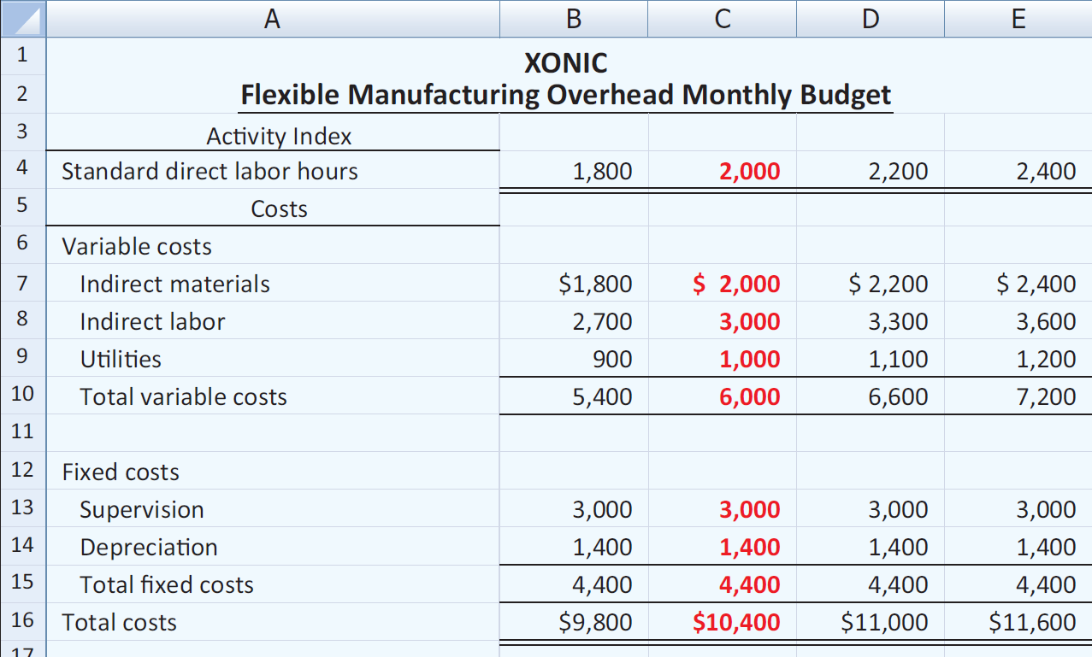
Closer look at overhead variances
For Xonic the budget formula for manufacturing overhead is variable manufacturing overhead cost of $3 per hour of labor plus fixed manufacturing overhead costs of $4,400.

Slide 30
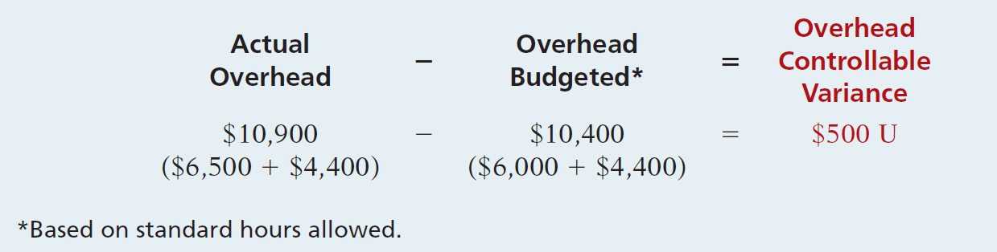
Closer look at overhead variances
Overhead Controllable Variance
Illustration 11B-2 shows the formula for the overhead controllable variance and the calculation for Xonic, Inc.

Slide 31
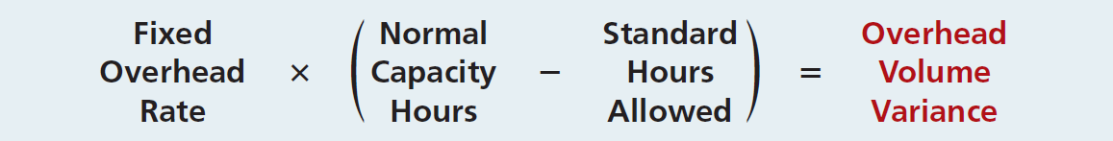
Closer look at overhead variances
Overhead Volume Variance
Difference between normal capacity hours and standard hours allowed times the fixed overhead rate.

Slide 32
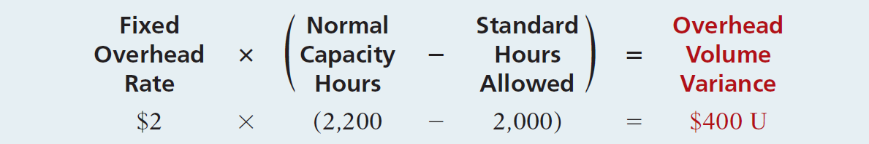
Closer look at overhead variances
Illustration: Xonic Inc. budgeted fixed overhead cost for the year of $52,800. At normal capacity, 26,400 standard direct labor hours are required. Xonic produced 1,000 units of Xonic Tonic in June. The standard hours allowed for the 1,000 gallons produced in June is 2,000 (1,000 gallons x 2 hours). For Xonic, standard direct labor hours for June at normal capacity is 2,200 (26,400 annual hours ÷ 12 months). The computation of the overhead volume variance in this case is as follows.

Slide 33
Closer look at overhead variances
In computing the overhead variances, it is important to remember the following.
  Standard hours allowed are used in each of the variances.
  Budgeted costs for the controllable variance are derived from the flexible budget.
  The controllable variance generally pertains to variable costs.
  The volume variance pertains solely to fixed costs.

Slide 34
Spoilage, Rework, and Scrap

Slide 35
Basic Terminology
Spoilage – units of production, either fully or partially completed, that do not meet the specifications required by customers for good units and that are discarded or sold for reduced prices

Slide 36
Basic Terminology
Rework – units of production that do not meet the specifications required by customers but which are subsequently repaired and sold as good finished goods
Scrap – residual material that results from manufacturing a product. Scrap has low total sales value compared with the total sales value of the product

Slide 37
Accounting for Spoilage
Accounting for spoilage aims to determine the magnitude of spoilage costs and to distinguish between costs of normal and abnormal spoilage
To manage, control and reduce spoilage costs, they should be highlighted, not simply folded into production costs

Slide 38
Types of Spoilage
Normal Spoilage – is spoilage inherent in a particular production process that arises under efficient operating conditions
  Management determines the normal spoilage rate
  Costs of normal spoilage are typically included as a component of the costs of good units manufactured because good units cannot be made without also making some units that are spoiled

Slide 39
Types of Spoilage
Abnormal Spoilage – is spoilage that is not inherent in a particular production process and would not arise under normal operating conditions
  Abnormal spoilage is considered avoidable and controllable
  Units of abnormal spoilage are calculated and recorded in the Loss from Abnormal Spoilage account, which appears as a separate line item no the income statement

Slide 40
Process Costing and Spoilage
Units of Normal Spoilage can be counted or not counted when computing output units (physical or equivalent) in a process costing system
Counting all spoilage is considered preferable

Slide 41
Inspection Points and Spoilage
Inspection Point – the stage of the production process at which products are examined to determine whether they are acceptable or unacceptable units.
Spoilage is typically assumed to occur at the stage of completion where inspection takes place

Slide 42
The Five-Step Procedure for Process Costing with Spoilage
Step 1: Summarize the flow of Physical Units of Output – identify both normal and abnormal spoilage
Step 2: Compute Output in Terms of Equivalent Units. Spoiled units are included in the computation of output units

Slide 43
The Five-Step Procedure for Process Costing with Spoilage
Step 3: Compute Cost per Equivalent Unit
Step 4: Summarize Total Costs to Account For
Step 5: Assign Total Costs to:
  Units Completed
  Spoiled Units
  Units in Ending Work in Process

Slide 44
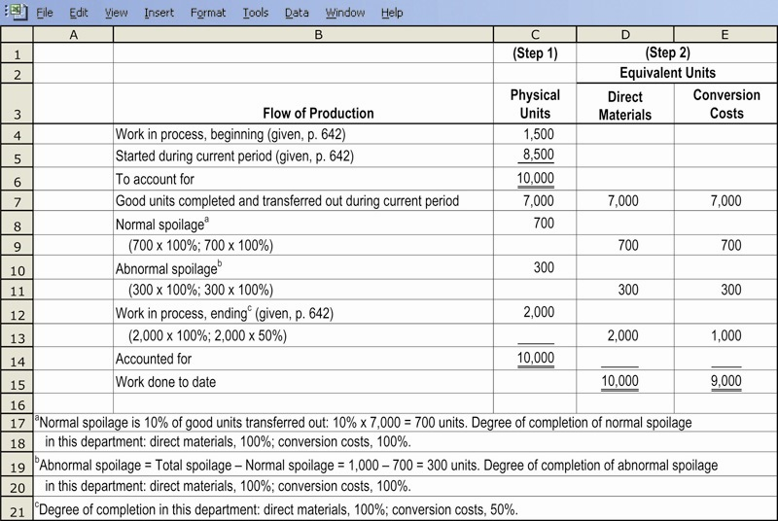
Steps 1 & 2 Illustrated

Slide 45
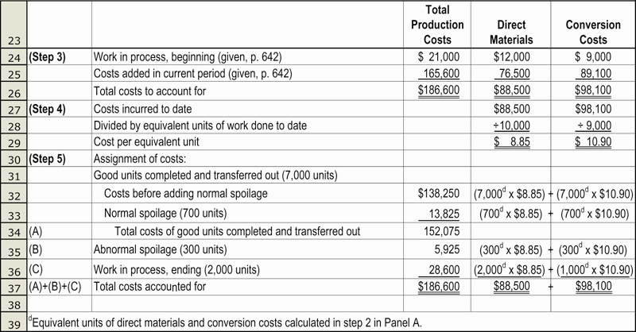
Steps 3, 4 & 5 Illustrated

Slide 46
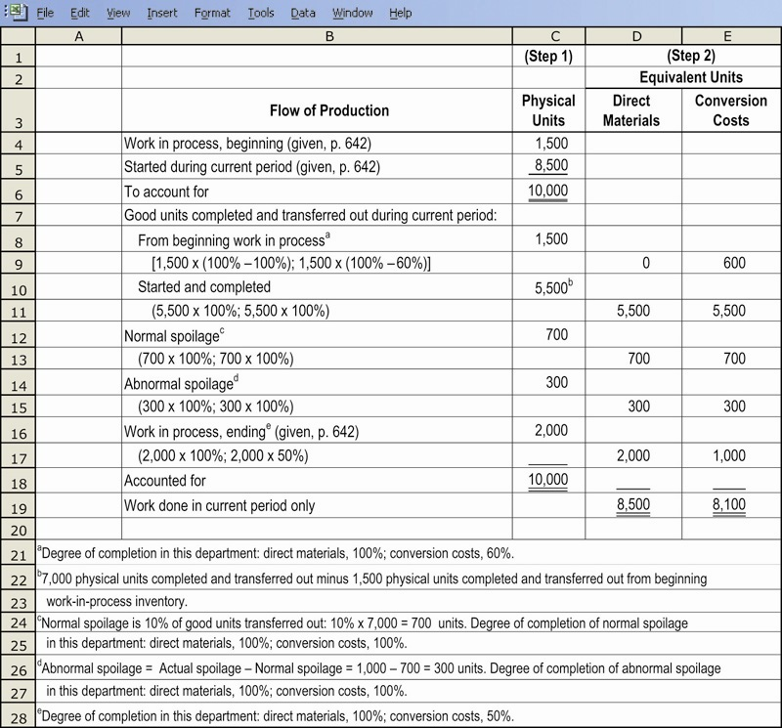
Steps 1 & 2, Illustrated

Slide 47
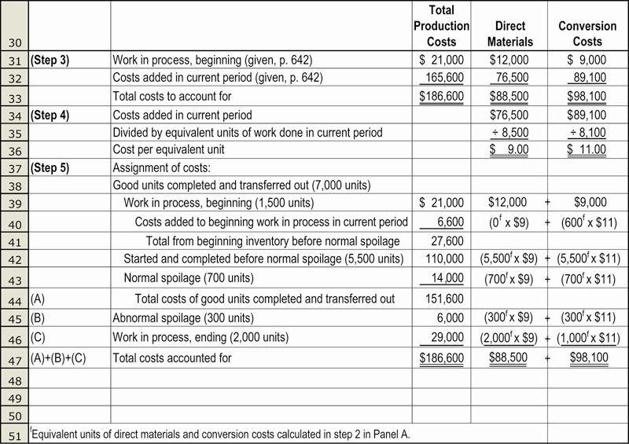
Steps 3, 4 & 5, Illustrated

Slide 48
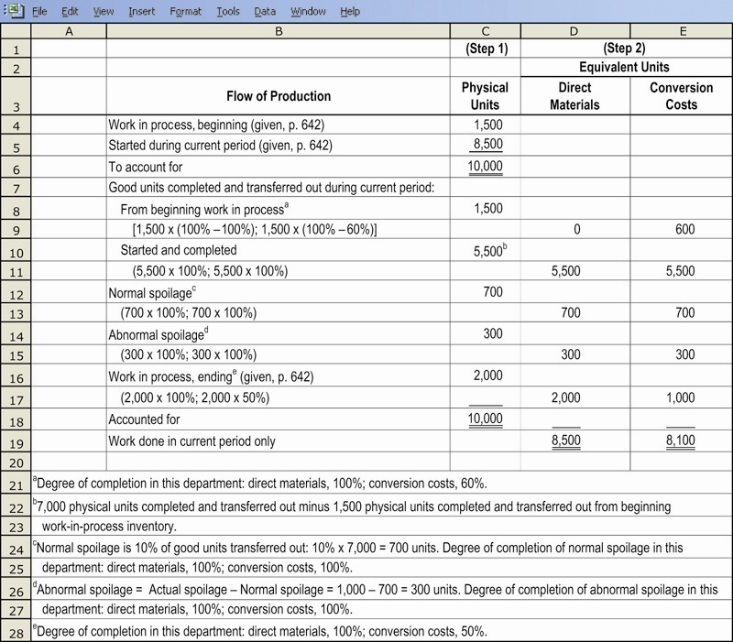
Steps 1 & 2, Illustrated

Slide 49
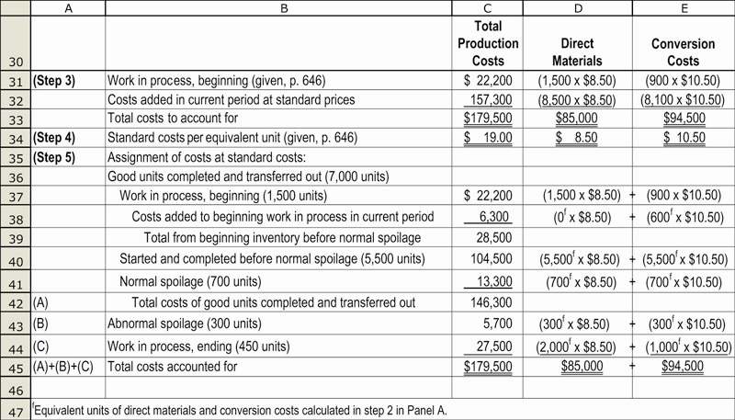
Steps 3, 4 & 5, Illustrated

Slide 50
Job Costing and Spoilage
Job costing systems generally distinguish between normal spoilage attributable to a specific job from normal spoilage common to all jobs

Slide 51
Job Costing and
Accounting for Spoilage
Normal Spoilage Attributable to a Specific Job: When normal spoilage occurs because of the specifications of a particular job, that job bears the cost of the spoilage minus the disposal value of the spoilage

Slide 52
Job Costing and
Accounting for Spoilage
Normal Spoilage Common to all Jobs: IN some cases, spoilage may be considered a normal characteristic of the production process.
  The spoilage is costed as manufacturing overhead because it is common to all jobs
  The Budgeted Manufacturing Overhead Rate includes a provision for normal spoilage

Slide 53
Job Costing and
Accounting for Spoilage
Abnormal Spoilage: If the spoilage is abnormal, the net loss is charged to the Loss From Abnormal Spoilage account
  Abnormal spoilage costs are not included as a part of the cost of good units produced

Slide 54
Job Costing and Rework
Three types of rework:
  Normal rework attributable to a specific job – the rework costs are charged to that job
  Normal rework common to all jobs – the costs are charged to manufacturing overhead and spread, through overhead allocation, over all jobs
  Abnormal rework – is charged to the Loss from Abnormal Rework account that appears on the income statement

Slide 55
Accounting for Scrap
No distinction is made between normal and abnormal scrap because no cost is assigned to scrap
The only distinction made is between scrap attributable to a specific job and scrap common to all jobs

Slide 56
Aspects of Accounting for Scrap
Planning & Control, including physical tracking
Inventory costing, including when and how it affects operating income
NOTE: Many firms maintain a distinct
account for scrap costs

Slide 57
Accounting for Scrap
Scrap Attributable to a Specific Job – job costing systems sometime trace the scrap revenues to the jobs that yielded the scrap.
  Done only when the tracing can be done in an economic feasible way
  No cost assigned to scrap

Slide 58
Accounting for Scrap
Scrap Common to all Jobs – all products bear production costs without any credit for scrap revenues except in an indirect manner
  Expected scrap revenues are considered when setting is lower than it would be if the overhead budget had not been reduced by expected scrap revenues

Slide 59
Accounting for Scrap
Recognizing Scrap at the Time of its Production – sometimes the value of the scrap is material, and the time between storing and selling it can be long
The firm assigns an inventory cost to scrap at a conservative estimate of its net realizable value so that production costs and related scrap revenues are recognized in the same accounting period

Slide 60
End of Lecture 23

