Slide 1
Chapter 09
Lecture 22
Inventory Costing and Capacity Analysis
Readings
Chapter 09,Cost Accounting, Managerial Emphasis, 14th edition by Horengren
Chapter 07, Managerial Accounting 12th edition by Garrison, Noreen, Brewer

Slide 2
Learning Objectives
Explain how variable costing differs from absorption costing and compute unit product costs under each method.
Prepare income statements using both variable and absorption costing.
Reconcile variable costing and absorption costing net operating incomes and explain why the two amounts differ.
Understand the advantages and disadvantages of both variable and absorption costing.

Slide 3
Inventory Costing Choices: Overview
Absorption Costing – product costs are capitalized; period costs are expensed
Variable Costing – variable product and period costs are capitalized; fixed product and period costs are expensed
Throughput Costing – only Direct Materials are capitalized; all other costs are expensed

Slide 4
Costing Comparison
Variable costing is a method of inventory costing in which only variable manufacturing costs are included as inventoriable costs
Absorption costing is a method of inventory costing in which all variable manufacturing costs and all fixed manufacturing costs are included as inventoriable costs

Slide 5
Differences in Income
Operating Income will differ between Absorption and Variable Costing
The amount of the difference represents the amount of Fixed Product Costs capitalized as Inventory under Absorption costing, and expensed as a period costs under Variable Costing

Slide 6
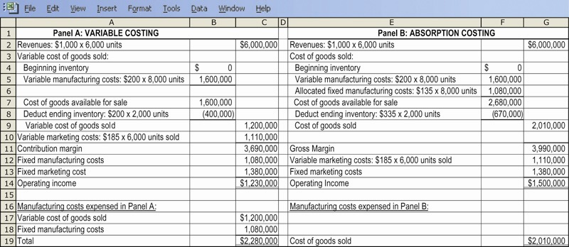
Comparative Income Statements

Slide 7
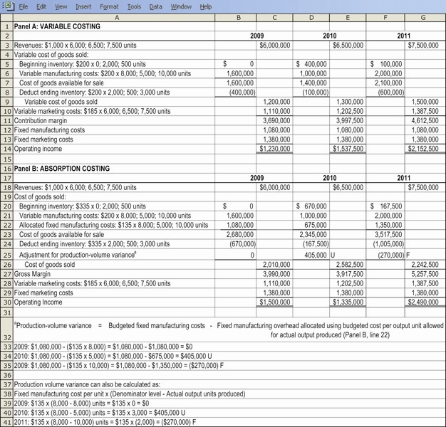
Comparative Income Statements – Three Years

Slide 8
Comparative Income Effects
 | Variable Costing | Absorption Costing
Are fixed product costs inventoried? | No | Yes
Is there a production-volume-variance? | No | Yes
Are classifications between variable & fixed costs routinely made? | Yes | Infrequently

Slide 9
Comparative Income Effects
 | Variable Costing | Absorption Costing
How do changes in unit inventory cost affect operating income if…?
Production = Sales | Equal | Equal
Production > Sales | Lower | Higher
Production < Sales | Higher | Lower

Slide 10
Comparative Income Effects
 | Variable Costing | Absorption Costing
What are the effects on cost-volume-profit (for a given level of fixed costs and a given contribution margin per unit? | Driven by: unit level of sales | Driven by: Unit level of sales Unit level of production Chosen denominator level

Slide 11
Comparison of Alternative Inventory Costing Systems
Variable Direct Manufacturing Cost
Actual Costing | Normal Costing | Standard Costing
Actual Prices X Actual Quantity of inputs used | Actual Prices X Actual Quantity of inputs used | Standard prices X Standard Quantity of inputs allowed for actual output achieved

Slide 12
Comparison of Alternative Inventory Costing Systems
Variable Indirect Manufacturing Cost
Actual Costing | Normal Costing | Standard Costing
Actual variable indirect rates X Actual quantity of cost-allocation bases used | Budgeted variable indirect rates X Actual quantity of cost-allocation bases used | Standard variable indirect rates X Standard quantity of cost-allocation bases allowed for actual output achieved

Slide 13
Comparison of Alternative Inventory Costing Systems
Fixed Direct Manufacturing Cost
Actual Costing | Normal Costing | Standard Costing
Actual prices X Actual quantity of inputs used | Actual prices X Actual quantity of inputs used | Standard prices X Standard quantity of inputs allowed for actual output achieved

Slide 14
Comparison of Alternative Inventory Costing Systems
Fixed Indirect Manufacturing Cost
Actual Costing | Normal Costing | Standard Costing
Actual fixed indirect rates X Actual quantity of cost-allocation bases used | Budgeted fixed indirect rates X Actual quantity of cost-allocation bases used | Standard fixed indirect rates X Standard quantity of cost-allocation bases allowed for actual output achieved

Slide 15
Performance Issues and Absorption Costing
Managers may seek to manipulate income by producing too many units
Production beyond demand will increase the amount of inventory on hand
This will result in more fixed costs being capitalized as inventory
That will leave a smaller amount of fixed costs to be expensed during the period
Profit increases, and potentially so does a manger’s bonus

Slide 16
Inventories and Costing Methods
One way to prevent the unnecessary buildup of inventory for bonus purposes is to base manager’s bonuses on profit calculated using Variable Costing
Drawback: complicated system of producing two inventory figures – one for external reporting and the other for bonus calculations

Slide 17
Other Manipulation Schemes Beyond Simple Overproduction
Deciding to manufacture products the absorb the highest amount of fixed costs, regardless of demand (“cherry-picking”)
Accepting an order to increase production, even though another plant in the same firm is better suited to handle that order
Deferring maintenance

Slide 18
Management Countermeasures for Fixed Cost Manipulation Schemes
Careful budgeting and inventory planning
Incorporate an internal carrying charge for inventory
Change (lengthen) the period used to evaluate performance
Include nonfinancial as well as financial variables in the measures to evaluate performance

Slide 19
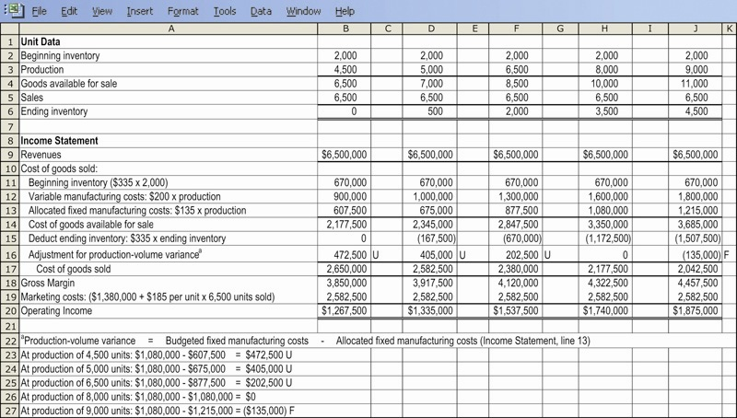
Income Effects of Inventory Buildup

Slide 20
Extreme Variable Costing:
Throughput Costing
Throughput costing (super-variable costing) is a method of inventory costing in which only direct material costs are included as inventory costs. All other product costs are treated as operating expenses

Slide 21
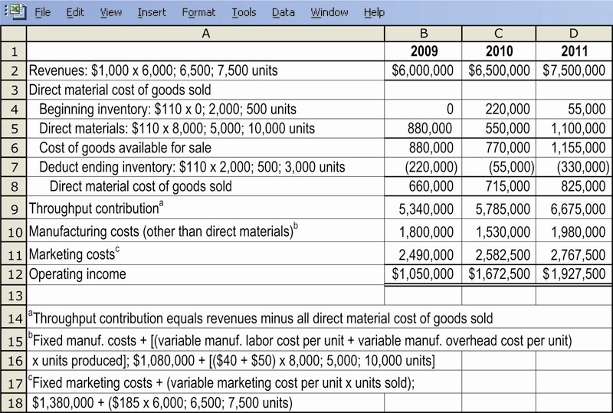
Throughput Costing Illustrated

Slide 22
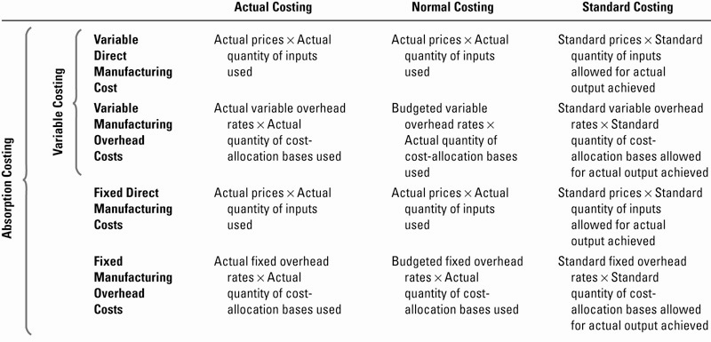
Costing Systems Compared

Slide 23
Overview of Absorption and Variable Costing
Absorption
Costing
Variable
Costing
Product
Costs
Direct Materials
Product
Costs
Direct Labor
Variable Manufacturing Overhead
Fixed Manufacturing Overhead
Period
Costs
Period
Costs
Variable Selling and Administrative Expenses
Fixed Selling and Administrative Expenses
Notes:
Absorption costing (also called the full cost method) treats all costs of production as product costs, regardless of whether they are variable or fixed. Since no distinction is made between variable and fixed costs, absorption costing is not well suited for CVP computations. Under absorption costing, the cost of a unit of product consists of direct materials, direct labor, and both variable and fixed overhead. Variable and fixed selling and administrative expenses are treated as period costs and are deducted from revenue as incurred.
Variable costing (also called direct costing or marginal costing) treats only those costs of production that vary with output as product costs. This approach dovetails with the contribution approach income statement and supports CVP analysis because of its emphasis on separating variable and fixed costs. The cost of a unit of product consists of direct materials, direct labor, and variable overhead. Fixed manufacturing overhead, and both variable and fixed selling and administrative expenses are treated as period costs and deducted from revenue as incurred.
Think about the impact of each method on inventory values, and then answer the following question.

Slide 24
Quick Check ✓
Which method will produce the highest values for work in process and finished goods inventories?
  a. Absorption costing.
  b. Variable costing.
  c. They produce the same values for these
  inventories.
  d. It depends. . .
Notes:
To answer this question correctly, recall which method includes more manufacturing costs in the unit product cost.

Slide 25
Quick Check ✓
Which method will produce the highest values for work in process and finished goods inventories?
  a. Absorption costing.
  b. Variable costing.
  c. They produce the same values for these
  inventories.
  d. It depends. . .
Notes:
Unit product costs are in both work in process and finished goods inventories. Absorption costing results in the highest inventory values because it treats fixed manufacturing overhead as a product cost. Using variable costing, fixed manufacturing overhead is expensed as incurred and never becomes a part of the product cost.

Slide 26
Unit Cost Computations
Harvey Company produces a single product
with the following information available:
Notes:
Harvey Company produces 25,000 units of a single product. Variable manufacturing costs total $10 per unit. Variable selling and administrative expenses are $3.00 per unit. Fixed manufacturing overhead for the year is $150,000 and fixed selling and administrative expenses for the year are $100,000.

Slide 27
Unit Cost Computations
Unit product cost is determined as follows:
Under absorption costing, selling and administrative expenses are
always treated as period expenses and deducted from revenue as incurred.
Notes:
The unit product costs under absorption and variable costing would be $16 and $10, respectively. Under absorption costing, all production costs, variable and fixed, are included when determining unit product cost. Under variable costing, only the variable production costs are included in product costs.

Slide 28

Income Comparison of Absorption and Variable Costing
Let’s assume the following additional information for Harvey Company.
  20,000 units were sold during the year at a price of $30 each.
  There were no units in beginning inventory.
Now, let’s compute net operating
income using both absorption
and variable costing.
Notes:
We need some additional information to allow us to prepare income statements for Harvey Company:
20,000 units were sold during the year.
The selling price per unit is $30.
There is no beginning inventory.
Now let’s prepare income statements for Harvey Company. We will start with an absorption income statement.

Slide 29
Absorption Costing
Notes:
Harvey sold only 20,000 of the 25,000 units produced, leaving 5,000 units in ending inventory. At a sales price of $30 per unit, sales revenue for the 20,000 units sold is $600,000. At a unit product cost of $16, cost of goods sold for the 20,000 units sold is $320,000. Subtracting cost of goods sold from sales, we find the gross margin of $280,000. After subtracting selling and administrative expenses from the gross margin, we see that net operating income is $120,000.

Slide 30
Variable Costing
Variable
manufacturing
costs only.
All fixed
manufacturing
overhead is
expensed.
Notes:
Now let’s examine a variable cost income statement. Notice that this is a contribution format statement. First, we subtract all variable expenses from sales to get contribution margin. At a product cost of $10 per unit, the variable cost of goods sold for 20,000 units is $200,000. The next variable expense is the variable selling and administrative expense. After computing contribution margin, we subtract fixed expenses to get the $90,000 net operating income. Note that all $150,000 of fixed manufacturing overhead is expensed in the current period.

Slide 31
Comparing the Two Methods
Notes:
Under absorption costing, $120,000 of fixed manufacturing overhead is included in cost of goods sold and $30,000 is deferred in ending inventory as an asset on the balance sheet. Under variable costing, the entire $150,000 of fixed manufacturing overhead is treated as a period expense.
The variable costing ending inventory is $30,000 less than absorption costing, thus explaining the difference in net operating income between the two methods.

Slide 32
Comparing the Two Methods
We can reconcile the difference between
absorption and variable income as follows:
Fixed mfg. Overhead $150,000
Units produced 25,000 units
= = $6.00 per unit
Notes:
The difference in net operating income between the two methods ($30,000) can also be reconciled by multiplying the number of units in ending inventory (5,000 units) by the fixed manufacturing overhead per unit ($6) that is deferred in ending inventory under absorption costing.

Slide 33
Extended Comparisons of Income Data Harvey Company Year Two
Notes:
In the second year, Harvey Company sells 30,000 units. The selling price per unit, variable costs per unit, total fixed costs, and number of units produced remain unchanged. Five thousand units are in beginning inventory, left from last year.

Slide 34
Unit Cost Computations
Since there was no change in the variable costs
per unit, total fixed costs, or the number of
units produced, the unit costs remain unchanged.
Notes:
Since the variable costs per unit, total fixed costs, and the number of units produced remained unchanged, the unit cost computations also remain unchanged.

Slide 35
Absorption Costing
These are the 25,000 units
produced in the current period.
Notes:
Of the 30,000 units sold in the second year, 25,000 units were produced in the second year and 5,000 units came from beginning inventory. The $30,000 of fixed manufacturing overhead deferred into inventory in the first year is released from inventory this year as part of the $16 unit product cost.
Selling and administrative expenses are deducted from gross margin to obtain the net operating income of $230,000.

Slide 36
Variable Costing
Variable
manufacturing
costs only.
All fixed
manufacturing
overhead is
expensed.
Notes:
Now, let’s examine a variable cost income statement for the second year. Again, notice that this is a contribution format statement. At a product cost of $10 per unit, the variable cost of goods sold for 30,000 units is $300,000.
After computing contribution margin, we subtract fixed expenses to get the $260,000 net operating income. Note that all $150,000 of fixed manufacturing overhead is expensed in the current period.

Slide 37
Comparing the Two Methods
We can reconcile the difference between
absorption and variable income as follows:
Fixed mfg. Overhead $150,000
Units produced 25,000 units
= = $6.00 per unit
Notes:
The difference in net operating income between the two methods ($30,000) can be reconciled by multiplying the number of units in beginning inventory (5,000 units) by the fixed manufacturing overhead per unit ($6) that is released from beginning inventory under absorption costing.

Slide 38
Comparing the Two Methods
Notes:
Across the two year time frame, both methods reported the same total net operating income ($350,000). This is because over an extended period of time sales cannot exceed production, nor can production much exceed sales. The shorter the time period, the more the net operating income figures will tend to differ.

Slide 39
Summary of Key Insights
Notes:
On your screen is a nice summary of what we have observed from the Harvey Company’s two years:
When production is greater than sales, as in year 1 for Harvey, absorption income is
greater than variable costing income.
When production is less than sales, as in year 2 for Harvey, absorption costing
income is less than variable costing income.
When production equals sales, the two methods report the same net operating
income.

Slide 40
Effect of Changes in Production on Net Operating Income
Let’s revise the Harvey Company example.
In the previous example,
25,000 units were produced each year,
but sales increased from 20,000 units in year
one to 30,000 units in year two.
In this revised example,
production will differ each year while
sales will remain constant.
Notes:
In the previous Harvey Company example, units of production was constant and sales fluctuated. In the forthcoming example, units of production will fluctuate and sales in units will remain constant.

Slide 41
Effect of Changes in Production
Harvey Company Year One
Notes:
In the first year, Harvey Company produces 30,000 units and sells 25,000 units. There is no beginning inventory. The selling price per unit, variable costs per unit, and total fixed costs remain unchanged from the prior example.

Slide 42
Unit Cost Computations for Year One
Unit product cost is determined as follows:
Since the number of units produced increased
in this example, while the fixed manufacturing overhead
remained the same, the absorption unit cost is less.
Notes:
The unit product costs under absorption and variable costing are $15 and $10, respectively. Note that the fixed manufacturing overhead cost per unit has declined from $6 in the previous example to $5 in this example. Since the number of units produced increased to 30,000 in this example, and the fixed manufacturing overhead remained the same, the unit cost is less.

Slide 43
Absorption Costing: Year One
Notes:
Harvey sold only 25,000 of the 30,000 units produced, leaving 5,000 units in ending inventory. At a sales price of $30 per unit, sales revenue for the 25,000 units sold is $750,000. At a unit product cost of $15, cost of goods sold for the 25,000 units sold is $375,000. Subtracting cost of goods sold from sales, we find the gross margin of $375,000.
After subtracting selling and administrative expenses from the gross margin, we see that net operating income is $200,000.

Slide 44
Variable Costing: Year One
Variable
manufacturing
costs only.
All fixed
manufacturing
overhead is
expensed.
Notes:
Now, let’s examine a variable cost income statement prepared in the contribution format. First, we subtract all variable expenses from sales to get contribution margin. At a product cost of $10 per unit, the variable cost of goods sold for 25,000 units is $250,000. The next variable expense is the variable selling and administrative expense.
After computing contribution margin, we subtract fixed expenses to get the $175,000 net operating income. Note that all $150,000 of fixed manufacturing overhead is expensed in the current period.

Slide 45
Effect of Changes in Production
Harvey Company Year Two
Notes:
In the second year, Harvey Company again sells 25,000 units, but produces only 20,000. Five thousand units are in beginning inventory, left from last year. The selling price per unit, variable costs per unit, and total fixed costs remain unchanged.

Slide 46
Unit Cost Computations for Year Two
Unit product cost is determined as follows:
Since the number of units produced decreased in the
second year, while the fixed manufacturing overhead
remained the same, the absorption unit cost is now higher.
Notes:
The unit product costs for the second year under absorption and variable costing are $17.50 and $10, respectively. Note that the fixed manufacturing overhead cost per unit has increased from $5 in year one to $7.50 in year two. Since the number of units produced decreased to 20,000 in year two, and the fixed manufacturing overhead remained the same, the unit cost is greater.

Slide 47
Absorption Costing: Year Two
These are the 20,000 units produced in the current
period at the higher unit cost of $17.50 each.
Notes:
Of the 25,000 units sold in the second year, 20,000 units were produced in the second year and 5,000 units came from beginning inventory. The unit product cost for units in beginning inventory is $15. The unit product cost for goods manufactured in year two is $17.50. The $25,000 of fixed manufacturing overhead deferred into inventory in the first year is released from inventory this year as part of the $15 unit product cost.
Selling and administrative expenses are deducted from gross margin to obtain the net operating income of $150,000.

Slide 48
Variable Costing: Year Two
Variable
manufacturing
costs only.
All fixed
manufacturing
overhead is
expensed.
Notes:
Now let’s examine a variable cost income statement for the second year. Again, notice that this is a contribution format statement. At a product cost of $10 per unit, the variable cost of goods sold for 25,000 units is $250,000.
After computing contribution margin, we subtract fixed expenses to get the $175,000 net operating income. Note that all $150,000 of fixed manufacturing overhead is expensed in the current period.

Slide 49
Comparing the Two Methods
Conclusions
❶ Net operating income is not affected by changes in
production using variable costing.
❷ Net operating income is affected by changes in production
using absorption costing even though the number of units
sold is the same each year.
Notes:
The difference in net operating income between the two methods ($25,000) can be reconciled by multiplying the number of units in beginning inventory (5,000 units) by the fixed manufacturing overhead per unit ($5) that is deferred in ending inventory and then released from beginning inventory in the next period under absorption costing.
Units sold, selling price, variable costs per unit, and total fixed costs remained constant across years 1 and 2. Thus, the contribution margin and variable costing net operating income did not change.
Across the two year time frame, both methods reported the same total net operating income ($350,000). This is because over an extended period of time sales cannot exceed production, nor can production much exceed sales. The shorter the time period, the more the net operating income figures will tend to differ.

Slide 50
Impact on the Manager
Opponents of absorption costing argue that
shifting fixed manufacturing overhead costs
between periods can lead to faulty decisions.
These opponents argue that variable costing income
statements are easier to understand because net operating
income is only affected by changes in unit sales. This
produces net operating income figures that are
more consistent with managers’ expectations.
Notes:
Opponents of absorption costing argue that shifting fixed manufacturing overhead costs between periods can lead to faulty decisions.
These opponents argue that variable costing income statements are easier to understand because net operating income is only affected by changes in unit sales. This produces net operating income figures that are more consistent with managers’ expectations.

Slide 51
CVP Analysis, Decision Making and Absorption costing
Absorption costing does not support CVP analysis because it essentially treats fixed manufacturing overhead as a variable cost by assigning a per unit amount of the fixed overhead to each unit of production.
Treating fixed manufacturing overhead as a
variable cost can:
Lead to faulty pricing decisions and keep-or-drop
decisions.
Produce positive net operating income even
when the number of units sold is less than the
breakeven point.
Notes:
Absorption costing does not dovetail with CVP analysis, nor does it support decision making. It treats fixed manufacturing overhead as a variable cost. This can lead to faulty pricing decisions and keep-or-drop decisions. It also assigns per unit fixed manufacturing overhead costs to production. This can potentially produce positive net operating income even when the number of units sold is less than the breakeven point.

Slide 52
External Reporting and Income Taxes
To conform to
GAAP requirements,
absorption costing must be used for
external financial reports in the
United States.
Under the Tax
Reform Act of 1986,
absorption costing must be
used when filing income
tax returns.
Since top executives
are usually evaluated based on
external reports to shareholders,
they may feel that decisions
should be based on
absorption cost income.
Notes:
Practically speaking, absorption costing is required for external reports in the United States. Under the Tax Reform Act of 1986, a form of absorption costing must be used when filling out income tax forms. Since top executives are typically evaluated based on earnings reported to shareholders in external reports, they may feel that decisions should be based on absorption costing data.

Slide 53
Advantages of Variable Costing and the Contribution Approach
Consistent with
CVP analysis.
Management finds
it more useful.
Net operating income
is closer to
net cash flow.
Consistent with standard
costs and flexible budgeting.
Advantages
Easier to estimate profitability
of products and segments.
Impact of fixed
costs on profits
emphasized.
Profit is not affected by
changes in inventories.
Notes:
The advantages of variable costing and the contribution approach include:
The data required for CVP analysis can be taken directly from a contribution
format income statement.
Profits move in the same direction as sales, assuming other things remain the
same.
Managers often assume that unit product costs are variable. Under variable
costing, this assumption is true.
Fixed costs appear explicitly on a contribution format income statement; thus the
impact of fixed costs on profits is emphasized.
Variable costing data make it easier to estimate the profitability of products,
customers, and other business segments.
Variable costing ties in with cost control methods, such as standard costs and
flexible budgeting.
Variable costing net operating income is closer to net cash flow than
absorption costing net operating income.

Slide 54
Variable versus Absorption Costing
Fixed manufacturing
costs must be assigned
to products to properly
match revenues and
costs.
Fixed manufacturing
costs are capacity costs
and will be incurred
even if nothing is
produced.
Absorption
Costing
Variable
Costing
Notes:
With all of these advantages, why is absorption costing still so prevalent? One reason (in addition to the external reporting issue) relates to the matching principle. Advocates of absorption costing argue that it better matches costs with revenues. They contend that fixed manufacturing costs are just as essential to manufacturing products as are the variable costs. However, advocates of variable costing view fixed manufacturing costs as capacity costs. They argue that fixed manufacturing costs would be incurred even if no units were produced.

Slide 55
Variable Costing and the
Theory of Constraints (TOC)
Companies involved in TOC use a form of variable costing. However, one difference of the TOC approach is that it treats direct labor as a fixed cost for three reasons:
  Many companies have a commitment to guarantee
  workers a minimum number of paid hours.
  Direct labor is usually not the constraint.
  TOC emphasizes the role direct laborers play in driving
  continuous improvement. Since layoffs often devastate
  morale, managers involved in TOC are extremely
  reluctant to lay off employees.
Notes:
Companies involved in TOC use a form of variable costing. However, one difference of the TOC approach is that it treats direct labor as a fixed cost for three reasons:
❶ Although direct laborers are paid an hourly wage, many companies have a
commitment — sometimes enforced by labor contracts or by the law — to
guarantee workers a minimum number of paid hours.
❷ Direct labor is usually not the constraint; therefore, there is no reason to
increase the number of direct laborers.
❸ TOC emphasizes the role direct laborers play in driving continuous
improvement. Since layoffs often devastate morale, managers involved in
TOC are extremely reluctant to lay off employees.

Slide 56
Impact of JIT Inventory Methods
In a JIT inventory system . . .
Production
tends to equal
sales . . .
So, the difference between variable and
absorption income tends to disappear.
Notes:
When companies use JIT methods, the goal is to eliminate finished goods inventories and reduce work in process inventory to almost nothing. This causes absorption costing net operating income to essentially move in the same direction as sales. Therefore, the difference between absorption costing and variable costing income tends to disappear.

Slide 57
End of Lecture 22
Notes:
End of Chapter 7.

