Slide 1
Chapter 11
Lecture 20
Decision Making and Relevant Information
Readings
Chapter 11,Cost Accounting, Managerial Emphasis, 14th edition by Horengren
Chapter 13, Managerial Accounting 12th edition by Garrison, Noreen, Brewer

Slide 2
Learning Objectives
Identify relevant and irrelevant costs and benefits in a decision.
Prepare an analysis showing whether a product line or other business segment should be dropped or retained.
Prepare a make or buy analysis.
Prepare an analysis showing whether a special order should be accepted.
Determine the most profitable use of a constrained resource and the value of obtaining more of the constrained resource.
Prepare an analysis showing whether joint products should be sold at the split-off point or processed further.

Slide 3
Decision Models
A decision model is a formal method of making a choice, often involving both quantitative and qualitative analyses
Managers often use some variation of the Five-Step Decision-Making Process

Slide 4
Five-Step Decision-Making Process

Slide 5
Relevance
Relevant Information has two characteristics:
  It occurs in the future
  It differs among the alternative courses of action
Relevant Costs – expected future costs
Relevant Revenues – expected future revenues

Slide 6
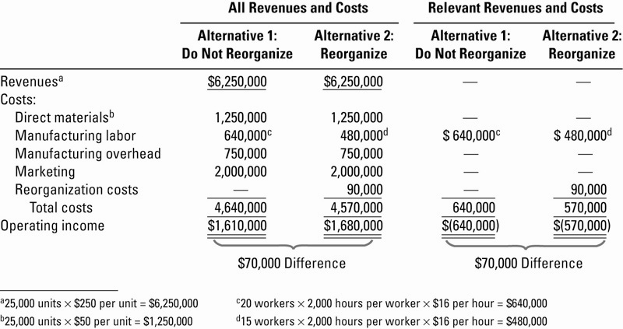
Relevant Cost Illustration

Slide 7
Features of Relevant Information
Past (historical) costs may be helpful as a basis for making predictions. However, past costs themselves are always irrelevant when making decisions.
Different alternatives can be compared by examining differences in expected total future revenues and expected total future costs.
Not all expected future revenues and expected future costs are relevant. Expected future revenues and expected future costs that do not differ among alternatives are irrelevant and, hence, can be eliminated from the analysis. The key question is always, What difference will an action make?
Appropriate weight must be given to qualitative factors and quantitative nonfinancial factors.

Slide 8
Irrelevance
Historical costs are past costs that are irrelevant to decision making
  Also called Sunk Costs

Slide 9
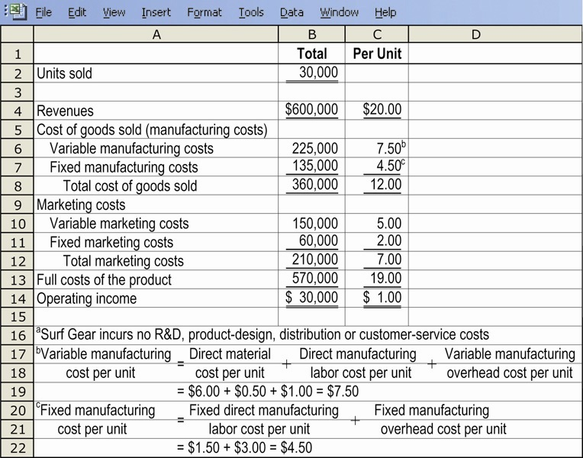
A Starting Point: Absorption-Based Budgeted Income Statement

Slide 10
Types of Information
Quantitative factors are outcomes that can be measured in numerical terms
Qualitative factors are outcomes that are difficult to measure accurately in numerical terms, such as satisfaction
  Are just as important as quantitative factors even though they are difficult to measure

Slide 11
Terminology
Incremental Cost – the additional total cost incurred for an activity
Differential Cost – the difference in total cost between two alternatives
Incremental Revenue – the additional total revenue from an activity
Differential Revenue – the difference in total revenue between two alternatives

Slide 12
Types of Decisions
One-Time-Only Special Orders
Insourcing vs. Outsourcing
Make or Buy
Product-Mix
Customer Profitability
Branch / Segment: Adding or Discontinuing
Equipment Replacement

Slide 13
One-Time-Only Special Orders
Accepting or rejecting special orders when there is idle production capacity and the special orders has no long-run implications
Decision Rule: does the special order generate additional operating income?
  Yes – accept
  No – reject
Compares relevant revenues and relevant costs to determine profitability

Slide 14
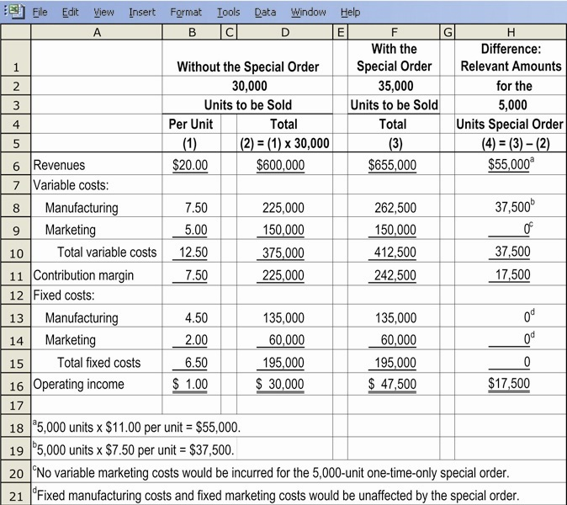
Special Order Illustration

Slide 15
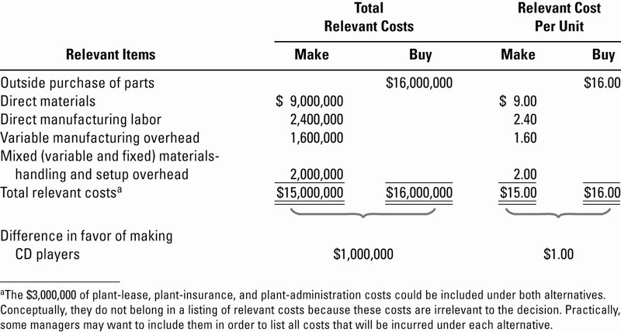
Make-or-Buy Illustration

Slide 16
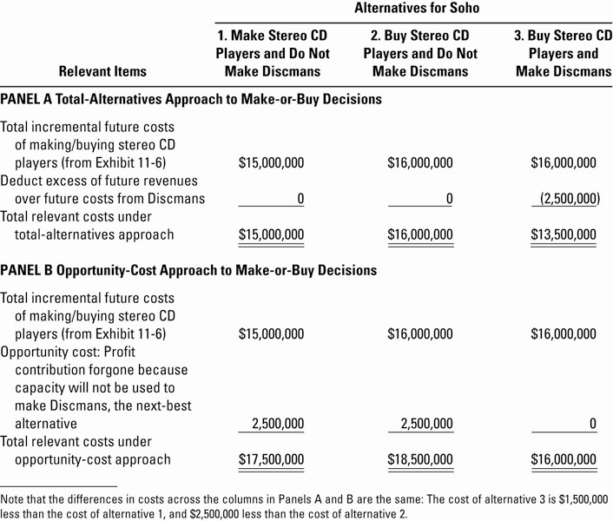
Make-or-Buy Illustration, Extended

Slide 17
Potential Problems with
Relevant-Cost Analysis
Avoid incorrect general assumptions about information, especially:
  “All variable costs are relevant and all fixed costs are irrelevant”
  There are notable exceptions for both costs

Slide 18
Potential Problems with
Relevant-Cost Analysis
Problems with using unit-cost data:
  Including irrelevant costs in error
  Using the same unit-cost with different output levels
    Fixed costs per unit change with different levels of output

Slide 19
Avoiding Potential Problems with
Relevant-Cost Analysis
Focus on Total Revenues and Total Costs, not their per-unit equivalents
Continually evaluate data to ensure that it meets the requirements of relevant information

Slide 20
Insourcing vs. Outsourcing
Insourcing – producing goods or services within an organization
Outsourcing – purchasing goods or services from outside vendors
Also called the “Make or Buy” decision
Decision Rule: Select the that option will provide the firm with the lowest cost, and therefore the highest profit.

Slide 21
Qualitative Factors
Non-quantitative factors may be extremely important in an evaluation process, yet do not show up directly in calculations:
  Quality Requirements
  Reputation of Outsourcer
  Employee Morale
  Logistical Considerations – distance from plant, etc

Slide 22
Opportunity Costs
Opportunity Cost is the contribution to operating income that is foregone by not using a limited resource in it’s next-best alternative use
  “How much profit did the firm ‘lose out on’ by not selecting this alternative?”
Special type of Opportunity Cost: Holding Cost for Inventory. Funds tied up in inventory are not available for investment elsewhere

Slide 23
Product-Mix Decisions
The decisions made by a company about which products to sell and in what quantities
Decision Rule (with a constraint): choose the product that produces the highest contribution margin per unit of the constraining resource

Slide 24
Adding or Dropping Customers
Decision Rule: Does adding or dropping a customer add operating income to the firm?
  Yes – add or don’t drop
  No – drop or don’t add
Decision is based on profitability of the customer, not how much revenue a customer generates

Slide 25
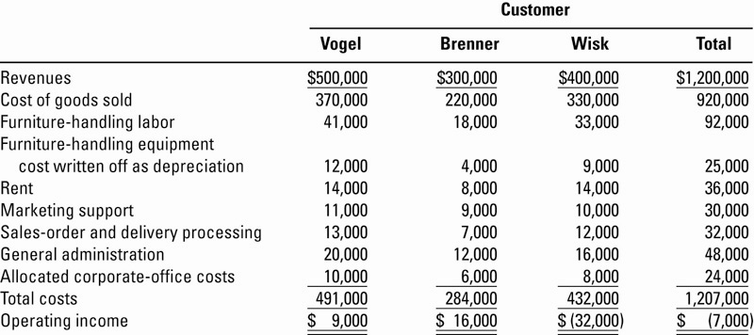
Customer Profitability Analysis, Illustrated

Slide 26
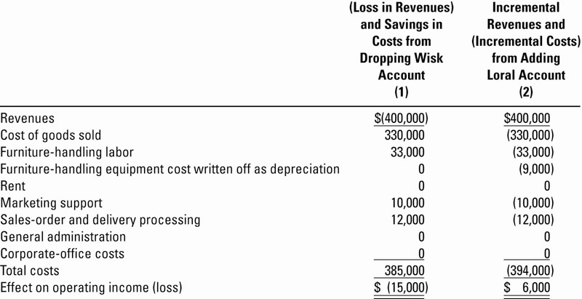
Customer Profitability Analysis, Extended

Slide 27
Adding or Discontinuing
Branches or Segments
Decision Rule: Does adding or discontinuing a branch or segment add operating income to the firm?
  Yes – add or don’t discontinue
  No – discontinue or don’t add
Decision is based on profitability of the branch or segment, not how much revenue the branch or segment generates

Slide 28
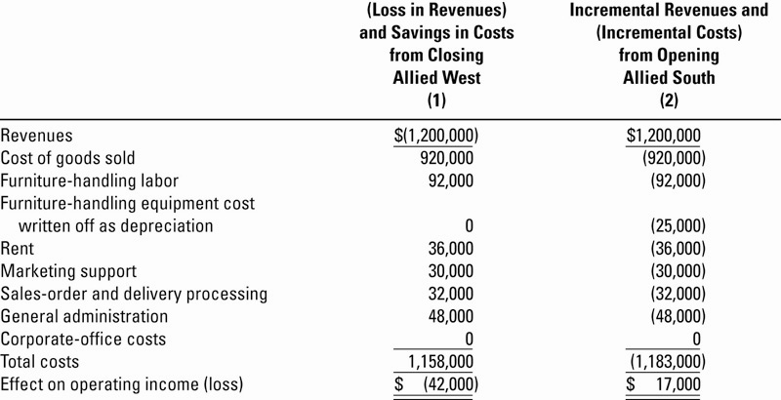
Adding/Closing Offices or Segments, Illustrated

Slide 29
Equipment-Replacement Decisions
Sometimes difficult due to amount of information at hand that is irrelevant:
  Cost, Accumulated Depreciation and Book Value of existing equipment
  Any potential Gain or Loss on the transaction – a Financial Accounting phenomenon only
Decision Rule: Select the alternative that will generate the highest operating income

Slide 30
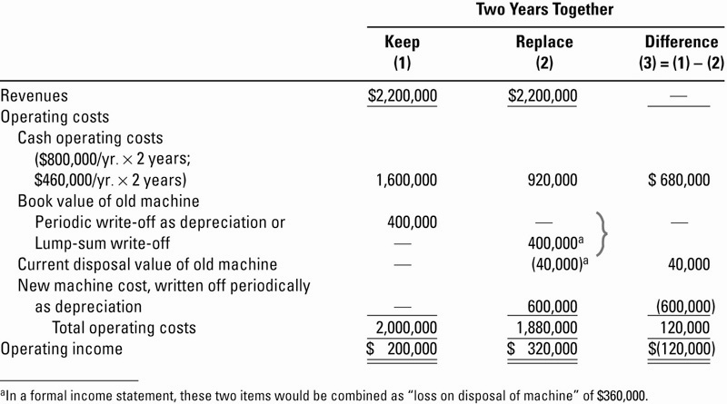
Equipment-Replacement Decisions, Illustrated

Slide 31
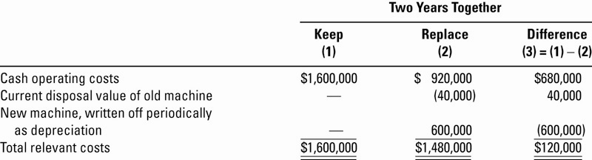
Equipment-Replacement Decisions, Illustrated (Relevant Costs Only)

Slide 32
Behavioral Implications
Despite the quantitative nature of some aspects of decision making, not all managers will choose the best alternative for the firm
Managers could engage in self-serving behavior such as delaying needed equipment maintenance in order to meet their personal profitability quotas for bonus consideration

Slide 33
Cost Concepts for Decision Making
A relevant cost is a cost that differs between alternatives.
1
2
Notes:
A relevant cost is a cost that differs between alternatives.

Slide 34
Identifying Relevant Costs
An avoidable cost can be eliminated, in whole or in part, by choosing one alternative over another. Avoidable costs are relevant costs. Unavoidable costs are irrelevant costs.
Two broad categories of costs are never relevant in any decision. They include:
  Sunk costs.
  Future costs that do not differ between the alternatives.
Notes:
An avoidable cost is a cost that can be eliminated, in whole or in part, by choosing one alternative over another. Avoidable costs are relevant costs. Unavoidable costs are irrelevant costs.
Two broad categories of costs are never relevant in any decision:
A sunk cost is a cost that has already been incurred and cannot be avoided regardless of what a manager decides to do.
A future cost that does not differ between alternatives is never a relevant cost.

Slide 35
Relevant Cost Analysis: A Two-Step Process
Step 1
Eliminate costs and benefits that do not differ between alternatives.
Use the remaining costs and benefits that differ between alternatives in making the decision. The costs that remain are the differential, or avoidable, costs.
Step 2
Notes:
Relevant cost analysis is a two-step process.
The first step is to eliminate costs and benefits that do not differ between alternatives. These irrelevant costs consist of sunk costs and future costs that do not differ between alternatives.
The second step is to use the remaining costs and benefits that differ between alternatives in making the decision. The costs that remain are the differential, or avoidable, costs.

Slide 36

Different Costs for Different Purposes
Costs that are relevant in one decision situation may not be relevant in another context.
Notes:
Costs that are relevant in one decision situation may not be relevant in another context. Thus, in each decision situation, the manager must examine the data at hand and isolate the relevant costs.

Slide 37
Identifying Relevant Costs
Cynthia, a Boston student, is considering visiting her friend in New York. She can drive or take the train. By car, it is 230 miles to her friend’s apartment. She is trying to decide which alternative is less expensive and has gathered the following information:
$45 per month × 8 months
$1.60 per gallon ÷ 32 MPG
$18,000 cost – $4,000 salvage value ÷ 5 years
Notes:
Part I
Assume the following information with respect to Cynthia, a Boston student who is considering visiting her friend in New York. Cynthia is trying to decide whether it would be less expensive to drive or take the train to New York. She has compiled the following information with respect to her automobile.
Part II
The straight-line depreciation is calculated as cost minus salvage value divided by useful life.
Part III
Gasoline per mile is calculated by taking the price per gallon of gasoline and dividing it by the number of miles per gallon of the car.
Part IV
The parking fee at school is $45 a month. Cynthia attends school only eight months out of the year.

Slide 38
Identifying Relevant Costs
Notes:
She has also gathered this additional information to aid in her decision.

Slide 39
Identifying Relevant Costs
Which costs and benefits are relevant in Cynthia’s decision?
The cost of the car is a sunk cost and is not relevant to the current decision.
The annual cost of insurance is not relevant. It will remain the same if she drives or takes the train.
However, the cost of gasoline is clearly relevant if she decides to drive. If she takes the train, the cost would now be incurred, so it varies depending on the decision.
Notes:
Part I
Which costs are relevant to her decision?
The cost of the car is irrelevant to the decision because it is a sunk cost.
The annual cost of auto insurance is irrelevant because it does not differ between alternatives.
Part II
The cost of the gasoline is relevant because it is avoidable if she takes the train.

Slide 40
Identifying Relevant Costs
Which costs and benefits are relevant in Cynthia’s decision?
The monthly school parking fee is not relevant because it must be paid if Cynthia drives or takes the train.
The cost of maintenance and repairs is relevant. In the long-run these costs depend upon miles driven.
At this point, we can see that some of the average cost of $0.569 per mile are relevant and others are not.
Notes:
Part I
The cost of maintenance and repairs is relevant because in the long-run these costs depend upon miles driven.
The parking fee is irrelevant because it is not a differential cost.
Part II
At this point, we can see that some of the average cost of $0.569 per mile are relevant and others are not.

Slide 41
Identifying Relevant Costs
Which costs and benefits are relevant in Cynthia’s decision?
The decline in resale value due to additional miles is a relevant cost.
The round-trip train fare is clearly relevant. If she drives the cost can be avoided.
Relaxing on the train is relevant even though it is difficult to assign a dollar value to the benefit.
The kennel cost is not relevant because Cynthia will incur the cost if she drives or takes the train.
Notes:
Part I
The decline in resale value is relevant due to the additional miles driven.
The round trip train fare is relevant because it is avoidable if she drives her car.
Relaxing on the train is relevant, but difficult to quantify.
Part II
The kennel cost is irrelevant because it is not a differential cost.

Slide 42
Identifying Relevant Costs
Which costs and benefits are relevant in Cynthia’s decision?
The cost of parking is relevant because it can be avoided if she takes the train.
The benefits of having a car in New York and the problems of finding a parking space are both relevant but are difficult to assign a dollar amount.
Notes:
The cost of parking is relevant because it is avoidable if she takes the train.
The benefits of having a car in New York and the problem of finding a parking space are both relevant, but difficult to quantify.

Slide 43
Identifying Relevant Costs
From a financial standpoint, Cynthia would be better off taking the train to visit her friend. Some of the non-financial factor may influence her final decision.
Notes:
From a financial standpoint, Cynthia would be better off taking the train. But, as with any decision we may face, it may be the non-financial or non-quantitative factors that have the most impact on our decision.

Slide 44
Total and Differential Cost Approaches
The management of a company is considering a new labor saving machine that rents for $3,000 per year. Data about the company’s annual sales and costs with and without the new machine are:
Notes:
Assume the following information for a company considering a new labor-saving machine that rents for $3,000 per year.
The total approach requires constructing two contribution format income statements – one for each alternative.
The difference between the two income statements of $12,000 equals the differential benefits shown at the bottom of the right-hand column.

Slide 45
Total and Differential Cost Approaches
As you can see, the only costs that differ between the alternatives are the direct labor costs savings and the increase in fixed rental costs.
We can efficiently analyze the decision by
looking at the different costs and revenues
and arrive at the same solution.
Notes:
The most efficient means of analyzing this decision is to use the differential approach to isolate the relevant costs and benefits as shown.

Slide 46
Total and Differential Cost Approaches
Using the differential approach is desirable for two reasons:
Only rarely will enough information be available to prepare detailed income statements for both alternatives.
Mingling irrelevant costs with relevant costs may cause confusion and distract attention away from the information that is really critical.
Notes:
Using the differential approach is desirable for two reasons:
First, only rarely will enough information be available to prepare detailed income statements for both alternatives.
Second, mingling irrelevant costs with relevant costs may cause confusion and distract attention away from the information that is really critical.

Slide 47
Adding/Dropping Segments
One of the most important decisions managers make is whether to add or drop a business segment, such as a product or a store.
Let’s see how relevant costs should be used in this type of decision.
Notes:
One of the most important decisions managers make is whether to add or drop a business segment. Ultimately, a decision to drop an old segment or add a new one is going to hinge primarily on the impact the decision will have on net operating income. To assess this impact it is necessary to carefully analyze the costs.
Let’s see how relevant costs should be used in this type of decision.

Slide 48
Adding/Dropping Segments
Due to the declining popularity of digital watches, Lovell Company’s digital watch line has not reported a profit for several years. Lovell is considering dropping this product line.
Notes:
Assume that Lovell Company’s digital watch line has not reported a profit for several years; accordingly, Lovell is considering discontinuing this product line.

Slide 49
A Contribution Margin Approach
DECISION RULE
Lovell should drop the digital watch segment only if its profit would increase. This would only happen if the fixed cost savings exceed the lost contribution margin.
Let’s look at this solution.
Notes:
To determine how dropping this line will affect the overall profits of the company, Lovell will compare the contribution margin that would be lost to the costs that would be avoided if the line was to be dropped.
Lovell should drop the digital watch segment only if its profit would increase. This would only happen if the fixed cost savings exceed the lost contribution margin.

Slide 50
Adding/Dropping Segments
Notes:
Assume a segmented income statement for the digital watches line is as shown.

Slide 51
Adding/Dropping Segments
Investigation has revealed that total fixed general factory overhead and general
administrative expenses would not be affected if the digital watch line is dropped. The fixed general factory overhead and general administrative expenses assigned to this product would be reallocated to other product lines.
Notes:
An investigation has revealed that the fixed general factory overhead and fixed general administrative expenses will not be affected by dropping the digital watch line. The fixed general factory overhead and general administrative expenses assigned to this product would be reallocated to other product lines.

Slide 52
Adding/Dropping Segments
The equipment used to manufacture
digital watches has no resale
value or alternative use.
Should Lovell retain or drop
the digital watch segment?
Notes:
Part I
The equipment used to manufacture digital watches has no resale value or alternative use.
Part II
Should Lovell retain or drop the digital watch segment?

Slide 53
A Contribution Margin Approach
Notes:
A contribution margin approach reveals that the contribution margin lost ($300,000) exceeds the fixed costs avoided ($260,000) by $40,000. Therefore, Lovell should retain the digital watch segment.

Slide 54
End of Lecture 20
Notes:
End of chapter 13.

