Slide 1
CHAPTER 2
An Introduction to Cost Terms and Purposes
Readings:
  Chapter 2: Cost Accounting : The Managerial Emphasis 14th Edition By Horngren
  Chapter 2: Managerial Accounting 12th Edition By Garrison et.al

Slide 2
Basic Cost Terminology
Cost – sacrificed resource to achieve a specific objective
Actual cost – a cost that has occurred
Budgeted cost – a predicted cost
Cost object – anything of interest for which a cost is desired

Slide 3
Cost Object Examples at BMW
Cost Object | Illustration
Product | BMW X 5 sports activity vehicle
Service | Dealer-support telephone hotline
Project | R&D project on DVD system enhancement
Customer | Herb Chambers Motors, a dealer that purchases a broad range of BMW vehicles
Activity | Setting up production machines
Department | Environmental, Health & Safety

Slide 4
Basic Cost Terminology
Cost accumulation – a collection of cost data in an organized manner
Cost assignment – a general term that includes gathering accumulated costs to a cost object. This includes:
  Tracing accumulated costs with a direct relationship to the cost object and
  Allocating accumulated costs with an indirect relationship to a cost object

Slide 5
Direct & Indirect Costs
Direct costs – can be conveniently and economically traced (tracked) to a cost object
Indirect costs – cannot be conveniently or economically traced (tracked) to a cost object. Instead of being traced, these costs are allocated to a cost object in a rational and systematic manner

Slide 6
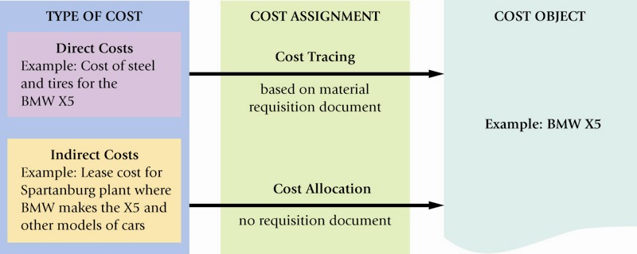
BMW: Assigning Costs to a Cost Object

Slide 7
Cost Examples
Direct Costs
  Parts
  Assembly line wages
Indirect Costs
  Electricity
  Rent
  Property taxes

Slide 8
Factors Affecting Direct / Indirect Cost Classification
Cost Materiality
Availability of information-gathering technology
Operational Design

Slide 9
Cost Behavior
Variable costs – changes in total in proportion to changes in the related level of activity or volume
Fixed costs – remain unchanged in total regardless of changes in the related level of activity or volume
Costs are fixed or variable only with respect to a specific activity or a given time period

Slide 10
Cost Behavior, continued
Variable costs – are constant on a per-unit basis. If a product takes 5 pounds of materials each, it stays the same per unit regardless of one, ten or a thousand units are produced
Fixed costs – change inversely with the level of production. As more units are produced, the same fixed cost is spread over more and more units, reducing the cost per unit

Slide 11
Cost Behavior Summarized
 | Total Dollars | Cost per Unit
Variable Costs | Change in proportion with output More output = More cost
Fixed Costs | Unchanged in relation to output | Change inversely with output More output = lower cost per unit
Total Dollars
Cost Per Unit
Change in proportion with output
More output = More cost
Unchanged in relation to output
Variable Costs
Change inversely with output
More output = lower cost
per unit
Fixed Costs
Unchanged in relation to output

Slide 12
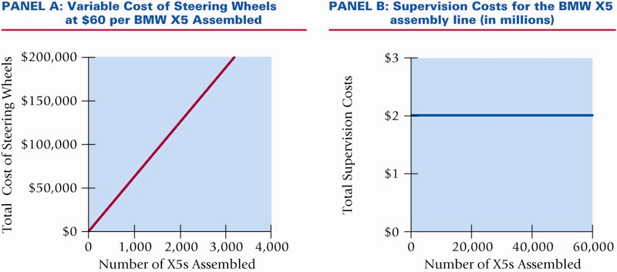
Cost Behavior Visualized

Slide 13
Other Cost Concepts
Cost Driver – a variable that causally affects costs over a given time span
Relevant Range – the band of normal activity level (or volume) in which there is a specific relationship between the level of activity (or volume) and a given cost
  For example, fixed costs are considered fixed only within the relevant range.

Slide 14
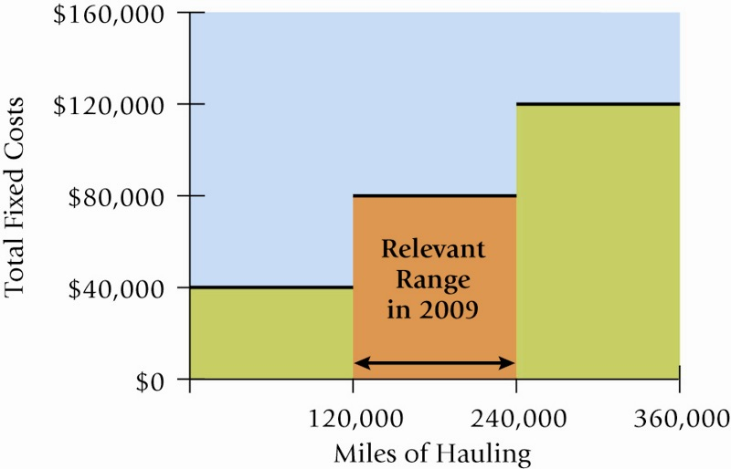
Relevant Range Visualized

Slide 15
A Cost Caveat
Unit costs should be used cautiously. Since unit costs change with a different level of output or volume, it may be more prudent to base decisions on a total dollar basis.
  Unit costs that include fixed costs should always reference a given level of output or activity
  Unit Costs are also called Average Costs

Slide 16
Multiple Classification of Costs
Costs may be classified as:
  Direct / Indirect, and
  Variable / Fixed
These multiple classifications give rise to important cost combinations:
  Direct & Variable
  Direct & Fixed
  Indirect & Variable
  Indirect & Fixed

Slide 17
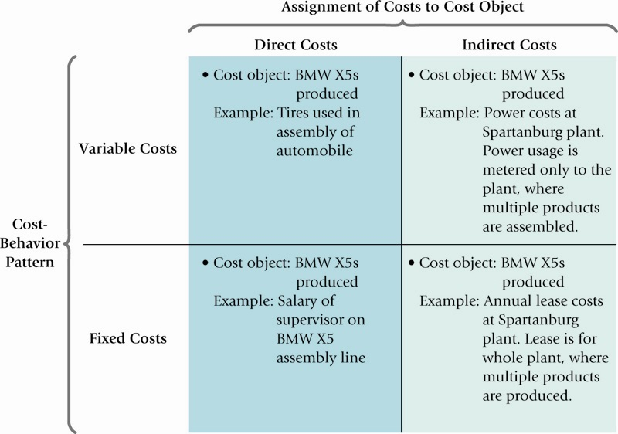
Multiple Classification of Costs, Visualized

Slide 18
Different Types of Firms
Manufacturing-sector companies – create and sell their own products
Merchandising-sector companies – product resellers
Service-sector companies – provide services (intangible products)

Slide 19
Types of Manufacturing Inventories
Direct Materials – resources in-stock and available for use
Work-in-Process (or progress) – products started but not yet completed. Often abbreviated as WIP
Finished Goods – products completed and ready for sale

Slide 20
Types of Product Costs
Also known as Inventoriable Costs
  Direct Materials
  Direct Labor
  Indirect Manufacturing – factory costs that are not traceable to the product. Other common names for this type of cost include Manufacturing Overhead costs or Factory Overhead costs.

Slide 21
Accounting Distinction Between Costs
Inventoriable costs – product manufacturing costs. These costs are capitalized as assets (inventory) until they are sold and transferred to Cost of Goods Sold.
Period costs – have no future value and are expensed as incurred.

Slide 22
Cost Flows
The Cost of Goods Manufactured and the Cost of Goods Sold section of the Income Statement are accounting representations of the actual flow of costs through a production system.
  Note the importance of inventory accounts in the following accounting reports, and in the cost flow chart

Slide 23
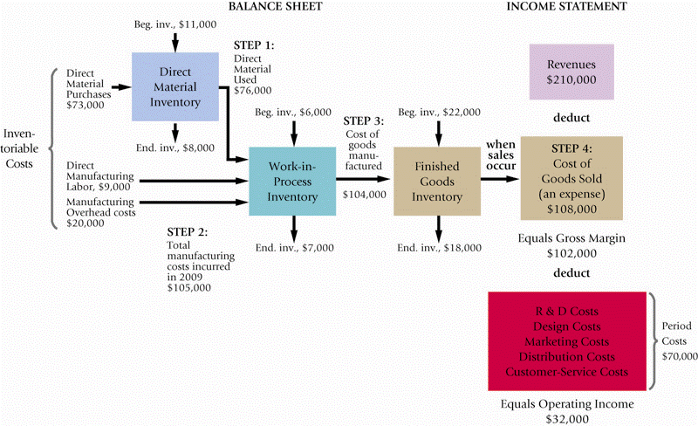
Cost Flows Visualized

Slide 24
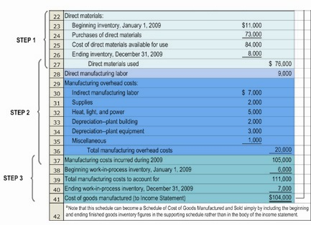
Cost of Goods Manufactured

Slide 25
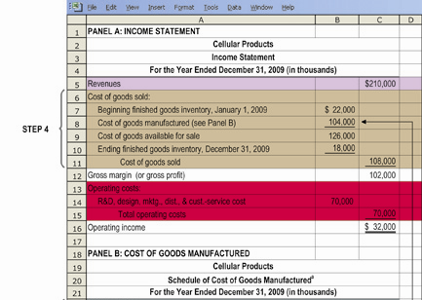
Multiple-Step Income Statement

Slide 26
Other Cost Considerations
Prime cost is a term referring to all direct manufacturing costs (labor and materials)
Conversion cost is a term referring to direct labor and factory overhead costs, collectively
Overtime labor costs are considered part of overhead due to the inability to precisely know the true cause of these costs

Slide 27
Different Definitions of Costs for Different Applications
Pricing and product-mix decisions – may use a “super” cost approach (comprehensive)
Contracting with government agencies – very specific definitions of cost for “cost plus profit” contracts
Preparing external-use financial statements – GAAP-driven product costs only

Slide 28
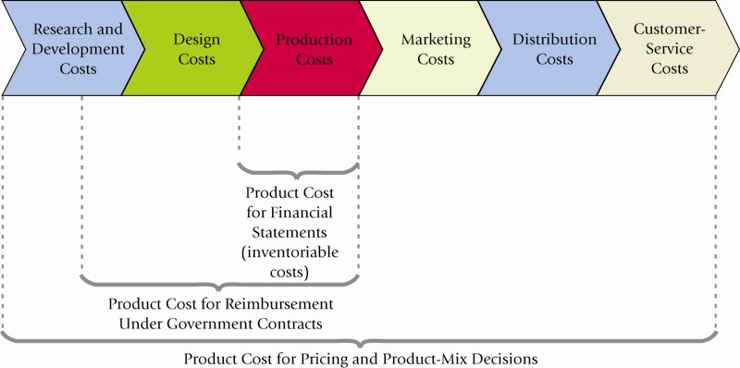
Different Definitions of Costs for Different Applications

Slide 29
Three Common Features of
Cost Accounting & Cost Management
Calculating the cost of products, services, and other cost objects
Obtaining information for planning & control, and performance evaluation
Analyzing the relevant information for making decisions

Slide 30
Cost Categories
Association with cost object
  Cost object is anything for which management wants to collect or accumulate costs
Reaction to changes in activity
Classification on the financial statements

Slide 31
Cost Categories
Association with cost object
  Direct—traceable to a cost object
  Indirect—not conveniently or practically traceable to a cost object
    treated as overhead
    allocated

Slide 32
Cost Categories
Association with cost object
Reaction to changes in activity
  Variable
  Fixed
  Mixed
  Step
Relevant Range—normal operating range

Slide 33
Total and Unit Cost Behavior
Total Cost
Unit Cost
Varies in direct
proportion to
changes in activity
Remains constant
throughout the
relevant range
Variable
Cost
Fixed
Cost
Remains constant
throughout
the relevant range
Varies inversely
with changes in
activity throughout
the relevant range

Slide 34
Cost Categories
Classification on the financial statements
  Unexpired—balance sheet assets
  Expired—income statement expenses
  Product—inventoriable costs
    Prime—direct material and direct labor
    Conversion—direct labor and overhead
    Product costs are unexpired before sale
    Product costs are expired when sold
  Period—expensed in period incurred

Slide 35
Product Costs
Direct material
  Measurable part of a product
Direct labor
  Labor used to manufacture a product or perform a service
Overhead
  Indirect production cost

Slide 36
Period Costs
Selling and administrative costs
Distribution costs
  Cost to warehouse, transport, and/or deliver a product or service
  Major impact on managerial decision making

Slide 37
Conversion Process
Change Inputs into Outputs
Input
Output
Purchase
raw materials
or supplies
Product or
Service
CONVERSION
© 2013 Cengage Learning. All Rights Reserved. May not be scanned, copied, duplicated, or posted to a publicly accessible website, in whole or in part.

Slide 38
Cost Accumulation in a Manufacturing Company
Materials
Inventory
Work in Process
Inventory
Cost of
Goods
Sold
Finished
Goods
Inventory
Income
Statement
Balance Sheet
© 2013 Cengage Learning. All Rights Reserved. May not be scanned, copied, duplicated, or posted to a publicly accessible website, in whole or in part.

Slide 39
Product Cost – Direct
Direct Material
  Conveniently and economically traced
  to cost object
Direct Labor
  to manufacture a product or perform a service
  includes wages paid to direct labor employees, production bonuses, and payroll taxes
  may include holiday and vacation pay, insurance, and retirement benefits

Slide 40
Product Cost – Indirect
Overhead—indirect production costs
  Fringe benefits, if cannot be easily traced to product
  Overtime, if due to random scheduling
  Cost of quality
    Prevention costs
    Appraisal costs
    Failure costs

Slide 41
Product Cost Behavior
Direct Material Variable
Direct Labor Variable
Overhead Variable, fixed, or mixed

Slide 42
Overhead Cost Allocation
Assign indirect costs to one or more cost objects
To determine full absorption cost (GAAP)
To motivate management
To compare alternative courses of action for planning, controlling, and decision making
Allocation process should be rational and systematic

Slide 43
Allocating Overhead
Actual vs. Normal
Product Cost
Direct Materials
Direct Labor
Overhead
Actual Cost System
Actual
Actual
Actual
Normal Cost System
Actual
Actual
Predetermined
Overhead Rate
© 2013 Cengage Learning. All Rights Reserved. May not be scanned, copied, duplicated, or posted to a publicly accessible website, in whole or in part.

Slide 44
Predetermined Overhead Rate
Allows overhead to be assigned
during the period
Compensates for fluctuations
  that are not related to activity level
  in activity level that do not affect fixed overhead

Slide 45
Questions
What is the difference between a fixed and variable cost?
What are the three components of product cost?
What are the three inventory accounts for a manufacturing company?

Slide 46
Ethical Issues
Expired costs—not on the balance sheet
Period costs—not inventory
Product costs—not selling or administrative costs
Direct labor—not overstated
Ending inventory—not overstated

Slide 47
End Of Lecture 2

