Slide 1
Chapter 8-Continued
Lecture 19
Flexible Budget,
Overhead Cost Variances and Management Control
Readings
Chapter 8,Cost Accounting, Managerial Emphasis, 14th edition by Horengren
Chapter 11, Managerial Accounting 12th edition by Garrison, Noreen, Brewer
Chapter 11, Managerial Accounting 6th edition by Weygandt, kimmel, kieso

Slide 2
Learning Objectives
Prepare a flexible budget and explain the advantages of the flexible budget approach over the static budget approach.
Prepare a performance report for both variable and fixed overhead costs using the flexible budget approach.
Use a flexible budget to prepare a variable overhead performance report containing only a spending variance
Use a flexible budget to prepare a variable overhead performance report containing both a spending and an efficiency variance.
Compute the predetermined overhead rate and apply overhead to products in a standard cost system.
Compute and interpret the fixed overhead budget and volume variances.

Slide 3
Variable Overhead Variances –
A Closer Look
If flexible budget
is based on
actual hours
If flexible budget
is based on
standard hours
Only a spending
variance can be
computed.
Both spending
and efficiency
variances can be
computed.
Notes:
When the flexible budget is based on hours of activity, the quantity of hours chosen can be based on actual hours or standard hours allowed for the actual output. If actual hours are used, only a spending variance can be computed. If both the actual and standard hours are used, both a spending and an efficiency variance can be computed.

Slide 4
Variable Overhead Variances – Example
ColaCo’s actual production for the period required 3,200 standard machine hours. Actual variable overhead incurred for the period was $6,740. Actual machine hours worked were 3,300. The standard variable overhead cost per machine hour is $2.00.
Compute the variable overhead spending variance first using actual hours. Then use standard hours allowed to calculate the variable overhead
efficiency variance.
Notes:
We can illustrate the computation of variable overhead spending and efficiency variances with an example. Assume the following:
1. ColaCo’s actual production for the period required 3,200 standard machine hours.
2. Actual variable cost incurred during the period was $6,740.
3. 3,300 machine-hours were actually worked during the period.
4. The standard variable overhead cost per machine hour is $2.00.

Slide 5
Variable Overhead Variances
Actual Flexible Budget
Variable for Variable
Overhead Overhead at
Incurred Actual Hours
AH × AR
AH × SR
AH = Actual hours
AR = Actual variable
overhead rate
SR = Standard variable
overhead rate
Spending Variance
Spending variance = AH(AR – SR)
Notes:
The general model for calculating the variable overhead spending variance is as shown. Notice, actual hours are used instead of standard hours allowed.

Slide 6
Variable Overhead Variances – Example
Actual Flexible Budget
Variable for Variable
Overhead Overhead at
Incurred Actual Hours
3,300 hours
×
$2.00 per hour
= $6,600
$6,740
Spending Variance
= $140 unfavorable
Notes:
In the case of ColaCo, the variable overhead spending variance is $140 unfavorable.

Slide 7
Variable Overhead Variances –A Closer Look
Spending Variance
Results from paying more
or less than expected for
overhead items and from
excessive usage of
overhead items.
Now, let’s use the standard hours allowed, along with the actual hours, to compute the efficiency variance.
Notes:
This variance is useful only to the extent that the cost driver for variable overhead really is the actual machine hours worked. The spending variance may contain both price and quantity components.
The unfavorable variance may be due to the variable overhead items costing
more to purchase than the standards allow.
The unfavorable variance may be due to using more of the variable
overhead items than the standards allow.

Slide 8
Variable Overhead Variances
Actual Flexible Budget Flexible Budget
Variable for Variable for Variable
Overhead Overhead at Overhead at
Incurred Actual Hours Standard Hours
AH × AR
AH × SR
SH × SR
Spending Variance
Efficiency
Variance
Spending variance = AH(AR - SR)
Efficiency variance = SR(AH - SH)
Notes:
The general model for calculating the variable overhead efficiency variance is now shown in addition to the spending variance. Notice that standard hours allowed is used to compute the efficiency variance.

Slide 9
Variable Overhead Variances – Example
Actual Flexible Budget Flexible Budget
Variable for Variable for Variable
Overhead Overhead at Overhead at
Incurred Actual Hours Standard Hours
3,300 hours 3,200 hours
× ×
$2.00 per hour $2.00 per hour
$6,740
$6,600
$6,400
Spending variance
$140 unfavorable
Efficiency variance
$200 unfavorable
$340 unfavorable flexible budget total variance
Notes:
If both actual hours and the standard hours allowed are used (in essence computing two sets of budget allowances), it results in a spending variance of $140 unfavorable, an efficiency variance of $200 unfavorable, and a total variance of $340 unfavorable. Notice that the spending variance has not changed from the prior scenario. Rather, we have just added an efficiency variance.

Slide 10
Variable Overhead Variances –A Closer Look
Efficiency Variance
Controlled by
managing the
overhead cost driver.
Notes:
The efficiency variance is useful only to the extent that the cost driver for variable overhead really is the actual machine hours worked. The efficiency variance estimates the indirect effect on variable overhead costs of inefficiency in the use of the activity base. Therefore, whoever controls the activity base is responsible for this variance.
Next, we will look at two questions that will require us to compute variable overhead spending and efficiency variances.

Slide 11
Quick Check ✓
Yoder Enterprises’ actual production for the period required 2,100 standard direct labor hours. Actual variable overhead for the period was $10,950. Actual direct labor hours worked were 2,050. The predetermined variable overhead rate is $5 per direct labor hour. What was the spending variance?
  a. $450 U
  b. $450 F
  c. $700 F
  d. $700 U
Notes:
Here’s the first question asking us to compute a spending variance.

Slide 12
Quick Check ✓
Spending variance = AH (AR - SR)
= Actual variable overhead incurred – (AH × SR)
= $10,950 – (2,050 hours × $5 per hour)
= $10,950 – $10,250
= $700 U
Yoder Enterprises’ actual production for the period required 2,100 standard direct labor hours. Actual variable overhead for the period was $10,950. Actual direct labor hours worked were 2,050. The predetermined variable overhead rate is $5 per direct labor hour. What was the spending variance?
  a. $450 U
  b. $450 F
  c. $700 F
  d. $700 U
Notes:
The spending variance is the difference between the actual variable overhead incurred and the flexible budget at the actual hours. Actual variable overhead is $10,950. The flexible budget amount is obtained by multiplying the standard rate of $5.00 per hour times 2,050 actual hours.

Slide 13
Quick Check ✓
Yoder Enterprises’ actual production for the period required 2,100 standard direct labor hours. Actual variable overhead for the period was $10,950. Actual direct labor hours worked were 2,050. The predetermined variable overhead rate is $5 per direct labor hour. What was the efficiency variance?
  a. $450 U
  b. $450 F
  c. $250 F
  d. $250 U
Notes:
Here’s the second question asking us to compute an efficiency variance.

Slide 14
Quick Check ✓
Yoder Enterprises’ actual production for the period required 2,100 standard direct labor hours. Actual variable overhead for the period was $10,950. Actual direct labor hours worked were 2,050. The predetermined variable overhead rate is $5 per direct labor hour. What was the efficiency variance?
  a. $450 U
  b. $450 F
  c. $250 F
  d. $250 U
Efficiency variance = SR (AH – SH)
= $5 per hour (2,050 hours – 2,100 hours)
= $250 F
Notes:
The variable overhead efficiency variance is found by multiplying the standard variable overhead rate of $5.00 per hour times the difference between 2,050 actual hours and 2,100 standard hours. Since actual hours are less than standard hours, the efficiency variance is favorable.

Slide 15
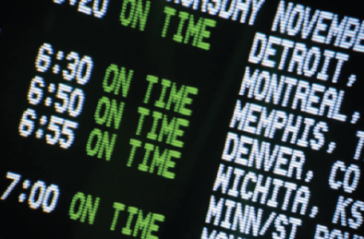
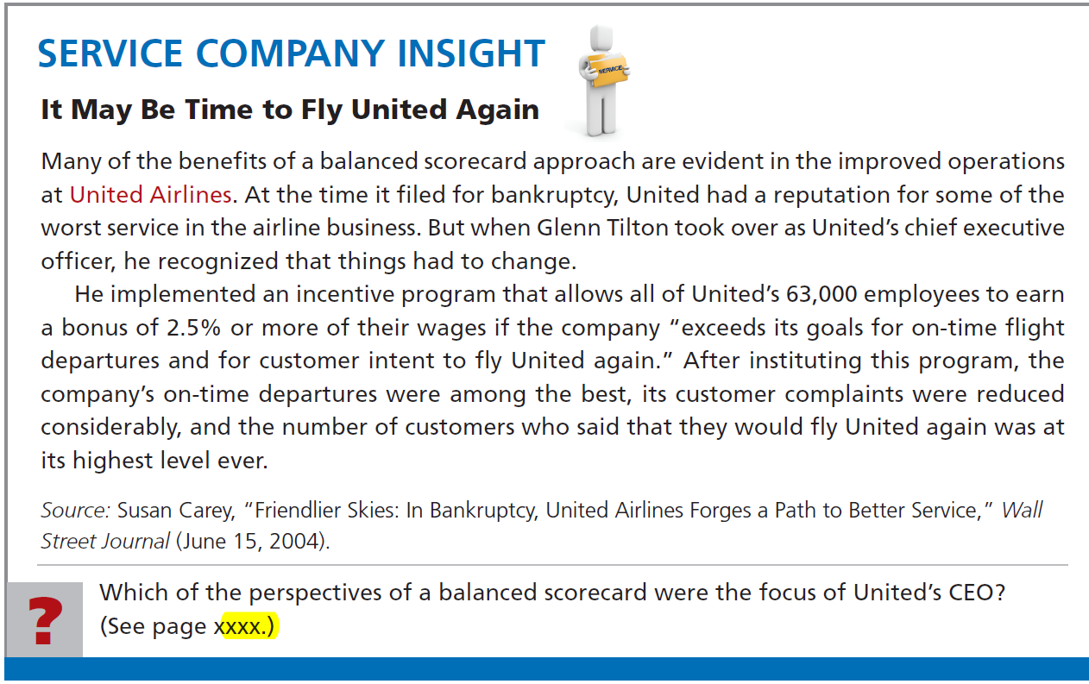

Slide 16
Quick Check Summary
Actual Flexible Budget Flexible Budget
Variable for Variable for Variable
Overhead Overhead at Overhead at
Incurred Actual Hours Standard Hours
2,050 hours 2,100 hours
× ×
$5 per hour $5 per hour
$10,950
$10,250
$10,500
Spending variance
$700 unfavorable
Efficiency variance
$250 favorable
$450 unfavorable flexible budget total variance
Notes:
Here we see a summary of our computations from the previous two questions in a convenient three-column format. The total variable overhead variance is the combination of the spending variance and the efficiency variance, $450 unfavorable.

Slide 17

Activity-based Costing and the Flexible Budget
It is unlikely that all
variable overhead will be
driven by a single activity.
Activity-based costing
can be used when multiple
activity bases drive
variable overhead costs.
Notes:
It is unlikely that all variable overhead costs within a company are driven by a single factor such as the number of units produced, labor hours, or machine hours. Activity-based costing offers a way to recognize the presence of more than one activity base within a company. It enables a company to evaluate overhead spending for each activity cost pool that has its own respective activity measure.

Slide 18
Overhead Rates and Overhead Analysis
Recall that overhead costs are assigned to products and services using a predetermined overhead rate (POHR):
Assigned Overhead = POHR × Standard Activity
Overhead from the
flexible budget for the
denominator level of activity
POHR =
Denominator level of activity
Notes:
Overhead costs are assigned to products using a predetermined overhead rate. The estimated total units in the base of the rate is called the denominator activity.

Slide 19
Overhead Rates and Overhead Analysis
The predetermined overhead rate
can be broken down into fixed
and variable components.
The variable
component is useful
for preparing and analyzing
variable overhead
variances.
The fixed
component is useful
for preparing and analyzing
fixed overhead
variances.
Notes:
The predetermined overhead rate can be broken down into variable and fixed components. As we have seen, the variable component is useful in preparing variable overhead variances. As will be shown shortly, the fixed component is useful in preparing fixed overhead variances.

Slide 20


Normal versus Standard Cost Systems
In a normal cost
system, overhead is
applied to work in
process based on
the actual number
of hours worked
in the period.
In a standard cost
system, overhead is
applied to work in
process based on
the standard hours
allowed for the actual
output of the period.
Notes:
In a normal cost system (as discussed in Chapter 3), overhead is applied to work in process on the basis of the actual number of hours worked. In a standard cost system, overhead is applied to work in process based on the standard hours allowed for the actual output of the period.

Slide 21
Fixed Overhead Variances
Actual Fixed Fixed Fixed
Overhead Overhead Overhead
Incurred Budget Applied
DH × FR
SH × FR
Budget Variance
Volume
Variance
FR = Standard Fixed Overhead Rate
SH = Standard Hours Allowed
DH = Denominator Hours
Notes:
Here we see the general model for computing fixed overhead variances. The budget variance is the actual fixed overhead cost minus the budgeted fixed overhead cost. The volume variance is budgeted fixed overhead minus the fixed overhead applied to production. In equation form, it can be computed by multiplying the fixed portion of the predetermined overhead rate by the difference between the denominator hours and the standard hours allowed.

Slide 22
Overhead Rates and Overhead
Analysis – Example
ColaCo prepared this budget for overhead:
Total
Variable
Total
Fixed
Machine
Variable
Overhead
Fixed
Overhead
Hours
Overhead
Rate
Overhead
Rate
3,000
$
6,000
?
$
9,000
?
4,000
8,000
?
9,000
?
Let’s calculate overhead rates.
ColaCo applies overhead based
on machine-hour activity.
Notes:
ColaCo prepared a flexible budget for overhead at two levels of activity, 3,000 and 4,000 machine hours. Its total variable and fixed overhead at these two activity levels is as shown. Notice that total variable overhead increases when activity increases, while total fixed overhead is the same at both levels of activity.

Slide 23
Overhead Rates and Overhead
Analysis – Example
ColaCo prepared this budget for overhead:
Total
Variable
Total
Fixed
Machine
Variable
Overhead
Fixed
Overhead
Hours
Overhead
Rate
Overhead
Rate
3,000
$
6,000
$
2.00
$
9,000
?
4,000
8,000
2.00
9,000
?
Rate = Total Variable Overhead ÷ Machine Hours
This rate is constant at all levels of activity.
Notes:
We calculate the variable overhead rate by dividing total variable overhead by the activity in machine hours. The variable overhead rate is constant at $2.00 per machine hour. Notice that this rate agrees with the standard variable overhead cost per machine hour that was previously used in the variable overhead portion of this example.

Slide 24
Overhead Rates and Overhead
Analysis – Example
ColaCo prepared this budget for overhead:
Total
Variable
Total
Fixed
Machine
Variable
Overhead
Fixed
Overhead
Hours
Overhead
Rate
Overhead
Rate
3,000
$
6,000
$
2.00
$
9,000
$
3.00
4,000
8,000
2.00
9,000
2.25
Rate = Total Fixed Overhead ÷ Machine Hours
This rate decreases when activity increases.
Notes:
We calculate the fixed overhead rate by dividing total fixed overhead by the activity in machine hours. The fixed overhead rate is $3.00 per machine hour at an activity level of 3,000 machine hours, and it is $2.25 at an activity level of 4,000 machine hours. Notice, the fixed overhead rate decreases as the activity level increases.

Slide 25
Overhead Rates and Overhead
Analysis – Example
ColaCo prepared this budget for overhead:
Total
Variable
Total
Fixed
Machine
Variable
Overhead
Fixed
Overhead
Hours
Overhead
Rate
Overhead
Rate
3,000
$
6,000
$
2.00
$
9,000
$
3.00
4,000
8,000
2.00
9,000
2.25
The total POHR is the sum of
the fixed and variable rates
for a given activity level.
Notes:
The total predetermined overhead rate at either activity level is the sum of the variable and fixed overhead rates.

Slide 26

Fixed Overhead Variances – Example
ColaCo’s actual production required 3,200
standard machine hours. Actual fixed overhead was $8,450. The predetermined overhead rate is based on 3,000 machine hours.
Notes:
Because the fixed overhead rate differs at different activity levels, an activity level must be chosen. ColaCo decided to base its predetermined overhead rate on 3,000 machine hours. It required 3,200 standard machine hours to meet its actual production requirements. The company incurred actual fixed overhead costs of $8,450.

Slide 27
Overhead Variances
Now let’s turn our attention to calculating fixed overhead variances.
Notes:
Now, let’s focus on the computations for fixed overhead variances.

Slide 28
Fixed Overhead Variances – Example
Actual Fixed Fixed Fixed
Overhead Overhead Overhead
Incurred Budget Applied
$8,450
$9,000
Budget variance
$550 favorable
Notes:
The budget variance of $550 favorable is computed by comparing the actual fixed overhead incurred ($8,450) to the budgeted fixed overhead ($9,000).

Slide 29
Fixed Overhead Variances –A Closer Look
Budget Variance
Results from spending
more or less than
expected for fixed
overhead items.
Now, let’s use the standard hours allowed to compute the fixed overhead volume variance.
Notes:
This variance represents the difference between how much should have been spent and how much was actually spent. A favorable (unfavorable) variance results when actual spending is less (more) than the budget.

Slide 30
Fixed Overhead Variances – Example
Actual Fixed Fixed Fixed
Overhead Overhead Overhead
Incurred Budget Applied
SH × FR
3,200 hours
×
$3.00 per hour
$8,450
$9,000
$9,600
Budget variance
$550 favorable
Volume variance
$600 favorable
Notes:
The volume variance of $600 favorable is computed by comparing the budgeted fixed overhead ($9,000) to the fixed overhead applied ($9,600). Since the budgeted fixed overhead is less than the applied fixed overhead, the volume variance is favorable.

Slide 31
Volume Variance – A Closer Look
Volume
Variance
Results when standard hours
allowed for actual output differs
from the denominator activity.
Unfavorable
when standard hours
< denominator hours
Favorable
when standard hours
> denominator hours
Notes:
The fixed overhead applied is computed by multiplying the standard hours allowed for the actual output (3,200 hours) by the fixed portion of the predetermined overhead rate ($3.00).
A favorable (unfavorable) variance results when the denominator activity is less (greater) than the standard hours allowed for the output of the period.

Slide 32
Volume Variance – A Closer Look
Volume
Variance
Does not measure over-
or under spending
Results when standard hours
allowed for actual output differs
from the denominator activity.
It results from treating fixed
overhead as if it were a
variable cost.
Unfavorable
when standard hours
< denominator hours
Favorable
when standard hours
> denominator hours
Notes:
The volume variance does not measure over-or under-spending. It is a measure of utilization of facilities. In essence, this variance variance is the error that occurs as a result of treating fixed overhead as though it were a variable cost.
Next, we will look at two questions that will require us to compute fixed overhead budget and volume variances.

Slide 33
Quick Check ✓
Yoder Enterprises’ actual production for the period required 2,100 standard direct labor hours. Actual fixed overhead for the period was $14,800. The budgeted fixed overhead was $14,450. The predetermined fixed overhead rate was $7 per direct labor hour. What was the budget variance?
  a. $350 U
  b. $350 F
  c. $100 F
  d. $100 U
Notes:
Here’s the first question asking us to compute a fixed overhead budget variance.

Slide 34
Quick Check ✓
Budget variance
= Actual fixed overhead – Budgeted fixed overhead
= $14,800 – $14,450
= $350 U
Yoder Enterprises’ actual production for the period required 2,100 standard direct labor hours. Actual fixed overhead for the period was $14,800. The budgeted fixed overhead was $14,450. The predetermined fixed overhead rate was $7 per direct labor hour. What was the budget variance?
  a. $350 U
  b. $350 F
  c. $100 F
  d. $100 U
Notes:
The fixed overhead budget variance is the difference between $14,800 of actual fixed overhead incurred and the $14,450 fixed overhead budget. Since the actual fixed overhead is greater than the budget for fixed overhead, the budget variance is unfavorable.

Slide 35
Quick Check ✓
Yoder Enterprises’ actual production for the period required 2,100 standard direct labor hours. Actual fixed overhead for the period was $14,800. The budgeted fixed overhead was $14,450. The predetermined fixed overhead rate was $7 per direct labor hour. What was the volume variance?
  a. $250 U
  b. $250 F
  c. $100 F
  d. $100 U
Notes:
Here’s the second question asking us to compute a fixed overhead volume variance.

Slide 36
Quick Check ✓
Volume variance
= Budgeted fixed overhead – (SH × FR)
= $14,450 – (2,100 hours × $7 per hour)
= $14,450 – $14,700
= $250 F
Yoder Enterprises’ actual production for the period required 2,100 standard direct labor hours. Actual fixed overhead for the period was $14,800. The budgeted fixed overhead was $14,450. The predetermined fixed overhead rate was $7 per direct labor hour. What was the volume variance?
  a. $250 U
  b. $250 F
  c. $100 F
  d. $100 U
Notes:
The volume variance is the difference between the $14,450 fixed overhead budget and the $14,700 of fixed overhead applied to production. The fixed overhead applied is computed by multiplying the 2,100 standard hours allowed times the $7.00 fixed portion of the predetermined overhead rate. Since the budgeted fixed overhead is less than the applied fixed overhead, the volume variance is favorable.

Slide 37
Quick Check Summary
Actual Fixed Fixed Fixed
Overhead Overhead Overhead
Incurred Budget Applied
SH × FR
2,100 hours
×
$7.00 per hour
$14,800
$14,450
$14,700
Budget variance
$350 unfavorable
Volume variance
$250 favorable
Notes:
Here we see a summary of our computations from the previous two questions in a convenient three-column format. The total fixed overhead variance is the combination of the unfavorable budget variance and the favorable volume variance, $100 unfavorable.

Slide 38
Fixed Overhead Variances –
A Graphic Approach
Let’s look at a graph showing fixed overhead variances. We will use ColaCo’s numbers from the previous example.
Notes:
Often it’s helpful to look at the fixed overhead relationships in graphical form. We will use the ColaCo data from the previous example for our graphical approach.

Slide 39
Fixed Overhead Variances –
A Graphic Approach
Cost
$9,000 budgeted fixed OH
Fixed overhead
applied to products
Activity
3,000 Hours Expected
Activity
Notes:
The vertical axis is used to graph fixed overhead cost. The first cost that ColaCo would plot on this axis is $9,000 of budgeted fixed overhead.
The horizontal axis is used to graph the volume of activity. The first activity level that ColaCo would plot is its denominator activity level of 3,000 machine hours.
The linear manner in which fixed overhead is applied to products is depicted by drawing a straight line from the origin to the intersection of the budgeted fixed overhead ($9,000) and the denominator activity (3,000 hours). The slope of this line indicates that fixed overhead is applied at a rate of $3.00 per machine hour.

Slide 40
Fixed Overhead Variances –
A Graphic Approach
Cost
$9,000 budgeted fixed OH
{
$8,450 actual fixed OH
$550
Favorable
Budget Variance
$8,450 actual fixed OH
Fixed overhead
applied to products
Activity
3,000 Hours Expected
Activity
Notes:
Next, plot the actual amount of fixed overhead costs on the vertical axis. The broken horizontal line below the budgeted fixed overhead represents the $8,450 of actual fixed manufacturing overhead. The vertical distance between the budgeted fixed overhead line and the actual fixed overhead line represents the fixed overhead budget variance of $550. Since the actual fixed overhead is less than the budgeted fixed overhead, the fixed overhead budget variance is favorable.

Slide 41
Fixed Overhead Variances –
A Graphic Approach
3,200 machine hours × $3.00 fixed overhead rate
Cost
$600
Favorable
Volume Variance
$9,600 applied fixed OH
{
$9,000 budgeted fixed OH
{
$8,450 actual fixed OH
$550
Favorable
Budget Variance
$8,450 actual fixed OH
Fixed overhead
applied to products
Activity
3,000 Hours Expected
Activity
3,200 Standard
Hours
Notes:
Finally, identify the standard hours allowed for the actual level of output (3,200 hours) on the horizontal axis. Draw a vertical line from this activity level until it intersects the sloped line that depicts the fixed overhead applied to products. From this point, draw a horizontal line that intersects the vertical axis. This dollar amount ($9,600) represents the fixed overhead applied.
The vertical distance between the budgeted fixed overhead line and the applied fixed overhead line represents the fixed overhead volume variance of $600. Since the budgeted fixed overhead is less than the applied fixed overhead, the volume variance is favorable.

Slide 42
Overhead Variances and Under- or Overapplied Overhead Cost
In a standard
cost system:
Unfavorable
variances are equivalent
to underapplied overhead.
Favorable
variances are equivalent
to overapplied overhead.
The sum of the overhead variances
equals the under- or overapplied
overhead cost for a period.
Notes:
In a standard cost system, the sum of the overhead variances equals the under-or overapplied overhead cost for a period. Unfavorable variances are equivalent to underapplied overhead. Favorable variances are equivalent to overapplied overhead.

Slide 43
Standard cost accounting system
A standard cost accounting system is a double-entry system of accounting. Companies may use a standard cost system with either
  job order or
  process costing.
The system is based on two important assumptions:
  Variances from standards are recognized at the earliest opportunity.
  The Work in Process account is maintained exclusively on the basis of standard costs.

Slide 44
Standard cost accounting system
Illustration: 1. Purchase raw materials on account for $13,020 when the standard cost is $12,600.
Raw materials inventory 12,600
Materials price variance 420
Accounts payable 13,020
2. Incur direct labor costs of $31,080 when the standard labor cost is $31,500.
Factory labor 31,500
Labor price variance 420
Wages payable 31,080

Slide 45
Standard cost accounting system
3. Incur actual manufacturing overhead costs of $10,900.
Manufacturing overhead 10,900
Accounts payable/Cash/Acc. Deprec. 10,900
4. Issue raw materials for production at a cost of $12,600 when the standard cost is $12,000.
Work in process inventory 12,000
Materials quantity variance 600
Raw materials inventory 12,600

Slide 46
Standard cost accounting system
5. Assign factory labor to production at a cost of $31,500 when standard cost is $30,000.
Work in process inventory 30,000
Labor quantity variance 1,500
Factory labor 31,500
6. Applying manufacturing overhead to production $10,000.
Work in process inventory 10,000
Manufacturing overhead 10,000

Slide 47
Standard cost accounting system
7. Transfer completed work to finished goods $52,000.
Finished goods inventory 52,000
Work in process inventory 52,000
8. The 1,000 gallons of Xonic Tonic are sold for $70,000.
Accounts receivable 70,000
Cost of goods sold 52,000
Sales 60,000
Finished goods inventory 52,000

Slide 48
Standard cost accounting system
9. Recognize unfavorable total overhead variance:
Overhead variance 900
Manufacturing overhead 900

Slide 49
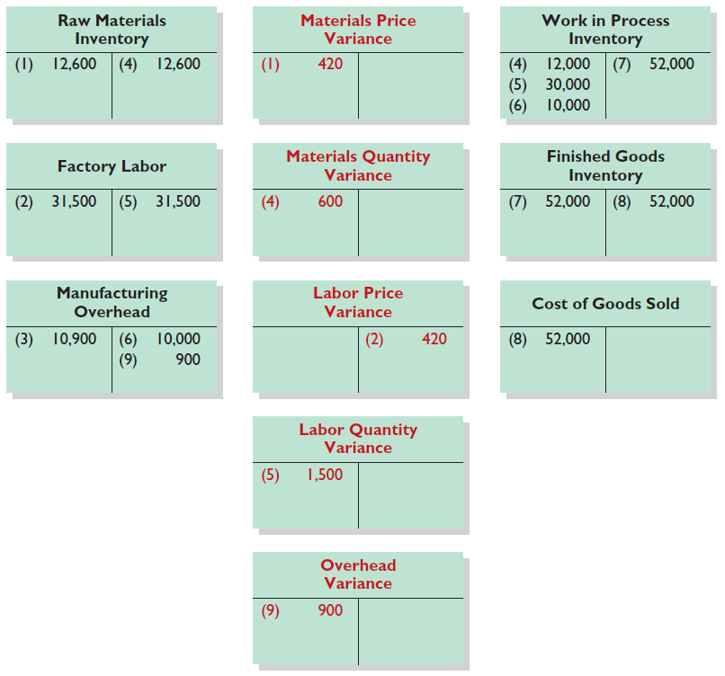
Standard Cost Accounting System

Slide 50
Closer look at overhead variances
The overhead variance is generally analyzed through a price variance and a quantity variance.
  Overhead controllable variance (price variance) shows whether overhead costs are effectively controlled.
  Overhead volume variance (quantity variance) relates to whether fixed costs were under- or over-applied during the year.

Slide 51
Closer look at overhead variances
Overhead Controllable Variance
The overhead controllable variance shows whether overhead costs are effectively controlled.
To compute this variance, the company compares actual overhead costs incurred with budgeted costs for the standard hours allowed.
The budgeted costs are determined from a flexible manufacturing overhead budget.

Slide 52
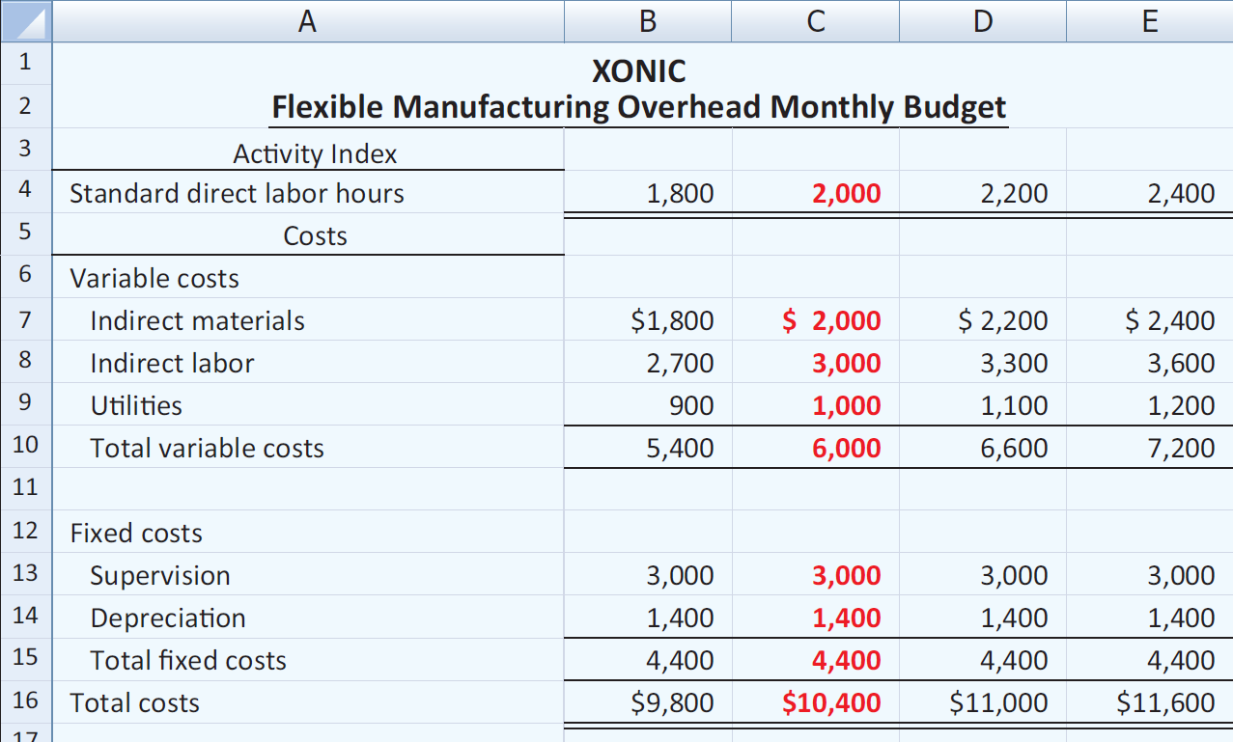
Closer look at overhead variances
For Xonic the budget formula for manufacturing overhead is variable manufacturing overhead cost of $3 per hour of labor plus fixed manufacturing overhead costs of $4,400.

Slide 53
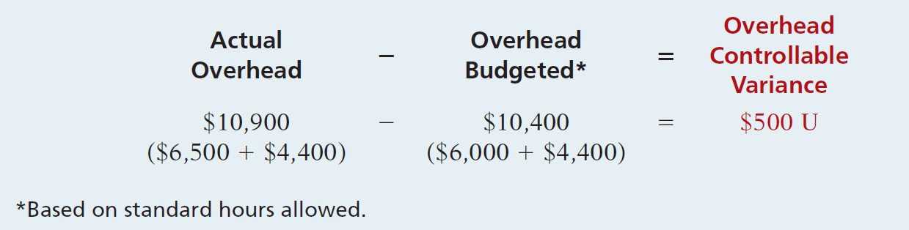
Closer look at overhead variances
Overhead Controllable Variance
Illustration 11B-2 shows the formula for the overhead controllable variance and the calculation for Xonic, Inc.

Slide 54
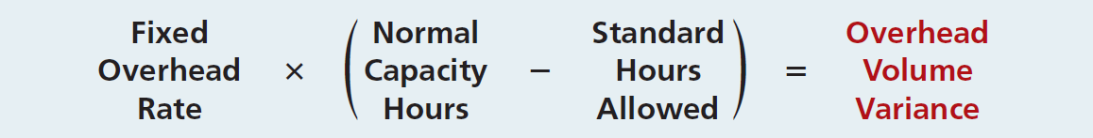
Closer look at overhead variances
Overhead Volume Variance
Difference between normal capacity hours and standard hours allowed times the fixed overhead rate.

Slide 55
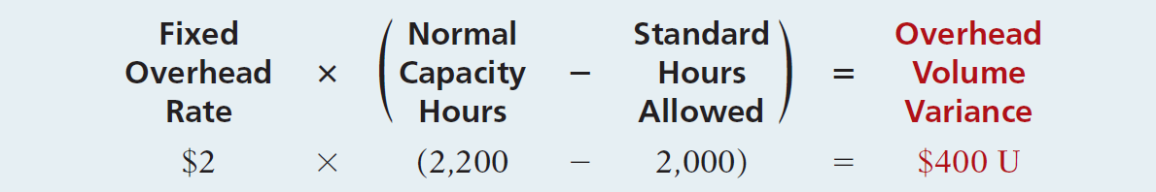
Closer look at overhead variances
Illustration: Xonic Inc. budgeted fixed overhead cost for the year of $52,800. At normal capacity, 26,400 standard direct labor hours are required. Xonic produced 1,000 units of Xonic Tonic in June. The standard hours allowed for the 1,000 gallons produced in June is 2,000 (1,000 gallons x 2 hours). For Xonic, standard direct labor hours for June at normal capacity is 2,200 (26,400 annual hours ÷ 12 months). The computation of the overhead volume variance in this case is as follows.

Slide 56
Closer look at overhead variances
In computing the overhead variances, it is important to remember the following.
  Standard hours allowed are used in each of the variances.
  Budgeted costs for the controllable variance are derived from the flexible budget.
  The controllable variance generally pertains to variable costs.
  The volume variance pertains solely to fixed costs.

Slide 57
End of Lecture 19
Notes:
End of Chapter 11.

