Slide 1
Chapter 8
Lecture 18
Flexible Budget,
Overhead Cost Variances and Management Control
Readings
Chapter 8,Cost Accounting, Managerial Emphasis, 14th edition by Horengren
Chapter 11, Managerial Accounting 12th edition by Garrison, Noreen, Brewer
Chapter 11, Managerial Accounting 6th edition by Weygandt, kimmel, kieso

Slide 2
Learning Objectives
Prepare a flexible budget and explain the advantages of the flexible budget approach over the static budget approach.
Prepare a performance report for both variable and fixed overhead costs using the flexible budget approach.
Use a flexible budget to prepare a variable overhead performance report containing only
a spending variance
Use a flexible budget to prepare a variable overhead performance report containing both a spending and an efficiency variance.
Compute the predetermined overhead rate and apply overhead to products in a standard cost system.
Compute and interpret the fixed overhead budget and volume variances.

Slide 3
Planning and Overhead
Variable Overhead: as efficiently as possible, plan only essential activities
Fixed Overhead: as efficiently as possible, plan only essential activities, especially since fixed costs are predetermined well before the budget period begins

Slide 4
Standard Costing
Traces direct costs to output by multiplying the standard prices or rate by the standard quantities of inputs allowed for actual outputs produced
Allocates overhead costs on the basis of the standard overhead-cost rates time the standard quantities of the allocation bases allowed for the actual outputs produced

Slide 5
A Roadmap: Variable Overhead

Slide 6
A Roadmap: Fixed Overhead

Slide 7
Overhead Variances
Overhead is the most difficult cost to manage, and is the least understood
Overhead variances involve taking differences between equations as the analysis moves back and forth between actual results and budgeted amounts

Slide 8
Developing Budgeted Variable Overhead Cost Rates
Choose the period to be used for the budget
Select the cost-allocation bases to use in allocating variable overhead costs to output produced
Identify the variable overhead costs associated with each cost-allocation base
Compute the rate per unit of each cost-allocation base used to allocate variable overhead costs to output produced

Slide 9
The Details: Variable OH Variances
Variable Overhead Flexible-Budget Variance measures the difference between actual variable overhead costs incurred and flexible-budget variable overhead amounts

Slide 10
The Details: Variable OH Variances
Variable Overhead Efficiency Variance is the difference between actual quantity of the cost-allocation base used and budgeted quantity of the cost per unit of the cost-allocation base

Slide 11
The Details: Variable OH Variances
Variable Overhead Spending Variance is the difference between actual and budgeted variable overhead cost per unit of the cost-allocation base, multiplied by actual quantity of variable overhead cost-allocation based used for actual output

Slide 12
Developing Budgeted Fixed Overhead Cost Rates
Choose the period to be used for the budget
Select the cost-allocation bases to use in allocating fixed overhead costs to output produced
Identify the fixed overhead costs associated with each cost-allocation base
Compute the rate per unit of each cost-allocation base used to allocate fixed overhead costs to output produced

Slide 13
The Details: Fixed OH Variances
Fixed Overhead Flexible-Budget Variance is the difference between actual fixed overhead costs and fixed overhead costs in the flexible budget
This is the same amount for the Fixed Overhead Spending Variance

Slide 14
The Details: Fixed OH Variances
Production-Volume Variance is the difference between budgeted fixed overhead and fixed overhead allocated on the basis of actual output produced
This variance is also known as the Denominator-Level Variance or the Output-Level Overhead Variance

Slide 15
Production-Volume Variance
Interpretation of this variance is difficult due to the nature of the costs involved and how they are budgeted
Fixed costs are by definition somewhat inflexible. While market conditions may cause production to flex up or down, the associated fixed costs remain the same
Fixed costs may be set years in advance, and may be difficult to change quickly
Contradiction: Despite this, examination of the fixed overhead budget formulae reveals that it is budgeted similar to a variable cost

Slide 16
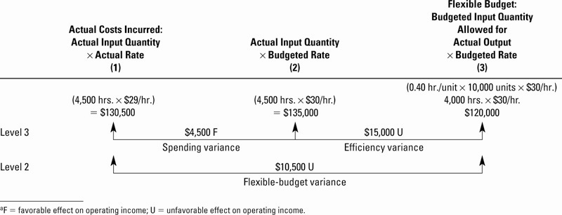
Variable Overhead
Variance Analysis Illustrated

Slide 17
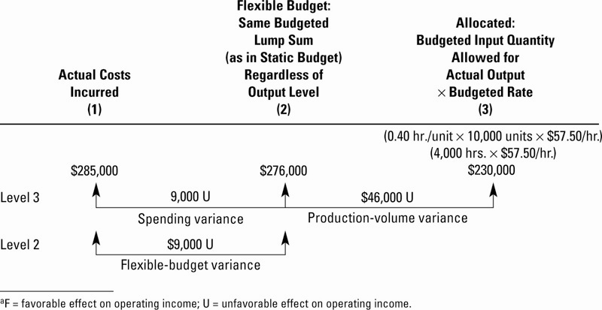
Fixed Overhead
Variance Analysis Illustrated

Slide 18
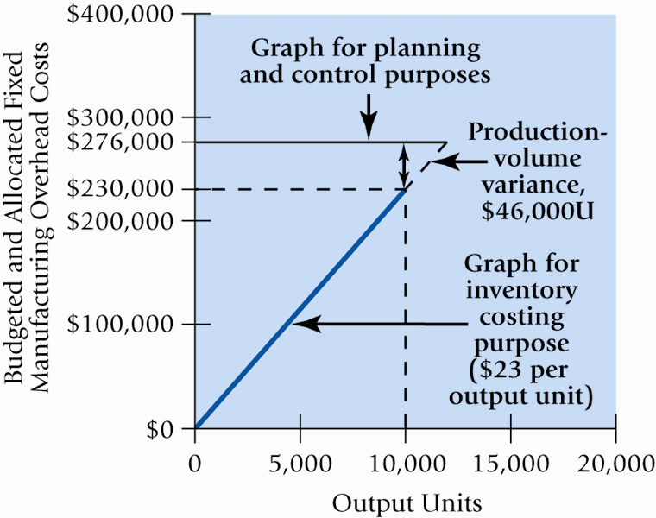
Fixed Overhead Behavior

Slide 19
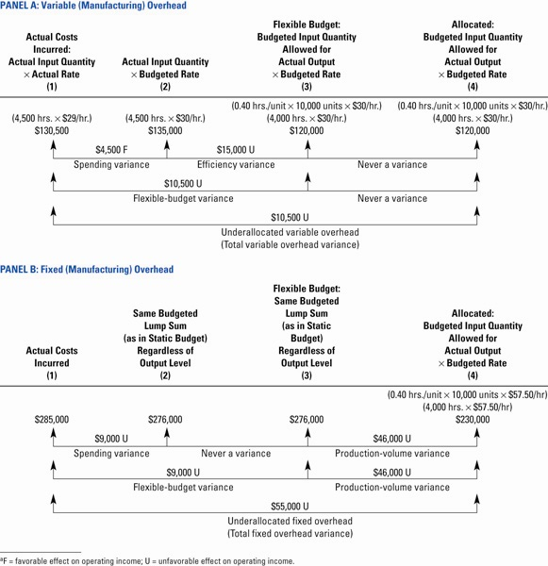
Integrated
Variance
Analysis
Illustrated

Slide 20
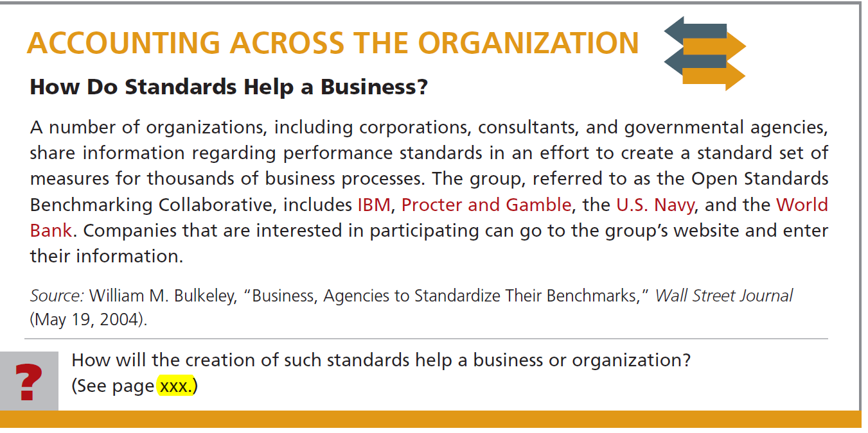
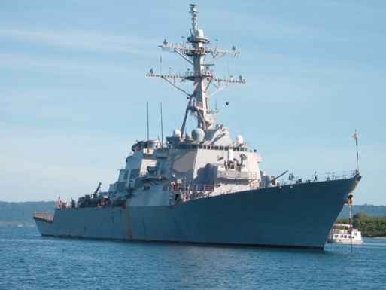

Slide 21

Static Budgets and Performance Reports
Hmm! Comparing
static budgets with
actual costs is like
comparing apples
and oranges.
Static budgets
are prepared for
a single, planned
level of activity.
Performance evaluation is difficult when actual activity differs from the planned level of activity.
Notes:
A static budget is prepared at the beginning of the budgeting period and is valid for only the planned level of activity. It is suitable for planning, but it is inadequate for evaluating how well costs are controlled because the actual level of activity is unlikely to equal the planned level of activity, thus resulting in “apples-to-oranges” cost comparisons.

Slide 22
Flexible Budgets
May be prepared for any activity
level in the relevant range.
Show costs that should have been
incurred at the actual level of
activity, enabling “apples to apples”
cost comparisons.
Reveal variances related to
cost control.
Improve performance evaluation.
Let’s look at CheeseCo.
Notes:
A flexible budget provides estimates of what costs should be for any level of activity, within a specified range. When used for performance evaluation purposes, actual costs are compared to what the costs should have been for the actual level of activity during the period. This enables “apples-to-apples” cost comparisons.

Slide 23
Static Budgets and Performance Reports
CheeseCo
Notes:
Assume that CheeseCo prepared the static budget as shown. Notice that the budget is based on an activity level of 10,000 machine hours.

Slide 24
Static Budgets and Performance Reports
CheeseCo
Notes:
Assume that the actual results for the period were as shown. Notice that only 8,000 machine hours were actually worked, thus resulting in “apples-to-oranges” comparisons with the static budget.

Slide 25
Static Budgets and Performance Reports
CheeseCo
U = Unfavorable variance CheeseCo was unable to achieve the budgeted level of activity.
Notes:
The variances between the static budget and actual results would be as shown. Notice that the machine hour variance is 2,000 unfavorable because CheeseCo was unable to achieve the budgeted level of activity.

Slide 26
Static Budgets and Performance Reports
CheeseCo
F = Favorable variance that occurs when actual costs are less than budgeted costs.
Notes:
All of the variable manufacturing overhead variances are favorable because the actual costs are less than the budgeted costs.

Slide 27
Static Budgets and Performance Reports
CheeseCo
Since cost variances are favorable, have
we done a good job controlling costs?
Notes:
These favorable variances beg the question – Has CheeseCo done a good job of controlling costs?

Slide 28
Static Budgets and Performance Reports
I don’t think I
can answer the
question using
a static budget.
Actual activity is below
budgeted activity.
So, shouldn’t variable costs
be lower if actual activity
is lower?
Notes:
The answer is unclear because the actual activity level (8,000 machine hours) does not equal the budgeted activity level (10,000 machine hours).

Slide 29
Static Budgets and Performance Reports
The relevant question is . . .
  “How much of the favorable cost variance is due to lower activity, and how much is due to good cost control?”
To answer the question,
we must
the budget to the
actual level of activity.
Notes:
This raises an additional question, namely – How much of the favorable cost variance is due to lower activity, and how much is due to good cost control? To answer this question, we must “flex” the budget.

Slide 30
Preparing a Flexible Budget
To a budget we need to know that:
  Total variable costs change
  in direct proportion to
  changes in activity.
  Total fixed costs remain
  unchanged within the
  relevant range.
Variable
Fixed
Notes:
Flexing a budget involves two key assumptions about cost behavior:
Total variable costs change in direct proportion to changes in activity; and
Total fixed costs remain unchanged within a specified activity range.

Slide 31
Preparing a Flexible Budget
Let’s prepare
budgets
for CheeseCo.
Notes:
Let’s continue the CheeseCo example by preparing flexible budgets at several different levels of activity.

Slide 32
Preparing a Flexible Budget
CheeseCo
Variable costs are expressed as a constant amount per hour.
$40,000 ÷ 10,000 hours is
$4.00 per hour.
Fixed costs are
expressed as a
total amount.
Notes:
The key to preparing a flexible budget is to specify the amount of each variable cost per unit of activity. Notice that indirect labor is $4.00 per machine hour, indirect material is $3.00 per machine hour, and power is $0.50 per machine hour. We can verify these numbers by dividing the total cost according to the static budget by the total amount of the activity per the static budget.
While variable costs are expressed per unit of activity, fixed costs are not. They are expressed as a total amount.

Slide 33
Preparing a Flexible Budget
CheeseCo
$4.00 per hour × 8,000 hours = $32,000
Notes:
The flexible budget for an activity level of 8,000 machine hours would be prepared by multiplying the cost per hour for each type of variable cost by the activity level of 8,000 hours. In the case of indirect labor, multiply $4.00 per hour by 8,000 hours to yield a budgeted amount of $32,000.

Slide 34
Preparing a Flexible Budget
CheeseCo
Notes:
Add the fixed costs, which remain unchanged, to yield a total overhead of $74,000.

Slide 35
Preparing a Flexible Budget
CheeseCo
Total fixed costs
do not change in
the relevant range.
Notes:
The flexible budget at 10,000 hours of activity is $89,000. This equals the amount from the static budget that was presented earlier in this example. Notice that the total variable costs changed (compared to the flexible budget at 8,000 hours), while the total fixed costs did not change.
Can you prepare a flexible budget for 12,000 machine hours? The question on the following screen will ask you to do that.

Slide 36
Quick Check ✓
What should be the total overhead costs for the Flexible Budget at 12,000 hours?
  a. $92,500.
  b. $89,000.
  c. $106,800.
  d. $104,000.
Notes:
Here’s the question. You can compute the total overhead amount directly, or you can flex the budget to 12,000 machine hours and sum the amounts to get the total overhead costs for 12,000 hours.

Slide 37
Quick Check ✓
What should be the total overhead costs for the Flexible Budget at 12,000 hours?
  a. $92,500.
  b. $89,000.
  c. $106,800.
  d. $104,000.
Total overhead cost
= $14,000 + $7.50 per hour × 12,000 hours
= $14,000 + $90,000 = $104,000
Notes:
Total overhead is the sum of the $14,000 of total fixed overhead plus the $90,000 of total variable overhead. The total variable overhead is computed by multiplying the $7.50 total variable overhead rate per machine hour times 12,000 machine hours.

Slide 38
Preparing a Flexible Budget
Notes:
The flexible budget at 12,000 hours is as shown. The answer to the Quick Check of $104,000 is shown in the bottom right-hand corner.

Slide 39
Flexible Budget Performance Report
Let’s prepare a
budget performance report
for CheeseCo.
Notes:
Now that we can prepare flexible budgets, let’s see how we can use them to develop performance reports. We will again use the CheeseCo data.

Slide 40
Flexible Budget Performance Report
CheeseCo
Flexible budget is prepared for the
same activity level (8,000 hours) as
actually achieved.
Notes:
Recall from earlier in our example that CheeseCo’s actual level of activity was 8,000 machine hours and its actual costs were as shown. To enable an “apples to apples” comparison, a flexible budget based on an activity level of 8,000 machine hours should be used to calculate variances that will be used to evaluate performance.
Now, let’s look at some questions that will require us to compute cost variances.

Slide 41
Quick Check ✓
What is the variance for indirect labor when the flexible budget for 8,000 hours is compared to the actual results?
  a. $2,000 U
  b. $2,000 F
  c. $6,000 U
  d. $6,000 F
Notes:
Here’s your first question.

Slide 42
Quick Check ✓
What is the variance for indirect labor when the flexible budget for 8,000 hours is compared to the actual results?
  a. $2,000 U
  b. $2,000 F
  c. $6,000 U
  d. $6,000 F
Notes:
To flex the budget for indirect labor, we multiply $4.00 per machine hour times 8,000 machine hours to get $32,000. When we compare the flexed budget amount of $32,000 with the actual cost of $34,000, we see that the indirect labor cost variance is $2,000 unfavorable.

Slide 43
Flexible Budget Performance Report
CheeseCo
Notes:
As shown in the solution to the Quick Check question, the indirect labor variance is $2,000 unfavorable.

Slide 44
Quick Check ✓
What is the variance for indirect material when the flexible budget for 8,000 hours is compared to the actual results?
  a. $1,500 U
  b. $1,500 F
  c. $4,500 U
  d. $4,500 F
Notes:
Here’s your second question.

Slide 45
Quick Check ✓
What is the variance for indirect material when the flexible budget for 8,000 hours is compared to the actual results?
  a. $1,500 U
  b. $1,500 F
  c. $4,500 U
  d. $4,500 F
Notes:
To flex the budget for indirect material, we multiply $3.00 per machine hour times 8,000 machine hours to get $24,000. When we compare the flexed budget amount of $24,000 with the actual cost of $25,500, we see that the indirect material cost variance is $1,500 unfavorable.

Slide 46
Flexible Budget Performance Report
CheeseCo
Notes:
As shown in the Quick Check question, the indirect material and power variances are $1,500 unfavorable and $200 favorable. In addition, the fixed cost variances for Depreciation and Insurance are $0 and $50 unfavorable, respectively.

Slide 47

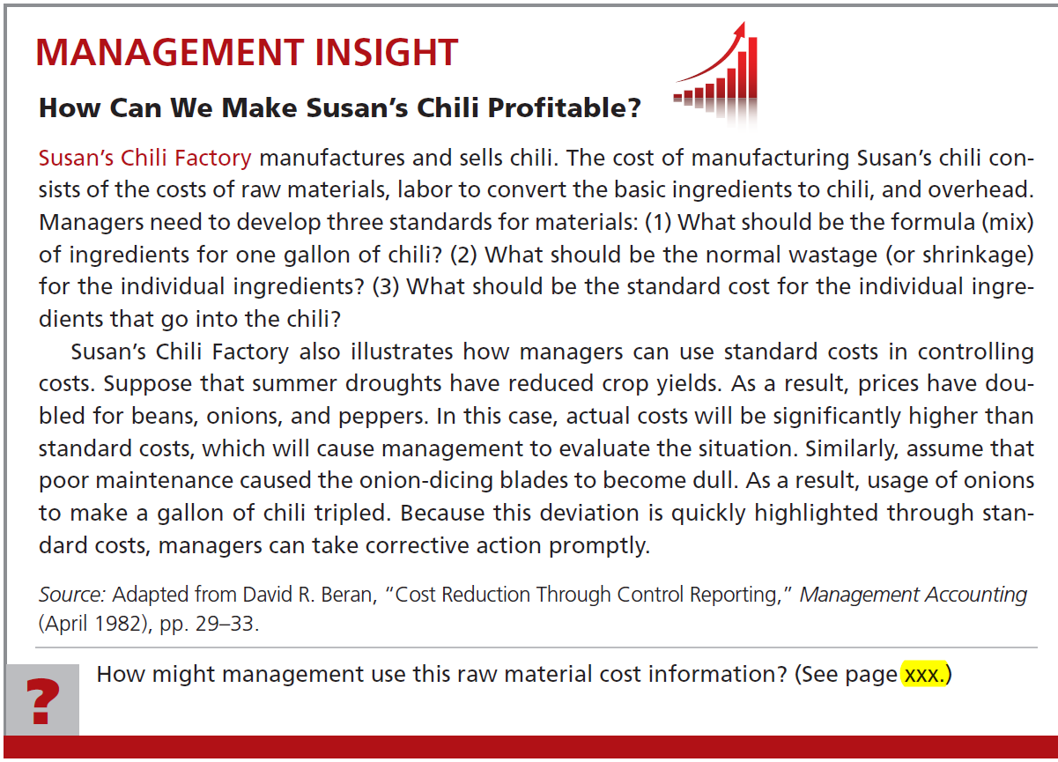

Slide 48
Flexible Budget Performance Report
Remember the question: “How much of the total variance is due to lower activity and how much is
due to cost control?”
Notes:
The flexible budget that we just prepared enables us to answer the previously posed compound question: How much of the the total variance is due to lower activity and how much is due to cost control?

Slide 49
Static Budgets and Performance
How much of the $11,650 favorable variance is due to lower activity and how much is due to cost control?
Notes:
Recall from our “apples-to-oranges” comparison which was presented earlier that CheeseCo’s static budget variance was $11,650 favorable. How much of the $11,650 favorable variance is due to lower activity and how much is due to cost control?

Slide 50
Flexible Budget Performance Report
Overhead Variance Analysis
Let’s place the flexible budget for 8,000 hours here.
Difference between original static budget
and actual overhead = $11,650 F.
Notes:
The difference of $11,650 can be depicted pictorially as shown. If we insert the flexible budget at 8,000 machine hours in the middle of this diagram, it enables us to compute two variances that answer the aforementioned question.

Slide 51
Flexible Budget Performance Report
Overhead Variance Analysis
Activity
Cost control
This $15,000F variance is due to lower activity.
This $3,350U
variance is due
to poor cost control.
Notes:
The $15,000 favorable variance resulting from the difference between the static budget at 10,000 hours and the flexible budget at 8,000 hours is due to lower activity. The $3,350 unfavorable variance resulting from the difference between the flexible budget at 8,000 hours and actual costs at 8,000 hours is due to poor cost control. These two amounts net to $11,650 favorable.

Slide 52
The Measure of Activity– A Critical Choice
Three important
factors in selecting an
activity base for an overhead
flexible budget
Activity base and
variable overhead
should be
causally related.
Activity base should
be simple and
easily understood.
Activity base should
not be expressed
in dollars or
other currency.
Notes:
At least three factors are important in selecting an activity base for an overhead flexible budget:
The activity base and variable overhead should be causally related.
The activity base should not be expressed in dollars or other currency. For
example, direct labor cost is usually a poor choice for an activity base
because changes in wage rates do not result in proportionate changes in
overhead.
The activity base should be simple and easily understood.

Slide 53
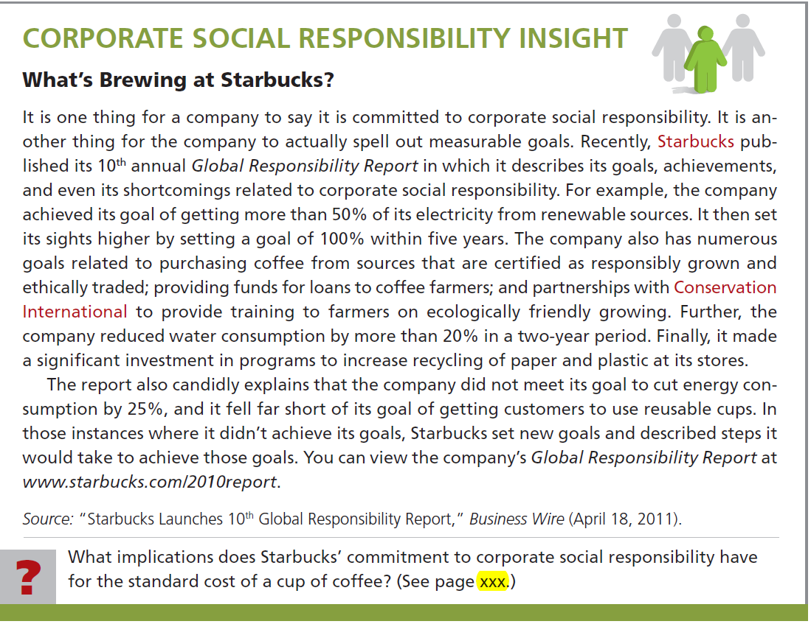

Slide 54
End of Lecture 18
Notes:
End of Chapter 11.

