Slide 1
Chapter 7
Lecture 16
Direct Cost Variance and Management Control
Readings
Chapter 7,Cost Accounting, Managerial Emphasis, 14th edition by Horengren
Chapter 10, Managerial Accounting 12th edition by Garrison, Noreen, Brewer

Slide 2
Learning Objectives
Explain how direct materials standards and direct labor standards are set.
Compute the direct materials price and quantity variances and explain their significance.
Compute the direct labor rate and efficiency variances and explain their significance.
Compute the variable manufacturing overhead spending and efficiency variances.
Understand how a balanced scorecard fits together and how it supports a company’s strategy.
Compute delivery cycle time, throughput time, and manufacturing cycle efficiency (MCE).
Prepare journal entries to record standard costs and variances.

Slide 3
Basic Concepts
Variance – difference between an actual and an expected (budgeted) amount
Management by Exception – the practice of focusing attention on areas not operating as expected (budgeted)
Static (Master) Budget – is based on the output planned at the start of the budget period

Slide 4
Basic Concepts
Static-Budget Variance (Level 0) – the difference between the actual result and the corresponding static budget amount
Favorable Variance (F) – has the effect of increasing operating income relative to the budget amount
Unfavorable Variance (U) – has the effect of decreasing operating income relative to the budget amount

Slide 5
Variances
Variances may start out “at the top” with a Level 0 analysis.
This is the highest level of analysis, a super-macro view of operating results.
The Level 0 analysis is nothing more than the difference between actual and static-budget operating income

Slide 6
Variances
Further analysis decomposes (breaks down) the Level 0 analysis down into progressively smaller and smaller components
  Answers: “How much were we off?”
Levels 1, 2, and 3 examine the Level 0 variance into progressively more-detailed levels of analysis
  Answers: “Where and why were we off?”

Slide 7
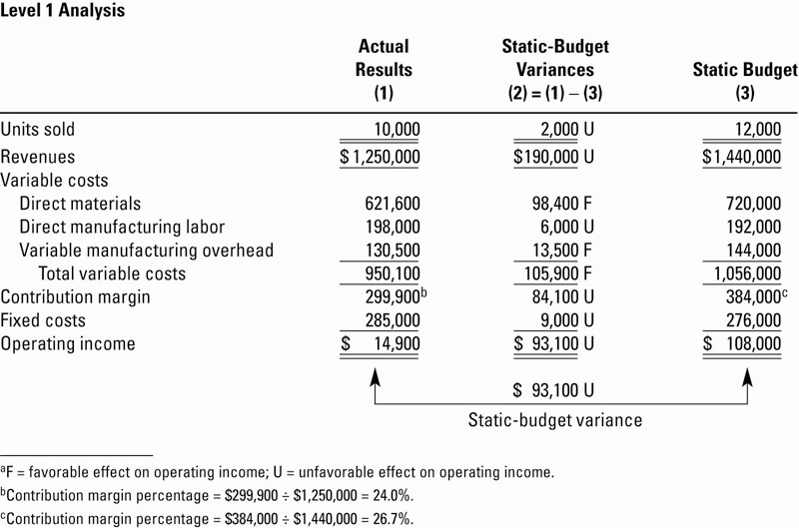
Level 1 Analysis, Illustrated

Slide 8
Evaluation
Level 0 tells the user very little other than how much Contribution Margin was off from budget.
  Level 0 answers the question: “How much were we off in total?”
Level 1 gives the user a little more information: it shows which line-items led to the total Level 0 variance.
  Level 1 answers the question: “Where were we off?”

Slide 9
Flexible Budget
Flexible Budget – shifts budgeted revenues and costs up and down based actual operating results (activities)
Represents a blending of actual activities and budgeted dollar amounts
Will allow for preparation of Level 2 and 3 variances
  Answers the question: “Why were we off?”

Slide 10
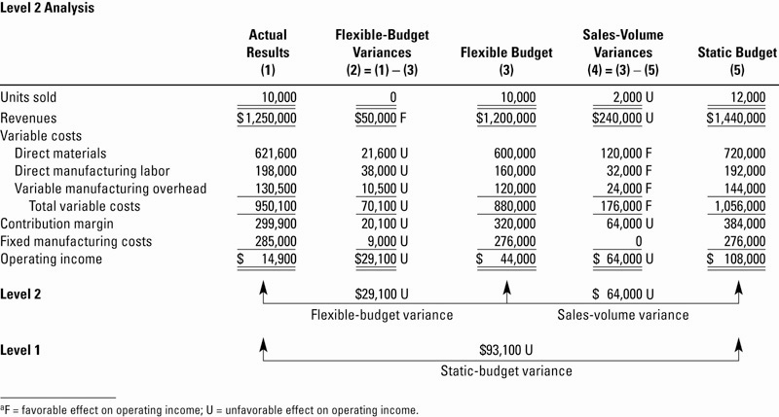
Level 2 Analysis, Illustrated

Slide 11
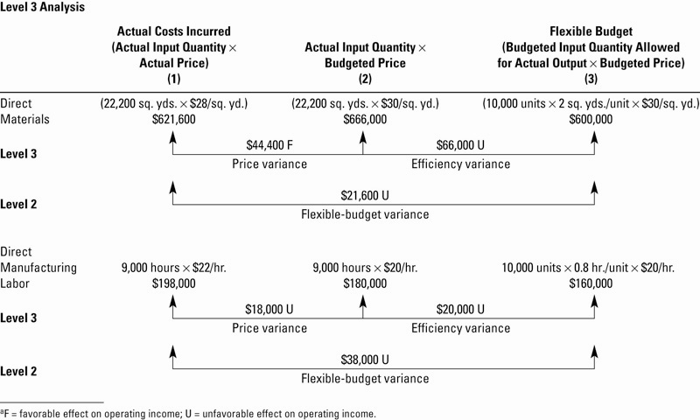
Level 3 Analysis, Illustrated

Slide 12
Level 3 Variances
All Product Costs can have Level 3 Variances. Direct Materials and Direct Labor will be handled next. Overhead Variances are discussed in detail in a later chapter
Both Direct Materials and Direct Labor have both Price and Efficiency Variances, and their formulae are the same

Slide 13
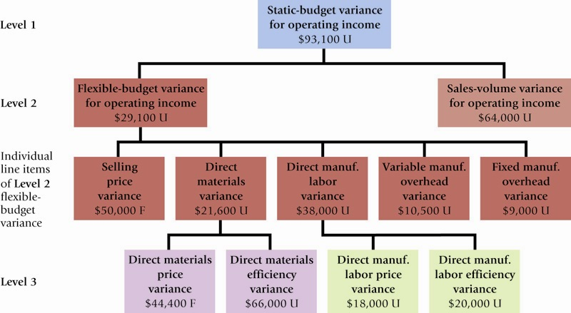
Variance Summary

Slide 14
Level 3 Variances
Price Variance formula:
Efficiency Variance formula:

Slide 15
Variances & Journal Entries
Each variance may be journalized
Each variance has its own account
Favorable variances are credits; Unfavorable variances are debits
Variance accounts are generally closed into Cost of Goods Sold at the end of the period, if immaterial

Slide 16
Standard Costing
Budgeted amounts and rates are actually booked into the accounting system
These budgeted amounts contrast with actual activity and give rise to Variance Accounts.

Slide 17
Standard Costing
Reasons for implementation:
  Improved software systems
  Wide usefulness of variance information

Slide 18
Management Uses of Variances
To understand underlying causes of variances.
Recognition of inter-relatedness of variances
Performance Measurement
  Managers ability to be Effective
  Managers ability to be Efficient

Slide 19
Activity-Based Costing and Variances
ABC easily lends its to budgeting and variance analysis.
Budgeting is not conducted on the departmental-wide basis (or other macro approaches)
Instead, budgets are built from the bottom-up with activities serving as the building blocks of the process

Slide 20
Benchmarking and Variances
Benchmarking is the continuous process of comparing the levels of performance in producing products & services against the best levels of performance in competing companies
Variances can be extended to include comparison to other entities

Slide 21
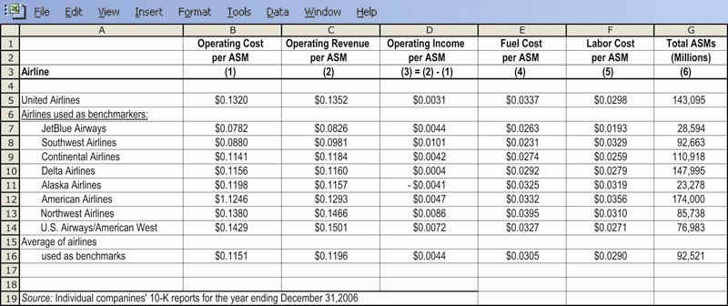
Benchmarking Example: Airlines

Slide 22
Standard Costs
Standards are benchmarks or “norms”
for measuring performance. Two types
of standards are commonly used.
Quantity standards
specify how much of an
input should be used to
make a product or
provide a service.
Cost (price)
standards specify
how much should be
paid for each unit
of the input.
Notes:
A standard is a benchmark or “norm” for measuring performance. In managerial accounting, two types of standards are commonly used by manufacturing, service, food and not-for-profit organizations:
❶ Quantity standards specify how much of an input should be used to make a
product or provide a service. For example:
a. Auto service centers like Firestone and Sears set labor time standards
for the completion of work tasks.
b. Fast-food outlets such as McDonald’s have exacting standards for the
quantity of meat going into a sandwich.
❷ Cost (price) standards specify how much should be paid for each unit of the
input. For example:
a. Hospitals have standard costs for food, laundry, and other items.
b. Home construction companies have standard labor costs that they apply
to sub-contractors such as framers, roofers, and electricians.
c. Manufacturing companies often have highly developed standard
costing systems that establish quantity and cost (price) standards for
each separate product’s material, labor and overhead inputs. These
standards are listed on a standard cost card.

Slide 23
Standard Costs
Deviations from standards deemed significant
are brought to the attention of management, a
practice known as management by exception.
Standard
Amount
Direct
Material
Direct
Labor
Manufacturing
Overhead
Type of Product Cost
Notes:
Management by exception is a system of management in which standards are set for various operating activities, with actual results compared to these standards. Any deviations that are deemed significant are brought to the attention of management as “exceptions.”
This chapter applies the management by exception principle to quantity and cost (price) standards with an emphasis on manufacturing applications.

Slide 24
Variance Analysis Cycle
Take
corrective actions
Identify
questions
Receive explanations
Conduct next period’s operations
Analyze variances
Prepare standard cost performance report
Begin
Notes:
The variance analysis cycle is a continuous five-step process:
❶ The cycle begins with the preparation of standard cost performance reports
in the accounting department.
❷ These reports highlight variances that are differences between actual results and
what should have occurred according to standards.
❸ The Variances raise questions such as:
a. Why did this variance occur?
b. Why is this variance larger than it was last period?
❹ The significant variances are investigated to discover their root causes.
❺ Corrective actions are taken and the next period’s operations are carried out.

Slide 25
Setting Standard Costs
Accountants, engineers, purchasing
agents, and production managers
combine efforts to set standards that encourage efficient future production.
Notes:
Setting price and quantity standards requires the combined expertise of everyone who has responsibility for purchasing and using inputs. In a manufacturing setting, this might include accountants, engineers, purchasing managers, production supervisors, line managers, and production workers.
Standards should be designed to encourage efficient future operations, not just a repetition of past inefficient operations.

Slide 26
Setting Standard Costs
Should we use
ideal standards that
require employees to
work at 100 percent
peak efficiency?
I recommend using practical standards that are currently attainable with reasonable and efficient effort.
Engineer
Managerial
Accountant
Notes:
Standards tend to fall into one of two categories:
❶ Ideal standards can only be attained under the best of circumstances. They allow
for no work interruptions, and they require employees to continually work at 100
percent peak efficiency.
❷ Practical standards are tight, but attainable. They allow for normal machine
downtime and employee rest periods and can be attained through reasonable,
highly efficient efforts of the average worker. Practical standards can also be used
for forecasting cash flows and in planning inventory.

Slide 27
Setting Direct Material Standards
Price
Standards
Quantity
Standards
Final, delivered
cost of materials,
net of discounts.
Summarized in
a Bill of Materials.
Notes:
The standard price per unit for direct materials should reflect the final, delivered cost of the materials, net of applicable discounts.
The standard quantity per unit for direct materials should reflect the amount of material required for each unit of finished product, as well as an allowance for unavoidable waste, spoilage, and other normal inefficiencies.
A bill of materials is a list that shows the quantity of each type of material in a unit of finished product.

Slide 28

Setting Standards
Six Sigma advocates have sought to
eliminate all defects and waste, rather than continually build them into standards.
As a result allowances for waste and
spoilage that are built into standards
should be reduced over time.
Notes:
Six Sigma advocates argue that waste and spoilage should not be tolerated. If allowances for waste and spoilage are built into the standard quantity, the level of those allowances should be reduced over time.

Slide 29


Setting Direct Labor Standards
Rate
Standards
Time
Standards
Often a single
rate is used that reflects
the mix of wages earned.
Use time and
motion studies for
each labor operation.
Notes:
The standard rate per hour for direct labor includes not only wages earned but also fringe benefits and other labor costs. Many companies prepare a single rate for all employees within a department that reflects the “mix” of wage rates earned.
The standard hours per unit reflects the labor hours required to complete one unit of product. Standards can be determined by using available references that estimate the time needed to perform a given task, or by relying on time and motion studies.

Slide 30
Setting Variable Overhead Standards
Rate
Standards
Activity
Standards
The rate is the
variable portion of the
predetermined overhead
rate.
The activity is the
base used to calculate the predetermined overhead.
Notes:
The price standard for variable manufacturing overhead comes from the variable portion of the predetermined overhead rate.
The quantity standard for variable manufacturing overhead is usually expressed in either direct labor hours or machine hours depending on which is used as the allocation base in the predetermined overhead rate.

Slide 31
Standard Cost Card – Variable Production Cost
A standard cost card for one unit of product might look like this:
Notes:
The standard cost card is a detailed listing of the standard amounts of direct materials, direct labor, and variable overhead inputs that should go into a unit of product, multiplied by the standard price or rate that has been set for each input.

Slide 32
Standards vs. Budgets
Are standards the same as budgets?
A budget is set for total costs.
  A standard is a per unit cost.
  Standards are often used when preparing budgets.
Notes:
A standard is a unit amount, whereas a budget is a total amount. A standard can be viewed as the budgeted cost for one unit of product.

Slide 33
Price and Quantity Standards
Price and and quantity standards are determined separately for two reasons:
The purchasing manager is responsible for raw
material purchase prices and the production manager
is responsible for the quantity of raw material used.
The buying and using activities occur at different times.
Raw material purchases may be held in inventory for a
period of time before being used in production.
Notes:
Price and and quantity standards are determined separately for two reasons:
❶Different managers are usually responsible for buying and for using inputs.
For example: The purchasing manager is responsible for raw material
purchase prices and the production manager is responsible for the quantity
of raw material used.
❷The buying and using activities occur at different points in time. For
example: Raw material purchases may be held in inventory for a period of
time before being used in production.

Slide 34
A General Model for Variance Analysis
Variance Analysis
Price Variance
Quantity Variance
Difference between
actual price and
standard price
Difference between
actual quantity and
standard quantity
Notes:
Differences between standard prices and actual prices and standard quantities and actual quantities are called variances. The act of computing and interpreting variances is called variance analysis.

Slide 35
A General Model for Variance Analysis
Variance Analysis
Price Variance
Quantity Variance
Materials price variance
Labor rate variance
VOH spending variance
Materials quantity variance
Labor efficiency variance
VOH efficiency variance
Notes:
Price and quantity variances can be computed for all three variable cost elements – direct materials, direct labor, and variable manufacturing overhead – even though the variances have different names as shown.

Slide 36
A General Model for Variance Analysis
Actual Quantity Actual Quantity Standard Quantity
× × ×
Actual Price Standard Price Standard Price
Price Variance
Quantity Variance
Notes:
Although price and quantity variances are known by different names, they are computed exactly the same way (as shown on this slide) for direct materials, direct labor, and variable manufacturing overhead.

Slide 37
A General Model for Variance Analysis
Actual Quantity Actual Quantity Standard Quantity
× × ×
Actual Price Standard Price Standard Price
Price Variance
Quantity Variance
Actual quantity is the amount of direct materials, direct labor, and variable manufacturing overhead actually used.
Notes:
The actual quantity represents the amount of direct materials, direct labor, and variable manufacturing overhead actually used.

Slide 38
A General Model for Variance Analysis
Actual Quantity Actual Quantity Standard Quantity
× × ×
Actual Price Standard Price Standard Price
Price Variance
Quantity Variance
Standard quantity is the standard quantity allowed for the actual output of the period.
Notes:
The standard quantity represents the standard quantity allowed for the actual output of the period.

Slide 39
A General Model for Variance Analysis
Actual Quantity Actual Quantity Standard Quantity
× × ×
Actual Price Standard Price Standard Price
Price Variance
Quantity Variance
Actual price is the amount actually
paid for the input used.
Notes:
The actual price represents the actual amount paid for the input used.

Slide 40
A General Model for Variance Analysis
Actual Quantity Actual Quantity Standard Quantity
× × ×
Actual Price Standard Price Standard Price
Price Variance
Quantity Variance
Standard price is the amount that should have been paid for the input used.
Notes:
The standard price represents the amount that should have been paid for the input used.

Slide 41
A General Model for Variance Analysis
Actual Quantity Actual Quantity Standard Quantity
× × ×
Actual Price Standard Price Standard Price
Price Variance
Quantity Variance
(AQ × AP) – (AQ × SP) (AQ × SP) – (SQ × SP)
AQ = Actual Quantity SP = Standard Price
AP = Actual Price SQ = Standard Quantity
Notes:
In equation form, price and quantity variances are calculated as shown.

Slide 42
Material Variances Example
Glacier Peak Outfitters has the following direct material standard for the fiberfill in its mountain parka.
0.1 kg. of fiberfill per parka at $5.00 per kg.
Last month 210 kgs of fiberfill were purchased and used to make 2,000 parkas. The material cost a total of $1,029.
Notes:
Here’s an example that will give us an opportunity to compute material price and quantity variances.

Slide 43
Material Variances Summary
Actual Quantity Actual Quantity Standard Quantity
× × ×
Actual Price Standard Price Standard Price
210 kgs. 210 kgs. 200 kgs.
× × ×
$4.90 per kg. $5.00 per kg. $5.00 per kg.
= $1,029 = $1,050 = $1,000
Price variance
$21 favorable
Quantity variance
$50 unfavorable
Notes:
The materials price variance, defined as the difference between what is paid for a quantity of materials and what should have been paid according to the standard, is $21 favorable. The price variance is labeled favorable because the actual price was less than the standard price by $0.10 per kilogram.
The materials quantity variance, defined as the difference between the quantity of materials used in production and the quantity that should have been used according to the standard, is $50 unfavorable. The quantity variance is labeled unfavorable because the actual quantity exceeds the standard quantity allowed by 10 kilograms

Slide 44
Material Variances Summary
Actual Quantity Actual Quantity Standard Quantity
× × ×
Actual Price Standard Price Standard Price
210 kgs. 210 kgs. 200 kgs.
× × ×
$4.90 per kg. $5.00 per kg. $5.00 per kg.
= $1,029 = $1,050 = $1,000
$1,029 ÷ 210 kgs = $4.90 per kg
Price variance
$21 favorable
Quantity variance
$50 unfavorable
Notes:
The actual price of $4.90 per kilogram is computed by dividing the actual cost of the material by the actual number of kilograms purchased.

Slide 45
Material Variances Summary
Actual Quantity Actual Quantity Standard Quantity
× × ×
Actual Price Standard Price Standard Price
210 kgs. 210 kgs. 200 kgs.
× × ×
$4.90 per kg. $5.00 per kg. $5.00 per kg.
= $1,029 = $1,050 = $1,000
0.1 kg per parka × 2,000 parkas = 200 kgs
Price variance
$21 favorable
Quantity variance
$50 unfavorable
Notes:
The standard quantity of 200 kilograms is computed by multiplying the standard quantity per parka times the number of parkas made.

Slide 46
Material Variances:
Using the Factored Equations
Materials price variance
  MPV = AQ (AP - SP)
  = 210 kgs ($4.90/kg - $5.00/kg)
  = 210 kgs (-$0.10/kg)
  = $21 F
Materials quantity variance
  MQV = SP (AQ - SQ)
  = $5.00/kg (210 kgs-(0.1 kg/parka× 2,000 parkas))
  = $5.00/kg (210 kgs - 200 kgs)
  = $5.00/kg (10 kgs)
  = $50 U
Notes:
The equations that we have been using thus far can be factored as shown and used to compute price and quantity variances.

Slide 47
Isolation of Material Variances
I’ll start computing
the price variance
when material is
purchased rather than
when it’s used.
I need the price variance
sooner so that I can better
identify purchasing problems.
You accountants just don’t
understand the problems that
purchasing managers have.
Notes:
Most companies compute the materials price variance when materials are purchased. They calculate the materials quantity variance after materials are used in production.

Slide 48
Material Variances
  The price variance is computed on the entire quantity purchased.
  The quantity variance is computed only on the quantity used.
Hanson purchased and used 1,700 pounds. How are the variances computed if the amount purchased differs from the amount used?
Notes:
The materials price variance is computed using the entire amount of material purchased during the period. The materials quantity variance is computed using only the portion of materials that was used in production during the period.

Slide 49
Responsibility for Material Variances
Materials Quantity Variance
Materials Price Variance
Production Manager
Purchasing Manager
The standard price is used to compute the quantity variance
so that the production manager is not held responsible for
the purchasing manager’s performance.
Notes:
The purchasing manager and production manager are usually held responsible for the materials price variance and materials quantity variance, respectively. The standard price is used to compute the quantity variance so that the production manager is not held responsible for the performance of the purchasing manager.

Slide 50
Responsibility for Material Variances
Your poor scheduling sometimes requires me to rush order material at a higher price, causing unfavorable price variances.
I am not responsible for
this unfavorable material
quantity variance.
You purchased cheap
material, so my people
had to use more of it.
Notes:
The materials variances are not always entirely controllable by one person or department. For example, the production manager may schedule production in such a way that it requires express delivery of raw materials resulting in an unfavorable materials price variance. The purchasing manager may purchase lower quality raw materials resulting in an unfavorable materials quantity variance for the production manager.

Slide 51
Quick Check ✓
Zippy
Hanson Inc. has the following direct material standard to manufacture one Zippy:
1.5 pounds per Zippy at $4.00 per pound
Last week, 1,700 pounds of material were purchased and used to make 1,000 Zippies. The material cost a total of $6,630.
Notes:
In this example, the company produces a Zippy. The direct materials standard calls for 1.5 pounds per Zippy at $4.00 per pound. Last week, Hanson purchased and used 1,700 pounds of material to produce 1,000 Zippies. The 1,700 pounds of material cost a total of $6,630. Now, we will see several questions based on the information on this screen. You may wish to take some notes to use as you answer the questions. Try to answer each question before advancing to the solution.

Slide 52
Quick Check ✓
Zippy
Hanson’s material price variance (MPV)
for the week was:
a. $170 unfavorable.
b. $170 favorable.
c. $800 unfavorable.
d. $800 favorable.
Notes:
Here’s your first question.

Slide 53
Quick Check ✓
Zippy
Hanson’s material price variance (MPV)
for the week was:
a. $170 unfavorable.
b. $170 favorable.
c. $800 unfavorable.
d. $800 favorable.
MPV = AQ(AP - SP)
MPV = 1,700 lbs. × ($3.90 - 4.00)
MPV = $170 Favorable
Notes:
We find the material price variance by multiplying the actual quantity of material purchased times the difference between the actual price per pound and the standard price per pound. We find the actual price per pound by dividing the $6,630 total actual price paid for the material by the 1,700 pounds purchased.
The $170 favorable material price variance results because Hanson paid 10 cents per pound less than standard for 1,700 pounds of material.

Slide 54
Quick Check ✓
Zippy
Hanson’s material quantity variance (MQV)
for the week was:
a. $170 unfavorable.
b. $170 favorable.
c. $800 unfavorable.
d. $800 favorable.
Notes:
Here’s your second question.

Slide 55
Quick Check ✓
Zippy
Hanson’s material quantity variance (MQV)
for the week was:
a. $170 unfavorable.
b. $170 favorable.
c. $800 unfavorable.
d. $800 favorable.
MQV = SP(AQ - SQ)
MQV = $4.00(1,700 lbs - 1,500 lbs)
MQV = $800 unfavorable
Notes:
The standard quantity is the amount of material that Hanson should have used to make 1,000 Zippies. We find the standard quantity by multiplying the 1.5 pounds per unit standard for one Zippy times the 1,000 Zippies.
Now that we know the standard quantity, let’s calculate the material quantity variance. We find the material quantity variance by multiplying the standard price for one pound of material times the difference between the actual quantity of material and the standard quantity of material. The $800 unfavorable material quantity variance results because Hanson used 200 pounds more than standard to make the 1,000 Zippies, and each pound of material has a standard price of $4.00.

Slide 56
Quick Check ✓
Zippy
Actual Quantity Actual Quantity Standard Quantity
× × ×
Actual Price Standard Price Standard Price
1,700 lbs. 1,700 lbs. 1,500 lbs.
× × ×
$3.90 per lb. $4.00 per lb. $4.00 per lb.
= $6,630 = $ 6,800 = $6,000
Price variance
$170 favorable
Quantity variance
$800 unfavorable
Notes:
Here we see a summary of the material price and quantity variance computations in a convenient three-column format. You may find this three-column format more helpful than the equations that we used to answer the previous two questions.

Slide 57
Quick Check ✓ Continued
Zippy
Hanson Inc. has the following material standard to manufacture one Zippy:
1.5 pounds per Zippy at $4.00 per pound
Last week, 2,800 pounds of material were purchased at a total cost of $10,920, and 1,700 pounds were used to make 1,000 Zippies.
Notes:
Let’s extend the Hanson example by increasing the quantity of material purchased to 2,800 pounds at a total cost of $10,920. All other information is the same as before.

Slide 58
Quick Check ✓ Continued
Actual Quantity Actual Quantity
Purchased Purchased
× ×
Actual Price Standard Price
2,800 lbs. 2,800 lbs.
× ×
$3.90 per lb. $4.00 per lb.
= $10,920 = $11,200
Price variance increases because quantity purchased increases.
Price variance
$280 favorable
Notes:
Hanson actually paid $10,920 for the 2,800 pounds of material. Multiplying the standard price of $4.00 per pound times the 2,800 pounds of material purchased, we find that Hanson should have paid $11,200. The price variance is now $280 favorable. The price variance increases in this example because the quantity purchased increased.
The $280 favorable material price variance results because Hanson paid $0.10 per pound less than standard for 2,800 pounds of material.

Slide 59
Quick Check ✓ Continued
Actual Quantity
Used Standard Quantity
× ×
Standard Price Standard Price
1,700 lbs. 1,500 lbs.
× ×
$4.00 per lb. $4.00 per lb.
= $6,800 = $6,000
Quantity variance is unchanged because actual and standard quantities are unchanged.
Quantity variance
$800 unfavorable
Notes:
The material quantity variance is the same as before because Hanson again used the same amount of material as before to make the same number of Zippies.

Slide 60
End of Lecture 16
Notes:
End of Chapter 10.

