Slide 1
Chapter 17
Lecture 13
Process Costing
Readings
Chapter 17,Cost Accounting, Managerial Emphasis, 14th edition by Horengren
Chapter 4, Managerial Accounting 12th edition by Garrison, Noreen, Brewer

Slide 2
Learning Objectives
Record the flow of materials, labor, and overhead through a process cost system.
Compute the equivalent units of production using the weighted-average method.
Compute the cost per equivalent unit using the weighted-average method.
Assign costs to units using the weighted-average method.
Compute the equivalent units of production using the FIFO method.
Compute the cost per equivalent unit using the FIFO method.
Assign costs to units using the FIFO method
Allocate service department costs to operating departments using the direct method.
To allocate service department costs to operating departments using the step-down method.

Slide 3
Job-Costing and Process Costing:
Opposite Ends of a Continuum
Job-Costing Systems
Distinct, identifiable
units of a product
or service
Examples:
Custom-made
machines,
Houses
Process-Costing
Systems
Masses of identical
or similar units of a
product or service
Examples:
Food,
Chemical processing

Slide 4
Process-Costing
Process-costing is a system where the unit cost of a product or service is obtained by assigning total costs to many identical or similar units
Each unit receives the same or similar amounts of direct materials costs, direct labor costs, and manufacturing overhead
Unit costs are computed by dividing total costs incurred by the number of units of output from the production process

Slide 5
Process-Costing Assumptions
Direct Materials are added at the beginning of the production process, or at the start of work in a subsequent department down the assembly line
Conversion Costs are added equally along the production process

Slide 6
Five-Step Process-Costing Allocation
Summarize the flow of physical units of output
Compute output in terms of equivalent units
Compute cost per equivalent unit
Summarize total costs to account for
Assign total costs to units completed and to units in ending Work-in-Process

Slide 7
Equivalent Units
A derived amount of output units that:
  Takes the quantity of each input in units completed and in unfinished units of work in process and
  converts the quantity of input into the amount of completed output units that could be produced with that quantity of input
Are calculated separately for each input (direct materials and conversion cost)

Slide 8
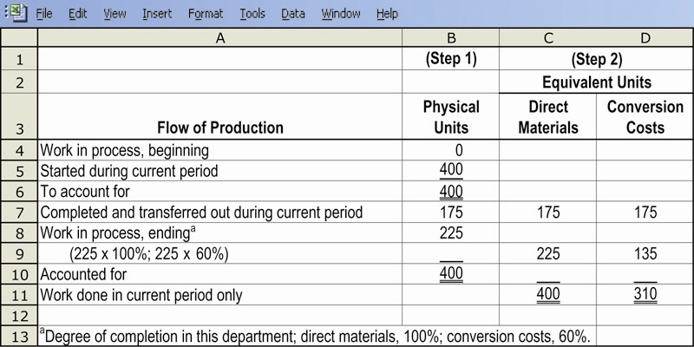
Steps 1 & 2 Illustrated

Slide 9
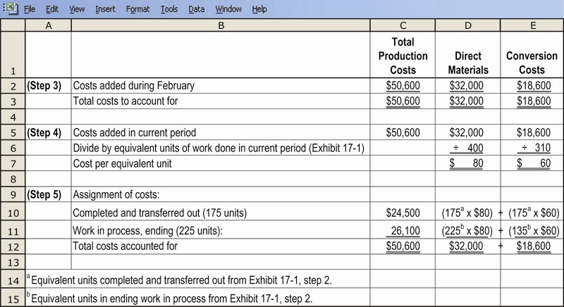
Steps 3, 4 & 5, Illustrated

Slide 10
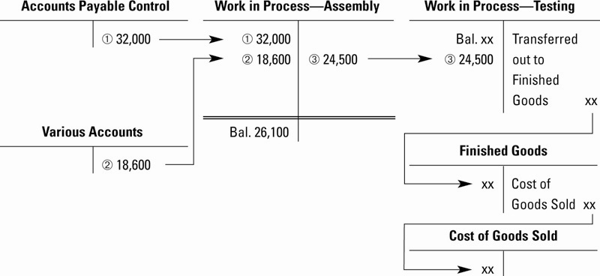
General Ledger Cost Flows Illustrated

Slide 11
Weighted-Average Process-Costing Method
Calculates cost per equivalent unit of all work done to date (regardless of the accounting period in which it was done)
Assigns this cost to equivalent units completed & transferred out of the process, and to incomplete units in still in-process

Slide 12
Weighted-Average Process-Costing Method
Weighted-average costs is the total of all costs in the Work-in-Process Account divided by the total equivalent units of work done to date
The beginning balance of the Work-in-Process account (work done in a prior period) is blended in with current period costs

Slide 13
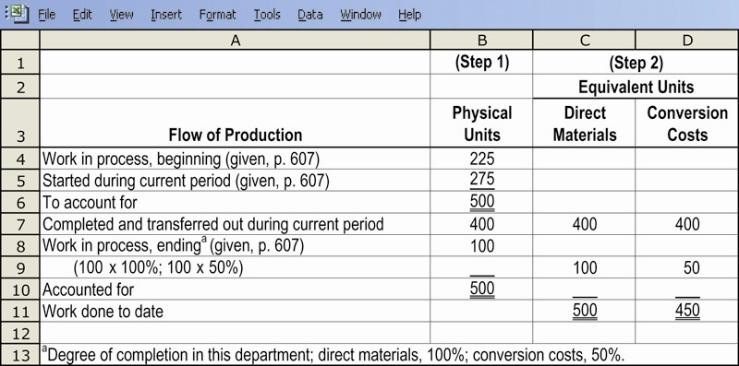
Steps 1 & 2 Illustrated

Slide 14
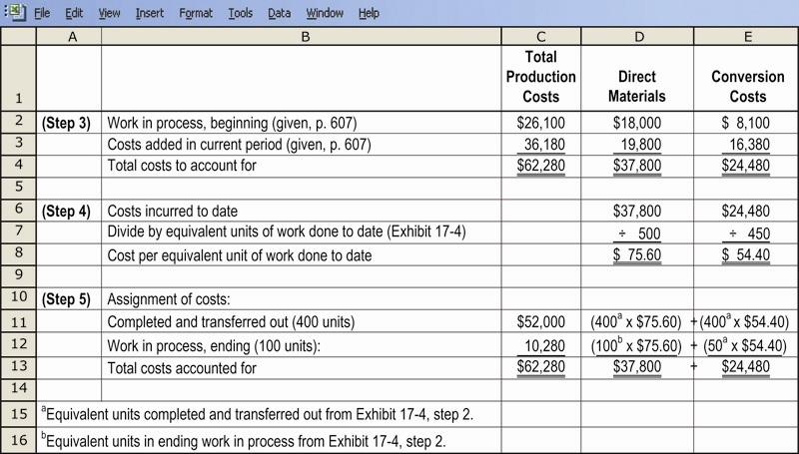
Steps 3, 4 & 5 Illustrated

Slide 15
Result of the Process
Two critical figures arise out of Step Five of the cost allocation process:
  The amount of the Journal Entry transferring the allocated cost of units completed and sent from Work-in-Process Inventory to Finished Goods Inventory
  The ending balance of the Work-in-Process Inventory account that will appear on the Balance Sheet

Slide 16
First-in, First-Out
Process-Costing Method
Assigns the cost of the previous accounting period’s equivalent units in beginning work-in-process inventory to the first units completed and transferred out of the process
Assigns the cost of equivalent units worked on during the current period first to complete beginning inventory, next to stat and complete new units, and lastly to units in ending work-in-process inventory

Slide 17
First-in, First-Out
Process-Costing Method
The beginning balance of the Work-in-Process account (work done in a prior period) is kept separate from current period costs

Slide 18
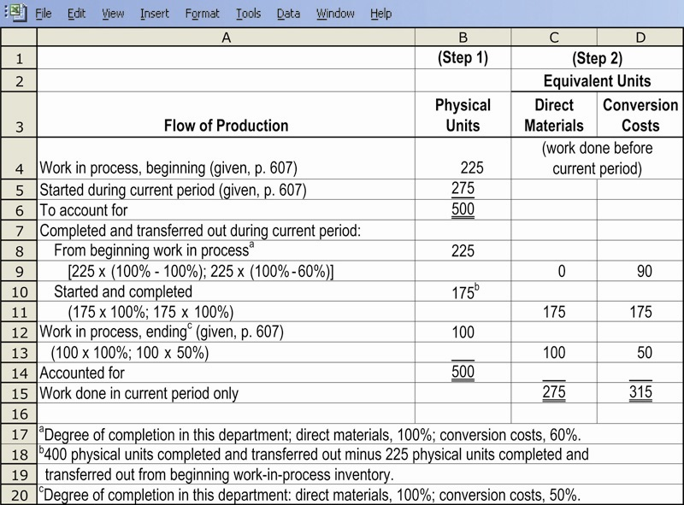
Steps 1 & 2, Illustrated

Slide 19
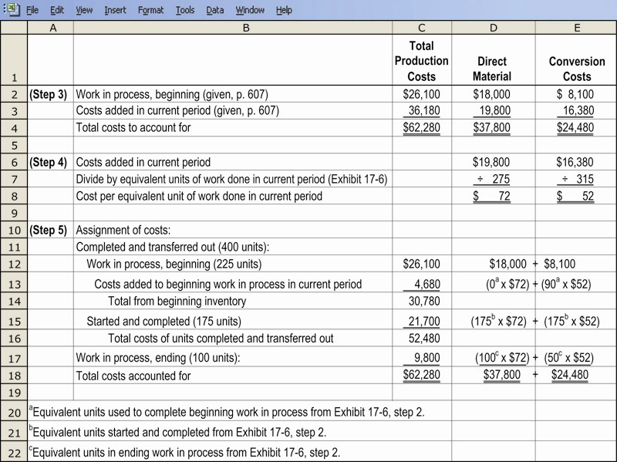
Steps 3, 4 & 5, Illustrated

Slide 20
Result of the Process (as before)
Two critical figures arise out of Step Five of the cost allocation process:
  The amount of the Journal Entry transferring the allocated cost of units completed and sent from Work-in-Process Inventory to Finished Goods Inventory
  The ending balance of the Work-in-Process Inventory account that will appear on the Balance Sheet

Slide 21
Standard Costing and Process Costing
Teams of design and process engineers, operations personnel, and management accountants work together to determine separate standard costs per equivalent unit on the basis of different technical processing specifications for each product
Standard costs replace actual costs in equivalent unit calculations

Slide 22
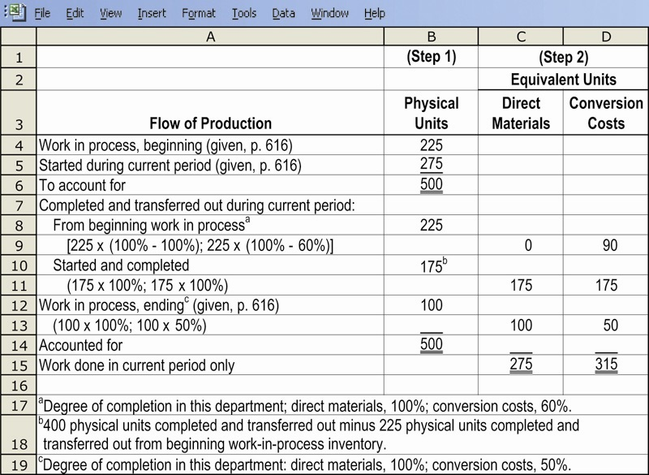
Steps 1 & 2, Illustrated

Slide 23
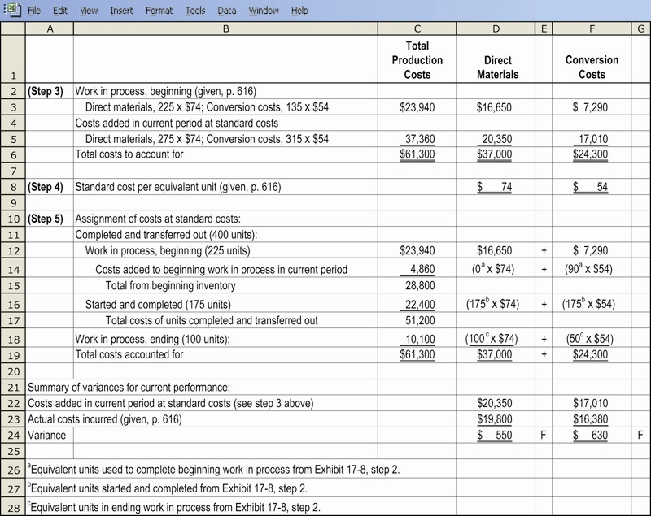
Steps 3, 4 & 5, Illustrated

Slide 24
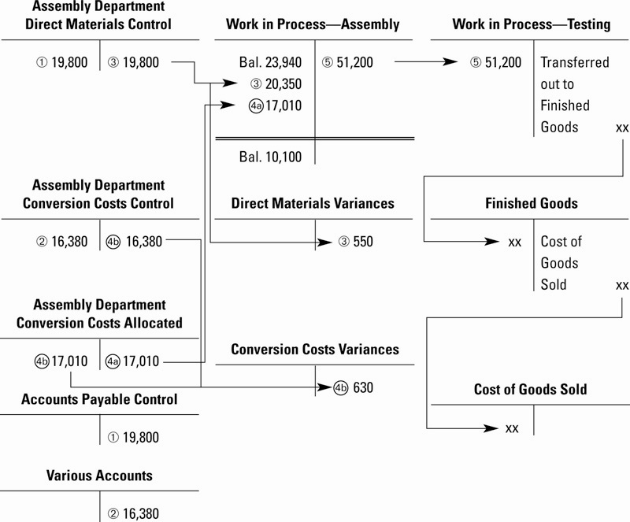
General Ledger Cost Flows Illustrated

Slide 25
Transferred-in Costs
Are costs incurred in previous departments that are carried forward as the products cost when it moves to a subsequent process in the production cycle
Also called Previous Department Costs
Journal entries are made to mirror the progress in production from department to department
Transferred-in costs are treated as if they are a separate type of direct material added at the beginning of the process

Slide 26
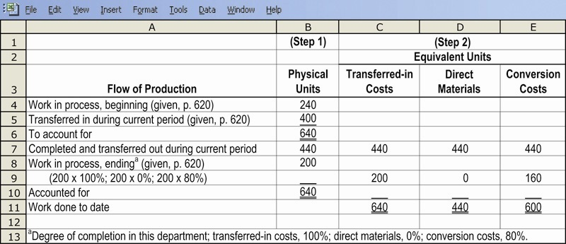
Steps 1 & 2, Illustrated

Slide 27
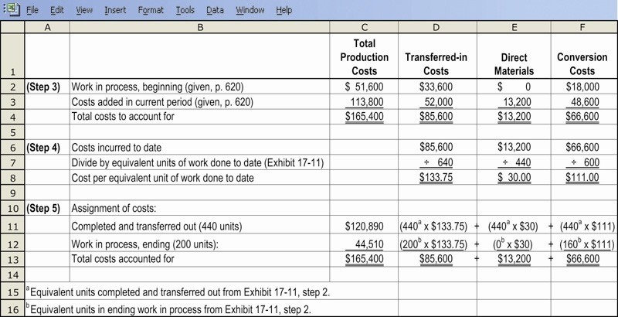
Steps 3, 4 & 5, Illustrated

Slide 28
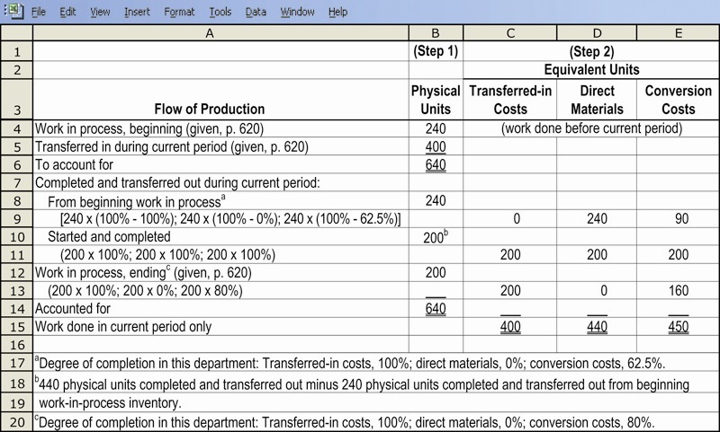
Steps 1 & 2, Illustrated

Slide 29
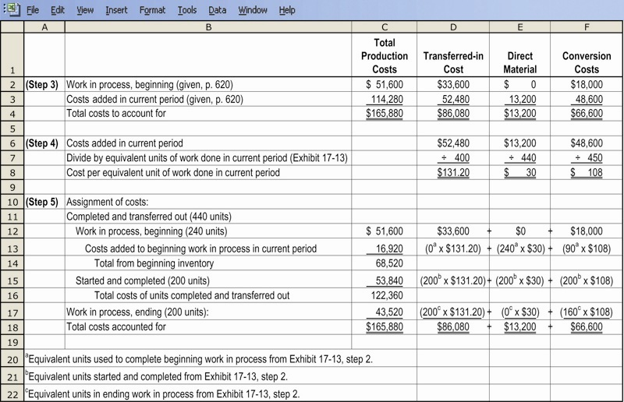
Steps 3, 4 & 5, Illustrated

Slide 30
Hybrid Costing Systems
A Hybrid-Costing System blends characteristics from both job-costing and process-costing systems
Many actual production systems are in fact hybrids
Examples include manufacturers of televisions, dishwashers and washing machines, as well as Adidas

Slide 31
Similarities Between Job-Order and Process Costing
Both systems assign material, labor and overhead costs to products and they provide a mechanism for computing unit product cost.
Both systems use the same manufacturing accounts, including Manufacturing Overhead, Raw Materials, Work in Process, and Finished Goods.
The flow of costs through the manufacturing accounts is basically the same in both systems.
Notes:
Job-order and process costing are similar in that they both deal with assigning materials, labor and overhead to products as a way to calculate the unit product cost.
Both systems use raw materials inventory, work in process inventory, and finished goods inventory.
The flow of costs is similar, but not exactly the same, in the two systems.

Slide 32
Differences Between Job-Order and Process Costing
Process costing is used when a single product is produced on a continuing basis or for a long period of time. Job-order costing is used when many different jobs are worked on each period.
Process costing systems accumulate costs by department. Job-order costing systems accumulated costs by individual jobs.
Process costing systems compute unit costs by department. Job-order costing systems compute unit costs by job on the job cost sheet.
Notes:
Process costing is best suited for the production of a single product that is continuously produced for a long period of time. Recall the mixing and bottling of Coca-Cola from Chapter Three. Job-order costing is best suited when jobs are produced as discrete projects. For example, building a house.
Process costing accumulates costs by department, while job-order costing accumulates costs by individual jobs.
Process costing uses a fundamental document called a department production report, while job-order costing uses the job cost sheet.
In process costing unit cost is computed by department, while in job-order systems unit cost is computed by job.
While there are similarities between the two systems, there are also significant differences.

Slide 33
Quick Check ✓
Process costing is used for products that are:
a. Different and produced continuously.
b. Similar and produced continuously.
c. Individual units produced to customer
specifications.
d. Purchased from vendors.
Notes:
Can you identify the most likely circumstances where a process costing system may be used?

Slide 34
Quick Check ✓
Process costing is used for products that are:
a. Different and produced continuously.
b. Similar and produced continuously.
c. Individual units produced to customer
specifications.
d. Purchased from vendors.
Notes:
Can you identify the most likely circumstances where a process costing system may be used?

Slide 35

Processing Departments
Any unit in an organization where materials, labor or overhead are added to the product.
The activities performed in a processing
department are performed uniformly on all
units of production. Furthermore, the output of
a processing department must be
homogeneous.
Notes:
A processing department is any location in an organization where materials, labor, or overhead are added to the product. The output from a processing department is homogeneous, that is, they all appear the same.

Slide 36
Comparing Job-Order and Process Costing
Direct Materials
Work in
Process
Finished
Goods
Direct Labor
ManufacturingOverhead
Cost of
Goods
Sold
Notes:
In all manufacturing systems, direct material, direct labor, and manufacturing overhead are charged to Work in Process Inventory. As we complete the production process, goods are transferred to the Finished Goods Inventory. Finally, when we sell the finished goods, we transfer the cost to cost of goods sold.

Slide 37
Comparing Job-Order and Process Costing
Costs are traced and
applied to individual
jobs in a job-order
cost system.
Direct Materials
Jobs
Finished
Goods
Direct Labor
ManufacturingOverhead
Cost of
Goods
Sold
Notes:
In a job-order cost system costs are traced to individual jobs. All of the jobs in process make up the company’s Work in Process Inventory.

Slide 38
Comparing Job-Order and Process Costing
Costs are traced and applied to departments in a process cost system.
Direct Materials
Processing
Department
Finished
Goods
Direct Labor
ManufacturingOverhead
Cost of
Goods
Sold
Notes:
In a process costing systems, costs are traced to departments that process the goods. In some companies there may be several processing departments that goods must pass through to become finished goods. Material, labor and overhead costs transferred from one department’s Work in Process account to another department’s Work in Process account are called transferred-in costs.

Slide 39
T-Account and Journal Entry Views of Cost Flows
For purposes of this example, assume there are two processing departments – Departments A and B.
We will use T-accounts and journal entries.
Notes:
Let’s look at the flow of costs through the tee accounts and related journal entries for a manufacturing process that has two departments – Department A and Department B.

Slide 40
Process Cost Flows
(in T-account form)
Work in Process
Department A
Raw Materials
Direct
Materials
Direct
Materials
Work in Process
Department B
Direct
Materials
Notes:
Part I
Direct materials can be requisitioned for use in both Department A and Department B. These direct materials are likely to be different in nature. Direct material costs are debited to the appropriate departmental Work in Process account depending upon where the materials were added to the production process. The Raw Materials account is credited for the corresponding amounts.

Slide 41
Process Cost Flows
(in journal entry form)
Notes:
The journal entry that shows the requisition of direct materials for use in Processing Departments A and B, is to debit the processing department of the direct materials requisitioned and credit Raw Materials Inventory. Notice that the direct materials are placed into a separate work in process account for each processing department.

Slide 42
Process Cost Flows
(in T-account form)
Work in Process
Department A
Wages Payable
Direct
Materials
Direct
Labor
Direct Labor
Work in Process
Department B
Direct
Materials
Direct
Labor
Notes:
Direct labor is transferred from the wages payable account into the work in process account of departments A and B depending upon where the individual employee worked. Direct labor costs are debited to the appropriate departmental Work in Process account depending upon where the labor was added to the production process. Salaries and Wages Payable is credited for the corresponding amounts.

Slide 43
Process Costing
(in journal entry form)
Notes:
Here is the journal entry to place the direct labor into the work in process inventory of departments A and B.

Slide 44
Process Cost Flows
(in T-account form)
Work in Process
Department A
Manufacturing Overhead
Direct
Materials
Direct Labor
Actual Overhead
Overhead
Applied to Work in
Process
Applied
Overhead
Work in Process
Department B
Direct
Materials
Direct
Labor
Applied
Overhead
Notes:
Manufacturing overhead is applied to each processing department based on a predetermined rate for each department. The predetermined rate does not have to be based on the same cost driver for each processing department. Manufacturing overhead costs are debited to the respective departmental Work in Process accounts. Manufacturing Overhead is credited by the corresponding amounts.

Slide 45
Process Costing
(In journal entry form)
Notes:
This is the journal entry we use to apply overhead to the work in process inventory of each of the processing departments.

Slide 46
Process Cost Flows
(in T-account form)
Work in Process
Department A
Work in Process Department B
Direct
Materials
Transferred
to Dept. B
Direct
Materials
Direct
Labor
Direct
Labor
Applied
Overhead
Applied
Overhead
Transferred
from Dept. A
Notes:
The cost of units complete as to processing in Department A are transferred into Department B for additional work. Department B has incurred additional costs to work on units that were in process at the beginning of the period. The transferred-in costs from Department A are added to the manufacturing costs incurred in Department B.

Slide 47
Process Costing
(in journal entry form)
Notes:
To transfer the costs, we debit the work in process inventory in Department B, and credit, or reduce, the work in process inventory in Department A.

Slide 48
Process Cost Flows
(in T-account form)
Work in Process
Department B
Finished Goods
Direct
Materials
Cost of
Goods Manufactured
Cost of
Goods
Manufactured
Direct
Labor
Applied
Overhead
Transferred
from Dept. A
Notes:
Here we see the transfer of completed goods our of Work in Process – Department B and into Finished Goods Inventory. The costs transferred represent the cost of good manufactured.

Slide 49
Process Costing
(in journal entry form)
Notes:
The necessary journal entry is to debit finished goods inventory and credit work in process inventory in Department B to transfer finished production.

Slide 50
Process Cost Flows
(in journal entry form)
Work in Process
Department B
Finished Goods
Direct
Materials
Cost of
Goods Manufactured
Cost of
Goods
Manufactured
Cost of
Goods
Sold
Direct
Labor
Applied
Overhead
Transferred
from Dept. A
Cost of Goods Sold
Cost of
Goods
Sold
Notes:
Once we sell finished goods, we debit cost of goods sold and credit finished goods inventory.

Slide 51
Process Costing
(in journal entry form)
Notes:
If we assume the company uses the perpetual inventory system, two entries are required to record a sale. The first entry is to record the sale and account receivable. The second entry is to transfer the finished goods sold to cost of goods sold.
Sales are recorded at selling price and cost of good sold is recorded at cost. The difference between the two is the gross margin on the sale.

Slide 52
End of Lecture 13
Notes:
End of chapter 4.

