Slide 1
Chapter 10-Continued
Lecture 12
Determining How Cost Behave
Readings
Chapter 10,Cost Accounting, Managerial Emphasis, 14th edition by Horengren
Chapter 5, Managerial Accounting 12th edition by Garrison, Noreen, Brewer

Slide 2
Learning Objectives
Understand how fixed and variable costs behave and how to use them to predict costs.
Use a scatter graph plot to diagnose cost behavior.
Analyze a mixed cost using the high-low method.
Prepare an income statement using the contribution format.
Analyze a mixed cost using the least-squares regression method

Slide 3
Types of Cost Behavior Patterns
Let’s look at fixed cost behavior on the next screens.
Notes:
Now, let’s look at fixed costs. Total fixed costs remain constant within the relevant range of activity.

Slide 4

Total Fixed Cost Example
A fixed cost is a cost whose total dollar amount remains constant as the activity level changes. Your monthly basic telephone bill is probably fixed and does not change when you make more local calls.
Monthly Basic Telephone Bill
Number of Local Calls
Notes:
If you have a land-line in your home, you pay a flat connection fee that is the same every month. This fee is fixed because it does not change in total regardless of the number of calls made.

Slide 5
Types of Cost Behavior Patterns
Recall the summary of our cost behavior discussion from an earlier chapter.
Notes:
Finally, fixed cost per unit decreases as activity level goes up.

Slide 6

Fixed Cost Per Unit Example
Average fixed costs per unit decrease as the activity level increases. The fixed cost per local call decreases as more local calls are made.
Monthly Basic Telephone Bill per Local Call
Number of Local Calls
Notes:
As you make more and more local calls, the connection fee cost per call decreases. If your connection fee is $15 and you make one local call per month, the average connection fee is $15 per call. However, if you make 100 local calls per month, the average connection fee drops to 15¢ per call.

Slide 7

Types of Fixed Costs
Committed
Long-term, cannot be significantly reduced in the short term.
Discretionary
May be altered in the short-term by current managerial decisions
Examples
Depreciation on Equipment and Real Estate Taxes
Examples
Advertising and Research and Development
Notes:
Part I
One type of fixed cost is known as committed fixed costs. These are long-term fixed costs that cannot be significantly reduced in the short term. Some examples include depreciation on manufacturing facilities and real estate taxes on factory property.
Part II
Another type of fixed cost is known as discretionary fixed costs. These fixed costs may be altered in the short-term by current management decisions. Some examples of discretionary fixed costs include advertising and research and development costs.

Slide 8
The Trend Toward Fixed Costs
The trend in many industries is toward greater fixed costs relative to variable costs.
As machines take over
many mundane tasks
previously performed
by humans,
“knowledge workers”
are demanded for
their minds rather
than their muscles.
Knowledge workers
tend to be salaried,
highly-trained and
difficult to replace. The
cost to compensate
these valued employees
is relatively fixed
rather than variable.
Notes:
Part I
In many industries, we see a trend toward greater fixed costs, relative to variable costs. In the past fifteen years, we have seen computers and robotics take over many mundane tasks previously performed by humans.
Part II
In today’s world economy, knowledge workers are in demand for their experience and knowledge rather than their muscle. Most knowledge workers tend to be salaried, highly trained and very difficult to replace. The cost of these valued employees tends to be fixed rather than variable.

Slide 9
Is Labor a Variable or a Fixed Cost?
The behavior of wage and salary costs can differ across countries, depending on labor regulations, labor contracts, and custom.
In France, Germany, China, and Japan, management has
little flexibility in adjusting the size of the labor force.
Labor costs are more fixed in nature.
In the United States and the United Kingdom, management
has greater latitude. Labor costs are more variable in nature.
Notes:
In much of Europe, China, and Japan, management has little flexibility in adjusting the size of the labor force. Labor costs tend to be viewed as more fixed than variable. In recent years, we have seen some changes in management’s flexibility.
In the U.S. and United Kingdom, management has much greater latitude to adjust the size of the labor force. Labor costs in some industries are still viewed as more variable than fixed.

Slide 10
Fixed Costs and Relevant Range
90
Total cost doesn’t change for a wide range of activity, and then jumps to a new higher cost for the next higher range of activity.
Relevant
Range
60
Rent Cost in Thousands of Dollars
30
0
0 1,000 2,000 3,000
Rented Area (Square Feet)
Notes:
Fixed costs only stay constant in total within the relevant range of activity. As we adjust the relevant range of activity upward or downward, we see changes in total fixed costs. These upward or downward adjustments are generally very wide.

Slide 11
Fixed Costs and Relevant Range
The relevant range of activity for a fixed cost is the range of activity over which the graph of the cost is flat.
Example: Office space is available at a rental rate of $30,000 per year in increments of 1,000 square feet. As the business grows, more space is rented, increasing the total cost.
Notes:
An example of changes in total fixed costs might be rent for office space. A company can rent 1,000 square feet of office space for $30,000 per year. If the company fills its current space and needs additional office space, the next 1,000 square feet will cost an additional $30,000 per year. So when a company needs 1,000 square feet of office space, the fixed office rent is $30,000. If another 1,000 square feet are needed, the fixed office rent will be $60,000.

Slide 12


Fixed Costs and Relevant Range
  Step-variable costs can be adjusted more quickly and . . .
  The width of the activity steps is much wider for the fixed cost.
How does this type of fixed cost differ from a step-variable cost?
Notes:
The question becomes, how do changes in fixed costs outside the relevant range differ from step-variable costs? While this step-function pattern appears similar to the idea of step-variable costs, there are two important differences between step-variable costs and fixed costs. First, step-variable costs can often be adjusted quickly as conditions change, whereas fixed costs cannot be changed easily. The second difference is that the width of the steps for fixed costs is wider than the width of the steps for step-variable costs. For example, a step-variable cost such as maintenance workers may have steps with a width of 40 hours a week. However, fixed costs may have steps that have a width of thousands or tens of thousands of hours of activity.

Slide 13
Quick Check ✓
Which of the following statements about cost behavior are true?
  Fixed costs per unit vary with the level of activity.
  Variable costs per unit are constant within the relevant range.
  Total fixed costs are constant within the relevant range.
  Total variable costs are constant within the relevant range.
Notes:
See how you do on this question. There can be more than one correct answer. Be careful and take your time.

Slide 14
Quick Check ✓
Which of the following statements about cost behavior are true?
  Fixed costs per unit vary with the level of activity.
  Variable costs per unit are constant within the relevant range.
  Total fixed costs are constant within the relevant range.
  Total variable costs are constant within the relevant range.
Notes:
Number 4 is not correct because total variable costs increase as activity increases within the relevant range and decrease as activity decreases within the relevant range.

Slide 15
Mixed Costs
A mixed cost has both fixed and variable
components. Consider the example of utility cost.
Y
Total mixed cost
Total Utility Cost
Variable
Cost per KW
X
Fixed Monthly
Utility Charge
Activity (Kilowatt Hours)
Notes:
A mixed cost has both a fixed and variable element.
If you pay your utility bill, you know that a portion of your total bill is fixed. This is the standard monthly utility charge. The variable portion of your utility costs depends upon the number of kilowatt hours you consume. In other words, your total utility bill has both a fixed and variable element.
The graph demonstrates the nature of a normal utility bill.

Slide 16
Mixed Costs
Y
Total mixed cost
Total Utility Cost
Variable
Cost per KW
X
Fixed Monthly
Utility Charge
Activity (Kilowatt Hours)
Notes:
The mixed cost line can be expressed with the equation Y = A + B*X. This equation should look familiar, from your algebra and statistics classes.
In the equation, Y is the total mixed cost; A is the total fixed cost (or the vertical intercept of the line); B is the variable cost per unit of activity (or the slope of the line), and X is the actual level of activity.
In our utility example, Y is the total mixed cost; A is the total fixed monthly utility charge; B is the cost per kilowatt hour consumed, and X is the number of kilowatt hours consumed.

Slide 17
Mixed Costs Example
If your fixed monthly utility charge is $40, your variable cost is $0.03 per kilowatt hour, and your monthly activity level is 2,000 kilowatt hours, what is the amount of your utility bill?
Y = a + bX
Y = $40 + ($0.03 × 2,000)
Y =
$100
Notes:
Part I
Read through this short question to see if you can calculate the total utility bill for the month.
Part II
The total bill is $100. How did you do?

Slide 18


Analysis of Mixed Costs
Account Analysis and the Engineering Approach
Each account is classified as either
variable or fixed based on the analyst’s
knowledge of how the account behaves.
Cost estimates are based on an evaluation of production methods, and material, labor and overhead requirements.
Notes:
We can analyze mixed costs by looking at each account and classifying the cost as variable, fixed or mixed based on the cost behavior over time.
A more sophisticated way to analyze the nature of a cost is to ask our engineers to evaluate each cost in terms of production methods, material requirements, labor usage and overhead.

Slide 19
The Scattergraph Method
Plot the data points on a graph (total cost vs. activity).
Y
20
*
*
*
*
*
*
*
Maintenance Cost
1,000’s of Dollars
*
*
*
10
0
X
0 1 2 3 4
Patient-days in 1,000’s
Notes:
A scattergraph plot is a quick and easy way to isolate the fixed and variable components of a mixed cost.
The first step is to identify the cost, which is referred to as the dependent variable, and plot it on the Y axis. The activity, referred to as the independent variable, is plotted on the X axis.
If the plotted dots do not appear to be linear, do not analyze the data any further. If there does appear to be a linear relationship between the level of activity and cost, we will continue our analysis.

Slide 20
The Scattergraph Method
Draw a line through the data points with about an
equal numbers of points above and below the line.
Y
20
*
*
*
*
*
*
*
Maintenance Cost
1,000’s of Dollars
*
*
*
10
0
X
0 1 2 3 4
Patient-days in 1,000’s
Notes:
Next, we draw a straight line where, roughly speaking, an equal number of points reside above and below the line. Make sure that the straight line goes through at least one data point on the scattergraph.

Slide 21
The Scattergraph Method
Use one data point to estimate the total level of activity and the total cost.
Y
Total maintenance cost = $11,000
20
*
*
*
*
*
*
*
Maintenance Cost
1,000’s of Dollars
*
*
*
10
Intercept = Fixed cost: $10,000
0
X
0 1 2 3 4
Patient-days in 1,000’s
Patient days = 800
Notes:
Part I
Where the straight line crosses the Y axis determines the estimate of total fixed costs. In this case, the fixed costs are $10,000.
Part II
Next, select one data point to estimate the variable cost per patient day. In our example, we used the first data point that was on the straight line. From this point, we estimate the total number of patient days and the total maintenance cost.
Part III
Our estimate of the total number of patient days at this data point is 800, and the estimate of the total maintenance cost is $11,000. We will use this information to estimate the variable cost per patient day.

Slide 22
The Scattergraph Method
Make a quick estimate of variable cost per unit and determine the cost equation.
$1,000
800
Variable cost per unit =
= $1.25/patient-day
Y = $10,000 + $1.25X
Total maintenance cost
Number of patient days
Notes:
Part I
The calculations include:
Subtract the fixed cost from the total estimated cost for 800 patient days. We arrive at an estimate of the total variable cost for 800 patients of $1,000.
Part II
Divide the total variable cost by the 800 patients, which yields a variable cost per patient day of $1.25. We can use this information to complete our basic cost equation.
Part III
Our maintenance cost equation tells us that the Y, the total maintenance cost, is $10,000, the total fixed cost, plus $1.25 times X, the number of patient days.

Slide 23
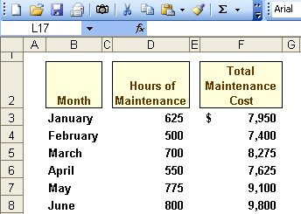
The High-Low Method
Assume the following hours of maintenance work and the total maintenance costs for six months.
Notes:
The high-low method can be used to analyze mixed costs, if a scattergraph plot reveals an approximately linear relationship between the X and Y variables. We will use the data shown in the Excel spreadsheet to determine the fixed and variable portions of maintenance costs. We have collected data about the number of hours of maintenance and total cost incurred.
Let’s see how the high-low method works.

Slide 24
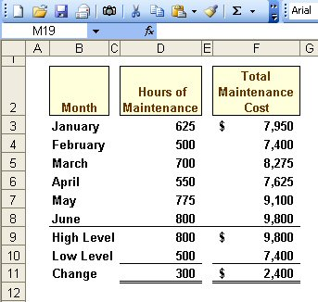
The High-Low Method
The variable cost per hour of maintenance is equal to the change in cost divided by the change in hours.
$2,400
300
= $8.00/hour
Notes:
Part II
The first step in the process is to identify the high level of activity and its related total cost and the low level of activity with its related total cost. You can see that the high level of activity is 800 hours with a cost of $9,800 dollars. The low level of activity is 500 hours with a related total cost of $7,400.
Part II
Now, we subtract the low level of activity from the high level and do the same for the costs we have identified. In our case, the change in level of activity and cost is 300 hours and $2,400, respectively.
The variable cost per unit of activity is determined by dividing the change in total cost by the change in activity. For our maintenance example, we divide $2,400 by 300 and determine that the variable cost per hour of maintenance is $8.00.

Slide 25
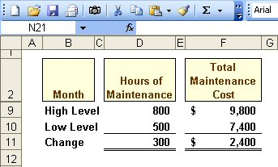
The High-Low Method
Total Fixed Cost = Total Cost – Total Variable Cost
Total Fixed Cost = $9,800 – ($8/hour × 800 hours)
Total Fixed Cost = $9,800 – $6,400
Total Fixed Cost = $3,400
Notes:
Part I
Here is the equation we will use to calculate total fixed cost.
Part II
We can substitute known data to estimated total fixed cost. We know that at 800 hours of maintenance, total cost is $9,800. We just calculated the variable cost per unit of activity at $8. So we will multiply the 800 hours of activity times the $8 variable rate per unit.
Part III
By solving the equation, we see that total fixed cost is equal to $3,400. We can now construct an equation to estimate total maintenance cost at any level of activity within the relevant range.

Slide 26
The High-Low Method
The Cost Equation for Maintenance
Y = $3,400 + $8.00X
Notes:
Our basic equation of Y is equal to $3,400 (our total fixed cost) plus $8 times the actual level of activity.
You can verify the equation by calculating total maintenance costs at 500 hours, the low level of activity. It will be worth your time to make the calculation.

Slide 27
Quick Check ✓
Sales salaries and commissions are $10,000 when 80,000 units are sold, and $14,000 when 120,000 units are sold. Using the high-low method, what is the variable portion of sales salaries and commission?
a. $0.08 per unit
b. $0.10 per unit
c. $0.12 per unit
d. $0.125 per unit
Notes:
See if you can apply what we have just discussed to determine the variable portion of sales salaries and commissions for this company.

Slide 28
Quick Check ✓
Sales salaries and commissions are $10,000 when 80,000 units are sold, and $14,000 when 120,000 units are sold. Using the high-low method, what is the variable portion of sales salaries and commission?
a. $0.08 per unit
b. $0.10 per unit
c. $0.12 per unit
d. $0.125 per unit
$4,000 ÷ 40,000 units
= $0.10 per unit
Notes:
The correct answer is 10 cents per unit.

Slide 29
Quick Check ✓
Sales salaries and commissions are $10,000 when 80,000 units are sold, and $14,000 when 120,000 units are sold. Using the high-low method, what is the fixed portion of sales salaries and commissions?
a. $ 2,000
b. $ 4,000
c. $10,000
d. $12,000
Notes:
Using the same data, calculate the total fixed cost portion of sales salaries and commissions.

Slide 30
Quick Check ✓
Sales salaries and commissions are $10,000 when 80,000 units are sold, and $14,000 when 120,000 units are sold. Using the high-low method, what is the fixed portion of sales salaries and commissions?
a. $ 2,000
b. $ 4,000
c. $10,000
d. $12,000
Notes:
The calculation of the answer is a bit more complex, but we see that total fixed cost equals $2,000.

Slide 31
Least-Squares Regression Method
A method used to analyze mixed costs if a scattergraph plot reveals an approximately linear relationship between the X and Y variables.
This method uses all of the
data points to estimate
the fixed and variable
cost components of a
mixed cost.
The goal of this method is
to fit a straight line to the
data that minimizes the
sum of the squared errors.
Notes:
The least-squares regression method is a more sophisticated approach to isolating the fixed and variable portion of a mixed cost. This method uses all of the data points to estimate the fixed and variable cost components of a mixed cost. This method is superior to the scattergraph plot method that relies upon only one data point and the high-low method that uses only two data points to estimate the fixed and variable cost components of a mixed cost. The basic goal of this method is to fit a straight line to the data that minimizes the sum of the squared errors. The regression errors are the vertical deviations from the data points to the regression line.

Slide 32
Least-Squares Regression Method
Software can be used to fit a regression line through the data points.
The cost analysis objective is the same: Y = a + bX
Least-squares regression also provides a statistic, called the R², which is a measure of the goodness
of fit of the regression line to the data points.
Notes:
The formulas that are used for least-squares regression are complex. Fortunately, computer software can perform the calculations, quickly. The observed values of the X and Y variables are entered into the computer program and all necessary calculations are made. In the appendix to this chapter, we show you how to use Microsoft Excel to complete a least-squares regression analysis.
Output from the regression analysis can be used to create the equation that enables us to estimate total costs at any activity level. The key statistic to examine when evaluating regression results is called R squared, which is a measure of the goodness of fit.

Slide 33
Least-Squares Regression Method
R² is the percentage of the variation in total cost explained by the activity.
Y
20
*
*
*
*
*
*
*
*
*
*
Total Cost
10
R² varies from 0% to 100%, and
the higher the percentage the better.
0
X
0 1 2 3 4
Activity
Notes:
The R square value can range from 0% to 100%. The higher the percentage, the better the fit.

Slide 34
Comparing Results From the Three Methods
The three methods just discussed provide slightly different estimates of the fixed and variable cost components of the mixed cost.
This is to be expected because each method uses differing amounts of the data points to provide estimates.
Least-squares regression provides the most accurate estimate because it uses all the data points.
Notes:
The three methods we discussed for isolating the fixed and variable portions of a mixed cost yield slightly different results. The most accurate estimate is provided by the least-squared regression method. Less accurate results are usually associated with the scattergraph. The high-low method provides results that fall somewhere in the middle of the other two methods.

Slide 35

The Contribution Format
Let’s put our knowledge of cost behavior to work by preparing a contribution format income statement.
Notes:
The contribution approach provides an income statement format geared directly to cost behavior, which has been the focus of discussion in this chapter.

Slide 36
The Contribution Format
The contribution margin format emphasizes cost behavior. Contribution margin covers fixed costs and provides for income.
Notes:
The contribution approach separates costs into fixed and variable. Sales minus variable costs equals contribution margin. The contribution margin minus fixed costs equals net operating income.

Slide 37
The Contribution Format
Used primarily for
external reporting.
Used primarily by
management.
Notes:
The contribution format allocates costs based on cost behavior. The contribution approach differs from the traditional approach covered in Chapter 2. The traditional approach organizes costs in a functional format. Costs relating to production, administration and sales are grouped together without regard to their cost behavior. The traditional approach is used primarily for external reporting purposes.

Slide 38
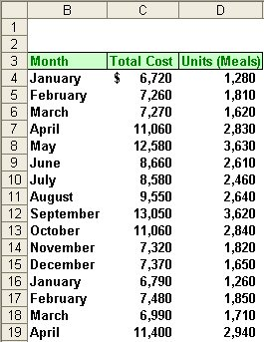
Simple Regression Analysis Example
Matrix, Inc. wants to know its average fixed cost and variable cost per unit.
Using the data to the right, let’s see how to do a regression using Microsoft Excel.
Notes:
Matrix, Inc. has gathered 15 month’s of information concerning the number of meals prepared and the total cost of preparing them each month. We will use this data in our least-squares regression model. Using Microsoft Excel, we will estimate the variable and fixed cost components of the total meals cost.

Slide 39
Simple Regression Using Excel
You will need three pieces of information from your regression analysis:
Estimated Variable Cost per Unit (line slope)
Estimated Fixed Costs (line intercept)
Goodness of fit, or R²
To get these three pieces information we will need to use three different Excel functions.
LINEST, INTERCEPT, & RSQ
Notes:
To gather the three pieces of information we need, we will use three special functions in Excel. These functions are named LINEST, INTERCEPT, and RSQ. LINEST provides us with the slope of the line, INTERCEPT gives us the fixed cost intercept, and RSQ yields the R squared value.
Load Excel on your computer and enter the data shown in the table on the right side of your screen. Start with the headings in cell B3, C3, and D3. Enter the months in column B, the total cost in column C, and the number of meals in column D. When finished entering this data, go to the next screen.

Slide 40
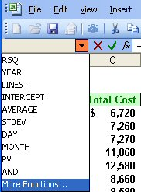
Simple Regression Using Excel
Place your cursor in cell F4 and press the = key. Click on the pull down menu and scroll down to “More Functions . . .”
Notes:
We will place the slope of the line in cell F4, so place your cursor in cell F4 and press the equal key. Look to the left of your screen and you will see the special functions drop-down menu. Click on the down arrow to the right of the special functions tab and scroll down to select more functions.

Slide 41
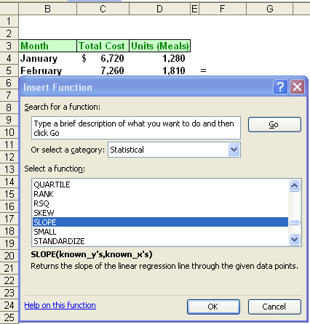
Simple Regression Using Excel
Scroll down to the “Statistical”, functions. Now scroll down the statistical functions until you highlight “SLOPE”
Notes:
Use the Or select a category option to select statistical. Once statistical is selected, move to the select a function window and scroll down until you find SLOPE. Click on SLOPE.

Slide 42
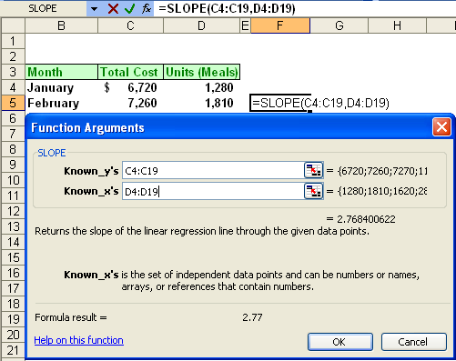
Simple Regression Using Excel
1. In the Known_y’s box, enter C4:C19 for the range.
2. In the Known_x’s box, enter D4:D19 for the range.
Notes:
The Function Arguments window will pop-up for SLOPE. The first blank space is for Known underscore y’s. We want to enter the total cost for each month in this space. To do this, click on cell C4, hold down the mouse button and drag down to cell C19. Now, release the mouse button and C4 colon C19 will appear in the first space. We have now entered the total cost.
Move your cursor down to the second space named Known underscore x’s. We want to enter the number of meals prepared in this space. Click on cell D4, hold down the mouse button and drag down to cell D19. Release the mouse button and you have entered the number of meals.

Slide 43
Simple Regression Using Excel
Here is the estimate of the slope of the line.
1. In the Known_y’s box, enter, C4:C19 for the range.
2. In the Known_x’s box, enter, D4:D19 for the range.
Notes:
Look at the bottom of your screen to locate the 2.77. This is the estimate of the slope of the line. Now look at your cell F4 and make sure it looks just like the cell contents on this screen. If you have 2.77 and your cell F4 looks like the one on your screen, press the enter key. You have calculated the slope of the line, which is the first piece of vital information.

Slide 44
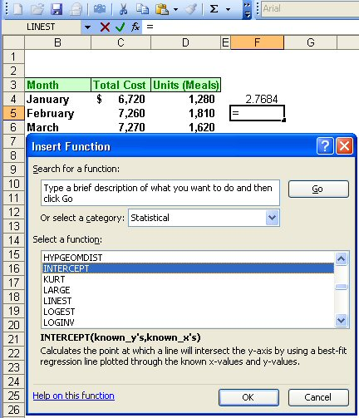
Simple Regression Using Excel
With your cursor in cell F5, press the = key and go to the pull down menu for special functions. Select Statistical and scroll down to highlight the INTERCEPT function.
Notes:
Move your cursor to cell F5 and press the equal key. Return to the special functions area and click on the down arrow. The statistical function should now be selected. Scroll the select a function window until you find INTERCEPT. Click on INTERCEPT to select this function.

Slide 45
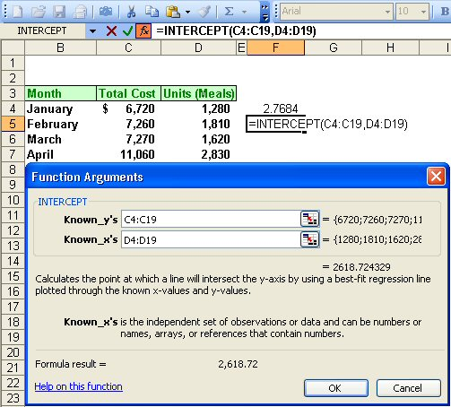
Simple Regression Using Excel
Here is the estimate of the fixed costs.
1. In the Known_y’s box, enter C4:C19 for the range.
2. In the Known_x’s box, enter D4:D19 for the range.
Notes:
Part I
Once again, we are asked to enter the Known underscore y’s and x’s. Follow the same procedures we used earlier to enter the total cost values in the Known underscore y’s and the number of meals in the Known underscore x’s spaces.
Part II
Notice that Excel has already calculated the estimated fixed costs at $2,618.72. If you find this amount and your cell F5 looks like the one on the screen, press the enter key. You have just determined the fixed cost intercept, which is the second piece of information needed.

Slide 46
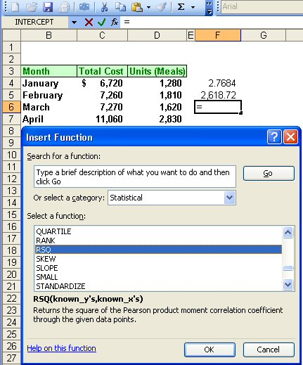
Simple Regression Using Excel
Finally, we will determine the “goodness of fit”, or R², by using the RSQ function.
Notes:
Move your cursor to cell F6, press the equal key, and select the special functions section of Excel. You are already in statistical, so scroll until you find the special function RSQ (or R squared). Click on RSQ and you are ready to enter the necessary data.

Slide 47
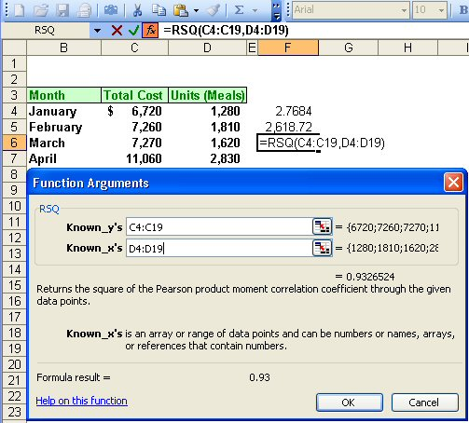
Simple Regression Using Excel
Here is the estimate of R².
1. In the Known_y’s box, enter C4:C19 for the range.
2. In the Known_x’s box, enter D4:D19 for the range.
Notes:
Part I
Once again, the function arguments window asks you to enter the Known underscore y’s and x’s. Follow the same procedure to enter total cost in the Known underscore y’s and the number of meals in the Known underscore x’s.
Part II
Look in the arguments window and notice that the R squared is equal to 93.3%. That is an excellent R squared. If you calculated this value for R squared and your cell F6 looks like the one on your screen, press the enter key. You have now completed gathering all the information necessary.
Using Excel to solve a least-squares regression problem is very easy. It is very important that you understand the output from these special functions.

Slide 48
End of Lecture 12
Notes:
End of chapter 5.

