Slide 1
Chapter 10
Lecture 11
Determining How Cost Behave
Readings
Chapter 10,Cost Accounting, Managerial Emphasis, 14th edition by Horengren
Chapter 5, Managerial Accounting 12th edition by Garrison, Noreen, Brewer

Slide 2
Learning Objectives
Understand how fixed and variable costs behave and how to use them to predict costs.
Use a scatter graph plot to diagnose cost behavior.
Analyze a mixed cost using the high-low method.
Prepare an income statement using the contribution format.
Analyze a mixed cost using the least-squares regression method

Slide 3
Cost Functions
A cost function is a mathematical representation of how a cost changes with changes in the level of an activity relating to that cost

Slide 4
Cost Terminology
Variable Costs – costs that change in total in relation to some chosen activity or output
Fixed Costs – costs that do not change in total in relation to some chosen activity or output
Mixed Costs – costs that have both fixed and variable components; also called semivariable costs

Slide 5
Cost Function Assumptions
Variations in the level of a single activity (the cost driver) explain the variations in the related total costs
Cost behavior is approximated by a linear cost function within the relevant range
  Graphically, the total cost versus the level of a single activity related to that cost is a straight line within the relevant rage

Slide 6
Bridging Accounting & Statistical Terminology
Accounting | Statistics
Variable Cost | Slope
Fixed Cost | Intercept
Mixed Cost | Linear Cost Function

Slide 7
The Linear Cost Function
y = a + bX
The Dependent
Variable:
The cost that is
being predicted
The Independent
Variable:
The cost driver
The slope of
the line:
variable cost
per unit
The Intercept:
Fixed Costs

Slide 8
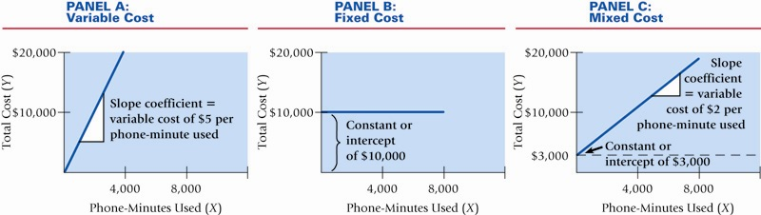
Linear Cost Functions Illustrated

Slide 9
Criteria for Classifying Variable & Fixed Components of a Cost
Choice of Cost Object – different objects may result in different classification of the same cost
Time Horizon – the longer the period, the more likely the cost will be variable
Relevant Range – behavior is predictable only within this band of activity

Slide 10
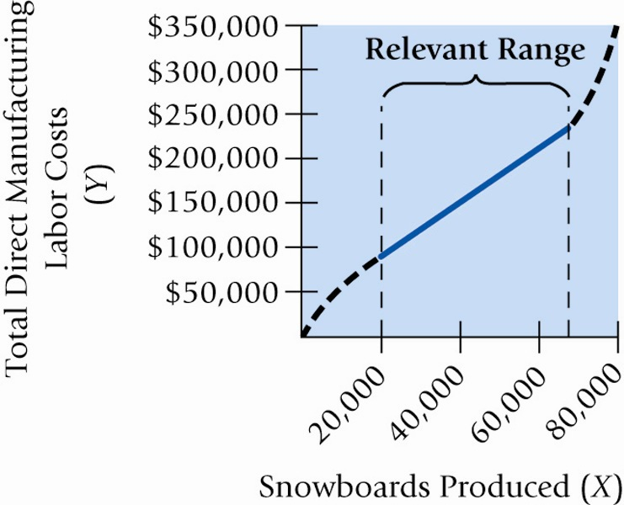
The Relevant
Range Illustrated

Slide 11
Cause & Effect as it relates to
Cost Drivers
The most important issue in estimating a cost function is determining whether a cause-and-effect relationship exists between the level of an activity and the costs related to that level of activity.

Slide 12
Cause & Effect as it relates to
Cost Drivers
A cause-and-effect relationship might arise as a result of:
  A physical relationship between the level of activity and costs
  A contractual agreement
  Knowledge of operations
Note: a high correlation (connection) between activities and costs does not necessarily mean causality

Slide 13
Cost Estimation Methods
Industrial Engineering Method
Conference Method
Account Analysis Method
Quantitative Analysis Methods
  High-Low Method
  Regression Analysis

Slide 14
Industrial Engineering Method
Estimates cost functions by analyzing the relationship between inputs and outputs in physical terms
Includes time-and-motion studies
Very thorough and detailed, but also costly and time-consuming
Also called the Work-Measurement Method

Slide 15
Conference Method
Estimates cost functions on the basis of analysis and opinions about costs and their drivers gathered from various departments of a company
Pools expert knowledge
Reliance on opinions still make this method subjective

Slide 16
Account Analysis Method
Estimates cost functions by classifying various cost accounts as variable, fixed or mixed with respect to the identified level of activity
Is reasonably accurate, cost-effective, and easy to use, but is subjective

Slide 17
Qualitative Analysis
Uses a formal mathematical method to fit cost functions to past data observations
Advantage: results are objective

Slide 18
Steps in Estimating a Cost Function Using Quantitative Analysis
Choose the dependent variable (the cost to be predicted)
Identify the independent variable or cost driver
Collect data on the dependent variable and the cost driver
Plot the data
Estimate the cost function using the High-Low Method or Regression Analysis
Evaluate the cost driver of the estimated cost function

Slide 19
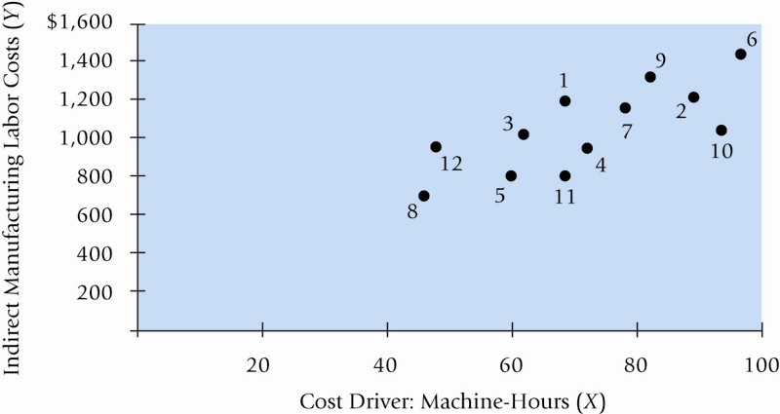
Sample Cost – Activity Plot

Slide 20
High-Low Method
Simplest method of quantitative analysis
Uses only the highest and lowest observed values

Slide 21
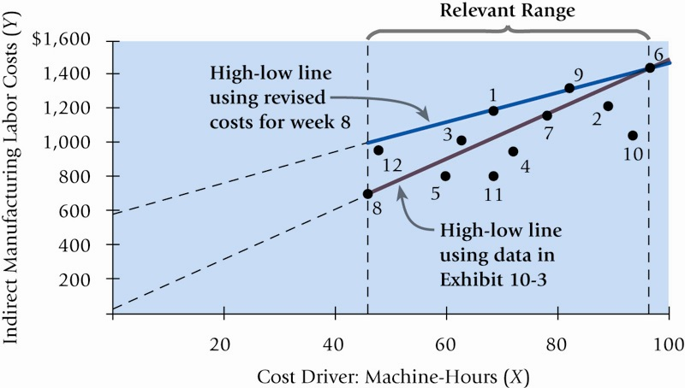
High – Low Method Plot

Slide 22
Steps in the High-Low Method
Calculate variable cost per unit of activity

Slide 23
Steps in the High-Low Method
Calculate Total Fixed Costs
Summarize by writing a linear equation

Slide 24
Regression Analysis
Regression analysis is a statistical method that measures the average amount of change in the dependent variable associated with a unit change in one or more independent variables
Is more accurate than the High-Low method because the regression equation estimates costs using information from all observations; the High-Low method uses only two observations

Slide 25
Types of Regression
Simple – estimates the relationship between the dependent variable and one independent variable
Multiple – estimates the relationship between the dependent variable and two or more independent variables

Slide 26
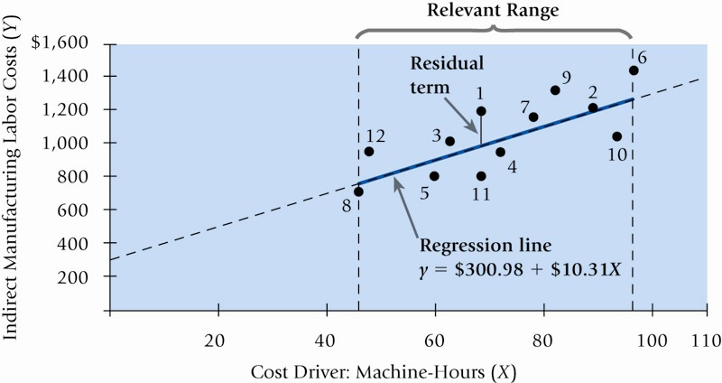
Sample Regression Model Plot

Slide 27
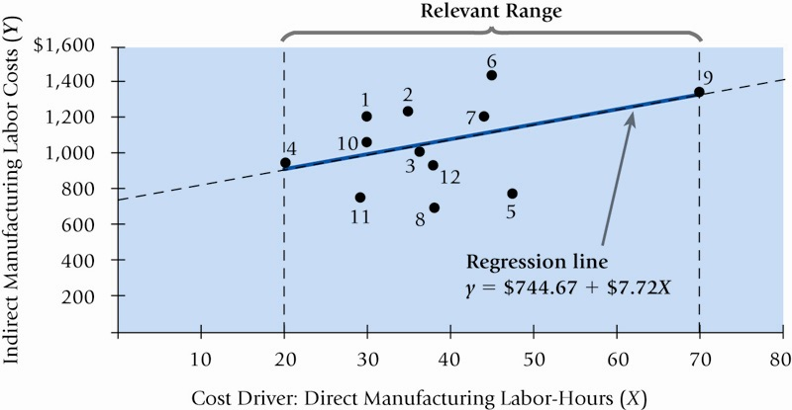
Alternative Regression Model Plot

Slide 28
Terminology
Goodness of Fit – indicates the strength of the relationship between the cost driver and costs
Residual Term – measures the distance between actual cost and estimated cost for each observation

Slide 29
Criteria for Evaluating
Alternative Cost Drivers
Economic Plausibility
Goodness of Fit
Significance of the Independent Variable

Slide 30
Nonlinear Cost Functions
Economies of Scale
Quantity Discounts
Step Cost Functions – resources increase in “lot-sizes”, not individual units
Learning Curves – labor hours consumed decrease as workers learn their jobs and become better at them
Experience Curve – broader application of learning curve that includes Downstream activities including marketing and distribution

Slide 31
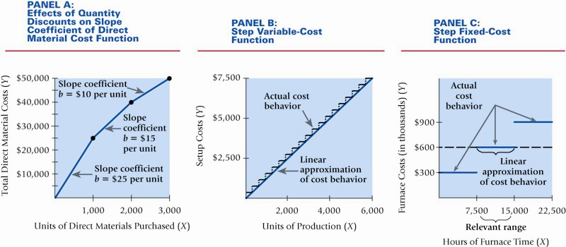
Nonlinear Cost Functions Illustrated

Slide 32
Types of Learning Curves
Cumulative Average-Time Learning Model – cumulative average time per unit declines by a constant percentage each time the cumulative quantity of units produced doubles
Incremental Unit-Time Learning Model – incremental time needed to produce the last unit declines by a constant percentage each time the cumulative quantity of units produced doubles

Slide 33
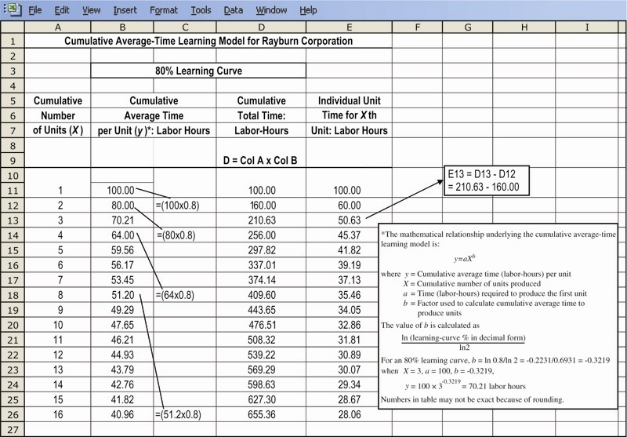
Sample Cumulative Average-Time Model

Slide 34
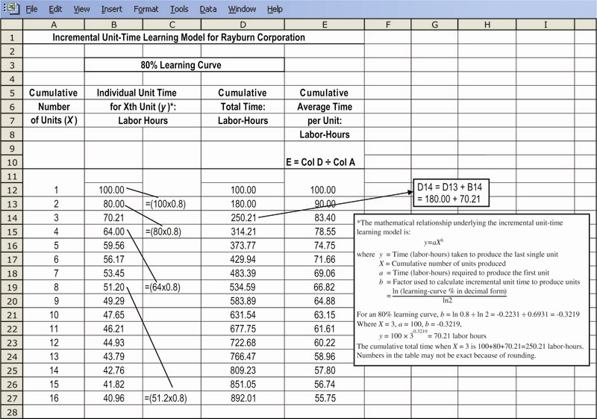
Sample Incremental Unit-Time Model

Slide 35
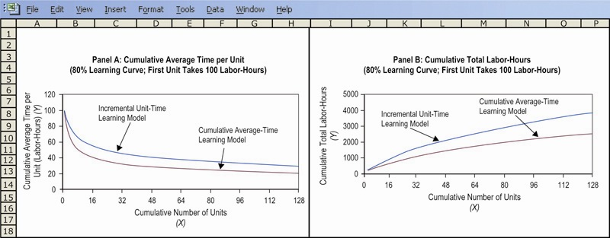
Time Learning Model Comparative Plots

Slide 36
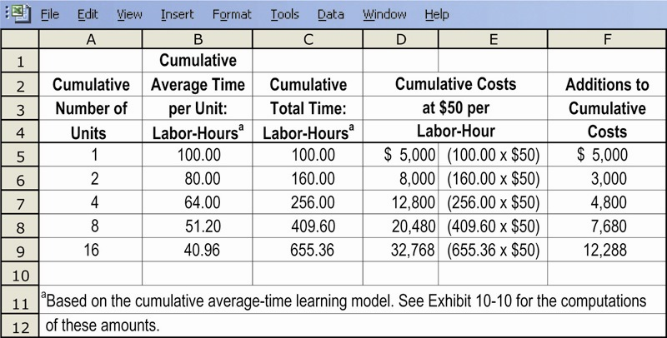
Predicting Costs Using Alternative Time Learning Models

Slide 37
The Ideal Database
The database should contain numerous reliably measured observations of the cost driver and the costs
In relation to the cost driver, the database should consider many values spanning a wide range

Slide 38
Data Problems
The time period for measuring the dependent variable does not match the period for measuring the cost driver
Fixed costs are allocated as if they are variable
Data are either not available for all observations or are not uniformly reliable

Slide 39
Data Problems
Extreme values of observations occur from errors in recording costs
There is no homogeneous relationship between the cost driver and the individual cost items in the dependent variable-cost pool. A homogeneous relationship exists when each activity whose costs are included in the dependent variable has the same cost driver

Slide 40
Data Problems
The relationship between the cost driver and the cost is not stationary
Inflation has affected costs, the driver, or both

Slide 41
Types of Cost Behavior Patterns
Recall the summary of our cost behavior discussion from an earlier chapter.
Notes:
We discussed this table in an earlier chapter. Let’s concentrate on variable costs in total. Recall that total variable cost is proportional to the activity level within the relevant range. As activity increases, total variable cost increases, and as activity decreases, total variable cost decreases.

Slide 42
The Activity Base
Units
produced
Machine hours
A measure of what causes the incurrence of a variable cost
Miles driven
Labor hours
Notes:
An activity base (also called a cost driver) is a measure of what causes the incurrence of variable costs. As the level of the activity base increases, the total variable cost increases proportionally. Units produced (or sold) is not the only activity base within companies. A cost can be considered variable if it varies with activity bases such as miles driven, machine hours, or labor hours.

Slide 43

True Variable Cost Example
A variable cost is a cost whose total dollar amount varies in direct proportion to changes in the activity level. Your total long distance telephone bill is based on how many minutes you talk.
Total Long Distance
Telephone Bill
Minutes Talked
Notes:
As an example of an activity base, consider your total long distance telephone bill. The activity base is the number of minutes that you talk. A true variable cost is one whose total dollar amount varies in direct proportion to changes in the level of activity. On your land-line, your total long distance telephone bill is determined by the number of minutes you talk. An activity base, or cost driver, is a measure of what causes the incurrence of variable costs. As the level of activity base increases, the variable cost increases proportionally.

Slide 44
Types of Cost Behavior Patterns
Recall the summary of our cost behavior discussion from an earlier chapter.
Notes:
On a per unit basis, variable costs remain the same over a wide range of activity.

Slide 45
Variable Cost Per Unit Example
A variable cost remains constant if expressed on a per unit basis. The cost per minute talked is constant. For example, 10 cents per minute.
Per Minute
Telephone Charge
Minutes Talked
Notes:
A variable cost remains constant if expressed on a per unit basis. Referring to the telephone example, the cost per minute talked is constant (e.g., 10 cents per minute).

Slide 46
Extent of Variable Costs
The proportion of variable costs differs across organizations. For example . . .
A public utility with
large investments in
equipment will tend
to have fewer
variable costs.
A manufacturing company
will often have many
variable costs.
A merchandising company
usually will have a high
proportion of variable costs,
like cost of sales.
A service company
will normally have a high
proportion of variable costs.
Notes:
A public utility has huge investments in property, plant and equipment, so it will tend to have fewer variable costs than a less capital intensive industry. In contrast, a merchandising company usually has a high proportion of variable costs like cost of goods sold. Service companies, like law firms and CPA firms, also tend to have a high proportion of variable costs.

Slide 47
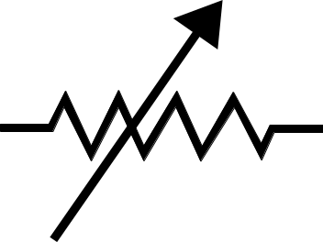
Examples of Variable Costs
Merchandising companies – cost of goods sold.
Manufacturing companies – direct materials, direct labor, and variable overhead.
Merchandising and manufacturing companies – commissions, shipping costs, and clerical costs, such as invoicing.
Service companies – supplies, travel, and clerical.
Notes:
Here are some examples of variable costs that are likely present in many types of businesses.

Slide 48

True Variable Cost
Direct materials is a true or proportionately variable cost because the amount used during a period will vary in direct proportion to the level of production activity.
Cost
Volume
Notes:
Recall that we previously stated that true variable costs vary directly and proportionately with changes in activity. Direct material is an example of a cost that behaves in a true variable pattern. Now let’s look at what are known as step-variable costs.

Slide 49

Step-Variable Costs
A resource that is obtainable only in large chunks (such as maintenance workers) and whose costs increase or decrease only in response to fairly wide changes in activity is known as a step-variable cost.
Cost
Volume
Notes:
A step variable cost remains constant within a narrow range of activity, so it tends to look like a fixed cost. Maintenance workers are often considered to be a variable cost, but this labor cost does not behave as a true variable cost. For example, fairly wide changes in the level of production will cause a change in the number of maintenance workers employed, thereby increasing the total maintenance cost.

Slide 50
Step-Variable Costs
Small changes in the level of production are not likely to have any effect on the number of maintenance workers employed.
Cost
Volume
Notes:
For a step-variable cost, total cost increases to a new higher level when we reach the next higher range of activity. For example, a maintenance worker is obtainable only as a whole person who is capable of working approximately two thousand hours per year.

Slide 51
Step-Variable Costs
Only fairly wide changes in the activity level will cause a change in the number of maintenance workers employed
Cost
Volume
Notes:
Only fairly wide changes in the level of activity will cause a change in a step-variable cost. Maintenance workers are obtainable only in large chunks of a whole person who is capable of working approximately two thousand hours a year.

Slide 52
The Linearity Assumption and the Relevant Range
Economist’s
Curvilinear Cost Function
A straight line closely approximates a curvilinear variable cost line within the relevant range.
Relevant
Range
Total Cost
Accountant’s Straight-Line Approximation (constant unit variable cost)
Activity
Notes:
Part I
Economists correctly point out that many costs that accountants classify as variable costs actually behave in a curvilinear fashion.
Part II
In many important decisions, accountants tend to treat costs as linear in nature.
Part III
As long as the company is operating within the relevant range of activity, the accountant’s approximation of the economist’s curvilinear cost function seems to work quite well.
The relevant range is the range of activity within which the assumptions made about cost behavior are valid.

Slide 53
End of Lecture 11
Notes:
End of chapter 5.

