Slide 1
Chapter 6-Continued
Lecture 10
Master Budgeting and Responsibility Accounting
Readings
Chapter 6,Cost Accounting, Managerial Emphasis, 14th edition by Horengren
Chapter 10, Managerial Accounting 6th edition by Weygandt, kimmel, kieso

Slide 2
Master Budgeting and Responsibility Accounting
Learning Objectives
After studying this chapter, you should be able to:
[1] Explain the development of flexible budgets and the usefulness of flexible budget reports.
[2] Describe the concept of responsibility accounting.
[3] Indicate the features of responsibility reports for cost centers.
[4] Identify the content of responsibility reports for profit centers.
[5] Explain the basis and formula used in evaluating performance in investment centers.

Slide 3
Flexible Budgets
Flexible Budget Reports
Monthly comparisons of actual and budgeted manufacturing overhead costs.
A type of internal report.
Consists of two sections:
  Production data for a selected activity index, such as direct labor hours.
  Cost data for variable and fixed costs.
Widely used in production and service departments to evaluate a manager’s performance.

Slide 4
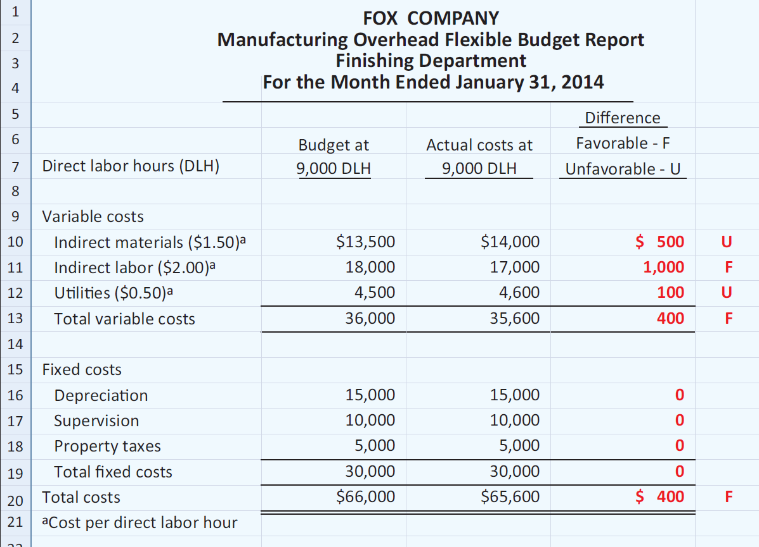
Flexible Budgets

Slide 5
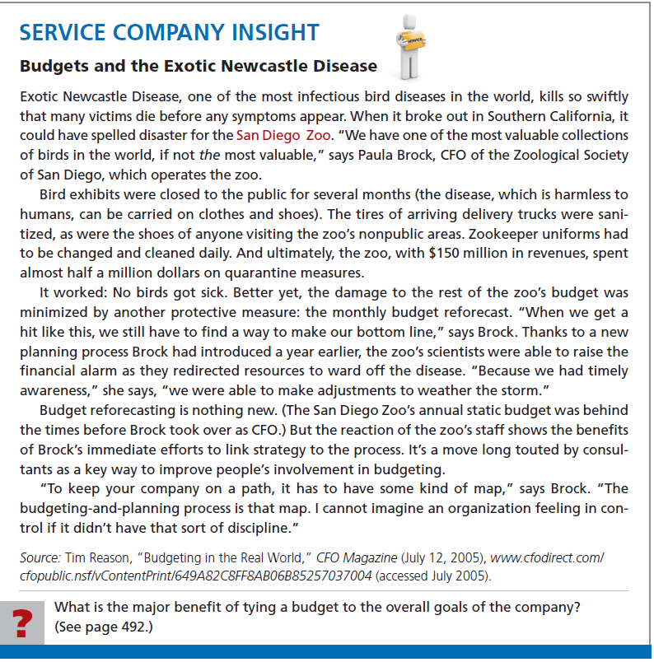


Slide 6
Flexible Budgets
Review Question
At 9,000 direct labor hours, the flexible budget for indirect materials is $27,000. If $28,000 of indirect materials costs are incurred at 9,200 direct labor hours, the flexible budget report should show the following difference for indirect materials:
  $1,000 unfavorable.
  $1,000 favorable.
  $400 favorable.
  $400 unfavorable.

Slide 7
Lawler Company expects to produce 40,000 units of product CV93 during the current year. Budgeted variable manufacturing costs per unit are direct materials $6, direct labor $15, and overhead $24. Annual budgeted fixed manufacturing overhead costs are $120,000 for depreciation and $60,000 for supervision.
In the current month, Lawler produced 5,000 units and incurred the following costs: direct materials $33,900, direct labor $74,200, variable overhead $120,500, depreciation $10,000, and supervision $5,000.
Prepare a flexible budget report. Were costs controlled?

Slide 8
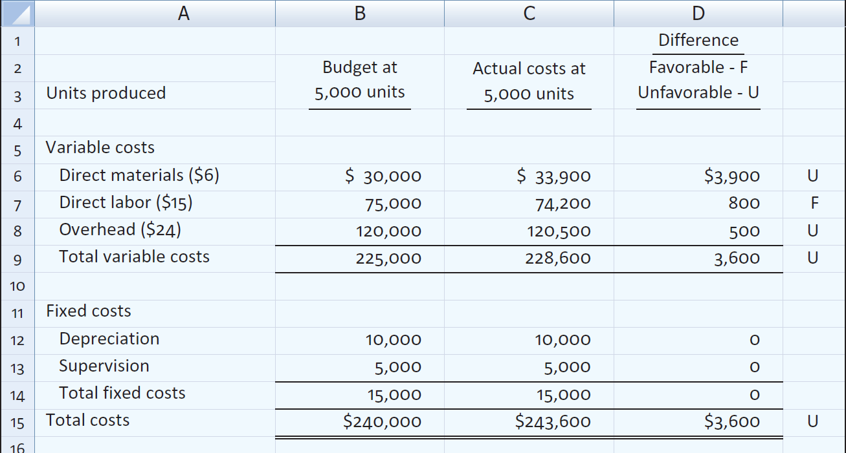
Prepare a flexible budget report. Were costs controlled?

Slide 9
Prepare a flexible budget report. Were costs controlled?
  The report indicates that actual direct labor was only about 1% different from the budget, and overhead was less than half a percent different. Both appear to have been well-controlled.
  The direct materials 13% unfavorable difference should probably be investigated.
  Actual fixed costs had no difference from budget and were well-controlled.

Slide 10
Responsibility Accounting
Accumulating and reporting costs (and revenues, where relevant) on the basis of the manager who has the authority to make the day-to-day decisions about the items.
Conditions:
  Costs and revenues can be directly associated with the specific level of management responsibility.
  Costs and revenues can be controlled by employees at the level of responsibility with which they are associated.
  Budget data can be developed for evaluating the manager’s effectiveness in controlling the costs and revenues.

Slide 11
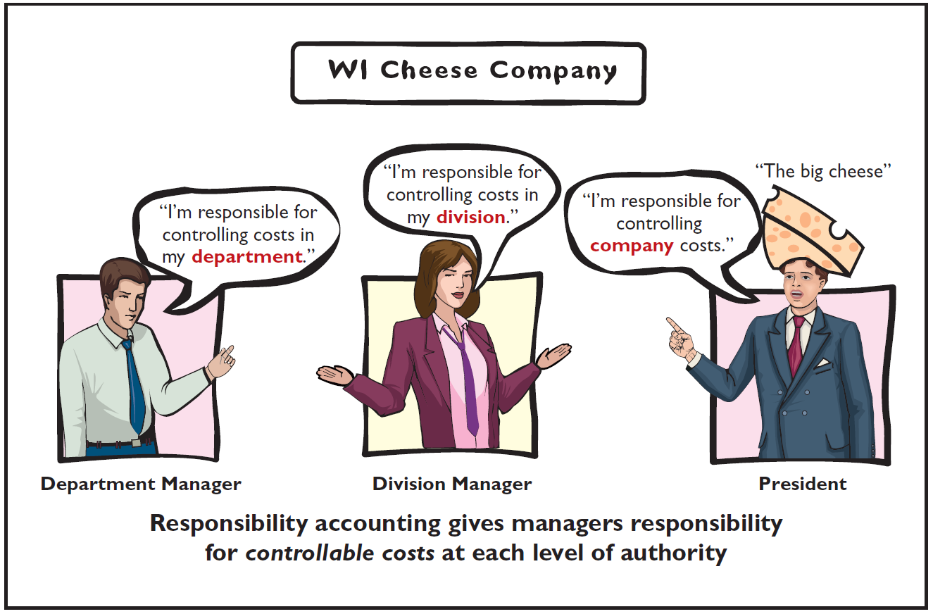
Responsibility Accounting
Levels of responsibility for controlling costs.

Slide 12
Responsibility Accounting
Responsibility center - any individual who has control and is accountable for activities.
May extend to any level of management.
Especially valuable in a decentralized company.
  Control of operations delegated to many managers throughout the organization.
  Segment – area of responsibility for which reports are prepared.

Slide 13
Responsibility Accounting
Two differences from budgeting in reporting costs and revenues:
  Distinguishes between controllable and noncontrollable costs.
  Emphasizes or includes only items controllable by the individual manager in performance reports.
Applies to both profit and not-for-profit entities.
  Profit entities: maximize net income.
  Not-for-profit: minimize cost of providing services.

Slide 14
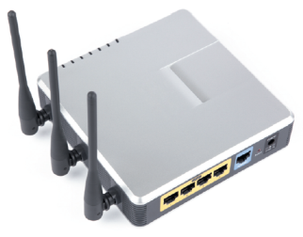
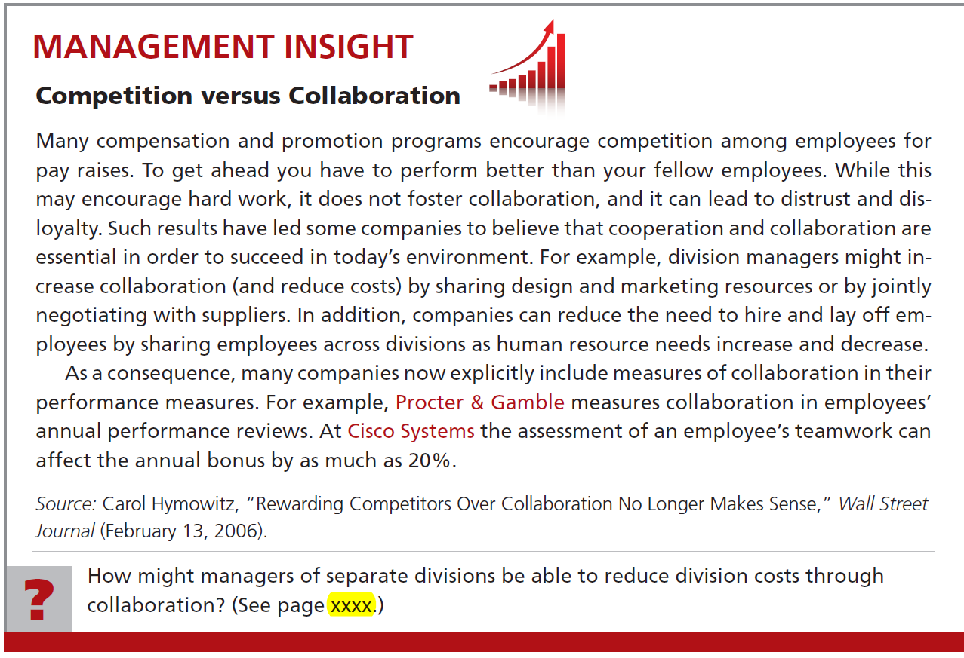

Slide 15
Responsibility Accounting
Controllable Versus Noncontrollable Revenues and Costs
Critical issue is whether the cost or revenue is controllable at the level of responsibility with which it is associated. A cost over which a manager has control is called a controllable cost.
  All costs are controllable by top management.
  Fewer costs are controllable as one moves down to each lower level of managerial responsibility.
Costs incurred indirectly and allocated to a responsibility level are noncontrollable costs.

Slide 16
Responsibility Accounting
Principles of Performance Evaluations
Management function that compares actual results with budget goals.
Includes both behavioral and reporting principles.

Slide 17
Principles of Performance Evaluation
Management by Exception
Management by exception means that top management’s review of a budget report is focused primarily on differences between actual results and planned objectives.
  Materiality - Without quantitative guidelines, management would have to investigate every budget difference regardless of the amount.
  Controllability of the item - Exception guidelines are more restrictive for controllable items than for items the manager cannot control.

Slide 18
Principles of Performance Evaluation
Behavioral Principles
Managers of responsibility centers should have direct input into the process of establishing budget goals of their area of responsibility.
The evaluation of performance should be based entirely on matters that are controllable by the manager being evaluated.
Top management should support the evaluation process.
The evaluation process must allow managers to respond to their evaluations.
The evaluation should identify both good and poor performance.

Slide 19
Principles of Performance Evaluation
Reporting Principles
Contain only data controllable by manager of responsibility center.
Provide accurate and reliable budget data to measure performance.
Highlight significant differences between actual results and budget goals.
Be tailor-made for intended evaluation.
Be prepared at reasonable intervals.

Slide 20
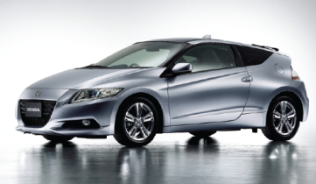
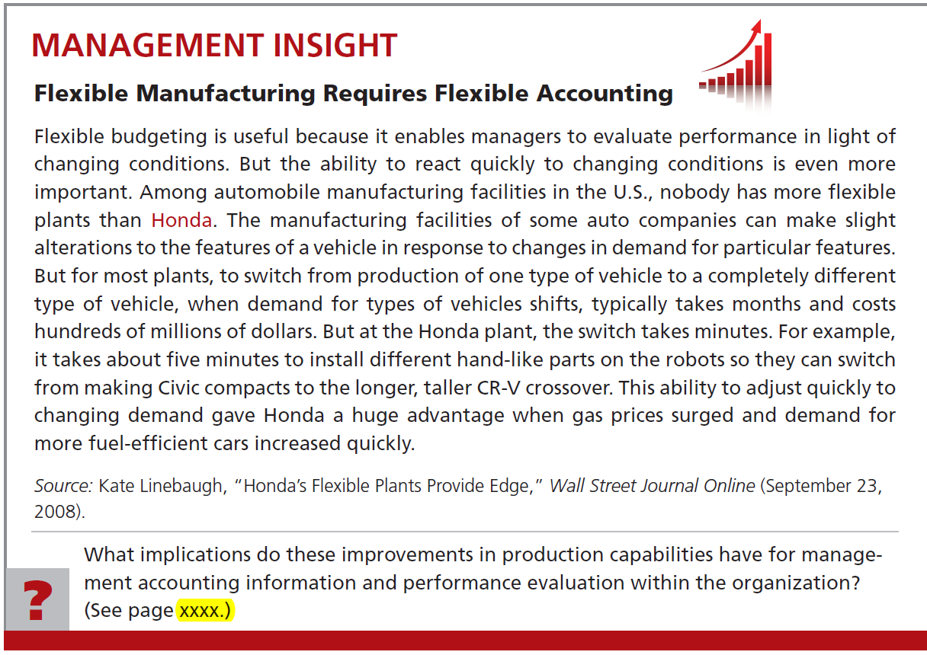

Slide 21
Responsibility Accounting
Responsibility Reporting System
Involves preparation of a report for each level of responsibility in the company's organization chart.
Begins with the lowest level of responsibility and moves upward to higher levels.
Permits management by exception at each level of responsibility.
Each higher level can obtain the detailed report for each lower level.

Slide 22
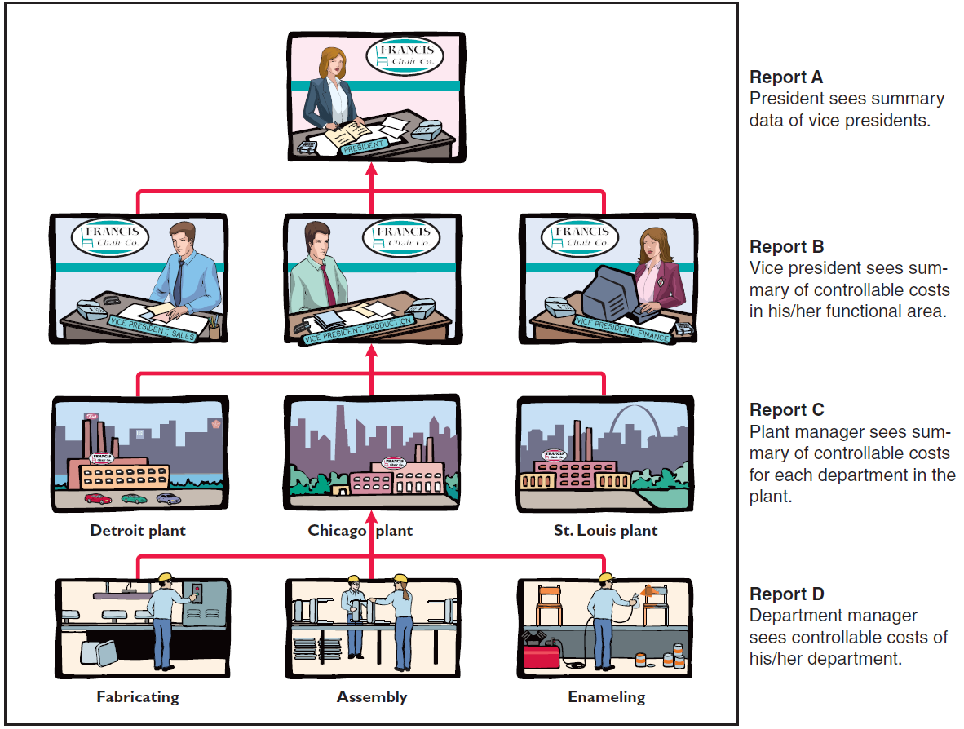
Responsibility Accounting

Slide 23
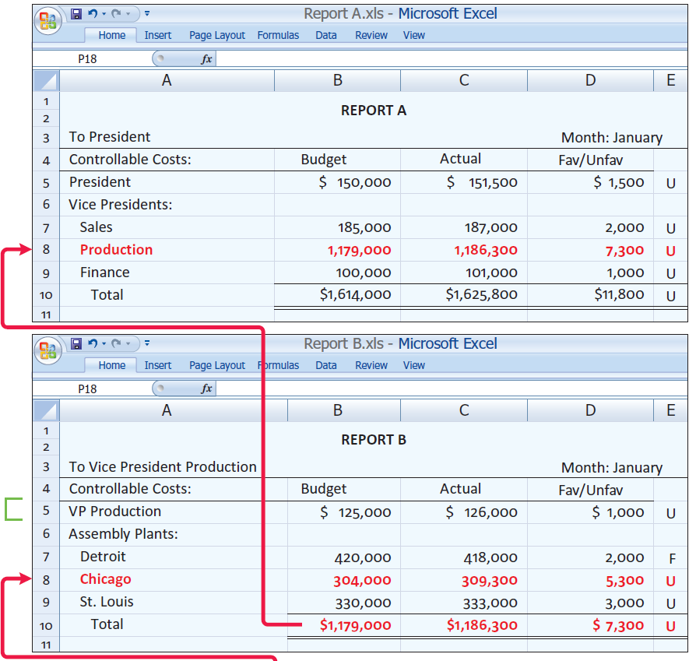
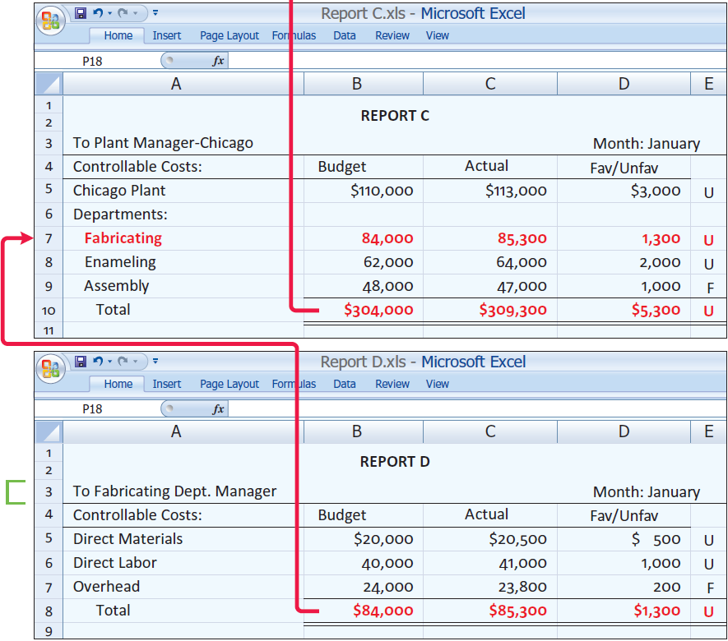
Responsibility Accounting
Report A
President sees summary
data of vice presidents.
Report B
Vice president sees summary of controllable costs in his/her functional area.
Permits comparative evaluations.
Plant manager can rank each department manager’s effectiveness in controlling manufacturing costs.
Comparative rankings provide incentive for a manager to control costs.
Report C
Plant manager sees summary of controllable costs for each department in the plant.
Report D
Department manager sees
controllable costs of his/her department.

Slide 24
Types of Responsibility Centers
Three basic types:
  Cost centers
    Incurs costs but does not directly generate revenues.
    Managers have authority to incur costs.
    Managers evaluated on ability to control costs.
    Usually a production department or a service department.
  Profit centers
  Investment centers

Slide 25
Types of Responsibility Centers
Three basic types:
  Cost centers
  Profit centers
    Incurs costs and generates revenues.
    Managers judged on profitability of center.
    Examples include individual departments of a retail store or branch bank offices.
  Investment centers

Slide 26
Types of Responsibility Centers
Three basic types:
  Cost centers
  Profit centers
  Investment centers
    Incurs costs, generates revenues, and has investment funds available for use.
    Manager evaluated on profitability of the center and rate of return earned on funds.
    Often a subsidiary company or a product line.
    Manager able to control or significantly influence investment decisions such as plant expansion.

Slide 27
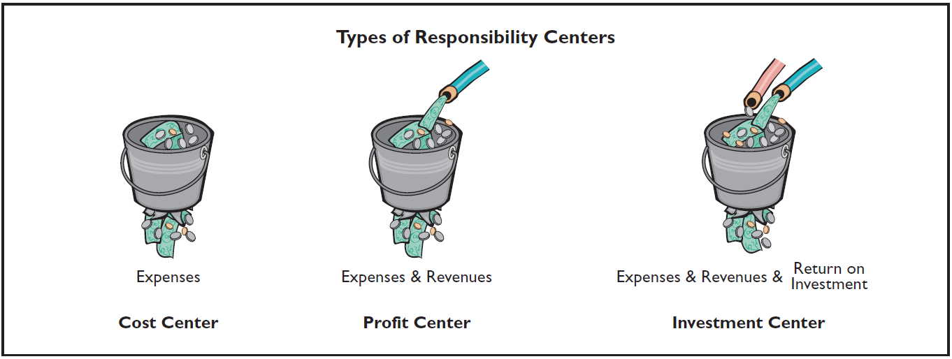
Types of Responsibility Centers

Slide 28
Types of Responsibility Centers
Review Question
Under responsibility accounting, the evaluation of a manager’s performance is based on matters that the manager:
  Directly controls.
  Directly and indirectly controls.
  Indirectly controls.
  Has shared responsibility for with another manager.

Slide 29
Types of Responsibility Centers
Responsibility Accounting for Cost Centers
Based on a manager’s ability to meet budgeted goals for controllable costs.
Results in responsibility reports which compare actual controllable costs with flexible budget data.
  Include only controllable costs in reports.
  No distinction between variable and fixed costs.

Slide 30
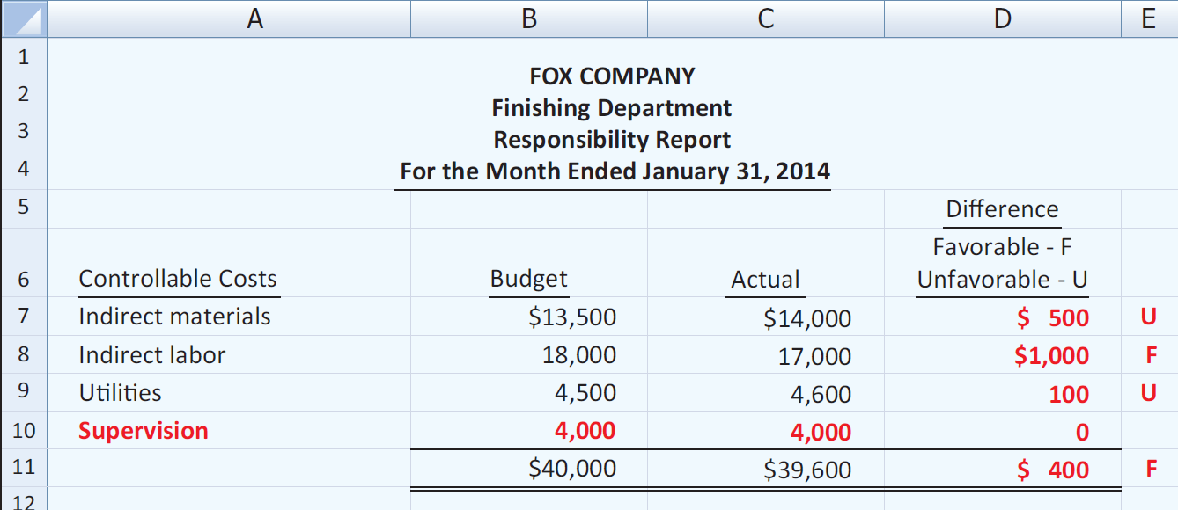
Types of Responsibility Centers
Illustration: The following report is adapted from the flexible budget report for Fox Manufacturing Company in Illustration 10-16.

Slide 31
Types of Responsibility Centers
Illustration: This report assumes:
  Finishing Department manager is able to control all manufacturing overhead costs except depreciation, property taxes, and his own monthly salary of $6,000.
  Remaining $4,000 ($10,000 - $6,000) of supervision costs are assumed to apply to other supervisory personnel within the Finishing Department, whose salaries are controllable by the manager.

Slide 32
Types of Responsibility Centers
Responsibility Accounting for Profit Centers
Based on detailed information about both controllable revenues and controllable costs.
Manager controls operating revenues earned, such as sales.
Manager controls all variable costs incurred by the center because they vary with sales.

Slide 33
Types of Responsibility Centers
Direct and Indirect Fixed Costs
  Direct fixed costs
    Relate specifically to one responsibility center.
    Incurred for the sole benefit of the center.
    Called traceable costs since they can be traced directly to one center.
    Most direct fixed costs are controllable by the profit center manager.

Slide 34
Types of Responsibility Centers
Direct and Indirect Fixed Costs
  Indirect fixed costs
    Pertain to a company's overall operating activities.
    Incurred for the benefit of more than one profit center.
    Called common costs since they apply to more than one center.
    Most are not controllable by the profit center manager.

Slide 35
Types of Responsibility Centers
Responsibility Report
  Budgeted and actual controllable revenues and costs.
  Uses cost-volume-profit income statement format:
    Deduct controllable fixed costs from the contribution margin.
    Controllable margin - excess of contribution margin over controllable fixed costs.
    Do not report noncontrollable fixed costs.

Slide 36
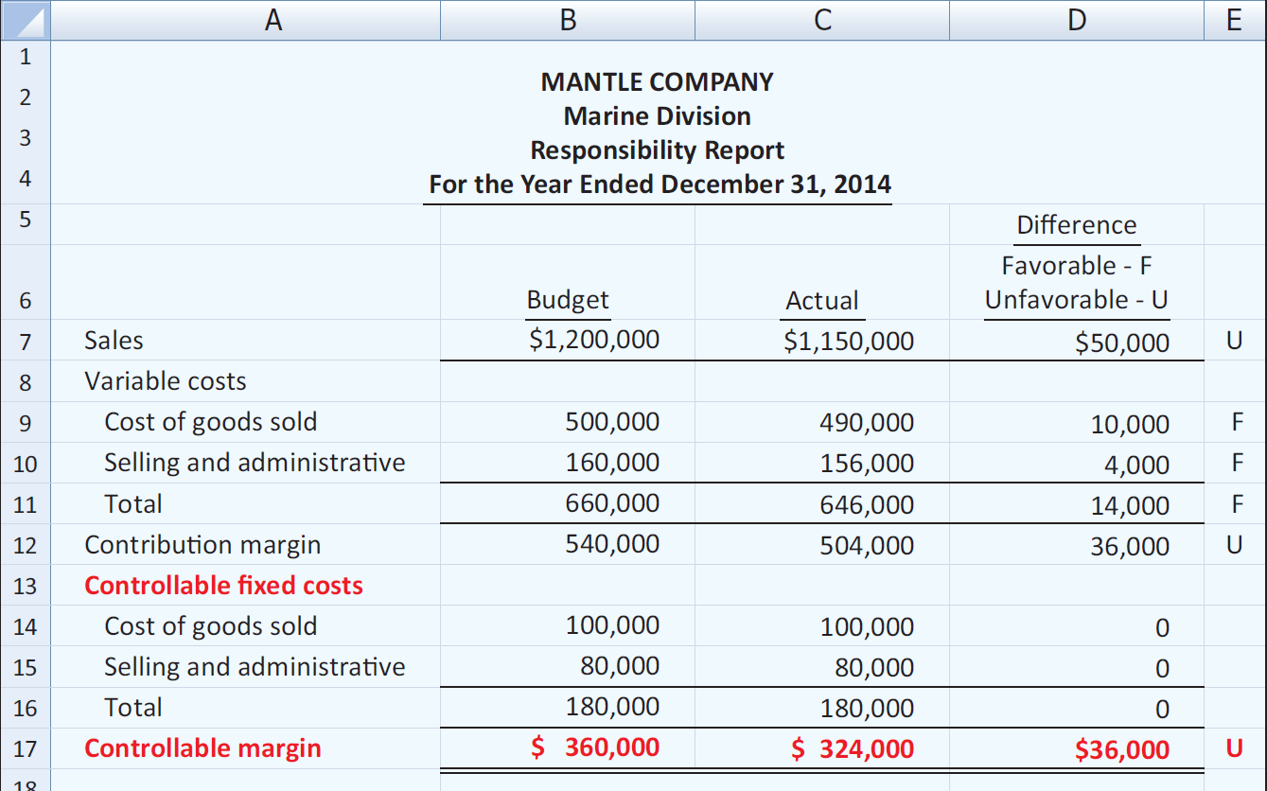
Types of Responsibility Centers
The Marine Division also had $60,000 of indirect fixed costs that were not controllable by the profit center manager.

Slide 37
Types of Responsibility Centers
Review Question
In a responsibility report for a profit center, controllable fixed costs are deducted from contribution margin to show:
  Profit center margin
  Controllable margin
  Net income
  Income from operations

Slide 38
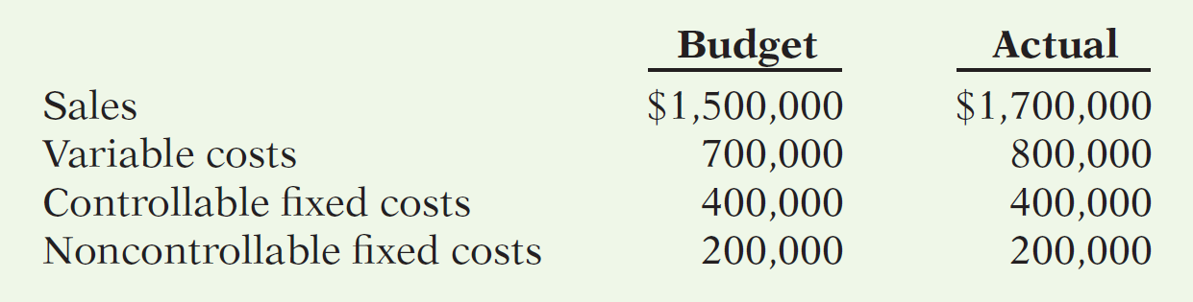
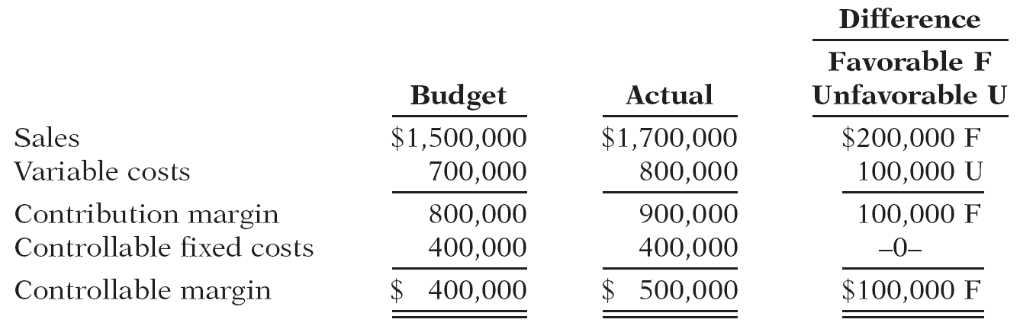
Midwest Division operates as a profit center. It reports the following for the year:
Prepare a responsibility report for December 31, 2014.

Slide 39
Types of Responsibility Centers
Responsibility Accounting for Investment Centers
Return on investment (ROI) is the primary basis for evaluating the performance of a manager of an investment center.
  Shows the effectiveness of the manager in using the assets at his/her disposal.
  Useful performance measure.
  Factors in ROI formula are controllable by manager.

Slide 40

Types of Responsibility Centers
Return on Investment (ROI)
  Operating assets include current assets and plant assets used in operations by the center and controlled by the manager.
  Base average operating assets on the beginning and ending cost or book values of the assets.

Slide 41
Types of Responsibility Centers
Responsibility Report
  Scope of manager’s responsibility affects content.
  Investment center is an independent entity for operating purposes.
  All fixed costs are controllable by center manager.
  Shows budgeted and actual ROI below controllable margin.

Slide 42
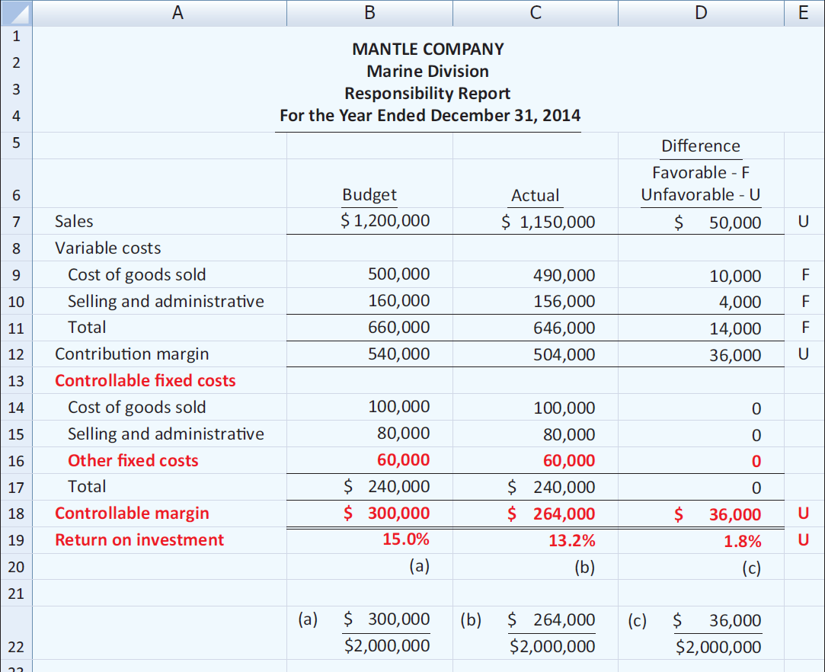
Types of Responsibility Centers
Illustration: The Marine Division is an investment center. It has budgeted and actual average operating assets of $2,000,000. The manager can control $60,000 of fixed costs.

Slide 43
Types of Responsibility Centers
Judgmental Factors in ROI
  Valuation of operating assets.
    Acquisition cost, book value, appraised value, or fair value.
    Each provides a reliable basis for evaluating performance.
  Margin (income) measure.
    Controllable margin, income from operations, or net income.
    Only controllable margin is a valid basis for evaluating performance of investment center manager.

Slide 44
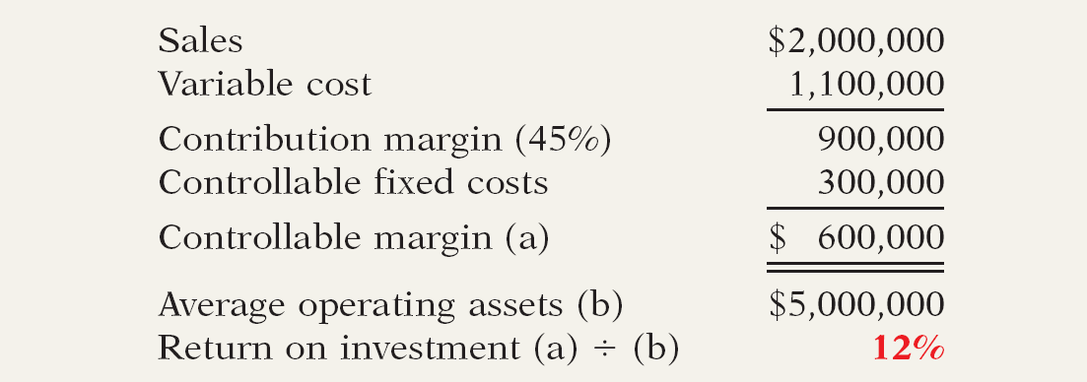
Types of Responsibility Centers
Improving ROI
Improve ROI by increasing controllable margin, and/or reducing average operating assets.

Slide 45

Types of Responsibility Centers
Increasing Controllable Margin Increase ROI by increasing sales or by reducing variable and controllable fixed costs.
  Increase sales by 10%.
    Sales increase $200,000 and contribution margin increases $90,000 ($200,000 X .45).
    Thus, controllable margin increases to $690,000 ($600,000 + $90,000).
    New ROI is 13.8%

Slide 46

Types of Responsibility Centers
Increasing Controllable Margin Increase ROI by increasing sales or by reducing variable and controllable fixed costs.
  Decrease variable and fixed costs 10%.
    Total costs decrease $140,000 [$1,100,000 - ($300,000 X 10%)].
    Controllable margin becomes $740,000.
    New ROI becomes 14.8%.

Slide 47

Types of Responsibility Centers
Reducing Average Operating Assets
  Assume that average operating assets are reduced 10% or $500,000 ($5,000,000 x .10).
  Average operating assets become $4,500,000.
  Controllable margin remains unchanged at $600,000.
  New ROI is 13.3%,

Slide 48
Types of Responsibility Centers
Review Question
In the formula for return on investment (ROI), the factors for controllable margin and operating assets are, respectively:
  Controllable margin percentage and total operating assets.
  Controllable margin dollars and average operating assets.
  Controllable margin dollars and total assets.
  Controllable margin percentage and average operating assets.

Slide 49
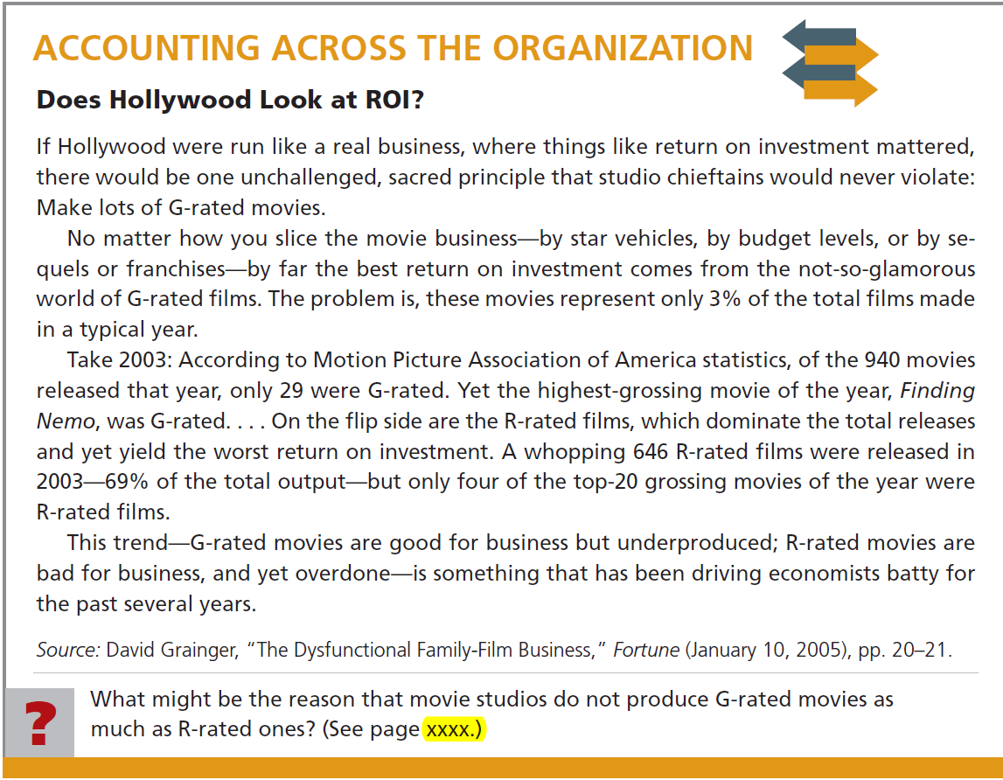


Slide 50
The service division of Metro Industries reported the following results for 2014.
Sales $400,000
Variable costs 320,000
Controllable fixed costs 40,800
Average operating assets 280,000
Management is considering the following independent courses of action in 2015 in order to maximize the return on investment.
  Reduce average operating assets by $80,000, with no change in controllable margin.
  Increase sales $80,000, with no change in the contribution margin percentage.
Compute controllable margin and the return on investment for 2014.
Compute controllable margin and the expected return on investment.

Slide 51
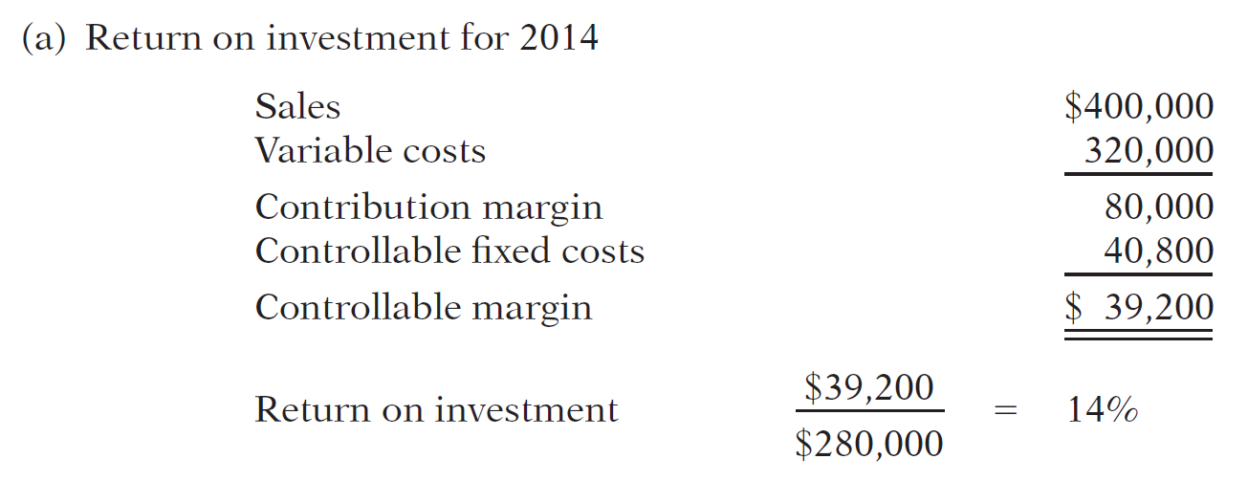
a. Compute controllable margin and the return on investment for 2014.

Slide 52
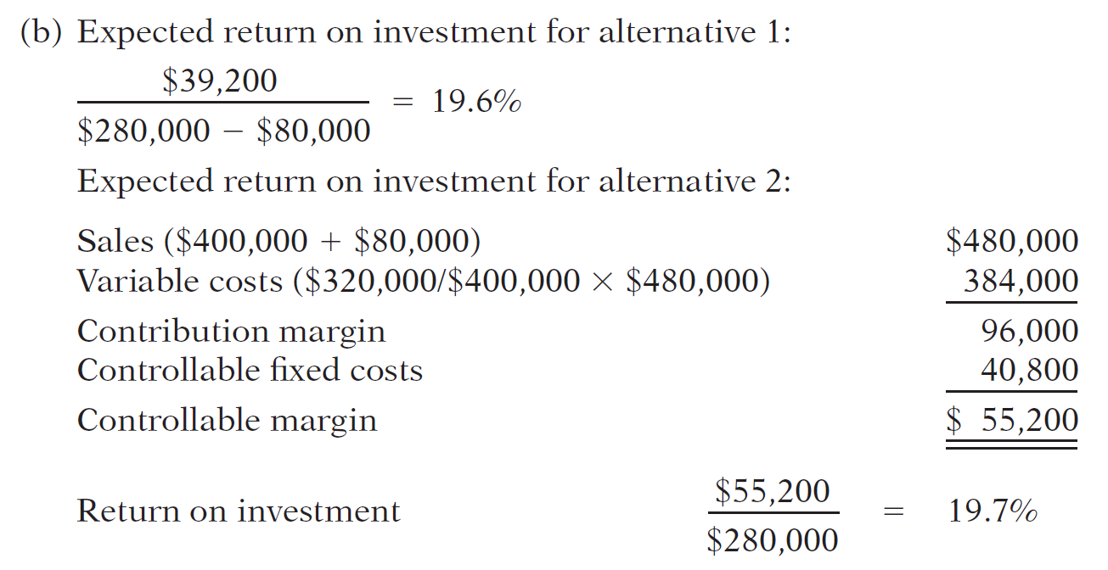
b. Compute controllable margin and the expected return on investment.

Slide 53
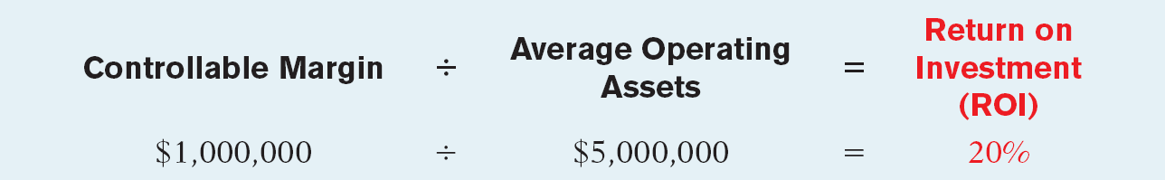
RESIDUAL INCOME
ROI has a significant disadvantage.
Illustration: Electronics Division of Pujols Company has an ROI of 20% computed as follows.
The Electronics Division is considering producing a new product, a GPS satellite tracker (referred to as Tracker), for its boats.

Slide 54
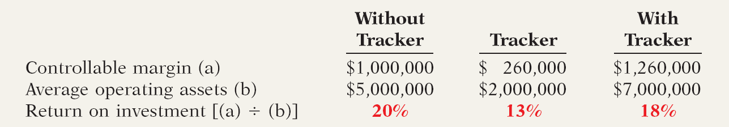
RESIDUAL INCOME
To produce Tracker, operating assets will have to increase $2,000,000. Tracker is expected to generate an additional $260,000 of controllable margin. How will the Tracker effect ROI?
The problem with this ROI analysis is that it ignores the minimum rate of return on a company’s operating assets.

Slide 55

RESIDUAL INCOME
Residual Income Compared to ROI
To evaluate performance using minimum rate of return, companies use the residual income approach. Residual income is the income that remains after subtracting from the controllable margin the minimum rate of return on a company’s average operating assets.

Slide 56
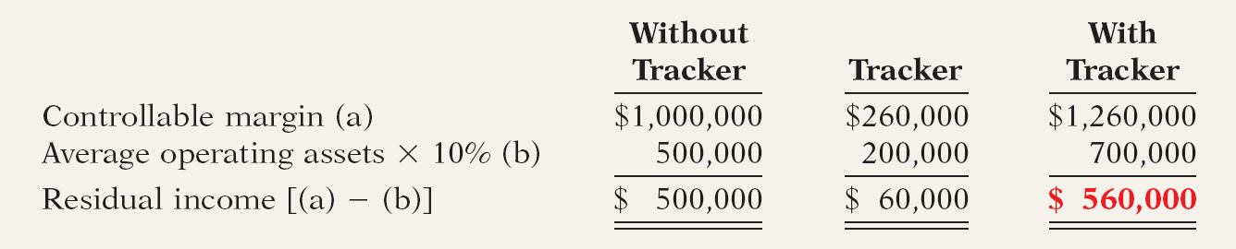
RESIDUAL INCOME
How does residual income change as the additional investment is made?

Slide 57
RESIDUAL INCOME
Residual Income Weakness
The goal to maximize the total amount of residual income in each division ignores the fact that one division might use substantially fewer assets to attain the same level of residual income.

Slide 58

RESIDUAL INCOME
Illustration: To produce Tracker, the Electronics Division used $2,000,000 of average operating assets to generate $260,000 of controllable margin. Assume a different division produced a product called SeaDog, which used $4,000,000 to generate $460,000 of controllable margin.
SeaDog required twice as many operating assets to achieve the same level of residual income.

Slide 59
End of Lecture 10

