Slide 1
CHAPTER 1
The Accountant’s Role in the Organization
Readings:
  Chapter 1: Cost Accounting : The Managerial Emphasis 14th Edition By Horngren
  Chapter 1: Managerial Accounting 12th Edition By Garrison et.al

Slide 2
Accounting Discipline Overview
Managerial Accounting – measures, analyzes and reports financial and nonfinancial information to help managers make decisions to fulfill organizational goals. Managerial accounting need not be GAAP compliant.
Financial Accounting – focus on reporting to external users including investors, creditors, and governmental agencies. Financial statements must be based on GAAP.

Slide 3
Major Differences Between
Financial & Managerial Accounting
 | Managerial Accounting | Financial Accounting
Purpose | Decision making | Communicate financial position to outsiders
Primary Users | Internal managers | External users
Focus/Emphasis | Future-oriented | Past-oriented
Rules | Do not have to follow GAAP; cost vs. benefit | GAAP compliant; CPA audited
Time Span | Ultra current to very long time horizons | Historical monthly, quarterly reports
Behavioral Issues | Designed to influence employee behavior | Indirect effects on employee behavior

Slide 4
Strategy & Management Accounting
Strategy – specifies how an organization matches its own capabilities with the opportunities in the marketplace to accomplish its objectives
Strategic Cost Management – focuses specifically on the cost dimension within a firm’s overall strategy

Slide 5
Strategy & Management Accounting
Management accounting helps answer important questions such as:
  Who are our most important customers, and how do we deliver value to them?
  What substitute products exist in the marketplace, and how do they differ from our own?
  What is our critical capability?
  Will we have enough cash to support our strategy or will we need to seek additional sources?

Slide 6
Management Accounting and Value
Creating value is an important part of planning and implementing strategy
Value is the usefulness a customer gains from a company’s product or service

Slide 7
Management Accounting and Value
Value Chain is the sequence of business functions in which customer usefulness is added to products or services
The Value-Chain consists of:
  Research & Development
  Design
  Production
  Marketing
  Distribution
  Customer Service

Slide 8
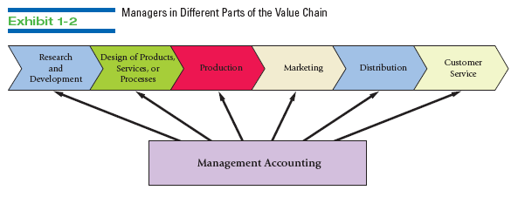
The Value Chain Illustrated

Slide 9
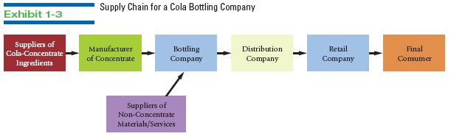
A Value Chain Implementation

Slide 10
Key Success Factors
The dimensions of performance that customers expect, and that are key to the success of a company include:
  Cost and efficiency
  Quality
  Time
  Innovation

Slide 11
Planning & Control Systems
Planning selects goals, predicts results, decides how to attain goals, and communicates this to the organization
  Budget – the most important planning tool
Control takes actions that implement the planning decision, decides how to evaluate performance, and provides feedback to the organization

Slide 12
A Five-Step Decision Making Process in Planning & Control
Identify the problem and uncertainties
Obtain information
Make predictions about the future
Make decisions by choosing between alternatives
Implement the decision, evaluate performance, and learn

Slide 13
Management Accounting Guidelines
Cost – Benefit approach is commonly used: benefits generally must exceed costs as a basic decision rule
Behavioral & Technical Considerations – people are involved in decisions, not just dollars and cents
Different definitions of cost may be used for different applications

Slide 14
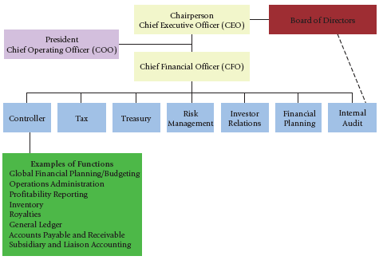
A Typical Organizational Structure and the Management Accountant

Slide 15
Professional Ethics
The four standards of ethical conduct for management accountants as advanced by the Institute of Management Accountants:
  Competence
  Confidentiality
  Integrity
  Objectivity

Slide 16
Professional Ethics
Earnings management—deliberate accounting adjustments to “hit” profit targets
Often adjustments involve cost accounting—product costs and inventory valuations
Stretching legitimate accounting techniques
Outright fraud

Slide 17
Potential Ethical Issues
Earnings management
Low cost production at any cost
Whistleblower retaliation
Fixing prices
Bribery and other corruption
Hiding managerial acts

Slide 18
Accountants
Financial accountants provide information to external parties
  Investors
  Creditors
  Regulators
  Donors
Managerial accountants provide information to internal users
  Managers
Cost accountants provide information to both internal and external users
  Product cost information

Slide 19
Accounting Differences
Financial
External focus
Whole organization
Historical
Quantitative
Monetary
Verifiable
GAAP
Formal recordkeeping
Managerial
Internal focus
Segments or divisions
Current/projected
Quantitative/qualitative
Monetary and nonmonetary
Timely/reasonable estimate
Benefits exceed costs
Formal and informal recordkeeping

Slide 20
Product Costs
Upstream costs
  Research
  Development
  Product design
  Supply chain
Downstream costs
  Marketing
  Distribution
  Customer service

Slide 21
Relationship of Financial, Management, and Cost Accounting
Product Costs
FINANCIAL
ACCOUNTING
COST
ACCOUNTING
MANAGEMENT
ACCOUNTING
© 2013 Cengage Learning. All Rights Reserved. May not be scanned, copied, duplicated, or posted to a publicly accessible website, in whole or in part.

Slide 22
Product Cost Information
External parties - stockholders, creditors, regulators, and donors
  For investment and credit decisions
  Complies with GAAP
  Enterprise focus
Internal parties - managers
  Planning, controlling, and decision making
  Evaluating performance
  Includes upstream and downstream costs
  Disaggregated

Slide 23
Accounting Bodies
Financial
Public Company Accounting Oversight Board (PCAOB)
Securities and Exchange Commission (SEC)
Financial Accounting Standards Board (FASB)
Management
Institute of Management Accountants (IMA)
Society of Management Accountants of Canada
Cost Accounting Standards Board (CASB)

Slide 24
Organizational Strategy
Develop mission statement
Implement strategy
Deploy resources to create value for customers and shareholders
Recognize that each organization is unique—thus unique strategies must be developed

Slide 25
Organizational Strategy
Five factors
core competencies
organizational structure
management style and organizational culture
organizational constraints
environmental constraints

Slide 26
Organizational Strategies
Core competency—critical function or activity providing a competitive advantage
Cost leadership strategy—undercut competitor prices
Product differentiation strategy—superior quality products or unique services sold at a premium

Slide 27
Organizational Structure
Distribution of authority and responsibility in an organization
  Authority—right to use resources to accomplish a task or achieve an objective
  Responsibility—obligation to accomplish a task or achieve an objective

Slide 28
Organizational Constraints
Four common organizational constraints
Monetary capital
Intellectual capital
Technology
Environmental constraints

Slide 29
Value Chain
A set of value-adding functions and processes that converts inputs into products/services
  Research and Development
  Product Design
  Supply
  Production
  Marketing
  Distribution
  Customer Service
Communicate strategy to all members of the value chain

Slide 30
Balanced Scorecard
Learning and Growth
  The organization’s intellectual capital
Internal Business
  Things to do well to meet customer needs and expectations
Customer Value
  How well the organization is doing relative to important customer criteria such as quality, service and price.
Financial Performance
  Address stockholders’/stakeholders’ concerns about profitability and organizational growth

Slide 31
Ethics and Legislation
Sarbanes-Oxley Act—CEOs and CFOs personally accountable for the accuracy of their organization’s financial reporting
False Claims Act—whistle-blower protection and penalties for failure to blow the whistle (disclose known financial frauds)
Dodd-Frank Act—encourages whistle-blowing with awards from 10 to 30 percent of amount recouped

Slide 32
Ethics & Management Accountants
Standards of Ethical Conduct for Management Accountants
  Competence
  Confidentiality
  Integrity
  Credibility

Slide 33
Ethics in Multinationals
Foreign Corrupt Practices Act—prohibits bribes to obtain/retain a business
Organization of Economic Cooperation and Development Convention—crime to offer, promise, or give bribes to obtain/retain internal business deals

Slide 34
Questions
What is the relationship among financial, management, and cost accounting?
How is the balanced scorecard used to implement an organization’s strategy?
Where can an accountant find ethical standards for cost accounting?

Slide 35
End of Lecture 1

