Slide 1
Plant Assets, Natural Resources, and Intangible Assets
LECTURE 11

Slide 2
DECLINING-BALANCE
Decreasing annual depreciation expense over the asset’s useful life
Periodic depreciation is based on a *declining book value
  (cost - accumulated depreciation)
To compute annual depreciation expense
  Multiply the book value at the beginning of the year by the declining-balance depreciation rate
Depreciation rate remains constant from year to year
  book value declines each year

Slide 3
DECLINING-BALANCE
Book value for the first year is the cost of the asset.
  Balance in accumulated depreciation at the beginning of the asset’s useful life is zero
In subsequent years, book value is the difference between cost and accumulated depreciation at the beginning of the year.
Formula for computing depreciation expense:
Book Value at Beginning of Year x Declining Balance Rate = Annual Depreciation Expense
Method compatible with the matching principle
  the higher depreciation in early years is matched with the higher benefits received in these years.

Slide 4
FORMULA FOR DECLINING-BALANCE METHOD
Unlike the other depreciation methods, salvage value is ignored in determining the amount to which the declining balance rate is applied.
A common application of the declining-balance method is the double-declining-balance method, in which the declining-balance rate is double the straight-line rate.
If Barb’s Florists uses the double-declining-balance method, the depreciation is 40% (2 X the straight-line rate of 20%).
Depreciable
Cost per Unit
Units of
Activity during the Year
Annual Depreciation Expense
=
$13,000 x 40% = $5,200

Slide 5
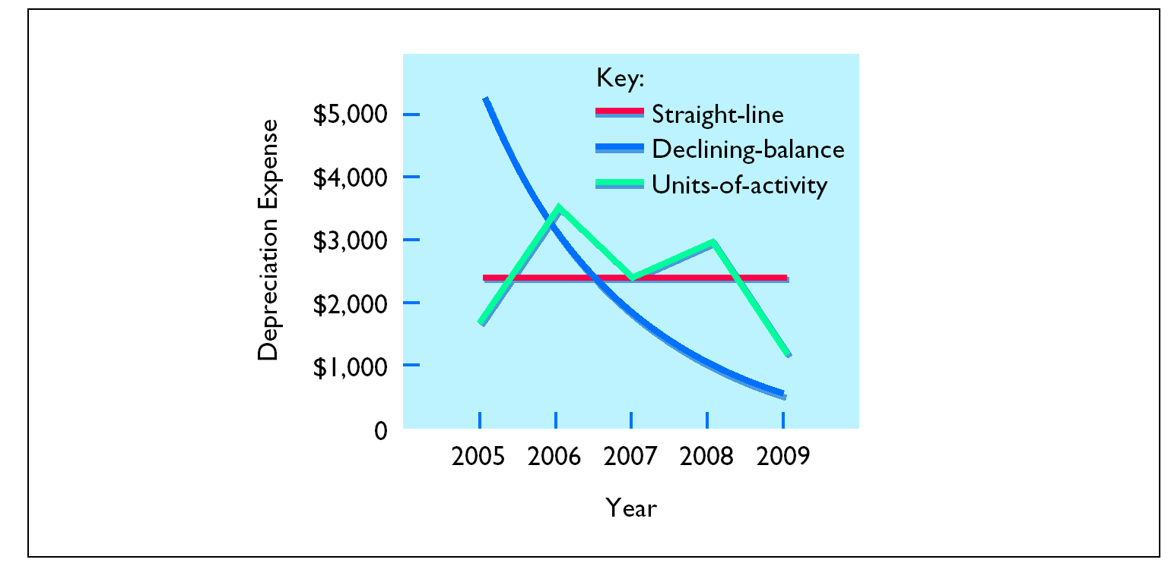
PATTERNS OF DEPRECIATION

Slide 6
REVISING PERIODIC DEPRECIATION
STUDY OBJECTIVE 4
Changes should be made
  Excessive wear and tear or obsolescence indicate that annual depreciation estimates are inadequate.
When a change is made
  No correction of previously recorded depreciation expense
  Depreciation expense for current and future years is revised
To determine the new annual depreciation expense
  The depreciable cost at the time of the revision is divided by the
  remaining useful life.

Slide 7
REVISED DEPRECIATION COMPUTATION
Barb’s Florists decides on January 1, 2008, to extend the useful life of the truck one year because of its excellent condition. The company has used the straight-line method to depreciate the asset to date, and book value is $5,800 ($13,000 - $7,200). The new annual depreciation is $1,600, calculated as follows:
Book value, 1/1/08
$5,800
Less: Salvage value
1,000
Depreciable cost
$4,800
Remaining useful life
3 years
(2008-2010)
Revised annual depreciation ($4,800 ÷ 3)
$1,600

Slide 8

EXPENDITURES DURING USEFUL LIFE
STUDY OBJECTIVE 5
Ordinary repairs
  expenditures to maintain the operating
  efficiency and productive life of the unit
  such repairs are debited to Repairs Expense as
  incurred and are often referred to as revenue
  expenditures.

Slide 9
EXPENDITURES DURING USEFUL LIFE
Capital expenditures
Additions and improvements
  increase the operating efficiency, productive capacity, or useful life of a plant asset
1 Usually material in amount and occur
infrequently.
  2 Increase the company’s investment in
  productive facilities.
  Debit the plant asset affected.

Slide 10
PLANT ASSET DISPOSALS
STUDY OBJECTIVE 6
Retirement
  Plant asset is scrapped or discarded.
  Eliminate the book value of the plant asset at the date of sale by debiting Accumulated Depreciation and crediting the asset account for its cost.
  Debit Cash to record the cash proceeds from the sale.
  Compute gain or loss.
If the cash proceeds > the book value
  recognize a gain by crediting Gain on Disposal for the difference.
If the cash proceeds are < the book value
  recognize a loss by debiting Loss on Disposal for the
  difference.

Slide 11
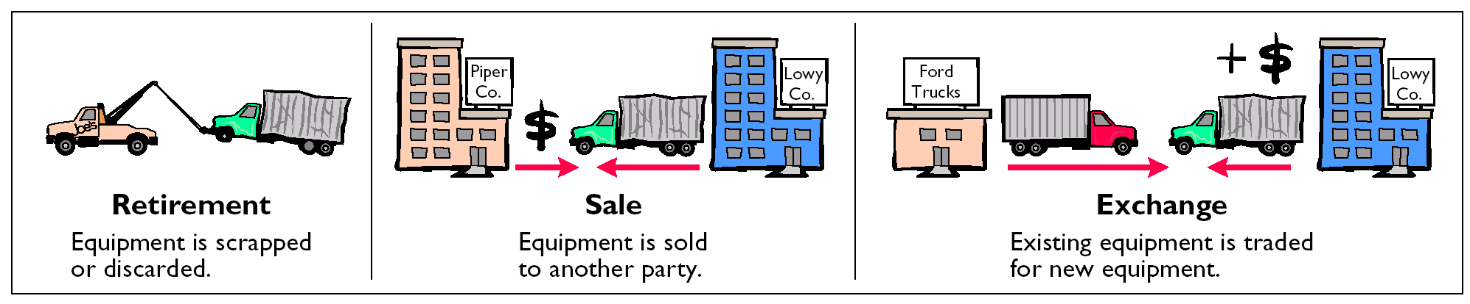
PLANT ASSET DISPOSALS

Slide 12
GAIN ON DISPOSAL
On July 1, 2005, Wright Company sells office furniture for $16,000 cash. Original cost was $60,000 and as of January 1, 2005, had accumulated depreciation of $41,000. Depreciation for the first 6 months of 2005 is $8,000. The entry to record depreciation expense and update accumulated depreciation to July 1 is as follows:

Slide 13
GAIN ON DISPOSAL
After the accumulated depreciation is updated, a gain on disposal of $5,000 is computed:
The entry to record the sale and the gain on disposal is as follows:

Slide 14
LOSS ON DISPOSAL
Instead of the selling the office furniture for $16,000, Wright sells it for $9,000. In this case, a loss of $2,000 is computed:
The entry to record the sale and the loss on disposal is as follows:

Slide 15

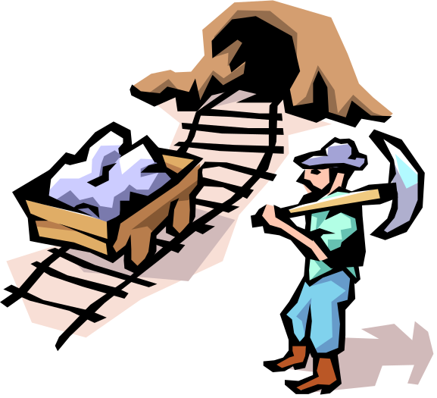

NATURAL RESOURCES
STUDY OBJECTIVE 7
Natural resources
  consists of standing timber and underground deposits of oil, gas, and minerals
These long-lived productive assets have two distinguishing characteristics:
1 They are physically extracted in operations.
2 They are replaceable only by an act of nature.

Slide 16
DEPLETION
DEPLETION
Allocation of the cost of natural resources to expense in a rational and systematic manner over the resource’s useful life.
Units-of-activity method is generally used to compute depletion.
  depletion generally is a function of the units extracted during the year

Slide 17
FORMULA TO COMPUTE DEPLETION EXPENSE
Total Cost minus Salvage Value
Total Estimated Units
Depletion
Cost per Unit
Depletion
Cost per Unit
Number of
Units Extracted and Sold
Annual Depletion
Expense
Helpful hint: This computation for depletion is similar to the computation for depreciation using the units-of-activity method of depreciation.

Slide 18
RECORDING DEPLETION
The Lane Coal Company invests $5 million in a mine estimated to have 10 million tons of coal and no salvage value. In the first year, 800,000 tons of coal are extracted and sold. Using the formulas, the calculations are as follows:
$5,000,000 ÷ 10,000,000 = $.50 depletion cost per ton
$.50 X 800,000 = $400,000 depletion expense
The entry to record depletion expense for the first year of operations is as follows:

Slide 19
STATEMENT PRESENTATION OF
ACCUMULATED DEPLETION
Accumulated Depletion is a contra asset account similar to accumulated depreciation. It is deducted from the cost of the natural resource in the balance sheet as follows:

Slide 20



INTANGIBLE ASSETS
Study Objective 8
Intangible assets
  Rights, privileges, and competitive advantages that result from the ownership of long lived assets that do not possess physical substance
  May arise from government grants, acquisition of another business, and private monopolistic arrangements

Slide 21
ACCOUNTING FOR INTANGIBLE ASSETS
In general, accounting for intangible assets parallels the accounting for plant assets.
Intangible assets are:
1 recorded at cost
2 written off over useful life in a rational and systematic manner
3 at disposal, book value is eliminated and gain or loss, if any, is recorded

Slide 22
ACCOUNTING FOR INTANGIBLE ASSETS
STUDY OBJECTIVE 8
Key differences between accounting for intangible assets and accounting for plant assets include:
  The systematic write-off of an intangible asset is referred to as amortization
To record amortization
  Debit Amortization Expense and credit the specific intangible asset
  Intangible assets typically amortized on a straight-line basis

Slide 23
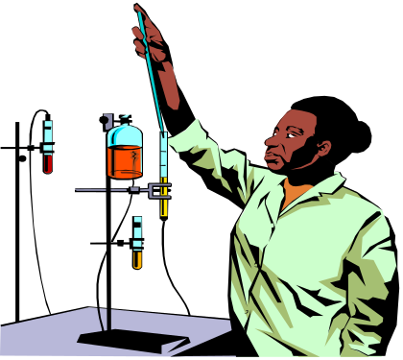
PATENTS
A patent
  exclusive right issued by the Patent Office
  manufacture, sell, or otherwise control an invention for a period of 20 years from the date of grant
Cost of a patent
  initial cost is the cash or cash equivalent price paid to acquire the patent
  legal costs – amount an owner incurs in successfully defending a patent are added to the Patent account and amortized over the remaining useful life of the patent
  should be amortized over its 20-year legal life or its useful life, whichever is shorter.

Slide 24
RECORDING PATENTS
National Labs purchases a patent at a cost of $60,000. If the useful life of the patent is 8 years, the annual amortization expense is $7,500 ($60,000 ÷ 8).
Amortization Expense is classified as an operating expense in the income statement. The entry to record the annual patent amortization is:

Slide 25



COPYRIGHTS
Copyrights
  grants from the federal government
  gives the owner the exclusive right to reproduce and sell an artistic or published work
Copyrights extend for the life of the creator plus 70 years.
The cost of a copyright is the cost of acquiring and defending it.

Slide 26

TRADEMARKS AND TRADE NAMES
A trademark or trade name
  word, phrase, jingle or symbol identifying a particular enterprise or product
Trademark or trade name purchased
  the cost is purchase price
Trademark developed by a company
  the cost includes attorney’s fees, registration
  fees, design costs and successful legal defense
  fees

Slide 27
FRANCHISES AND LICENSES
Franchise
  contractual arrangement under which the franchisor grants the franchisee the right to sell certain products, render specific services, or use certain trademarks or trade names, usually restricted to a designated geographical area
Another type of franchise, commonly referred to as a license or permit
  entered into between a governmental body and a business enterprise and permits the enterprise to use public property in performing its services.

Slide 28

GOODWILL
Goodwill
  value of all favorable attributes that relate to a business enterprise
  attributes may include exceptional management, desirable location, good customer relations and skilled employees
  cannot be sold individually in the marketplace; it can be identified only with the business as a whole

Slide 29

GOODWILL
Goodwill
  recorded only when a transaction involves the purchase of an entire business
  excess of cost over the fair market value of the net assets (assets less liabilities) acquired
  not amortized
  reported under Intangible Assets

Slide 30


RESEARCH AND DEVELOPMENT COSTS
Research and development costs
  pertain to expenditures incurred to develop
  new products and processes
These costs are not intangible costs
  recorded as an expense when incurred

