Slide 1
Consumer Markets and Consumer Buyer Behavior
(Part-1)
LECTURE-8

Slide 2
Topic Outline
Model of Consumer Behavior
Characteristics Affecting Consumer Behavior
Types of Buying Decision Behavior
The Buyer Decision Process
The Buyer Decision Process for New Products
Notes:
In this chapter, we dig deeper into steps two and three of the marketing process: designing customer-driven marketing strategies and constructing marketing programs. First, we look at the organization’s overall strategic planning, which guides marketing strategy and planning. Next, we discuss how, guided by the strategic plan, marketers partner closely with others inside and outside the firm to create value for customers. We then examine marketing strategy and planning—how marketers choose target markets, position their market offerings, develop a marketing mix, and manage their marketing programs. Finally, we look at the important step of measuring and managing return on marketing investment (marketing ROI).

Slide 3
Consumer Behavior
Consumer Behavior is the study of how individuals, groups, and organizations select, buy, use & dispose of goods, services, ideas, or experiences to satisfy their needs and wants.

Slide 4
Consumer Behavior
Consumer Behavior is the study of how individuals, groups, and organizations select, buy, use & dispose of goods, services, ideas, or experiences to satisfy their needs and wants.

Slide 5
Model of Consumer Behavior
Consumer buyer behavior :
The buying behavior of final consumers, individuals and households, who buy goods and services for personal consumption
Consumer market :
All of the personal consumption of final consumers
Notes:
Note to Instructor
Discussion Question
What have you recently purchased that cost over $100? Write down all the reasons you purchased this particular item.
Because students are all consumers—it is interesting to start the class with a discussion of products they have recently purchased. When you ask them why they purchased a particular item or product, you can bring them through many topics in this chapter including the characteristics that affect consumer behavior (cultural, social, personal, and psychological). You can also try to determine the process they went through including how and where they searched for information and how they evaluated their alternatives. Finally, ask them how they feel about their purchase (postpurchase behavior). This discussion will lead nicely to the next slide which is the Model of Buyer Behavior.
Consumers make many buying decisions every day, and the buying decision is the focal point of the marketer’s effort. Most large companies research consumer buying decisions in great detail to answer questions about what consumers buy, where they buy, how and how much they buy, when they buy, and why they buy. Marketers can study actual consumer purchases to find out what they buy, where, and how much. But learning about the whys of consumer buying behavior is not so easy—the answers are often locked deep within the consumer’s mind. Often, consumers themselves don’t know exactly what influences their purchases.

Slide 6
Consumer Buying Process
Problem recognition
Information search
Evaluation of alternatives
Purchase decision
Post purchase behavior

Slide 7
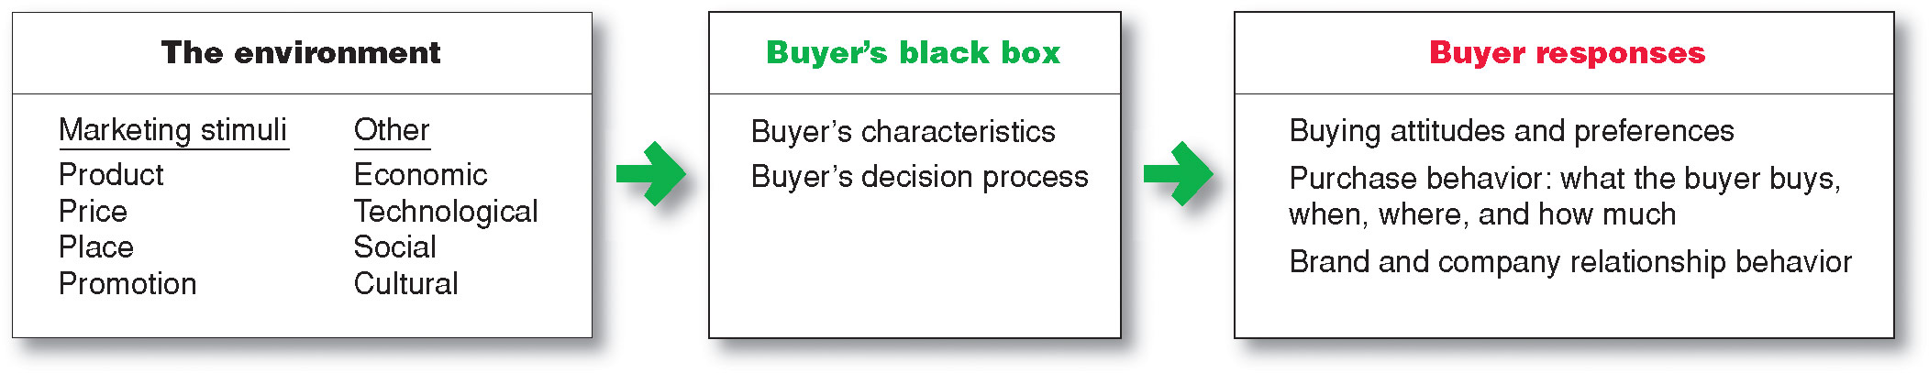
Model of Consumer Behavior
Notes:
Note to Instructor
Figure 5.1 Understanding the whys of buying behavior is very difficult. Says one expert, “The mind is a whirling, swirling, jumbled mass of neurons
bouncing around…”
It is interesting to talk about the buyer’s black box and one of the largest challenges in marketing is to understand what happens in this black box. Students will enjoy this video by Derren Brown. It is unclear how he obtains his results and how scientific this is, but it will certainly have students realize the mystery of the consumer’s brain.
The central question for marketers is this: How do consumers respond to various marketing efforts the company might use? The starting point is the stimulus-response model of buyer behavior shown in Figure 5.1. This figure shows that marketing and other stimuli enter the consumer’s “black box” and produce certain responses. Marketers must figure out what is in the buyer’s black box.
Marketing stimuli consist of the four Ps: product, price, place, and promotion. Other stimuli include major forces and events in the buyer’s environment: economic, technological, social, and cultural. All these inputs enter the buyer’s black box, where they are turned into a set of buyer responses—the buyer’s brand and company relationship behavior and what he or she buys, when, where, and how much.
Marketers want to understand how the stimuli are changed into responses inside the consumer’s black box, which has two parts. First, the buyer’s characteristics influence how he or she perceives and reacts to the stimuli. Second, the buyer’s decision process itself affects his or her behavior. We look first at buyer characteristics as they affect buyer behavior and then discuss the buyer decision process.

Slide 8
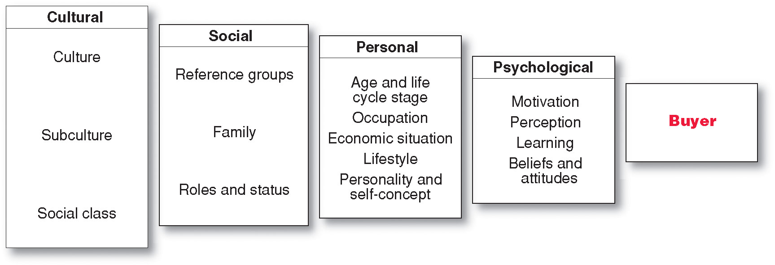
Characteristics Affecting Consumer Behavior
Factors Influencing Consumer Behavior
Notes:
Consumer purchases are influenced strongly by cultural, social, personal, and psychological characteristics, as shown in Figure 5.2. For the most part, marketers cannot control such factors, but they must take them into account.
Discussion Question: Many levels of factors affect our buying behavior—from broad cultural and social influences to motivations, beliefs, and attitudes lying deep within us.
For example, why did you buy that specific cell phone?

Slide 9
Characteristics Affecting Consumer Behavior
Culture is the learned values, perceptions, wants, and behavior from family and other important institutions
Notes:
Cultural Factors
Cultural factors exert a broad and deep influence on consumer behavior. Marketers need to understand the role played by the buyer’s culture, subculture, and social class.
Culture
Culture is the most basic cause of a person’s wants and behavior. Human behavior is largely learned. Growing up in a society, a child learns basic values, perceptions, wants, and behaviors from his or her family and other important institutions. A child in the United States normally learns or is exposed to the following values: achievement and success, individualism, freedom, hard work, activity and involvement, efficiency and practicality, material comfort, youthfulness, and fitness and health. Every group or society has a culture, and cultural influences on buying behavior may vary greatly from both county to county and country to country.
Marketers are always trying to spot cultural shifts so as to discover new products that might be wanted. For example, the cultural shift toward greater concern about health and fitness has created a huge industry for health-and-fitness services, exercise equipment and clothing, organic foods, and a variety of diets.

Slide 10
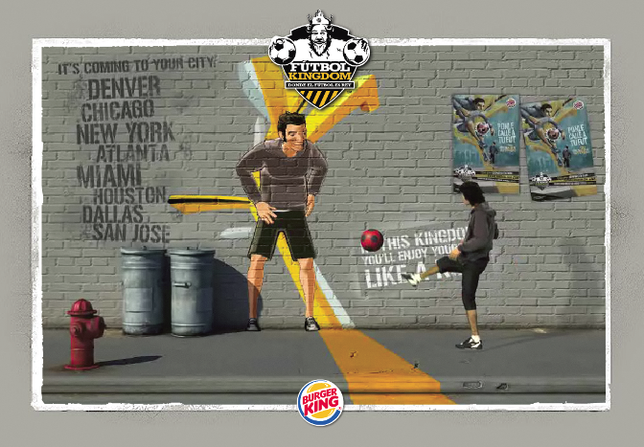
Characteristics Affecting Consumer Behavior
Subculture are groups of people within a culture with shared value systems based on common life experiences and situations
Hispanic American
African American
Asian American
Cross-Cultural
Notes:
Each culture contains smaller subcultures, or groups of people with shared value systems based on common life experiences and situations. Subcultures include nationalities, religions, racial groups, and geographic regions. Many subcultures make up important market segments, and marketers often design products and marketing programs tailored to their needs. Examples of three such important subculture groups are Hispanic American, African American, and Asian American consumers.
Discussion Question
What subculture do you belong to? How does this influence you as a consumer?
Although Hispanic consumers share many characteristics and behaviors with the mainstream buying public, there are also distinct differences. They tend to be deeply family oriented and make shopping a family affair—children have a big say in what brands they buy. Older, first-generation Hispanic consumers tend to be very brand loyal and to favor brands and sellers who show special interest in them. Younger Hispanics, however, have shown increasing price sensitivity in recent years and a willingness to switch to store brands.
Within the Hispanic market, there exist many distinct subsegments based on nationality, age, income, and other factors. A company’s product or message may be more relevant to one nationality over another, such as Mexicans, Costa Ricans, Argentineans, or Cubans. Companies must also vary their pitches across different Hispanic economic segments.
Similarly, Hispanic consumers shop for groceries three times more often than the general U.S. shopper, so Nestlé, General Mills, and other food companies compete heavily to get their brands into Hispanic shoppers’ grocery carts. For example, Nestlé targets Hispanic family buyers with its extensive Construye el Mejor Nido (Create the Best Nest) marketing campaign, which connects Nestlé’s products with family nutrition and wellness resources. The multi-pronged campaign includes a bilingual website (www.elmejornido.com), a Facebook page, Spanish-language television ads, sampling, and in-store marketing. No matter what the medium, the Construye el Mejor Nido campaign focuses heavily on how Nestlé and its brands help to build family togetherness and wellbeing. For example, four Hispanic mothers blog on the website, offering tips on parenting and healthy eating.
African American Consumers The U.S. African American population is growing in affluence and sophistication. In recent years, many companies have developed special products, appeals, and marketing programs for African American consumers. For example, Procter & Gamble has long been the leader in African American advertising, spending nearly twice as much as the second-place spender. P&G also tailors products to the specific needs of black consumers. For example, its CoverGirl Queen Latifah line is specially formulated “to celebrate the beauty of women of color.”
Asian American Consumers Asian Americans are the most affluent U.S. demographic segment. They now number more than 16 million, with annual buying power approaching buying power of $775 billion by 2015. Asian Americans are the second-fastest-growing subsegment after Hispanic Americans. And like Hispanic Americans, they are a diverse group. Chinese Americans constitute the largest group, followed by Filipinos, Asian Indians, Vietnamese, Korean Americans, and Japanese Americans. Yet, unlike Hispanics that all speak various dialects of Spanish, Asians speaks many different languages.
As a group, Asian consumers shop frequently and are the most brand conscious of all the ethnic groups. They can be fiercely brand loyal. As a result, many firms now target the Asian American market.
cross-cultural marketing—the practice of including ethnic themes and cross-cultural perspectives within their mainstream marketing. Cross-cultural marketing appeals to consumer similarities across subcultures rather than differences. Many marketers are finding that insights gleaned from ethnic consumers can influence their broader markets.

Slide 11
Characteristics Affecting Consumer Behavior
Social classes are society’s relatively permanent and ordered divisions whose members share similar values, interests, and behaviors
Measured by a combination of occupation, income, education, wealth, and other variables
Notes:
Social class is not determined by a single factor, such as income, but is measured as a combination of occupation, income, education, wealth, and other variables. In some social systems, members of different classes are reared for certain roles and cannot change their social positions. In the United States, however, the lines between social classes are not fixed and rigid; people can move to a higher social class or drop into a lower one.

Slide 12
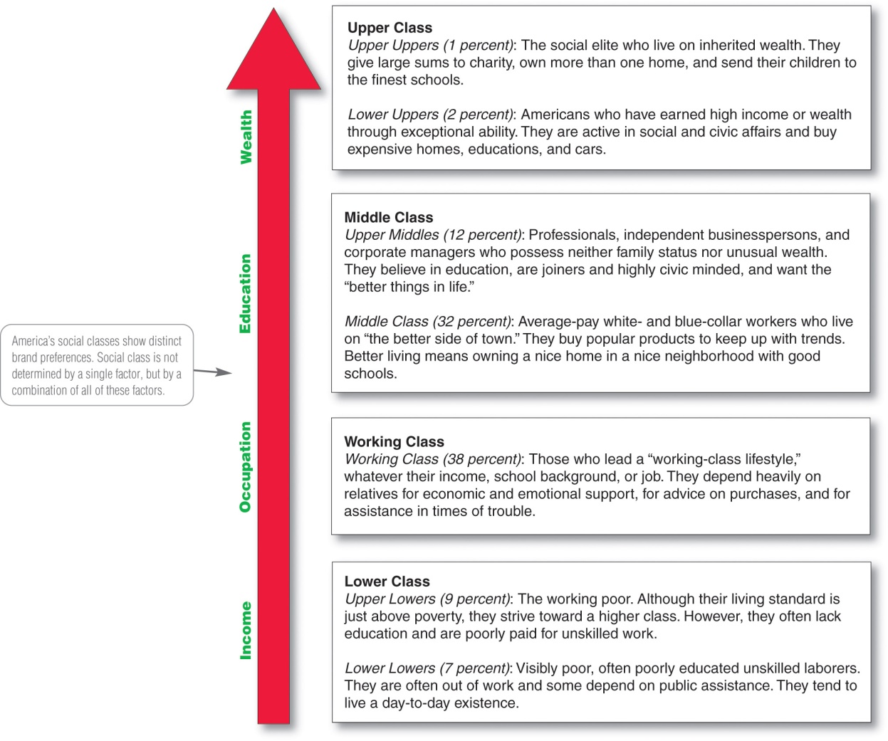
Major American Social Classes
Notes:
Marketers are interested in social class because people within a given social class tend to exhibit similar buying behavior. Social classes show distinct product and brand preferences in areas such as clothing, home furnishings, travel and leisure activity, financial services, and automobiles.

Slide 13
Characteristics of Social Classes
Within a class, people tend to behave alike.
Social class conveys perceptions of inferior or superior position.
Class may be indicated by a cluster of variables (occupation, income, wealth).
Class designation is mobile over time.

Slide 14
Characteristics Affecting Consumer Behavior
Groups and Social Networks
Membership Groups
Groups with direct influence and to which a person belongs
Aspirational Groups
Groups an individual wishes to belong to
Reference Groups
Groups that form a comparison or reference in forming attitudes or behavior
Notes:
Groups that have a direct influence and to which a person belongs are called membership groups.
Aspirational: People often are influenced by reference groups to which they do not belong.
Reference groups serve as direct (face-to-face) or indirect points of comparison or reference in forming a person’s attitudes or behavior.
Discussion Question
What groups are you a member of and what are your aspirational groups. How does this influence you as a consumers?
Marketers try to identify the reference groups of their target markets. Reference groups expose a person to new behaviors and lifestyles, influence the person’s attitudes and self-concept, and create pressures to conform that may affect the person’s product and brand choices. The importance of group influence varies across products and brands. It tends to be strongest when the product is visible to others whom the buyer respects.

Slide 15
Characteristics Affecting Consumer Behavior
Groups and Social Networks
Word-of-mouth influence and buzz marketing
  Opinion leaders are people within a reference group who exert social influence on others
  Also called influentials or leading adopters
  Marketers identify them to use as brand ambassadors
Notes:
Word-of-Mouth Influence and Buzz Marketing Word-of-mouth influence can have a powerful impact on consumer buying behavior. The personal words and recommendations of trusted friends, associates, and other consumers tend to be more credible than those coming from commercial sources, such as advertisements or salespeople. Most word-of-mouth influence happens naturally: Consumers start chatting about a brand they use or feel strongly about one way or the other. Often, however, rather than leaving it to chance, marketers can help to create positive conversations about their brands.
Marketers of brands subjected to strong group influence must figure out how to reach opinion leaders—people within a reference group who, because of special skills, knowledge, personality, or other characteristics, exert social influence on others. Some experts call this group the influentials or leading adopters. When these influentials talk, consumers listen. Marketers try to identify opinion leaders for their products and direct marketing efforts toward them.
Buzz marketing involves enlisting or even creating opinion leaders to serve as “brand ambassadors” who spread the word about a company’s products. Many companies are now turning everyday customers into brand evangelists.

Slide 16
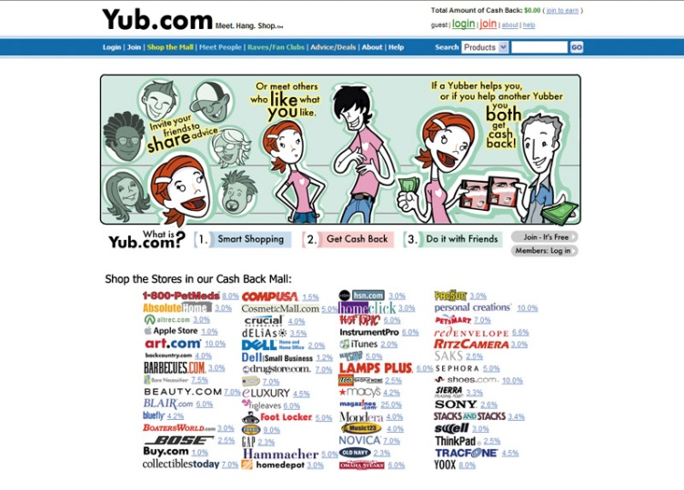
Characteristics Affecting Consumer Behavior
Groups and Social Networks
Online Social Networks are online communities where people socialize or exchange information and opinions
Include blogs, social networking sites (facebook), virtual worlds (second life)
Notes:
Note to Instructor:
Discussion Question
How can marketers use these networks?
This slide should provide a lively discussion for students because they all are users of social networks. Ask students for examples they have seen or experienced. Then be sure to ask if they think the marketing efforts were effective for the marketer and why? The text gives many examples .
Online Social Networks More broadly, over the past few years, a new type of social interaction has exploded onto the scene—online social networking. Online social networks are online communities where people socialize or exchange information and opinions. Social networking media range from blogs (Gizmodo, Zenhabits) and message boards (Craigslist) to social networking websites (Facebook, Twitter, and Foursquare) and virtual worlds (Second Life). This new form of consumer-to-consumer and business-to-consumer dialog has big implications for marketers.
Marketers are working to harness the power of these new social networks and other “word-of-Web” opportunities to promote their products and build closer customer relationships. Instead of throwing more one-way commercial messages at consumers, they hope to use the Internet and social networks to interact with consumers and become a part of their conversations and lives.
Most brands have built a comprehensive social media presence. But marketers must be careful when tapping into online social networks. Results are difficult to measure and control. Ultimately, the users control the content, so social network marketing attempts can easily backfire.

Slide 17
Characteristics Affecting Consumer Behavior
Social Factors
Family is the most important consumer-buying organization in society
Social roles and status are the groups, family, clubs, and organizations that a person belongs to that can define role and social status
Notes:
Note to Instructor
Discussion Question
What brands do you purchase because it is what their parents used? Why do you think this occurs?
Family
Family members can strongly influence buyer behavior. The family is the most important consumer buying organization in society, and it has been researched extensively. Marketers are interested in the roles and influence of the husband, wife, and children on the purchase of different products and services.
Husband-wife involvement varies widely by product category and by stage in the buying process. Buying roles change with evolving consumer lifestyles. For example, in the United States, the wife traditionally has been considered the main purchasing agent for the family in the areas of food, household products, and clothing. But with more women working outside the home and the willingness of husbands to do more of the family’s purchasing, all this is changing. A recent survey of men ages 18 to 64 found that 51 percent identify themselves as primary grocery shoppers in their households and 39 percent handle most of their household’s laundry. At the same time, today women account for 50 percent of all technology purchases and influence two-thirds of all new car purchases.
Such shifting roles signal a new marketing reality. Marketers in industries that have traditionally sold their products to only women or only men—from groceries and personal care products to cars and consumer electronics—are now carefully targeting the opposite sex. For example, most grocery products marketers have now added pitches to dads.
Children may also have a strong influence on family buying decisions. The nation’s 36 million children ages 9 to 12 wield an estimated $43 billion in disposable income. They also influence an additional $150 billion that their families spend on them in areas such as food, clothing, entertainment, and personal care items. One study found that kids significantly influence family decisions about everything from what cars they buy to where they eat out and take vacations.
Roles and Status
A person belongs to many groups—family, clubs, organizations, online communities. The person’s position in each group can be defined in terms of both role and status. A role consists of the activities people are expected to perform according to the people around them. Each role carries a status reflecting the general esteem given to it by society.
People usually choose products appropriate to their roles and status. Consider the various roles a working mother plays. In her company, she may play the role of a brand manager; in her family, she plays the role of wife and mother; at her favorite sporting events, she plays the role of avid fan. As a brand manager, she will buy the kind of clothing that reflects her role and status in her company. At the game, she may wear clothing supporting her favorite team.

Slide 18
Characteristics Affecting Consumer Behavior
Personal Factors
Age and life-cycle stage
RBC Royal Band stages
  Youth: younger than 18
  Getting started: 18–35
  Builders: 35–50
  Accumulators: 50–60
  Preservers: over 60
Notes:
Personal Factors
A buyer’s decisions also are influenced by personal characteristics such as the buyer’s age and life-cycle stage, occupation, economic situation, lifestyle, and personality and self-concept.
Age and Life-Cycle Stage
People change the goods and services they buy over their lifetimes. Tastes in food, clothes, furniture, and recreation are often age related. Buying is also shaped by the stage of the family life cycle—the stages through which families might pass as they mature over time. Life-stage changes usually result from demographics and life-changing events—marriage, having children, purchasing a home, divorce, children going to college, changes in personal income, moving out of the house, and retirement. Marketers often define their target markets in terms of life-cycle stage and develop appropriate products and marketing plans for each stage.
“Consumers experience many life-stage changes during their lifetimes,” says Acxiom. “As their life stages change, so do their behaviors and purchasing preferences.” Armed with data about the timing and makeup of life-stage changes, marketers can create targeted, personalized campaigns.
In line with recent tougher economic times, Acxiom has also developed a set of economic life-stage segments, including groups such as Squeaking By, Eye on Essentials, Tight with a Purpose, It’s My Life, Full Speed Ahead, and Potential Rebounders. The Potential Rebounders are those more likely to loosen up on spending sooner. This group appears more likely than other segments to use online research before purchasing electronics, appliances, home decor, and jewelry. Thus, home improvement retailers appealing to this segment should have a strong online presence, providing pricing, features and benefits, and product availability.

Slide 19
Characteristics Affecting Consumer Behavior
Personal Factors
Occupation affects the goods and services bought by consumers
Economic situation includes trends in:
Personal income
Savings
Interest rates
Notes:
Discussion Question: Ask the students how their occupations and economic situations affect the goods and services they buy.
Occupation
A person’s occupation affects the goods and services bought. Blue-collar workers tend to buy more rugged work clothes, whereas executives buy more business suits. Marketers try to identify the occupational groups that have an above-average interest in their products and services. A company can even specialize in making products needed by a given occupational group.
Economic Situation
A person’s economic situation will affect his or her store and product choices. Marketers watch trends in personal income, savings, and interest rates. In the more frugal times following the Great Recession, most companies have taken steps to redesign, reposition, and reprice their products and services. For example, upscale discounter Target has replaced some of its “chic” with “cheap.” It is putting more emphasis on the “Pay less” side of its “Expect more. Pay less.” positioning promise.

Slide 20

Characteristics Affecting Consumer Behavior
Personal Factors
Lifestyle is a person’s pattern of living as expressed in his or her psychographics
Measures a consumer’s AIOs (activities, interests, opinions) to capture information about a person’s pattern of acting and interacting in the environment
Notes:
Note to Instructor
Discussion Question
What categories of products seem to be targeted to consumer’s lifestyles?
They will realize many products in addition to cars including food, cosmetics, shampoo also appeal to a consumer’s lifestyles.
When used carefully, the lifestyle concept can help marketers understand changing consumer values and how they affect buyer behavior. Consumers don’t just buy products; they buy the values and lifestyles those products represent.
Marketers look for lifestyle segments with needs that can be served through special products or marketing approaches. Such segments might be defined buy anything from family characteristics or outdoor interests to pet ownership. In fact, today’s involved pet ownership lifestyles have created a huge market for everything from basic pet supplies to exotic pet services marketed to indulgent “pet parents.”

Slide 21
Characteristics Affecting Consumer Behavior
Personal Factors
Personality: the unique psychological characteristics that lead to consistent and lasting responses to the consumer’s environment
Notes:
Personality is usually described in terms of traits such as self-confidence, dominance, sociability, autonomy, defensiveness, adaptability, and aggressiveness. Personality can be useful in analyzing consumer behavior for certain product or brand choices.
The idea is that brands also have personalities, and consumers are likely to choose brands with personalities that match their own. A brand personality is the specific mix of human traits that may be attributed to a particular brand. One researcher identified five brand personality traits: sincerity (down-to-earth, honest, wholesome, and cheerful); excitement (daring, spirited, imaginative, and up-to-date); competence (reliable, intelligent, and successful); sophistication (upper class and charming); and ruggedness (outdoorsy and tough). “Your personality determines what you consume, what TV shows you watch, what products you buy, and [most] other decisions you make,” says one consumer behavior expert.
Most well-known brands are strongly associated with one particular trait: the Ford F150 with “ruggedness,” Apple with “excitement,” the Washington Post with “competence,” and Method with “sincerity.” Hence, these brands will attract persons who are high on the same personality traits.
Many marketers use a concept related to personality—a person’s self-concept (also called self-image). The idea is that people’s possessions contribute to and reflect their identities—that is, “we are what we consume.” Thus, to understand consumer behavior, marketers must first understand the relationship between consumer self-concept and possessions.

Slide 22
Characteristics Affecting Consumer Behavior
Personal Factors
Dominance
Autonomy
Defensiveness
Adaptability
Aggressiveness
Notes:
Note to Instructor
It is interesting to talk about brand personalities and ask students the personality of several brands:
A brand personality is the specific mix of human traits that may be attributed to a particular brand.
One researcher identified five brand personality traits
1. Sincerity (down-to-earth, honest, wholesome, and cheerful)
2. Excitement (daring, spirited, imaginative, and up-to-date)
3. Competence (reliable, intelligent, and successful)
4. Sophistication (upper class and charming)
5. Ruggedness (outdoorsy and tough)

Slide 23

Characteristics Affecting Consumer Behavior
Psychological Factors
Motivation
Perception
Learning
Beliefs and attitudes
Notes:
A person has many needs at any given time. Some are biological, arising from states of tension such as hunger, thirst, or discomfort. Others are psychological, arising from the need for recognition, esteem, or belonging.

Slide 24
Characteristics Affecting Consumer Behavior
Psychological Factors
Motivation
A motive is a need that is sufficiently pressing to direct the person to seek satisfaction
Motivation research refers to qualitative research designed to probe consumers’ hidden, subconscious motivations
Notes:
Psychologists have developed theories of human motivation. Two of the most popular—the theories of Sigmund Freud and Abraham Maslow—carry quite different meanings for consumer analysis and marketing.
Sigmund Freud assumed that people are largely unconscious about the real psychological forces shaping their behavior. His theory suggests that a person’s buying decisions are affected by subconscious motives that even the buyer may not fully understand. Thus, an aging baby boomer who buys a sporty BMW convertible might explain that he simply likes the feel of the wind in his thinning hair. At a deeper level, he may be trying to impress others with his success. At a still deeper level, he may be buying the car to feel young and independent again.
The term motivation research refers to qualitative research designed to probe consumers’ hidden, subconscious motivations. Consumers often don’t know or can’t describe why they act as they do. Thus, motivation researchers use a variety of probing techniques to uncover underlying emotions and attitudes toward brands and buying situations.
Many companies employ teams of psychologists, anthropologists, and other social scientists to carry out motivation research. One ad agency routinely conducts one-on-one, therapy-like interviews to delve into the inner workings of consumers. Another company asks consumers to describe their favorite brands as animals or cars (say, a Mercedes versus a Chevy) to assess the prestige associated with various brands. Still others rely on hypnosis, dream therapy, or soft lights and mood music to plumb the murky depths of consumer psyches.
Such projective techniques seem pretty goofy, and some marketers dismiss such motivation research as mumbo jumbo. But many marketers use such touchy-feely approaches, now sometimes called interpretive consumer research, to dig deeper into consumer psyches and develop better marketing strategies.

Slide 25
Characteristics Affecting Consumer Behavior
Maslow’s
Hierarchy of Needs
SELF
ACTUALIZATION
ESTEEM NEEDS
Prestige
LOVE, AFFECTION, AND
BELONGINGNESS NEEDS
SAFETY NEEDS
Security and Safety
PHYSIOLOGICAL OR SURVIVAL NEEDS
Food, Water, Warmth, Rest
Notes:
Abraham Maslow sought to explain why people are driven by particular needs at particular times. Why does one person spend a lot of time and energy on personal safety and another on gaining the esteem of others? Maslow’s answer is that human needs are arranged in a hierarchy, as shown in Figure 5.4, from the most pressing at the bottom to the least pressing at the top. They include physiological needs, safety needs, social needs, esteem needs, and self-actualization needs.
A person tries to satisfy the most important need first. When that need is satisfied, it will stop being a motivator, and the person will then try to satisfy the next most important need. For example, starving people (physiological need) will not take an interest in the latest happenings in the art world (self-actualization needs) nor in how they are seen or esteemed by others (social or esteem needs) nor even in whether they are breathing clean air (safety needs). But as each important need is satisfied, the next most important need will come into play.
See Abraham H. Maslow, “A Theory of Human Motivation,” Psychological Review, 50 (1943), pp. 370–396. Also see Maslow, Motivation and Personality, 3rd ed. (New York: HarperCollins Publishers, 1987); and Michael R. Solomon, Consumer Behavior, 9th ed. (Upper Saddle River, NJ: Prentice Hall, 2011), pp. 135-136.

Slide 26
Bibliography
Principles of Marketing by Philip Kotler & Gary Armstrong
Fifteenth Edition, Published by Prentice Hall
Marketing Management – A South Asian Perspective
by Philip Kotler, Kevin Lane Keller, Abraham Koshy &
Mithileshwar Jha, 13th Edition, Published by Pearson
Education, Inc.
Principles and Practices of Marketing by Jobber, D. 4th
edition, McGraw Hill International.
Principles of Advertising & IMC by Tom Duncan 2nd
Edition, Published by McGraw-Hill Irwin.

Slide 27


The End
"Remember there's no such thing as a small act of kindness. Every act creates a ripple with no logical end."
Scott Adams

