Slide 1
Analyzing the Marketing Environment
LECTURE-5

Slide 2
Topic Outline
Analyzing The Marketing Environment
The Company’s Micro-environment
The Company’s Macro-environment
Responding to the Marketing Environment
Notes:
In this chapter, we dig deeper into steps two and three of the marketing process: designing customer-driven marketing strategies and constructing marketing programs. First, we look at the organization’s overall strategic planning, which guides marketing strategy and planning. Next, we discuss how, guided by the strategic plan, marketers partner closely with others inside and outside the firm to create value for customers. We then examine marketing strategy and planning—how marketers choose target markets, position their market offerings, develop a marketing mix, and manage their marketing programs. Finally, we look at the important step of measuring and managing return on marketing investment (marketing ROI).

Slide 3
Analyzing the Marketing Environment
Micro-environment
Macro-environemnt
  Demographic Environment
  Economic Environment
  Natural Environment
  Technological Environment
  Political and Social Environment
  Cultural Environment
  Responding to the Marketing Environment
Notes:
We begin digging deeper into the first step of the marketing process—understanding the marketplace and customer needs and wants. In this chapter, you’ll see that marketing operates in a complex and changing environment. Other actors in this environment—suppliers, intermediaries, customers, competitors, publics, and others—may work with or against the company. Major environmental forces—demographic, economic, natural, technological, political, and cultural—shape marketing opportunities, pose threats, and affect the company’s ability to build customer relationships. To develop effective marketing strategies, a company must first understand the environment in which marketing operates.

Slide 4
The Marketing Environment
The marketing environment includes the actors and forces outside marketing that affect marketing management’s ability to build and maintain successful relationships with customers
Notes:
A company’s marketing environment consists of the actors and forces outside marketing that affect marketing management’s ability to build and maintain successful relationships with target customers. Like YouTube, companies constantly watch and adapt to the changing environment—or, in many cases, lead those changes.
More than any other group in the company, marketers must be environmental trend trackers and opportunity seekers. Although every manager in an organization should watch the outside environment, marketers have two special aptitudes. They have disciplined methods—marketing research and marketing intelligence—for collecting information about the marketing environment. They also spend more time in customer and competitor environments. By carefully studying the environment, marketers can adapt their strategies to meet new marketplace challenges and opportunities.

Slide 5
The Marketing Environment
Microenvironment consists of the actors close to the company that affect its ability to serve its customers, the company, suppliers, marketing intermediaries, customer markets, competitors, and publics
Notes:
The marketing environment consists of a microenvironment and a macroenvironment. The microenvironment consists of the actors close to the company that affect its ability to serve its customers—the company, suppliers, marketing intermediaries, customer markets, competitors, and publics. The macroenvironment consists of the larger societal forces that affect the microenvironment—demographic, economic, natural, technological, political, and cultural forces.

Slide 6
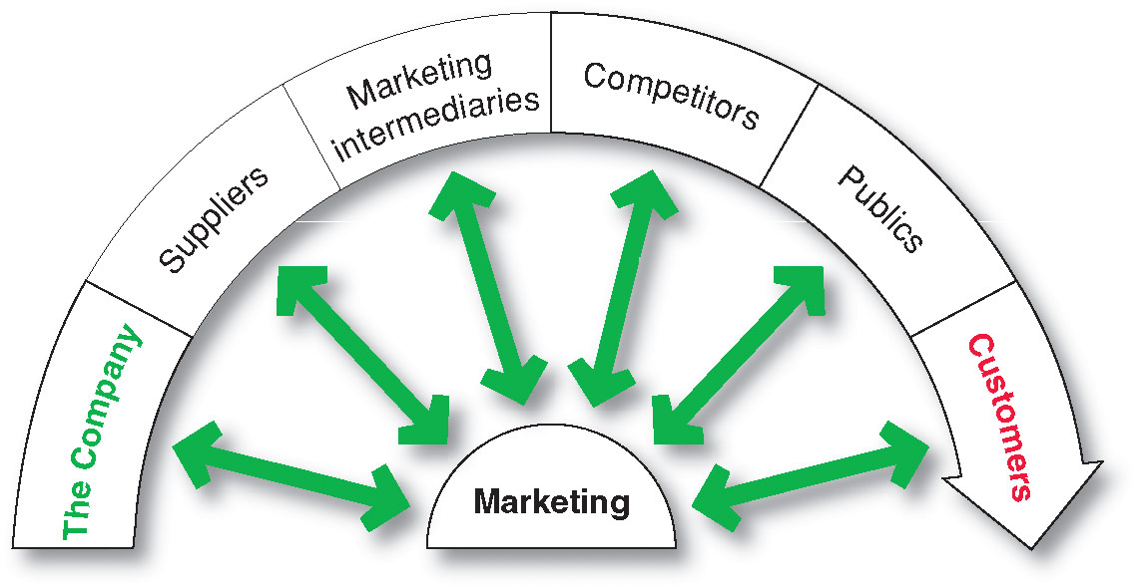
The Company’s Microenvironment
Actors in the Microenvironment
Notes:
Marketing management’s job is to build relationships with customers by creating customer value and satisfaction. However, marketing managers cannot do this alone. Figure 3.1 shows the major actors in the marketer’s microenvironment. Marketing success requires building relationships with other company departments, suppliers, marketing intermediaries, competitors, various publics, and customers, which combine to make up the company’s value delivery network.

Slide 7
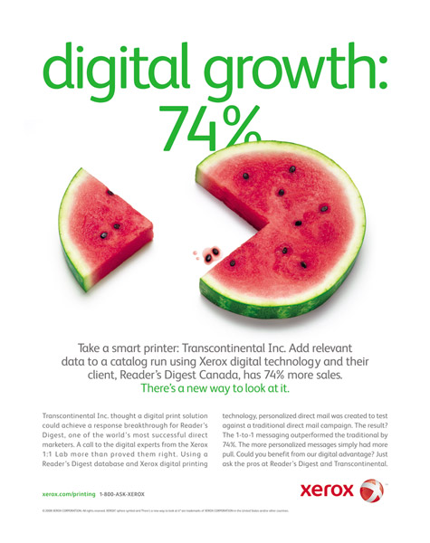
The Company’s Microenvironment
The Company
Top management
Finance
R&D
Purchasing
Operations
Accounting
Notes:
Note to Instructor
Discussion Questions
What types of collaboration do there need to be between the departments?
How might projects be integrated between marketing and finance?
How might projects be integrated between marketing and information systems?
This question on finance could lead to a discussion about budgeting for marketing. The collaboration between marketing and IS could lead to discussions of market research, ordering systems, and customer relationship management systems.
In designing marketing plans, marketing management takes other company groups into account—groups such as top management, finance, research and development (R&D), purchasing, operations, and accounting. All of these interrelated groups form the internal environment. Top management sets the company’s mission, objectives, broad strategies, and policies. Marketing managers make decisions within the broader strategies and plans made by top management. Then, as we discussed in Chapter 2, marketing managers must work closely with other company departments. With marketing taking the lead, all departments—from manufacturing and finance to legal and human resources—share the responsibility for understanding customer needs and creating customer value.

Slide 8
The Company’s Microenvironment
Suppliers
Provide the resources to produce goods and services
Treat as partners to provide customer value
Notes:
Suppliers
Suppliers form an important link in the company’s overall customer value delivery network. They provide the resources needed by the company to produce its goods and services. Supplier problems can seriously affect marketing. Marketing managers must watch supply availability and costs. Supply shortages or delays, labor strikes, natural disasters, and other events can cost sales in the short run and damage customer satisfaction in the long run. Rising supply costs may force price increases that can harm the company’s sales volume.
Most marketers today treat their suppliers as partners in creating and delivering customer value.

Slide 9
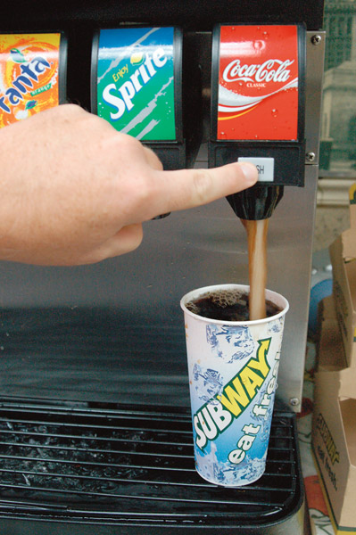
The Company’s Microenvironment
Marketing Intermediaries
Help the company to promote, sell and distribute its products to final buyers
Notes:
Marketing intermediaries help the company promote, sell, and distribute its products to final buyers. They include resellers, physical distribution firms, marketing services agencies, and financial intermediaries.
The text explains how Coke delivers value for their marketing intermediaries:
They understand each retailer partner’s business
The conduct consumer research and share with partners
They develop marketing programs and merchandising for partners

Slide 10
The Company’s Microenvironment
Types of Marketing Intermediaries
Resellers
Physical distribution firms
Marketing services agencies
Financial intermediaries
Notes:
Resellers are distribution channel firms that help the company find customers or make sales to them. These include wholesalers and retailers who buy and resell merchandise. Selecting and partnering with resellers is not easy. No longer do manufacturers have many small, independent resellers from which to choose. They now face large and growing reseller organizations, such as Walmart, Target, Home Depot, Costco, and Best Buy. These organizations frequently have enough power to dictate terms or even shut smaller manufacturers out of large markets.
Physical distribution firms help the company stock and move goods from their points of origin to their destinations. Marketing services agencies are the marketing research firms, advertising agencies, media firms, and marketing consulting firms that help the company target and promote its products to the right markets. Financial intermediaries include banks, credit companies, insurance companies, and other businesses that help finance transactions or insure against the risks associated with the buying and selling of goods.
Like suppliers, marketing intermediaries form an important component of the company’s overall value delivery network. In its quest to create satisfying customer relationships, the company must do more than just optimize its own performance. It must partner effectively with marketing intermediaries to optimize the performance of the entire system.
Thus, today’s marketers recognize the importance of working with their intermediaries as partners rather than simply as channels through which they sell their products.
Coke delivers value for their marketing intermediaries:
They understand each retailer partner’s business
The conduct consumer research and share with partners
They develop marketing programs and merchandising for partners

Slide 11
The Company’s Microenvironment
Competitors
Firms must gain strategic advantage by positioning their offerings against competitors’ offerings
Notes:
Note to Instructor
Students should note that the competition is just a click away with online purchasing.
The marketing concept states that, to be successful, a company must provide greater customer value and satisfaction than its competitors do. Thus, marketers must do more than simply adapt to the needs of target consumers. They also must gain strategic advantage by positioning their offerings strongly against competitors’ offerings in the minds of consumers.
No single competitive marketing strategy is best for all companies. Each firm should consider its own size and industry position compared to those of its competitors. Large firms with dominant positions in an industry can use certain strategies that smaller firms cannot afford. But being large is not enough. There are winning strategies for large firms, but there are also losing ones. And small firms can develop strategies that give them better rates of return than large firms enjoy.

Slide 12
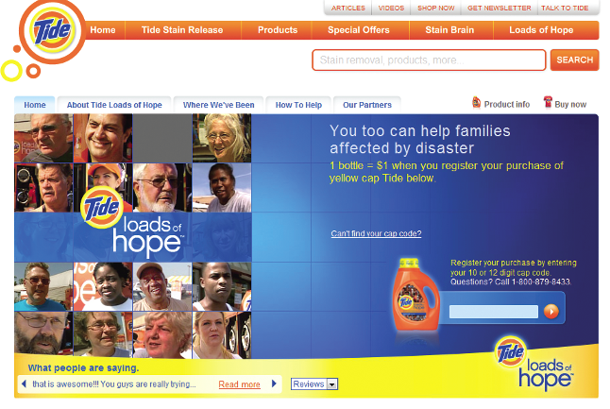
The Company’s Microenvironment
Publics
Any group that has an actual or potential interest in or impact on an organization’s ability to achieve its objectives
  Financial publics
  Media publics
  Government publics
  Citizen-action publics
  Local publics
  General public
  Internal publics
Notes:
Financial publics. This group influences the company’s ability to obtain funds. Banks, investment analysts, and stockholders are the major financial publics.
Media publics. This group carries news, features, and editorial opinion. It includes newspapers, magazines, television stations, and blogs and other Internet media.
Government publics. Management must take government developments into account. Marketers must often consult the company’s lawyers on issues of product safety, truth in advertising, and other matters.
Citizen-action publics. A company’s marketing decisions may be questioned by consumer organizations, environmental groups, minority groups, and others. Its public relations department can help it stay in touch with consumer and citizen groups.
<ex03.03>
Local publics. This group includes neighborhood residents and community organizations. Large companies usually create departments and programs that deal with local community issues and provide community support. For example, the Life is good Company recognizes the importance of community publics. Its Playmakers foundation promotes the philosophy that “Life can hurt, play can heal.” It provides training and support for child-care professionals to use the power of play to help children overcome challenges ranging from violence and illness to extreme poverty in cities around the world, from Danbury, CT, to Port-au-Prince, Haiti. So far, the organization has raised more than $4 million to benefit children.
General public. A company needs to be concerned about the general public’s attitude toward its products and activities. The public’s image of the company affects its buying.
Internal publics. This group includes workers, managers, volunteers, and the board of directors. Large companies use newsletters and other means to inform and motivate their internal publics. When employees feel good about the companies they work for, this positive attitude spills over to the external publics.
A company can prepare marketing plans for these major publics as well as for its customer markets. Suppose the company wants a specific response from a particular public, such as goodwill, favorable word of mouth, or donations of time or money. The company would have to design an offer to this public that is attractive enough to produce the desired response.

Slide 13
The Company’s Microenvironment
Customers
Consumer markets
Business markets
Government markets
International markets
Notes:
Consumer markets consist of individuals.
Business markets buy goods and services for further
processing or use in their production processes, whereas reseller markets buy goods and
services to resell at a profit.
Government markets consist of government agencies that buy goods
and services to produce public services or transfer the goods and services to others who need
them.
International markets consist of these buyers in other countries, including consumers,
producers, resellers, and governments. Each market type has special characteristics
that call for careful study by the seller.

Slide 14
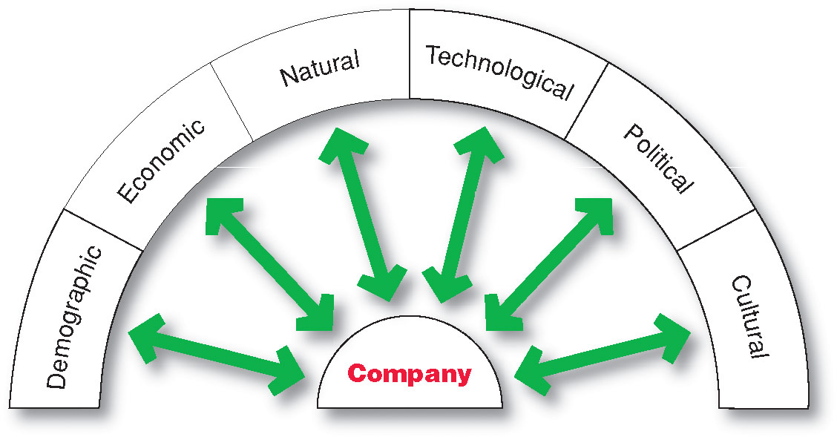
The Company’s Macroenvironment
Notes:
The company and all of the other actors operate in a larger macroenvironment of forces that shape opportunities and pose threats to the company. This Figure shows the six major forces in the company’s macroenvironment. Even the most dominant companies can be vulnerable to the often turbulent and changing forces in the marketing environment. Some of these forces are unforeseeable and uncontrollable. Others can be predicted and handled through skillful management. Companies that understand and adapt well to their environments can thrive. Those that don’t can face difficult times. In the remaining sections of this chapter, we examine these forces and show how they affect marketing plans.

Slide 15
The Company’s Macroenvironment
Demographic Environment
Demography: the study of human populations-- size, density, location, age, gender, race, occupation, and other statistics
Demographic environment: involves people, and people make up markets
Demographic trends: shifts in age, family structure, geographic population, educational characteristics, and population diversity
Notes:
The demographic environment is of major interest to marketers because it involves people, and people make up markets. The world population is growing at an explosive rate. It now exceeds 7 billion people and is expected to grow to more than 8 billion by the year 2030. The world’s large and highly diverse population poses both opportunities and challenges.
Changes in the world demographic environment have major implications for business. Thus, marketers keep a close eye on demographic trends and developments in their markets. They analyze changing age and family structures, geographic population shifts, educational characteristics, and population diversity. Here, we discuss the most important demographic trends in the United States.
World POPClock, U.S. Census Bureau, at www.census.gov/main/www/popclock.html, accessed July 2012. This website provides continuously updated projections of the U.S. and world populations.

Slide 16
The Company’s Macroenvironment
Demographic Environment
Baby Boomers
  Born 1946 to 1964
  Rethinking the purpose and value of their work, responsibilities, and relationships.
  spending more carefully and planning to work longer
  The wealthiest generation in U.S. history
Notes:
The more active boomers—sometimes called zoomers, or baby boomers with zip—have no intention of abandoning their youthful lifestyles as they age.
They have a thirst for adventure, and the financial freedom to explore that passion

Slide 17
The Company’s Macroenvironment
Demographic Environment
Generation X includes people born between 1965 and 1976
  High parental divorce rates
  Cautious economic outlook
  Less materialistic
  Family comes first
Notes:
From a marketing standpoint, the Gen Xers are a more skeptical bunch. They tend to research products before they consider a purchase, prefer quality to quantity, and tend to be less receptive to overt marketing pitches. They are more likely to be receptive to irreverent ad pitches that make fun of convention and tradition.
The first to grow up in the Internet era, Generation X is a highly connected generation that embraces the benefits of new technology. Some 49 percent own smartphones and 11 percent own tablets. Of the Xers on the Internet, 74 percent use the Internet for banking, 72 percent use it for researching companies or products, and 81 percent have made purchases online. Ninety-five percent have a Facebook page.
The Gen Xers have now grown up and are taking over. They are increasingly displacing the lifestyles, culture, and values of the baby boomers. They are moving up in their careers, and many are proud homeowners with growing families. They are the most educated generation to date, and they possess hefty annual purchasing power. They spend 62 percent more on housing, 50 percent more on apparel, and 27 percent more on entertainment than the average. However, like the baby boomers, the Gen Xers now face growing economic pressures. Like almost everyone else these days, they are spending more carefully.
Still, with so much potential, many brands and organizations are focusing on Gen Xers as a prime target segment. For example, Dairy Queen targets this segment directly, with a marketing campaign that fits the Gen Xer family situation and sense of humor:

Slide 18
The Company’s Macroenvironment
Demographic Environment
Millennials (gen Y or echo boomers) include those born between 1977 and 2000
  Most financially strapped generation
  Higher unemployment and saddled with more debt
  Comfortable with technology
Notes:
The Millennials were the first generation to grow up in a world filled with computers, mobile phones, satellite TV, iPods and iPads, and online social networks. As a result, they engage with brands in an entirely new way, such as with mobile or social media. “They tend to expect one-to-one communication with brands,” says one analyst, “and embrace the ability to share the good and bad about products and services with friends and strangers.”
Rather than having mass marketing messages pushed at them, the Millennials prefer to seek out information and engage in two-way brand conversations. Thus, reaching them effectively requires creative marketing approaches.

Slide 19

The Company’s Macroenvironment
Demographic Environment
  Generational marketing is important in segmenting people by lifestyle of life state instead of age
Notes:
Discussion Question: Do marketers need to create separate products and marketing programs for each generation?
Some experts warn that marketers need to be careful about turning off one generation each time they craft a product or message that appeals effectively to another. Others caution that each generation spans decades of time and many socioeconomic levels. For example, marketers often split the baby boomers into three smaller groups—leading-edge boomers, core boomers, and trailing-edge boomers—each with its own beliefs and behaviors. Similarly, they split the Millennials into teens and young adults.
Thus, marketers need to form more precise age-specific segments within each group. More important, defining people by their birth date may be less effective than segmenting them by their lifestyle, life stage, or the common values they seek in the products they buy.

Slide 20
The Company’s Macroenvironment
Demographic Environment
Changes in the Workforce
  More educated
  More white collar
Notes:
Note to Instructor
Students are probably very familiar with job search sites such as this link to monster.com. It might be interesting to compare the listings for white collar versus blue collar job opportunities including the associated pay and benefits.
The rising number of educated professionals will affect not just what people buy but also how they buy.

Slide 21

The Company’s Macroenvironment
Demographic Environment
Increasing Diversity
Markets are becoming more diverse
  International
  National
Includes:
  Ethnicity
  Disabled
Notes:
Countries vary in their ethnic and racial makeup. At one extreme is Japan, where almost everyone is Japanese. At the other extreme is the United States, with people from virtually all national origins. The United States has often been called a melting pot, where diverse groups from many nations and cultures have melted into a single, more homogenous whole. Instead, the United States seems to have become more of a “salad bowl” in which various groups have mixed together but have maintained their diversity by retaining and valuing important ethnic and cultural differences.
Marketers now face increasingly diverse markets, both at home and abroad, as their operations become more international in scope. The U.S. population is about 65 percent white, with Hispanics at about 16 percent and African Americans at about 13 percent. The U.S. Asian American population now totals 4.7 percent of the total U.S. population, with the remaining 1.3 percent being Native Hawaiian, Pacific Islander, American Indian, Eskimo, Aleut, or people of two or more races. Moreover, more than 40 million people living in the United States—about 13 percent of the population—were born in another country. The nation’s ethnic populations are expected to explode in coming decades. By 2050, Hispanics will be an estimated 30 percent of the population, African Americans will hold steady at about 13 percent, and Asians will increase to 8 percent.
Diversity goes beyond ethnic heritage. For example, many major companies explicitly target gay and lesbian consumers. According to one estimate, the 6 to 7 percent of U.S. adults who identify themselves as lesbian, gay, bisexual, and transgender (LGBT) have buying power of more than $790 billion. A number of media now provide companies with access to this market. For example, Planet Out Inc., a leading global media and entertainment company that exclusively serves the LGBT community, offers several successful magazines (Out, The Advocate, Out Traveler) and websites (Gay.com and PlanetOut.com). In addition, media giant Viacom’s MTV Networks offer LOGO, a cable television network aimed at gays and lesbians and their friends and family. LOGO is now available in 46 million U.S. households. More than 100 mainstream marketers have advertised on LOGO.
How are companies trying to reach consumers with disabilities? Many marketers now recognize that the worlds of people with disabilities and those without disabilities are one in the same. Marketers such as McDonald’s, Verizon Wireless, Nike, Samsung, and Honda have featured people with disabilities in their mainstream marketing. For instance, Samsung and Nike sign endorsement deals with Paralympic athletes and feature them in advertising.
As the population in the United States grows more diverse, successful marketers will continue to diversify their marketing programs to take advantage of opportunities in fast-growing segments.

Slide 22
The Company’s Macroenvironment
Economic Environment
Economic environment consists of factors that affect consumer purchasing power and spending patterns
Industrial economies are richer markets
Subsistence economies consume most of their own agriculture and industrial output
Notes:
The economic
environment can offer
both opportunities and threats. For
example, facing a still-uncertain
economy, luxury car maker Infiniti now
promises to “make luxury affordable.”
Nations vary greatly in their levels and distribution of income. Some countries have industrial economies, which constitute rich markets for many different kinds of goods. At the other extreme are subsistence economies; they consume most of their own agricultural and industrial output and offer few market opportunities. In between are developing economies that can offer outstanding marketing opportunities for the right kinds of products.
Consider India with its population of more than 1.2 billion people. In the past, only India’s elite could afford to buy a car. In fact, only one in seven Indians currently owns one. But recent dramatic changes in India’s economy have produced a growing middle class and rapidly rising incomes. Now, to meet the new demand, European, North American, and Asian automakers are introducing smaller, more-affordable vehicles in India. But they’ll have to find a way to compete with India’s Tata Motors, which markets the least expensive car ever in the world, the Tata Nano. Dubbed “the people’s car,” the Nano sells for just over 158,000 rupees (about US$2,900). It can seat four passengers, gets 50 miles per gallon, and travels at a top speed of 60 miles per hour. The ultralow-cost car is designed to be India’s Model T—the car that puts the developing nation on wheels. “Can you imagine a car within the reach of all?” asks a Nano advertisement. “Now you can,” comes the answer. Tata hopes to sell one million of these vehicles per year.

Slide 23
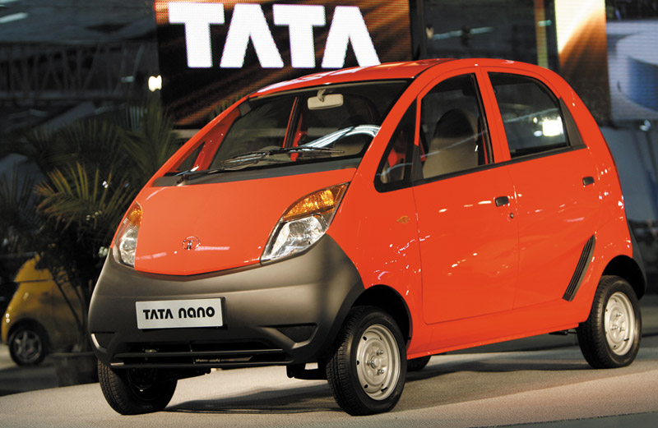
The Company’s Macroenvironment
Economic Environment
Changes in Consumer Spending
Value marketing
offering financially cautious buyers greater value—
the right combination of quality and service at a fair price
Notes:
Discussion Questions
What changes might there be in U.S. income over the next year? What are positioned as “value cars.”
The students might quote current economic declines or rises. The “value cars” will probably include some of the smaller cars by Kia, Ford, Honda, and Toyota.
Economic factors can have a dramatic effect on consumer spending and buying behavior. For example, until fairly recently, American consumers spent freely, fueled by income growth, a boom in the stock market, rapid increases in housing values, and other economic good fortunes. They bought and bought, seemingly without caution, amassing record levels of debt. However, the free spending and high expectations of those days were dashed by the Great Recession of 2008/2009.
As a result, as discussed in Chapter 1, consumers have now adopted a back-to-basics sensibility in their lifestyles and spending patterns that will likely persist for years to come. They are buying less and looking for greater value in the things that they do buy. In turn, value marketing has become the watchword for many marketers. Marketers in all industries are looking for ways to offer today’s more financially frugal buyers greater value—just the right combination of product quality and good service at a fair price.
You’d expect value pitches from the sellers of everyday products. For example, as Target has shifted emphasis toward the “Pay less” side of its “Expect more. Pay less.” slogan, the once-chic headlines at the Target.com website have been replaced by more practical appeals such as “Our lowest prices of the season,” “Fun, sun, save,” and “Free shipping, every day.” However, these days, even luxury-brand marketers are emphasizing good value. For instance, upscale car brand Infiniti now promises to “make luxury affordable.”
Marketers should pay attention to income distribution as well as income levels. Over the past several decades, the rich have grown richer, the middle class has shrunk, and the poor have remained poor. The top 5 percent of American earners get nearly 22 percent of the country’s adjusted gross income, and the top 20 percent of earners capture over 50 percent of all income. In contrast, the bottom 40 percent of American earners get just 12 percent of the total income.
This distribution of income has created a tiered market. Many companies—such as Nordstrom and Neiman Marcus—aggressively target the affluent. Others—such as Dollar General and Family Dollar—target those with more modest means. In fact, dollar stores are now the fastest-growing retailers in the nation. Still other companies tailor their marketing offers across a range of markets, from the affluent to the less affluent. For example, Ford offers cars ranging from the low-priced Ford Fiesta, starting at $13,200, to the luxury Lincoln Navigator SUV, starting at $57,775.
Changes in major economic variables, such as income, cost of living, interest rates, and savings and borrowing patterns, have a large impact on the marketplace. Companies watch these variables by using economic forecasting. Businesses do not have to be wiped out by an economic downturn or caught short in a boom. With adequate warning, they can take advantage of changes in the economic environment.

Slide 24
The Company’s Macroenvironment
Natural Environment
Natural environment: natural resources that are needed as inputs by marketers or that are affected by marketing activities
Trends
  Increased shortages of raw materials
  Increased pollution
  Increased government intervention
  Increased environmentally sustainable strategies
Notes:
Note to Instructor
This Web link connects to greenbiz.com. There are several websites like this that provide information on business as to how to practice green strategies including green marketing.
At the most basic level, unexpected happenings in the physical environment—anything from weather to natural disasters—can affect companies and their marketing strategies. For example, a recent unexpectedly warm winter put the chill on sales of products ranging from cold-weather apparel to facial tissues and Campbell’s soups. In contrast, the warmer weather boosted demand for products such as hiking and running shoes, house paint, and gardening supplies. Similarly, the damage caused by the recent earthquake and tsunami in Japan had a devastating effect on the ability of Japanese companies such as Sony and Toyota to meet worldwide demand for their products. Although companies can’t prevent such natural occurrences, they should prepare contingency plans for dealing with them.
At a broader level, environmental sustainability concerns have grown steadily over the past three decades. In many cities around the world, air and water pollution have reached dangerous levels. World concern continues to mount about the possibilities of global warming, and many environmentalists fear that we soon will be buried in our own trash.
Marketers should be aware of several trends in the natural environment. The first involves growing shortages of raw materials. Air and water may seem to be infinite resources, but some groups see long-run dangers. Air pollution chokes many of the world’s large cities, and water shortages are already a big problem in some parts of the United States and the world. By 2030, more than one in three people in the world will not have enough water to drink. Renewable resources, such as forests and food, also have to be used wisely. Nonrenewable resources, such as oil, coal, and various minerals, pose a serious problem. Firms making products that require these scarce resources face large cost increases, even if the materials remain available.
A second environmental trend is increased pollution. Industry will almost always damage the quality of the natural environment. Consider the disposal of chemical and nuclear wastes; the dangerous mercury levels in the ocean; the quantity of chemical pollutants in the soil and food supply; and the littering of the environment with nonbiodegradable bottles, plastics, and other packaging materials.
A third trend is increased government intervention in natural resource management. The governments of different countries vary in their concern and efforts to promote a clean environment. Some, such as the German government, vigorously pursue environmental quality. Others, especially many poorer nations, do little about pollution, largely because they lack the needed funds or political will. Even richer nations lack the vast funds and political accord needed to mount a worldwide environmental effort. The general hope is that companies around the world will accept more social responsibility and that less expensive devices can be found to control and reduce pollution.
In the United States, the Environmental Protection Agency (EPA) was created in 1970 to create and enforce pollution standards and conduct pollution research. In the future, companies doing business in the United States can expect continued strong controls from government and pressure groups. Instead of opposing regulation, marketers should help develop solutions to the material and energy problems facing the world.
Concern for the natural environment has spawned the so-called green movement. Today, enlightened companies go beyond what government regulations dictate. They are developing strategies and practices that support environmental sustainability—an effort to create a world economy that the planet can support indefinitely. Environmental sustainability means meeting present needs without compromising the ability of future generations to meet their needs.
Many companies are responding to consumer demands with more environmentally responsible products. Others are developing recyclable or biodegradable packaging, recycled materials and components, better pollution controls, and more energy-efficient operations.
Companies today are looking to do more than just good deeds. More and more, they are recognizing the link between a healthy ecology and a healthy economy. They are learning that environmentally responsible actions can also be good business.

Slide 25

The Company’s Macroenvironment
Technological Environment
Most dramatic force in changing the marketplace
New products, opportunities
Concern for the safety of new products
Notes:
Note to Instructor
Discussion Question
Ask students what changes they have seen in technology in the past four years including medical products, communications, and media.
New technologies can offer exciting opportunities for marketers.
Many firms are already using RFID technology radio-frequency identification to track products through various points in the distribution channel.
The technological environment changes rapidly.
New technologies create new markets and opportunities. However, every new technology replaces an older technology.
Marketers should watch the technological environment closely. Companies that do not keep up will soon find their products outdated. If that happens, they will miss new product and market opportunities.
As products and technology become more complex, the public needs to know that these items are safe. Thus, government agencies investigate and ban potentially unsafe products. In the United States, the Food and Drug Administration (FDA) has created complex regulations for testing new drugs. The Consumer Product Safety Commission (CPSC) establishes safety standards for consumer products and penalizes companies that fail to meet them. Such regulations have resulted in much higher research costs and longer times between new product ideas and their introduction. Marketers should be aware of these regulations when applying new technologies and developing new products.

Slide 26

The Company’s Macroenvironment
Political and Social Environment
Legislation regulating business
  Increased legislation
  Changing government agency enforcement
Increased emphasis on ethics
  Socially responsible behavior
  Cause-related marketing
Notes:
Political environment
laws, government agencies, and pressure groups that influence or limit various organizations and individuals in a given society
Even the strongest advocates of free-market economies agree that the system works best with at least some regulation. Well-conceived regulation can encourage competition and ensure fair markets for goods and services. Thus, governments develop public policy to guide commerce—sets of laws and regulations that limit business for the good of society as a whole. Almost every marketing activity is subject to a wide range of laws and regulations.
Legislation affecting business around the world has increased steadily over the years. The United States and many other countries have many laws covering issues such as competition, fair trade practices, environmental protection, product safety, truth in advertising, consumer privacy, packaging and labeling, pricing, and other important areas.
Understanding the public policy implications of a particular marketing activity is not a simple matter. In the United States, there are many laws created at the national, state, and local levels, and these regulations often overlap.
Business legislation has been enacted for a number of reasons. The first is to protect companies from each other. Although business executives may praise competition, they sometimes try to neutralize it when it threatens them. Therefore, laws are passed to define and prevent unfair competition. In the United States, such laws are enforced by the FTC and the Antitrust Division of the Attorney General’s office.
The second purpose of government regulation is to protect consumers from unfair business practices. Some firms, if left alone, would make shoddy products, invade consumer privacy, mislead consumers in their advertising, and deceive consumers through their packaging and pricing. Unfair business practices have been defined and are enforced by various agencies.
The third purpose of government regulation is to protect the interests of society against unrestrained business behavior. Profitable business activity does not always create a better quality of life. Regulation arises to ensure that firms take responsibility for the social costs of their production or products.
International marketers will encounter dozens, or even hundreds, of agencies set up to enforce trade policies and regulations. In the United States, Congress has established federal regulatory agencies, such as the FTC, the FDA, the Federal Communications Commission, the Federal Energy Regulatory Commission, the Federal Aviation Administration, the Consumer Product Safety Commission, the Environmental Protection Agency, and hundreds of others. Because such government agencies have some discretion in enforcing the laws, they can have a major impact on a company’s marketing performance.
New laws and their enforcement will continue to increase. Business executives must watch these developments when planning their products and marketing programs. Marketers need to know about the major laws protecting competition, consumers, and society. They need to understand these laws at the local, state, national, and international levels.

Slide 27
The Company’s Macroenvironment
Cultural Environment
Cultural environment consists of institutions and other forces that affect a society’s basic values, perceptions, and behaviors
Notes:
Cultural factors strongly
affect how people think
and how they consume. So marketers
are keenly interested in the cultural

Slide 28
The Company’s Macroenvironment
Cultural Environment
Persistence of Cultural Values
Core beliefs and values are persistent and are passed on from parents to children and are reinforced by schools, religious institutions, businesses, and government
Secondary beliefs and values are more open to change and include people’s views of themselves, others, organization, society, nature, and the universe
Notes:
The cultural environment consists of institutions and other forces that affect a society’s basic values, perceptions, preferences, and behaviors. People grow up in a particular society that shapes their basic beliefs and values. They absorb a worldview that defines their relationships with others. The following cultural characteristics can affect marketing decision making.
People in a given society hold many beliefs and values. Their core beliefs and values have a high degree of persistence. For example, most Americans believe in individual freedom, hard work, getting married, and achievement and success. These beliefs shape more specific attitudes and behaviors found in everyday life. Core beliefs and values are passed on from parents to children and are reinforced by schools, churches, business, and government.
Secondary beliefs and values are more open to change. Believing in marriage is a core belief; believing that people should get married early in life is a secondary belief. Marketers have some chance of changing secondary values but little chance of changing core values. For example, family-planning marketers could argue more effectively that people should get married later than not getting married at all.

Slide 29
The Company’s Macroenvironment
Cultural Environment
Shifts in Secondary Cultural Values
People’s view of themselves
  People vary in their emphasis on
  serving themselves versus serving others.
People’s view of others
  More “cocooning” – staying home, home cooked meals
Notes:
People’s Views of Themselves. People vary in their emphasis on serving themselves versus serving others. Some people seek personal pleasure, wanting fun, change, and escape. Others seek self-realization through religion, recreation, or the avid pursuit of careers or other life goals. Some people see themselves as sharers and joiners; others see themselves as individualists. People use products, brands, and services as a means of self-expression, and they buy products and services that match their views of themselves.
People’s Views of Others. People’s attitudes toward and interactions with others shift over time. In recent years, some analysts have voiced concerns that the Internet age would result in diminished human interaction, as people buried their heads in their computers or e-mailed and texted rather than interacting personally. Instead, today’s digital technologies seem to have launched an era of what one trend watcher calls “mass mingling.” Rather than interacting less, people are using online social media and mobile communications to connect more than ever. And, often, more online and mobile interactions result in more offline mingling:
More people than ever [are] living large parts of their lives online. Yet, those same people also mingle, meet up, and congregate more often with other “warm bodies” in the offline world. In fact, social media and mobile communications are fueling a mass mingling that defies virtually every cliché about diminished human interaction in our “online era.” Ironically, the same technology that was once condemned for turning entire generations into mobile gaming zombies and avatars is now deployed to get people out of their homes.
Basically, the more [people] date and network and twitter and socialize online, the more likely they are to eventually meet up with friends and followers in the real world. Thanks to social networking services such as Facebook (whose more than billion fans spend more than 700 billion minutes a month on the site), people are developing more diverse social networks, defying the notion that technology pulls people away from social engagement. Rather than being more isolated, people today are increasingly tapping into their networks of friends.
This new way of interacting strongly affects how companies market their brands and communicate with customers. “Consumers are increasingly tapping into their networks of friends, fans, and followers to discover, discuss, and purchase goods and services in ever-more sophisticated ways,” says one analyst. “As a result, it’s never been more important for brands to make sure they [tap into these networks] too.”

Slide 30
The Company’s Macroenvironment
Cultural Environment
Shifts in Secondary Cultural Values
People’s view of organizations
  Decline of loyalty toward companies
People’s view of society
  Patriots defend it
  Reformers want to change it
  Malcontents want to leave it
Notes:
People’s Views of Organizations. People vary in their attitudes toward corporations, government agencies, trade unions, universities, and other organizations. By and large, people are willing to work for major organizations and expect them, in turn, to carry out society’s work.
The past two decades have seen a sharp decrease in confidence in and loyalty toward America’s business and political organizations and institutions. In the workplace, there has been an overall decline in organizational loyalty. Waves of company downsizings bred cynicism and distrust. In just the last decade, major corporate scandals, rounds of layoffs resulting from the recent recession, the financial meltdown triggered by Wall Street bankers’ greed and incompetence, and other unsettling activities have resulted in a further loss of confidence in big business. Many people today see work not as a source of satisfaction but as a required chore to earn money to enjoy their non-work hours. This trend suggests that organizations need to find new ways to win consumer and employee confidence.
People’s Views of Society. People vary in their attitudes toward their society—patriots defend it, reformers want to change it, and malcontents want to leave it. People’s orientation to their society influences their consumption patterns and attitudes toward the marketplace. American patriotism has been increasing gradually for the past two decades. It surged, however, following the September 11, 2001, terrorist attacks and the Iraq war. For example, the summer following the start of the Iraq war saw a surge of pumped-up Americans visiting U.S. historic sites, ranging from the Washington, DC monuments, Mount Rushmore, the Gettysburg battlefield, and the USS Constitution (“Old Ironsides”) to Pearl Harbor and the Alamo. Following these peak periods, patriotism in the United States still remains high. A recent global survey on “national pride” found Americans tied for number one among the 17 democracies polled.
Marketers respond with patriotic products and promotions, offering everything from orange juice to clothing to cars with patriotic themes. For example, ads for PepsiCo’s Tropicana Pure Premium orange juice proclaim that the brand is “100% pure Florida orange juice—made from oranges grown, picked, and squeezed in Florida.” Chrysler’s “Imported from Detroit” campaign, which declared that “the world’s going to hear the roar of our engines,” resonated strongly with Americans consumers. Although most of these marketing efforts are tasteful and well received, waving the red, white, and blue can sometimes prove tricky. Flag-waving promotions can be viewed as corny, or as attempts to cash in on the nation’s triumphs or tragedies. Marketers must take care when responding to such strong national emotions

Slide 31

The Company’s Macroenvironment
Cultural Environment
Shifts in Secondary Cultural Values
People’s view of nature
  Some feel ruled by it
  Some feel in harmony with it
  Some seek to master it
People’s view of the universe
  Renewed interest in spirituality
  Developed more permanent values
      family, community, earth,
      spirituality, ethics
Notes:
Discussion Questions: Ask the students about their cultural values regarding nature and the universe. Do they see a difference between what the student values versus what their parents value?
People’s Views of Nature. People vary in their attitudes toward the natural world—some feel ruled by it, others feel in harmony with it, and still others seek to master it. A long-term trend has been people’s growing mastery over nature through technology and the belief that nature is bountiful. More recently, however, people have recognized that nature is finite and fragile; it can be destroyed or spoiled by human activities.
This renewed love of things natural has created a 63-million-person “lifestyles of health and sustainability” (LOHAS) market, consumers who seek out everything from natural, organic, and nutritional products to fuel-efficient cars and alternative medicine. This segment spends nearly $300 billion annually on such products.
People’s Views of the Universe. Finally, people vary in their beliefs about the origin of the universe and their place in it. Although most Americans practice religion, religious conviction and practice have been dropping off gradually through the years. According to a recent poll, 16 percent of Americans now say they are not affiliated with any particular faith, almost double the percentage of 18 years earlier. Among Americans ages 18 to 29, 25 percent say they are not currently affiliated with any particular religion.

Slide 32
Responding to the Marketing
Environment
Views on Responding
Uncontrollable
React and adapt to forces in the environment
Proactive
Aggressive actions to affect forces in the environment
Reactive
Watching and reacting to forces in the environment
Notes:
Someone once observed, “There are three kinds of companies: those who make things happen, those who watch things happen, and those who wonder what’s happened.” Many companies view the marketing environment as an uncontrollable element to which they must react and adapt. They passively accept the marketing environment and do not try to change it. They analyze environmental forces and design strategies that will help the company avoid the threats and take advantage of the opportunities the environment provides.
Other companies take a proactive stance toward the marketing environment. “Instead of letting the environment define their strategy,” advises one marketing expert, “craft a strategy that defines your environment.” Rather than assuming that strategic options are bounded by the current environment, these firms develop strategies to change the environment. “Business history . . . reveals plenty of cases in which firms’ strategies shape industry structure,” says the expert, “from Ford’s Model T to Nintendo’s Wii.”
Even more, rather than simply watching and reacting to environmental events, these firms take aggressive actions to affect the publics and forces in their marketing environment. Such companies hire lobbyists to influence legislation affecting their industries and stage media events to gain favorable press coverage. They run “advertorials” (ads expressing editorial points of view) and blogs to shape public opinion. They press lawsuits and file complaints with regulators to keep competitors in line, and they form contractual agreements to better control their distribution channels.
By taking action, companies can often overcome seemingly uncontrollable environmental events.
Marketing management cannot always control environmental forces. In many cases, it must settle for simply watching and reacting to the environment. For example, a company would have little success trying to influence geographic population shifts, the economic environment, or major cultural values. But whenever possible, smart marketing managers take a proactive rather than reactive approach to the marketing environment

Slide 33
Bibliography
Principles of Marketing by Philip Kotler & Gary Armstrong
Fifteenth Edition, Published by Prentice Hall
Marketing Management – A South Asian Perspective
by Philip Kotler, Kevin Lane Keller, Abraham Koshy &
Mithileshwar Jha, 13th Edition, Published by Pearson
Education, Inc.
Principles and Practices of Marketing by Jobber, D. 4th
edition, McGraw Hill International.
Principles of Advertising & IMC by Tom Duncan 2nd
Edition, Published by McGraw-Hill Irwin.

Slide 34


The End
"Life is like a combination lock; your job is to find the right numbers, in the right order so you can have anything you want."

