Slide 1
Developing Marketing
Strategies and Plans
LECTURE-4

Slide 2
Topic Outline
How is strategic planning carried out at different levels of the organization?
What does a marketing plan include?
Managing the Marketing Effort
Measuring and Managing Return on Marketing Investment
Notes:
In this chapter, we dig deeper into steps two and three of the marketing process: designing customer-driven marketing strategies and constructing marketing programs. First, we look at the organization’s overall strategic planning, which guides marketing strategy and planning. Next, we discuss how, guided by the strategic plan, marketers partner closely with others inside and outside the firm to create value for customers. We then examine marketing strategy and planning—how marketers choose target markets, position their market offerings, develop a marketing mix, and manage their marketing programs. Finally, we look at the important step of measuring and managing return on marketing investment (marketing ROI).

Slide 3
Planning Marketing
Partnering to Build Customer Relationships
Value delivery network is made up of the company, suppliers, distributors, and ultimately customers who partner with each other to improve performance of the entire system
Notes:
Marketing alone can’t create superior customer value. Under the company-wide strategic plan, marketers must work closely with other companies in the marketing system to create an overall external value delivery network that
jointly serves customers.
In its quest to create customer value, the firm needs to look beyond its own internal value chain and into the value chains of its suppliers, distributors, and, ultimately, its customers.
More companies today are partnering with other members of the supply chain—suppliers, distributors, and, ultimately, customers—to improve the performance of the customer value delivery network. Competition no longer takes place only between individual competitors. Rather, it takes place between the entire value delivery networks created by these competitors.

Slide 4
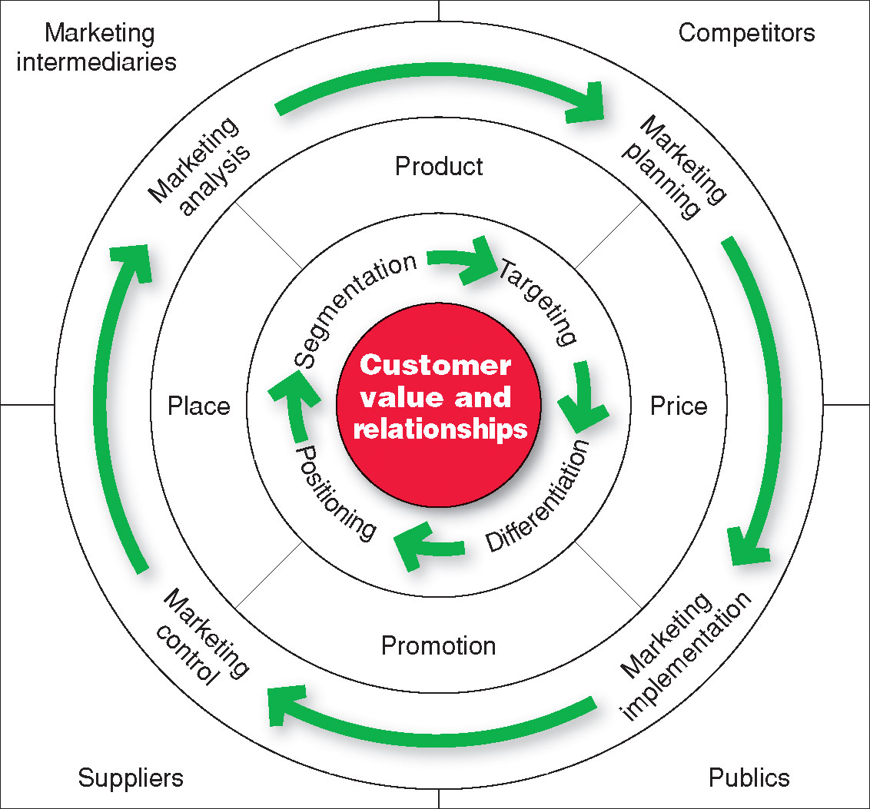
Marketing Strategy and the Marketing Mix
Notes:
Note to Instructor
Consumers stand in the center. The goal is to create value for customers and build profitable customer relationships. Next comes marketing strategy—the marketing logic by which the company hopes to create this customer value and achieve these profitable relationships. The company decides which customers it will serve (segmentation and targeting) and how (differentiation and positioning). It identifies the total market, then divides it into smaller segments, selects the most promising segments, and focuses on serving and satisfying the customers in these segments. Guided by marketing strategy, the company designs an integrated marketing mix made up of factors under its control—product, price, place, and promotion (the four Ps). To find the best marketing strategy and mix, the company engages in marketing analysis, planning, implementation, and control. Through these activities, the company watches and adapts to the actors and forces in the marketing environment.

Slide 5
Marketing Strategy and the Marketing Mix
Market segmentation is the division of a market into distinct groups of buyers who have different needs, characteristics, or behavior and who might require separate products or marketing mixes
Market segment is a group of consumers who respond in a similar way to a given set of marketing efforts
Notes:
The market consists of many types of customers, products, and needs. The marketer must determine which segments offer the best opportunities. Consumers can be grouped and served in various ways based on geographic, demographic, psychographic, and behavioral factors. The process of dividing a market into distinct groups of buyers who have different needs, characteristics, or behaviors, and who might require separate products or marketing programs, is called market segmentation.
Every market has segments, but not all ways of segmenting a market are equally useful. For example, Tylenol would gain little by distinguishing between low-income and high-income pain relief users if both respond the same way to marketing efforts. A market segment consists of consumers who respond in a similar way to a given set of marketing efforts. In the car market, for example, consumers who want the biggest, most comfortable car regardless of price make up one market segment. Consumers who care mainly about price and operating economy make up another segment. It would be difficult to make one car model that was the first choice of consumers in both segments. Companies are wise to focus their efforts on meeting the distinct needs of individual market segments.

Slide 6
Marketing Strategy and the Marketing Mix
Market Targeting
Market targeting
is the process of evaluating each market segment’s attractiveness and selecting one or more segments to enter
Notes:
After a company has defined its market segments, it can enter one or many of these segments. Market targeting involves evaluating each market segment’s attractiveness and selecting one or more segments to enter. A company should target segments in which it can profitably generate the greatest customer value and sustain it over time.
A company with limited resources might decide to serve only one or a few special segments or market niches. Such nichers specialize in serving customer segments that major competitors overlook or ignore.
A company might choose to serve several related segments—perhaps those with different kinds of customers but with the same basic wants.
A large company might decide to offer a complete range of products to serve all market segments.
Most companies enter a new market by serving a single segment; if this proves successful, they add more segments.

Slide 7
Marketing Strategy and the Marketing Mix
Market positioning is the arranging for a product to occupy a clear, distinctive, and desirable place relative to competing products in the minds of the target consumer
Whole marketing plan supports the positioning strategy
Notes:
Discussion Questions (can include the topic of positioning which is on the following slide).
Specific questions for the students:
How does Nike segment their market?
What appears to be their most important segments?
How does Nike position their products in the marketplace?
The company must determine how to differentiate its market offering for each targeted segment and what positions it wants to occupy in those segments.
A product’s position is the place it occupies relative to competitors’ products in consumers’ minds. Marketers want to develop unique market positions for their products. If a product is perceived to be exactly like others on the market, consumers would have no reason to buy it.
Positioning is arranging for a product to occupy a clear, distinctive, and desirable place relative to competing products in the minds of target consumers.
Marketers plan positions that distinguish their products from competing brands and give them the greatest advantage in their target markets.

Slide 8
Marketing Strategy and the Marketing Mix
Differentiation begins the positioning process
Whole marketing plan supports the positioning strategy
Notes:
In positioning its brand, a company first identifies possible customer value differences that provide competitive advantages on which to build the position. A company can offer greater customer value by either charging lower prices than competitors or offering more benefits to justify higher prices. But if the company promises greater value, it must then deliver that greater value. Thus, effective positioning begins with differentiation—actually differentiating the company’s market offering so that it gives consumers more value. Once the company has chosen a desired position, it must take strong steps to deliver and communicate that position to target consumers. The company’s entire marketing program should support the chosen positioning strategy.

Slide 9
Marketing Strategy and the Marketing Mix
Developing an Integrated Marketing Mix
Marketing mix is the set of controllable tactical marketing tools—product, price, place, and promotion—that the firm blends to produce the response it wants in the target market
Notes:
After determining its overall marketing strategy, the company is ready to begin planning the details of the marketing mix, one of the major concepts in modern marketing. The marketing mix is the set of tactical marketing tools that the firm blends to produce the response it wants in the target market. The marketing mix consists of everything the firm can do to influence the demand for its product.

Slide 10
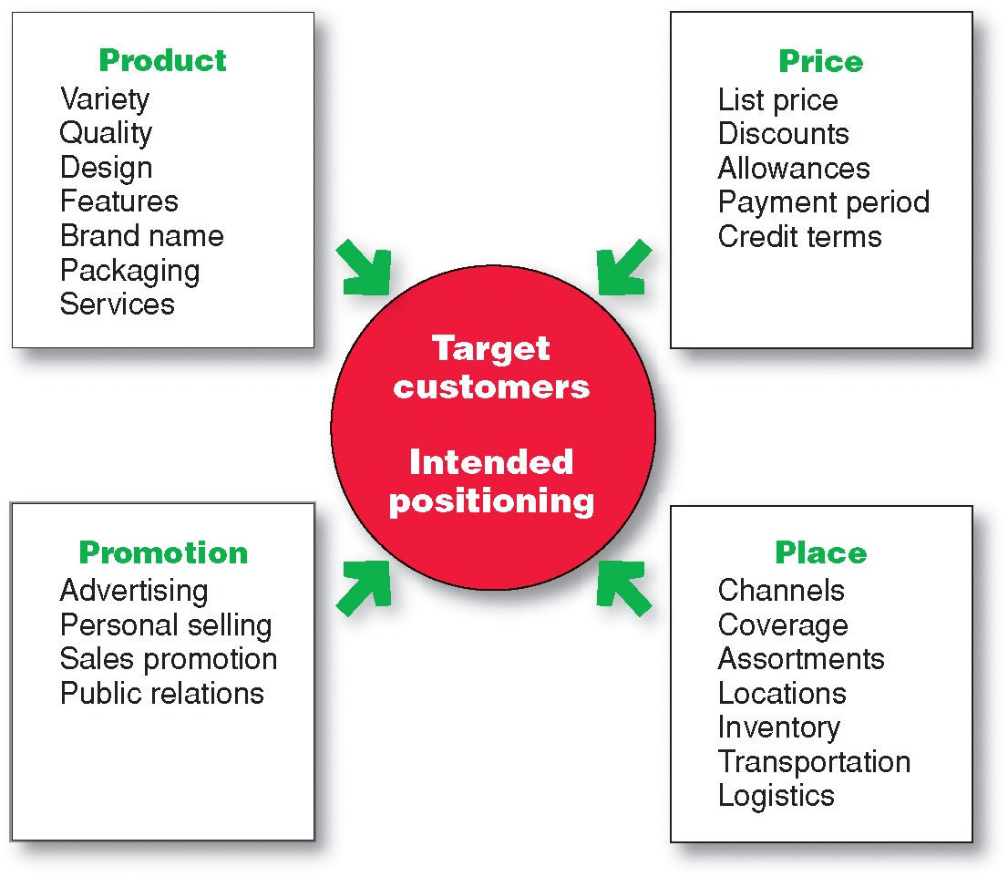
Marketing Strategy and the Marketing Mix
Developing an Integrated Marketing Mix
Notes:
The many possibilities can be collected into four groups of variables—the four Ps. Figure 2.5 shows the marketing tools under each P.
Product means the goods-and-services combination the company offers to the target market. Thus, a Ford Escape consists of nuts and bolts, spark plugs, pistons, headlights, and thousands of other parts. Ford offers several Escape models and dozens of optional features. The car comes fully serviced and with a comprehensive warranty that is as much a part of the product as the tailpipe.
Price is the amount of money customers must pay to obtain the product. For example, Ford calculates suggested retail prices that its dealers might charge for each Escape. But Ford dealers rarely charge the full sticker price. Instead, they negotiate the price with each customer, offering discounts, trade-in allowances, and credit terms. These actions adjust prices for the current competitive and economic situations and bring them into line with the buyer’s perception of the car’s value.
Place includes company activities that make the product available to target consumers. Ford partners with a large body of independently owned dealerships that sell the company’s many different models. Ford selects its dealers carefully and strongly supports them. The dealers keep an inventory of Ford automobiles, demonstrate them to potential buyers, negotiate prices, close sales, and service the cars after the sale.
Promotion refers to activities that communicate the merits of the product and persuade target customers to buy it. Ford spends more than $1.9 billion each year on U.S. advertising to tell consumers about the company and its many products. Dealership salespeople assist potential buyers and persuade them that Ford is the best car for them. Ford and its dealers offer special promotions—sales, cash rebates, and low financing rates—as added purchase incentives.
An effective marketing program blends the marketing mix elements into an integrated marketing program designed to achieve the company’s marketing objectives by delivering value to consumers. The marketing mix constitutes the company’s tactical tool kit for establishing strong positioning in target markets.
Some critics think that the four Ps may omit or underemphasize certain important activities. For example, they ask, “Where are services?” Just because they don’t start with a P doesn’t justify omitting them. The answer is that services, such as banking, airline, and retailing services, are products too. We might call them service products. “Where is packaging?” the critics might ask. Marketers would answer that they include packaging as one of many product decisions. All said, as Figure 2.5 suggests, many marketing activities that might appear to be left out of the marketing mix are included under one of the four Ps. The issue is not whether there should be four, six, or ten Ps so much as what framework is most helpful in designing integrated marketing programs.
It is interesting to ask how to make the 4Ps more customer centric. This leads to a redefining of the 4Ps to the 4Cs as follows:
Product—Customer solution
Price—Customer cost
Place—Convenience
Promotion—Communication

Slide 11
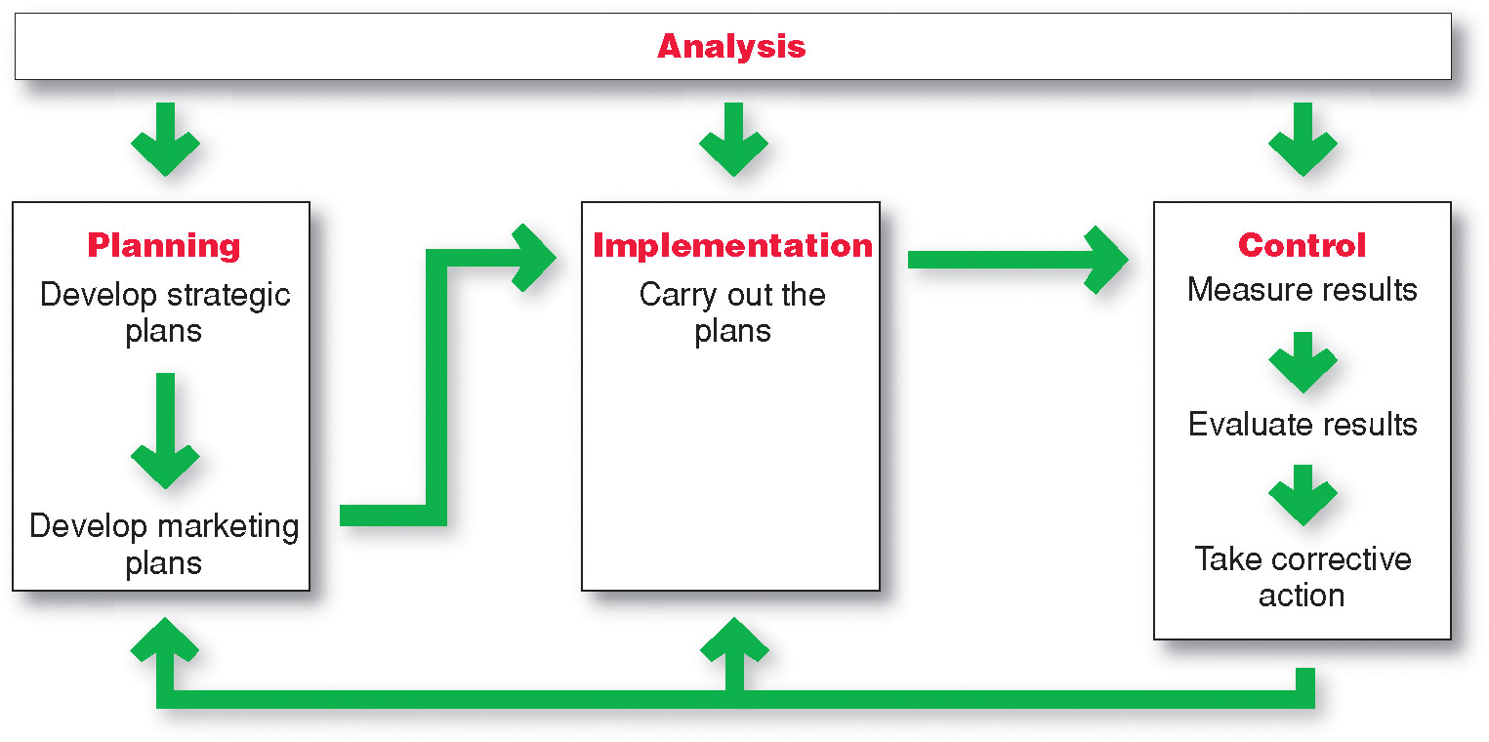
Managing the Marketing Effort
Notes:
Managing the marketing process requires the four marketing management functions shown in Figure 2.6—analysis, planning, implementation, and control. The company first develops company-wide strategic plans and then translates them into marketing and other plans for each division, product, and brand. Through implementation, the company turns the plans into actions. Control consists of measuring and evaluating the results of marketing activities and taking corrective action where needed. Finally, marketing analysis provides information and evaluations needed for all the other marketing activities.

Slide 12
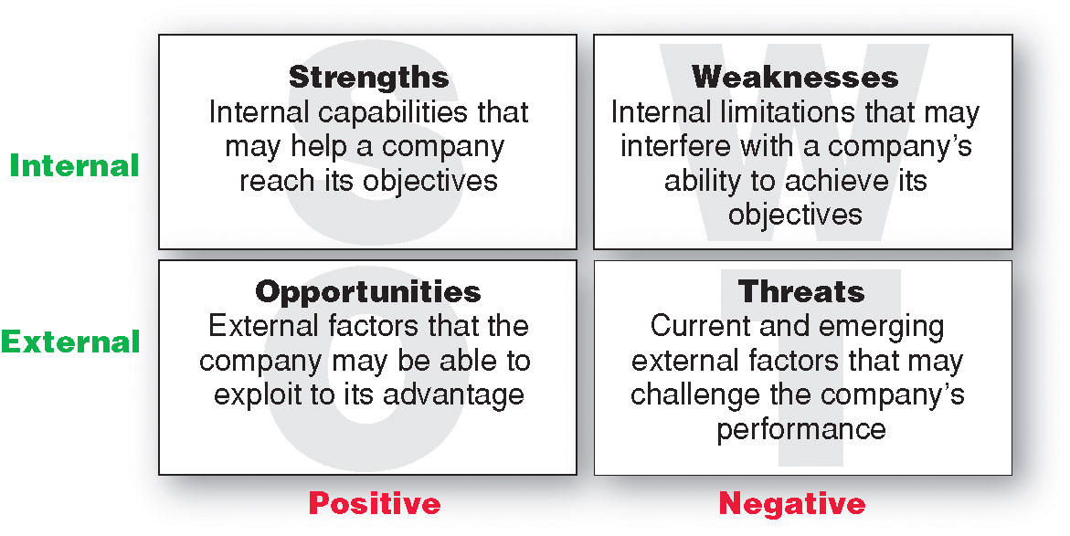
Managing the Marketing Effort
Marketing Analysis – SWOT Analysis
Notes:
Marketing Analysis
Managing the marketing function begins with a complete analysis of the company’s situation. The marketer should conduct a SWOT analysis (pronounced “swat” analysis), by which it evaluates the company’s overall strengths (S), weaknesses (W), opportunities (O), and threats (T) (see Figure 2.7). Strengths include internal capabilities, resources, and positive situational factors that may help the company serve its customers and achieve its objectives. Weaknesses include internal limitations and negative situational factors that may interfere with the company’s performance. Opportunities are favorable factors or trends in the external environment that the company may be able to exploit to its advantage. And threats are unfavorable external factors or trends that may present challenges to performance.
The company should analyze its markets and marketing environment to find attractive opportunities and identify environmental threats. It should analyze company strengths and weaknesses as well as current and possible marketing actions to determine which opportunities it can best pursue. The goal is to match the company’s strengths to attractive opportunities in the environment, while simultaneously eliminating or overcoming the weaknesses and minimizing the threats. Marketing analysis provides inputs to each of the other marketing management functions.

Slide 13
What is a Marketing Plan?
A marketing plan is the central instrument for directing and coordinating the marketing effort.
It operates at a strategic and tactical level.

Slide 14
Levels of a Marketing Plan
Strategic
  Target marketing decisions
  Value proposition
  Analysis of marketing opportunities
Tactical
  Product features
  Promotion
  Merchandising
  Pricing
  Sales channels
  Service

Slide 15
Marketing Plan Contents
Executive summary
Table of contents
Situation analysis
Marketing strategy
Financial projections
Implementation controls

Slide 16
Marketing Plan Contents Details
Executive Summary
Table Of Contents
Situation Analysis (SWOT Analysis)
  Customers
  Competitors
  Company
  Context
Marketing Strategy
  Mission
  Marketing & Financial Objective
  Product Lines
  Competitive positioning
Financial Projections
  Sales forecast
  Expense Forecast
  Break Even Analysis
  Forecasted Sales Value
  Expected Marketing Cost
Implementation Controls
  Outlines The Controls For Monitoring & Adjusting
  Spells out The Goals & Budgets
  Contingency Plan

Slide 17
Evaluating a Marketing Plan
Is the plan simple?
Is the plan specific?
Is the plan realistic?
Is the plan complete?

Slide 18
Managing the Marketing Effort
Marketing Implementation
Implementing
Turns marketing plans into marketing actions to accomplish strategic marketing objectives
Addresses who, where, when, how
Notes:
A brilliant marketing strategy counts for little if the company fails to implement it properly.
Marketing implementation is the process that turns marketing plans into marketing actions to accomplish strategic marketing objectives.
Whereas marketing planning addresses the what and why of marketing activities, implementation addresses the who, where, when, and how.
Many managers think that “doing things right” (implementation) is as important as, or even more important than, “doing the right things” (strategy). The fact is that both are critical to success, and companies can gain competitive advantages through effective implementation. One firm can have essentially the same strategy as another, yet win in the marketplace through faster or better execution. Still, implementation is difficult—it is often easier to think up good marketing strategies than it is to carry them out.
In an increasingly connected world, people at all levels of the marketing system must work together to implement marketing strategies and plans. At Michelin, for example, marketing implementation for the company’s original equipment, replacement, industrial, and commercial tires requires day-to-day decisions and actions by thousands of people both inside and outside the organization. Marketing managers make decisions about target segments, branding, product development, pricing, promotion, and distribution. They talk with engineering about product designs, with manufacturing about production and inventory levels, and with finance about funding and cash flows. They also connect with outside people, such as advertising agencies to plan ad campaigns and the news media to obtain publicity support.

Slide 19
Managing the Marketing Effort
Marketing Department Organization
Functional organization
Geographic organization
Product management organization
Market or customer management
Notes:
Note to Instructor
Functional organization: This is the most common form of marketing organization with different marketing functions headed by a functional specialist.
Geographic organization: Useful for companies that sell across the country or internationally. Managers are responsible for developing strategies and plans for a specific region.
Product management: Useful for companies with different products or brands. Managers are responsible for developing strategies and plans for a specific product or brand.
Market or customer management organization: Useful for companies with one product line sold to many different markets and customers. Managers are responsible for developing strategies and plans for their specific markets or customers.
Customer management involves a customer focus and not a product focus for managing customer profitability and customer equity.

Slide 20
Managing the Marketing Effort
Marketing Control
Controlling
Evaluating of results
Taking of corrective action to achieve objectives
Operating control
Strategic control
Notes:
Because many surprises occur during the implementation of marketing plans, marketers must practice constant marketing control—evaluating the results of marketing strategies and plans and taking corrective action to ensure that the objectives are attained. Marketing control involves four steps. Management first sets specific marketing goals. It then measures its performance in the marketplace and evaluates the causes of any differences between expected and actual performance. Finally, management takes corrective action to close the gaps between goals and performance. This may require changing the action programs or even changing the goals.
Operating control involves checking ongoing performance against the annual plan and taking corrective action when necessary. Its purpose is to ensure that the company achieves the sales, profits, and other goals set out in its annual plan. It also involves determining the profitability of different products, territories, markets, and channels. Strategic control involves looking at whether the company’s basic strategies are well matched to its opportunities. Marketing strategies and programs can quickly become outdated, and each company should periodically reassess its overall approach to the marketplace.

Slide 21
Measuring and Managing
Return on Marketing Investment
Return on Marketing Investment (Marketing ROI)
Return on marketing investment
is net return from a marketing investment divided by the costs of the marketing investment.
provides a measurement of the profits generated by investments in marketing activities.
Notes:
Measuring return on marketing investment has become a major marketing emphasis. But it can be difficult How do you measure the
specific return on a media investment?
Marketing performance—the practice of measuring, learning from, and improving upon marketing strategies and tactics over time—is taking hold. More companies are now working to connect the dots between marketing activities and results than ever before.
One important marketing performance measure is return on marketing investment (or marketing ROI). Marketing ROI is the net return from a marketing investment divided by the costs of the marketing investment. It measures the profits generated by investments in marketing activities.
there is no consistent definition of marketing ROI. For instance, returns like advertising and brand-building impact aren’t easily put into dollar returns.
A company can assess marketing ROI in terms of standard marketing performance measures, such as brand awareness, sales, or market share. Many companies are assembling such measures into marketing dashboards—meaningful sets of marketing performance measures in a single display used to monitor strategic marketing performance. The marketing dashboard gives marketers the detailed measures they need to assess and adjust their marketing strategies.
A marketing dashboard could track brand equity and trends, share of voice, market share, online sentiment, and marketing ROI in key markets worldwide, for company brands and also for competing brands.
Increasingly, however, beyond standard performance measures, marketers are using customer-centered measures of marketing impact, such as customer acquisition, customer retention, customer lifetime value, and customer equity. These measures capture not only current marketing performance but also future performance resulting from stronger customer relationships.
We can view marketing expenditures as investments that produce returns in the form of more profitable customer relationships. Marketing investments result in improved customer value and satisfaction, which in turn increases customer attraction and retention. This increases individual customer lifetime values and the firm’s overall customer equity. Increased customer equity, in relation to the cost of the marketing investments, determines return on marketing investment.
Regardless of how it’s defined or measured, the marketing ROI concept is here to stay. “In good times and bad, whether or not marketers are ready for it, they’re going to be asked to justify their spending with financial data,” says one marketer. Adds another, marketers “have got to know how to count.”

Slide 22
Bibliography
Principles of Marketing by Philip Kotler & Gary Armstrong
Fifteenth Edition, Published by Prentice Hall
Marketing Management – A South Asian Perspective
by Philip Kotler, Kevin Lane Keller, Abraham Koshy &
Mithileshwar Jha, 13th Edition, Published by Pearson
Education, Inc.
Principles and Practices of Marketing by Jobber, D. 4th
edition, McGraw Hill International.
Principles of Advertising & IMC by Tom Duncan 2nd
Edition, Published by McGraw-Hill Irwin.

Slide 23


The End
"Life is like a combination lock; your job is to find the right numbers, in the right order so you can have anything you want."

