Slide 1
Course Revision
LECTURE-32

Slide 2
Marketing:
Creating and Capturing Customer Value
LECTURE-1

Slide 3
Topic Outline
What Is Marketing?
Marketing process
Understanding the Marketplace and Customer Needs
Notes:
Objective 1 Define marketing and outline the steps in the marketing process.
What Is Marketing?
Objective 2 Explain the importance of understanding customers and the marketplace and identify the five core marketplace concepts.
Understanding the Marketplace and Customer Needs
Objective 3 Identify the key elements of a customer-driven marketing strategy and discuss the marketing management orientations that guide marketing strategy.
Designing a Customer-Driven Marketing Strategy
Preparing an Integrated Marketing Plan and Program 000–000
Objective 4 Discuss customer relationship management and identify strategies for creating value for customers and capturing value from customers in return.
Building Customer Relationships
Capturing Value from Customers
Objective 5 Describe the major trends and forces that are changing the marketing landscape in this age of relationships.
The Changing Marketing Landscape

Slide 4
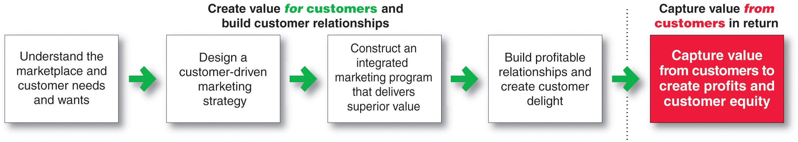
Marketing Process
Notes:
This important figure shows the simple, five-step model of the marketing process. By creating value for customers, marketers capture value from customers in return.
This five-step process forms the marketing framework for the rest of the chapter and the remainder of the book.
In the first four steps, companies work to understand consumers, create customer value, and build strong customer relationships.
In the final step, companies reap the rewards of creating superior customer value. By creating value for consumers, they in turn capture value from consumers in the form of sales, profits, and long-term customer equity.
In this chapter, we review each step but focus more on the customer relationship steps—understanding customers, building customer relationships, and capturing value from customers..
Marketing is all about creating value for customers. So, as the first step in the marketing process, the company must fully understand consumers and the marketplace in which it operates.

Slide 5
Marketing:
Creating and Capturing Customer Value
LECTURE-2

Slide 6
Topic Outline
What Is Marketing Management?
Designing a Customer-Driven Marketing Strategy
Preparing an Integrated Marketing Plan and Program
Building Customer Relationships
Capturing Value from Customers
The Changing Marketing Landscape
Notes:
Objective 1 Define marketing and outline the steps in the marketing process.
What Is Marketing?
Objective 2 Explain the importance of understanding customers and the marketplace and identify the five core marketplace concepts.
Understanding the Marketplace and Customer Needs
Objective 3 Identify the key elements of a customer-driven marketing strategy and discuss the marketing management orientations that guide marketing strategy.
Designing a Customer-Driven Marketing Strategy
Preparing an Integrated Marketing Plan and Program 000–000
Objective 4 Discuss customer relationship management and identify strategies for creating value for customers and capturing value from customers in return.
Building Customer Relationships
Capturing Value from Customers
Objective 5 Describe the major trends and forces that are changing the marketing landscape in this age of relationships.
The Changing Marketing Landscape

Slide 7
Designing a Customer-Driven Marketing Strategy
Marketing Management Orientations
Production concept
Product concept
Selling concept
Marketing concept
Societal concept
Notes:
Marketing management wants to design strategies that will build profitable relationships with target consumers. But what philosophy should guide these marketing strategies? What weight should be given to the interests of customers, the organization, and society? Very often, these interests conflict.
There are five alternative concepts under which organizations design and carry out their marketing strategies: the production, product, selling, marketing, and societal marketing concepts.

Slide 8
Company and Marketing Strategy
Partnering to Build Customer Relationships
LECTURE-3

Slide 9
Topic Outline
Companywide Strategic Planning: Defining Marketing’s Role
Planning Marketing: Partnering to Build Customer Relationships
Marketing Strategy and the Marketing Mix
Notes:
In this chapter, we dig deeper into steps two and three of the marketing process: designing customer-driven marketing strategies and constructing marketing programs. First, we look at the organization’s overall strategic planning, which guides marketing strategy and planning. Next, we discuss how, guided by the strategic plan, marketers partner closely with others inside and outside the firm to create value for customers. We then examine marketing strategy and planning—how marketers choose target markets, position their market offerings, develop a marketing mix, and manage their marketing programs. Finally, we look at the important step of measuring and managing return on marketing investment (marketing ROI).

Slide 10
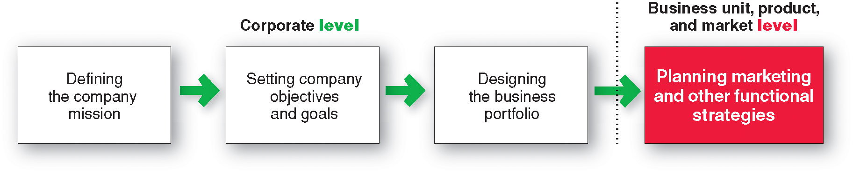
Companywide Strategic Planning
Steps in Strategic Planning
Notes:
At the corporate level, the company starts the strategic planning process by defining its overall purpose and mission (see Figure 2.1). This mission is then turned into detailed supporting objectives that guide the entire company. Next, headquarters decides what portfolio of businesses and products is best for the company and how much support to give each one. In turn, each business and product develops detailed marketing and other departmental plans that support the company-wide plan. Thus, marketing planning occurs at the business-unit, product, and market levels. It supports company strategic planning with more detailed plans for specific marketing opportunities.

Slide 11
Developing Marketing
Strategies and Plans
LECTURE-4

Slide 12
Topic Outline
How is strategic planning carried out at different levels of the organization?
What does a marketing plan include?
Managing the Marketing Effort
Measuring and Managing Return on Marketing Investment
Notes:
In this chapter, we dig deeper into steps two and three of the marketing process: designing customer-driven marketing strategies and constructing marketing programs. First, we look at the organization’s overall strategic planning, which guides marketing strategy and planning. Next, we discuss how, guided by the strategic plan, marketers partner closely with others inside and outside the firm to create value for customers. We then examine marketing strategy and planning—how marketers choose target markets, position their market offerings, develop a marketing mix, and manage their marketing programs. Finally, we look at the important step of measuring and managing return on marketing investment (marketing ROI).

Slide 13
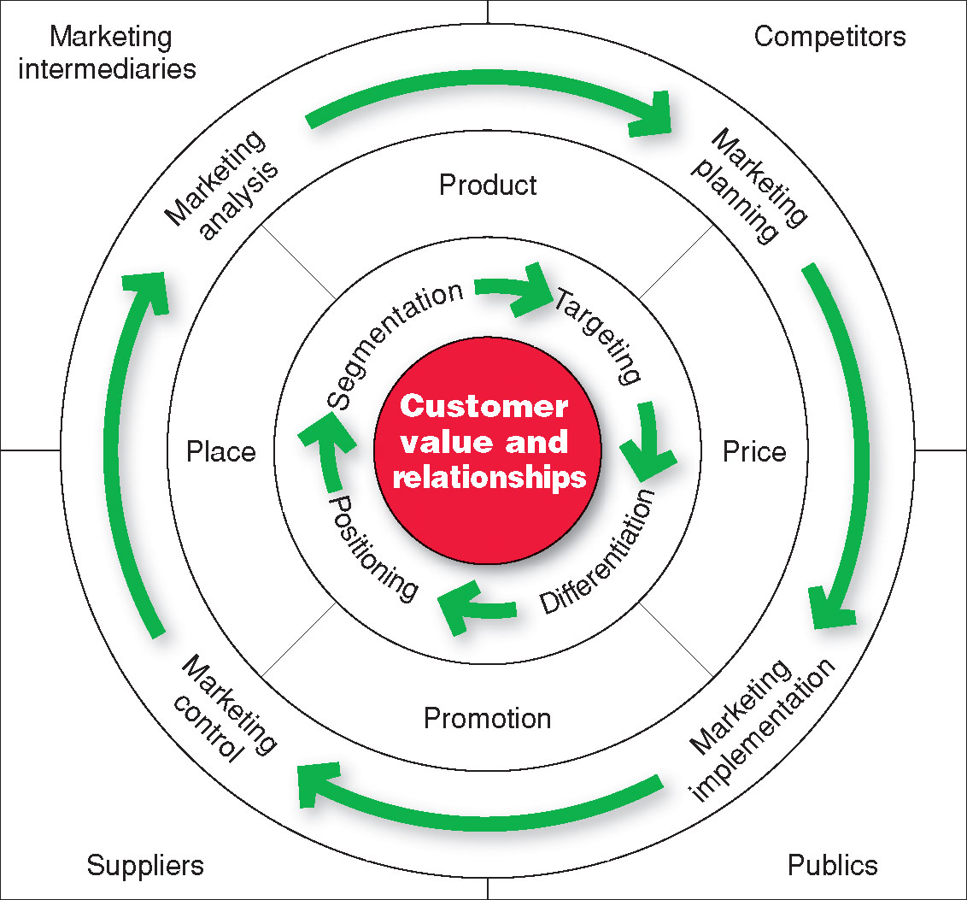
Marketing Strategy and the Marketing Mix
Notes:
Note to Instructor
Consumers stand in the center. The goal is to create value for customers and build profitable customer relationships. Next comes marketing strategy—the marketing logic by which the company hopes to create this customer value and achieve these profitable relationships. The company decides which customers it will serve (segmentation and targeting) and how (differentiation and positioning). It identifies the total market, then divides it into smaller segments, selects the most promising segments, and focuses on serving and satisfying the customers in these segments. Guided by marketing strategy, the company designs an integrated marketing mix made up of factors under its control—product, price, place, and promotion (the four Ps). To find the best marketing strategy and mix, the company engages in marketing analysis, planning, implementation, and control. Through these activities, the company watches and adapts to the actors and forces in the marketing environment.

Slide 14
Analyzing the Marketing Environment
LECTURE-5

Slide 15
Topic Outline
Analyzing The Marketing Environment
The Company’s Micro-environment
The Company’s Macro-environment
Responding to the Marketing Environment
Notes:
In this chapter, we dig deeper into steps two and three of the marketing process: designing customer-driven marketing strategies and constructing marketing programs. First, we look at the organization’s overall strategic planning, which guides marketing strategy and planning. Next, we discuss how, guided by the strategic plan, marketers partner closely with others inside and outside the firm to create value for customers. We then examine marketing strategy and planning—how marketers choose target markets, position their market offerings, develop a marketing mix, and manage their marketing programs. Finally, we look at the important step of measuring and managing return on marketing investment (marketing ROI).

Slide 16
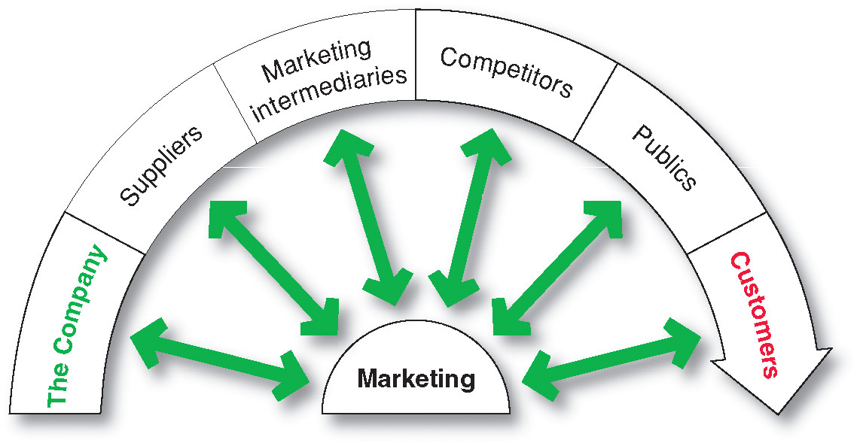
The Company’s Microenvironment
Actors in the Microenvironment
Notes:
Marketing management’s job is to build relationships with customers by creating customer value and satisfaction. However, marketing managers cannot do this alone. Figure 3.1 shows the major actors in the marketer’s microenvironment. Marketing success requires building relationships with other company departments, suppliers, marketing intermediaries, competitors, various publics, and customers, which combine to make up the company’s value delivery network.

Slide 17
Managing Marketing Information to Gain Customer Insights
Part-1
LECTURE-6

Slide 18
Topic Outline
Marketing Information and Customer Insights
Assessing Marketing Information Needs
Developing Marketing Information
Marketing Research
Analyzing and Using Marketing Information
Other Marketing Information Considerations

Slide 19
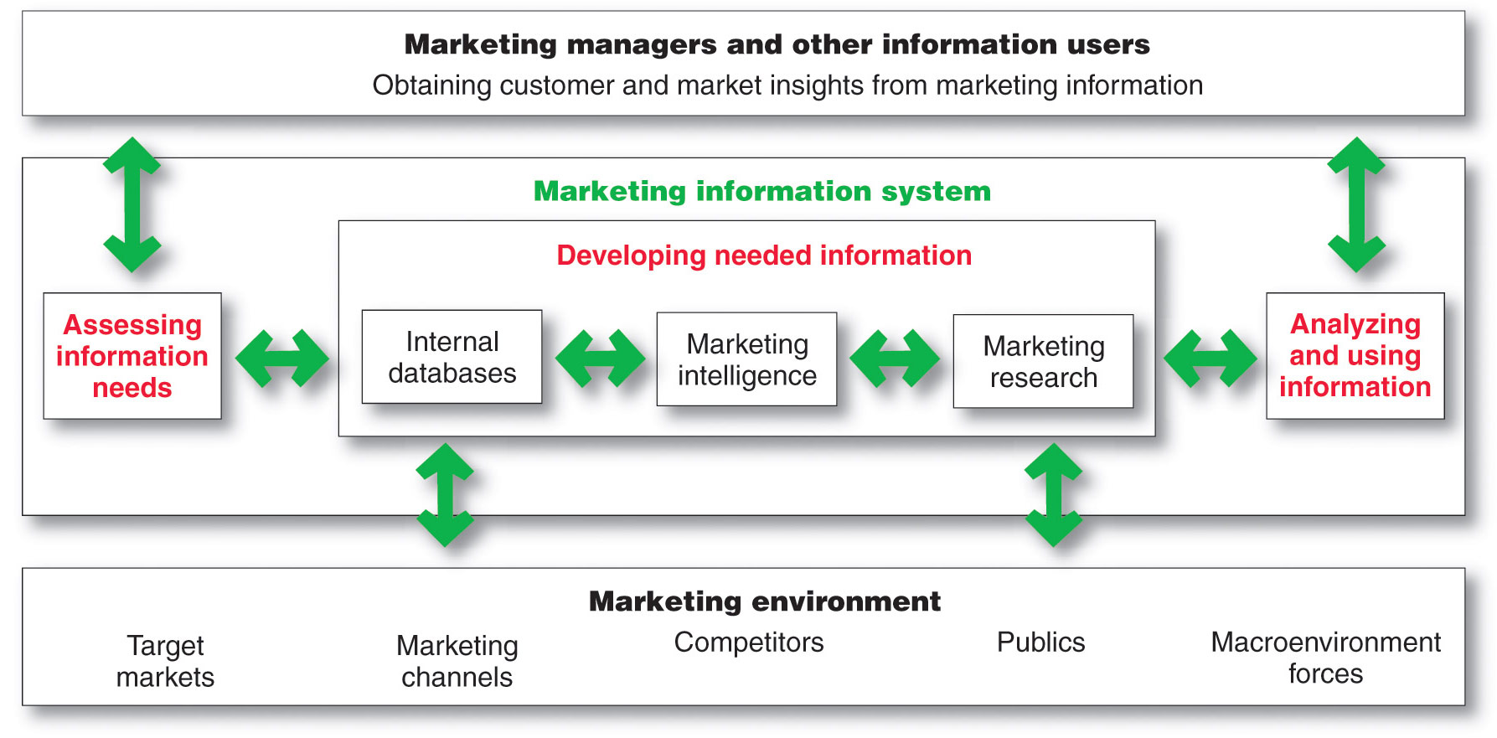
Marketing Information System
Notes:
MIS begins and ends with information users—marketing managers, internal and external partners, and others who need marketing information. First, it interacts with these information users to assess information needs. Next, it interacts with the marketing environment to develop needed information through internal company databases, marketing intelligence activities, and marketing research. Finally, the MIS helps users to analyze and use the information to develop customer insights, make marketing decisions, and manage customer relationships.

Slide 20
Managing Marketing Information to Gain Customer Insights
Part-2
LECTURE-7

Slide 21
Developing Marketing Information
Marketing Research
Implementing the Research Plan
Collecting the information
Processing the information
Analyzing the information
Interpret findings
Draw conclusions
Report to management
Notes:
The researcher next puts the marketing research plan into action. This involves collecting, processing, and analyzing the information. Data collection can be carried out by the company’s marketing research staff or outside firms. Researchers should watch closely to make sure that the plan is implemented correctly. They must guard against problems of interacting with respondents, with the quality of participants’ responses, and with interviewers who make mistakes or take shortcuts.
Researchers must also process and analyze the collected data to isolate important information and insight. They need to check data for accuracy and completeness and code it for analysis. The researchers then tabulate the results and compute statistical measures.
Interpreting and Reporting the Findings
The market researcher must now interpret the findings, draw conclusions, and report them to management. The researcher should not try to overwhelm managers with numbers and fancy statistical techniques. Rather, the researcher should present important findings and insights that are useful in the major decisions faced by management.
However, interpretation should not be left only to researchers. Although they are often experts in research design and statistics, the marketing manager knows more about the problem and the decisions that must be made. The best research means little if the manager blindly accepts faulty interpretations from the researcher. Similarly, managers may be biased. They might tend to accept research results that show what they expected and reject those that they did not expect or hope for. In many cases, findings can be interpreted in different ways, and discussions between researchers and managers will help point to the best interpretations. Thus, managers and researchers must work together closely when interpreting research results, and both must share responsibility for the research process and resulting decisions.

Slide 22
Consumer Markets and Consumer Buyer Behavior
(Part-1)
LECTURE-8

Slide 23
Topic Outline
Model of Consumer Behavior
Characteristics Affecting Consumer Behavior
Types of Buying Decision Behavior
The Buyer Decision Process
The Buyer Decision Process for New Products
Notes:
In this chapter, we dig deeper into steps two and three of the marketing process: designing customer-driven marketing strategies and constructing marketing programs. First, we look at the organization’s overall strategic planning, which guides marketing strategy and planning. Next, we discuss how, guided by the strategic plan, marketers partner closely with others inside and outside the firm to create value for customers. We then examine marketing strategy and planning—how marketers choose target markets, position their market offerings, develop a marketing mix, and manage their marketing programs. Finally, we look at the important step of measuring and managing return on marketing investment (marketing ROI).

Slide 24
Consumer Buying Process
Problem recognition
Information search
Evaluation of alternatives
Purchase decision
Post purchase behavior

Slide 25
Consumer Markets and Consumer Buyer Behavior
(Part-2)
LECTURE-9

Slide 26
Characteristics Affecting Consumer Behavior
Maslow’s
Hierarchy of Needs
SELF
ACTUALIZATION
ESTEEM NEEDS
Prestige
LOVE, AFFECTION, AND
BELONGINGNESS NEEDS
SAFETY NEEDS
Security and Safety
PHYSIOLOGICAL OR SURVIVAL NEEDS
Food, Water, Warmth, Rest
Notes:
Abraham Maslow sought to explain why people are driven by particular needs at particular times. Why does one person spend a lot of time and energy on personal safety and another on gaining the esteem of others? Maslow’s answer is that human needs are arranged in a hierarchy, as shown in Figure 5.4, from the most pressing at the bottom to the least pressing at the top. They include physiological needs, safety needs, social needs, esteem needs, and self-actualization needs.
A person tries to satisfy the most important need first. When that need is satisfied, it will stop being a motivator, and the person will then try to satisfy the next most important need. For example, starving people (physiological need) will not take an interest in the latest happenings in the art world (self-actualization needs) nor in how they are seen or esteemed by others (social or esteem needs) nor even in whether they are breathing clean air (safety needs). But as each important need is satisfied, the next most important need will come into play.
See Abraham H. Maslow, “A Theory of Human Motivation,” Psychological Review, 50 (1943), pp. 370–396. Also see Maslow, Motivation and Personality, 3rd ed. (New York: HarperCollins Publishers, 1987); and Michael R. Solomon, Consumer Behavior, 9th ed. (Upper Saddle River, NJ: Prentice Hall, 2011), pp. 135-136.

Slide 27
Business Markets and Business Buying Behavior
LECTURE-10

Slide 28
Topic Outline
Business Markets
Business Buyer Behavior
The Business Buying Process
E-Procurement: Buying on the Internet
Institutional and Government Markets
Notes:
In this chapter, we dig deeper into steps two and three of the marketing process: designing customer-driven marketing strategies and constructing marketing programs. First, we look at the organization’s overall strategic planning, which guides marketing strategy and planning. Next, we discuss how, guided by the strategic plan, marketers partner closely with others inside and outside the firm to create value for customers. We then examine marketing strategy and planning—how marketers choose target markets, position their market offerings, develop a marketing mix, and manage their marketing programs. Finally, we look at the important step of measuring and managing return on marketing investment (marketing ROI).

Slide 29
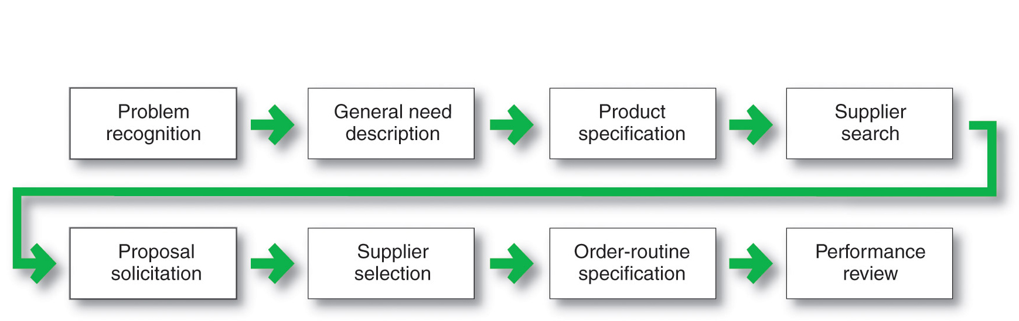
Business Buyer Behavior
The Buying Process
Notes:
The Business Buying Process
Figure 6.3 lists the eight stages of the business buying process. Buyers who face a new task buying situation usually go through all stages of the buying process. Buyers making modified or straight rebuys, in contrast, may skip some of the stages. We will examine these steps for the typical new task buying situation.

Slide 30
Customer-Driven Marketing Strategy
LECTURE-11

Slide 31
Topic Outline
Market Segmentation
Notes:
In this chapter, we dig deeper into steps two and three of the marketing process: designing customer-driven marketing strategies and constructing marketing programs. First, we look at the organization’s overall strategic planning, which guides marketing strategy and planning. Next, we discuss how, guided by the strategic plan, marketers partner closely with others inside and outside the firm to create value for customers. We then examine marketing strategy and planning—how marketers choose target markets, position their market offerings, develop a marketing mix, and manage their marketing programs. Finally, we look at the important step of measuring and managing return on marketing investment (marketing ROI).

Slide 32
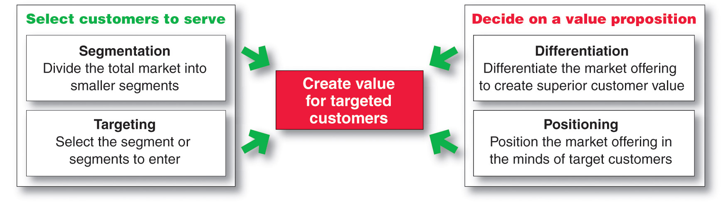
Market Segmentation
Notes:
Thus, most companies have moved away from mass marketing and toward target marketing: identifying market segments, selecting one or more of them, and developing products and marketing programs tailored to each. Instead of scattering their marketing efforts (the “shotgun” approach), firms are focusing on the buyers who have greater interest in the values they create best (the “rifle” approach).
four major steps in designing a customer-driven marketing strategy. In the first two steps, the company selects the customers that it will serve. Market segmentation involves dividing a market into smaller segments of buyers with distinct needs, characteristics, or behaviors that might require separate marketing strategies or mixes. The company identifies different ways to segment the market and develops profiles of the resulting market segments. Market targeting (or targeting) consists of evaluating each market segment’s attractiveness and selecting one or more market segments to enter.
In the final two steps, the company decides on a value proposition—how it will create value for target customers. Differentiation involves actually differentiating the firm’s market offering to create superior customer value. Positioning consists of arranging for a market offering to occupy a clear, distinctive, and desirable place relative to competing products in the minds of target consumers. We discuss each of these steps in turn.

Slide 33
Creating Value for Target Customers
LECTURE-12

Slide 34
Topic Outline
Market Targeting
Differentiation and Positioning
Notes:
In this chapter, we dig deeper into steps two and three of the marketing process: designing customer-driven marketing strategies and constructing marketing programs. First, we look at the organization’s overall strategic planning, which guides marketing strategy and planning. Next, we discuss how, guided by the strategic plan, marketers partner closely with others inside and outside the firm to create value for customers. We then examine marketing strategy and planning—how marketers choose target markets, position their market offerings, develop a marketing mix, and manage their marketing programs. Finally, we look at the important step of measuring and managing return on marketing investment (marketing ROI).

Slide 35
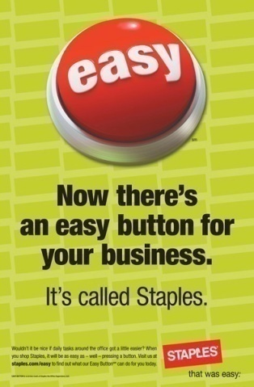
Differentiation and Positioning
Choosing a Differentiation and Positioning Strategy
Identifying a set of possible competitive advantages to build a position by providing superior value from:
Product differentiation
Service differentiation
Channel differentiation
People differentiation
Image differentiation
Notes:
To find points of differentiation, marketers must think through the customer’s entire experience with the company’s product or service. An alert company can find ways to differentiate itself at every customer contact point. In what specific ways can a company differentiate itself or its market offer? It can differentiate along the lines of product, services, channels, people, or image.
<ex07.17>
Through product differentiation, brands can be differentiated on features, performance, or style and design. Thus, Bose positions its speakers on their striking design and sound characteristics. By gaining the approval of the American Heart Association as an approach to a healthy lifestyle, Subway differentiates itself as the healthy fast-food choice. And Seventh Generation, a maker of household cleaning and laundry supplies, paper products, diapers, and wipes, differentiates itself not so much by how its products perform but by the fact that its products are greener. Seventh Generation products are “Protecting Planet Home.”
Beyond differentiating its physical product, a firm can also differentiate the services that accompany the product. Some companies gain services differentiation through speedy, convenient, or careful delivery. For example, First Convenience Bank of Texas offers “Real Hours for Real People”; it is open seven days a week, including evenings. Others differentiate their service based on high-quality customer care. In an age where customer satisfaction with airline service is in constant decline, Singapore Airlines sets itself apart through extraordinary customer care and the grace of its flight attendants. “Everyone expects excellence from us,” says the international airline. “[So even] in the smallest details of flight, we rise to each occasion and deliver the Singapore Airlines experience.”
Firms that practice channel differentiation gain competitive advantage through the way they design their channel’s coverage, expertise, and performance. Amazon.com and GEICO, for example, set themselves apart with their smooth-functioning direct channels. Companies can also gain a strong competitive advantage through people differentiation—hiring and training better people than their competitors do. People differentiation requires that a company select its customer-contact people carefully and train them well. For example, Disney World people are known to be friendly and upbeat. Disney trains its theme park people thoroughly to ensure that they are competent, courteous, and friendly—from the hotel check-in agents, to the monorail drivers, to the ride attendants, to the people who sweep Main Street USA. Each employee is carefully trained to understand customers and to “make people happy.”
Even when competing offers look the same, buyers may perceive a difference based on company or brand image differentiation. A company or brand image should convey a product’s distinctive benefits and positioning. Developing a strong and distinctive image calls for creativity and hard work. A company cannot develop an image in the public’s mind overnight by using only a few ads. If Ritz-Carlton means quality, this image must be supported by everything the company says and does.
Symbols, such as the McDonald’s golden arches, the colorful Google logo, the Nike swoosh, or Apple’s “bite mark” logo, can provide strong company or brand recognition and image differentiation. The company might build a brand around a famous person, as Nike did with its Michael Jordan, Kobe Bryant, and LeBron James basketball shoe and apparel collections. Some companies even become associated with colors, such as Coca-Cola (red), IBM (blue), or UPS (brown). The chosen symbols, characters, and other image elements must be communicated through advertising that conveys the company’s or brand’s personality.

Slide 36
Product And Services
LECTURE-13

Slide 37
Topic Outline
Product, Services, and Experiences
Product and Services Decisions
Services Marketing
Notes:
After examining customer-driven marketing strategy, we now take a deeper look at the marketing mix: the tactical tools that marketers use to implement their strategies and deliver superior customer value. The product and brand are usually the first and most basic marketing consideration. We start with a seemingly simple question: What is a product? In this and the next chapter, we study how companies develop and manage products and brands.

Slide 38
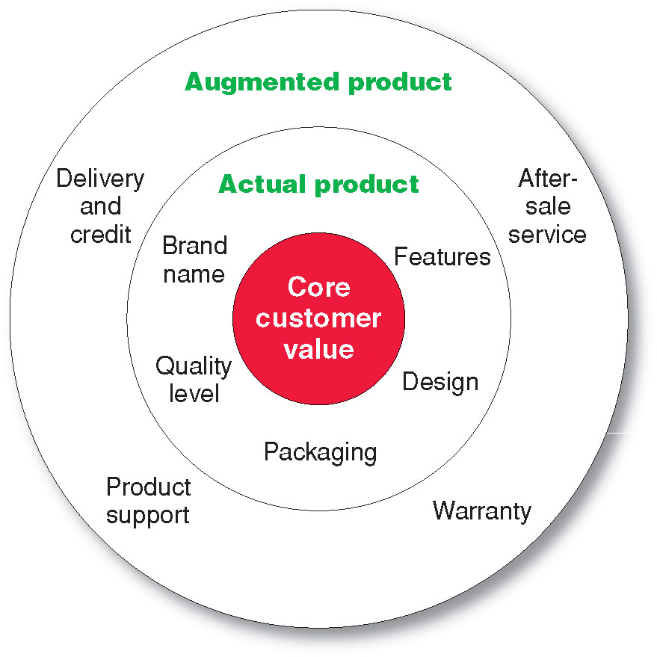
What Is a Product?
Levels of Product and Services
Notes:
Levels of Product and Services
Product planners need to think about products and services on three levels (see Figure 8.1). Each level adds more customer value. The most basic level is the core customer value, which addresses the question: What is the buyer really buying? When designing products, marketers must first define the core, problem-solving benefits or services that consumers seek. A woman buying lipstick buys more than lip color. Charles Revson of Revlon saw this early: “In the factory, we make cosmetics; in the store, we sell hope.” And people who buy an Apple iPad are buying much more than just a tablet computer. They are buying entertainment, self-expression, productivity, and connectivity with friends and family—a mobile and personal window to the world.
<ex08.03>
At the second level, product planners must turn the core benefit into an actual product. They need to develop product and service features, a design, a quality level, a brand name, and packaging. For example, the iPad is an actual product. Its name, parts, styling, features, packaging, and other attributes have all been carefully combined to deliver the core customer value of staying connected.
Finally, product planners must build an augmented product around the core benefit and actual product by offering additional consumer services and benefits. The iPad is more than just a digital device. It provides consumers with a complete connectivity solution. Thus, when consumers buy an iPad, Apple and its resellers also might give buyers a warranty on parts and workmanship, instructions on how to use the device, quick repair services when needed, and a website to use if they have problems or questions. It also provides access to a huge assortment of apps and accessories.
Consumers see products as complex bundles of benefits that satisfy their needs. When developing products, marketers first must identify the core customer value that consumers seek from the product. They must then design the actual product and find ways to augment it to create this customer value and the most satisfying brand experience.
Discussion Question: It is a good idea for the students to bring in some products so the class can discuss the levels of product and services. Products including Gatorade, toothpaste, facial moisturizer or cosmetics work well in this discussion. You can often find augmented product features on the product’s websites including games, features and support.

Slide 39
Brand, Branding And Building Customer Value
LECTURE-14

Slide 40
Topic Outline
Brand
Branding
Branding Strategy: Building Strong Brands
Notes:
After examining customer-driven marketing strategy, we now take a deeper look at the marketing mix: the tactical tools that marketers use to implement their strategies and deliver superior customer value. The product and brand are usually the first and most basic marketing consideration. We start with a seemingly simple question: What is a product? In this and the next chapter, we study how companies develop and manage products and brands.

Slide 41
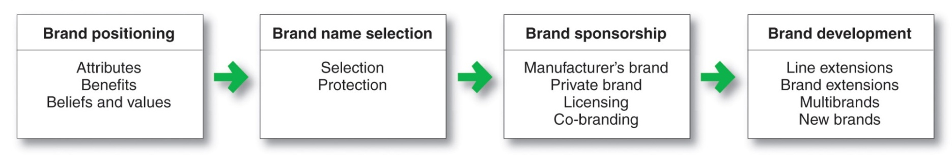
Branding Strategy: Building Strong Brands
Notes:
Building Strong Brands
Branding poses challenging decisions to the marketer. Figure 8.5 shows that the major brand strategy decisions involve brand positioning, brand name selection, brand sponsorship, and brand development.

Slide 42
New-Product Development and Product Life-Cycle Strategies
LECTURE-15

Slide 43
Topic Outline
New-Product Development Strategy
New-Product Development Process
Managing New-Product Development
Product Life-Cycle Strategies
Additional Product and Service Considerations

Slide 44
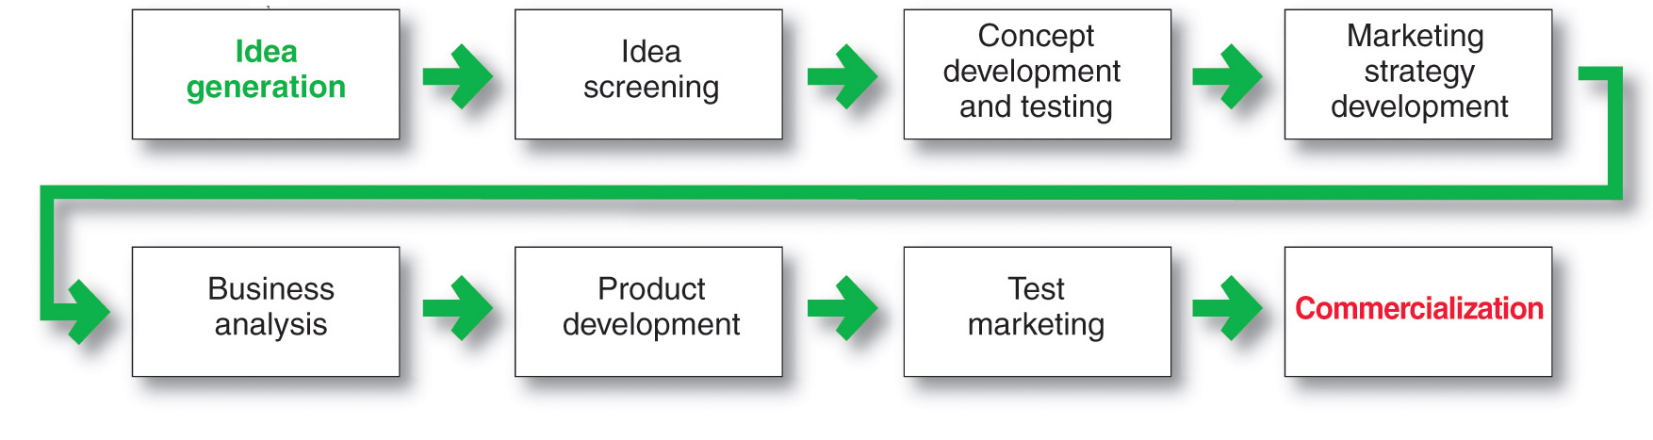
New-Product Development Process
Major Stages in New-Product Development
Notes:
A firm can obtain new products in two ways. One is through acquisition—by buying a whole company, a patent, or a license to produce someone else’s product. The other is through the firm’s own new-product development efforts. By new products we mean original products, product improvements, product modifications, and new brands that the firm develops through its own R&D efforts. In this chapter, we concentrate on new-product development.
New products are important to both customers and the marketers who serve them: They bring new solutions and variety to customers’ lives, and they are a key source of growth for companies. In today’s fast-changing environment, many companies rely on new products for the majority of their growth. For example, new products have almost completely transformed Apple in recent years. Sales of the iPhone and iPad—neither of which was available just six years ago—now bring in 72 percent of the company’s total revenues.
Yet innovation can be very expensive and very risky. New products face tough odds. By one estimate, 67 percent of all new products introduced by established companies fail. For new companies, the failure rate soars to 90 percent. Each year, U.S. companies lose an estimated $260 billion on failed new products.
Why do so many new products fail? There are several reasons. Although an idea may be good, the company may overestimate market size. The actual product may be poorly designed. Or it might be incorrectly positioned, launched at the wrong time, priced too high, or poorly advertised. A high-level executive might push a favorite idea despite poor marketing research findings. Sometimes the costs of product development are higher than expected, and sometimes competitors fight back harder than expected.
So, companies face a problem: They must develop new products, but the odds weigh heavily against success. To create successful new products, a company must understand its consumers, markets, and competitors and develop products that deliver superior value to customers.
New-product development starts with
good new-product ideas—lots of
them. For example, Cisco’s recent
I-Prize “crowdsourcing” challenge
attracted 1,200 ideas from 2,500
innovators in 104 countries.
The remaining steps reduce the
number of ideas and develop
only the best ones into
profitable products. Of the 1,200
ideas from Cisco’s I-Prize
challenge, only a handful were
developed.

Slide 45
Pricing:
Understanding and Capturing Customer Value
LECTURE-16

Slide 46
Topic Outline
What Is a Price?
Major Pricing Strategies
Other Internal and External Considerations Affecting Price Decisions
Notes:
We now look at the second major marketing mix tool—pricing. If effective product development, promotion, and distribution sow the seeds of business success, effective pricing is the harvest. Firms successful at creating customer value with the other marketing mix activities must still capture some of this value in the prices they earn. In this chapter, we discuss the importance of pricing, dig into three major pricing strategies, and look at internal and external considerations that affect pricing decisions. In the next chapter, we examine some additional pricing considerations and approaches.
Companies today face a fierce and fast-changing pricing environment. Value-seeking customers have put increased pricing pressure on many companies. Thanks to economic woes in recent years, the pricing power of the Internet, and value-driven retailers such as Walmart, today’s more frugal consumers are pursuing spend-less strategies. In response, it seems that almost every company has been looking for ways to cut prices.
<ex10.02>
Yet, cutting prices is often not the best answer. Reducing prices unnecessarily can lead to lost profits and damaging price wars. It can cheapen a brand by signaling to customers that price is more important than the customer value a brand delivers. Instead, in both good economic times and bad, companies should sell value, not price. In some cases, that means selling lesser products at rock-bottom prices. But in most cases, it means persuading customers that paying a higher price for the company’s brand is justified by the greater value they gain.

Slide 47
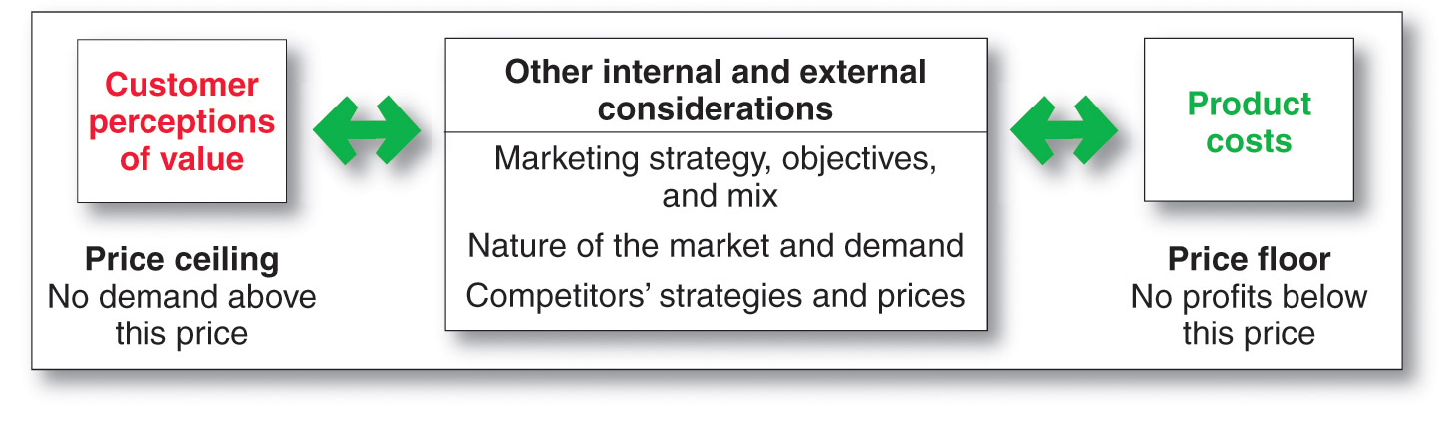
Major Pricing Strategies
Customer Value-Based Pricing
Notes:
Figure 10.1 suggests three major pricing strategies: customer value-based pricing, cost-based pricing, and competition-based pricing.

Slide 48
Pricing Strategies
LECTURE-17

Slide 49
Topic Outline
New-Product Pricing Strategies
Product Mix Pricing Strategies
Price Adjustment Strategies
Price Changes
Public Policy and Marketing
Notes:
Price is an important marketing mix tool for both creating and capturing customer value. You explored the three main pricing strategies—customer value-based, cost-based, and competition-based pricing—and the many internal and external factors that affect a firm’s pricing decisions. In this chapter, we’ll look at some additional pricing considerations: new-product pricing, product mix pricing, price adjustments, and initiating and reacting to prices changes. We close the chapter with a discussion of public policy and pricing.

Slide 50
Product Mix Pricing Strategies
Product line pricing
Optional- product pricing
Captive- product pricing
By-product pricing
Product bundle pricing
Notes:
The strategy for setting a product’s price often has to be changed when the product is part of a product mix. In this case, the firm looks for a set of prices that maximizes its profits on the total product mix. Pricing is difficult because the various products have related demand and costs and face different degrees of competition. We now take a closer look at the five product mix pricing situations summarized in Table 11.1: product line pricing, optional product pricing, captive product pricing, by-product pricing, and product bundle pricing.

Slide 51
Marketing Channels: Delivering Customer Value
LECTURE-18

Slide 52
Topic Outline
Supply Chains and the Value Delivery Network
The Nature and Importance of Marketing Channels
Channel Behavior and Organization
Channel Design Decisions
Channel Management Decisions
Public Policy and Distribution Decisions
Marketing Logistics and Supply Chain Management
Notes:
Companies rarely work alone in creating value for customers and building profitable customer relationships. Instead, most are only a single link in a larger supply chain and marketing channel. As such, a firm’s success depends not only on how well it performs but also on how well its entire marketing channel competes with competitors’ channels. The first part of this chapter explores the nature of marketing channels and the marketer’s channel design and management decisions. We then examine physical distribution—or logistics—an area that is growing dramatically in importance and sophistication. In the next chapter, we’ll look more closely at two major channel intermediaries: retailers and wholesalers.

Slide 53
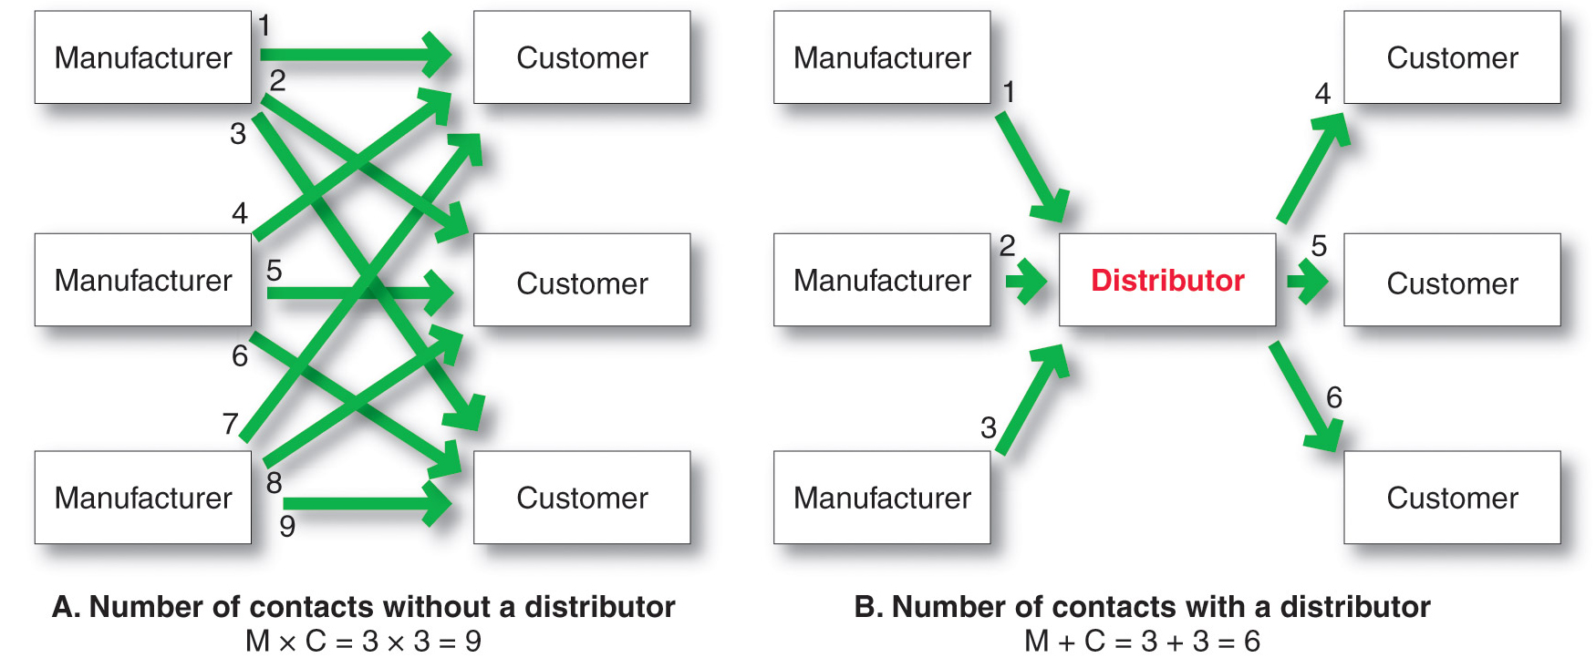
The Nature and Importance of Marketing Channels
How Channel Members Add Value
Notes:
Figure 12.1 shows how using intermediaries can provide economies. Figure 12.1A shows three manufacturers, each using direct marketing to reach three customers. This system requires nine different contacts. Figure 12.1B shows the three manufacturers working through one distributor, which contacts the three customers. This system requires only six contacts. In this way, intermediaries reduce the amount of work that must be done by both producers and consumers.
From the economic system’s point of view, the role of marketing intermediaries is to transform the assortments of products made by producers into the assortments wanted by consumers. Producers make narrow assortments of products in large quantities, but consumers want broad assortments of products in small quantities. Marketing channel members buy large quantities from many producers and break them down into the smaller quantities and broader assortments desired by consumers.

Slide 54
Retailing and Wholesaling
LECTURE-19

Slide 55
Topic Outline
Retailing
Retailer Marketing Decisions
Retailing Trends and Developments
Wholesaling

Slide 56
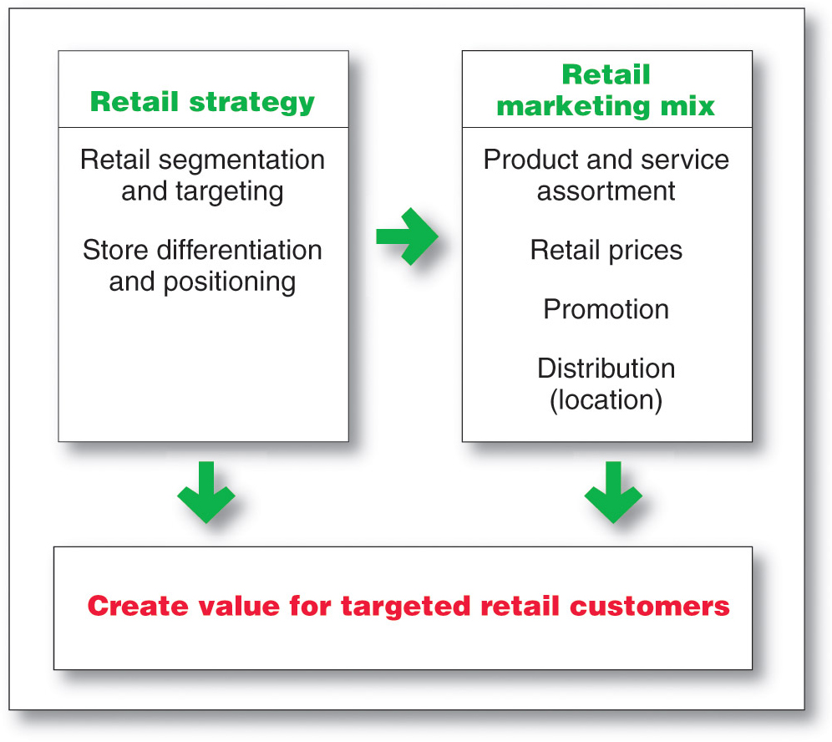
Retailing
Retailer Marketing Decisions
Notes:
Retailers are always searching for new marketing strategies to attract and hold customers. In the past, retailers attracted customers with unique product assortments and more or better services. Today, the assortments and services of various retailers are looking more and more alike. You can find most consumer brands not only in department stores but also in mass-merchandise discount stores, off-price discount stores, and all on the Internet. Thus, it’s now more difficult for any one retailer to offer exclusive merchandise.
Service differentiation among retailers has also eroded. Many department stores have trimmed their services, whereas discounters have increased theirs. In addition, customers have become smarter and more price sensitive. They see no reason to pay more for identical brands, especially when service differences are shrinking. For all these reasons, many retailers today are rethinking their marketing strategies.
As shown in Figure 13.1, retailers face major marketing decisions about segmentation and targeting, store differentiation and positioning, and the retail marketing mix.

Slide 57
Communicating Customer Value: Integrated Marketing Communications Strategy
LECTURE-20

Slide 58
Topic Outline
The Promotion Mix
Integrated Marketing Communications
A View of the Communications Process
Steps in Developing Effective Marketing Communication
Setting the Total Promotion Budget and Mix
Socially Responsible Marketing Communication

Slide 59
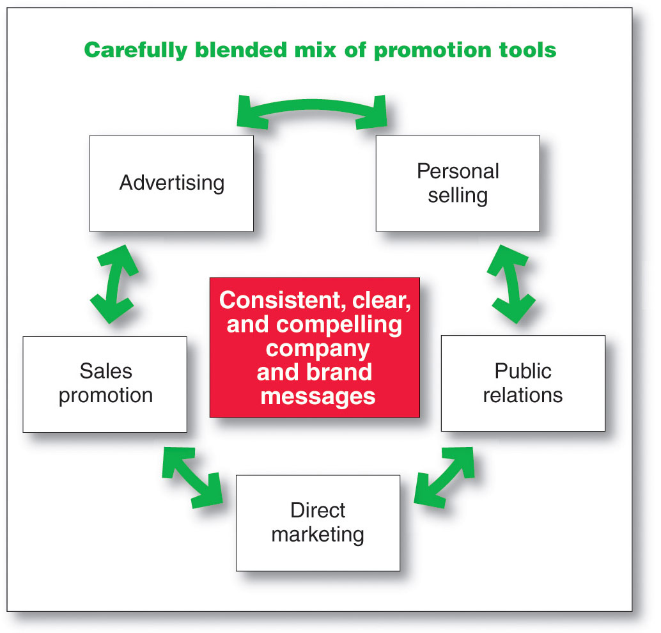
Integrated Marketing Communications Strategy
Notes:
To that end, more companies today are adopting the concept of integrated marketing communications (IMC). Under this concept, as illustrated in Figure 14.1, the company carefully integrates its many communications channels to deliver a clear, consistent, and compelling message about the organization and its brands.
Integrated marketing communications calls for recognizing all touch points where the customer may encounter the company and its brands. Each contact with the brand will deliver a message—whether good, bad, or indifferent. The company’s goal should be to deliver a consistent and positive message at each contact. Integrated marketing communications ties together all of the company’s messages and images. Its television and print ads have the same message, look, and feel as its e-mail and personal selling communications. And its PR materials project the same image as its website, online social networks, or mobile marketing efforts. Often, different media play unique roles in attracting, informing, and persuading consumers; these roles must be carefully coordinated under the overall marketing communications plan.
In the past, no one person or department was responsible for thinking through the communication roles of the various promotion tools and coordinating the promotion mix. To help implement integrated marketing communications, some companies have appointed a marketing communications director who has overall responsibility for the company’s communications efforts. This helps to produce better communications consistency and greater sales impact. It places the responsibility in someone’s hands—where none existed before—to unify the company’s image as it is shaped by thousands of company activities.
A View of the Communication Process
Integrated marketing communications involves identifying the target audience and shaping a well-coordinated promotional program to obtain the desired audience response. Too often, marketing communications focus on immediate awareness, image, or preference goals in the target market. But this approach to communication is too shortsighted. Today, marketers are moving toward viewing communications as managing the customer relationship over time.
Because customers differ, communications programs need to be developed for specific segments, niches, and even individuals. And, given the new interactive communications technologies, companies must ask not only “How can we reach our customers?” but also “How can we let our customers reach us?”
Thus, the communications process should start with an audit of all the potential touchpoints that target customers may have with the company and its brands. For example, someone purchasing a new phone plan may talk to others, see television or magazine ads, visit various websites for prices and reviews, and check out plans at Best Buy, Walmart, or a wireless provider’s kiosk or store. The marketer needs to assess what influence each communication experience will have at different stages of the buying process. This understanding helps marketers allocate their communication dollars more efficiently and effectively.
To communicate effectively, marketers need to understand how communication works. Communication involves the nine elements shown in figure 14.2. Two of these elements are the major parties in a communication—the sender and the receiver. Another two are the major communication tools—the message and the media. Four more are major communication functions—encoding, decoding, response, and feedback. The last element is noise in the system. Definitions of these elements follow and are applied to a McDonald’s “I’m lovin’ it” television commercial.
Sender: The party sending the message to another party—here, McDonald’s.
Encoding: The process of putting thought into symbolic form—for example, McDonald’s ad agency assembles words, sounds, and illustrations into a TV advertisement that will convey the intended message.
Message: The set of symbols that the sender transmits—the actual McDonald’s ad.
Media: The communication channels through which the message moves from the sender to the receiver—in this case, television and the specific television programs that McDonald’s selects.
Decoding: The process by which the receiver assigns meaning to the symbols encoded by the sender—a consumer watches the McDonald’s commercial and interprets the words and images it contains.
Receiver: The party receiving the message sent by another party—the customer who watches the McDonald’s ad.
Response: The reactions of the receiver after being exposed to the message—any of hundreds of possible responses, such as the consumer likes McDonald’s better, is more likely to eat at McDonald’s next time, hums the “I’m lovin’ it” jingle, or does nothing.
Feedback: The part of the receiver’s response communicated back to the sender—McDonald’s research shows that consumers are either struck by and remember the ad or they write or call McDonald’s, praising or criticizing the ad or its products.
Noise: The unplanned static or distortion during the communication process, which results in the receiver getting a different message than the one the sender sent—the consumer is distracted while watching the commercial and misses its key points.
For a message to be effective, the sender’s encoding process must mesh with the receiver’s decoding process. The best messages consist of words and other symbols that are familiar to the receiver. The more the sender’s field of experience overlaps with that of the receiver, the more effective the message is likely to be. Marketing communicators may not always share their customer’s field of experience. For example, an advertising copywriter from one socioeconomic level might create ads for customers from another level—say, wealthy business owners. However, to communicate effectively, the marketing communicator must understand the customer’s field of experience.
This model points out several key factors in good communication. Senders need to know what audiences they wish to reach and what responses they want. They must be good at encoding messages that take into account how the target audience decodes them. They must send messages through media that reach target audiences, and they must develop feedback channels so that they can assess an audience’s response to the message. Also, in today’s interactive media environment, companies must be prepared to “flip” the communications process—to become good receivers of and responders to messages sent by consumers.

Slide 60
IMC Partners & Industry Organization
LECTURE-21

Slide 61
Chapter Questions
Who are the IMC partners?
How is the agency world organized?
How do media partners fit in?
Behind the message is the company (client)
How does the agency/client relationship work?

Slide 62
Chapter Perspective: Changing World
Old World
New World
Marketing Communications Dominated by Advertising Agencies
More Use of Other Marketing Communications Functions
Focus on mass media
Willingness to consider other media to reach consumers

Slide 63
Advertising
LECTURE-22

Slide 64
Topic Outline
  Advertising
    Setting Advertising Objectives
    Setting the Advertising Budget
    Developing Advertising Strategy
    Evaluating Advertising Effectiveness and Return on Advertising Investment
    Other Advertising Considerations
Notes:
In this chapter, we explore advertising and PR. Advertising involves communicating the company’s or brand’s value proposition by using paid media to inform, persuade, and remind consumers. PR involves building good relations with various company publics—from consumers and the general public to the media, investor, donor, and government publics. As with all the promotion mix tools, advertising and PR must be blended into the overall IMC program. In chapters 16 and 17, we will discuss the remaining promotion mix tools: personal selling, sales promotion, and direct marketing.

Slide 65
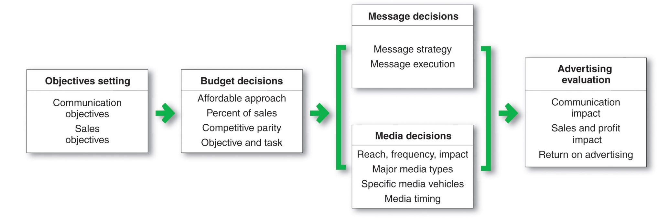
Advertising
Major Advertising Decisions
Notes:
Marketing management must make four important decisions when developing an advertising program (see Figure 15.1): setting advertising objectives, setting the advertising budget, developing advertising strategy (message decisions and media decisions), and evaluating advertising campaigns.

Slide 66
Public Relations
LECTURE-23

Slide 67
Topic Outline
  Public Relations
    What is public relations
    The Role and Impact of Public Relations
  Major Public Relations Tools
  What are the strengths and limitations of brand publicity?
  What are the brand publicity tools?
  Why is corporate communication important to IMC programs?
Notes:
In this chapter, we explore advertising and PR. Advertising involves communicating the company’s or brand’s value proposition by using paid media to inform, persuade, and remind consumers. PR involves building good relations with various company publics—from consumers and the general public to the media, investor, donor, and government publics. As with all the promotion mix tools, advertising and PR must be blended into the overall IMC program. In chapters 16 and 17, we will discuss the remaining promotion mix tools: personal selling, sales promotion, and direct marketing.

Slide 68
PR Responsibilities
Serve As the Official Channel of Information
Serve As the Official Channel of Information
Keep the Public Aware of Organization’s Activities
Keep the Public Aware of Organization’s Activities
PR
Coordinate the Programs With Other MC Functions
Coordinate Relationships With Stakeholders
Coordinate Relationships With Stakeholders
Plan and Administer Information Programs
Plan and Administer Information Programs
Collect and Analyze Stakeholder Attitudes
Collect and Analyze Stakeholder Attitudes

Slide 69
Personal Selling
LECTURE-24

Slide 70
Topic Outline
  Personal Selling
  Managing the Sales Force
Notes:
In this chapter, we explore advertising and PR. Advertising involves communicating the company’s or brand’s value proposition by using paid media to inform, persuade, and remind consumers. PR involves building good relations with various company publics—from consumers and the general public to the media, investor, donor, and government publics. As with all the promotion mix tools, advertising and PR must be blended into the overall IMC program. In chapters 16 and 17, we will discuss the remaining promotion mix tools: personal selling, sales promotion, and direct marketing.

Slide 71
Managing the Sales Force
Sales force management is the analysis, planning, implementation, and control of sales force activities
Notes:
We define sales force management as analyzing, planning, implementing, and controlling sales force activities. It includes designing sales force strategy and structure, as well as recruiting, selecting, training, compensating, supervising, and evaluating the firm’s salespeople. These major sales force management decisions are shown in Figure 16.1 and discussed in the following sections.

Slide 72
Personal Selling Process
LECTURE-25

Slide 73
Topic Outline
  The Preliminary steps in Personal Selling Process
  The Advance steps in Personal Selling Process
Notes:
In this chapter, we explore advertising and PR. Advertising involves communicating the company’s or brand’s value proposition by using paid media to inform, persuade, and remind consumers. PR involves building good relations with various company publics—from consumers and the general public to the media, investor, donor, and government publics. As with all the promotion mix tools, advertising and PR must be blended into the overall IMC program. In chapters 16 and 17, we will discuss the remaining promotion mix tools: personal selling, sales promotion, and direct marketing.

Slide 74
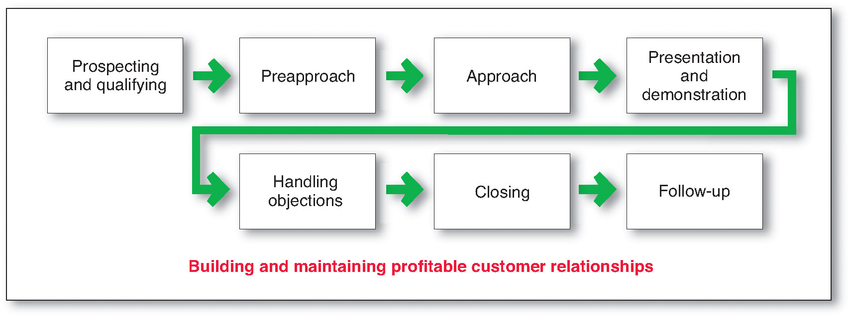
The Personal Selling Process
The goal of the personal selling process is to get new customers and obtain orders from them
Notes:
The selling process consists of several steps that salespeople must master. These steps focus on the goal of getting new customers and obtaining orders from them. However, most salespeople spend much of their time maintaining existing accounts and building long-term customer relationships. We will discuss the relationship aspect of the personal selling process in a later section.
Steps in the Selling Process
As shown in Figure 16.3, the selling process consists of seven steps: prospecting and qualifying, preapproach, approach, presentation and demonstration, handling objections, closing, and follow-up.

Slide 75
Sales Promotion & Packaging
LECTURE-26

Slide 76
Topic Outline
  What is “Sales Promotion”
  How do sales promotions add value to a brand?
  What are consumer sales promotions designed to accomplish and what are their strengths and limitations?
  What role does packaging play when consumers make brand decisions?
Notes:
In this chapter, we explore advertising and PR. Advertising involves communicating the company’s or brand’s value proposition by using paid media to inform, persuade, and remind consumers. PR involves building good relations with various company publics—from consumers and the general public to the media, investor, donor, and government publics. As with all the promotion mix tools, advertising and PR must be blended into the overall IMC program. In chapters 16 and 17, we will discuss the remaining promotion mix tools: personal selling, sales promotion, and direct marketing.

Slide 77
Sales Promotion Tools
Premiums
Premiums
Specialties
Specialties
Sweepstakes, Contests, and Games
Tools
Coupons
Coupons
Sampling
Sampling
Price Reductions
Price Reductions
Rebates
Rebates

Slide 78
Direct Marketing:
The Dialogue Builder
LECTURE-27

Slide 79
Topic Outline
  The New Direct-Marketing Model
  Growth and Benefits of Direct Marketing
  Customer Databases and Direct Marketing
  Forms of Direct Marketing

Slide 80
Forms of Direct Marketing
Personal selling direct marketing
Direct-mail direct marketing
Catalog direct marketing
Telephone marketing
Direct-response television marketing
Kiosk marketing
Digital direct marketing
Online marketing
Notes:
The major forms of direct marketing—as shown in Figure 17.1—are face-to-face or personal selling, direct-mail marketing, catalog marketing, telemarketing, direct-response television (DRTV) marketing, kiosk marketing, and online marketing. We examined personal selling in depth in Chapter 16. Here, we look into the other forms of direct marketing.

Slide 81
Online Marketing:
Building Direct Customer Relationships
LECTURE-28

Slide 82
Topic Outline
  Online Marketing
  Setting up an Online Marketing Presence
  Public Policy Issues in Direct Marketing

Slide 83
Roles Played By The Internet
Shifting Power
Shifting Power
Being Accessible
Being Accessible
Internet
Roles
Lower Operating Costs
Providing Extensive Range of Info
Providing Extensive Range of Info
Lower Cost of Entry
Lower Cost of Entry
Fast, Worldwide Coverage
Fast, Worldwide Coverage

Slide 84
Creating Competitive Advantage
LECTURE-29

Slide 85
Topic Outline
  Competitor Analysis
  Competitive Strategies
  Balancing Customer and Competitor Orientations

Slide 86
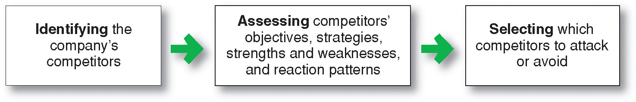
Competitor Analysis
Competitor analysis is the process of identifying, assessing, and selecting key competitors
Notes:
In this chapter, we examine competitive marketing strategies—how companies analyze their competitors and develop successful, customer value-based strategies for building and maintaining profitable customer relationships. The first step is competitor analysis, the process of identifying, assessing, and selecting key competitors. The second step is developing competitive marketing strategies that strongly position the company against competitors and give it the greatest possible competitive advantage.
To plan effective marketing strategies, a company needs to find out all it can about its competitors. It must constantly compare its marketing strategies, products, prices, channels, and promotions with those of close competitors. In this way, the company can find areas of potential competitive advantage and disadvantage. As shown in Figure 18.1, competitor analysis involves first identifying and assessing competitors and then selecting which competitors to attack or avoid.

Slide 87
The Global Marketplace
LECTURE-30

Slide 88
Topic Outline
  Global Marketing Today
  Looking at the Global Marketing Environment
  Deciding Whether to Go Global
  Deciding Which Markets to Enter
  Deciding How to Enter the Market
  Deciding on the Global Marketing Program
  Deciding on the Global Marketing Organization

Slide 89
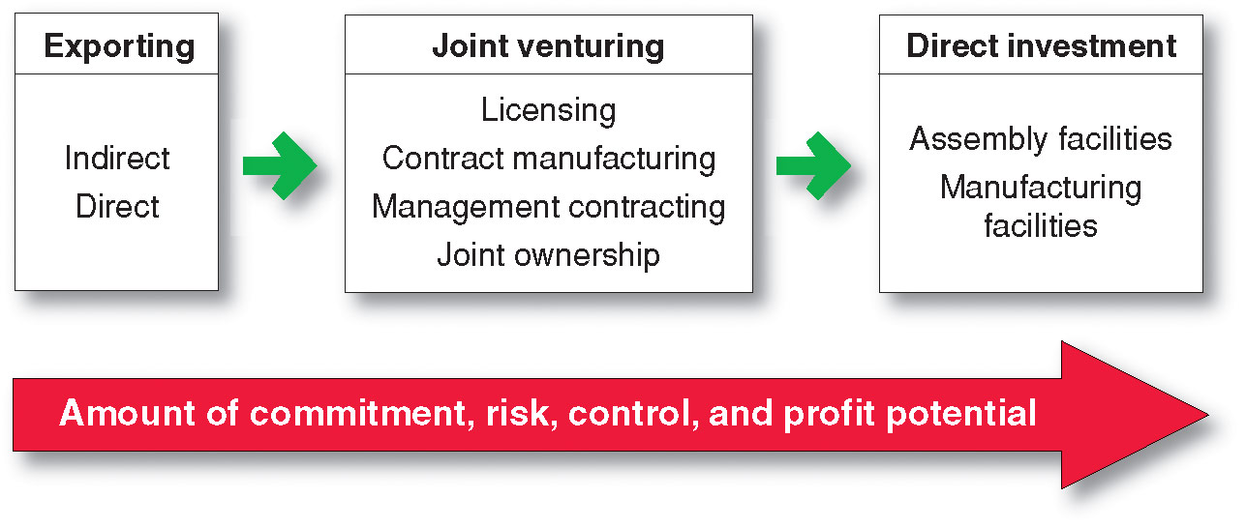
Deciding How to Enter the Market
Notes:
Deciding How to Enter the Market
Once a company has decided to sell in a foreign country, it must determine the best mode of entry. Its choices are exporting, joint venturing, and direct investment. Figure 19.2 shows three market entry strategies, along with the options each one offers. As the figure shows, each succeeding strategy involves more commitment and risk but also more control and potential profits.

Slide 90
Sustainable Marketing
Social Responsibility and Ethics
LECTURE-31

Slide 91
Topic Outline
  Sustainable Marketing
  Social Criticisms of Marketing
  Consumer Actions to Promote Sustainable Marketing
  Business Actions Toward Sustainable Marketing
  Marketing Ethics
  The Sustainable Company

Slide 92
Social Criticisms of Marketing
Marketing’s Impact on Individual Consumers
High Prices
Deceptive Practices
High-Pressure Selling
Shoddy, Harmful or Unsafe Products
Planned Obsolescence
Poor Service to Disadvantaged Consumers
Notes:
Social Criticisms of Marketing
Marketing receives much criticism. Some of this criticism is justified; much is not. Social critics claim that certain marketing practices hurt individual consumers, society as a whole, and other business firms.
Marketing’s Impact on Individual Consumers
Consumers have many concerns about how well the American marketing system serves their interests. Surveys usually show that consumers hold mixed or even slightly unfavorable attitudes toward marketing practices. Consumer advocates, government agencies, and other critics have accused marketing of harming consumers through high prices, deceptive practices, high-pressure selling, shoddy or unsafe products, planned obsolescence, and poor service to disadvantaged consumers. Such questionable marketing practices are not sustainable in terms of long-term consumer or business welfare.
High Prices
Many critics charge that the American marketing system causes prices to be higher than they would be under more “sensible” systems. Such high prices are hard to swallow, especially when the economy takes a downturn. Critics point to three factors—high costs of distribution, high advertising and promotion costs, and excessive markups.

Slide 93


The End
"When a man is willing and eager, the Gods join in."
- Aeschylus

