Slide 1
Company and Marketing Strategy
Partnering to Build Customer Relationships
LECTURE-3

Slide 2
Topic Outline
Companywide Strategic Planning: Defining Marketing’s Role
Planning Marketing: Partnering to Build Customer Relationships
Marketing Strategy and the Marketing Mix
Notes:
In this chapter, we dig deeper into steps two and three of the marketing process: designing customer-driven marketing strategies and constructing marketing programs. First, we look at the organization’s overall strategic planning, which guides marketing strategy and planning. Next, we discuss how, guided by the strategic plan, marketers partner closely with others inside and outside the firm to create value for customers. We then examine marketing strategy and planning—how marketers choose target markets, position their market offerings, develop a marketing mix, and manage their marketing programs. Finally, we look at the important step of measuring and managing return on marketing investment (marketing ROI).

Slide 3
Companywide Strategic Planning
Strategic Planning
Strategic planning is the process of developing and maintaining a strategic fit between the organization’s goals and capabilities and its changing marketing opportunities
Notes:
Note to Instructor
Discussion Question
How might the strategic plan of the college or university influence decisions in the schools programs and offerings. How might it influence decisions in food services, dormitories, executive education, and undergraduate versus graduate programs?
Strategic planning sets the stage for the rest of planning in the firm. Companies usually prepare annual plans, long-range plans, and strategic plans. The annual and long-range plans deal with the company’s current businesses and how to keep them going. In contrast, the strategic plan involves adapting the firm to take advantage of opportunities in its constantly changing environment.
At the corporate level, the company starts the strategic planning process by defining its overall purpose and mission (see Figure 2.1). This mission is then turned into detailed supporting objectives that guide the entire company. Next, headquarters decides what portfolio of businesses and products is best for the company and how much support to give each one. In turn, each business and product develops detailed marketing and other departmental plans that support the company-wide plan. Thus, marketing planning occurs at the business-unit, product, and market levels. It supports company strategic planning with more detailed plans for specific marketing opportunities.

Slide 4
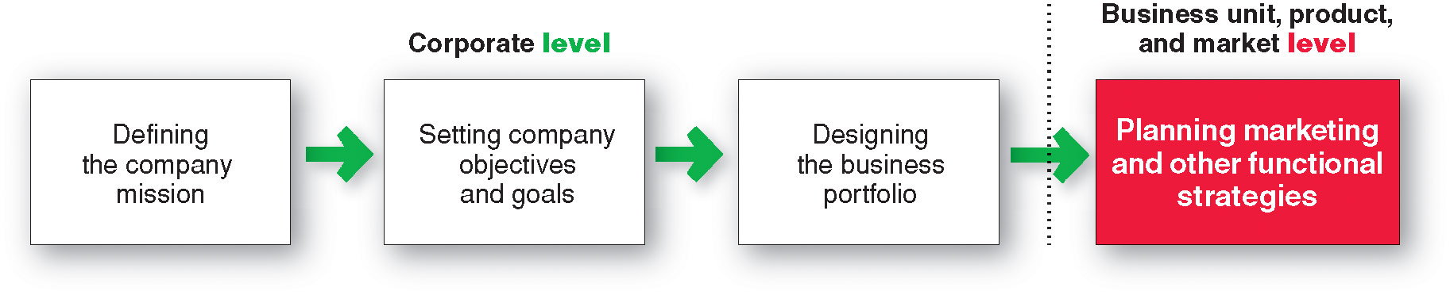
Companywide Strategic Planning
Steps in Strategic Planning
Notes:
At the corporate level, the company starts the strategic planning process by defining its overall purpose and mission (see Figure 2.1). This mission is then turned into detailed supporting objectives that guide the entire company. Next, headquarters decides what portfolio of businesses and products is best for the company and how much support to give each one. In turn, each business and product develops detailed marketing and other departmental plans that support the company-wide plan. Thus, marketing planning occurs at the business-unit, product, and market levels. It supports company strategic planning with more detailed plans for specific marketing opportunities.

Slide 5

Companywide Strategic Planning
Defining a Market-Oriented Mission
The mission statement is the organization’s purpose, what it wants to accomplish in the larger environment
Market-oriented mission statement defines the business in terms of satisfying basic customer needs
We help you organize the world’s information and make it universally accessible and useful.
Notes:
Note to Instructor
Forging a sound mission begins with the following questions: What is our business? Who is the customer? What do consumers value? What should our business be? These simple-sounding questions are among the most difficult the company will ever have to answer. Successful companies continuously raise these questions and answer them carefully and completely.
A mission statement should:
Not be myopic in product terms
Meaningful and specific
Motivating
Emphasize the company’s strengths
Contain specific workable guidelines
Not be stated as making sales or profits
Discussion Question:
Ask the students to evaluate how the Google mission statement meets the criteria of a market-oriented mission statement.

Slide 6
Good Mission Statements
Focus on a limited number of goals
Stress major policies and values
Define major competitive spheres
Take a long-term view
Short, memorable, meaningful

Slide 7
Rubbermaid Commercial Products, Inc.
“Our vision is to be the Global Market Share
Leader in each of the markets we serve. We
will earn this leadership position by
providing to our distributor and end-user
customers innovative, high-quality, cost-
effective and environmentally responsible
products. We will add value to these products
by providing legendary customer service
through our Uncompromising Commitment
to Customer Satisfaction.”

Slide 8
Motorola
“The purpose of Motorola is to honorably
serve the needs of the community by providing
products and services of superior quality at a
fair price to our customers; to do this so as to
earn an adequate profit which is required for
the total enterprise to grow; and by doing so,
provide the opportunity for our employees and
shareholders to achieve their personal
objectives.”

Slide 9
eBay
“We help people trade anything on earth.
We will continue to enhance the online
trading experiences of all—collectors,
dealers, small businesses, unique item
seekers, bargain hunters, opportunity
sellers, and browsers.”

Slide 10
Companywide Strategic Planning
Setting Company Objectives and Goals
Business objectives
Build profitable customer relationships
Invest in research
Improve profits
Marketing objectives
Increase market share
Create local partnerships
Increase promotion
Notes:
The company needs to turn its mission into detailed supporting objectives for each level of management. Each manager should have objectives and be responsible for reaching them
The company can tie a diverse product portfolio together under a mission.
This broad mission leads to a hierarchy of objectives, including business objectives and marketing objectives such as: to build profitable customer relationships by developing superior products.
Improving profits is another example of a major objective.
Profits can be improved by increasing sales or reducing costs. Sales can be increased by improving the company’s share of domestic and international markets. These goals then become the company’s current marketing objectives.
Marketing strategies and programs must be developed to support these marketing objectives such as:
to increase market share by broadening its product lines,
to increase product availability and promotion in existing markets
To expand into new markets.
Each broad marketing strategy must then be defined in greater detail. For example, increasing the product’s promotion may require more advertising and public relations efforts; if so, both requirements will need to be spelled out. In this way, the firm’s mission is translated into a set of objectives for the current period.

Slide 11
Companywide Strategic Planning
Designing the Business Portfolio
The business portfolio is the collection of businesses and products that make up the company
Portfolio analysis is a major activity in strategic planning whereby management evaluates the products and businesses that make up the company
Notes:
The best business portfolio is the one that best fits the company’s strengths and weaknesses to opportunities in the environment.
Most large companies have complex portfolios of businesses and brands. Strategic and marketing planning for such business portfolios can be a daunting but critical task.
Business portfolio planning involves two steps. First, the company must analyze its current business portfolio and determine which businesses should receive more, less, or no investment. Second, it must shape the future portfolio by developing strategies for growth and downsizing.

Slide 12
Companywide Strategic Planning
Analyzing the Current Business Portfolio
Strategic business units can be
Company division
Product line within a division
Single product or brand
Notes:
Note to Instructor
The major activity in strategic planning is business portfolio analysis, whereby management evaluates the products and businesses that make up the company. The company will want to put strong resources into its more profitable businesses and phase down or drop its weaker ones.

Slide 13
Companywide Strategic Planning
Analyzing the Current Business Portfolio
Identify key businesses (strategic business units, or SBUs) that make up the company
Assess the attractiveness of its various SBUs
Decide how much support each SBU deserves
Notes:
Management’s first step is to identify the key businesses that make up the company, called strategic business units (SBUs). An SBU can be a company division, a product line within a division, or sometimes a single product or brand. The company next assesses the attractiveness of its various SBUs and decides how much support each deserves. When designing a business portfolio, it’s a good idea to add and support products and businesses that fit closely with the firm’s core philosophy and competencies.
The purpose of strategic planning is to find ways in which the company can best use its strengths to take advantage of attractive opportunities in the environment. For this reason, most standard portfolio analysis methods evaluate SBUs on two important dimensions: the attractiveness of the SBU’s market or industry and the strength of the SBU’s position in that market or industry.

Slide 14
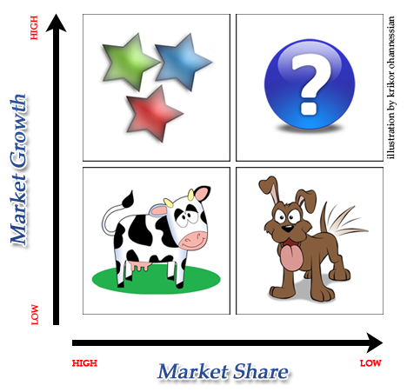
Companywide Strategic Planning
BCG Matrix
Stars are high growth, high businesses or products, they often need heavy investment to finance their rapid growth.
Cash cows are low-growth, high share businesses or products, they need less investment to hold their market share.

Slide 15
Companywide Strategic Planning
BCG Matrix
Question marks are low-share business units in high growth markets, they need lot of cash to hold their share.
Dogs are low-growth, low-share businesses and products. They may generate enough cash to maintain themselves but don't promise to be large sources of cash.

Slide 16
Companywide Strategic Planning
Problems with Matrix Approaches
Difficulty in defining SBUs and measuring market share and growth
Time consuming
Expensive
Focus on current businesses, not future planning
Notes:
Because of these problems, many companies have dropped formal matrix methods in favor of more customized approaches that better suit their specific situations.
Unlike former strategic-planning efforts that rested mostly in the hands of senior managers at company headquarters, today’s strategic planning has been decentralized.
Increasingly, companies are placing responsibility for strategic planning in the hands of cross-functional teams of divisional managers who are close to their markets.

Slide 17
Companywide Strategic Planning
Developing Strategies for Growth and Downsizing
Product/Market Expansion Grid
Market penetration
Market development
Product development
Diversification
a tool for identifying company growth opportunities
Notes:
Beyond evaluating current businesses, designing the business portfolio involves finding businesses and products the company should consider in the future. Companies need growth if they are to compete more effectively, satisfy their stakeholders, and attract top talent. At the same time, a firm must be careful not to make growth itself an objective. The company’s objective must be to manage “profitable growth.”
Marketing has the main responsibility for achieving profitable growth for the company. Marketing needs to identify, evaluate, and select market opportunities and establish strategies for capturing them. One useful device for identifying growth opportunities is the product/market expansion grid,

Slide 18
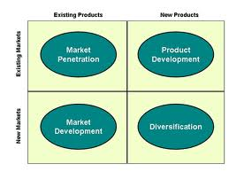
Ansoff’s Product-Market Expansion Grid

Slide 19
Companywide Strategic Planning
Developing Strategies
for Growth and Downsizing
Market penetration growth by increasing sales to current market segments without changing the product
Market development growth by identifying and developing new market segments for current products
Notes:
market penetration—making more sales to current customers without changing its original product such as:
Add new stores in current market areas to make it easier for customers to visit.
market development—identifying and developing new markets for its current products.
For instance, managers could review new demographic markets. Perhaps new groups—such as seniors—could be encouraged.
Managers could consider new geographic markets. In U.S. markets and in non-U.S. markets, especially Asia.

Slide 20
Companywide Strategic Planning
Developing Strategies
for Growth and Downsizing
Product development is a growth strategy that offers new or modified products to existing market segments
Diversification is a growth strategy through starting up or acquiring businesses outside the company’s current products and markets
Notes:
product development—offering modified or new products to current markets.
For instance moving into new product categories
diversification—starting up or buying businesses beyond its current products and markets.
For example, the company could acquire a company that operates in different market segments with a different product mix.

Slide 21
Companywide Strategic Planning
Developing Strategies
for Growth and Downsizing
Downsizing prune, harvest or divest businesses that are unprofitable or that no longer fit the strategy
Notes:
Companies must not only develop strategies for growing their business portfolios but also strategies for downsizing them.
A firm might want to abandon products or markets because:
The firm may have grown too fast or entered areas where it lacks experience.
The market environment might change, making some products or markets less profitable.
For example, in difficult economic times, many firms prune out weaker, less-profitable products and markets to focus their more limited resources on the strongest ones.
Some products or business units simply age and die.
When a firm finds brands or businesses that are unprofitable or that no longer fit its overall strategy, it must carefully prune, harvest, or divest them.
Weak businesses usually require a disproportionate amount of management attention.
Managers should focus on promising growth opportunities, not fritter away energy trying to salvage fading ones.

Slide 22
What is the Value Chain?
The value chain is a tool for identifying ways to create more customer value because every firm is a synthesis of primary and support activities performed to design, produce, market, deliver, and support its product.

Slide 23
Value Chain Analysis
The way in which primary and support activities are combined in providing goods and services and increasing profit margins.

Slide 24
Value Chain Analysis
Identifying Resources and Capabilities That Can Add Value
Support
Activities
Primary Activities

Slide 25
Value Chain Analysis
Identifying Resources and Capabilities That Can Add Value
Support
Activities
Inbound
Logistics
Primary Activities

Slide 26
Value Chain Analysis
Identifying Resources and Capabilities That Can Add Value
Support
Activities
Inbound
Logistics
Operations
Primary Activities

Slide 27
Value Chain Analysis
Identifying Resources and Capabilities That Can Add Value
Support
Activities
Inbound
Logistics
Outbound
Logistics
Operations
Primary Activities

Slide 28
Value Chain Analysis
Identifying Resources and Capabilities That Can Add Value
Support
Activities
Inbound
Logistics
Outbound
Logistics
Marketing
& Sales
Operations
Primary Activities

Slide 29
Value Chain Analysis
Identifying Resources and Capabilities That Can Add Value
Support
Activities
Service
Inbound
Logistics
Outbound
Logistics
Marketing
& Sales
Operations
Primary Activities

Slide 30
Value Chain Analysis
Identifying Resources and Capabilities That Can Add Value
Support
Activities
Procurement
Service
Inbound
Logistics
Outbound
Logistics
Marketing
& Sales
Operations
Primary Activities

Slide 31
Value Chain Analysis
Identifying Resources and Capabilities That Can Add Value
Support
Activities
Technological Development
Procurement
Service
Inbound
Logistics
Outbound
Logistics
Marketing
& Sales
Operations
Primary Activities

Slide 32
Value Chain Analysis
Identifying Resources and Capabilities That Can Add Value
Human Resource Management
Support
Activities
Technological Development
Procurement
Service
Inbound
Logistics
Outbound
Logistics
Marketing
& Sales
Operations
Primary Activities

Slide 33
Value Chain Analysis
Identifying Resources and Capabilities That Can Add Value
Firm Infrastructure
Human Resource Management
Support
Activities
Technological Development
Procurement
Service
Inbound
Logistics
Outbound
Logistics
Marketing
& Sales
Operations
Primary Activities

Slide 34
Value Chain Analysis
Identifying Resources and Capabilities That Can Add Value
Firm Infrastructure
Human Resource Management
Support
Activities
MARGIN
Technological Development
Procurement
Service
Inbound
Logistics
Outbound
Logistics
Marketing
& Sales
Operations
MARGIN
Primary Activities

Slide 35
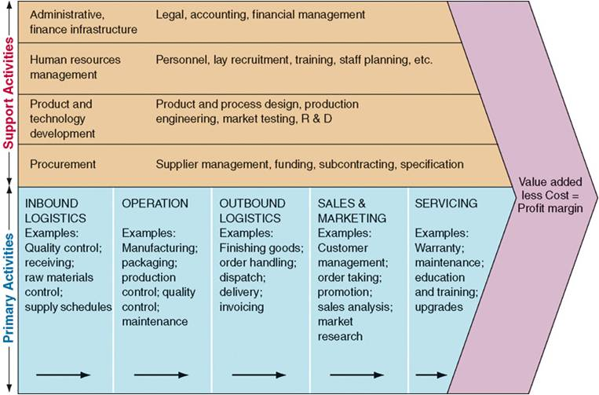
Value Chain Analysis
Identifying Resources and Capabilities That Can Add Value

Slide 36
Bibliography
Principles of Marketing by Philip Kotler & Gary Armstrong
Fifteenth Edition, Published by Prentice Hall
Marketing Management – A South Asian Perspective
by Philip Kotler, Kevin Lane Keller, Abraham Koshy &
Mithileshwar Jha, 13th Edition, Published by Pearson
Education, Inc.
Principles and Practices of Marketing by Jobber, D. 4th
edition, McGraw Hill International.
Principles of Advertising & IMC by Tom Duncan 2nd
Edition, Published by McGraw-Hill Irwin.

Slide 37


The End
"The secret of getting started is breaking your complex, overwhelming tasks into small manageable tasks, and then starting on the first one.“
Mark Twain

