Slide 1
Sales Promotion & Packaging
LECTURE-26

Slide 2
Topic Outline
  What is “Sales Promotion”
  How do sales promotions add value to a brand?
  What are consumer sales promotions designed to accomplish and what are their strengths and limitations?
  What role does packaging play when consumers make brand decisions?
Notes:
In this chapter, we explore advertising and PR. Advertising involves communicating the company’s or brand’s value proposition by using paid media to inform, persuade, and remind consumers. PR involves building good relations with various company publics—from consumers and the general public to the media, investor, donor, and government publics. As with all the promotion mix tools, advertising and PR must be blended into the overall IMC program. In chapters 16 and 17, we will discuss the remaining promotion mix tools: personal selling, sales promotion, and direct marketing.

Slide 3
Chapter Perspective
Sales promotion and packaging help move prospects and customers through the decision process started by other marketing communication functions
Awareness Interest
Desire Action
Public Relations
Direct Marketing
Website
Sales Promotion Packaging

Slide 4
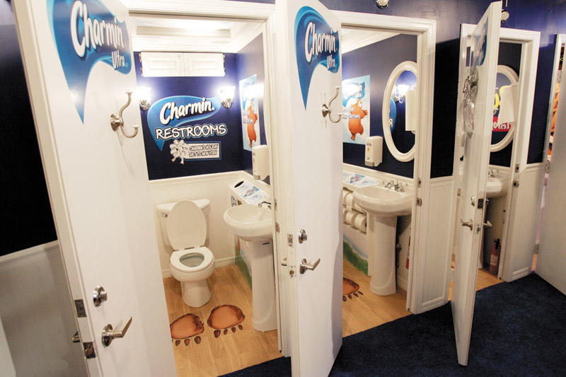
Sales Promotion
Sales promotion refers to the short-term incentives to encourage purchases or sales of a product or service:
  Consumer promotions
  Trade promotions
  Sales force promotions
Notes:
Personal selling and advertising often work closely with another promotion tool, sales promotion. Sales promotion consists of short-term incentives to encourage the purchase or sales of a product or service. Whereas advertising offers reasons to buy a product or service, sales promotion offers reasons to buy now.
Examples of sales promotions are found everywhere. A freestanding insert in the Sunday newspaper contains a coupon offering $1 off PEDIGREE GoodBites treats for your dog. A Bed Bath & Beyond ad in your favorite magazine offers 20 percent off on any single item. The end-of-the-aisle display in the local supermarket tempts impulse buyers with a wall of Coca-Cola cases—four 12-packs for $12. Buy a new HP laptop and get a free memory upgrade. A hardware store chain receives a 10 percent discount on selected Stihl power lawn and garden tools if it agrees to advertise them in local newspapers. Sales promotion includes a wide variety of promotion tools designed to stimulate earlier or stronger market response.
Sales promotion tools are used by most organizations, including manufacturers, distributors, retailers, and not-for-profit institutions. They are targeted toward final buyers (consumer promotions), retailers and wholesalers (trade promotions), business customers (business promotions), and members of the sales force (sales force promotions). Today, in the average consumer packaged-goods company, sales promotion accounts for 77 percent of all marketing expenditures.

Slide 5

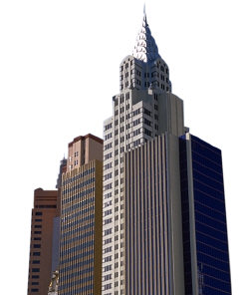
Two Types of Sales Promotion
Consumer Promotion
Trade Promotion
The use of incentives to motivate end users to purchase a brand and thus pressure retailers to stock that brand
  Used by marketers as part of a pull strategy
The use of incentives to motivate end users to purchase a brand and thus pressure retailers to stock that brand
  Used by marketers as part of a pull strategy
The use of incentives to motivate the buying and reselling of products
  Used as part of a push strategy

Slide 6
Sales Promotion
Rapid Growth of Sales Promotions
Product managers are under pressure to increase current sales
Companies face more competition
Competing brands offer less differentiation
Advertising efficiency has declined due to rising costs, clutter, and legal constraints
Consumers have become more deal-oriented
Notes:
Discussion Questions: Ask the students what sales promotions they have participated in as a consumer, i.e. used a coupon in buying a product.
Several factors have contributed to the rapid growth of sales promotion, particularly in consumer markets. First, inside the company, product managers face greater pressures to increase current sales, and they view promotion as an effective short-run sales tool. Second, externally, the company faces more competition, and competing brands are less differentiated. Increasingly, competitors are using sales promotion to help differentiate their offers. Third, advertising efficiency has declined because of rising costs, media clutter, and legal restraints. Finally, consumers have become more deal oriented. In the current economy, consumers are demanding lower prices and better deals. Sales promotions can help attract today’s more thrift-oriented consumers. The growing use of sales promotion has resulted in promotion clutter, which is similar to advertising clutter. According to one recent study, 37 percent of all groceries were sold with some sort of promotional support. A given promotion runs the risk of being lost in a sea of other promotions, weakening its ability to trigger an immediate purchase. Manufacturers are now searching for ways to rise above the clutter, such as offering larger coupon values, creating more dramatic point-of-purchase displays, or delivering promotions through new interactive media—such as the Internet or mobile phones.

Slide 7
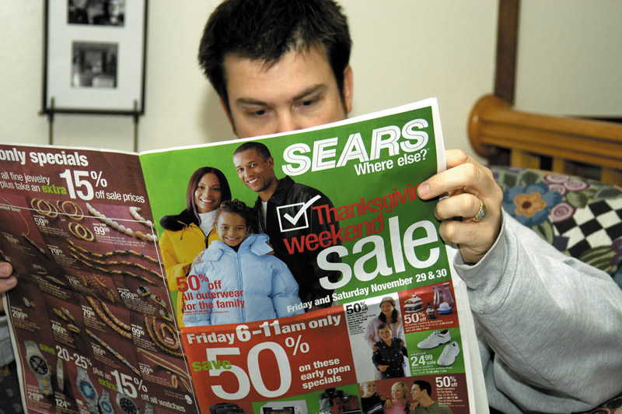
Sales Promotion
Sales Promotion Objectives
Setting sales promotion objectives includes using:
  Consumer promotions
  Trade promotions
  Sales force promotions
Notes:
Note to Instructor
Consumer promotion objectives:
Urge short-term customer buying
Enhance long-term customer relationships
Trade promotions urge retailers to:
Carry new items or more inventory
Buy in advance
Advertise company products
Get more shelf space
Sales force objectives include getting:
More sales force support for new or current products
Salespeople to sign up new accounts
Sales Promotion Objectives
Sales promotion objectives vary widely. Sellers may use consumer promotions to urge short-term customer buying or boost customer brand involvement. Objectives for trade promotions include getting retailers to carry new items and more inventory, buy ahead, or promote the company’s products and give them more shelf space. Business promotions are used to generate business leads, stimulate purchases, reward customers, and motivate salespeople. For the sales force, objectives include getting more sales force support for current or new products or getting salespeople to sign up new accounts.
Sales promotions are usually used together with advertising, personal selling, direct marketing, or other promotion mix tools. Consumer promotions must usually be advertised and can add excitement and pulling power to ads. Trade and business sales promotions support the firm’s personal selling process.
When the economy tightens and sales lag, it’s tempting to offer deep promotional discounts to spur consumer spending. In general, however, rather than creating only short-term sales or temporary brand switching, sales promotions should help to reinforce the product’s position and build long-term customer relationships. If properly designed, every sales promotion tool has the potential to build both short-term excitement and long-term consumer relationships. Marketers should avoid “quick fix,” price-only promotions in favor of promotions that are designed to build brand equity. Examples include the various frequency marketing programs and loyalty cards that have mushroomed in popularity in recent years. Most hotels, supermarkets, and airlines offer frequent-guest/buyer/flyer programs that give rewards to regular customers to keep them coming back. All kinds of companies now offer rewards programs. Such promotional programs can build loyalty through added value rather than discounted prices.

Slide 8
Sales Promotion Objectives
Increase Trial and Repurchase
Increase Trial and Repurchase
Increase Frequency And/or Quantity of Purchases
Increase Frequency And/or Quantity of Purchases
Reinforce Brand Image/Strengthen Brand Relationships
Counter Competitive Offers
Counter Competitive Offers
Objectives
Extend the Use of a Brand
Extend the Use of a Brand
Build Customer Databases
Build Customer Databases
Cross-sell
Cross-sell
Increase Level of Customer Retention
Increase Level of Customer Retention

Slide 9
Sales Promotion Tools
Premiums
Premiums
Specialties
Specialties
Sweepstakes, Contests, and Games
Tools
Coupons
Coupons
Sampling
Sampling
Price Reductions
Price Reductions
Rebates
Rebates

Slide 10
Sales Promotion
Major Sales Promotion Tools
Consumer Promotion Tools
Samples offer a trial amount of a product
Coupons are certificates that give buyers a saving when they purchase specified products
Rebates are similar to coupons except that the price reduction occurs after the purchase
Price packs offer consumers savings off the regular price of a product
Notes:
Samples are offers of a trial amount of a product. Sampling is the most effective—but most expensive—way to introduce a new product or create new excitement for an existing one. Some samples are free; for others, the company charges a small amount to offset its cost. The sample might be sent by mail, handed out in a store or at a kiosk, attached to another product, or featured in an ad or an e-mail. Samples are sometimes combined into sample packs, which can then be used to promote other products and services. Sampling can be a powerful promotional tool.
Coupons are certificates that save buyers money when they purchase specified products. Most consumers love coupons. U.S. consumer packaged-goods companies distributed 305 billion coupons with an average face value of $1.55 last year, a 26 percent increase since 2007. Consumers redeemed more than 3.5 billion of them for a total savings of about $4.6 billion, 58.6 percent higher than five years ago. Coupons can promote early trial of a new brand or stimulate sales of a mature brand. However, to combat the increase in coupon clutter, most major consumer-goods companies are issuing fewer coupons and targeting them more carefully.
Marketers are also cultivating new outlets for distributing coupons, such as supermarket shelf dispensers, electronic point-of-sale coupon printers, and online and mobile coupon programs. According to a recent study, digital coupons represent today’s fastest growing coupon segment. Digital coupons now account for 11 percent of all coupons redeemed. More than 25 percent of the U.S. population uses online coupons from sites such as Coupons.com, MyCoupster, Groupon, LivingSocial, and Cellfire. And as mobile phones become appendages that many people can’t live without, businesses are increasingly eyeing them as prime real estate for coupons offers and other marketing messages. For example, drugstore chain Walgreens makes coupons available to its customers through several mobile channels: Shannon Bryant, “ConsumersRebates (or cash refunds) are like coupons except that the price reduction occurs after the purchase rather than at the retail outlet. The customer sends proof of purchase to the manufacturer, which then refunds part of the purchase price by mail. For example, Toro ran a clever preseason promotion on some of its snowblower models, offering a rebate if the snowfall in the buyer’s market area turned out to be below average. Competitors were not able to match this offer on such short notice, and the promotion was very successful.
Price packs (also called cents-off deals) offer consumers savings off the regular price of a product. The producer marks the reduced prices directly on the label or package. Price packs can be single packages sold at a reduced price (such as two for the price of one) or two related products banded together (such as a toothbrush and toothpaste). Price packs are very effective—even more so than coupons—in stimulating short-term sales.

Slide 11
Sales Promotion
Major Sales Promotion Tools
Consumer Promotion Tools
Premiums are goods offered either for free or at a low price
Advertising specialties are useful articles imprinted with the advertiser’s name, logo, or message that are given as gifts to consumers
Point-of-purchase promotions include displays and demonstrations that take place at the point of sales
Notes:
Premiums are goods offered either free or at low cost as an incentive to buy a product, ranging from toys included with kids’ products to phone cards and DVDs. A premium may come inside the package (in-pack), outside the package (on-pack), or through the mail. For example, over the years, McDonald’s has offered a variety of premiums in its Happy Meals—from Madagascar characters to Beanie Babies and Pokémon toy figures. Customers can visit www.happymeal.com to play games and watch commercials associated with the current Happy Meal sponsor.
Advertising specialties, also called promotional products, are useful articles imprinted with an advertiser’s name, logo, or message that are given as gifts to consumers. Typical items include T-shirts and other apparel, pens, coffee mugs, calendars, key rings, mouse pads, tote bags, coolers, golf balls, and caps. U.S. marketers spent nearly $18 billion on advertising specialties last year. Such items can be very effective. The “best of them stick around for months, subtly burning a brand name into a user’s brain,” notes a promotional products expert.
Point-of-purchase (POP) promotions include displays and demonstrations that take place at the point of sale. Think of your last visit to the local Safeway, Costco, CVS, or Bed Bath & Beyond. Chances are good that you were tripping over aisle displays, promotional signs, “shelf talkers,” or demonstrators offering free tastes of featured food products. Unfortunately, many retailers do not like to handle the hundreds of displays, signs, and posters they receive from manufacturers each year. Manufacturers have therefore responded by offering better POP materials, offering to set them up, and tying them in with television, print, or online messages.

Slide 12
Sales Promotion
Major Sales Promotion Tools
Consumer Promotion Tools
Contests, sweepstakes, and games give consumers the chance to win something—such as cash, trips, or goods—by luck or through extra effort
Contests require an entry by a consumer
Sweepstakes require consumers to submit their names for a lucky draw
Games present consumers with something that may or may not help them win a prize
Event marketing
Notes:
Contests, sweepstakes, and games give consumers the chance to win something, such as cash, trips, or goods, by luck or through extra effort. A contest calls for consumers to submit an entry—a jingle, guess, suggestion—to be judged by a panel that will select the best entries. A sweepstakes calls for consumers to submit their names for a drawing. A game presents consumers with something—bingo numbers, missing letters—every time they buy, which may or may not help them win a prize.
All kinds of companies use sweepstakes and contests to create brand attention and boost consumer involvement. For example, Outback’s Kick Back with the Guys Sweepstakes offers chances to win a dinner for four of “crave-able appetizers and juicy steaks.” The O’Reilly Auto Parts Win Free Gas for a Year Giveaway promises to let you “forget about gas prices for a year.” Enter the Coleman Great American Family Vacation Sweepstakes and you could win a family trip to Yellowstone and a Coleman camping package. And separate Chevrolet Race to Win sweepstakes recently offered either a new Corvette 427 convertible plus a trip to the 24 Hours of Le Mans, France, or a new Camaro plus a weekend at the Indy500.
Finally, marketers can promote their brands through event marketing (or event sponsorships). They can create their own brand-marketing events or serve as sole or participating sponsors of events created by others. The events might include anything from mobile brand tours to festivals, reunions, marathons, concerts, or other sponsored gatherings. Event marketing is huge, and it may be the fastest-growing area of promotion. Effective event marketing links events and sponsorships to a brand’s value proposition.
All kinds of brands now hold events. One week, it might be the National Football League filling the southern tip of Times Square with NFL players to promote new NFL jersey designs. The next week, it’s a mob of Russian models on the 45th street island between Broadway and Seventh Avenue in New York City, using it as a fashion runway for Maybelline. But according to one business reporter, energy drink maker Red Bull is the “mother of all event marketers”:
Event pioneer Red Bull holds hundreds of events each year in dozens of sports around the world. Each event features off-the-grid experiences designed to bring the high-octane world of Red Bull to its community of enthusiasts. The brand even hosts a “Holy S**t” tab on its website, featuring videos of everything from 27-meter ocean cliff dives at its Cliff Diving Series event in Grimstad, Norway, to dare-devil freeskiing feats at its Red Bull Cold Rush event in the Colorado mountain peaks, to absolutely breathtaking wind suit flights at Red Bull events staged in exotic locations from Monterrey, Mexico, to Hunan Province, China. The Red Bull Final Descent series is a mountain biking challenge that pushes riders to the brink and back, over some of the most technically challenging terrain in North America. Red Bull events draw large crowds and plenty of media coverage. But it’s not just about events. It’s about creating tactile engagements where people can feel, touch, taste, and live the product face to face rather than simply reading about or watching it. It’s about deepening and enhancing relationships.

Slide 13
Sales Promotion
Major Sales Promotion Tools
Trade Promotion Tools
Discount
Allowance
Free goods
Specialty advertising
Notes:
Trade promotions can persuade resellers to carry a brand, give it shelf space, promote it in advertising, and push it to consumers. Shelf space is so scarce these days that manufacturers often have to offer price-offs, allowances, buy-back guarantees, or free goods to retailers and wholesalers to get products on the shelf and, once there, to keep them on it.
Manufacturers use several trade promotion tools. Many of the tools used for consumer promotions—contests, premiums, displays—can also be used as trade promotions. Or the manufacturer may offer a straight discount off the list price on each case purchased during a stated period of time (also called a price-off, off-invoice, or off-list). Manufacturers also may offer an allowance (usually so much off per case) in return for the retailer’s agreement to feature the manufacturer’s products in some way. For example, an advertising allowance compensates retailers for advertising the product, whereas a display allowance compensates them for using special displays.
Manufacturers may offer free goods, which are extra cases of merchandise, to resellers who buy a certain quantity or who feature a certain flavor or size. They may also offer push money—cash or gifts to dealers or their sales forces to “push” the manufacturer’s goods. Manufacturers may give retailers free specialty advertising items that carry the company’s name, such as pens, calendars, memo pads, flashlights, and tote bags.

Slide 14
Sales Promotion
Major Sales Promotion Tools
Business Promotion Tools
Conventions and trade shows are effective to reach many customers not reached with the regular sales force
Sales contests are effective in motivating salespeople or dealers to increase performance over a given period
Notes:
Business Promotions
Companies spend billions of dollars each year on promotion geared toward industrial customers. Business promotions are used to generate business leads, stimulate purchases, reward customers, and motivate salespeople. Business promotions include many of the same tools used for consumer or trade promotions. Here, we focus on two additional major business promotion tools: conventions and trade shows and sales contests.
Many companies and trade associations organize conventions and trade shows to promote their products. Firms selling to the industry show their products at the trade show. Vendors at these shows receive many benefits, such as opportunities to find new sales leads, contact customers, introduce new products, meet new customers, sell more to present customers, and educate customers with publications and audiovisual materials. Trade shows also help companies reach many prospects that are not reached through their sales forces.
Some trade shows are huge. For example, at this year’s International Consumer Electronics Show, 3,100 exhibitors attracted some 153,000 professional visitors. Even more impressive, at the BAUMA mining and construction equipment trade show in Munich, Germany, more than 3,200 exhibitors from 53 countries presented their latest product innovations to over 420,000 attendees from more than 200 countries. Total exhibition space equaled about 5.9 million square feet (more than 124 football fields).
A sales contest is a contest for salespeople or dealers to motivate them to increase their sales performance over a given period. Sales contests motivate and recognize good company performers, who may receive trips, cash prizes, or other gifts. Some companies award points for performance, which the receiver can turn in for any of a variety of prizes. Sales contests work best when they are tied to measurable and achievable sales objectives (such as finding new accounts, reviving old accounts, or increasing account profitability).

Slide 15
Sales Promotion
Developing the Sales Promotion Program
Size of the incentive
Conditions for participation
Promote and distribute the program
Length of the program
Evaluation of the program
Notes:
Developing the Sales Promotion Program
Beyond selecting the types of promotions to use, marketers must make several other decisions in designing the full sales promotion program. First, they must determine the size of the incentive. A certain minimum incentive is necessary if the promotion is to succeed; a larger incentive will produce more sales response. The marketer also must set conditions for participation. Incentives might be offered to everyone or only to select groups.
Marketers must determine how to promote and distribute the promotion program itself. For example, a $2-off coupon could be given out in a package, in an advertisement, at the store, via the Internet, or in a mobile download. Each distribution method involves a different level of reach and cost. Increasingly, marketers are blending several media into a total campaign concept. The length of the promotion is also important. If the sales promotion period is too short, many prospects (who may not be buying during that time) will miss it. If the promotion runs too long, the deal will lose some of its “act now” force.
Evaluation is also very important. Marketers should work to measure the returns on their sales promotion investments, just as they should seek to assess the returns on other marketing activities. The most common evaluation method is to compare sales before, during, and after a promotion. Marketers should ask: Did the promotion attract new customers or more purchasing from current customers? Can we hold onto these new customers and purchases? Will the long-run customer relationship and sales gains from the promotion justify its costs?
Clearly, sales promotion plays an important role in the total promotion mix. To use it well, the marketer must define the sales promotion objectives, select the best tools, design the sales promotion program, implement the program, and evaluate the results. Moreover, sales promotion must be coordinated carefully with other promotion mix elements within the overall IMC program.

Slide 16
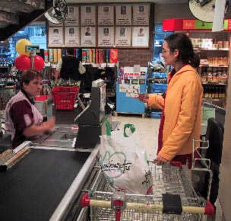
Promotion In Action: Catalina Coupons

Slide 17
Promotion In Action: Catalina Coupons
Challenge:
Personalize consumer sales promo offers
Personalize consumer sales promo offers
Sophisticated product by Catalina that checks a consumer’s buying history and prints out personalized coupons at the check-out for:
  $1 off 3 jars to reward a “loyal customer”
  50¢ off 1 jar to convert a “switcher” from another brand
  $1 off 1 jar to motivate a “never buyer” to try the brand
Sophisticated product by Catalina that checks a consumer’s buying history and prints out personalized coupons at the check-out for:
  $1 off 3 jars to reward a “loyal customer”
  50¢ off 1 jar to convert a “switcher” from another brand
  $1 off 1 jar to motivate a “never buyer” to try the brand
Answer:
Results:
This type of service has become very common in supermarkets throughout the nation

Slide 18


Think About It
Fly to NYC for $149*
*one-way based on a round-trip purchase
½ price sale*
*buy one at full price and get ½ off a second of equal or lesser value
Save up to 70%*
*a few racks are on sale for 70% off; other sale items are 20-30% off
  Are these offers ethical?
  What do you think about firms that use them?

Slide 19
Consumer Promotion Strategies
Partnership Strategies
Cross promotion:
  Two or more products are promoted together, such as cheese and crackers
  Brands team up to boost their image power
  They also share in costs

Slide 20
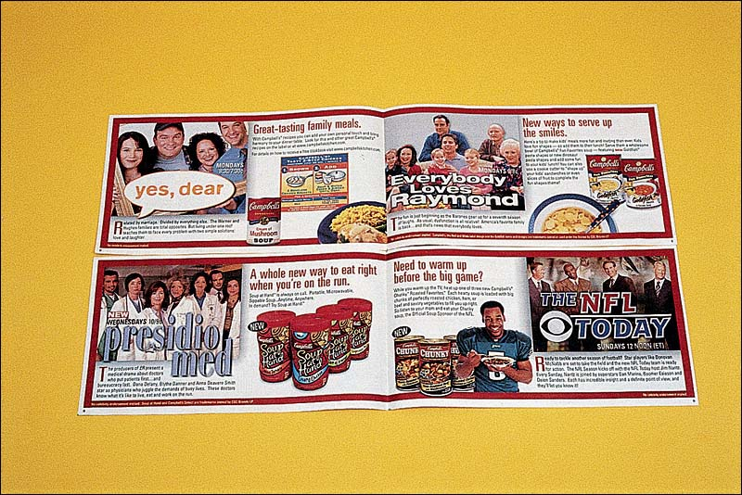
A CBS/Campbell’s Soup Cross Promotion
+

Slide 21
Consumer Promotion Strategies
Loyalty Strategies
Loyalty marketing:
  Using promotions specifically designed for customer retention
    Example: punch card offering a free coffee (“buy 10 and get the 11th one free”)

Slide 22
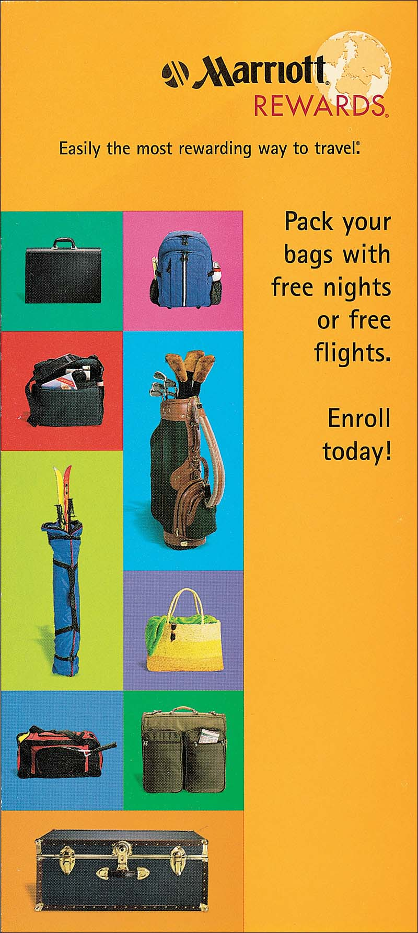
An Example of Marriott Hotels Loyalty Promotion
+

Slide 23
What Are Consumer Sales Promotions Designed To Accomplish?
Strengths
Strengths
Limitations
Good at generating trial
Drives repurchase and increased purchase frequency
Strengthens customer relationships
Good at generating trial
Drives repurchase and increased purchase frequency
Strengthens customer relationships
Can be copied by competitors
Most promotions are not profitable
Overuse can lead to lower brand loyalty and profits
Vs.

Slide 24
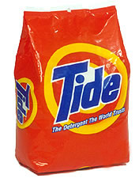
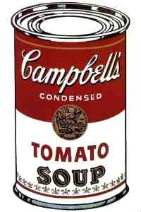
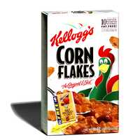
Packaging
Often the “last ad seen” for a brand
Critical for packaged goods
  Heavily promoted products that are usually sold through food and drug stores in small packages and carry a low unit price

Slide 25

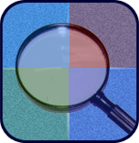
Insight: Generic Product Packaging
Generic products often come in plain white packages with black lettering that gives a basic product description (e.g. paper towels). Although they are often referred to as “unbranded,” they are in fact fairly distinctive. Their unique package design allows customers to recognize them easily, but more importantly, the package design cues a certain association (low-price) and a bundle of perceptions that differentiates them from competing and traditional brand-name products.

Slide 26
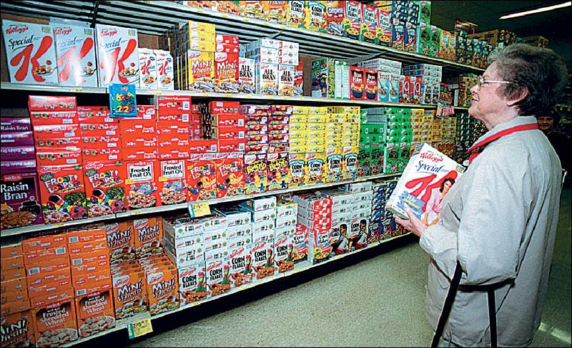
Packaging is Critical to Make Brands Stand Out in The Crowded Cereal Aisle

Slide 27
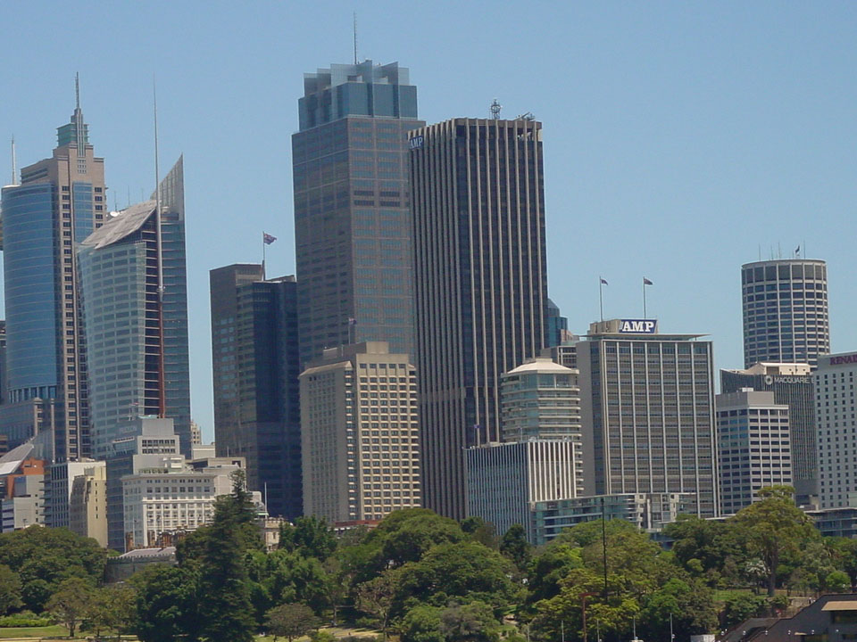

Tales From the Real World
Packaging consultants and agencies are now typically involved in some of the earliest stages of planning for new or improved products in the real world.
This early input can lead to unique aspects of a brand’s package that may even become the most important aspects of the brand’s MC program—like the new Heinz squeezable ketchup bottle.

Slide 28
What Role Does Packaging Play?
Strengths
Strengths
Limitations
Protects the product
Free media before, during and after purchase
Add value and convenience
Protects the product
Free media before, during, and after purchase
Adds value and convenience
Can be copied by competitors
Can contribute to waste explosion
Vs.

Slide 29


Final Note:
While advertising often gets credit
for being the most glamorous part of MC, sales promotion and packaging offer the opportunity of being the most inventive areas—and those best suited to move consumers through the final steps in the buying decision toward purchase

Slide 30
Bibliography
Principles of Marketing by Philip Kotler & Gary Armstrong
Fifteenth Edition, Published by Prentice Hall
Marketing Management – A South Asian Perspective
by Philip Kotler, Kevin Lane Keller, Abraham Koshy &
Mithileshwar Jha, 13th Edition, Published by Pearson
Education, Inc.
Principles and Practices of Marketing by Jobber, D. 4th
edition, McGraw Hill International.
Principles of Advertising & IMC by Tom Duncan 2nd
Edition, Published by McGraw-Hill Irwin.

Slide 31
The End
“Never deprive someone of hope;
it might be all they have”

