Slide 1
Personal Selling Process
LECTURE-25

Slide 2
Topic Outline
  The Preliminary steps in Personal Selling Process
  The Advance steps in Personal Selling Process
Notes:
In this chapter, we explore advertising and PR. Advertising involves communicating the company’s or brand’s value proposition by using paid media to inform, persuade, and remind consumers. PR involves building good relations with various company publics—from consumers and the general public to the media, investor, donor, and government publics. As with all the promotion mix tools, advertising and PR must be blended into the overall IMC program. In chapters 16 and 17, we will discuss the remaining promotion mix tools: personal selling, sales promotion, and direct marketing.

Slide 3
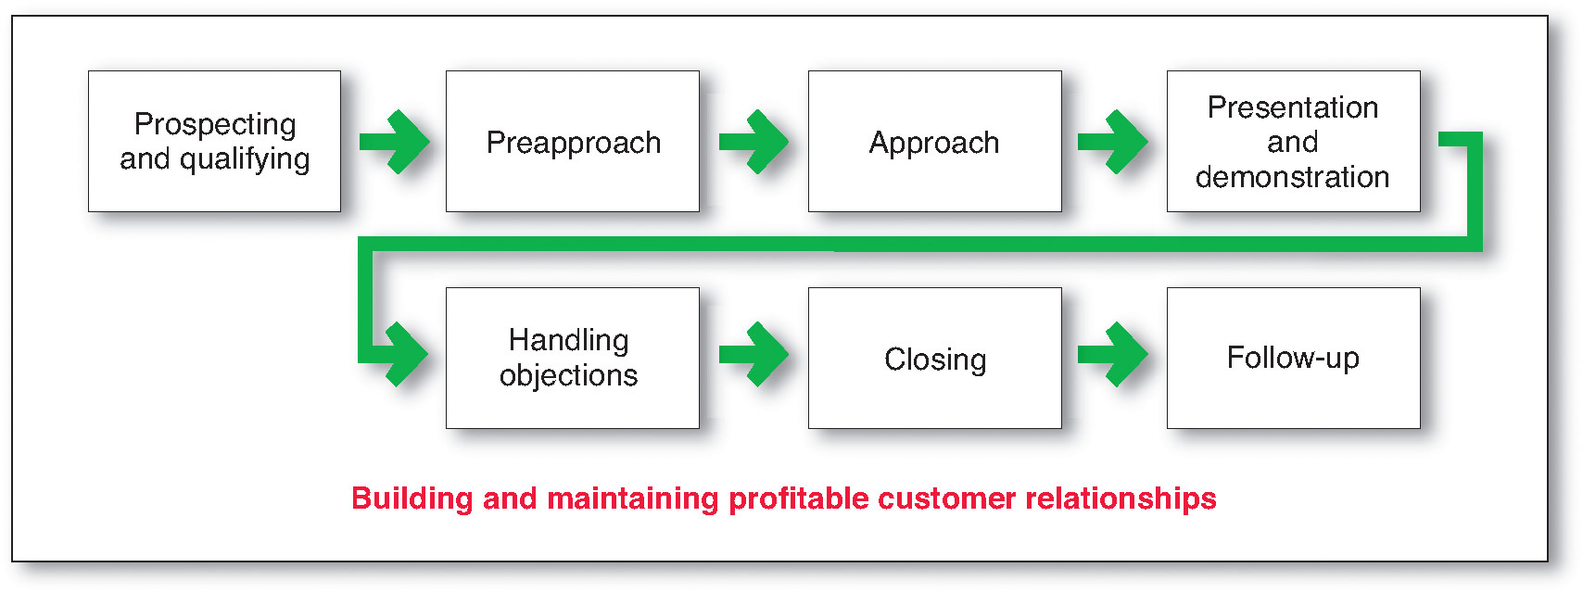
The Personal Selling Process
The goal of the personal selling process is to get new customers and obtain orders from them
Notes:
The selling process consists of several steps that salespeople must master. These steps focus on the goal of getting new customers and obtaining orders from them. However, most salespeople spend much of their time maintaining existing accounts and building long-term customer relationships. We will discuss the relationship aspect of the personal selling process in a later section.
Steps in the Selling Process
As shown in Figure 16.3, the selling process consists of seven steps: prospecting and qualifying, preapproach, approach, presentation and demonstration, handling objections, closing, and follow-up.

Slide 4
The Personal Selling Process
Steps in the Personal Selling Process
Prospecting identifies qualified potential customers through referrals from:
Customers
Suppliers
Dealers
Internet
Notes:
The first step in the selling process is prospecting—identifying qualified potential customers. Approaching the right customers is crucial to selling success. Salespeople don’t want to call on just any potential customers. They want to call on those who are most likely to appreciate and respond to the company’s value proposition—those the company can serve well and profitably.
A salesperson must often approach many prospects to get only a few sales. Although the company supplies some leads, salespeople need skill in finding their own. The best source is referrals. Salespeople can ask current customers for referrals and cultivate other referral sources, such as suppliers, dealers, noncompeting salespeople, and Web or other social network contacts. They can also search for prospects in directories or on the Internet and track down leads using the telephone and e-mail. Or, as a last resort, they can drop in unannounced on various offices (a practice known as cold calling).

Slide 5
Prospecting
Identifying Prospects
Present Customers
Former Customers
End Less Chain
Center Of Influence
Cold Calling
Spotters
Directories
Mailing Lists
Prospecting Services
Advertising
Personal Contacts
Trade Shows And Exhibitions
Internet/Social Media

Slide 6
The Personal Selling Process
Steps in the Personal Selling Process
Qualifying is identifying good customers and screening out poor ones by looking at:
  Financial ability
  Volume of business
  Needs
  Location
  Growth potential
Notes:
Salespeople also need to know how to qualify leads—that is, how to identify the good ones and screen out the poor ones. Prospects can be qualified by looking at their financial ability, volume of business, special needs, location, and possibilities for growth.
Discussion Question: Ask the students what questions they might ask to qualify a prospect.

Slide 7
Qualifying Prospects
MAN
APPROACH
Money
Money
Authority
Authority
Need

Slide 8
The Personal Selling Process
Steps in the Personal Selling Process
Pre-approach is the process of learning as much as possible about a prospect, including needs, who is involved in the buying, and the characteristics and styles of the buyers
Objectives
Qualify the prospect
Gather information
Make an immediate sale
Approaches
Personal visit
Phone call
Letter
Notes:
Preapproach
Before calling on a prospect, the salesperson should learn as much as possible about the organization (what it needs, who is involved in the buying) and its buyers (their characteristics and buying styles). This step is known as preapproach. A successful sale begins long before the salesperson sets foot into a prospect’s office. Preapproach begins with good research and preparation. The salesperson can consult standard industry and online sources, acquaintances, and others to learn about the company. Then the salesperson must apply the research gathered to develop a customer strategy.
The salesperson should set call objectives, which may be to qualify the prospect, gather information, or make an immediate sale. Another task is to determine the best approach, which might be a personal visit, a phone call, a letter, or an e-mail. The ideal timing should be considered carefully because many prospects are busiest at certain times of the day or week. Finally, the salesperson should give thought to an overall sales strategy for the account.

Slide 9
PREPARATION
PRE APPROACH
Who is the customer?
  Who will be the actual decision maker?
  Who will influence the decision?
  Who will be the actual user?
  With Whom will develop favorable relationship?
What are the customer’s needs?
  Identify the prospects need
  Try to understand his liking or disliking
What other information is required?
  Family back ground
  Hobbies / Interest / Memberships etc.

Slide 10
PREPARATION….
PRE APPROACH
Where does one obtain information?
  Company’s internal records
  Annual reports
  Catalogs
  Trade publications
  Advertisements
  Yellow pages
  Company’s official website

Slide 11
PREPARATION....
CALL PLANNING
Specify the objectives
  Why am I going?
  What am I trying to happen?
  What am I going to recommend?
Develop a strategy
  Course of action
  Various alternatives
Make an appointment
  Sales call are costly

Slide 12
The Personal Selling Process
Personal Selling and Managing Customer Relationships
Personal selling is transaction-oriented to close a specific sale with a specific customer
The long-term goal is to develop a mutually profitable relationship
Notes:
Personal Selling and Managing Customer Relationships
The steps in the just-described selling process are transaction oriented—their aim is to help salespeople close a specific sale with a customer. But in most cases, the company is not simply seeking a sale. Rather, it wants to serve the customer over the long haul in a mutually profitable relationship. The sales force usually plays an important role in customer relationship building. Thus, as shown in Figure 16.3, the selling process must be understood in the context of building and maintaining profitable customer relationships.
Successful sales organizations recognize that winning and keeping accounts requires more than making good products and directing the sales force to close lots of sales. If the company wishes only to close sales and capture short-term business, it can do this by simply slashing its prices to meet or beat those of competitors. Instead, most companies want their salespeople to practice value selling—demonstrating and delivering superior customer value and capturing a return on that value that is fair for both the customer and the company. For example, companies like Procter & Gamble understand that they aren’t just selling products to and through their retailer customers. They are partnering with these retail accounts to create more value for final consumers to their mutual benefit. P&G knows that it can succeed only if its retail partners succeed
Unfortunately, in the heat of closing sales—especially in a tight economy—salespeople too often take the easy way out by cutting prices rather than selling value. Sales management’s challenge is to transform salespeople from customer advocates for price cuts into company advocates for value.
Value selling requires listening to customers, understanding their needs, and carefully coordinating the whole company’s efforts to create lasting relationships based on customer value. “If you’re not selling value, you’re not selling smart,” concludes one sales consultant.

Slide 13
The Personal Selling Process
Steps in the Personal Selling Process
Approach is the process where the salesperson meets and greets the buyer and gets the relationship off to a good start and involves the salesperson’s:
Notes:
Approach
During the approach step, the salesperson should know how to meet and greet the buyer and get the relationship off to a good start. This step involves the salesperson’s appearance, opening lines, and follow-up remarks. The opening lines should be positive to build goodwill from the outset. This opening might be followed by some key questions to learn more about the customer’s needs or by showing a display or sample to attract the buyer’s attention and curiosity. As in all stages of the selling process, listening to the customer is crucial.

Slide 14
Presentation
APPROACH
  First impressions are essentials.
    Wear neat, conservative clothes
    Be clean and carefully groomed
    Know the prospect’s name and pronounce it correctly
    Be alert and pleasant
    Let the prospect offer to shake hands
    Forget about yourself and concentrate on the prospect
    Avoid smoking or chewing gum

Slide 15
Presentation
APPROACH
  Beginning the presentation.
    Ask questions
    Use a reference
    Offer a benefit
    Offer a service
    Compliment the prospect
    Give something of value
  Probing for needs
    SPIN selling
    S(Situation question) P(Problem question) I(Implication question N(Need assessment)

Slide 16
Presentation
APPROACH
Benefits of questions
    Learn about prospect’s needs
    To maintain control
    To involve the prospect
    To build relationship
    To establish trust

Slide 17
Presentation
APPROACH
  Types of questions
  Open ended questions
    Broad questions that are asked early in the presentation
  Reflective questions
    Questions asked in response to prospect’s comments
  Directive questions
    Leading questions designed to point the prospect towards areas of agreement

Slide 18
The Personal Selling Process
Steps in the Personal Selling Process
Presentation is when the salesperson tells the product story to the buyer, presenting customer benefits and showing how the product solves the customer’s problems
Need-satisfaction approach: Buyers want solutions and salespeople should listen and respond with the right products and services to solve customer problems
Notes:
Presentation and Demonstration
During the presentation step of the selling process, the salesperson tells the “value story” to the buyer, showing how the company’s offer solves the customer’s problems. The customer-solution approach fits better with today’s relationship marketing focus than does a hard sell or glad-handing approach. “Stop selling and start helping,” advises one sales consultant. “Your goal should be to sell your customers exactly what will benefit them most,” says another. Buyers today want solutions, not smiles; results, not razzle-dazzle. Moreover, they don’t want just products. More than ever in today’s economic climate, buyers want to know how those products will add value to their businesses. They want salespeople who listen to their concerns, understand their needs, and respond with the right products and services.

Slide 19
Convincing the prospect
Seek agreement
Read signals
Emphasize benefit relating to customer
Narrow choice

Slide 20
Presentation technique
Visual Aids/Exhibits
Testimonials
Examples
Guarantees
Demonstrations

Slide 21
The Personal Selling Process
Steps in the Personal Selling Process
Bad Traits
Good traits
Pushy
Late
Deceitful
Disorganized
Unprepared
Good listeners
Empathetic
Honest
Dependable
Thorough
Follow-up types
Notes:
Note to Instructor
Before advancing to second set of traits—ask students what qualities buyers like in a salesperson.
But before salespeople can present customer solutions, they must develop solutions to present. The solutions approach calls for good listening and problem-solving skills. The qualities that buyers dislike most in salespeople include being pushy, late, deceitful, unprepared, disorganized, or overly talkative. The qualities they value most include good listening, empathy, honesty, dependability, thoroughness, and follow-through. Great salespeople know how to sell, but more importantly they know how to listen and build strong customer relationships. According to an old sales adage, “You have two ears and one mouth. Use them proportionally.” A classic ad from office products maker Boise Cascade makes the listening point. It shows a Boise salesperson with huge ears drawn on. “With Boise, you’ll notice a difference right away, especially with our sales force,” says the ad. “At Boise . . . our account representatives have the unique ability to listen to your needs.”
Finally, salespeople must also plan their presentation methods. Good interpersonal communication skills count when it comes to making effective sales presentations. However, the current media-rich and cluttered communications environment presents many new challenges for sales presenters. Today’s information-overloaded customers demand richer presentation experiences. For their part, presenters now face multiple distractions during presentations from mobile phones, text messages, and mobile Internet devices. As a result, salespeople must deliver their messages in more engaging and compelling ways.
Thus, today’s salespeople are employing advanced presentation technologies that allow for full multimedia presentations to only one or a few people. The venerable old sales presentation flip chart has been replaced with sophisticated presentation software, online presentation technologies, interactive whiteboards, digital projectors, and tablet computers.

Slide 22
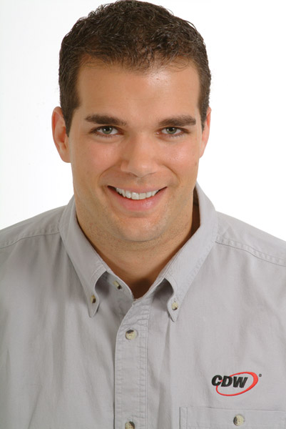
The Personal Selling Process
Steps in the Personal Selling Process
Handling objections is the process where salespeople resolve problems that are logical, psychological, or unspoken
Notes:
Note to Instructor
When handling objections from buyers, salespeople should:
Be positive
Seek out hidden objections
Ask the buyer to clarify any objections
Take objections as opportunities to provide more information
Turn objections into reasons for buying

Slide 23
Identifying and handling objections
Sales resistance: Actions or statements by a prospect that postpone, hinder or prevent the completion of a sale.
Objection: Outwards expression of a prospect’s doubts or negative feelings about a sales proposal.
Objections represent sales opportunities.

Slide 24
Types of objections
Timing
Price
Competition
Source

Slide 25
Confronting an objections
Listen carefully:
  Make sure you know what has been said
Ask Questions:
  Clarify the objection so there is no misunderstanding
Respond to the objection:
  Use an appropriate technique be tactful and honest
    Yes.....But method
    Boomerang method
    Comparison method
    The compensation method
    Case history method

Slide 26
The Personal Selling Process
Steps in the Personal Selling Process
Closing is the process where salespeople should recognize signals from the buyer—including physical actions, comments, and questions—to close the sale
Notes:
Note to Instructor
Discussion Question
How does a salesperson can close a sale?
Closing techniques can include:
Asking for the order
Reviewing points of agreement
Offering to help write up the order
Asking if the buyer wants this model or another one
Making note that the buyer will lose out if the order is not placed now
Offering incentives to buy, including lower price or additional quantity

Slide 27
Closing
When to close
  Looking & listening for buying signals
  Verbal buying signals
  Non verbal buying signals

Slide 28
Closing
How to close
  Alternative proposal close
    Choice between details….truck or rail shipment
  Assumptive Close
    Prepare all documents and ask the prospect to sign
  Gift Close
    Added inducement for taking immediate action

Slide 29
Closing
How to close
  Action close
    Follow up with other people and do the needful yourself
  One-more-yes
    Restate the benefits in a series of question that will result in positive response and final question ask the person to complete the sales
  Balance Sheet
    List reasons for action now and delaying and out weight the reasons for delay

Slide 30
Sales funnel
Qualification
Preparation
Presentation
Closing

Slide 31
The Personal Selling Process
Steps in the Personal Selling Process
Follow-up is the last step in which the salesperson follows up after the sale to ensure customer satisfaction and repeat business
Notes:
Follow-Up
The last step in the selling process—follow-up—is necessary if the salesperson wants to ensure customer satisfaction and repeat business. Right after closing, the salesperson should complete any details on delivery time, purchase terms, and other matters. The salesperson then should schedule a follow-up call after the buyer receives the initial order to make sure proper installation, instruction, and servicing occur. This visit would reveal any problems, assure the buyer of the salesperson’s interest, and reduce any buyer concerns that might have arisen since the sale.

Slide 32
Follow up
Post Sale Action
Customer Relations
Handle Complaints Promptly and Pleasantly
Maintain Contact with Customers
Keep Serving the Customers
Show Appreciation
Self Analysis
  Were the plan sales objectives achieved?
  What could I have done better?
  What did I learn from this sales call that will contribute to my future success?

Slide 33
Bibliography
Principles of Marketing by Philip Kotler & Gary Armstrong
Fifteenth Edition, Published by Prentice Hall
Marketing Management – A South Asian Perspective
by Philip Kotler, Kevin Lane Keller, Abraham Koshy &
Mithileshwar Jha, 13th Edition, Published by Pearson
Education, Inc.
Principles and Practices of Marketing by Jobber, D. 4th
edition, McGraw Hill International.
Principles of Advertising & IMC by Tom Duncan 2nd
Edition, Published by McGraw-Hill Irwin.

Slide 34


The End
Don’t use time or words carelessly.
Neither can be retrieved.

