Slide 1
Public Relations
LECTURE-23

Slide 2
Topic Outline
  Public Relations
    What is public relations
    The Role and Impact of Public Relations
  Major Public Relations Tools
  What are the strengths and limitations of brand publicity?
  What are the brand publicity tools?
  Why is corporate communication important to IMC programs?
Notes:
In this chapter, we explore advertising and PR. Advertising involves communicating the company’s or brand’s value proposition by using paid media to inform, persuade, and remind consumers. PR involves building good relations with various company publics—from consumers and the general public to the media, investor, donor, and government publics. As with all the promotion mix tools, advertising and PR must be blended into the overall IMC program. In chapters 16 and 17, we will discuss the remaining promotion mix tools: personal selling, sales promotion, and direct marketing.

Slide 3
Lecture Perspective
Two major developments recently:
Public relations has forced all marketers to value stakeholder relationships
IMC is helping to bridge the gap between Public Relations and Marketing
IMC
Marketing
Traditionally separate from the PR area
Public Relations
Traditionally separate from the Marketing area

Slide 4


What is Public Relations?
Public relations (PR):
A communication function used to promote mutual understanding between an organization and its various stakeholder groups

Slide 5
Public Relations
  Public relations involves building good relations with the company’s various publics by obtaining favorable publicity, building up a good corporate image, and handling or heading off unfavorable rumors, stories, and events
  Public relations is used to promote product, people, ideas, and activities
Notes:
Not long ago, public relations was considered a marketing stepchild because of its limited marketing use. That situation is changing fast, however, as more marketers recognize PR’s brand-building power.
Public relations is used to promote products, people, places, ideas, activities, organizations, and even nations. Companies use PR to build good relations with consumers, investors, the media, and their communities. Trade associations have used PR to rebuild interest in commodities, such as eggs, apples, potatoes, milk, and even onions. For example, the Vidalia Onion Committee built a PR campaign around the DreamWorks character Shrek—complete with Shrek images on packaging and in-store displays with giant inflatable Shreks—that successfully promoted onions to children. Even government organizations use PR to build awareness. For example, the National Heart, Lung, and Blood Institute (NHLBI) of the National Institutes of Health sponsors a long-running PR campaign that builds awareness of heart disease in women:
Heart disease is the number one killer of women; it kills more women each year than all forms of cancer combined. But a 2000 survey by the NHLBI showed that only 34 percent of women knew this, and that most people thought of heart disease as a problem mostly affecting men. So with the help of Ogilvy Public Relations Worldwide, the NHLBI set out to “create a personal and urgent wakeup call to American women.” In 2002, it launched a national PR campaign—“The Heart Truth”—to raise awareness of heart disease among women and get women to discuss the issue with their doctors.
The centerpiece of the campaign is the Red Dress, now the national symbol for women and heart disease awareness. The campaign creates awareness through an interactive website, Facebook and Pinterest pages, mass media placements, and campaign materials—everything from brochures, DVDs, and posters to speaker’s kits and airport dioramas. It also sponsors several major national events, such as the National Wear Red Day, an annual Red Dress Collection Fashion Show, and The Heart Truth Road Show, featuring heart disease risk factor screenings in major U.S. cities. Finally, the campaign works with more than three-dozen corporate sponsors, such as Diet Coke, St. Joseph aspirin, Tylenol, Cheerios, CVS Pharmacy, Swarovski, and Bobbi Brown Cosmetics. So far, some 2.65 billion product packages have carried the Red Dress symbol.
The results are impressive: Awareness among American women of heart disease as the number one killer of women has increased to 57 percent, and the number of heart disease deaths in women has declined steadily from one in three women to one in four. The American Heart Association has also adopted the Red Dress symbol and introduced its own complementary campaign.

Slide 6
Public Relations
Press relations or press agency involves the creation and placing of newsworthy information to attract attention to a person, product, or service
Product publicity involves publicizing specific products
Public affairs involves building and maintaining national or local community relations
Notes:
Another major mass-promotion tool, public relations, consists of activities designed to build good relations with the company’s various publics. PR departments may perform any or all of the following functions:
Press relations or press agency: Creating and placing newsworthy information in the news media to attract attention to a person, product, or service.
Product publicity: Publicizing specific products.
Public affairs: Building and maintaining national or local community relationships.
Adapted from Scott Cutlip, Allen Center, and Glen Broom, Effective Public Relations, 10th ed. (Upper Saddle River, NJ: Prentice Hall, 2009), Chapter 1.

Slide 7
Public Relations
Lobbying involves building and maintaining relations with legislators and government officials to influence legislation and regulation
Investor relations involves maintaining relationships with shareholders and others in the financial community
Development involves public relations with donors or members of nonprofit organizations to gain financial or volunteer support
Notes:
Lobbying: Building and maintaining relationships with legislators and government officials to influence legislation and regulation.
Investor relations: Maintaining relationships with shareholders and others in the financial community.
Development: Working with donors or members of nonprofit organizations to gain financial or volunteer support.

Slide 8
PR Responsibilities
Serve As the Official Channel of Information
Serve As the Official Channel of Information
Keep the Public Aware of Organization’s Activities
Keep the Public Aware of Organization’s Activities
PR
Coordinate the Programs With Other MC Functions
Coordinate Relationships With Stakeholders
Coordinate Relationships With Stakeholders
Plan and Administer Information Programs
Plan and Administer Information Programs
Collect and Analyze Stakeholder Attitudes
Collect and Analyze Stakeholder Attitudes

Slide 9
PR Activities
Brand Publicity
Brand Publicity
Media Relations
Media Relations
PR
Activities
Crisis Management
Corporate Communications
Corporate Communications
Financial/
Investor Relations
Financial/
Investor Relations
Employee Relations
Employee Relations

Slide 10
Public Relations
Major Public Relations Tools
News
Speeches
Special events
Written materials
Corporate identity materials
Public service activities
Buzz marketing
Social networking
Internet
Notes:
Although public relations still captures only a small portion of the overall marketing budgets of most firms, PR can be a powerful brand-building tool. And in this digital age, the lines between advertising and PR are becoming more and more blurred. For example, are brand websites, blogs, online social networks, and viral brand videos advertising efforts or PR efforts? All are both. The point is that PR should work hand in hand with advertising within an integrated marketing communications program to help build brands and customer relationships.
“This is PR’s time to shine,” says P&G’s global marketing and brand building officer. “PR is going to grow its impact on the future [of] marketing because it is a great amplifier, builds relationships and invites consumer participation,” he says. “PR [gives] our big ideas a megaphone that we used to spur participation [leading] to spontaneous combustion.”
The Role and Impact of PR
Public relations can have a strong impact on public awareness at a much lower cost than advertising can. When using public relations, the company does not pay for the space or time in the media. Rather, it pays for a staff to develop and circulate information and manage events. If the company develops an interesting story or event, it could be picked up by several different media and have the same effect as advertising that would cost millions of dollars. What’s more, public relations has the power to engage consumers and make them a part of the brand story and its telling Consider the recent Wrangler NextBlue PR campaign:
Wrangler wanted to reach out beyond its core consumers—to a young, metropolitan mindset. But rather than using ads or standard PR approaches, it created NextBlue, an online project giving consumers and fledgling designers a chance to create the next style of Wrangler jeans. Working with its PR agency, Wrangler created a microsite that asked consumers to create videos of themselves and their jeans designs. The campaign was promoted on Wrangler’s website and Facebook page and in its e-mails to Wrangler subscribers. The brand also used a mix of traditional PR media, along with paid ads on Facebook and social media promotions on YouTube and Twitter, allowing the public to comment and vote on the submitted designs.
The rich integration of a paid, owned, earned, and shared PR media produced the desired results. Within just two weeks, Wrangler received 50 video submissions. The winning entry will be sold on Wrangler.com as the first design in the NextBlue line. But in addition to the new design, Wrangler also signed up 19 young designers to blog for its Next Blue site, garnered 5,000 new subscribers to its e-mail database, and counted more than 80,000 views of the finalist videos. “The heart of the NextBlue [PR] project was a brand collaboration with consumers,” says a Wrangler marketing communications executive. “The social media are a natural fit for [that].
As with the other promotion tools, in considering when and how to use product public relations, management should set PR objectives, choose the PR messages and vehicles, implement the PR plan, and evaluate the results. The firm’s PR should be blended smoothly with other promotion activities within the company’s overall integrated marketing communications effort. Michael Bush, “P&G’s Marc Pritchard Touts Value of PR,” Advertising Age, October 27, 2010, http://adage.com/article/news/p-g-s-marc-pritchard-touts-pr/146749/.
Adapted from information in Julie Liesse, “The Big Idea,” Advertising Age, November 28, 2011, pp. C4-C6.

Slide 11
Public Relations
The Role and Impact of Public Relations
Lower cost than advertising
Stronger impact on public awareness than advertising
Notes:
The Role and Impact of PR
Public relations can have a strong impact on public awareness at a much lower cost than advertising can. When using public relations, the company does not pay for the space or time in the media. Rather, it pays for a staff to develop and circulate information and manage events. If the company develops an interesting story or event, it could be picked up by several different media and have the same effect as advertising that would cost millions of dollars. What’s more, public relations has the power to engage consumers and make them a part of the brand story and its telling.

Slide 12

PR In Action: Maytag

Slide 13
PR In Action: Maytag
Help introduce the new Neptune washer
Challenge:
Help introduce the new Neptune washer
A public relations program featuring:
New York launch party for news media and appliance dealers starring the Maytag “Lonely Repairman” and famous TV “moms”
Sponsored a water conservation test in a small Kansas town demonstrating overall water savings for the town
A public relations program featuring:
New York launch party for news media and appliance dealers starring the Maytag “Lonely Repairman” and famous TV “moms”
Sponsored a water conservation test in a small Kansas town demonstrating overall water savings for the town
Answer:
Results:
Most successful Maytag product launch ever
Maytag stock increased 100%

Slide 14
What Is Brand Publicity?
Brand publicity:
The use of nonpaid media messages to deliver brand information designed to positively influence customers and prospects

Slide 15
Brand Publicity Process
Reviewing the situation
Fits with organization’s overall SWOT assessment
Reviewing the situation
Fits with organization’s overall SWOT assessment
Process
Setting objectives
Similar to advertising, but can also include:
  Creating word of mouth buzz (excited talk about a brand)
Setting objectives
Similar to advertising, but can also include:
  Creating word of mouth buzz (excited talk about a brand)
Developing strategies and tactics
Traditional media
Guerilla marketing techniques
Viral marketing (spreading word of mouth via the internet)

Slide 16
Key Part of Brand Publicity: Media Relations
Key part of brand publicity:
Media relations: Maintaining a positive professional relationship with the media in general or with media that specialize in covering a specific industry
The challenge: getting past media gatekeepers
  Editors and reporters who select (or reject) stories for their publications or stations based on what they think will interest their audiences

Slide 17


Tales From the Real World
In the real world, PR people know that the media
is not always going to cover a story exactly the way they would wish. So, like a football coach’s reaction to a referee’s “call,” PR professionals sometimes challenge the media on their “call.”
The result is often the same as in sports: the current story will stand, but the media may write something more favorable next time. Just like a referee refusing a coach’s plea to reconsider a call, but then calling the other team for a penalty on the next series.

Slide 18
Strengths And Limitations Of Brand Publicity
Strengths
Strengths
Limitations
Builds a climate of acceptance for the brand
Makes brand’s claims more credible
Breaks through clutter
Reaches the hard-to-reach
Cost effective
Builds a climate of acceptance for the brand
Makes brand’s claims more credible
Breaks through clutter
Reaches the hard-to-reach
Cost effective
Less control over message
Limited frequency
Vs.

Slide 19
What Are Brand Publicity Tools?
News Release
(Press Release)
News Release
(Press Release)
Publicity
Tools
Pitch Letter
Pitch Letter
News Kit (Press Kit)

Slide 20
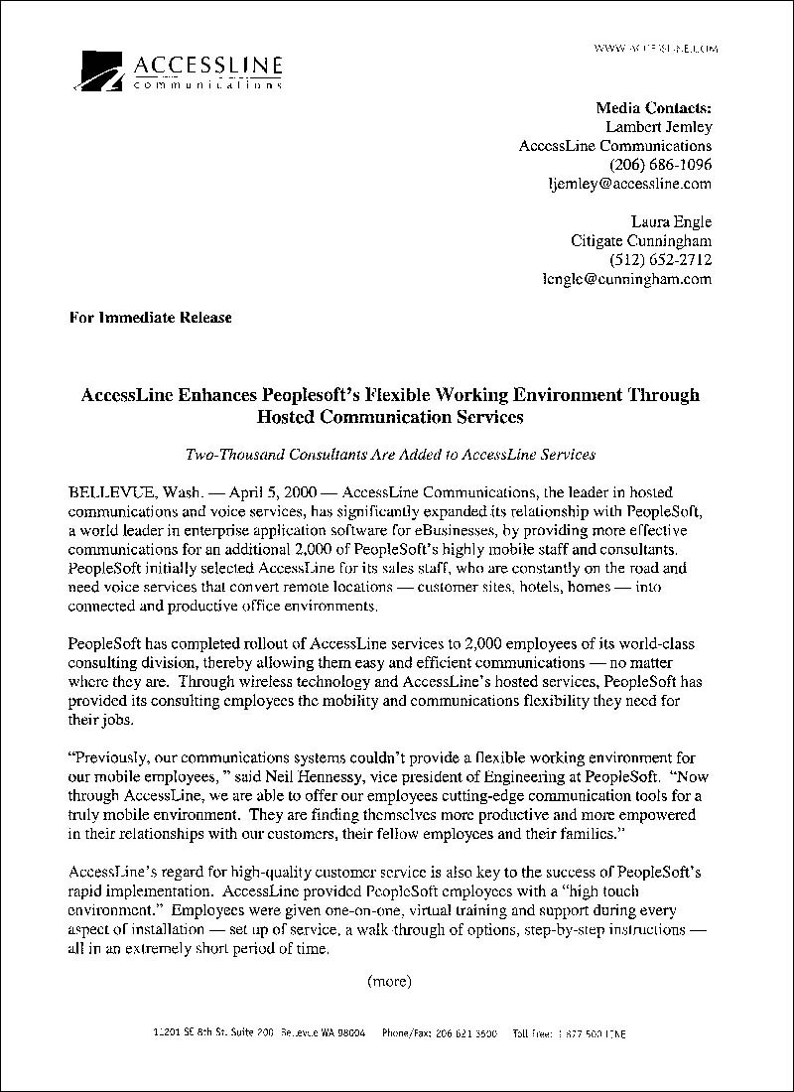
A New Release Developed By PeopleSoft’s Agency
+

Slide 21
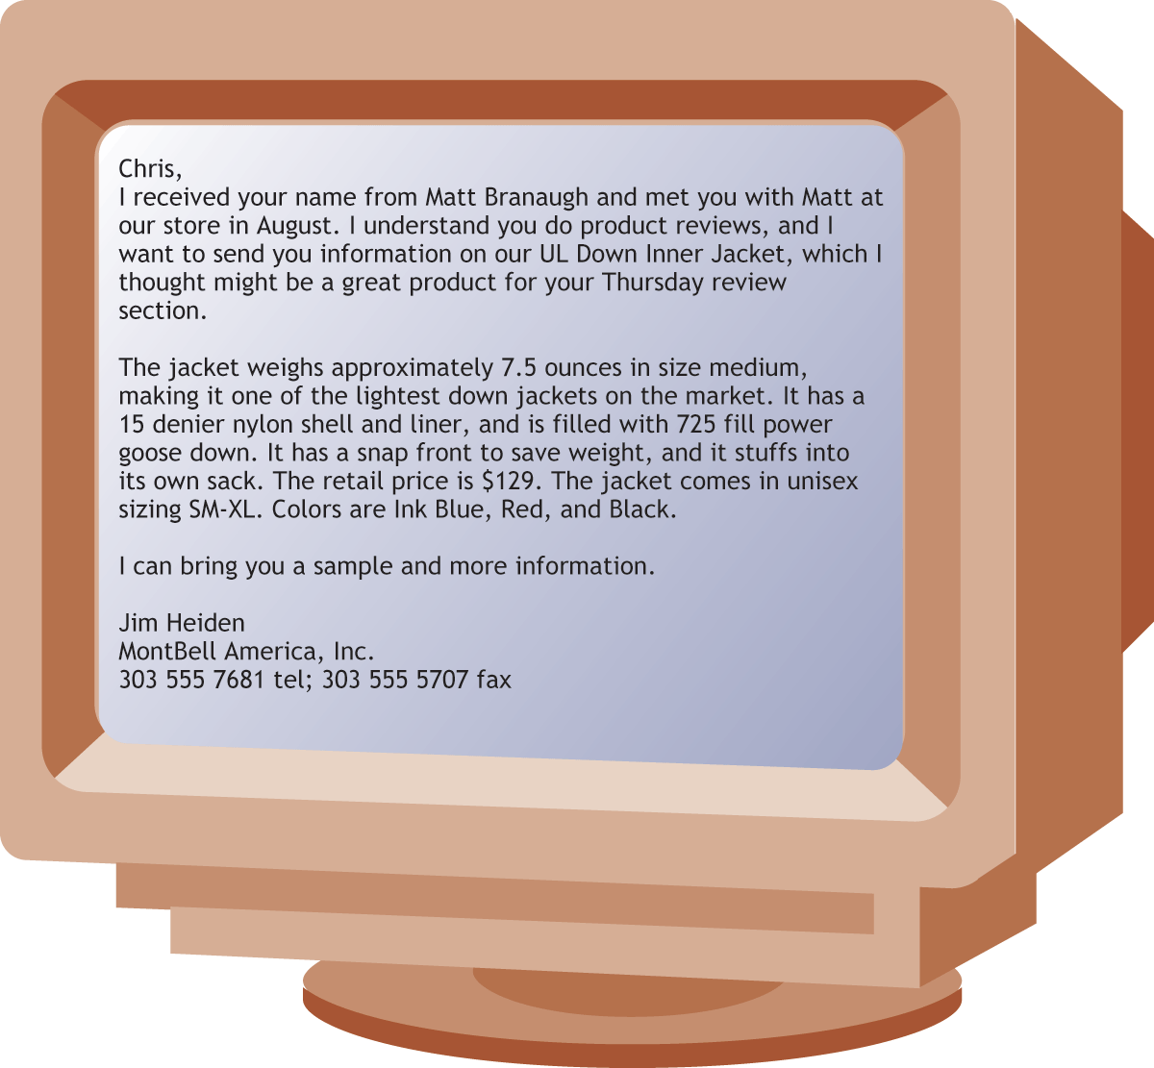
A Pitch Letter From A Clothing Maker
+

Slide 22
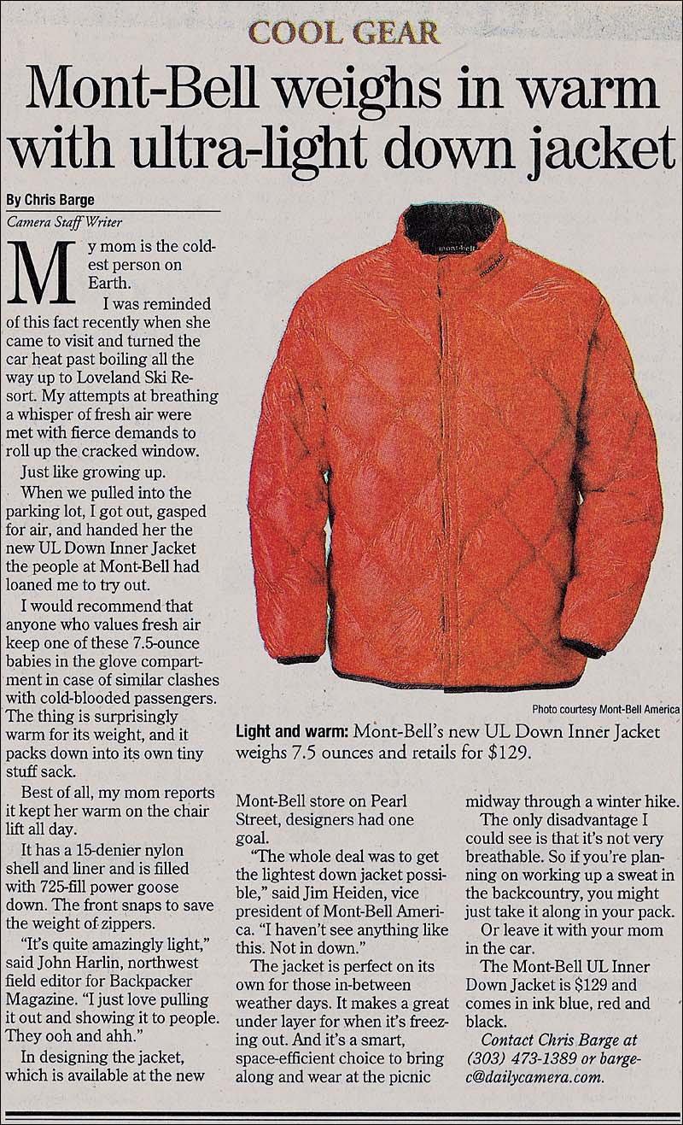
A News Story Written About The New Jacket
+

Slide 23
What Is Corporate Communication?
Corporate communication:
High level public relations carried out by executives who work at a senior level in a company and advise top management on how the organization presents itself
Goal: to manage the image
and reputation of the organization

Slide 24
Bibliography
Principles of Marketing by Philip Kotler & Gary Armstrong
Fifteenth Edition, Published by Prentice Hall
Marketing Management – A South Asian Perspective
by Philip Kotler, Kevin Lane Keller, Abraham Koshy &
Mithileshwar Jha, 13th Edition, Published by Pearson
Education, Inc.
Principles and Practices of Marketing by Jobber, D. 4th
edition, McGraw Hill International.
Principles of Advertising & IMC by Tom Duncan 2nd
Edition, Published by McGraw-Hill Irwin.

Slide 25
The End
“Take care of your reputation. It’s your most valuable asset”

