Slide 1
Communicating Customer Value: Integrated Marketing Communications Strategy
LECTURE-20

Slide 2
Topic Outline
The Promotion Mix
Integrated Marketing Communications
A View of the Communications Process
Steps in Developing Effective Marketing Communication
Setting the Total Promotion Budget and Mix
Socially Responsible Marketing Communication

Slide 3
The Promotion Mix
The promotion mix is the specific blend of advertising, public relations, personal selling, and direct-marketing tools that the company uses to persuasively communicate customer value and build customer relationships
Notes:
A company’s total promotion mix—also called its marketing communications mix—consists of the specific blend of advertising, public relations, personal selling, sales promotion, and direct-marketing tools that the company uses to persuasively communicate customer value and build customer relationships.

Slide 4
The Promotion Mix
The Promotion Mix
Advertising is any paid form of non-personal presentation and promotion of ideas, goods, or services by an identified sponsor
Broadcast
Print
Internet
Outdoor
Notes:
Advertising: Any paid form of nonpersonal presentation and promotion of ideas, goods, or services by an identified sponsor.
advertising includes broadcast, print, Internet, mobile, outdoor, and other forms.

Slide 5
The Promotion Mix
The Promotion Mix
Sales promotion is the short-term incentive to encourage the purchase or sale of a product or service
Discounts
Coupons
Displays
Demonstrations
Notes:
Note to Instructor
Discussion Question
What sales promotions have you seen in the last two months?
They will often mention similar coupon books, fast food contests, and demonstrations in stores. Sales promotion: Short-term incentives to encourage the purchase or sale of a product or service. Sales promotion includes discounts, coupons, displays, and demonstrations.

Slide 6
The Promotion Mix
The Promotion Mix
Public relations involves building good relations with the company’s various publics by obtaining favorable publicity, building up a good corporate image, and handling or heading off unfavorable rumors, stories, and events
Press releases
Sponsorships
Special events
Web pages
Notes:
Public relations: Building good relations with the company’s various publics by obtaining favorable publicity, building up a good corporate image, and handling or heading off unfavorable rumors, stories, and events. Public relations (PR) includes press releases, sponsorships, events, and Web pages.

Slide 7
The Promotion Mix
The Promotion Mix
Personal selling is the personal presentation by the firm’s sales force for the purpose of making sales and building customer relationships
Sales presentations
Trade shows
Incentive programs
Notes:
Personal selling: Personal presentation by the firm’s sales force for the purpose of making sales and building customer relationships. Personal selling includes sales presentations, trade shows, and incentive programs.

Slide 8
The Promotion Mix
The Promotion Mix
Direct marketing involves making direct connections with carefully targeted individual consumers to both obtain an immediate response and cultivate lasting customer relationships—through the use of direct mail, telephone, direct-response television, e-mail, and the Internet to communicate directly with specific consumers
Catalog
Telemarketing
Kiosks
Notes:
Direct marketing: Direct connections with carefully targeted individual consumers to both obtain an immediate response and cultivate lasting customer relationships. direct marketing includes catalogs, direct-response TV, kiosks, the Internet, mobile marketing, and more.

Slide 9
Integrated Marketing Communications
The New Marketing Communications Model
Consumers are better informed
More communication
Less mass marketing
Changing communications technology
Notes:
Integrated Marketing Communications
In past decades, marketers perfected the art of mass marketing: selling highly standardized products to masses of customers. In the process, they developed effective mass-media communications techniques to support these strategies. Large companies now routinely invest millions or even billions of dollars in television, magazine, or other mass-media advertising, reaching tens of millions of customers with a single ad. Today, however, marketing managers face some new marketing communications realities. Perhaps no other area of marketing is changing so profoundly as marketing communications, creating both exciting and anxious times for marketing communicators.
The New Marketing Communications Model
Several major factors are changing the face of today’s marketing communications. First, consumers are changing. In this digital, wireless age, they are better informed and more communications empowered. Rather than relying on marketer-supplied information, they can use the Internet and other technologies to find information on their own. They can connect more easily with other consumers to exchange brand-related information or even create their own marketing messages.
Second, marketing strategies are changing. As mass markets have fragmented, marketers are shifting away from mass marketing. More and more, they are developing focused marketing programs designed to build closer relationships with customers in more narrowly defined micromarkets.
Finally, sweeping advances in communications technology are causing remarkable changes in the ways in which companies and customers communicate with each other. The digital age has spawned a host of new information and communication tools—from smartphones and iPads to satellite and cable television systems to the many faces of the Internet (e-mail, brand websites, online social networks, blogs, and so much more). These explosive developments have had a dramatic impact on marketing communications. Just as mass marketing once gave rise to a new generation of mass-media communications, the new digital media have given birth to a new marketing communications model.
Although network television, magazines, newspapers, and other traditional mass media remain very important, their dominance is declining. In their place, advertisers are now adding a broad selection of more-specialized and highly targeted media to reach smaller customer segments with more-personalized, interactive messages. The new media range from specialty cable television channels and made-for-the-Web videos to Internet catalogs, e-mail, blogs, mobile phone content, and online social networks. In all, companies are doing less broadcasting and more narrowcasting.
Some advertising industry experts even predict that the old mass-media communications model will eventually become obsolete. Mass media costs are rising, audiences are shrinking, ad clutter is increasing, and viewers are gaining control of message exposure through technologies such as video streaming or DVRs that let them skip disruptive television commercials. As a result, they suggest, marketers are shifting ever-larger portions of their marketing budgets away from old-media mainstays and moving them to digital and other new-age media. In recent years, although TV still dominates as an advertising medium, ad spending on the major TV networks has stagnated as ad spending on the Internet and other digital media has surged. Ad spending in magazines, newspapers, and radio, in contrast, has lost considerable ground.
In some cases, marketers are skipping traditional media altogether. For example, when Heinz introduced its limited-time Heinz Tomato Ketchup with Balsamic Vinegar flavor, customers were able to learn about and buy the product only through the brand’s Facebook page, until it appeared on store shelves six weeks later. Heinz used no TV or print advertising for the introduction, instead relying on its 825,000 Facebook followers to spread the word. Customers responded strongly, and six months later Heinz added the product to its standard lineup, the first new flavor from Heinz Ketchup in nearly a decade.
Similarly, eco-friendly household products maker Method recently employed a digital-only promotional campaign themed “Clean happy”:
Method is known for offbeat campaigns using slogans like “People against dirty” and “For the love of clean.” But the most notable thing about the “Clean happy” campaign is that, unlike previous Method campaigns, it uses zero ads in traditional media like TV or magazines. Instead, the centerpiece of the campaign is a two-minute brand video clip that can be watched only on YouTube and on the Method Facebook page. That video is followed at monthly intervals by four other clips that focus on individual Method products. The campaign also employs online media ads, as well as a major presence in social media that include YouTube and Facebook.
In the new marketing communications world, rather than using old approaches that interrupt customers and force-feed them mass messages, new media formats let marketers reach smaller groups of consumers in more interactive, engaging ways. For example, think about television viewing these days. Consumers can now watch their favorite programs on just about anything with a screen—on televisions but also laptops, mobile phones, or tablets. And they can choose to watch programs whenever and wherever they wish, often without commercials. Increasingly, some programs, ads, and videos are being produced only for Internet viewing.
Despite the shift toward new digital media, however, traditional mass media still capture a lion’s share of the promotion budgets of most major marketing firms, a fact that probably won’t change quickly. For example, P&G, a leading proponent of digital media, still spends the majority of its huge advertising budget on mass media. Although P&G’s digital outlay more than doubled last year to $169 million, digital still accounts for less than 5 percent of the company’s annual global advertising budget.
At a broader level, although some may question the future role of TV advertising, it’s still very much in use today. Last year, television captured more than 40 percent of global advertising spending compared to the 21 percent captured by all online advertising media. Still, online advertising remains the fastest growing medium. It is now the second largest medium behind television, well ahead of newspapers and magazines.
Thus, rather than the old media model rapidly collapsing, most industry insiders see a more gradual blending of new and traditional media. The new marketing communications model will consist of a shifting mix of both traditional mass media and a wide array of exciting, new, more-targeted, and more-personalized but sometimes less-controllable media.
Many advertisers and ad agencies are now grappling with this transition. In the end, however, regardless of the communications channel, the key is to integrate all of these media in a way that best communicates the brand message and enhances the customer’s brand experience. As the marketing communications environment shifts, so will the role of marketing communicators. Rather than just creating and placing “TV ads” or “print ads” or “Facebook display ads,” many marketers now view themselves more broadly as brand content managers who manage brand conversations with and among customers across a fluid mix of channels, both traditional and new, controlled and not controlled.

Slide 10
Integrated Marketing Communications
The Need for Integrated Marketing Communications
Integrated marketing communications is the integration by the company of its communication channels to deliver a clear, consistent, and compelling message about the organization and its brands
Notes:
The Need for Integrated Marketing Communications
The shift toward a richer mix of media and communication approaches poses a problem for marketers. Consumers today are bombarded by commercial messages from a broad range of sources. But consumers don’t distinguish between message sources the way marketers do. In the consumer’s mind, messages from different media and promotional approaches all become part of a single message about the company. Conflicting messages from these different sources can result in confused company images, brand positions, and customer relationships.
All too often, companies fail to integrate their various communications channels. The result is a hodgepodge of communications to consumers. Mass-media advertisements say one thing, whereas an in-store promotion sends a different signal, and the company’s Internet site, e-mails, Facebook page, or videos posted on YouTube say something altogether different. The problem is that these communications often come from different parts of the company. Advertising messages are planned and implemented by the advertising department or an ad agency. Other company departments are responsible for PR, sales promotion events, and Internet or social network efforts. However, whereas companies may have separated their communications tools, customers don’t. Mixed communications from these sources result in blurred brand perceptions by consumers.
The new world of digital and social marketing, tablet computers, smartphones, and apps presents both tremendous opportunities and but also big challenges. It can “give companies increased access to their customers, fresh insights into their preferences, and a broader creative palette to work with,” says one marketing executive. But “the biggest issue is complexity and fragmentation ... the amount of choice out there,” says another. The challenge is to “make it come together in an organized way.

Slide 11
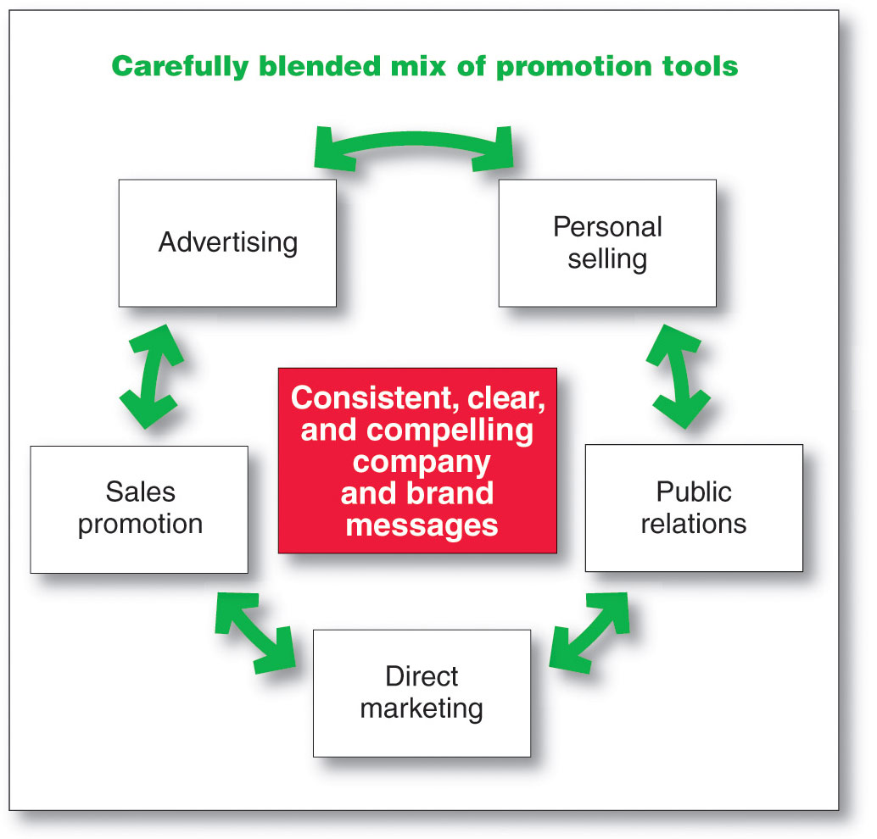
Integrated Marketing Communications Strategy
Notes:
To that end, more companies today are adopting the concept of integrated marketing communications (IMC). Under this concept, as illustrated in Figure 14.1, the company carefully integrates its many communications channels to deliver a clear, consistent, and compelling message about the organization and its brands.
Integrated marketing communications calls for recognizing all touch points where the customer may encounter the company and its brands. Each contact with the brand will deliver a message—whether good, bad, or indifferent. The company’s goal should be to deliver a consistent and positive message at each contact. Integrated marketing communications ties together all of the company’s messages and images. Its television and print ads have the same message, look, and feel as its e-mail and personal selling communications. And its PR materials project the same image as its website, online social networks, or mobile marketing efforts. Often, different media play unique roles in attracting, informing, and persuading consumers; these roles must be carefully coordinated under the overall marketing communications plan.
In the past, no one person or department was responsible for thinking through the communication roles of the various promotion tools and coordinating the promotion mix. To help implement integrated marketing communications, some companies have appointed a marketing communications director who has overall responsibility for the company’s communications efforts. This helps to produce better communications consistency and greater sales impact. It places the responsibility in someone’s hands—where none existed before—to unify the company’s image as it is shaped by thousands of company activities.
A View of the Communication Process
Integrated marketing communications involves identifying the target audience and shaping a well-coordinated promotional program to obtain the desired audience response. Too often, marketing communications focus on immediate awareness, image, or preference goals in the target market. But this approach to communication is too shortsighted. Today, marketers are moving toward viewing communications as managing the customer relationship over time.
Because customers differ, communications programs need to be developed for specific segments, niches, and even individuals. And, given the new interactive communications technologies, companies must ask not only “How can we reach our customers?” but also “How can we let our customers reach us?”
Thus, the communications process should start with an audit of all the potential touchpoints that target customers may have with the company and its brands. For example, someone purchasing a new phone plan may talk to others, see television or magazine ads, visit various websites for prices and reviews, and check out plans at Best Buy, Walmart, or a wireless provider’s kiosk or store. The marketer needs to assess what influence each communication experience will have at different stages of the buying process. This understanding helps marketers allocate their communication dollars more efficiently and effectively.
To communicate effectively, marketers need to understand how communication works. Communication involves the nine elements shown in figure 14.2. Two of these elements are the major parties in a communication—the sender and the receiver. Another two are the major communication tools—the message and the media. Four more are major communication functions—encoding, decoding, response, and feedback. The last element is noise in the system. Definitions of these elements follow and are applied to a McDonald’s “I’m lovin’ it” television commercial.
Sender: The party sending the message to another party—here, McDonald’s.
Encoding: The process of putting thought into symbolic form—for example, McDonald’s ad agency assembles words, sounds, and illustrations into a TV advertisement that will convey the intended message.
Message: The set of symbols that the sender transmits—the actual McDonald’s ad.
Media: The communication channels through which the message moves from the sender to the receiver—in this case, television and the specific television programs that McDonald’s selects.
Decoding: The process by which the receiver assigns meaning to the symbols encoded by the sender—a consumer watches the McDonald’s commercial and interprets the words and images it contains.
Receiver: The party receiving the message sent by another party—the customer who watches the McDonald’s ad.
Response: The reactions of the receiver after being exposed to the message—any of hundreds of possible responses, such as the consumer likes McDonald’s better, is more likely to eat at McDonald’s next time, hums the “I’m lovin’ it” jingle, or does nothing.
Feedback: The part of the receiver’s response communicated back to the sender—McDonald’s research shows that consumers are either struck by and remember the ad or they write or call McDonald’s, praising or criticizing the ad or its products.
Noise: The unplanned static or distortion during the communication process, which results in the receiver getting a different message than the one the sender sent—the consumer is distracted while watching the commercial and misses its key points.
For a message to be effective, the sender’s encoding process must mesh with the receiver’s decoding process. The best messages consist of words and other symbols that are familiar to the receiver. The more the sender’s field of experience overlaps with that of the receiver, the more effective the message is likely to be. Marketing communicators may not always share their customer’s field of experience. For example, an advertising copywriter from one socioeconomic level might create ads for customers from another level—say, wealthy business owners. However, to communicate effectively, the marketing communicator must understand the customer’s field of experience.
This model points out several key factors in good communication. Senders need to know what audiences they wish to reach and what responses they want. They must be good at encoding messages that take into account how the target audience decodes them. They must send messages through media that reach target audiences, and they must develop feedback channels so that they can assess an audience’s response to the message. Also, in today’s interactive media environment, companies must be prepared to “flip” the communications process—to become good receivers of and responders to messages sent by consumers.

Slide 12
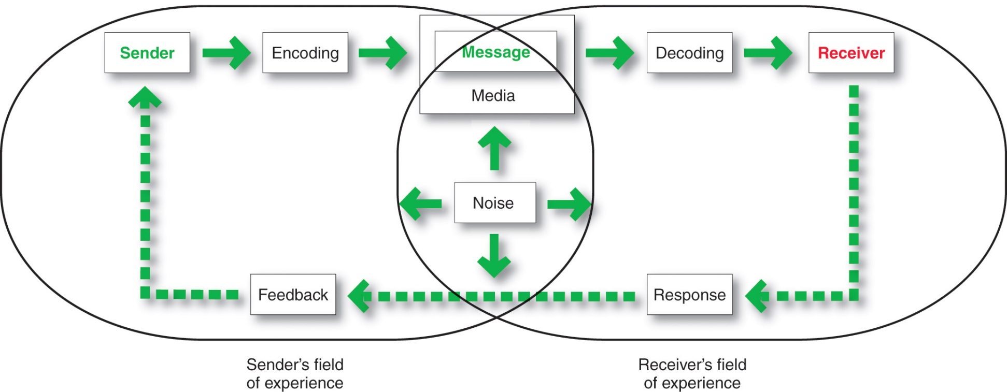
A View of the Communication Process
The Communication Process
Notes:
Sender is the party sending the message to another party.
Encoding is the process of putting thought into symbolic form.
Message is the set of symbols the sender transmits.
Media is the communications channels through which the message moves from sender to receiver.
Decoding is the process by which the receiver assigns meaning to the symbols.
Receiver is the party receiving the message sent by another party.
Response is the reaction of the receiver after being exposed to the message.
Feedback is the part of the receiver’s response communicated back to the sender
Noise is the unplanned static or distortion during the communication process, which results in the receiver’s getting a different message than the one the sender sent.

Slide 13
Steps in Developing Effective Marketing Communication
Identify the target audience
Determine the communication objectives
Design the message
Choose the media
Select the message source
Notes:
Steps in Developing Effective Marketing Communication
We now examine the steps in developing an effective integrated communications and promotion program. Marketers must do the following: Identify the target audience, determine the communication objectives, design a message, choose the media through which to send the message, select the message source, and collect feedback.

Slide 14
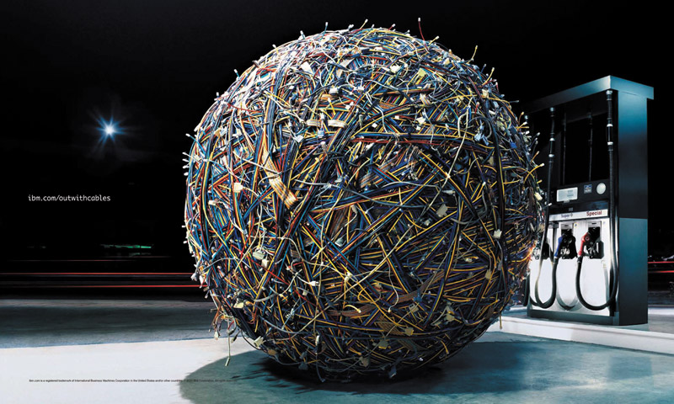
Steps in Developing Effective Communication
Identifying the Target market
What will be said
How it will be said
When it will be said
Where it will be said
Who will say it
Notes:
Identifying the Target Audience
A marketing communicator starts with a clear target audience in mind. The audience may be current users or potential buyers, those who make the buying decision or those who influence it. The audience may be individuals, groups, special publics, or the general public. The target audience will heavily affect the communicator’s decisions on what will be said, how it will be said, when it will be said, where it will be said, and who will say it.

Slide 15
Steps in Developing Effective Marketing Communication
Determining the Communication Objectives
Marketers seek a purchase response that results from a consumer decision-making process that includes the stages of buyer readiness
Notes:
Determining the Communication Objectives
Once the target audience has been defined, marketers must determine the desired response. Of course, in many cases, they will seek a purchase response. But purchase may result only after a lengthy consumer decision-making process. The marketing communicator needs to know where the target audience now stands and to what stage it needs to be moved. The target audience may be in any of six buyer-readiness stages, the stages consumers normally pass through on their way to making a purchase. These stages include awareness, knowledge, liking, preference, conviction, and purchase (see figure 14.3).
The marketing communicator’s target market may be totally unaware of the product, know only its name, or know only a few things about it. Thus, the communicator must first build awareness and knowledge. For example, Procter & Gamble used a massive $150 million marketing campaign to introduce consumers to its innovative new laundry product, Tide Pods, single-use tablets called pods that combine liquid detergent, stain remover, and brightener. The introductory campaign, themed “Pop in. Stand out,” showed consumers how simply popping a Tide pod into the washing machine could clean and freshen clothes while also making colors pop. The extensive introductory campaign used a broad range of traditional, digital, mobile, social, and in-store media to quickly create awareness and knowledge across the entire market.
<ex14.05>
Assuming that target consumers know about a product, how do they feel about it? Once potential buyers knew about Tide Pods, marketers wanted to move them through successively stronger stages of feelings toward the new model. These stages include liking (feeling favorable about Tide Pods), preference (preferring Tide Pods to regular detergents and competing pod products), and conviction (believing that Tide Pods are the best laundry product for them).
Tide marketers used a combination of the promotion mix tools to create positive feelings and conviction. The initial commercials helped build anticipation and an emotional brand connection. Video clips on YouTube and the Tide Facebook fan page demonstrated the product’s use and features. Press releases and other PR activities helped keep the buzz going about the product. A packed microsite (tidepods.com) provided additional information.
Finally, some members of the target market might be convinced about the product but not quite get around to making the purchase. The communicator must lead these consumers to take the final step. To help reluctant consumers over such hurdles, Tide offered buyers special promotional prices, samples, and supporting comments from customers at its website, Facebook page, and elsewhere.
Of course, marketing communications alone could not create positive feelings and purchases for the new Tide Pods. The product itself must provide superior value for the customer. In fact, outstanding marketing communications can actually speed the demise of a poor product. The more quickly potential buyers learn about a poor product, the more quickly they become aware of its faults. Thus, good marketing communications call for “good deeds followed by good words.”
See Stuart Elliott, “A Product to Add Sparkle and Pop to Laundry Day,” New York Times, February 15, 2012, p. B3.

Slide 16
Steps in Developing Effective Marketing Communication
Designing a Message
AIDA Model
Get Attention
Hold Interest
Arouse Desire
Obtain Action
Notes:
Designing a Message
Having defined the desired audience response, the communicator then turns to developing an effective message. Ideally, the message should get attention, hold interest, arouse desire, and obtain action (a framework known as the AIDA model). In practice, few messages take the consumer all the way from awareness to purchase, but the AIDA framework suggests the desirable qualities of a good message.
When putting a message together, the marketing communicator must decide what to say (message content) and how to say it (message structure and format).

Slide 17

Steps in Developing Effective Marketing Communication
Designing a Message
Message content is an appeal or theme that will produce the desired response
Message Format
Notes:
The marketer has to figure out an appeal or theme that will produce the desired response. There are three types of appeals: rational, emotional, and moral. Rational appeals relate to the audience’s self-interest. They show that the product will produce the desired benefits. Examples are messages showing a product’s quality, economy, value, or performance. Thus, an ad for Aleve makes this matter-of-fact claim: “More pills doesn’t mean more pain relief. Aleve has the strength to keep back, body, and arthritis pain away all day with fewer pills than Tylenol.” And a Weight Watchers’ ad states this simple fact: “The diet secret to end all diet secrets is that there is no diet secret.”
Message Format
The marketing communicator also needs a strong format for the message. In a print ad, the communicator has to decide on the headline, copy, illustration, and colors. To attract attention, advertisers can use novelty and contrast; eye-catching pictures and headlines; distinctive formats; message size and position; and color, shape, and movement. If the message is to be communicated by television or video, the communicator must incorporate motion, pace, and sound. Presenters plan every detail carefully, from start to finish.
If the message is carried on the product or its package, the communicator must watch texture, scent, color, size, and shape. For example, color alone can enhance message recognition for a brand. One study suggests that color increases brand recognition by up to 80 percent—think about Target (red), McDonald’s (yellow and red), John Deere (green and yellow), IBM (blue); or UPS (brown). Thus, in designing effective marketing communications, marketers must consider color and other seemingly unimportant details carefully.

Slide 18
Steps in Developing Effective Marketing Communication
Message Content
Rational appeal relates to the audience’s self-interest
Emotional appeal is an attempt to stir up positive or negative emotions to motivate a purchase
Moral appeal is directed at the audience’s sense of right and proper
Notes:
Rational appeals relate to the audience’s self-interest. They show that the product will produce the desired benefits. Examples are messages showing a product’s quality, economy, value, or performance. Thus, an ad for Aleve makes this matter-of-fact claim: “More pills doesn’t mean more pain relief. Aleve has the strength to keep back, body, and arthritis pain away all day with fewer pills than Tylenol.” And a Weight Watchers’ ad states this simple fact: “The diet secret to end all diet secrets is that there is no diet secret.”
Emotional appeals attempt to stir up either negative or positive emotions that can motivate purchase. Communicators may use emotional appeals ranging from love, joy, and humor to fear and guilt. Advocates of emotional messages claim that they attract more attention and create more belief in the sponsor and the brand. The idea is that consumers often feel before they think, and persuasion is emotional in nature. Good storytelling in a commercial often strikes an emotional chord. For example, to promote its Chrome browser, Google ran a heart-warming 90-second “Dear Sophie” commercial that shows a father using Google products to catalog his daughter Sophie’s life events, from birth and important birthdays to loss of baby teeth and learning how to ski. He writes her notes using Gmail and posts videos of her on YouTube. The ad closes with “The web is what you make of it.” To date, the ad has captured nearly 6 million YouTube views.
These days, it seems as if every company is using humor in its advertising, from consumer product firms such as Anheuser-Busch to old-line insurance companies such as Allstate. For example, nine of the top 10 most popular ads in USA Today’s ad meter consumer rankings of last year’s Super Bowl ads used humor. Properly used, humor can capture attention, make people feel good, and give a brand personality. However, advertisers must be careful when using humor. Used poorly, it can detract from comprehension, wear out its welcome fast, overshadow the product, and even irritate consumers.
Moral appeals are directed to an audience’s sense of what is “right” and “proper.” They are often used to urge people to support social causes, such as a cleaner environment or aid to the disadvantaged. For example, the United Way’s Live United campaign urges people to give back to their communities—to “Live United. Make a difference. Help create opportunities for everyone in your community.” An EarthShare ad urges environmental involvement by reminding people that “We live in the house we all build. Every decision we make has consequences. . . . We choose the world we live in, so make the right choices. . . .”

Slide 19

Steps in Developing Effective Marketing Communication
Choosing Media
Personal communication involves two or more people communicating directly with each other
Face to face
Phone
Mail
E-mail
Internet chat
Notes:
Personal Communication Channels
In personal communication channels, two or more people communicate directly with each other. They might communicate face to face, on the phone, via mail or e-mail, or even through texting or an Internet chat. Personal communication channels are effective because they allow for personal addressing and feedback.
Some personal communication channels are controlled directly by the company. For example, company salespeople contact business buyers. But other personal communications about the product may reach buyers through channels not directly controlled by the company. These channels might include independent experts—consumer advocates, online buying guides, bloggers, and others—making statements to buyers. Or they might be neighbors, friends, family members, associates, or other consumers talking to target buyers. This last channel, word-of-mouth influence, has considerable effect in many product areas.

Slide 20
Steps in Developing Effective Marketing Communication
Choosing Media
Personal communication is effective because it allows personal addressing and feedback
Control of personal communication
Company
Independent experts
Word of mouth

Slide 21
Steps in Developing Effective Marketing Communication
Choosing Media
Personal Communication
Opinion leaders are people within a reference group who, because of their special skills, knowledge, personality, or other characteristics, exerts social influence on others
Buzz marketing involves cultivating opinion leaders and getting them to spread information about a product or service to others in their communities
Notes:
Personal influence carries great weight, especially for products that are expensive, risky, or highly visible. One recent survey found that recommendations from friends and family are far and away the most powerful influence on consumers worldwide: More than 50 percent of consumers said friends and family are the number one influence on their awareness and purchase. Another study found that 90 percent of customers trust recommendations from people they know and 70 percent trust consumer opinions posted online, whereas trust in ads runs from a high of about 62 percent to less than 24 percent, depending on the medium. Is it any wonder, then, that few consumers buy a big-ticket item before checking out what existing users have to say about the product at a such as Amazon.com? Who hasn’t made an Amazon purchase based on another customer’s review or the “Customers who bought this also bought . . .” section?
Companies can take steps to put personal communication channels to work for them. For example, as we discussed in chapter 5, they can create opinion leaders for their brands—people whose opinions are sought by others—by supplying influencers with the product on attractive terms or by educating them so that they can inform others. Buzz marketing involves cultivating opinion leaders and getting them to spread information about a product or a service to others in their communities.
P&G has created a huge word-of-mouth marketing arm—Vocalpoint—consisting of 500,000 moms. Vocalpoint recruits “connectors”—natural-born buzzers with vast networks of friends and a gift for gab. They create buzz not only for P&G brands but also for those of other client companies as well—half its business comes from non-P&G brands. P&G routinely uses the Vocalpoint network in the launch of new products such as the Bounce Dryer Bar and Tide Pods. P&G doesn’t pay the moms or coach them on what to say. It simply educates Vocalpointers about a new product, arms them with free samples and coupons for friends, and then asks them to share their “honest opinions with us and with other real women.” In turn, the Vocalpoint moms create hundreds of thousands of personal recommendations for the new products..

Slide 22
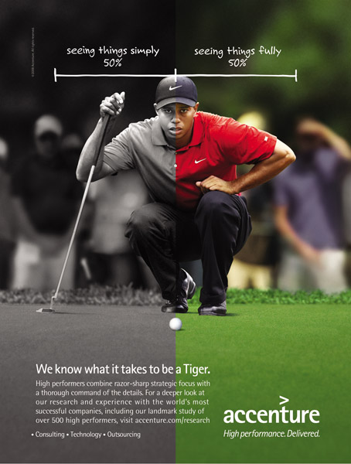
Steps in Developing Effective Marketing Communication
Non-Personal Communication Channels
Non-personal communication is media that carry messages without personal contact or feedback, including major media, atmospheres, and events that affect the buyer directly

Slide 23
Steps in Developing Effective Marketing Communication
Non-Personal Communication Channels
Major media include print, broadcast, display, and online media
Atmospheres are designed environments that create or reinforce the buyer’s leanings toward buying a product
Notes:
Nonpersonal Communication Channels
Nonpersonal communication channels are media that carry messages without personal contact or feedback. They include major media, atmospheres, and events. Major media include print media (newspapers, magazines, direct-mail), broadcast media (television, radio), display media (billboards, signs, posters), and online media (e-mail, company websites, and online social and sharing networks). Atmospheres are designed environments that create or reinforce the buyer’s leanings toward buying a product. Thus, lawyers’ offices and banks are designed to communicate confidence and other qualities that might be valued by clients.
Nonpersonal communication affects buyers directly. In addition, using mass media often affects buyers indirectly by causing more personal communication. For example, communications might first flow from television, magazines, and other mass media to opinion leaders and then from these opinion leaders to others. Thus, opinion leaders step between the mass media and their audiences and carry messages to people who are less exposed to media. Interestingly, marketers often use nonpersonal communications channels to replace or stimulate personal communications by embedding consumer endorsements or word-of-mouth testimonials in their ads and other promotions.

Slide 24
Steps in Developing Effective Marketing Communication
Nonpersonal Communication Channels
Events are staged occurrences that communicate messages to target audiences
Press conferences
Grand openings
Exhibits
Public tours
Notes:
Events are staged occurrences that communicate messages to target audiences. For example, public relations departments arrange grand openings, shows and exhibits, public tours, and other events.

Slide 25
Steps in Developing Effective Marketing Communication
Selecting the Message Source
The message’s impact on the target audience is affected by how the audience views the communicator
Celebrities
  Athletes
  Entertainers
Professionals
  Health care providers
Notes:
Selecting the Message Source
In either personal or non-personal communication, the message’s impact also depends on how the target audience views the communicator. Messages delivered by highly credible sources are more persuasive. Thus, many food companies promote to doctors, dentists, and other health-care providers to motivate these professionals to recommend specific food products to their patients. And marketers hire celebrity endorsers—well-known athletes, actors, musicians, and even cartoon characters—to deliver their messages. But companies must be careful when selecting celebrities to represent their brands. Picking the wrong spokesperson can result in embarrassment and a tarnished image. For example, more than a dozen big brands—including Nike, Gatorade, Gillette, EA Sports, and Accenture—faced embarrassment when golfer Tiger Woods’ personal problems were publically exposed, tarnishing his previously pristine image. “Arranged marriages between brands and celebrities are inherently risky,” notes one expert. “Ninety-nine percent of celebrities do a strong job for their brand partners,” says another, “and 1 percent goes off the rails.”

Slide 26
Steps in Developing Effective Marketing Communication
Collecting Feedback
Involves the communicator understanding the effect on the target audience by measuring behavior resulting from the behavior
Notes:
Collecting Feedback
After sending the message, the communicator must research its effect on the target audience. This involves asking target audience members whether they remember the message, how many times they saw it, what points they recall, how they felt about the message, and their past and present attitudes toward the product and company. The communicator would also like to measure behavior resulting from the message—how many people bought the product, talked to others about it, or visited the store.
Feedback on marketing communications may suggest changes in the promotion program or in the product offer itself. For example, Macy’s uses television and newspaper advertising to inform area consumers about its stores, services, and merchandising events. Suppose feedback research shows that 80 percent of all shoppers in an area recall seeing the store’s ads and are aware of its merchandise and sales. Sixty percent of these aware shoppers have visited a Macy’s store in the past month, but only 20 percent of those who visited were satisfied with the shopping experience.
These results suggest that although promotion is creating awareness, Macy’s stores aren’t giving consumers the satisfaction they expect. Therefore, Macy’s needs to improve the shopping experience while staying with the successful communications program. In contrast, suppose research shows that only 40 percent of area consumers are aware of the store’s merchandise and events, only 30 percent of those aware have shopped recently, but 80 percent of those who have shopped return soon to shop again. In this case, Macy’s needs to strengthen its promotion program to take advantage of its power to create customer satisfaction in the store.

Slide 27

Setting the Total Promotion
Budget and Mix
Setting the Total Promotion Budget
Affordable budget method sets the budget at an affordable level
Ignores the effects of promotion on sales
Notes:
Setting the Total Promotion Budget
<ex14.11>
One of the hardest marketing decisions facing a company is how much to spend on promotion. John Wanamaker, the department store magnate, once said, “I know that half of my advertising is wasted, but I don’t know which half. I spent $2 million for advertising, and I don’t know if that is half enough or twice too much.” Thus, it is not surprising that industries and companies vary widely in how much they spend on promotion. Promotion spending may be 10–12 percent of sales for consumer packaged goods, 20 percent for cosmetics, and only 1.9 percent for household appliances. Within a given industry, both low and high spenders can be found.
How does a company determine its promotion budget? Here, we look at four common methods used to set the total budget for advertising: the affordable method, the percentage-of-sales method, the competitive-parity method, and the objective-and-task method.
Affordable Method
Some companies use the affordable method: They set the promotion budget at the level they think the company can afford. Small businesses often use this method, reasoning that the company cannot spend more on advertising than it has. They start with total revenues, deduct operating expenses and capital outlays, and then devote some portion of the remaining funds to advertising.
Unfortunately, this method of setting budgets completely ignores the effects of promotion on sales. It tends to place promotion last among spending priorities, even in situations in which advertising is critical to the firm’s success. It leads to an uncertain annual promotion budget, which makes long-range market planning difficult. Although the affordable method can result in overspending on advertising, it more often results in underspending.

Slide 28
Setting the Total Promotion
Budget and Mix
Setting the Total Promotion Budget
Percentage of sales method sets the budget at a certain percentage of current or forecasted sales or unit sales price
Easy to use and helps management think about the relationship between promotion, selling price, and profit per unit
Wrongly views sales as the cause rather than the result of promotion
Notes:
Percentage-of-Sales Method
Other companies use the percentage-of-sales method, setting their promotion budget at a certain percentage of current or forecasted sales. Or they budget a percentage of the unit sales price. The percentage-of-sales method is simple to use and helps management think about the relationships between promotion spending, selling price, and profit per unit.
Despite these claimed advantages, however, the percentage-of-sales method has little to justify it. It wrongly views sales as the cause of promotion rather than as the result. Although studies have found a positive correlation between promotional spending and brand strength, this relationship often turns out to be effect and cause, not cause and effect. Stronger brands with higher sales can afford the biggest ad budgets.
Thus, the percentage-of-sales budget is based on the availability of funds rather than on opportunities. It may prevent the increased spending sometimes needed to turn around falling sales. Because the budget varies with year-to-year sales, long-range planning is difficult. Finally, the method does not provide any basis for choosing a specific percentage, except what has been done in the past or what competitors are doing.

Slide 29
Setting the Total Promotion
Budget and Mix
Setting the Total Promotion Budget
Competitive-parity method sets the budget to match competitor outlays
Represents industry standards
Avoids promotion wars
Notes:
Competitive-Parity Method
Still other companies use the competitive-parity method, setting their promotion budgets to match competitors’ outlays. They monitor competitors’ advertising or get industry promotion spending estimates from publications or trade associations and then set their budgets based on the industry average.
Two arguments support this method. First, competitors’ budgets represent the collective wisdom of the industry. Second, spending what competitors spend helps prevent promotion wars. Unfortunately, neither argument is valid. There are no grounds for believing that the competition has a better idea of what a company should be spending on promotion than does the company itself. Companies differ greatly, and each has its own special promotion needs. Finally, there is no evidence that budgets based on competitive parity prevent promotion wars.

Slide 30
Setting the Total Promotion
Budget and Mix
Setting the Total Promotion Budget
Objective-and-task method sets the budget based on what the firm wants to accomplish with promotion and includes:
Defining promotion objectives
Determining tasks to achieve the objectives
Estimating costs
Notes:
Objective-and-Task Method
The most logical budget-setting method is the objective-and-task method, whereby the company sets its promotion budget based on what it wants to accomplish with promotion. This budgeting method entails (1) defining specific promotion objectives, (2) determining the tasks needed to achieve these objectives, and (3) estimating the costs of performing these tasks. The sum of these costs is the proposed promotion budget.
The advantage of the objective-and-task method is that it forces management to spell out its assumptions about the relationship between dollars spent and promotion results. But it is also the most difficult method to use. Often, it is hard to figure out which specific tasks will achieve the stated objectives. For example, suppose Samsung wants a 95-percent awareness for its latest camcorder model during the six-month introductory period. What specific advertising messages and media schedules should Samsung use to attain this objective? How much would these messages and media schedules cost? Samsung management must consider such questions, even though they are hard to answer.

Slide 31
Setting the Total Promotion
Budget and Mix
Shaping the Overall Promotion Mix
The Nature of Each Promotion Tool
Advertising reaches masses of geographically dispersed buyers at a low cost per exposure, and it enables the seller to repeat a message many times
Notes:
Shaping the Overall Promotion Mix
The concept of integrated marketing communications suggests that the company must blend the promotion tools carefully into a coordinated promotion mix. But how does it determine what mix of promotion tools to use? Companies within the same industry differ greatly in the design of their promotion mixes. For example, cosmetics maker Mary Kay spends most of its promotion funds on personal selling and direct marketing, whereas competitor CoverGirl spends heavily on consumer advertising. We now look at factors that influence the marketer’s choice of promotion tools.
The Nature of Each Promotion Tool
Each promotion tool has unique characteristics and costs. Marketers must understand these characteristics in shaping the promotion mix.
Advertising. Advertising can reach masses of geographically dispersed buyers at a low cost per exposure, and it enables the seller to repeat a message many times. For example, television advertising can reach huge audiences. Nearly 111 million Americans watched the most recent Super Bowl, more than 39 million people watched at least part of the last Academy Awards broadcast, and more than 26 million fans tuned in for the kick-off of the eleventh season of American Idol. And consumers viewing the ads again on YouTube and company websites extended their reach by millions more. For companies that want to reach a mass audience, TV is the place to be.
Beyond its reach, large-scale advertising says something positive about the seller’s size, popularity, and success. Because of advertising’s public nature, consumers tend to view advertised products as more legitimate. Advertising is also very expressive; it allows the company to dramatize its products through the artful use of visuals, print, sound, and color. On the one hand, advertising can be used to build up a long-term image for a product (such as Coca-Cola ads). On the other hand, advertising can trigger quick sales (as when Kohl’s advertises weekend specials).
Advertising also has some shortcomings. Although it reaches many people quickly, advertising is impersonal and lacks the direct persuasiveness of company salespeople. For the most part, advertising can carry on only a one-way communication with an audience, and the audience does not feel that it has to pay attention or respond. In addition, advertising can be very costly. Although some advertising forms, such as newspaper and radio advertising, can be done on smaller budgets, other forms, such as network TV advertising, require very large budgets.
See Christopher S. Stewart, “Super Bowl Viewers Set Record,” Wall Street Journal, February 6, 2012; Lisa de Moraes, “Oscar 2012 Ratings: About 39 Million Viewers,” Washington Post, February 27, 2012; and Verne Gray, “American Idol: 21.6 Million Viewers,” Newsday, January 19, 2012, www.newsday.com/entertainment/tv/tv-zone-1.811968/american-idol-21-6-million-viewers-1.3464121.

Slide 32

Setting the Total Promotion
Budget and Mix
Shaping the Overall Promotion Mix
The Nature of Each Promotion Tool
Personal selling is the most effective method at certain stages of the buying process, particularly in building buyers’ preferences, convictions, actions, and developing customer relationships
Notes:
Personal Selling. Personal selling is the most effective tool at certain stages of the buying process, particularly in building up buyers’ preferences, convictions, and actions. It involves personal interaction between two or more people, so each person can observe the other’s needs and characteristics and make quick adjustments. Personal selling also allows all kinds of customer relationships to spring up, ranging from matter-of-fact selling relationships to personal friendships. An effective salesperson keeps the customer’s interests at heart to build a long-term relationship by solving a customer’s problems. Finally, with personal selling, the buyer usually feels a greater need to listen and respond, even if the response is a polite “No thank-you.”
These unique qualities come at a cost, however. A sales force requires a longer-term commitment than does advertising—although advertising can be turned up or down, the size of a sales force is harder to change. Personal selling is also the company’s most expensive promotion tool, costing companies on average $350 or more per sales call, depending on the industry. U.S. firms spend up to three times as much on personal selling as they do on advertising.
See discussions at “The Costs of Personal Selling,” April 13, 2011, www.seekarticle.com/business-sales/personal-selling.html; and “What Is the Real Cost of a B2B Sales Call?” accessed at www.marketing-playbook.com/sales-marketing-strategy/what-is-the-real-cost-of-a-b2b-sales-call, July 2012.

Slide 33
Setting the Total Promotion
Budget and Mix
Shaping the Overall Promotion Mix
The Nature of Each Promotion Tool
Sales promotion includes coupons, contests, cents-off deals, and premiums that attract consumer attention and offer strong incentives to purchase, and can be used to dramatize product offers and to boost sagging sales
Notes:
Sales Promotion. Sales promotion includes a wide assortment of tools—coupons, contests, discounts, premiums, and others—all of which have many unique qualities. They attract consumer attention, offer strong incentives to purchase, and can be used to dramatize product offers and boost sagging sales. Sales promotions invite and reward quick response. Whereas advertising says, “Buy our product,” sales promotion says, “Buy it now.” Sales promotion effects are often short lived, however, and often are not as effective as advertising or personal selling in building long-run brand preference and customer relationships.

Slide 34
Setting the Total Promotion
Budget and Mix
Shaping the Overall Promotion Mix
The Nature of Each Promotion Tool
Public relations is a very believable form of promotion that includes news stories, features, sponsorships, and events
Direct marketing is a non-public, immediate, customized, and interactive promotional tool that includes direct mail, catalogs, telemarketing, and online marketing
Notes:
Public Relations. Public relations is very believable—news stories, features, sponsorships, and events seem more real and believable to readers than ads do. PR can also reach many prospects who avoid salespeople and advertisements—the message gets to buyers as “news” rather than as a sales-directed communication. And, as with advertising, public relations can dramatize a company or product. Marketers tend to underuse public relations or use it as an afterthought. Yet a well-thought-out public relations campaign used with other promotion mix elements can be very effective and economical.
Direct Marketing. Although there are many forms of direct marketing—direct mail and catalogs, online marketing, mobile marketing, and others—they all share four distinctive characteristics. Direct marketing is less public: The message is normally directed to a specific person. Direct marketing is immediate and customized: Messages can be prepared very quickly and can be tailored to appeal to specific consumers. Finally, direct marketing is interactive: It allows a dialogue between the marketing team and the consumer, and messages can be altered depending on the consumer’s response. Thus, direct marketing is well suited to highly targeted marketing efforts and building one-to-one customer relationships.

Slide 35
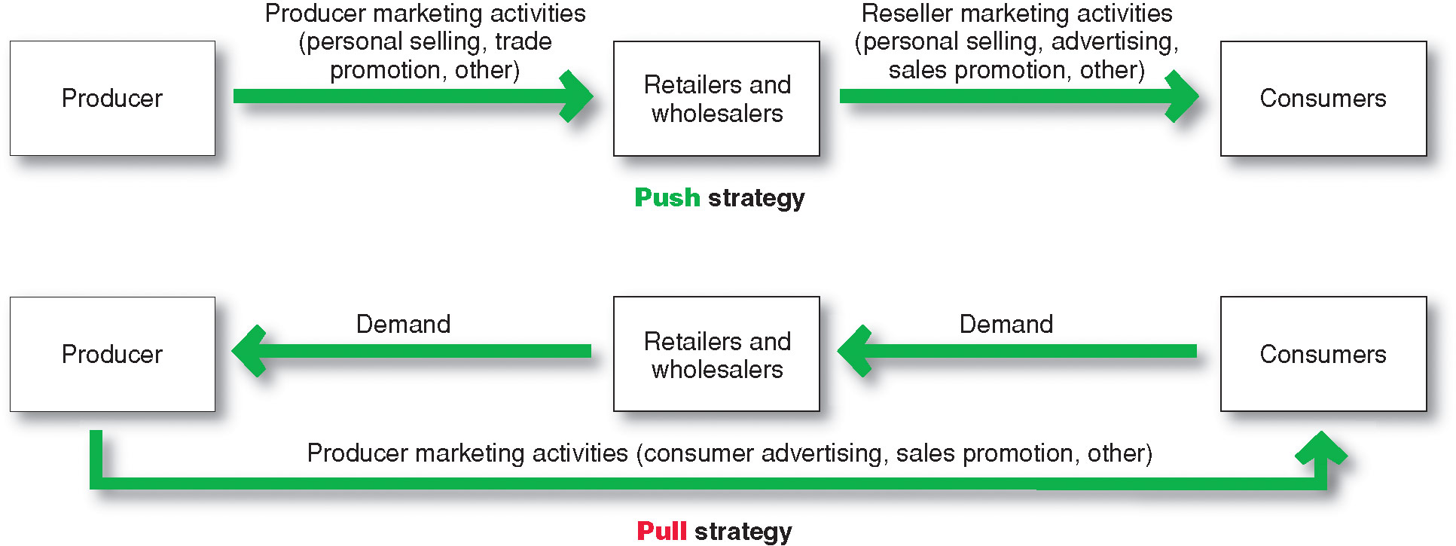
Shaping the Overall Promotion
Mix
Promotion Mix Strategies
Notes:
Promotion Mix Strategies
Marketers can choose from two basic promotion mix strategies: push promotion or pull promotion. Figure 14.4 contrasts the two strategies. The relative emphasis given to the specific promotion tools differs for push and pull strategies. A push strategy involves “pushing” the product through marketing channels to final consumers. The producer directs its marketing activities (primarily personal selling and trade promotion) toward channel members to induce them to carry the product and promote it to final consumers. For example, John Deere does very little promoting of its lawn mowers, garden tractors, and other residential consumer products to final consumers. Instead, John Deere’s sales force works with Lowe’s, Home Depot, independent dealers, and other channel members, who in turn push John Deere products to final consumers.
Using a pull strategy, the producer directs its marketing activities (primarily advertising and consumer promotion) toward final consumers to induce them to buy the product. For example, Unilever promotes its Axe grooming products directly to its young male target market using TV and print ads, a brand website, its YouTube channel and Facebook page, and other channels. If the pull strategy is effective, consumers will then demand the brand from retailers, such as CVS, Walgreens, or Walmart, who will in turn demand it from Unilever. Thus, under a pull strategy, consumer demand “pulls” the product through the channels.
Some industrial-goods companies use only push strategies; likewise, some direct-marketing companies use only pull strategies. However, most large companies use some combination of both. For example, Unilever spends more than $8 billion worldwide each year on consumer marketing and sales promotions to create brand preference and pull customers into stores that carry its products. At the same time, it uses its own and distributors’ sales forces and trade promotions to push its brands through the channels, so that they will be available on store shelves when consumers come calling.
Companies consider many factors when designing their promotion mix strategies, including the type of product and market. For example, the importance of different promotion tools varies between consumer and business markets. Business-to-consumer companies usually pull more, putting more of their funds into advertising, followed by sales promotion, personal selling, and then public relations. In contrast, business-to-business marketers tend to push more, putting more of their funds into personal selling, followed by sales promotion, advertising, and public relations.
Now that we’ve examined the concept of integrated marketing communications and the factors that firms consider when shaping their promotion mixes, let’s look more closely at the specific marketing communications tools.
Jack Neff, “Unilever Cuts Agency, Production Spending as Ad Costs Rise,” Advertising Age, February 2, 2012, http://adage.com/article//232485/.
.

Slide 36

Socially Responsible Marketing Communication
Communicate openly and honestly with consumers and resellers
Avoid deceptive or false advertising
Avoid bait-and-switch advertising
Conform to all federal, state, and local regulations
  Follow rules of “fair competition”
  Do not offer bribes
  Do not attempt to obtain competitors’ trade secrets
  Do not disparage competitors or their products
Notes:
Socially Responsible Marketing Communication
In shaping its promotion mix, a company must be aware of the many legal and ethical issues surrounding marketing communications. Most marketers work hard to communicate openly and honestly with consumers and resellers. Still, abuses may occur, and public policy makers have developed a substantial body of laws and regulations to govern advertising, sales promotion, personal selling, and direct marketing. In this section, we discuss issues regarding advertising, sales promotion, and personal selling.
Advertising and Sales Promotion
By law, companies must avoid false or deceptive advertising. Advertisers must not make false claims, such as suggesting that a product cures something when it does not. They must avoid ads that have the capacity to deceive, even though no one actually may be deceived. An automobile cannot be advertised as getting 32 miles per gallon unless it does so under typical conditions, and a diet bread cannot be advertised as having fewer calories simply because its slices are thinner.
Sellers must avoid bait-and-switch advertising that attracts buyers under false pretenses. For example, a large retailer advertised a sewing machine at $179. However, when consumers tried to buy the advertised machine, the seller downplayed its features, placed faulty machines on showroom floors, understated the machine’s performance, and took other actions in an attempt to switch buyers to a more expensive machine. Such actions are both unethical and illegal.
A company’s trade promotion activities also are closely regulated. For example, under the Robinson-Patman Act, sellers cannot favor certain customers through their use of trade promotions. They must make promotional allowances and services available to all resellers on proportionately equal terms.
Beyond simply avoiding legal pitfalls, such as deceptive or bait-and-switch advertising, companies can use advertising and other forms of promotion to encourage and promote socially responsible programs and actions. For example, following the disastrous explosion and oil spill at its Deepwater Horizon oil rig in the Gulf of Mexico in 2010, BP has spent billions of dollars on Gulf Coast restoration projects. The efforts include a 3-year, $92 million “My Gulf” promotion campaign designed to help restore tourism along the Gulf Coast. The integrated television, online, and social media campaign features spokespeople from the Gulf Coast states discussing their states’ great beaches, fishing, and seafood and extending an invitation to vacation along there. In addition to the tourism series, BP has also been running an online My Gulf campaign featuring videos of people who live and work in the Gulf. Thanks in part to the BP-sponsored promotion campaigns, despite the still-sluggish economy, tourism in many Gulf Coast areas has now surpassed pre-spill levels.
Personal Selling
A company’s salespeople must follow the rules of “fair competition.” Most states have enacted deceptive sales acts that spell out what is not allowed. For example, salespeople may not lie to consumers or mislead them about the advantages of buying a particular product. To avoid bait-and-switch practices, salespeople’s statements must match advertising claims.
Different rules apply to consumers who are called on at home or who buy at a location that is not the seller’s permanent place of business versus those who go to a store in search of a product. Because people who are called on may be taken by surprise and may be especially vulnerable to high-pressure selling techniques, the Federal Trade Commission (FTC) has adopted a three-day cooling-off rule to give special protection to customers who are not seeking products. Under this rule, customers who agree in their own homes, workplace, dormitory, or facilities rented by the seller on a temporary basis—such as hotel rooms, convention centers, and restaurants—to buy something costing more than $25 have 72 hours in which to cancel a contract or return merchandise and get their money back—no questions asked.
Much personal selling involves business-to-business trade. In selling to businesses, salespeople may not offer bribes to purchasing agents or others who can influence a sale. They may not obtain or use technical or trade secrets of competitors through bribery or industrial espionage. Finally, salespeople must not disparage competitors or competing products by suggesting things that are not true.

Slide 37
Bibliography
Principles of Marketing by Philip Kotler & Gary Armstrong
Fifteenth Edition, Published by Prentice Hall
Marketing Management – A South Asian Perspective
by Philip Kotler, Kevin Lane Keller, Abraham Koshy &
Mithileshwar Jha, 13th Edition, Published by Pearson
Education, Inc.
Principles and Practices of Marketing by Jobber, D. 4th
edition, McGraw Hill International.
Principles of Advertising & IMC by Tom Duncan 2nd
Edition, Published by McGraw-Hill Irwin.

Slide 38


The End
" There is only one difference between dream and aim.
Dream requires effortless sleep, while aim requires sleepless effort.

